Slide 1


Annual Train the Trainer Session
YOUR HEALTH ED PROS TEAM
Tanya Shelburne MPH, CHES
Alison Perez MPH, CHES
Type name, county,
& email in chatbox!
Notes:
Quick intros and description of Breathe and our role as a statewide partner, reference the wide scope of experience or inexperience with Breathe and we feel this training will have something for everyone. We hope that some of the activities and way we will engage with all of you during the training will also serve as a model or give you inspiration for how you can engage with the organizations and the families you are trying to reach.

Slide 2
Guidelines for Virtual Training
Training is being recorded
Video on; Mute when not speaking
Rename yourself, if necessary
Name, county, and email in chatbox
Stay for entire training – Prizes throughout!
Interact!!! (chat box, unmute, polls, whiteboard)
Notify Alison if you have issues

Slide 3
Connection Before Content
No one cares how much you know,
until they know how much you care.
- Theodore Roosevelt

Slide 4
If you were alone on a deserted Island…
What one FOOD item would you bring?
Notes:
Will get to bring 3 items in 3 specific categories, write in the chat box the item you would choose for each category. What one food item would you bring? Image you would have an endless supply of this one food item for however long you would be on the island!

Slide 5
If you were alone on a deserted Island…
What one BOOK would you bring?

Slide 6
If you were alone on a deserted Island…
What one LUXURY item would you bring?

Slide 7

THE ISLAND IS CLOSER THAN YOU THINK!

Slide 8
Let’s Talk About Breathe!
MISSION: Breathe trains staff in organizations that serve families with low incomes across Indiana so they feel equipped and empowered to educate families about the harms of tobacco and share helpful resources.
VISION: All young children in Indiana grow up free from exposure to second and thirdhand smoke or vapor.

Slide 9
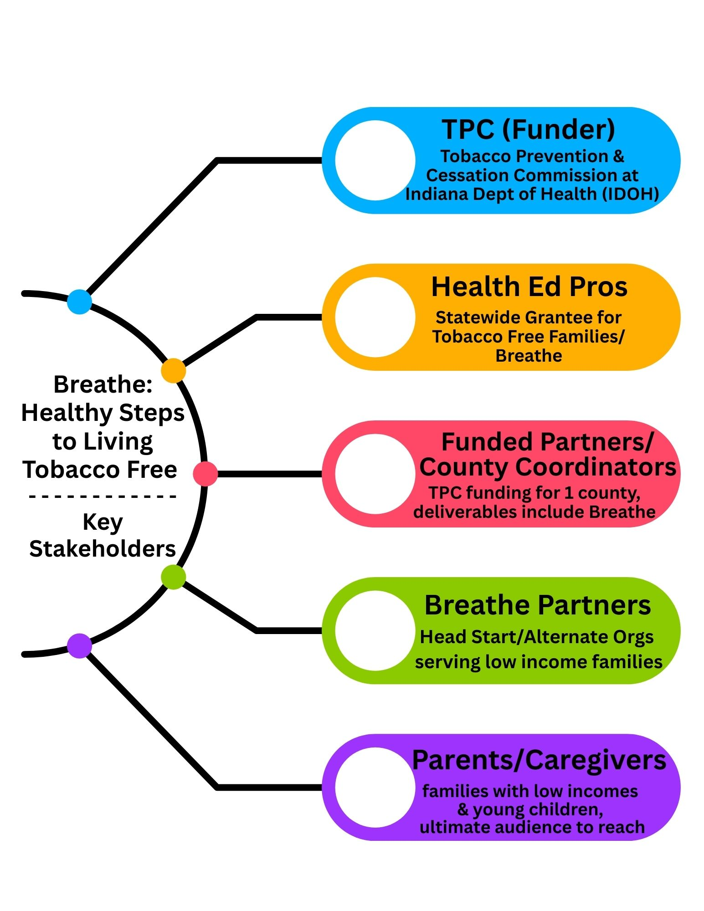
Train staff in organizations
Educate families they serve

Slide 10
TERMINOLOGY CLARIFICATION
TPC – Tobacco Prevention & Cessation Commission
IDOH – Indiana Department of Health
HEP – Health Ed Pros (That’s Tanya & Alison!)
TFF – Tobacco Free Families (grant indicator for Breathe!)
Funded Partners – (That’s You!) Organizations receiving TPC funds
Breathe Partners – The organizations you recruit & train
Train the Trainer – What you are experiencing right now!
Breathe Trainings – The trainings you (and HEP) will deliver to staff at organizations

Slide 11
Poll Questions!

Slide 12



Which County/Funded Partners Conducted the most Breathe trainings in grant year 1?
1
5
Elkhart
5
Bartholomew
2
2
0
St. Joseph
3
0
TEAM 1
TEAM 2
3
Orange
3
ADD ROUND POINTS
ADD ROUND POINTS
4
Marion/LHO
2
BACK TO SCORES
0
NEXT ROUND
Notes:
KEY POINT: Review common tobacco products.
SCRIPT/INSTRUCTIONS: (When first opening these slides either wait for numbers to appear or push the right arrow key to show numbers.)
“(Team 1) will go first and the question is What common products are used to deliver nicotine to the body? (Team 1 provides an answer. Use the Family Feud Cheat sheet to know which number on the board corresponds to that answer. Click on that number to reveal the answer and give that team 10 points.) “(Team 2) Now it is your turn to answer the same question.” (Keep alternating between teams until all answers are revealed or until both teams fail to get a correct answer and then reveal any remaining answers.) “Great job everyone! There are lots of tobacco products on the market these days, so it is helpful to know a little about the various products when you are providing education to parents.” (Give some background information about each of these products, especially emerging or new versions of these products and share how NRT are proven to help people step down their tobacco use. Then click the right arrow key to advance to the next question/slide.)

Slide 13
Time for a Prize!
Notes:
1 entry for every training you conducted in grant year 1…random drawing for a $10 Starbucks or Target gift card, winner’s choice. Alison select winner and have them private message you or email you with the address to mail it to.

Slide 14
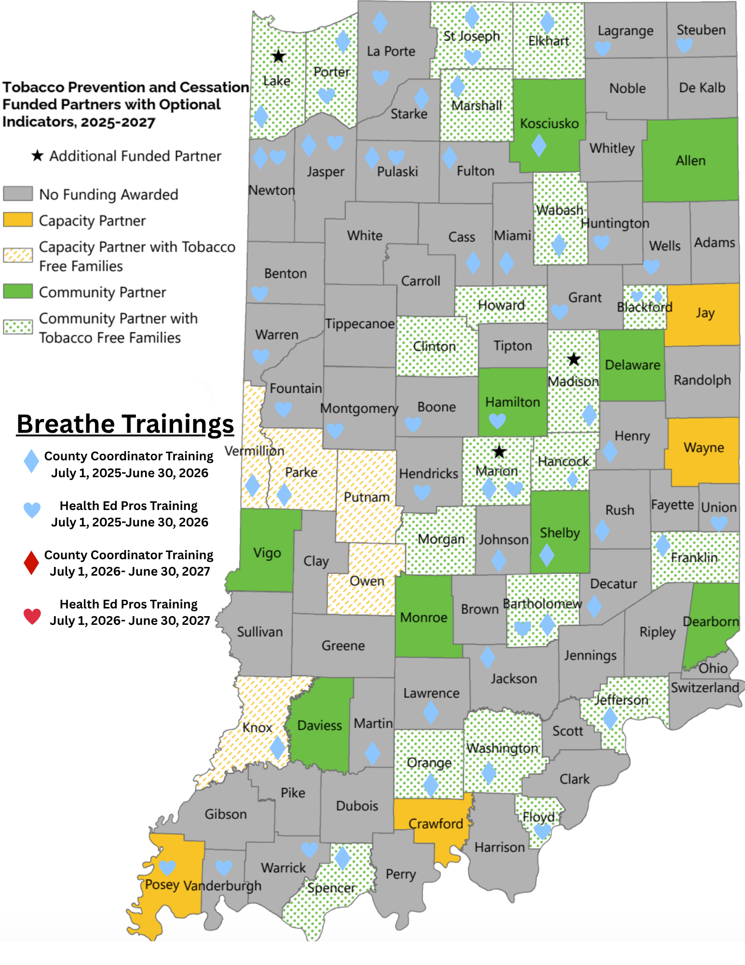
2025-2026 Breathe Stats
35 Breathe trainings!
(11 Breathe Refreshers, 2 teasers, & 6 parent presentations)
Trained 648 people in 53 of the 92 counties!
97.8% would recommend Breathe Training!
Those who felt prepared to discuss exposure to second and thirdhand smoke/vapor with parents went from 62.8% before training to 92.2% after training

Slide 15
TFF/Breathe Deliverables
Implement Breathe in at least one Head Start Center or Alternate Organization serving families most impacted in your county.
Maintain Breathe in at least one existing Head Start Center or Alternate Organization serving families most impacted in your county.
Utilize Breathe materials for promotion and education outside formal trainings.

Slide 16
Sharing Time!
Let’s experiment with the Whiteboard!
Which Breathe resource is your favorite?

Slide 17
Sharing Time!
How have you utilized Breathe materials for promotion & education outside of formal trainings?

Slide 18
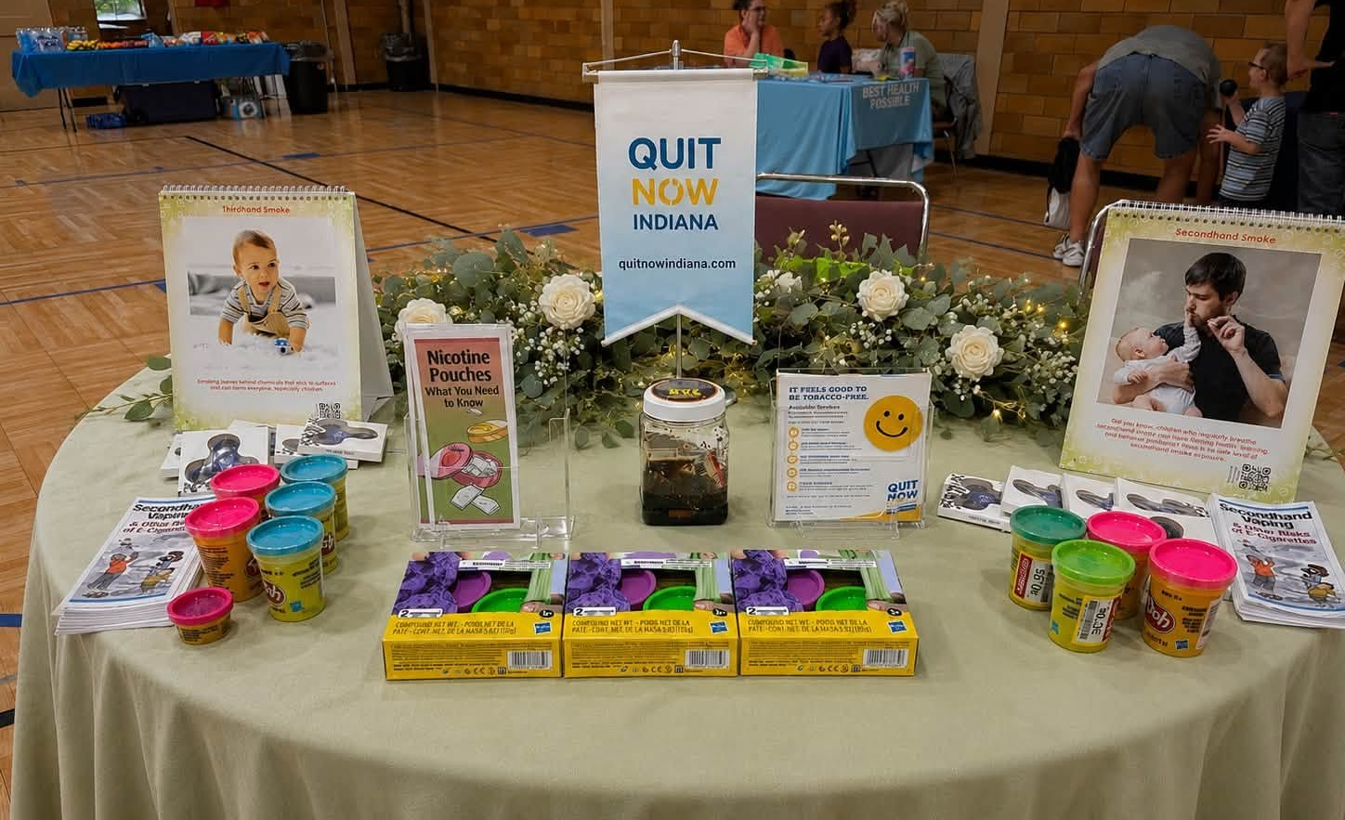
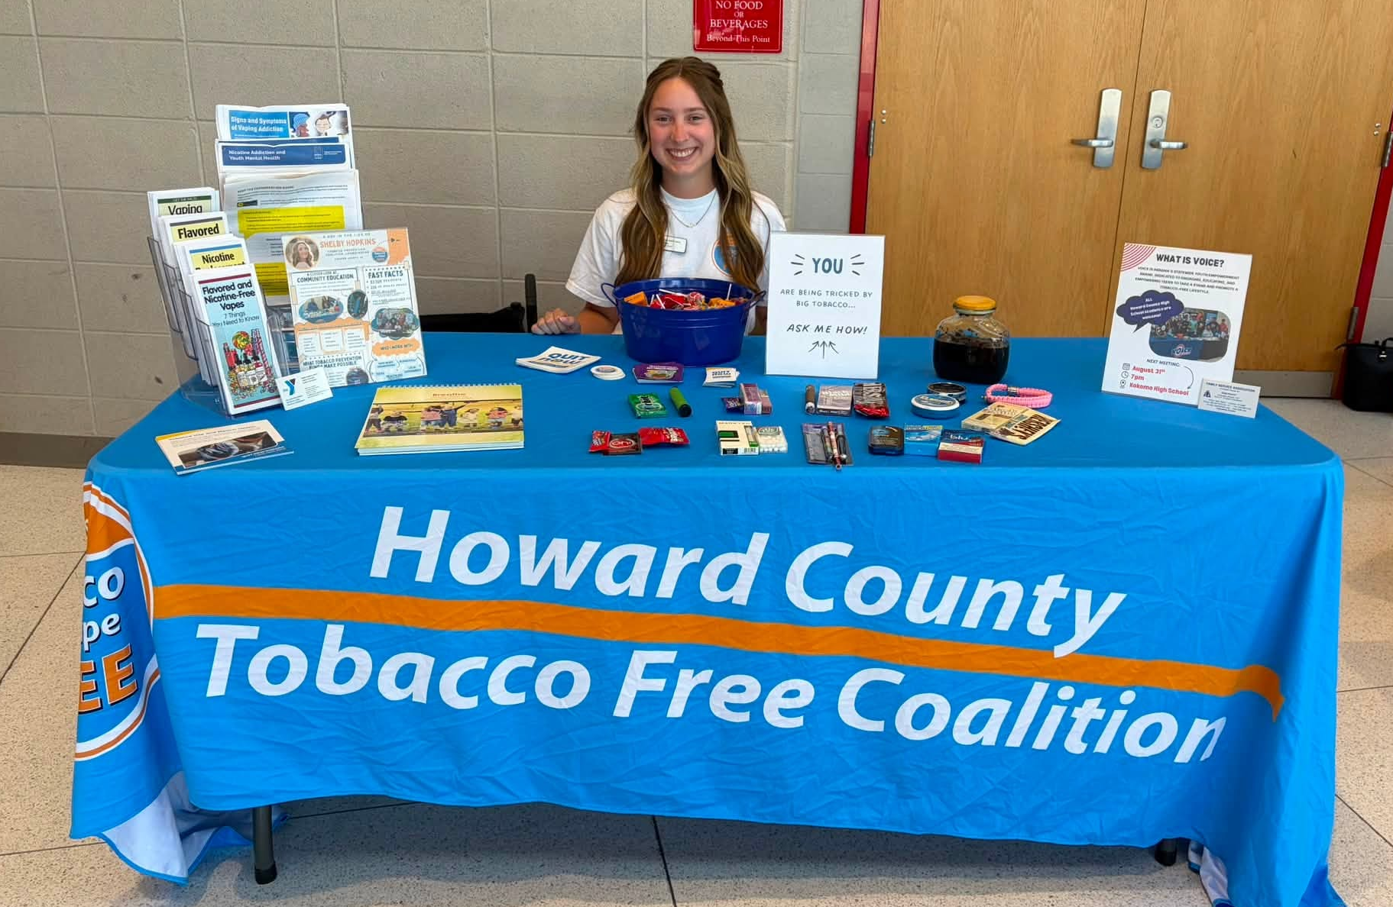
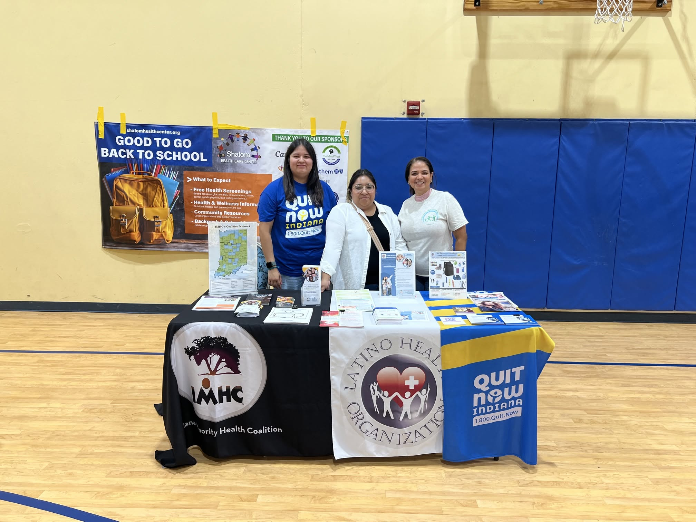
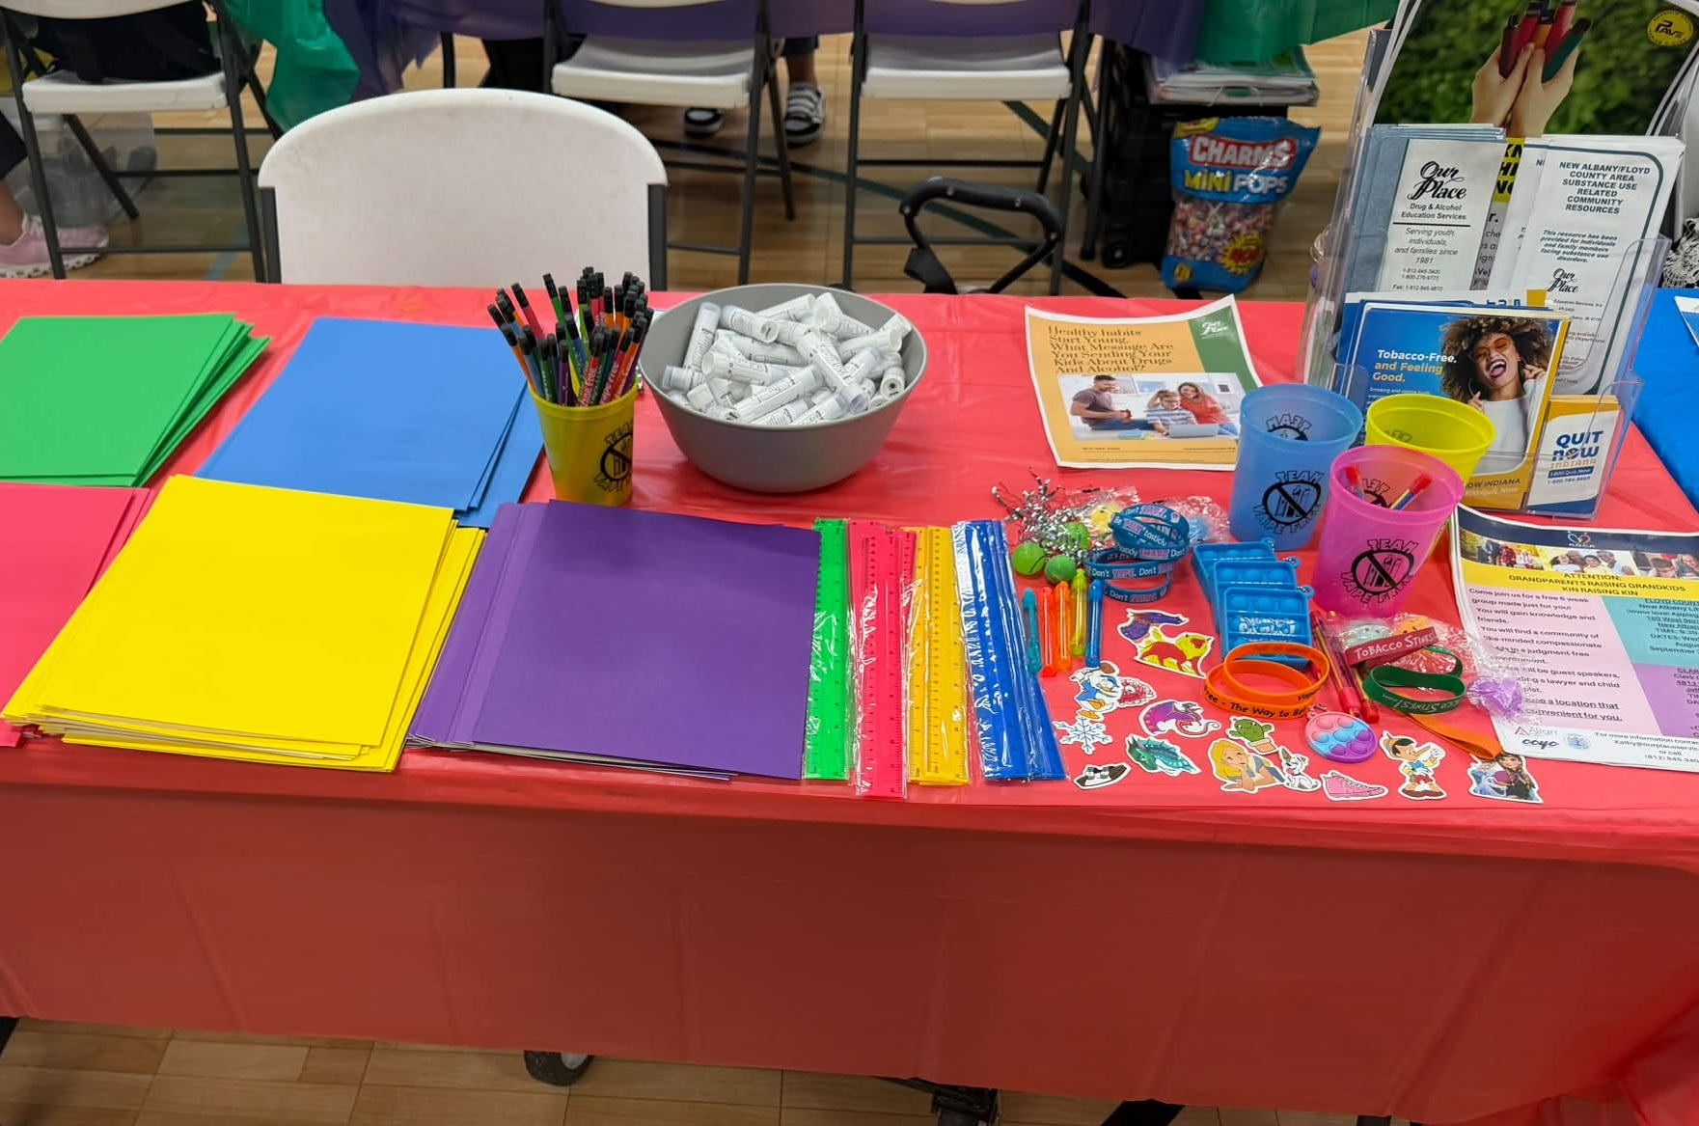
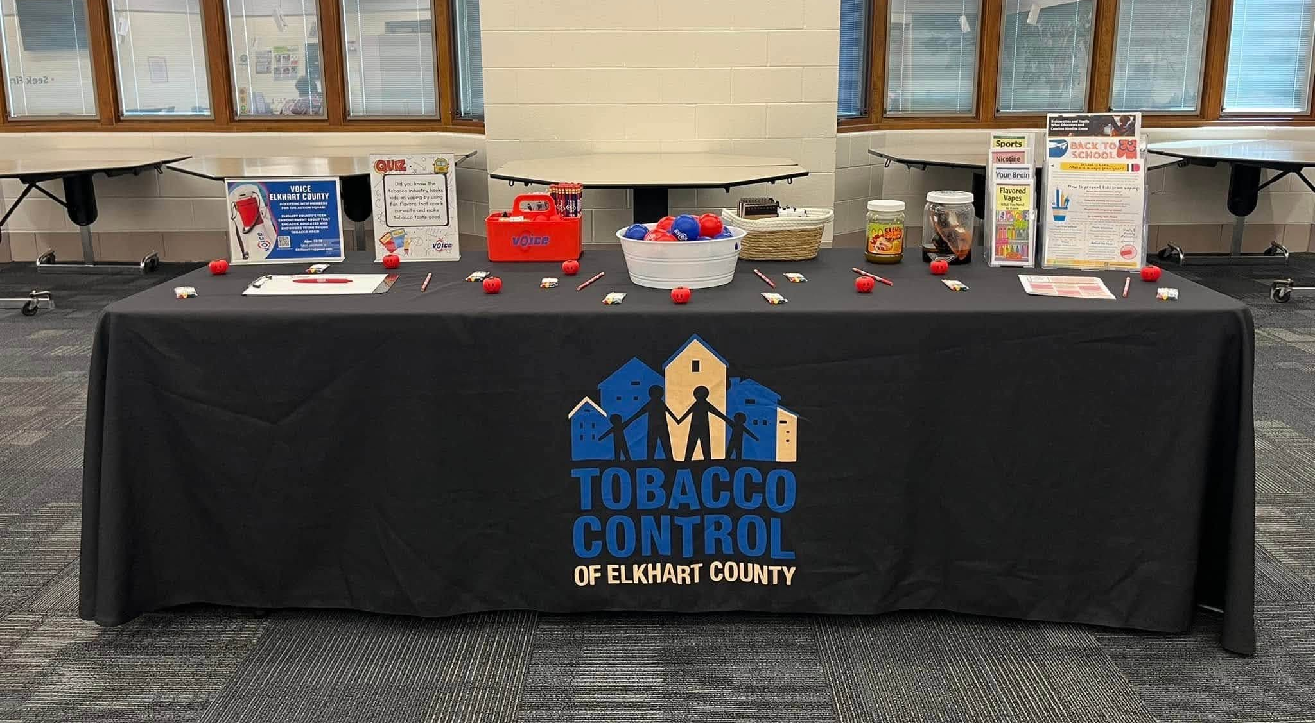
Back-to-School Contest
Notes:
Add up number of posts, Alison to create spreadsheet of all entries and do random drawing. Have alison post link to facebook group in chat box, share how posts have really increased with the contest and this is how we want to use this page, sharing ideas and successes and challenges

Slide 19
And the winner is…
Notes:
Alison to create spreadsheet and do random drawing for $25 gift card (winner can choose from Starbucks, Walmart, Amazon, or Target)

Slide 20
New For Parents Webpage!
Made specifically for parents/caregivers
Easy to read and use for busy parents
          12 tobacco education topics
              - Videos for visual/auditory learners
          - handouts for reading
          - worksheets for engaging
Children’s resources
Spanish resources (coming soon!)
FAQs & a place to ask additional questions
Parent Surveys and Personal Tobacco Stories
Quick, digestible tobacco info!

Slide 21
Let’s Take a Peek!
www.justbreathein.org/for-parents
Notes:
Go to main page of Breathe website, remind them that the first several tabs are for funded partners, For Partners is for Breathe Partners/organizations they train, and For Parents is for parents/caregivers. Then click on For Parents section and quickly show the home page and 1 or 2 of the topic pages.

Slide 22

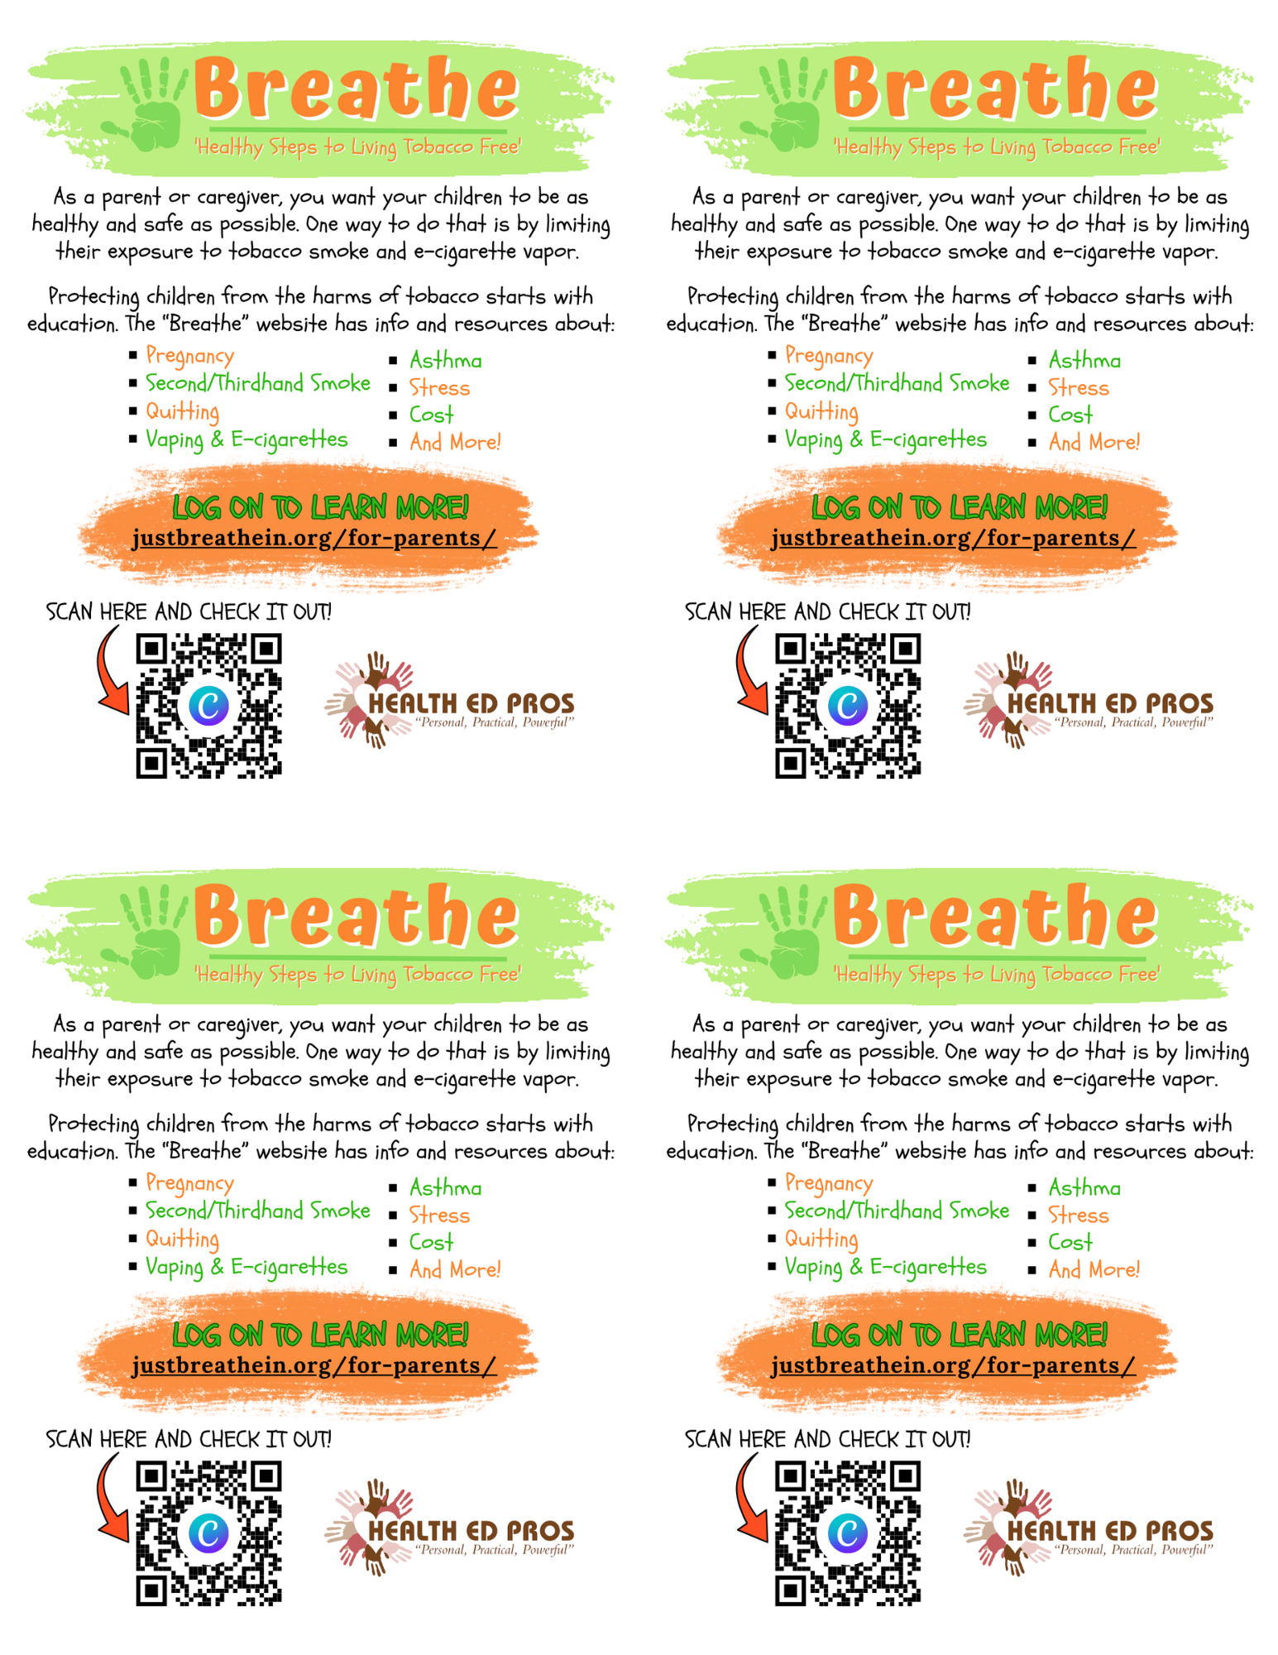
Contact Alison to personalize flyers!
Download Here: justbreathein.org/additional-resources/materials/

Slide 23
Promoting ‘For Parents’ webpage
ALWAYS SEND PARENTS/CAREGIVERS DIRECTLY TO
‘FOR PARENTS’ PAGE!
Share with Breathe Partners
Post flyers
Hand out cards at community events/health fairs and presentations
Share in newsletters
Post on social media
Add to your signature line
How will you promote the ‘For Parents’ webpage?

Slide 24
Give us your feedback…
get another chance to win!
Look for survey link in training follow-up email
Notes:
Alison to create spreadsheet and do random drawing for $25 gift card (winner can choose from Starbucks, Walmart, Amazon, or Target)

Slide 25
They’re Back…Parent Surveys!
New & IMPROVED Parent/Caregiver Survey is now available!
Purpose:
provide a tangible opportunity to engage with parents at events and through other communication channels, and the surveys put tobacco education on their radar
allow us to gather data about tobacco use from the population we aim serve with Breathe, and they provide an opportunity to share personal tobacco stories, which gives us qualitative insights
give us feedback on how parents feel about tobacco education, which we can use to modify Breathe
Spanish Survey Coming Soon!!

Slide 26
They’re Back…Parent Surveys!
Goal:
250 surveys by the end of May, 2027…and we need your help!
Make sure your county is represented!
Any county that collects at least 10 surveys will be get an individualized report
Incentive:
Any parent/guardian who completes a survey (and provides their contact information) will be entered into monthly drawing for a $50 Walmart gift card!

Slide 27
Parent Survey Ideas/Tips
Funded Partners AND Breathe Partners can collect surveys
Talk to organizations you have trained; work with them to develop survey implementation plan that works for them
Sample text on website you can use and personalize
Complete surveys at enrollment, parent nights, community events/health fairs, parent-teacher conferences, home visits, etc.
Share on social media, in newsletters, in parent emails, or post flyers
Can be done any time (before or after providing tobacco education)
Includes built-in skip logic (for those who use tobacco, formerly used, or never used) - can ONLY be filled out ONLINE (no paper/pencil version)
If someone requests help with quitting (and provides contact information), HEP will share info with County Coordinator to follow up with resources
All details can be found on Breathe website!

Slide 28
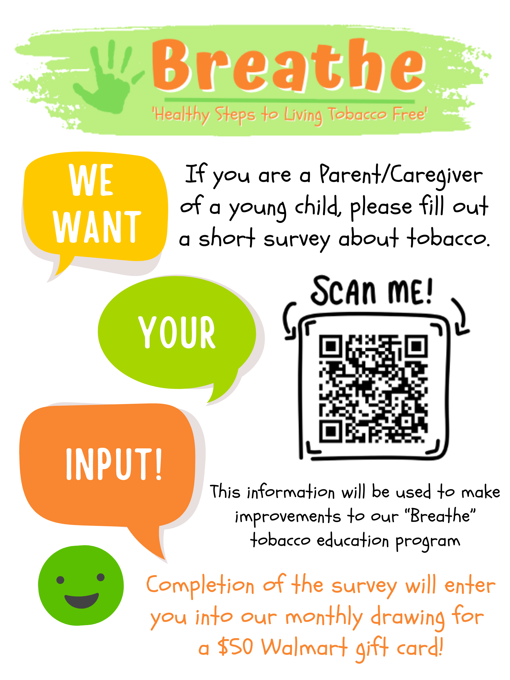
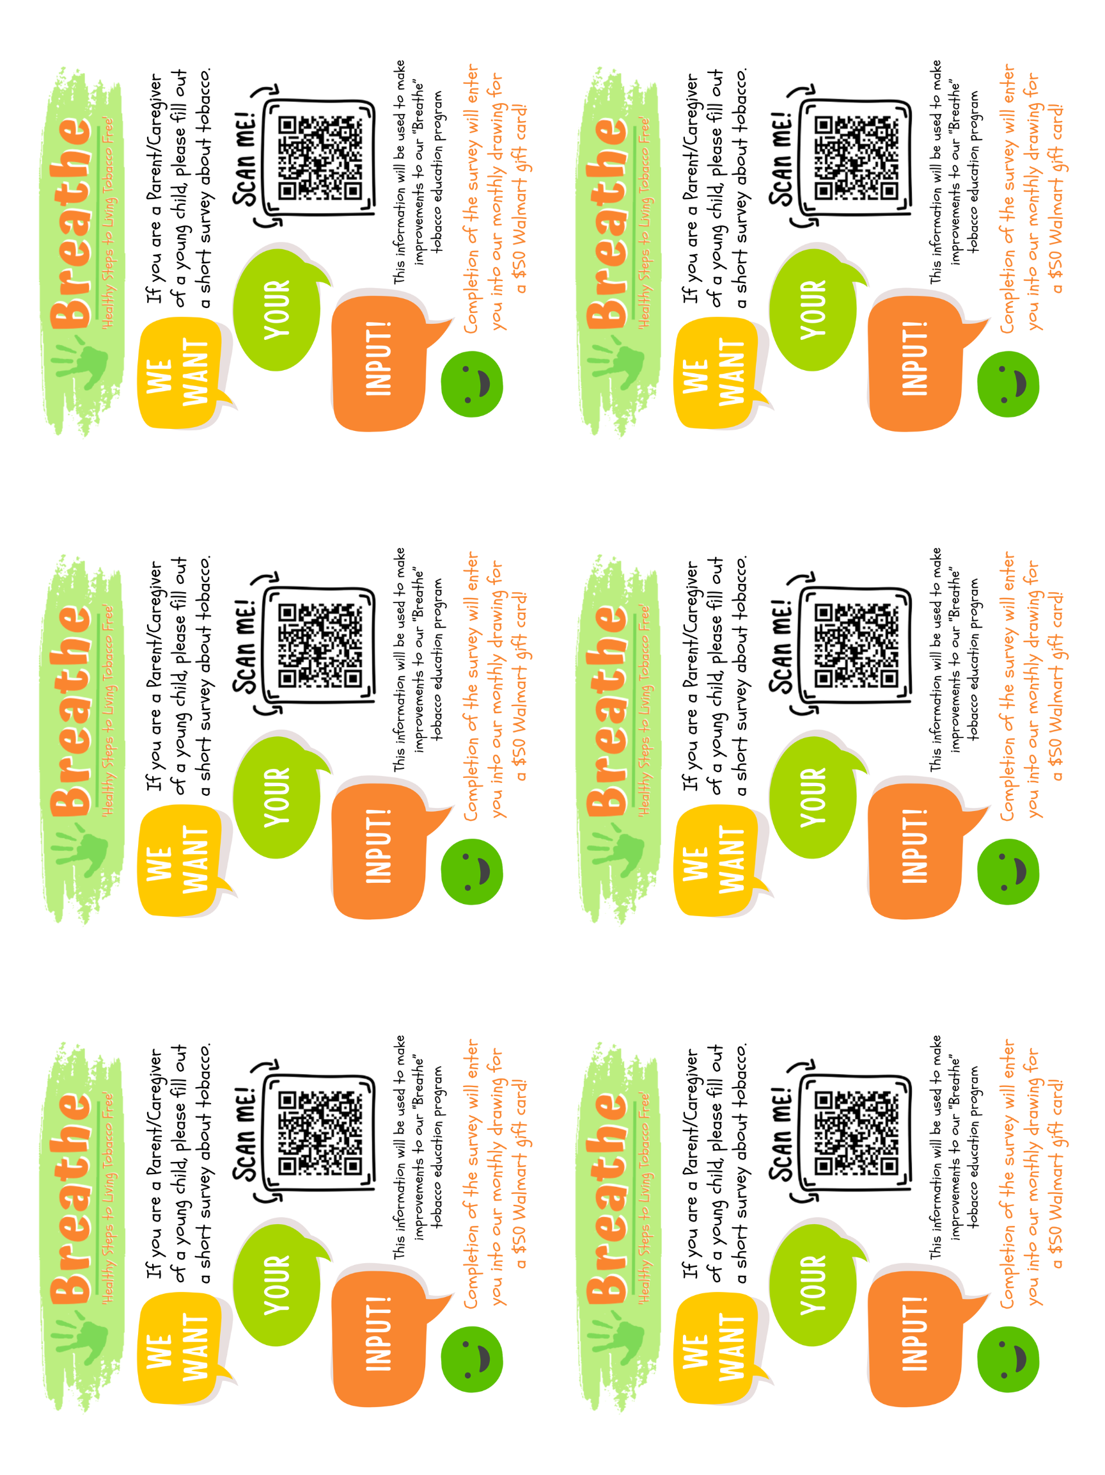
Print flyers & postcards from the Breathe website!
Download Here: justbreathein.org/additional-resources/materials/
Notes:
Print and post, put sign at booth, set up computer for survey, download and share flyer; hand out small cards at events or presentations; next time training powerpoints are updated a slide will be added about parent surveys

Slide 29
Good to Know
Recordings of this webinar will be on website soon
Working with LHO to get Parent Survey and For Parents webpage in Spanish
Training PowerPoints will be updated with info about For Parents webpage and Parent Surveys soon…always use most current version on website
Hard copies of Children’s Activities booklets are gone, Parent Activities booklets will run out soon…all resources are on the Breathe website!

Slide 30
Friendly Reminders
www.justbreathein.org Your Go-To Source for Info
FOR PARTNERS Webpage - for the Breathe Partners you train
FOR PARENTS Webpage - where Parents/Caregivers should be directed
The Foundation of Breathe is still Annual Staff Trainings
Complete Breathe Training Notification Form for ALL Breathe presentations (Initial, Refresher, Teaser, & Parent–gets star on the map!)
Submit sign in sheet AS A WORD DOCUMENT
Remind training participants about 1 month follow up – monthly $25 gift card drawing!
Breathe Facebook Group - Timely Updates & Ideas
HEP is here for Technical Assistance & Evaluation Support
Notes:
If you have been working on Breathe for a while this is stuff you should know…but it may be new for some…and even our veterans do a lot of other things and may not remember all the steps…so these are your friendly reminders!!

Slide 31
QUESTIONS??

Slide 32
NEXT STEPS
Review For Parents webpage: justbreathein.org/for-parents/ and complete survey
Email alisonp@healthedpros.org if you would like personalized For Parents flyer/cards
Promote For Parents webpage and use Breathe resources at events/presentations
Start collecting Parent Surveys!
Keep recruiting and training partner organizations and conduct annual Breathe Refreshers
Reach out to Health Ed Pros for support!
See you at Partner Xchange!

Slide 33
Time for another Prize!
Notes:
Random drawing from all participants…will give away another $10 gift card to Starbucks or Target.

Slide 34
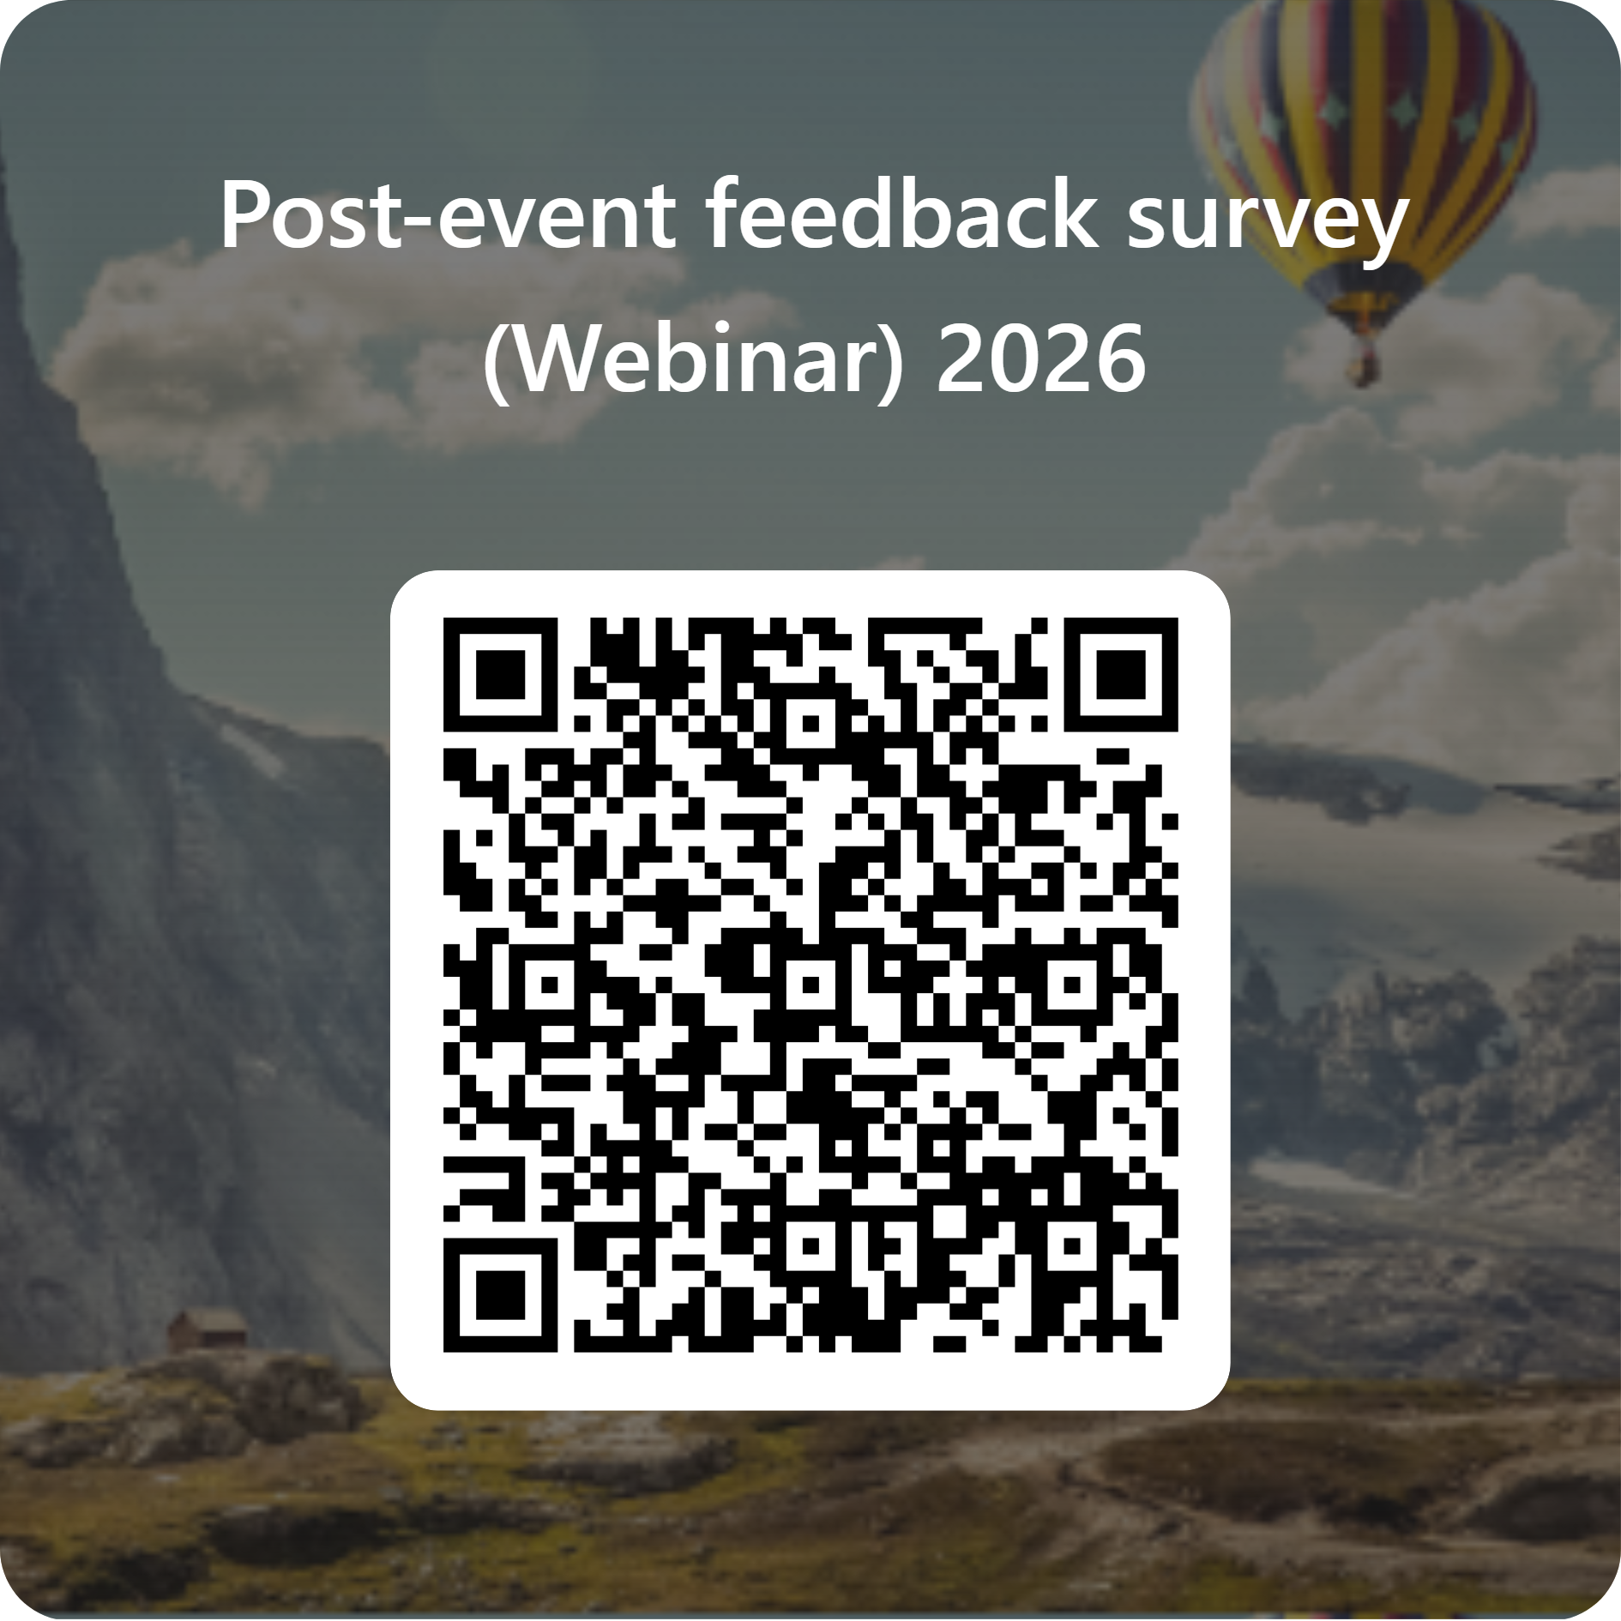
Notes:
Get evaluation code from TPC

Slide 35


THANK YOU!!
Tanya Shelburne, Project Manager
tanyas@healthedpros.org
317-902-4505
Alison Perez, Tobacco Control Specialist
alisonp@healthedpros.org

