Slide 1
Breathe/Refresher Pre-Training Assessments - Data Report
Grant Year 1: July 1, 2025 – June 30, 2026
>> 384 Pre-Assessments completed

Slide 2
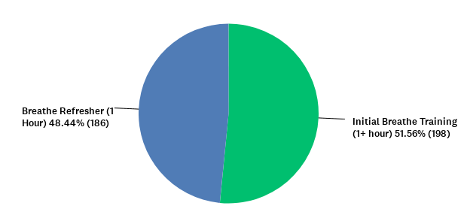
Breathe training attended:
Answered: 384 Skipped: 0

Slide 3
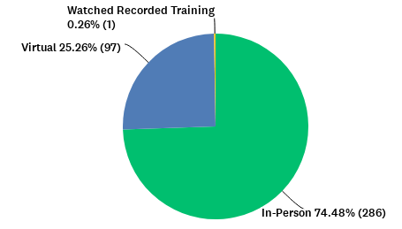
Format of Breathe Training:
Answered: 384 Skipped: 0

Slide 4
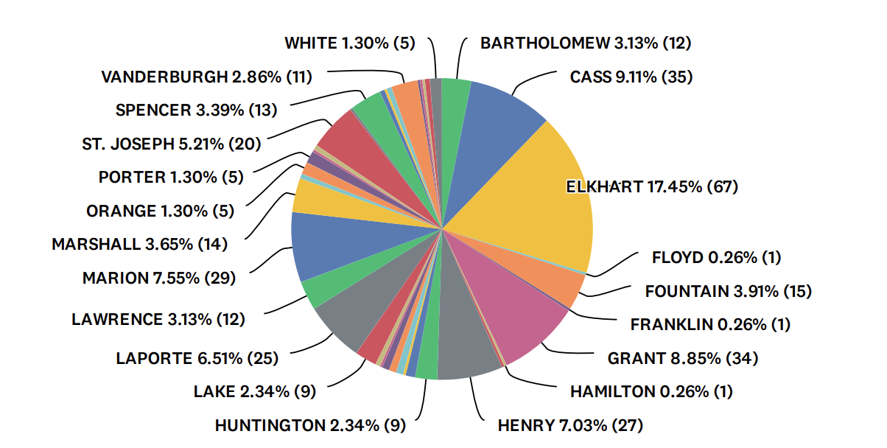
27 Breathe trainings for staff in local organizations were conducted in the following counties from July 1, 2025 – June 30, 2026:

Slide 5
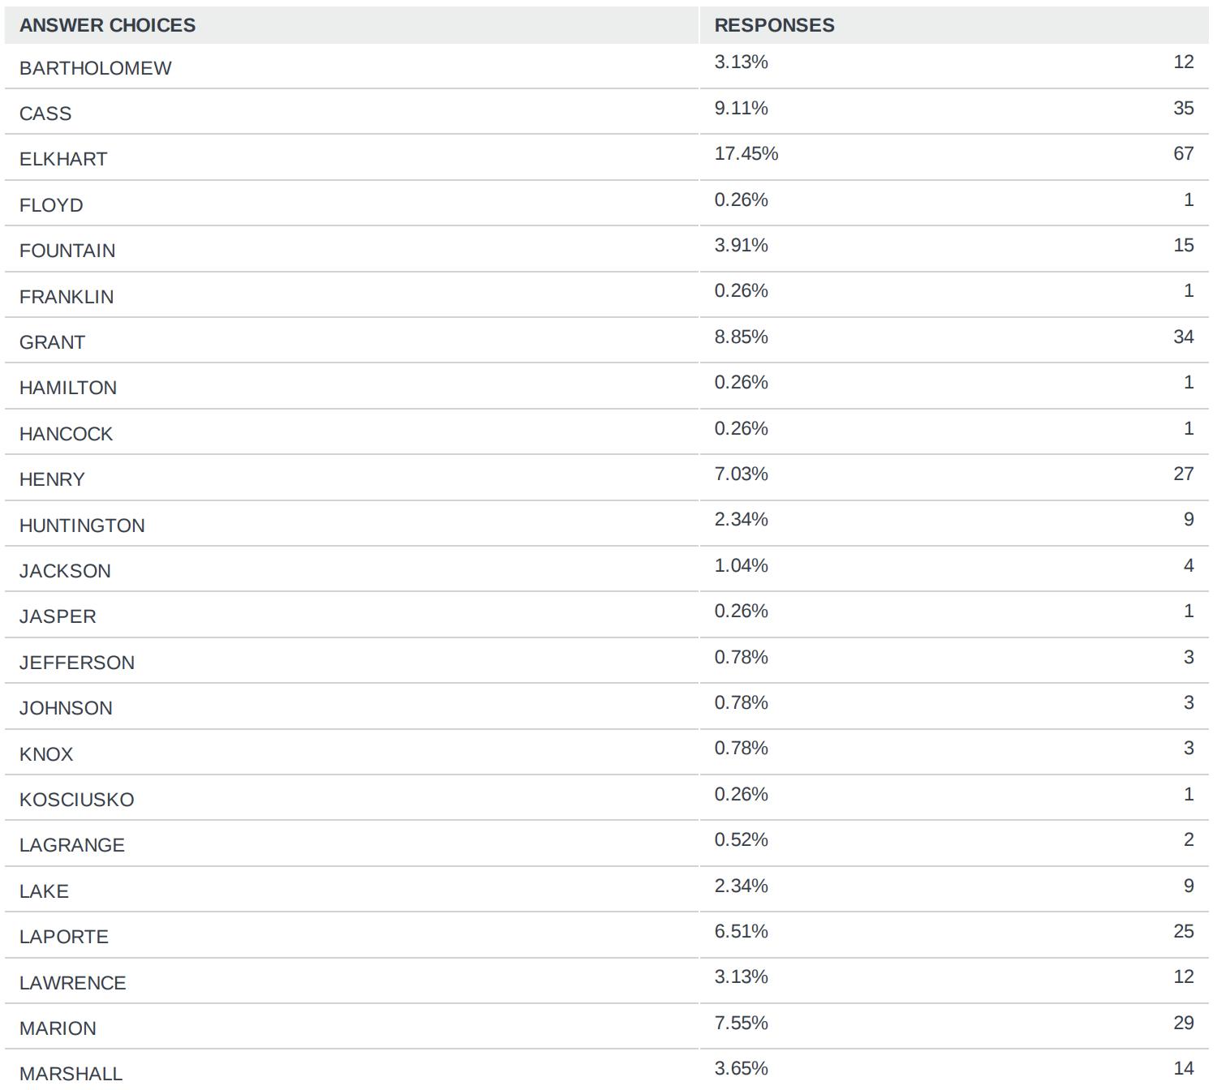
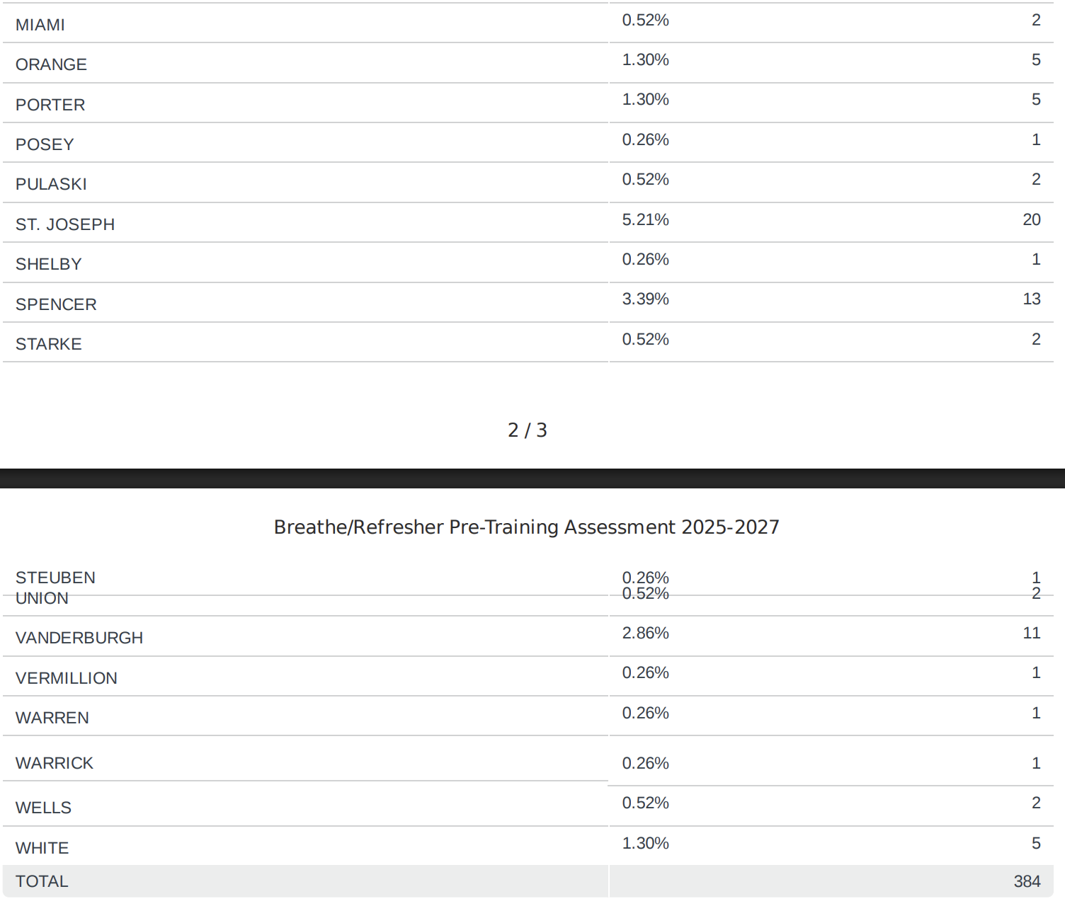
Notes:
Add in all the counties and make sure that it is readable – make them side by side in two columns

Slide 6
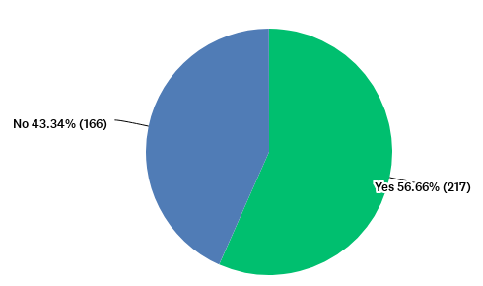
Have you had any previous training on tobacco/smoking/vaping (including previous Breathe trainings)?
Answered: 383 Skipped: 1
Notes:
Can this be a percentage? No pie chart
Add in data tables

Slide 7
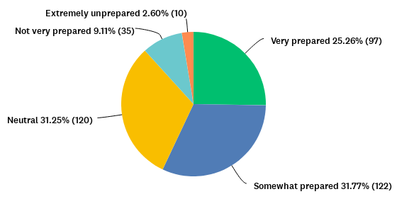
How prepared do you feel to discuss SMOKING with parents/caregivers?
Answered: 384 Skipped: 0
Notes:
Can this be a percentage? No pie chart
Add in data tables

Slide 8
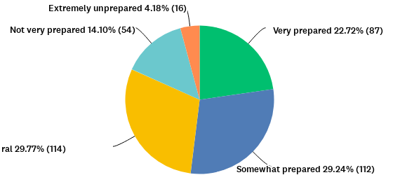
How prepared do you feel to discuss VAPING with parents/caregivers?
Answered: 383 Skipped: 1
Neut
Notes:
Can this be a percentage? No pie chart
Add in data tables

Slide 9
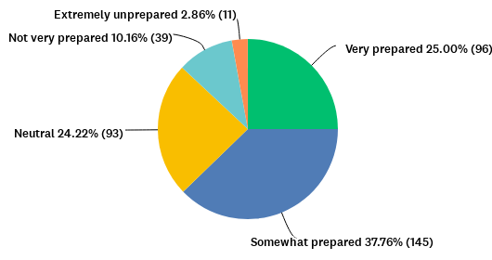
How prepared do you feel to discuss children's exposure to second and thirdhand smoke/vapor with parents/caregivers?
Answered: 384 Skipped: 0
Notes:
Can this be a percentage? No pie chart

Slide 10
Have you ever shared smoking/vaping education or cessation resources with parents (including Breathe materials, if you were previously trained)? Check all that apply.
Answered: 382 Skipped: 2
Notes:
Can this be a percentage? No pie chart

Slide 11
Do you have any questions about smoking/vaping? Or is there anything specific you hope to learn?
“No questions, hope to learn from resources”
“Would like more info I can share with expectant moms”
“I am open to learning all information presented”
“The impact smoking and vaping has on vulnerable populations.”
“I’m curious about the new oxygen zero nicotine vapes. Do you know much about them?”
“I just do not have many parents that share/admit they want to stop smoking/vaping. I have shared once or twice is all.”
“What are the effects of vaping in the home?”
“Learn about this problem in young people”
“Lean about vape problem in teens “
“I hope to learn more on the effects of second hand smoke.”
“How do I get through to my teen how bad vaping is when all their friends are doing it?”
“Learning how to have a successful dialogue with parents about smoking cessation.”
“I used to be a smoker. I quit about 30 years ago. So I know a few things about it. It was the hardest thing I have ever done.”

Slide 12
Do you have any questions about smoking/vaping? Or is there anything specific you hope to learn? (continued)
“No had refresher multiple times”
“More on vaping since they feel it is safer”
“How much tobacco in vaping”
“I don’t know very much about vaping—looking forward to learning today”
"The difference in danger risks with vaping vs smoking”
“Dangers if vaping around kids "
“Learn about resources”
“I don’t really understand exactly what is in a vape cartridge and how it correlates to cigarettes. Like if they smoked a pack a day and switched to vape, how would that be classified.”
“Can we also learn about effects of marijuana/ CBD pens in pregnancy for our population?”
“The book called “the easy way to quit smoking” by Allen Carr is a great smoking cessation tool!”
“Is vaping better or worse than smoking cigarettes and why?”
“Differences of all the vapes and the risks”
“Any updates”
“Would love to be able to help explain the impact on children”

Slide 13
“There’s so many vape products.. I don’t know what they look like or how to measure the amount they take in so we can work at lowering the amount of vaping they do.”
“New products on the market over the past 12 months”
“Number 9 is a bit hard for me to answer at the moment just because I feel a bit unprepared to share with parents the safety and also education on recreational drugs”
“when will the next Initial Breathe Training be offered? thank you”
“Are there business card sized vaping info we can share with families? Are there any testimonies from local people who were affected by vaping that we can share? People with mental health issues struggle to find healthier ways to calm self. What are alternative options to share with them?”
“Just wish it wasn't such a difficult thing to discuss with parents.”
“The best way to communicate with families and the severity of smoking and vaping.”
“How to deal with parents on denial that they smoke or vape”

