Slide 1
Breathe/Refresher Post-Training Assessment 2025-2027
Grant Year 1: July 1, 2025 – June 30, 2026
>> 350 Post-Assessments completed

Slide 2
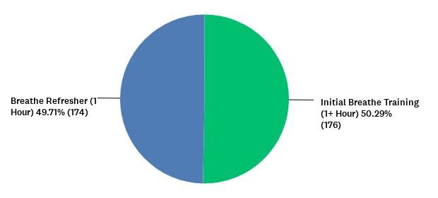
Breathe training attended:
Answered: 350 Skipped: 0

Slide 3
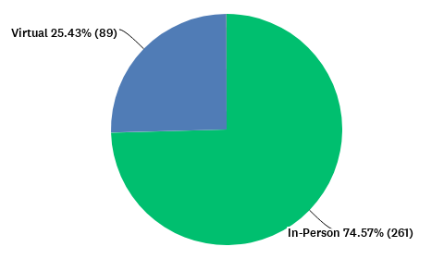
Format of Breathe training:
Answered: 350 Skipped: 0

Slide 4
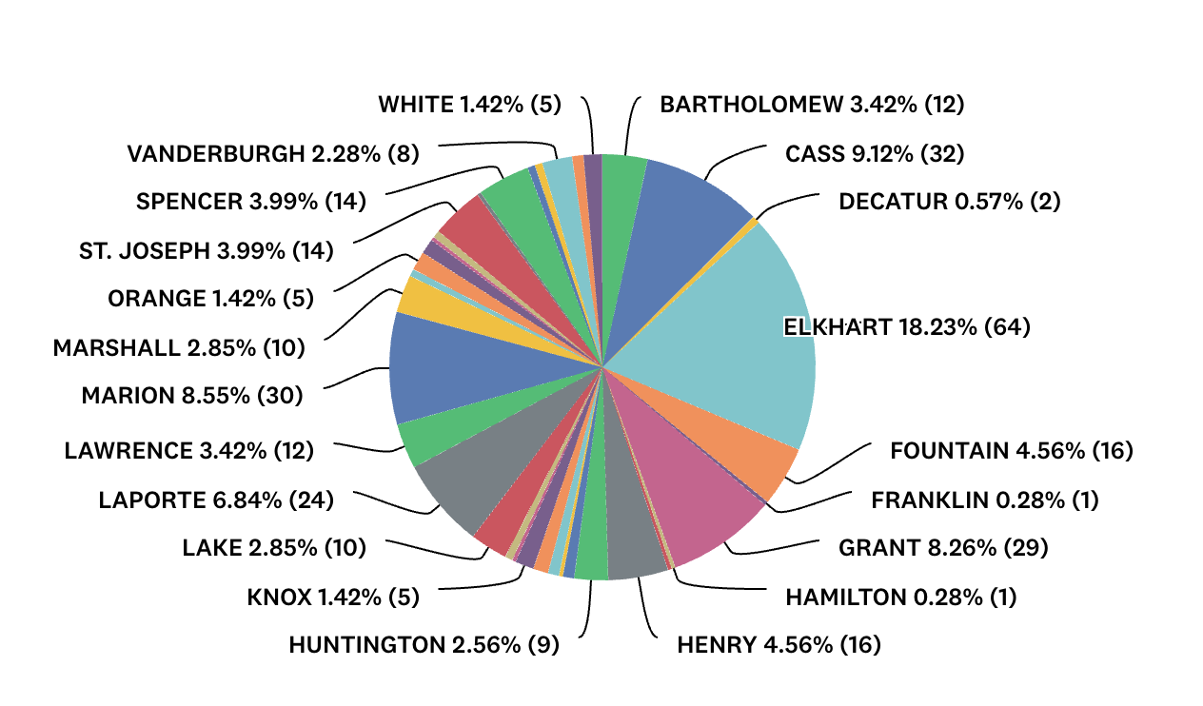
27 Breathe trainings for staff in local organizations were conducted in the following counties from July 1, 2025 – June 30, 2026:

Slide 5
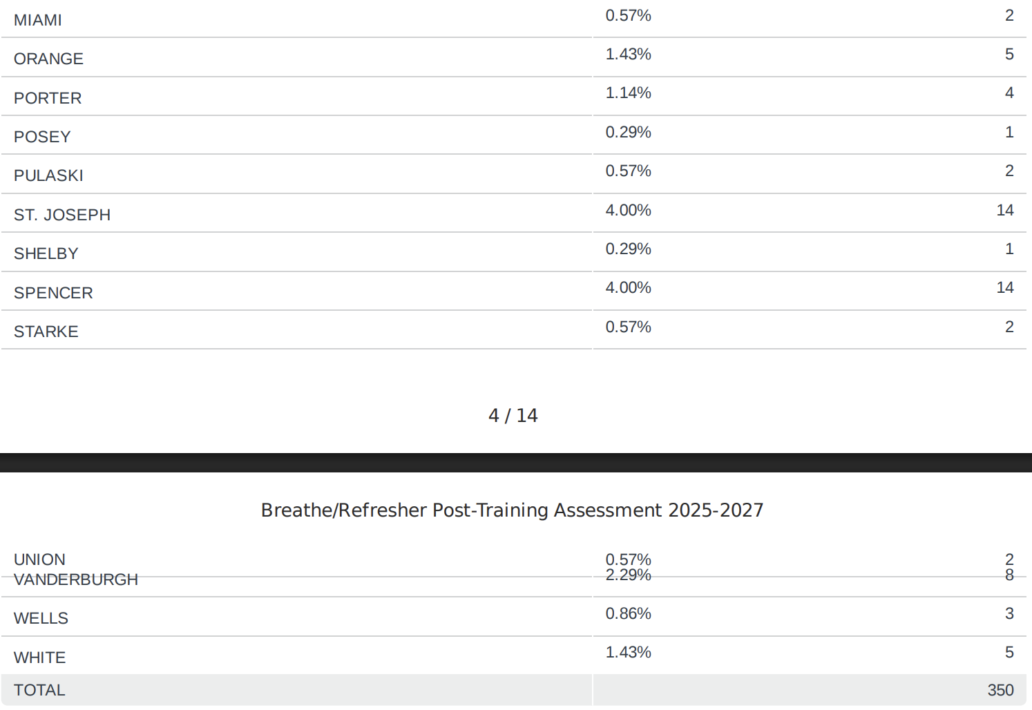
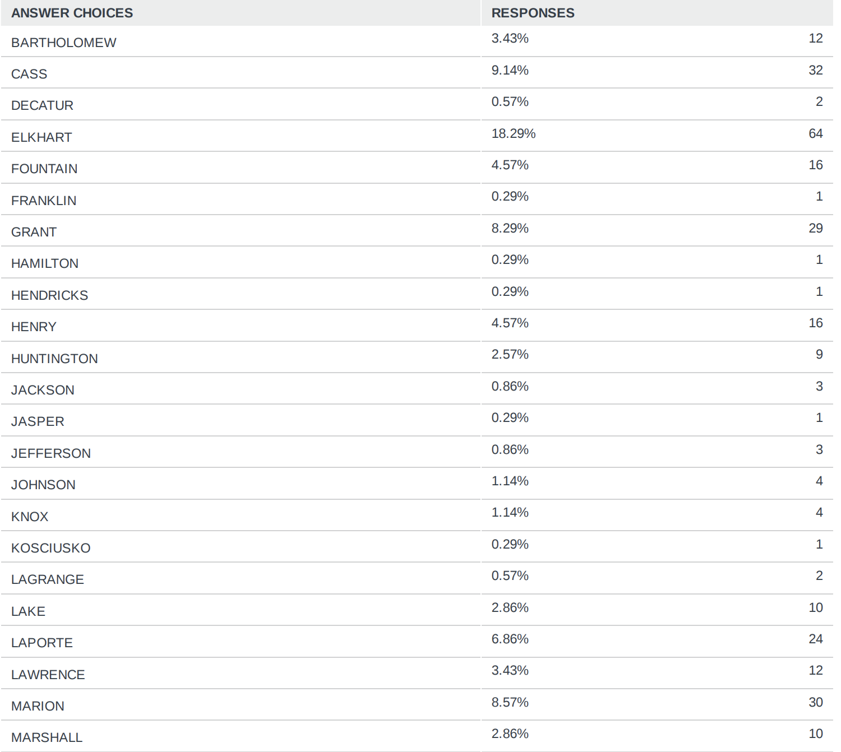

Slide 6
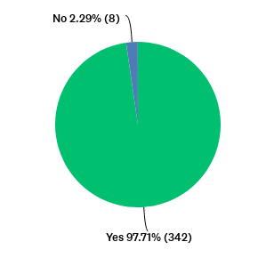
Would you recommend this training to others?
Answered: 350 Skipped: 0

Slide 7
What was your favorite part of the Breathe training?
“Learning about the harms of smoking beyond the lungs”
“Information on vapes and how they are made to keep users addicted and attract to younger kids”
“Learning about the new types of tobacco products and how they’re packaged to attract the youths.”
“Learning about different types of nicotine products”
“Education on how to talk to people”
“Learning how to discuss tobacco use with families”
“Parent worksheets and activities”
“Knowing where I find information”
“Incredible resources that are free to share with families!! Great info!”
“Info on second/third hand exposure and vape / thc look alike pictures”
“I found the slide with the various vape pictures the most helpful/interesting.”
“I like the ask>advise>refer strategy and I didn’t know on average it could take 8-11 times to be successful at quitting”
“Learning more about what are stuff is in cigarettes and vapes and zens”
“Education of facts. Very well presented. Personal and relatable.”

Slide 8
What was your favorite part of the Breathe training? (Continued)
“The handouts available to print through the website.”
“The find the vapes picture”
“Easily understood and clearly presented. Great flow!”
“Access to the handouts, videos. And resources”
“Knowing what vaping and tobacco can do to the pregnancy”
“Education of second and third hand smoke”
“The inclusion of vaping devices and marijuana. My clients use these primarily.”
“learning how harmful third hand smoke is”
“THE HISTORY OF TOBACCO MARKETING”
”Learning about all the new tobacco products and their health risks for children and adults “
“The health problem caused by the cigarette or by smoking/the game was fun”
“My favorite part was receiving and learning new and useful information that i can use in my everyday life and work.”
“Empowering to invite others to quit.”

Slide 9
What was your favorite part of the Breathe training? (Continued)
“Talking about the ways people can get help”
“The PowerPoint and speaker was very informative”
“Devices, I didn't know about that 😳 “
”The question and answer”
“The cost of the ads”
“Prevention”
“New device for smoke.”
“Mentioning new information regarding to the children.”
“The Jeopardy was my favorite part of the training. Very interactive and informative.”
“Learning more kinds of things attracting our kids now.”
“Learning about all the cessation resources”
“Learned what vapes look like more geared towards kids”
“Being made aware of how prevalent vaping and tobacco products are.”
“To have have information about new products and information to Share with parents”
“Learning what new things that are coming up @zyn pouches”
“Jeopardy game. It is a fun way to see what you know.”

Slide 10
What was your least favorite part of the Breathe training?
“Skipped around a few topics due to time constraints”
“Need more structure on how to implement”
“Not all subjects covered as in-depth as others”
“Need additional time to get further in depth on each discussion”
“Repetitive”
“Preparing myself to have hard conversations with parents.”
“I’m in the middle of quitting smoking so it is personal for me.”
“Having hard conversations with family about smoking”
“Thinking about having hard conversations.”
“The myths”
“The numbers. Never stick with me”
“Aiming so much towards African Americans.”
“I feel this is more for family advocates vs teachers. We already have enough on our plates to do.”
“Not much hands on. 🤷‍♀️”
“I've known this info primarily for decades.”
“Maybe more examples of some of the things they were explaining -vapes etc”

Slide 11
What was your least favorite part of the Breathe training? (Continued)
“Guessing how many people in Indiana.”
“The length, the games. I would have preferred to get the information not play games.”
“We can’t always change their minds”
“How repetitive hearing about smoking effects as far as hearing it in trainings as a nurse.”
“All information applicable to what we do.”
“It’s just an activating topic.”
“I didn’t like it was virtual”
“Because it was virtual, it was not possible to see materials in person”
“Statistics—but most of presentation was interesting”
“The videos and pictures”
“Wanting to have hands on training with the activities for kids and parents to know how to properly show the training examples”
“learning how appealing the market company is making things”
“We could use more strategies”
“How long it took”
“Knowing how harmful it is to children.”

Slide 12
What was your least favorite part of the Breathe training? (Continued)
“How bad companies spend on ads”
“Knowing how much money is spent on advertising”
“The presentation”
“The devices of the vape”
“See and hearing about younger kids being exposed to tobacco products”
“Hearing the same information i knew already.”
“already did the training”
“The amount spent of marketing that is horrible. The money could be used so many other ways”
”Kids vaping more”
“The sadness of seeing how much people spend on these addictions and how sneaky kids can be with it.”
“The questions at the end”
“Not long enough”
“Learning that parents will buy their own kids vapes as a reward.”
“Lack of prep”
“Hearing how the companies target kids”
“That it keeps evolving into the new generations.”

Slide 13
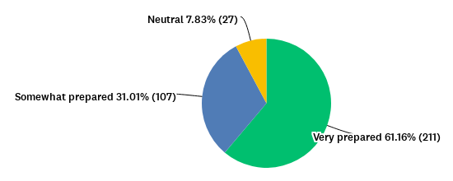
After completing the Breathe Training, how prepared do you feel to discuss SMOKING with parents/caregivers?
Answered: 345 Skipped: 5

Slide 14
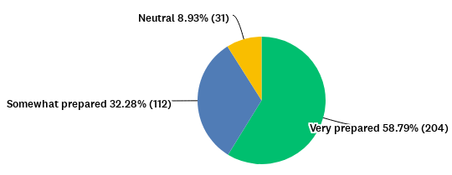
After completing the Breathe Training, how prepared do you feel to discuss VAPING with parents/caregivers?
Answered: 347 Skipped: 3

Slide 15
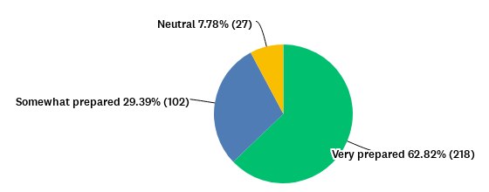
After completing the Breathe Training, how prepared do you feel to discuss children's exposure to second and thirdhand smoke/vapor with parents/caregivers?
Answered: 347 Skipped: 3

Slide 16
How likely are you to use each of the Breathe Materials? (Extremely Likely, Somewhat Likely, Extremely Unlikely, or Will Never Use)
Answered: 338 Skipped: 12

Slide 17
Additional Comments/Questions
“The presenter was very good and very knowledgeable”
“It was a great presentation and we had a great conversation with the whole group.”
“Thank you- you do a great job with this in a fun way”
“I liked it and the good information on what these types of things can do to your health”
“Thanks was a great topic , Thanks to the people for share with us”
“Do you have any handouts in Haitian Creole? This is one of the primary populations we serve here in Vanderburgh county”
“This was excellent to learn. I used to smoke weed but stopped when I got pregnant because I wanted to be the best healthiest mom ever. My daughter turned two on Wednesday. I have been sober since that day I found out. I’m proud to say I don’t drink, smoke, cuss, and even gave up caffeine!! All for her betterment. Thank you Jesus for strength and empowerment to honor my temple. 🙌”
“Thanks for bringing the information back up again . It was nice to have a Refresher!!!!”
“I wish it had a bigger section on vapes with how common the use is”
“I really appreciate the information in Spanish!”
“None at this time just wanting to know about training of recreational drugs in Indiana”
“I always enjoy the Breathe refresher”
“Maybe a little more information on 3rd hand smoke just to refresh our memory. Everyone knows about 2nd hand but not 3rd hand. Thank you!”
“Thank you! Love resources and fun webinar.”
“Thanks for giving resources I can use with family members.”
“Loved this training and how informative it was.”

