Slide 1
Breathe 1 Month Follow Up – Data Report
Grant Year 1: July 1, 2025 – June 30, 2026
>> 72 Pre-Assessments completed, 19.8% response rate

Slide 2
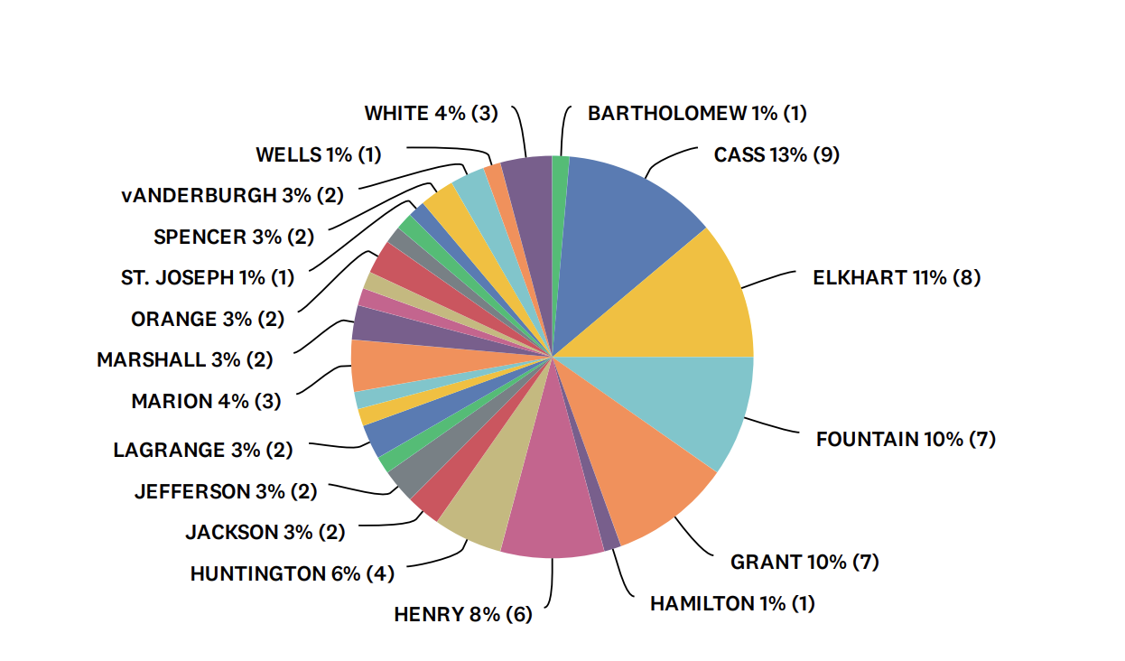
Breathe training participants in the following counties completed a 1 month follow up survey from July 1, 2025 – June 30, 2026:
Answered: 72 Skipped: 0

Slide 3
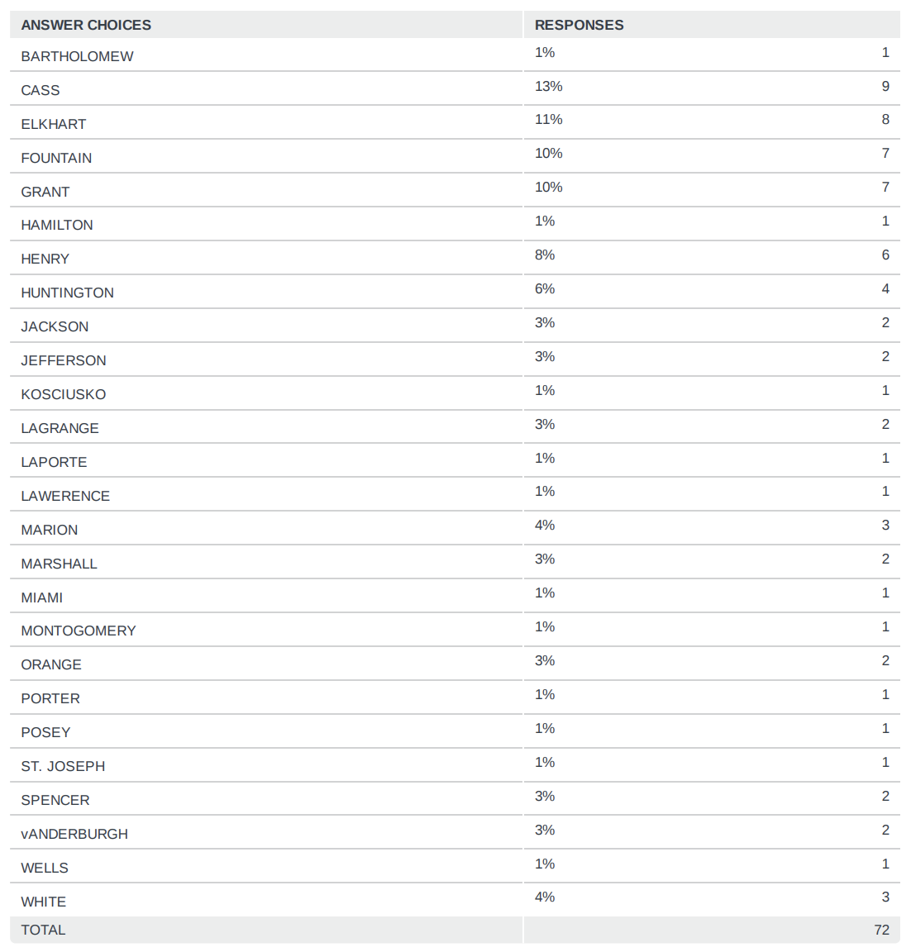

Slide 4
The title/role that best describes your position(s) within your organization (check all that apply):
Answered: 72 Skipped: 0

Slide 5
Since completing the “Breathe” Training, HOW OFTEN have you used each of the materials?
Answered: 72 Skipped: 0

Slide 6
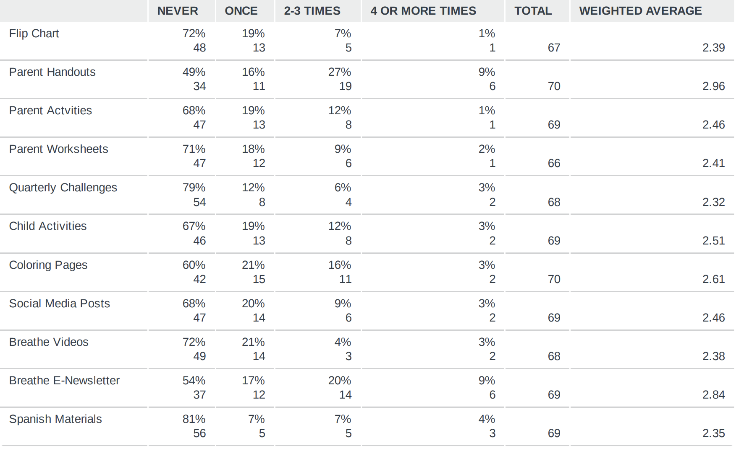

Slide 7
HOW USEFUL have you found each of the “Breathe” materials to be when providing education on tobacco? (Extremely Useful, Somewhat Useful, Not At All Useful, or Have Not Used Yet)
Answered: 72 Skipped: 0

Slide 8
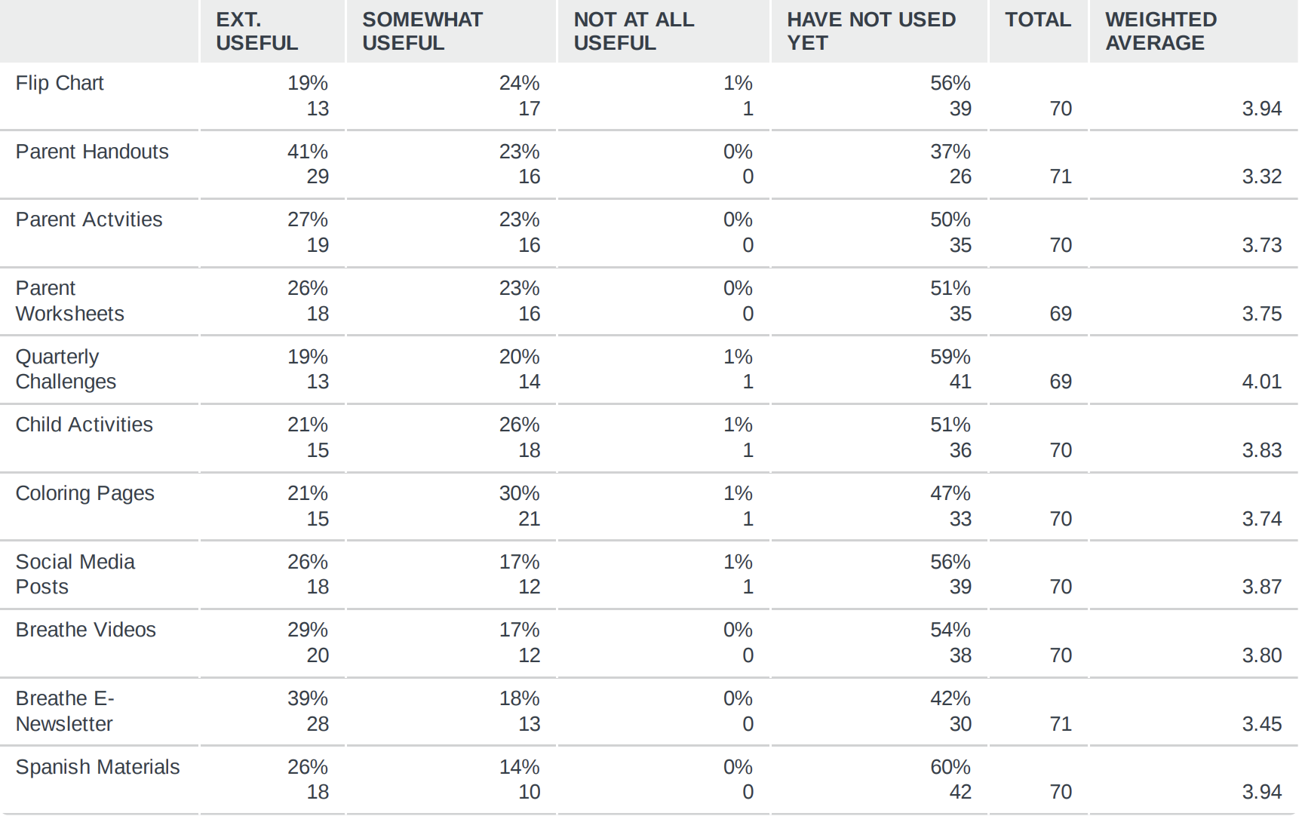

Slide 9
IN THE FUTURE, how likely are you to use each of the “Breathe” materials? (Extremely Likely, Somewhat Likely, Extremely Unlikely, or Will Never Use)
Answered: 72 Skipped: 0

Slide 10
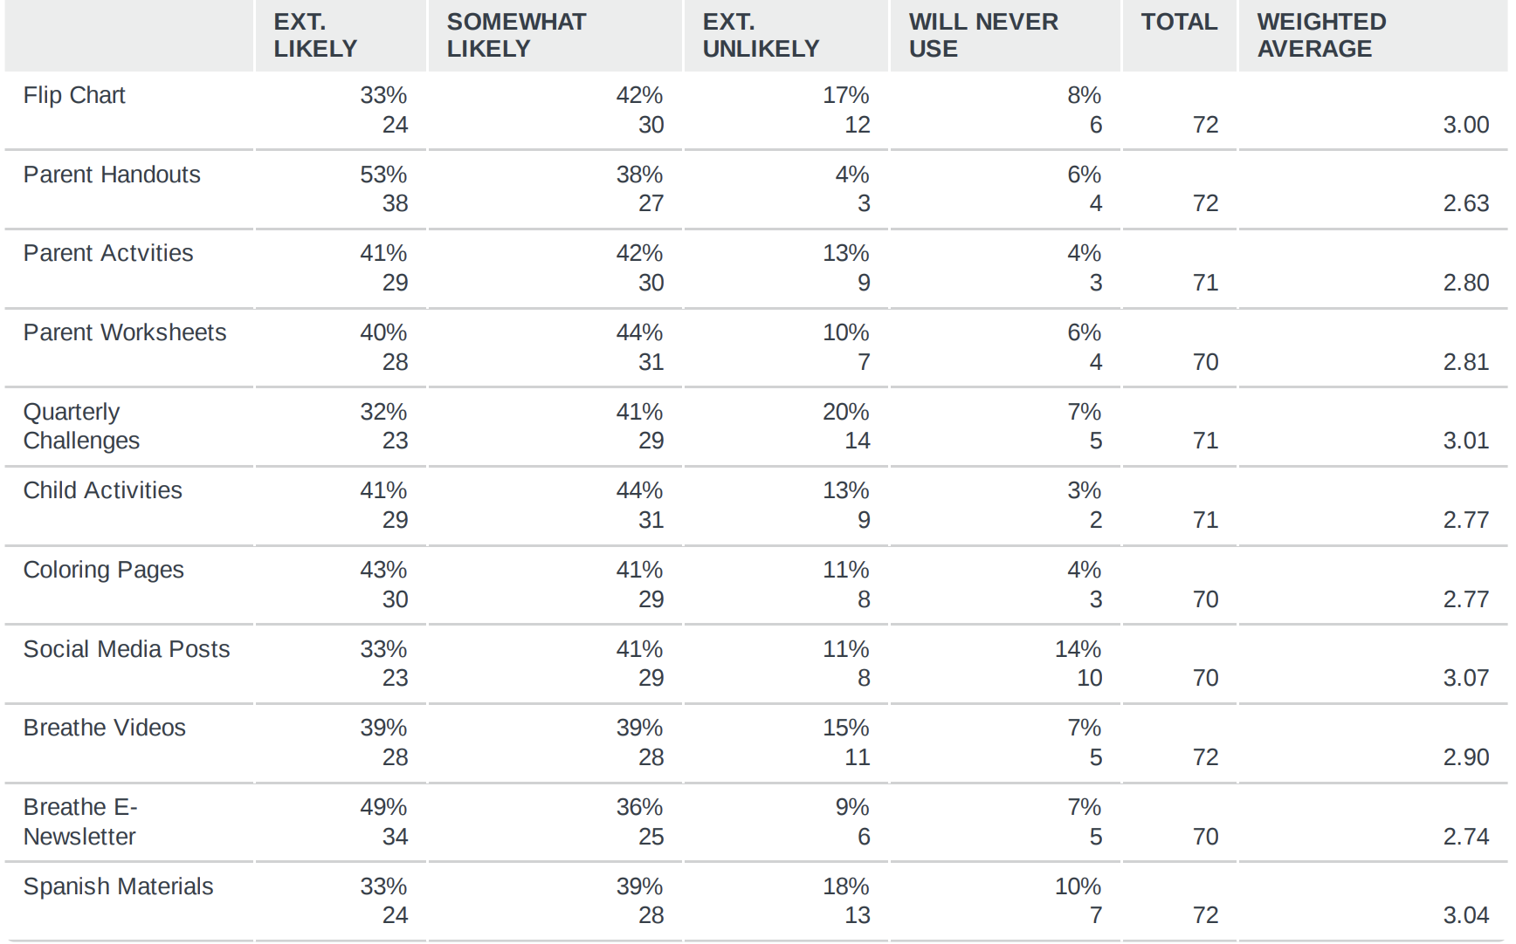

Slide 11
Please share any successes/challenges you have experienced while using the “Breathe” materials as well as any suggestions for improving “Breathe”.
“The challenge for me, is that I do not really have families that share with me they want this information. We try to educate, whenever possible, but parents wanting more information, just hasn't really happened for me.”
“I recently just attended my first "Breath" training about a monthly ago and I thought it was very fun and had a lot of useful and interesting facts in it that I will be able to use for a parent meeting later this year.”
“I haven't had the opportunity to use any of the materials yet but am hoping to incorporate somehow with my SRAE.”
“Some parents have shared that they really appreciate the materials”
“not yet assigned a case for casa, but the training was informative and will be useful whenever..”
“Very interesting and informative session, I feel like I learned a lot”
“Parents wanting to change their lives and their children's told me they didn't want their kids breathing in smoke like they did as a kid.”
“The setup was a bit of a mess. I don't think that the material was as detailed as I expected it to be. I felt like I had heard most of the information before EXCEPT for the Vaping section. I think there could be a lot more info on research and the effects on the teens and young adults.”

Slide 12
Please share any successes/challenges you have experienced while using the “Breathe” materials as well as any suggestions for improving “Breathe”.
“While I have not given them out, I have instructed my Home Visitors to use them.”
“Parents often are not interested in the papers. Most interested in the quit line info.”
“The materials have been helpful for the families or parents rather that want to quit.”
“I’m not a main teacher so I don’t lesson plan and non of the classes I’ve been in recently have done anything with it but the information was sound but unless someone actively brings it up I don’t know if anyone has had the conversation or if the even needed to”
“My biggest challenge in using the breathe materials is that I don't have any clients that are smokers, nor do they have a past history of smoking.”
“Since I am in management, I don't directly work with families, so that is why I have not used the materials myself. The breathe materials are fantastic and of great use to our home visitors and family advocates when they work with families.”
“I have had two parents quit smoking.”
“Parents have said they feel encouragement and support to stop vaping.”
“I met with a client and she has quit smoking as much as she used to and is improving after sharing this information.”

Slide 13
Please share any successes/challenges you have experienced while using the “Breathe” materials as well as any suggestions for improving “Breathe”.
“Great resources and useful for home visiting and for community health events. No suggestions for improvement”
“In my role I usually do not meet with parents and education is usually in the classroom or by video. I am on the tobacco action team and the education is valuable for that and keeping up with what is going on in the schools and culture. This information is passed on to dental professionals through continuing education classes I provide.”
“Great material for those who are choosing to stop smoking”
“I have not been able to use this yet this school year.”
“I have families who speak Arabic, Kirundi and Bengali.”
“The kids like the toss and roll activity”
“Parents became more aware of the dangers of tobacco smoking especially if they have kids below 5 years of age”
“Family feel more open to learn about side effects and take information.”
“I have been combining some of the lessons with the coloring pages to try to simplify some of the children's activities for our younger preschoolers.”

