Slide 1
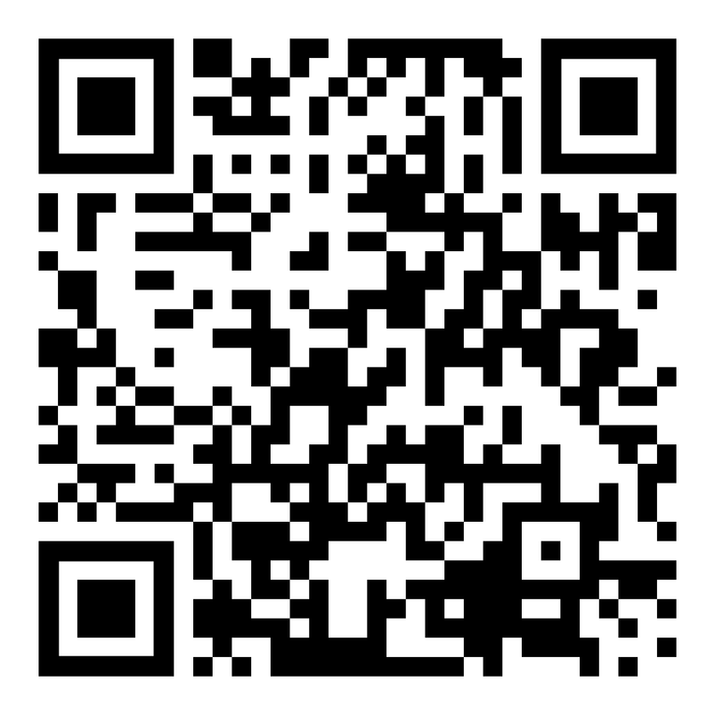
CAPACITACIÓN BREATHE
“REPASO DEL PROGRAMA BREATHE”
USA EL CÓDIGO QR
Para tomar la PRE- EVALUACIÓN
Notes:
HOW TO USE THE NOTES SECTION: Each slide in this presentation has a notes section that can help you deliver the presentation.
The KEY POINT let’s you know the most important message to convey and along with the text on the screen, that may be all the guidance an experienced County Coordinator/tobacco expert may need to conduct the training effectively.
If any handouts or other resources are necessary for a given slide you will see a MATERIALS NEEDED section.
If modifications are needed to share a slide or conduct an activity for a virtual training, you will see a VIRTUAL MODIFICATION section.
The SCRIPT portion of each page will give you a sample script (in italics) of what you might say for each slide as well as instructions, if needed. DO NOT READ THE SCRIPT VERBATIM! Instead, use the script to practice the presentation and then adjust it as needed to make it your own. The script is simply meant to be a guide/suggestion!
KEY POINT: All participants need to complete a pre assessment and sign the sign-in sheet.
MATERIALS NEEDED: Participants can complete the pre assessment online with the QR code on this slide. This is the preferred method as it will save you time doing data entry after the training! The slide indicates “Breathe Refresher” so they know how to answer the first question regarding the type of training they are attending. To encourage compliance, you could have them indicate they are done or show you their completion screen and you could give them a handout, magnet, or other giveaway when they do. You still need to bring copies of the sign-in sheets and some printed out pre assessments in case participants prefer to complete a hard copy….then after the training you will need to complete the data entry. **If you choose NOT to have participants complete the assessment online, modify this slide by removing the QR code.
VIRTUAL MODIFICATION: Participants can use another device to access the QR code on the screen and/or you can place the link in the chat box so they can complete it on the device they are using for the training. You may need to keep posting the link in the chat box as people enter the training since they may not be able to see earlier chat box entries. Ask participants to type DONE in the chat box to encourage compliance and assess completion. Here is the link to the pre assessment: https://www.surveymonkey.com/r/PreAssess2527
SCRIPT: “Before we get started, I need everyone to complete a pre assessment. To access the survey, just open the camera on your smartphone and point it at the QR code on the screen to get the link. If you prefer to complete the assessment with pen and paper just let me know and I will bring you a hard copy. I will also be asking you to complete a post-assessment at the end of the training, and these are important parts of our evaluation, so I appreciate you completing them. There are also sign-in sheets being passed around. Please make sure you put your name and contact info on one of the sign-in sheets so we will have a record of everyone’s attendance and if you want to receive our monthly Breathe E-newsletter you can indicate that on the sign in as well.”

Slide 2


HEALTH ED PROS
Tanya Shelburne MPH, CHES
Alison Muckerheide MPH, CHES
Notes:
KEY POINT: Participants should know your name and a bit about your background and position.
MATERIALS NEEDED: Breathe kits and Quit Now Indiana materials
VIRTUAL MODIFICATION: Make plans with your site contact to deliver Breathe Kits and Quit Now Indiana materials either before or after the training and discuss how the materials should be divided up between the training participants.
INSTRUCTIONS: Personalize this slide with your information. Welcome everyone to the training, introduce yourself, and give a brief background on your experience, your organization, and your position. Bring materials to the training (breathe kits, Quit Now Indiana materials, etc.) but do not distribute them until the end of the training as some attendees will leave/not pay attention if materials are distrusted too early.

Slide 3
PAUTAS PARA LA CAPACITACIÓN VIRTUAL
La capacitación está siendo grabada.
Mantén tu video encendido.
Silencia tu micrófono cuando no estés hablando.
Renombra tu usuario si es necesario.
Minimiza las distracciones.
Permanece durante toda la capacitación (60 minutos).
¡Interactúa! (evaluaciones previas/posteriores, chat, activar micrófono).
Notifica al coanfitrión si tienes algún problema.
Notes:
DELETE THIS SLIDE IF CONDUCTING AN IN-PERSON TRAINING!
KEY POINT: Go over housekeeping and expectations for the training.
SCRIPT/INSTRUCTIONS: (Personalize this slide as needed.) “Now before we jump into the actual training I want to go over a few housekeeping items. I want to make sure everyone is aware that the training is being recorded and I will share a link to the recording in a follow up email in a day or two should you want to watch it again or share it with someone on staff who may have missed the training. I do ask that you keep your videos on during the training so I can see everyone’s smiling faces and it will feel a bit more like we are actually in person, but do keep yourself on mute to minimize background noise and just unmute yourself when you want to share something or ask a question. If the name on the screen is not your name, please rename yourself, which will help us with attendance and knowing who everyone is. To rename yourself put your cursor in your box on the screen and click the blue box in the upper right corner with 3 dots in it and you should see the option to rename yourself. Do your best to minimize distractions around you and I do ask that you stay for the full 90 minute training. There will be several options to interact so feel free to use the chat box or raise your hand at any time, and I hope you will interact as it is way more fun when it’s not just me talking the whole time! If you have any issues during the training feel free to message the co-host and we will try to assist.”

Slide 4






Conexión Antes Que Contenido
"A nadie le importa cuánto sabes, hasta que saben cuánto te importan.“
-Theodore Roosevelt
Notes:
KEY POINT: Connect with participants before you get into the training content.
SCRIPT: “We will get to discussing tobacco in just a bit, but I think it is important that we focus on “Connection Before Content”. This quote from Theodore Roosevelt really sums up why Connection Before Content is important and serves as the basis for why we designed the Breathe program the way we did. He said ‘No one cares how much you know, until they know how much you care.’ Hopefully as we continue to get to know each other you will see that I have a heart for protecting children and families and supporting the staff who serve them! And we know all of you have a heart for the families you serve and that they know and trust you. That’s why we focus on training staff at Head Start and other organizations rather than going directly to the parents ourselves. So let’s connect a bit with an ice breaker I call That’s Me!”

Slide 5
Soy o he sido padre/madre de familia en Head Start.
¡No tengo idea de qué es Breathe!
He utilizado los videos de Breathe.
He utilizado las actividades infantiles o las hojas para colorear de Breathe.
He utilizado las actividades, folletos o fichas de trabajo para padres de Breathe.
¡Me vendría bien más ayuda para hablar con los padres sobre el tabaco y el humo de segunda mano!
Realizo visitas domiciliarias.
Ese/a soy yo!
Asistí a la última capacitación de
Breathe
¡Amo mi trabajo!
Soy maestro(a) o asistente de Head Start.
He utilizado el rotafolio (flip chart) de Breathe.
He leído el boletín electrónico mensual de Breathe
Formo parte del equipo directivo o de liderazgo de Head Start.
He hablado con los padres sobre el tema del tabaco.
Notes:
DELETE THIS SLIDE IF YOU ARE TRAINING AN ALTERNATE PARTNER (NOT HEAD START)!!
KEY POINT: Get to know the participants with an interactive game.
VIRTUAL MODIFICATION: Instruct the participants to wave their hands, type in the chat box, or use the reaction buttons to signify if each statement applies to them and provide commentary as appropriate. If it is a small group, you may even choose to have everyone unmute and just shout out that’s me when appropriate. Given that it is hard to look at the participants and the slide as the statements appear, you can print out a cheat sheet with the statements in order here: https://justbreathein.org/staff-training/breathe-refresher/
SCRIPT/INSTRUCTIONS: “This fun game will help me learn a bit more about more about all of you. That’s Me is a super easy game. I’ll read a statement, which will also appear on the screen. When you hear that statement, if it applies to you just stand up, throw your arms in the air, and shout That’s Me! The more you agree with the statement the louder I want to hear you! Sound good? Ok, let’s go!” (Flip through each statement and read it out loud as you learn about who is in the audience. Based on the amount of space and the ability of the participants you can ask them to actually stand for each statement or just throw their hands up as they say That’s Me! For non-Head Start organizations use the next slide instead.)

Slide 6
¡No tengo idea de qué es Breathe!
Soy padre, madre, padrastro, madrastra, padre de crianza o abuelo(a).
He utilizado los videos de Breathe.
He utilizado las actividades infantiles o las hojas para colorear de Breathe.
He utilizado las actividades, folletos o fichas de trabajo para padres de Breathe.
¡Me vendría bien más ayuda para hablar con los padres sobre el tabaco y el humo de segunda mano!
Realizo visitas domiciliarias.
Ese/a soy yo!
Asistí a la última capacitación de
Breathe
¡Amo mi trabajo!
Trabajo directamente con niños o adolescentes.
He utilizado el rotafolio (flip chart) de Breathe
He leído el boletín electrónico mensual de Breathe
Formo parte del equipo directivo de mi organización.
He hablado con los padres sobre el tema del tabaco
Notes:
DELETE THIS SLIDE IF YOU ARE TRAINING A HEAD START CENTER!!
KEY POINT: Get to know the participants with an interactive game.
VIRTUAL MODIFICATION: Instruct the participants to wave their hands, type in the chat box, or use the reaction buttons to signify if each statement applies to them and provide commentary as appropriate. If it is a small group, you may even choose to have everyone unmute and just shout out that’s me when appropriate. Given that it is hard to look at the participants and the slide as the statements appear, you can print out a cheat sheet with the statements in order here: https://justbreathein.org/staff-training/breathe-refresher/
SCRIPT/INSTRUCTIONS: “This fun game will help me learn a bit more about all of you. That’s Me is a super easy game. I’ll read a statement, which will also appear on the screen. When you hear that statement if it applies to you just stand up, throw your arms in the air, and shout That’s Me! The more you agree with the statement the louder I want to hear you! Sound good? Ok, let’s go!” (Flip through each statement and read it out loud as you learn about who is in the audience. Based on the amount of space and the ability of the participants you can ask them to actually stand for each statement or just throw their hands up as they say That’s Me! For Head Start organizations use the slide before this instead.)

Slide 7
¿Qué tanto sabes o recuerdas sobre el tabaco?
Notes:
KEY POINT: Set the stage for this training being a refresher.
SCRIPT: “Now that I know a bit more about all of you, let’s see how much you remember from our last training. Of course if I expect you to talk to parents/caregivers about tobacco use and secondhand smoke then you need to be aware of some basic information on this topic. I realize not everyone attended the previous training and you have all slept since then, so just do your best! We are going to have a little fun with this…and play Jeopardy!!! I’m guessing we may have at least a few competitive people in this group so this should be fun!”

Slide 8
¡Juguemos Jeopardy!
Notes:
KEY POINT: Review the structure for how to play Jeopardy.
VIRTUAL MODIFICATION: With virtual Jeopardy everyone gets to play as individuals. Instruct participants to use the chat box to answer the questions and let them know that both speed and accuracy count. For multiple choice, tell them to just type the letter that corresponds with the correct answer into the chat box. For true or false they can just type T or F. It helps to have a co-trainer who determines who gets the correct answer in first and keeps score...or you can decide just to play for fun and not keep score. You can find a tracking sheet to help you keep score here: https://justbreathein.org/staff-training/breathe-refresher/
SCRIPT/INSTRUCTIONS: “This is a modified version of Jeopardy, played with teams. Everyone on this side of the room will be on one team and everyone on this side will be on the other team. Decide who will be your team’s spokesperson and pick a name for your team. The team leader with the closest birthday will go first. Then we will take turns going back and forth between the two teams and you don’t have to worry about answering in the form of a question for this version of Jeopardy! (After diving the participants into two teams, ask for a volunteer or have your co-trainer record the score on newsprint or a dry erase board. After each answer is revealed, you can fill in some additional info on that particular topic and then click on the green house at the bottom of the screen to return to the list of categories/questions and alternate between teams to select and answer a question. Questions already completed will change to Orange. Or instead of clicking the house to go back to the main screen, you can just click through all the slides and go in order. Determine how much time you have to play the game and stop when that time is up and do the Final Jeopardy question. You may or may get through all the questions and that is fine.)

Slide 9
JEOPARDY
Tabaco
1 a 1
Tácticas de la
Industria
Embarazo/ Salud Infantil
Cigarrillos Electrónicos
Renunciando al Tabaco
$100
$100
$100
$100
$100
$200
$200
$200
$200
$200
$300
$300
$300
$300
$300
El Desafío Final
Notes:
KEY POINT: Review the Jeopardy Game Board.
SCRIPT/INSTRUCTIONS: “We have five categories on the game board: Tobacco 101, Industry Tactics, Pregnancy/Child Health, E-cigs, and Quitting. And there are options for $100, $200, and $300 questions for each one. (Team one) will go first. Which question would you like?” (Click on the category and dollar amount they choose to go to that question.)

Slide 10
Pregunta por $100
Tabaco 1a1
    Verdadero o Falso:
    Las tasas de consumo de cigarrillos tradicionales han disminuido en los últimos 30 años.
Notes:
INSTRUCTIONS: Read the question out loud.

Slide 11
Respuesta por $100
Tabaco 1a1
    ¡Verdadero!
Notes:
KEY POINT: While traditional cigarette smoking has gone down there is still work to be done, especially with e-cigarettes.
SCRIPT: “That is true! There has been a lot of great progress as people have learned about the danger of smoking and laws have been put in place to restrict some forms of tobacco marketing and to protect people from secondhand smoke exposure. But there is still work to be done, and especially with the recent growth of e-cigarettes and vaping. (Team X) gets $100!”

Slide 12

Pregunta por $200
Tabaco 1a1
    ¿La mayoría de las personas comienzan a usar tabaco antes de qué edad?
    21 años
    25 años
    30 años
    40 años
Notes:
INSTRUCTIONS: Read the question out loud.

Slide 13
Respuesta por $200
Tabaco 1a1
A) 21 años
Notes:
KEY POINT: Most smokers start by the age of 21.
SCRIPT: “The answer is A. About 95% of adult smokers begin smoking before they turn 21 so that is why preventing teens and young adults from starting is so critical. (Team X) gets $200!”

Slide 14
Pregunta por $300
Tabaco 1a1
¿Los bebés y los niños pequeños ingieren qué cantidad de productos químicos del humo de tercera mano en comparación con los adultos?
La misma cantidad que los adultos.
Cuatro veces más que los adultos.
Cuatro veces menos que los adultos.
Notes:
INSTRUCTIONS: Read the question out loud.

Slide 15
Respuesta por $300
Tabaco 1a1
B) ¡Cuatro veces más que los adultos!
Notes:
KEY POINT: Thirdhand smoke is especially dangerous for infants and children.
SCRIPT: “The answer is B. If you remember from our last training, Thirdhand smoke includes the toxins and chemicals left behind in a room or a car when someone smokes there. Because of the way infants breathe and the size of their developing lungs they actually take in 4 times the amount of chemicals that an adult would in the same space. That is why it is critical to educate parents about thirdhand smoke and encourage them not to smoke in places where children will later be. (Team X) gets $300!”

Slide 16
Pregunta por $100
Tácticas de la industria
    Verdadero o Falso:
    La industria del tabaco comercializa sus productos para que se parezcan a dulces y alimentos populares.
Notes:
INSTRUCTIONS: Read the question out loud.

Slide 17
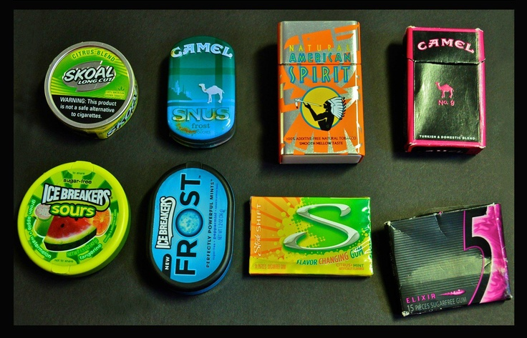
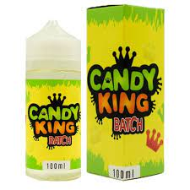
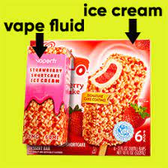
Respuesta por $100
Tácticas de la industria
    ¡Verdadero!
Notes:
KEY POINT: The tobacco industry markets to youth with packaging that is similar to candy.
SCRIPT: “The answer is true! The tobacco industry deliberately targets young people and one of their strategies is to mimic the packaging of popular candy and other items that appeal to youth. These pictures show just a few examples of vape juice, chewing tobacco and cigarettes that look strikingly similar to candy! (Team X) gets $100!”

Slide 18
Pregunta por $200
Tácticas de la industria
¿Cuánto dinero gasta la industria del tabaco cada día en marketing en los Estados Unidos?
$750,000
$3.5 Millones
$10 Millones
$23.5 Millones
Notes:
INSTRUCTIONS: Read the question out loud.

Slide 19
Respuesta por $200
Tácticas de la industria
D) $23.5 Millones!
Notes:
KEY POINT: The tobacco industry spends A LOT of money on marketing.
SCRIPT: “The answer is D. The tobacco industry spends 23.5 MILLION dollars every day to market their deadly products in the United States.. I personally could think of a lot better ways to spend that money! (Team X) gets $200!”

Slide 20
Pregunta por $300
Tácticas de la industria
¿A qué grupo(s) de personas apunta la industria del tabaco?
A la Gente de Color.
A los Jóvenes.
A las Comunidades de Bajos Ingresos.
LGBTQ+
Todas las Anteriores.
Notes:
INSTRUCTIONS: Read the question out loud.

Slide 21
Respuesta por $300
Tácticas de la industria
D) ¡TODAS LAS ANTERIORES!
Notes:
KEY POINT: The tobacco industry aggressively markets several marginalized populations.
SCRIPT: “The answer is D, all of the above. The tobacco industry preys on several marginalized populations with aggressive marketing strategies in order to create life-long customers, which results in even greater health disparities. (Team X) gets $300!”

Slide 22
Pregunta por $100 Embarazo/Salud Infantil
    ¿Cuál se considera una cantidad segura de consumo de tabaco durante el embarazo?
    1 paquete durante todo el embarazo.
    1 paquete al mes.
    1-2 cigarrillos al mes.
    NO hay una cantidad segura.
Notes:
INSTRUCTIONS: Read the question out loud.

Slide 23
Respuesta por $100 Embarazo/Salud Infantil
D) ¡NO HAY UNA CANTIDAD SEGURA!
Notes:
KEY POINT: There is no safe amount of tobacco use during pregnancy.
SCRIPT: “The answer is D. There is no safe amount of tobacco use during pregnancy. But even if someone has smoked during part of their pregnancy it is always a good idea to stop now to help their baby have the healthiest outcome possible. (Team X) gets $100!”

Slide 24
Pregunta por $200 Embarazo/Salud Infantil
    Verdadero or Falso:
    El THC en la marihuana puede pasar a través de la leche materna.
Notes:
INSTRUCTIONS: Read the question out loud.

Slide 25
Respuesta por $200
Embarazo/Salud Infantil
¡VERDADERO!
Notes:
KEY POINT: THC passes to babies through breastmilk.
SCRIPT: “That is true. THC can pass to babies through breastmilk so we need to encourage those who are breastfeeding not to use marijuana. (Team X) gets $200!”

Slide 26
Pregunta por $300 Embarazo/Salud Infantil
    ¿Qué problemas de salud puede causar fumar durante el embarazo en los niños?
    Bajo Peso al Nacer.
    Parto Prematuro.
    Aborto Espontáneo
    Todas las Anteriores.
Notes:
INSTRUCTIONS: Read the question out loud.

Slide 27
Respuesta por $300
Embarazo/Salud Infantil
D) ¡TODAS LAS ANTERIORES!
Notes:
KEY POINT: Smoking during pregnancy can lead to asthma attacks, bronchitis, and ear infections.
SCRIPT: “The answer is D, all of the above. These are just some of the health problems children may face when exposed to secondhand smoke. (Team X) gets $300!”

Slide 28
Pregunta por $100
Cigarrillos electrónicos
    Verdadero o Falso:
    El uso de cigarrillos electrónicos /Vapeadores es un método comprobado para dejar el consumo de tabaco.
Notes:
INSTRUCTIONS: Read the question out loud.

Slide 29
Respuesta por $100
Cigarrillos electrónicos
¡FALSO!
Notes:
KEY POINT: Vaping is not a proven cessation method.
SCRIPT: “That is false. While you may hear of some people using e-cigarettes to help them quit smoking, vaping is not a proven cessation method, and many people end up becoming dual users and teens start vaping when they never would have started using traditional cigarettes. (Team X) gets $100!”

Slide 30
Pregunta por $200
Cigarrillos electrónicos
    Es seguro usar cigarrillos electrónicos cerca de lo siguiente:
    Niños
    Adultos
    Mascotas
    Ninguna de las anteriores
Notes:
INSTRUCTIONS: Read the question out loud.

Slide 31
Respuesta por $200
Cigarrillos electrónicos
D) ¡NINGUNA DE LAS ANTERIORES!
Notes:
KEY POINT: It is not safe to use e-cigarettes around anyone.
SCRIPT: “The answer is D, none of the above. Anyone, even pets, who are around people who are vaping are exposed to the dangerous toxins in the aerosol that comes from these products. Of course, infants and children with developing lungs are especially susceptible to health problems from this exposure. (Team X) gets $200!”

Slide 32
Pregunta por $300
Cigarrillos electrónicos
    Verdadero o Falso:
    Los cigarrillos electrónicos emiten vapor de agua inofensivo.
Notes:
INSTRUCTIONS: Read the question out loud.

Slide 33

Respuesta por $300
Cigarrillos electrónicos
¡Falso!
Notes:
KEY POINT: E-cigarettes emit an aerosol that is full of harmful chemicals.
SCRIPT: “That is false. Many people incorrectly think that vaping just creates harmless water vapor, but e-cigarettes actually produce aerosol that is full of harmful chemicals. (Team X) gets $300!”

Slide 34
Pregunta por $100
Renunciando al Tabaco
    ¿Cuál es el programa gratuito, clínicamente comprobado, basado en llamadas y mensajes de texto para dejar de fumar disponible en Indiana?
    Quit Now Indiana
    Smoke, The Big NOPE Foundation
    You Can Do it Incorporated
    Helping Hoosiers Quit
Notes:
INSTRUCTIONS: Read the question out loud.

Slide 35
Respuesta por $100 Renunciando al Tabaco
QUIT NOW INDIANA
Notes:
KEY POINT: Quit Now Indiana is a free cessation resource that can be shared with parents.
SCRIPT: “The answer is A. Quit Now Indiana is a wonderful free resource that parents can use 24/7 to get help and support if they are ready to quit tobacco. (Team X) gets $100!”

Slide 36
Pregunta por $200
Renunciando al Tabaco
    Verdadero o Falso:
    Medicaid en Indiana ofrece múltiples recursos para la cesación del tabaco para las personas que intentan dejar de fumar.
Notes:
INSTRUCTIONS: Read the question out loud.

Slide 37
Respuesta por $200
Renunciando al Tabaco
¡Verdadero!
Notes:
KEY POINT: Those with Indiana Medicaid coverage have access to lots of great tobacco cessation resources.
SCRIPT: “That is true! Indiana Medicaid covers several forms of proven nicotine replacement products as well as prescription medications and counseling sessions. (Team X) gets $200!”

Slide 38
Pregunta por $300
Renunciando al Tabaco
    En promedio, ¿cuántos intentos se necesitan para dejar de fumar con éxito?
    1 intento.
    3-4 intentos.
    8-11 intentos.
    5 millones de veces.
Notes:
INSTRUCTIONS: Read the question out loud.

Slide 39
Respuesta por $300
Renunciando al tabaco
C) ¡8-11 INTENTOS!
Notes:
KEY POINT: It often takes 8-11 quit attempts before someone quits for good.
SCRIPT: “The answer is C. Quitting smoking is not easy and it often takes 8-11 quit attempts before someone quits for good. All quit attempts are a step in the right direction so offer plenty of support along the way. (Team X) gets $300!”

Slide 40
Pregunta Jeopardy Final
    ¿Cuánto gastaría al año una persona en Indiana si fuma un paquete de cigarrillos al día?
    (Basado en el precio promedio de una cajetilla)
Notes:
KEY POINT: Determine how much smoking costs.
VIRTUAL MODIFICATION: Have participants type their guess into the chat box and then read the responses aloud and provide commentary and praise.
SCRIPT/INSTRUCTIONS: “It is now time for final Jeopardy! Each team get out a blank sheet of paper. When I share the question write your team’s answer down and how much you want to wager, then wait until I ask you to hold it up.
(CLICK TO THE STATEMENT) How much would someone in Indiana spend on cigarettes in a year if they smoke 1 pack a day? Your answer should be based on the average price of a pack of cigarettes currently in Indiana. I’ll give you wiggle room of $50 over or under for a correct answer. Don’t forget to write down how much you want to wager as well. (Give teams a minute to confer and write down their answer.) (Team 1) what is your answer? (Team 2) please share your answer.”

Slide 41
Respuesta Jeopardy Final
¡¡$4,015!!
(¡$4,026 si es año bisiesto!)
Aceptaré respuestas entre $3,965 y $4,076
(basado en $11 como precio promedio de un paquete de cigarrillos en Indiana x 365 días)
Notes:
KEY POINT: It costs over $4,000 a year for someone who smokes a pack a day.
VIRTUAL MODIFICATION: If you chose to keep score, announce who had the highest score, add or deduct the wagers, and offer a round of applause!
SCRIPT/INSTRUCTIONS: “And the answer is…$4,015 a year, $4,026 if its Leap Year! That is A LOT of money and I bet we could all think of better ways to spend that money. This is based on the average price of a pack of cigarettes being $11 in Indiana. That number went up recently as Indiana’s new cigarette tax increase went into effect on July 1 of 2025. The other number that shot up…calls to Quit Now Indiana! Raising the cost of tobacco products is a proven strategy that motivates people to quit as well as discourages youth from starting. This means that the parents/caregivers you serve who smoke may be even more receptive to quit support now, so it is a great time to share the Breathe and Quit Now Indiana resources.” (Determine the winning team and shower them with praise!)

Slide 42
¡Gracias por jugar Jeopardy!
Ayudar a que nuestras comunidades sean más saludables y libres de humo y vapeo es tarea de TODOS.
Notes:
KEY POINT: It is everyone’s job to help our communities become healthier and smoke/vape free.
SCRIPT/INSTRUCTIONS: “Thank you so much for playing Jeopardy! I hope everyone had fun and learned something. As one of our Breathe Partners, I also hope you recognize that it is EVERYONE’S job to help our communities become healthier and smoke/vape free! You can all play a role in lowering the tobacco burden by sharing this information and using the Breathe materials that work best with your specific job. And if you would like to play this same round of Jeopardy with the parents you serve or other staff members who couldn’t be here today, you can now find the Jeopardy game on the Breathe website along with all the other Breathe Resources.”

Slide 43
Materiales de Breathe
¡Revisemos todos los materiales a los que tienen acceso!
Notes:
KEY POINT: Remind participants that they have access to lot of Breathe materials online.
VIRTUAL MODIFICATION: Place the link to the For Partners webpage in the chat box: https://justbreathein.org/for-partners/
SCRIPT/INSTRUCTIONS: “Now that we have all brushed up on our knowledge of tobacco and the importance of protecting children from second and thirdhand smoke, I want to remind you about all the Breathe resources you have access to that can aid in educating and supporting the families you work with. Hopefully you know where your Breathe kits are stored, but if not, talk to your leadership to find out and let me know if you need any replacement items. If you are new or haven’t used some of the Breathe materials yet I hope this refresher will get your wheels spinning as you think about which materials would work best depending on your specific job and how you may interact with families and young children.”

Slide 44
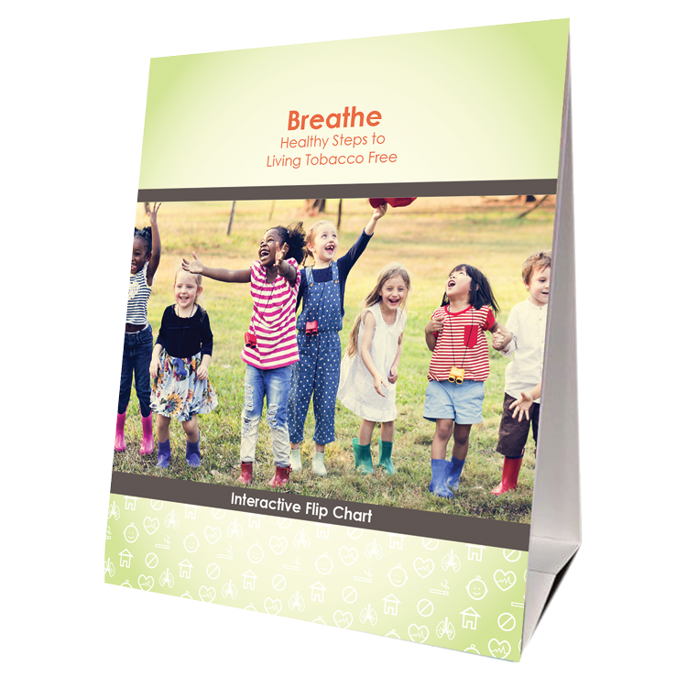

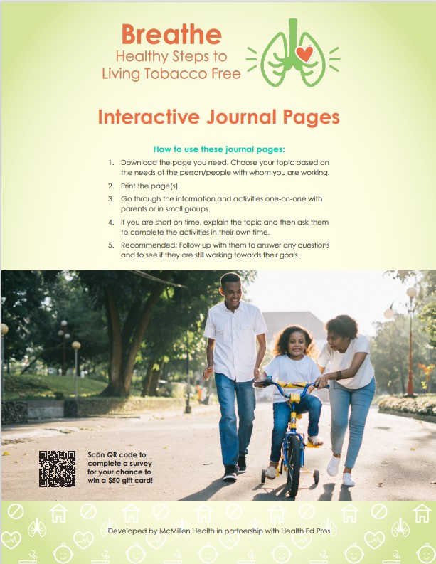
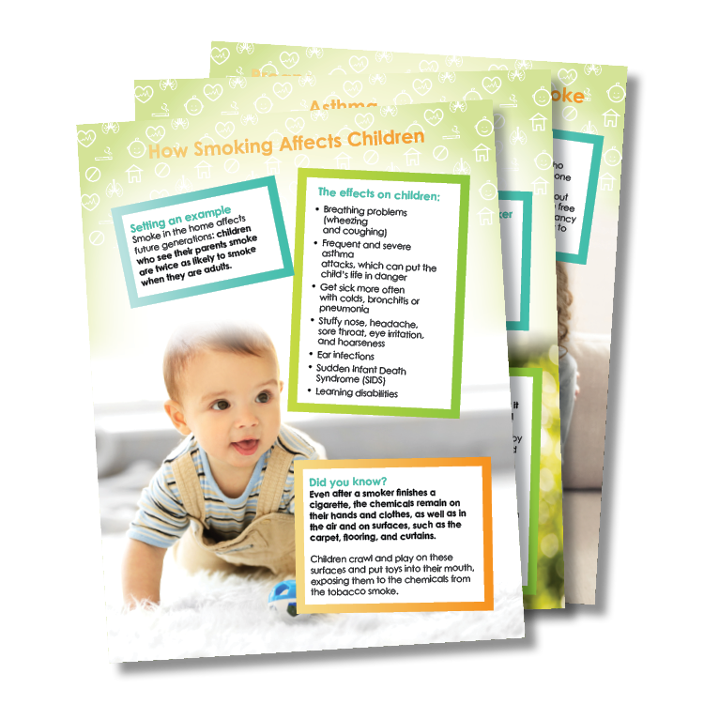
PARA PADRES/CUIDADORES
Rotafolio
Cuaderno de Actividades
Folletos informativos
Hojas
de trabajo
Notes:
KEY POINT: Review Breathe resources focused on parents/caregivers.
MATERIALS NEEDED: Sample Breathe kit; additional supplies as needed.
SCRIPT/INSTRUCTIONS: “Several of the items in the Breathe kit are specifically geared towards parents/caregivers or the adults in the household. (CLICK TO REVEAL THE LABELS AS YOU TALK ABOUT EACH BREATHE RESOURCE) The flipchart is great for one on one or small group interactions with talking points on the back of each page to guide your conversation. The parent handouts cover many different tobacco topics and can be printed or downloaded and shared electronically with all parents or with specific parents when relevant. The worksheets also provide great information on many tobacco topics but also include interactive components that help parents set goals and think through challenges of quitting or minimizing smoke/vapor exposure for their children. The activities booklet is a great tool for anyone who needs activities to do with groups of parents. There are instructions for 9 different activities that take very little prep and minimal materials and will get parents discussing a variety of tobacco related topics.

Slide 45
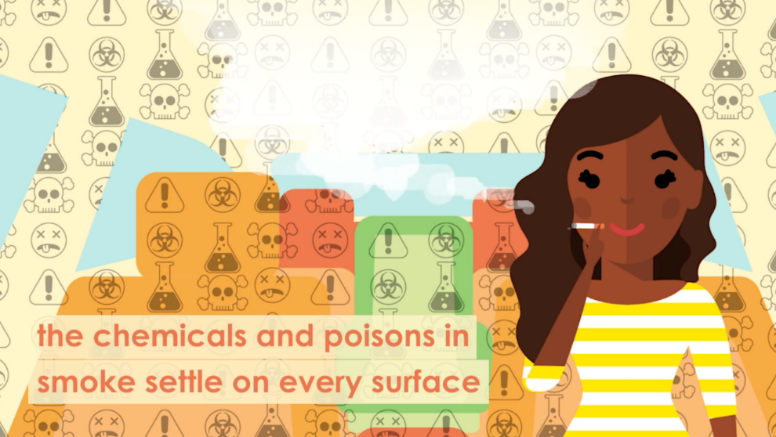
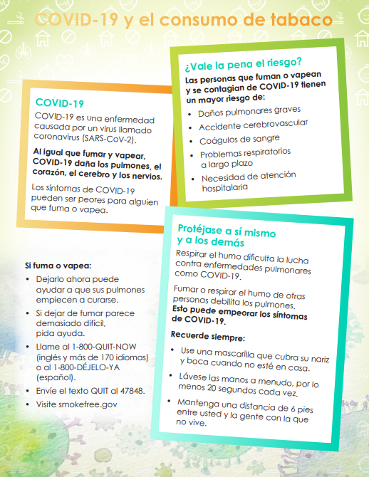

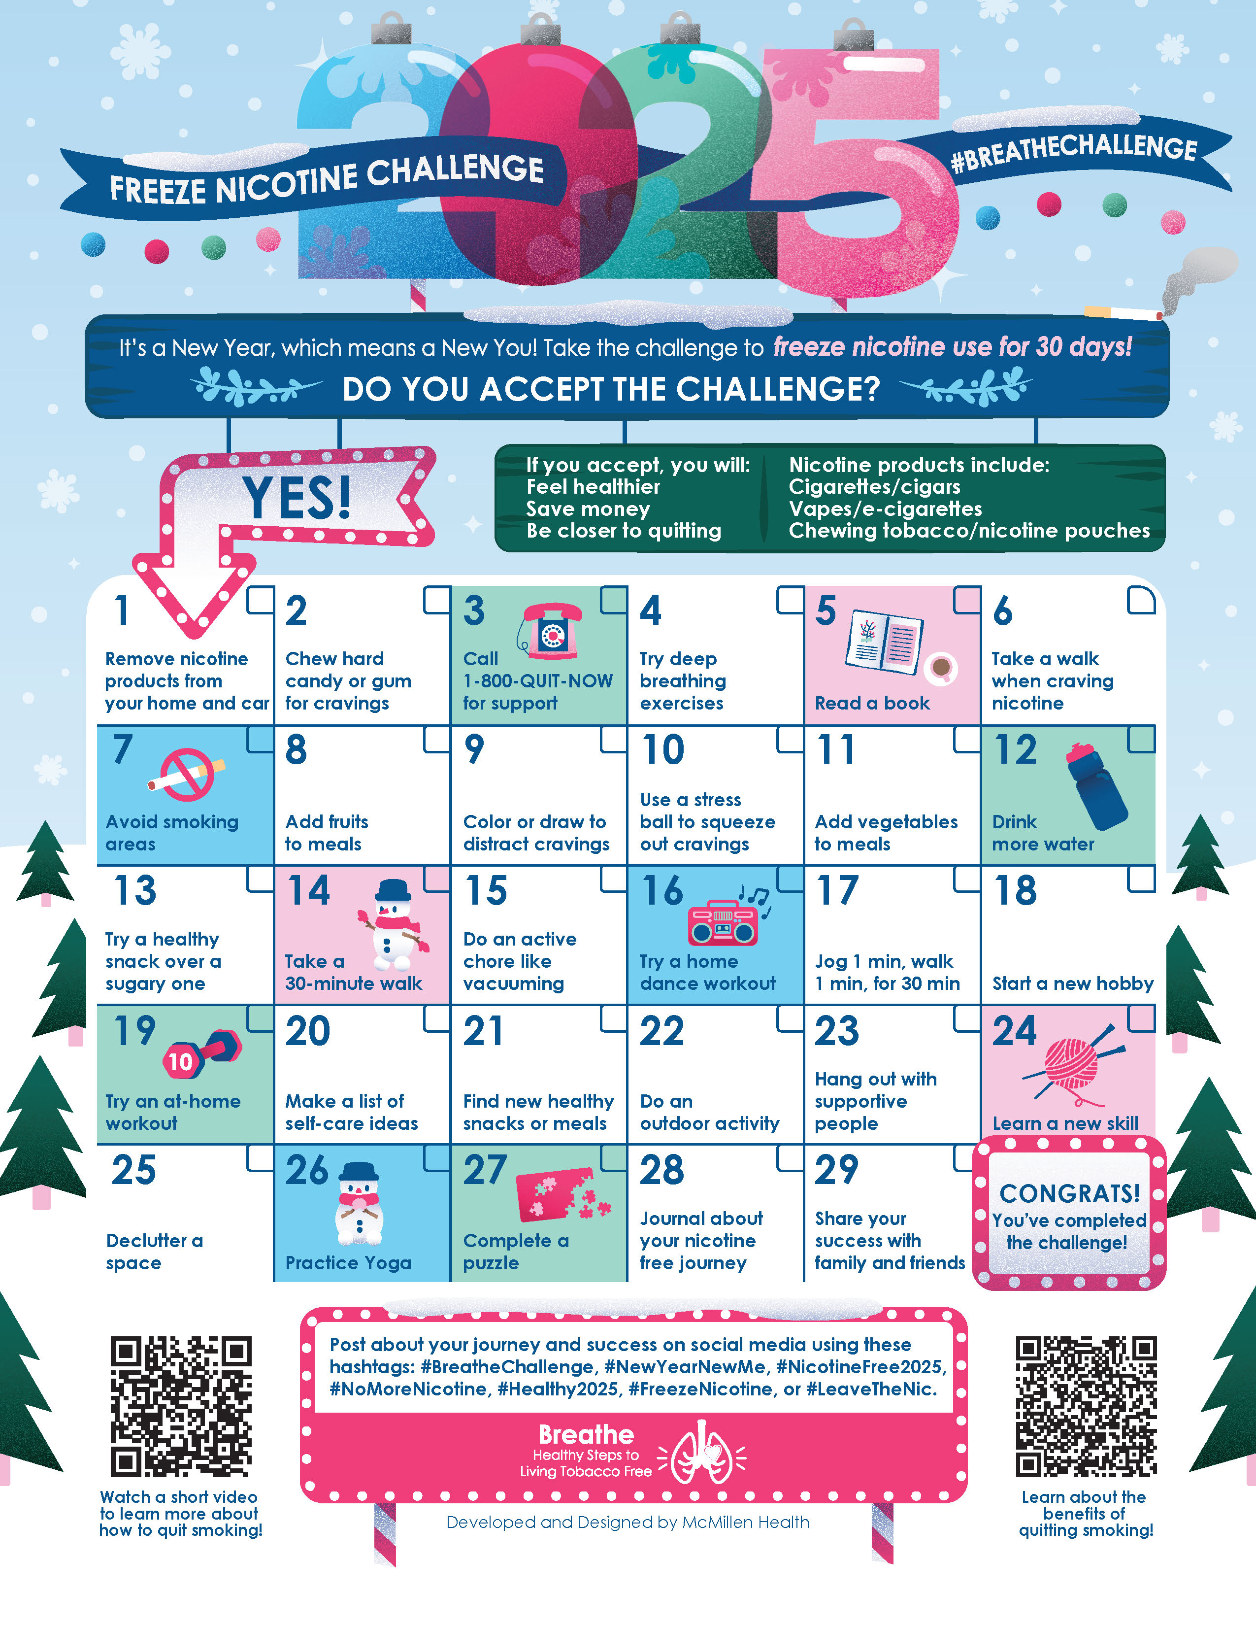
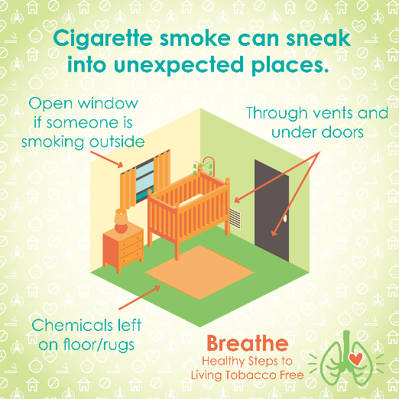
MÁS RECURSOS
Materiales en Español
Videos
Cortos
Desafíos trimestrales
Publicaciones para
redes sociales
Boletín electrónico mensual
Notes:
KEY POINT: Review additional Breathe resources and ways to share tobacco information.
SCRIPT: (CLICK TO REVEAL THE LABELS AS YOU TALK ABOUT EACH BREATHE RESOURCE) “And that’s not all! Many of the Breathe materials are also available in Spanish, so please access those materials if you are working with Spanish Speaking parents/caregivers. There are also lots of short videos, just 2-3 minutes each that help reinforce important tobacco related topics. Feel free to pull these up on an ipad to show to parents as appropriate or post them on your social media. Speaking of social media, the website also includes 12 ready to go graphics and accompanying text that you can post on your social media pages as a way to keep tobacco education on everyone’s radar. We also create a monthly Breathe e-newsletter that we will send directly to anyone who indicated they would like to receive it on today’s sign in sheet, if you aren’t already. We hope that you will share the newsletter by forwarding it, printing the pdf, or copying and pasting sections of it into your own organization’s newsletter. Finally, we have a new challenge each quarter that is a fun way to motivate families when it comes to quitting tobacco or minimizing exposure to second and thirdhand smoke/vapor. I hope this quick overview of the Breathe materials was a helpful refresher and that each of you can find at least one or two resources that might be useful in your current role and that you will feel comfortable sharing.”

Slide 46
¡Accede a todos los materiales BREATHE en línea!
Los socios capacitados pueden descargar los materiales en
justbreathein.org/for-partners/
Notes:
KEY POINT: Trained Breathe partners can access all the Breathe materials online.
MATERIALS NEEDED: Print outs of the Partner QR code flyers that can be found here: https://justbreathein.org/for-partners/
VIRTUAL MODIFICATION: Place the link to the For Partners webpage in the chat box: https://justbreathein.org/for-partners/
SCRIPT/INSTRUCTIONS: “All of the Breathe materials can be accessed at the webpage on the screen. Don’t worry I’ll send you this link in a follow up email in case you don’t already have it bookmarked.”

Slide 47
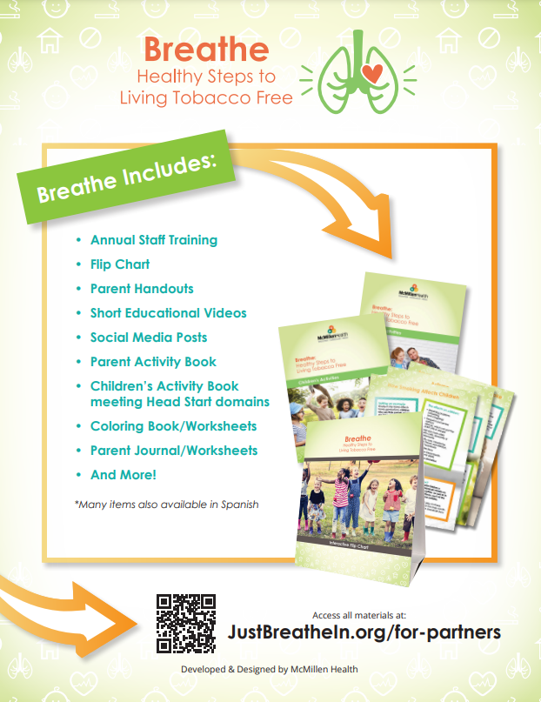
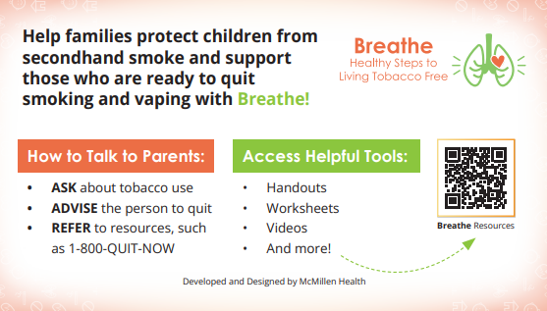
ACCEDA AL SITIO WEB DE BREATHE
            Folleto con código QR
            Guía de bolsillo
Notes:
KEY POINT: Share resources that will link participants to the Breathe resources online.
MATERIALS NEEDED: Optional, Print outs of the Breathe Kit QR code flyers (https://justbreathein.org/wp-content/uploads/2024/07/Breathe-Flyer-QR-Code-For-Partners.pdf) and Pocket Guides for Partners (https://justbreathein.org/wp-content/uploads/2024/09/Pocket-Fact-Sheet-Partner-w-cut-marks.pdf)
SCRIPT: “To help you remember how to access the Breathe materials, we have flyers as well as pocket guides with QR codes to the Breathe website. I printed and brought some with me today, but you can also find these resources on the website and download or print more yourself and share them with your staff.”

Slide 48




Solicite materiales de QNI de forma GRATUITA en: quitnowindiana.com/educational-materials
QUIT NOW INDIANA
En Ingles & Español
Notes:
KEY POINT: Quit Now Indiana handouts are free to order and are great resources to have on hand.
MATERIALS NEEDED: Bring a variety of Quit Now Indiana handouts, in English and Spanish.
VIRTUAL MODIFICATION: Paste the link to order QNI materials in the chat box so they can order their own and/or let them know if you plan to drop off materials. Here is the link: https://www.quitnowindiana.com/educational-materials
SCRIPT: “I also brought a bunch of Quit Now Indiana handouts for you today. I encourage you to make these handouts easily accessible in your lobbies and to have them on hand when you do home visits or meet with parents so you can share this valuable resource when the time is right. You are also welcome to order these materials yourself for free at the website on the screen. In case you have forgotten about Quit Now Indiana, this is a great resource for anyone who is ready and wants help to quit tobacco.”

Slide 49

QUIT NOW INDIANA
GRATIS y disponible 24/7 >> Llamada, Texto, En Línea o App
Entrenador Para Dejar de Fumar Capacitado >> Plan Personalizado
    Terapias de reemplazo de nicotina (TRN) GRATUITAS, según la disponibilidad
1-800-Quit-Now (784-8669)
1-855-DÉJELO-YA (Spanish)
1-877-777-6534 (TTY)
Text READY to 34191
Text LISTO to 34191 (Spanish)
quitnowindiana.com
Notes:
KEY POINT: There are lots of resources available for those who want to quit.
SCRIPT: “You don’t have to be the expert on quitting, but you can help parents who want to quit by connecting them to Quit Now Indiana. Quit Now Indiana is free and available 24/7. People can call, text, go online or use the app to access services in whatever way works best for them. A trained quit coach will help them create a customized quit plan just for them. Free Nicotine Replacement Therapies, including the patch and gum, are provided for free, as available. Quit Now Indiana has a dedicated number for those who speak Spanish and other language services are available as well as TTY capabilities for those who are deaf or hard of hearing.”

Slide 50
PROGRAMAS ESTÁNDAR Y PERSONALIZADOS DE QNI
Programa (autorreporte) | Sesiones | NRT | Ofrece | Duración (subject to change)
Embarazo | 7 | Si* | Parche o Goma de Mascar | 4 semanas
Salud Conductual | 7 | Si | Parche o Goma de Mascar | 4 semanas
Jóvenes en Linea | 6 Pasos | No | N/A | N/A
Refuerzo de mentol | 5 or 7 | Si | Parche o Goma de Mascar | 4 semanas
Adulto Estandar | 5 | Si* para los que califican | Parche o Goma de Mascar | 4 semanas
Notes:
KEY POINT: Quit Now Indiana offers specialized services for pregnant people, those with behavioral health issues, youth and those who use menthol products.
SCRIPT: “Quit Now Indiana offers specialized services for several populations that may need a tailored approach. This chart shows what is offered for the standard adult program at the bottom as well as the services available to pregnant people, those with behavioral health issues, youth ages 13-17, and people who use menthol products.”

Slide 51
VOTACIÓN DE VALOR
¿Cuál ha sido tu experiencia con los materiales BREATHE y al abordar el tema del tabaco con las familias?
      Párate en el extremo derecho de la sala si estás 100% de acuerdo con la afirmación.
    Párate en el extremo izquierdo de la sala si estás 100% en desacuerdo con la afirmación.
    O párate en algún lugar intermedio, dependiendo de tu nivel de acuerdo con la afirmación.
¡Aprendamos los unos de los otros!
Notes:
KEY POINT: Introduce how Value Voting works.
VIRTUAL MODIFICATION: Let participants know that since we are not all in the same room we will use hand gestures to signify their level of agreement with each statement. If they agree with the statement 100% then they can give a thumbs up. If they 100% disagree with that statement, they can give a thumbs down. Or they can do a thumbs sideways or somewhere in between depending on their level of agreement with that statement. Demonstrate with your own hand gestures as you explain the hand signals and advise them to have their cameras on and use their actual hands rather than the reaction buttons. Given that it is hard to look at the participants and the slide as the statements appear, you can print out a cheat sheet with thethree statements in order here: https://justbreathein.org/additional-resources/materials/ Provide appropriate commentary as necessary and ask some people to expand on the reasoning behind their hand gesture by either unmuting and sharing or typing in the chat box.
SCRIPT/INSTRUCTIONS: “Now we really want to dive into learning more about your experience with the Breathe materials and addressing tobacco with families over the past year. Whether you are using the materials on a regular basis, have used them just a few times, or you’ve tucked them away and never pulled them out, I think we can all learn from each other about how we are or are not addressing this topic with our families. So I’m going to ask for your active involvement again with Value Voting. Here is how value voting works. I will post a statement on the screen and read it out loud. If you agree with the statement 100% then I want you to move to the far right side of the room. If you 100% disagree with that statement, move to the far left of the room. Or you can stand anywhere in between depending on your level of agreement with that statement. Everybody understand? (If there is not room for everyone to move around you can have everyone do a thumbs up, thumbs down, or thumbs sideways to indicate their level of agreement.)
(CLICK TO BRING UP AND WHAT CAN WE LEARN FROM EACH OTHER?) Like I said this will help me learn a bit more about your experience with Breathe, and you can also learn from each other!”

Slide 52
Durante el último año, he enfrentado retos al comunicarme con padres o tutores acerca del consumo de tabaco
Notes:
KEY POINT: Assess level of agreement with “I have experienced challenges talking to parents about tobacco in the past year” and validate everyone’s comments.
SCRIPT/INSTRUCTIONS: “The first statement is ‘I have experienced challenges talking to parents about tobacco in the past year.’ If you are in 100% agreement with that statement make your way to the right side of the room. If you disagree completely with that statement move to the left side. Or stand somewhere in between.”
(Once everyone has moved to their chosen spot, start with one side of the room and ask 1 or 2 people to state why they chose to stand there. Then flip to the opposite side and inquire about their choice. Then ask a few people who chose to be somewhere in the middle what their reason was. As people share their experiences provide helpful comments, validate that the challenges they faced are common and ask others to chime in as well. Some people may say they disagree with this statement because they haven’t had any conversations with parents about tobacco yet and this is fine. Let them know that is exactly why we do the refresher trainings!)

Slide 53
He encontrado formas creativas de compartir información sobre el tabaco
Notes:
KEY POINT: Assess level of agreement with “I have been successful talking to parents about tobacco use/secondhand smoke exposure in the past year OR I have found creative ways to share this information.” and validate everyone’s comments.
SCRIPT/INSTRUCTIONS: “Great job! Get ready to move. Our second statement is ‘I have been successful talking to parents about tobacco use/secondhand smoke exposure in the past year OR I have found creative ways to share this information.’ If you are in 100% agreement with that statement make your way to the right side of the room. If you disagree completely with that statement move to the left side. Or stand somewhere in between.”
(Once everyone has moved to their chosen spot, start with one side of the room and ask 1 or 2 people to state why they chose to stand there. Then flip to the opposite side and inquire about their choice. Then ask a few people who chose to be somewhere in the middle what their reason was. As people share their experiences/ideas provide helpful comments, validate those who have had success or used creative strategies, and encourage the others to think about if those same strategies might work for them or if they can help support each other.)

Slide 54
Soy capaz de hablar sobre el tabaco sin juzgar
Notes:
KEY POINT: Assess level of agreement with “I have some ideas for how we could address tobacco with the families we serve” and validate everyone’s comments.
SCRIPT/INSTRUCTIONS: “Awesome! For our last statement decide how much you agree with this statement. ‘I am able to talk about tobacco in a non-judgmental way.’ Go ahead and move around the room to show your level of agreement for that statement. (Once everyone has moved to their chosen spot, start with one side of the room and ask 1 or 2 people to state why they chose to stand there. Then flip to the opposite side and inquire about their choice. Then ask a few people who chose to be somewhere in the middle what their reason was. As people share their thoughts, validate any concerns/challenges about being non-judgmental and provide support and encouragement for the ideas they share. Ask others to chime in if they support those ideas. Remind participants that having one on one conversations with parents about tobacco isn’t the only way to provide education. Encourage them to share information on social media, create a bulletin board about Quit Now Indiana, send parent handouts home in back packs, add tobacco related questions to intake forms, or other strategies you have heard similar partners use.) You guys did a great job with that activity. I know it isn’t always easy to discuss tobacco with the families you serve, but I’m excited about all the ideas you have for how your organization can continue to use the Breathe materials and promote healthy families. We even have a new handout and short video about discussing tobacco in a non-judgmental way, so look for those on the Breathe website! Thanks for participating in this activity! You can go ahead and find your seat.”

Slide 55
¿¿PREGUNTAS??
Notes:
KEY POINT: I am happy to answer any questions now or in the future.
VIRTUAL MODIFICATION: Check the chat box for any questions that may have been posted during the training and let participants know they can post questions in the chat box or unmute to ask questions now.
SCRIPT: “Awesome job today! I am encouraged to hear all the ways you are already supporting the families you serve and the new ideas that were generated in today’s Breathe Refresher. We are just about done with the training, but I would love to answer any additional questions you may have. And as you continue implementing Breathe please do not hesitate to reach out with questions as they come up.”

Slide 56
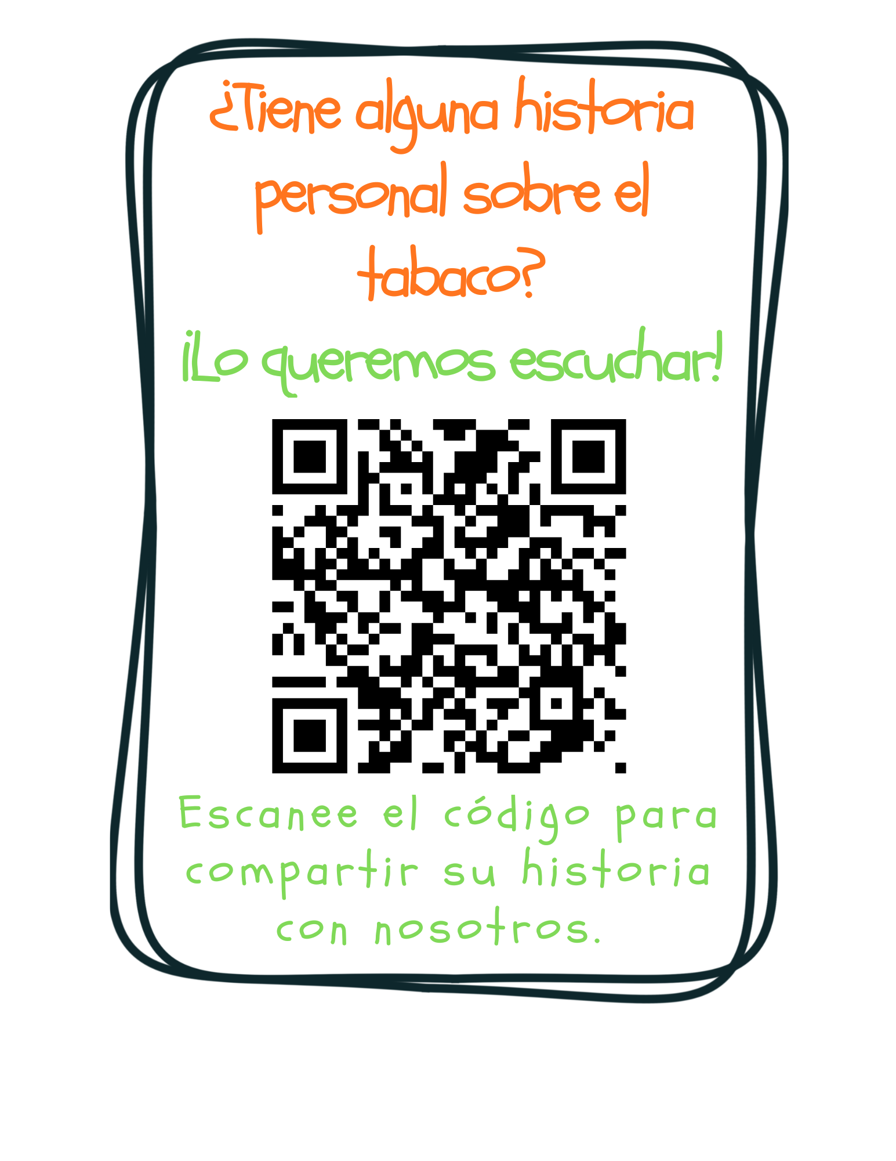
Notes:
KEY POINT: Ask for personal stories about tobacco.
VIRTUAL MODIFICATION: Post this link in the chat box: https://www.surveymonkey.com/r/tobaccostory
SCRIPT: “We love answering your questions as well as hearing stories about how tobacco has affected you, the people you love, and the families you serve. We don’t have time to hear all those great stories today, but we encourage you to share those stories with us at this link, which you can also find on the Breathe website and in the monthly newsletters. Tobacco isn’t just about stats, it’s about people and sharing stories about tobacco helps us all make a personal connection to this important work we are doing. We look forward to hearing your stories!”

Slide 57
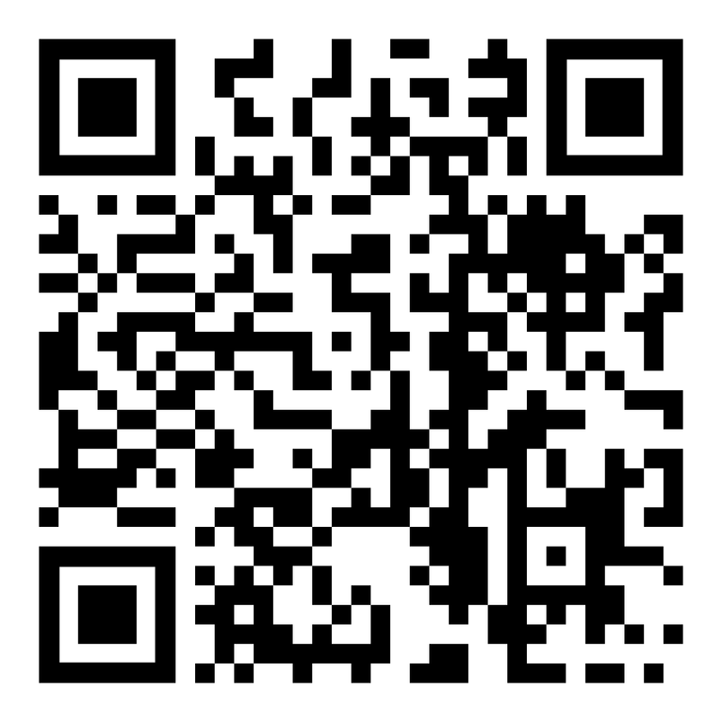
ENTRENAMIENTO BREATHE
“REPASO DEL PROGRAMA BREATHE”
USA EL CÓDIGO QR
para realizar la
POS- EVALUACIÓN
Notes:
Como lo mencione al principio, tambien hay una encuesta que deves llenar posterior a la capacitacion.
Asi que te agradeceria si de la misma manera que llenaste la anterior, Puedes llenar esta ultima.
Dejame saber si tienes alguna pregunta con respecto a la evaluacion. O si necesitas ayuda.
PUNTO CLAVE: Todos los participantes deben completar una evaluación posterior.
MATERIALES NECESARIOS: Los participantes pueden completar la evaluación posterior en línea con el código QR de esta diapositiva. Este es el método recomendado, ya que les ahorrará tiempo al ingresar datos después de la capacitación. (La diapositiva ahora indica "Repaso de la respiración" para que sepan cómo responder la primera pregunta sobre el tipo de capacitación a la que asistieron). Para fomentar el cumplimiento, puede pedirles que indiquen que ya terminaron o que le muestren la pantalla de finalización, y puede entregarles un folleto, un imán u otro obsequio cuando lo hagan. Aun así, es necesario traer algunas evaluaciones posteriores impresas, preferiblemente en un color diferente, por si los participantes prefieren completarlas en papel. La evaluación posterior se puede descargar de esta página web: https://justbreathein.org/additional-resources/materials/ **Si decide que los participantes NO completen la evaluación en línea, modifique esta diapositiva eliminando el código QR. MODIFICACIÓN VIRTUAL: Los participantes pueden usar otro dispositivo para acceder al código QR en pantalla o colocar el enlace en el chat para que puedan completarlo en el dispositivo que estén usando para la capacitación. Pida a los participantes que escriban "HECHO" en el chat para fomentar el cumplimiento y evaluar su finalización. Aquí está el enlace a la evaluación posterior: https://www.surveymonkey.com/r/BreathePostAssessments
KEY POINT: All participants need to complete a post assessment.
MATERIALS NEEDED: Participants can complete the post assessment online with the QR code on this slide. This is the preferred method as it will save you time doing data entry after the training! (The slide now indicates “Breathe Refresher” so they know how to fill answer the first question regarding the type of training they attended.) To encourage compliance you could have them indicate they are done or show you their completion screen and you could give them a handout, magnet, or other giveaway when they do. You still need to bring some printed out post assessments, preferable on a different color of paper, in case participants prefer to complete a hard copy. The Post Assessment can be downloaded from this webpage: https://justbreathein.org/additional-resources/materials/ **If you choose NOT to have participants complete the assessment online, modify this slide by removing the QR code.
VIRTUAL MODIFICATION: Participants can use another device to access the QR code on the screen and/or you can place the link in the chat box so they can complete it on the device they are using for the training. Ask participants to type DONE in the chat box to encourage compliance and assess completion. Here is the link to the post assessment: https://www.surveymonkey.com/r/BreathePostAssessments
SCRIPT: “Thank you for participating in today’s Breathe training! Before we wrap up, I need everyone to complete the post assessment. Once you have completed the post assessment please bring it to me/hold it up and I will give you (a magnet, certificate of completion, or whatever handout you choose).”

Slide 58
RECOJA LOS MATERIALES
Espere una encuesta 1-Mes después de la capacitación de parte de JustBreatheIndiana@gmail.com
¡NUEVO INCENTIVO!
Cada mes - ¡Sorteo de una tarjeta de regalo de $25 entre todas las encuestas mensuales recibidas!
Notes:
KEY POINT: Participants can pick up Quit Now Indiana materials and should expect a follow up survey in one month.
SCRIPT: “After you complete the post assessment you can pick up Quit Now Indiana handouts/parent survey cards/QR code flyers/supplemental Breathe materials. I’ll be sending a follow up email soon with the link to the webpage with all the digital materials as well as a certificate of completion for today’s training. Then expect an email in about a month from justbreatheindiana@gmail.com with our 1 month survey. Please complete that survey when you get it as it really helps us gain feedback to evaluate and improve the Breathe program.”

Slide 59


¡¡Gracias!!
Tanya Shelburne, Project Manager
tanyas@healthedpros.org
317-902-4505
Alison Muckerheide, Tobacco Control Specialist
alisonm@healthedpros.org
Notes:
KEY POINT: Share contact information.
SCRIPT/INSTRUCTIONS: (Personalize this slide with your contact information.) “Thank you so much for participating in today’s Breathe Refresher. It was my pleasure to get to see all of you again and meet the new staff. I know that working with families on this topic may not be easy, but I hope this training reinvigorated you and that you have even more ideas for how utilize the Breathe materials. As always, please reach out to me any time you have questions or great ideas and want to share your successes!”

Slide 60
FUENTES DE DATOS
2023 Indiana Behavioral Risk Factor Surveillance System (BRFSS)
www.in.gov/health/tpc/
www.cdc.gov/tobacco/
www.cancer.org/cancer/risk-prevention/tobacco
For a more detailed list of data sources used
to create Breathe materials go to
justbreathein.org/additional-resources/data-sources/
Notes:
KEY POINT: Share basic data sources and where they can find more.
SCRIPT/INSTRUCTIONS: (You can just leave this slide up for people to see or refer to it if anyone asks about the source of information you shared.)

