Slide 1


HEALTH ED PROS
Tanya Shelburne MPH, CHES
Alison Muckerheide MPH, CHES
Notes:
KEY POINT: Participants should know your name and a bit about your background and position.
MATERIALS NEEDED: Breathe Parent Handouts, Parent Worksheets, and Quit Now Indiana materials
INSTRUCTIONS: Personalize this slide with your information. Welcome everyone, introduce yourself, and give a brief background on your experience, your organization, and your position. Bring materials to the presentation, but do not distribute them until the end as some attendees will leave/not pay attention if materials are distrusted too early.

Slide 2
¡MOMENTO DE DESESTRESARSE!
¿Qué preocupaciones te están agobiando?
¿Cuáles son tus maneras saludables de desestresarte?
¿Cómo se relaciona esto con el tabaco?
Notes:
KEY POINT: Help everyone reduce their stress level.
MATERIALS NEEDED: Each participant needs two blank half sheets of paper and something to write with, and you may want print outs of the stress management parent handout found here: https://justbreathein.org/additional-resources/breathe-kit-materials/
VIRTUAL MODIFICATION: Have participants write their stressors down, rip them up, and then write down their healthy ways to de-stress just as you would in person. Then ask them to share examples of their de-stressing activities in the chat box. Read the responses aloud and provide validation.
SCRIPT/INSTRUCTIONS: “Before we jump into talking about tobacco, I’m going to ask all of you to participate in a short activity. Chances are each of you came into this presentation with lots of things on your mind and stuff that is stressing you out…long to-do lists, job or money related stress, family challenges…and now you have to sit through a presentation about tobacco! I take no offense that some of you may wish you were somewhere else right now and that this isn’t your favorite topic of discussion! But I do hope that we make the best use of this hour so you can leave here with more knowledge and some strategies on how you can create a healthy environment for your children. But first, let’s work on being mindful and de-stress with a short activity.!
(CLICK TO BRING UP WHAT WORRIES ARE WEIGHING ON YOU?) First, take a moment to “check-in” with yourself by writing down a few worries or things that are weighing on your mind right now. You won’t be asked to share what you write down, this is just for you! (Give them 1 minute to write down their worries) Now that you have written down what is stressing you, I want you to rip up those sheets into tiny pieces and toss them in the trash can. (Walk around with the trash can to collect the paper scraps) With this activity I am encouraging you to let those worries and stressors go…just Let It Go at least for the next hour. Please know that this activity is in no way making light of significant stressors some of you may be carrying today and that ripping up our papers doesn’t magically solve anything or make those challenges disappear. But I do hope this activity will allow you to have better focus and feel a bit lighter even if just for a short while while. I’ll resist the urge to sing the Frozen theme song, but I do hope you can all Let It Go!
(CLICK TO BRING UP WHAT ARE HEALHY WAYS YOU LIKE TO DE-STRESS?) Next, I want everyone to write down on another slip of paper a few healthy ways you like to de-stress. (Give them a minute or two to write down their ways to de-stress) Would anyone like to share some of their tactics for de-stressing? (Let several people share examples.) Not everyone’s list will look the same and that’s ok! The idea of going for a really long run sounds like torture to me, but for someone else that is exactly what they need to clear their mind and release tension! The most important thing is that we each have some healthy go-to options for when the worries and responsibilities of life get to be a bit much. (If people share somewhat unhealthy habits like drinking wine, eating chocolate, etc, acknowledge that for most people those things, in moderation, can be reasonable ways to de-stress.)
(CLICK TO BRING UP HOW DOES THIS RELATED TO TOBACCO?) So you may be thinking, what the heck does any of this have to do with learning about tobacco? I’m so glad you asked! For many stressed out people and maybe some of you, smoking or vaping might have been on your list of de-stressing activities…it we weren’t focusing on HEALTHY stress management. While many people who use tobacco think of it as a stress reliever, it can be a vicious cycle that actually creates more stress. From the added expense, health problems, lingering odor, physical dependence, and more…tobacco use just adds unnecessary stress and more worries. I’d actually like to help you deal with stress in a healthier way that will benefit yourself and your family. Even though we can’t do all the de-stressing activities on your lists right now, I hope you will all take time for a bubble bath or a long walk of some other kind of self-care that appeals to you this evening!”

Slide 3
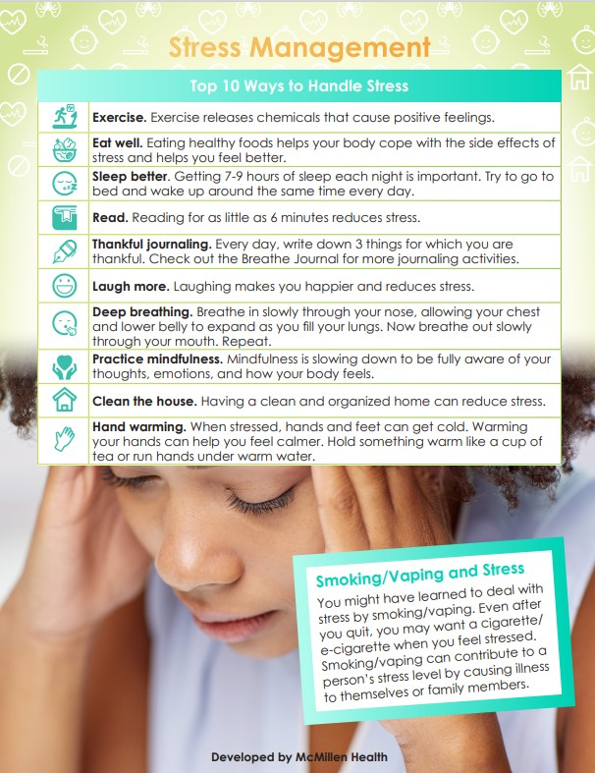
GUÍA PARA EL MANEJO DEL ESTRÉS
¡Descubre consejos para manejar el estrés SIN TABACO!
Notes:
KEY POINT: Share the tips found on the Stress Management handout.
MATERIALS NEEDED: You can provide copies of the Stress Management handout, if you choose.
SCRIPT/INSTRUCTIONS: “This Stress Management handout offers lots of healthy ways to deal with stress without using tobacco, so I hope you will find ones that work for you and share these tips with others you know who might be turning to tobacco as a way to deal with stress.”

Slide 4
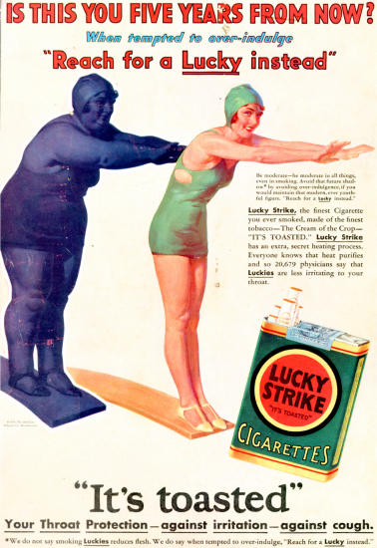
PREPARANDO EL ESCENARIO​
La industria tabacalera gasta miles de millones de dólares en comercializar agresivamente productos letales
Notes:
KEY POINT: The tobacco industry spends a lot of money to aggressively market deadly products.
SCRIPT/INSTRUCTIONS: (STAY ON BLANK SLIDE) “Now let’s all take a deep breath (take a deep breath)…and we will dive into the topic of tobacco, I first want to set the stage and provide some context for the tobacco burden here in Indiana and all across the country.
(DOUBLE CLICK) For many decades the tobacco industry has been hard at work creating and selling addictive products that when used as directed lead to all kinds of negative health outcomes, including death. Billions of dollars are spent by the tobacco industry to market their deadly products, and Big Tobacco uses targeted and aggressive marketing strategies to prey on certain populations, thereby creating health disparities. Here you can see a very old ad encouraging women to take up smoking as a way to lose weight. The tobacco industry is still aggressively marketing to women with new and deceptive strategies as well as targeting many other groups of people.”

Slide 5
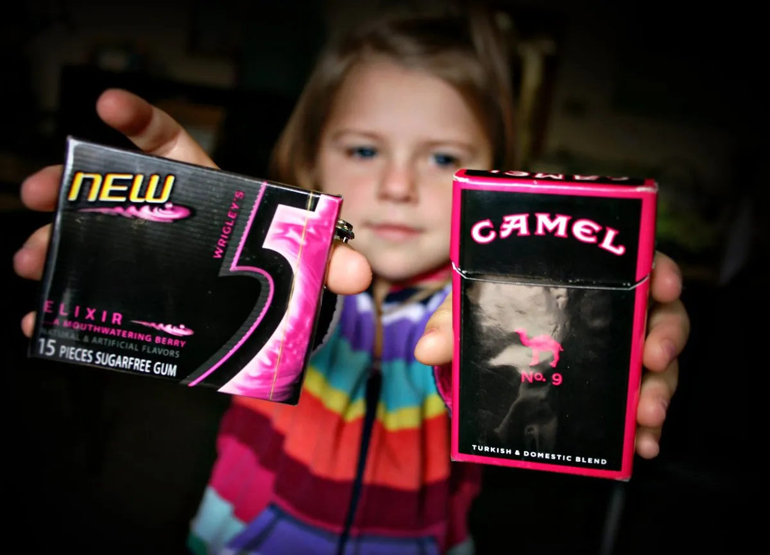
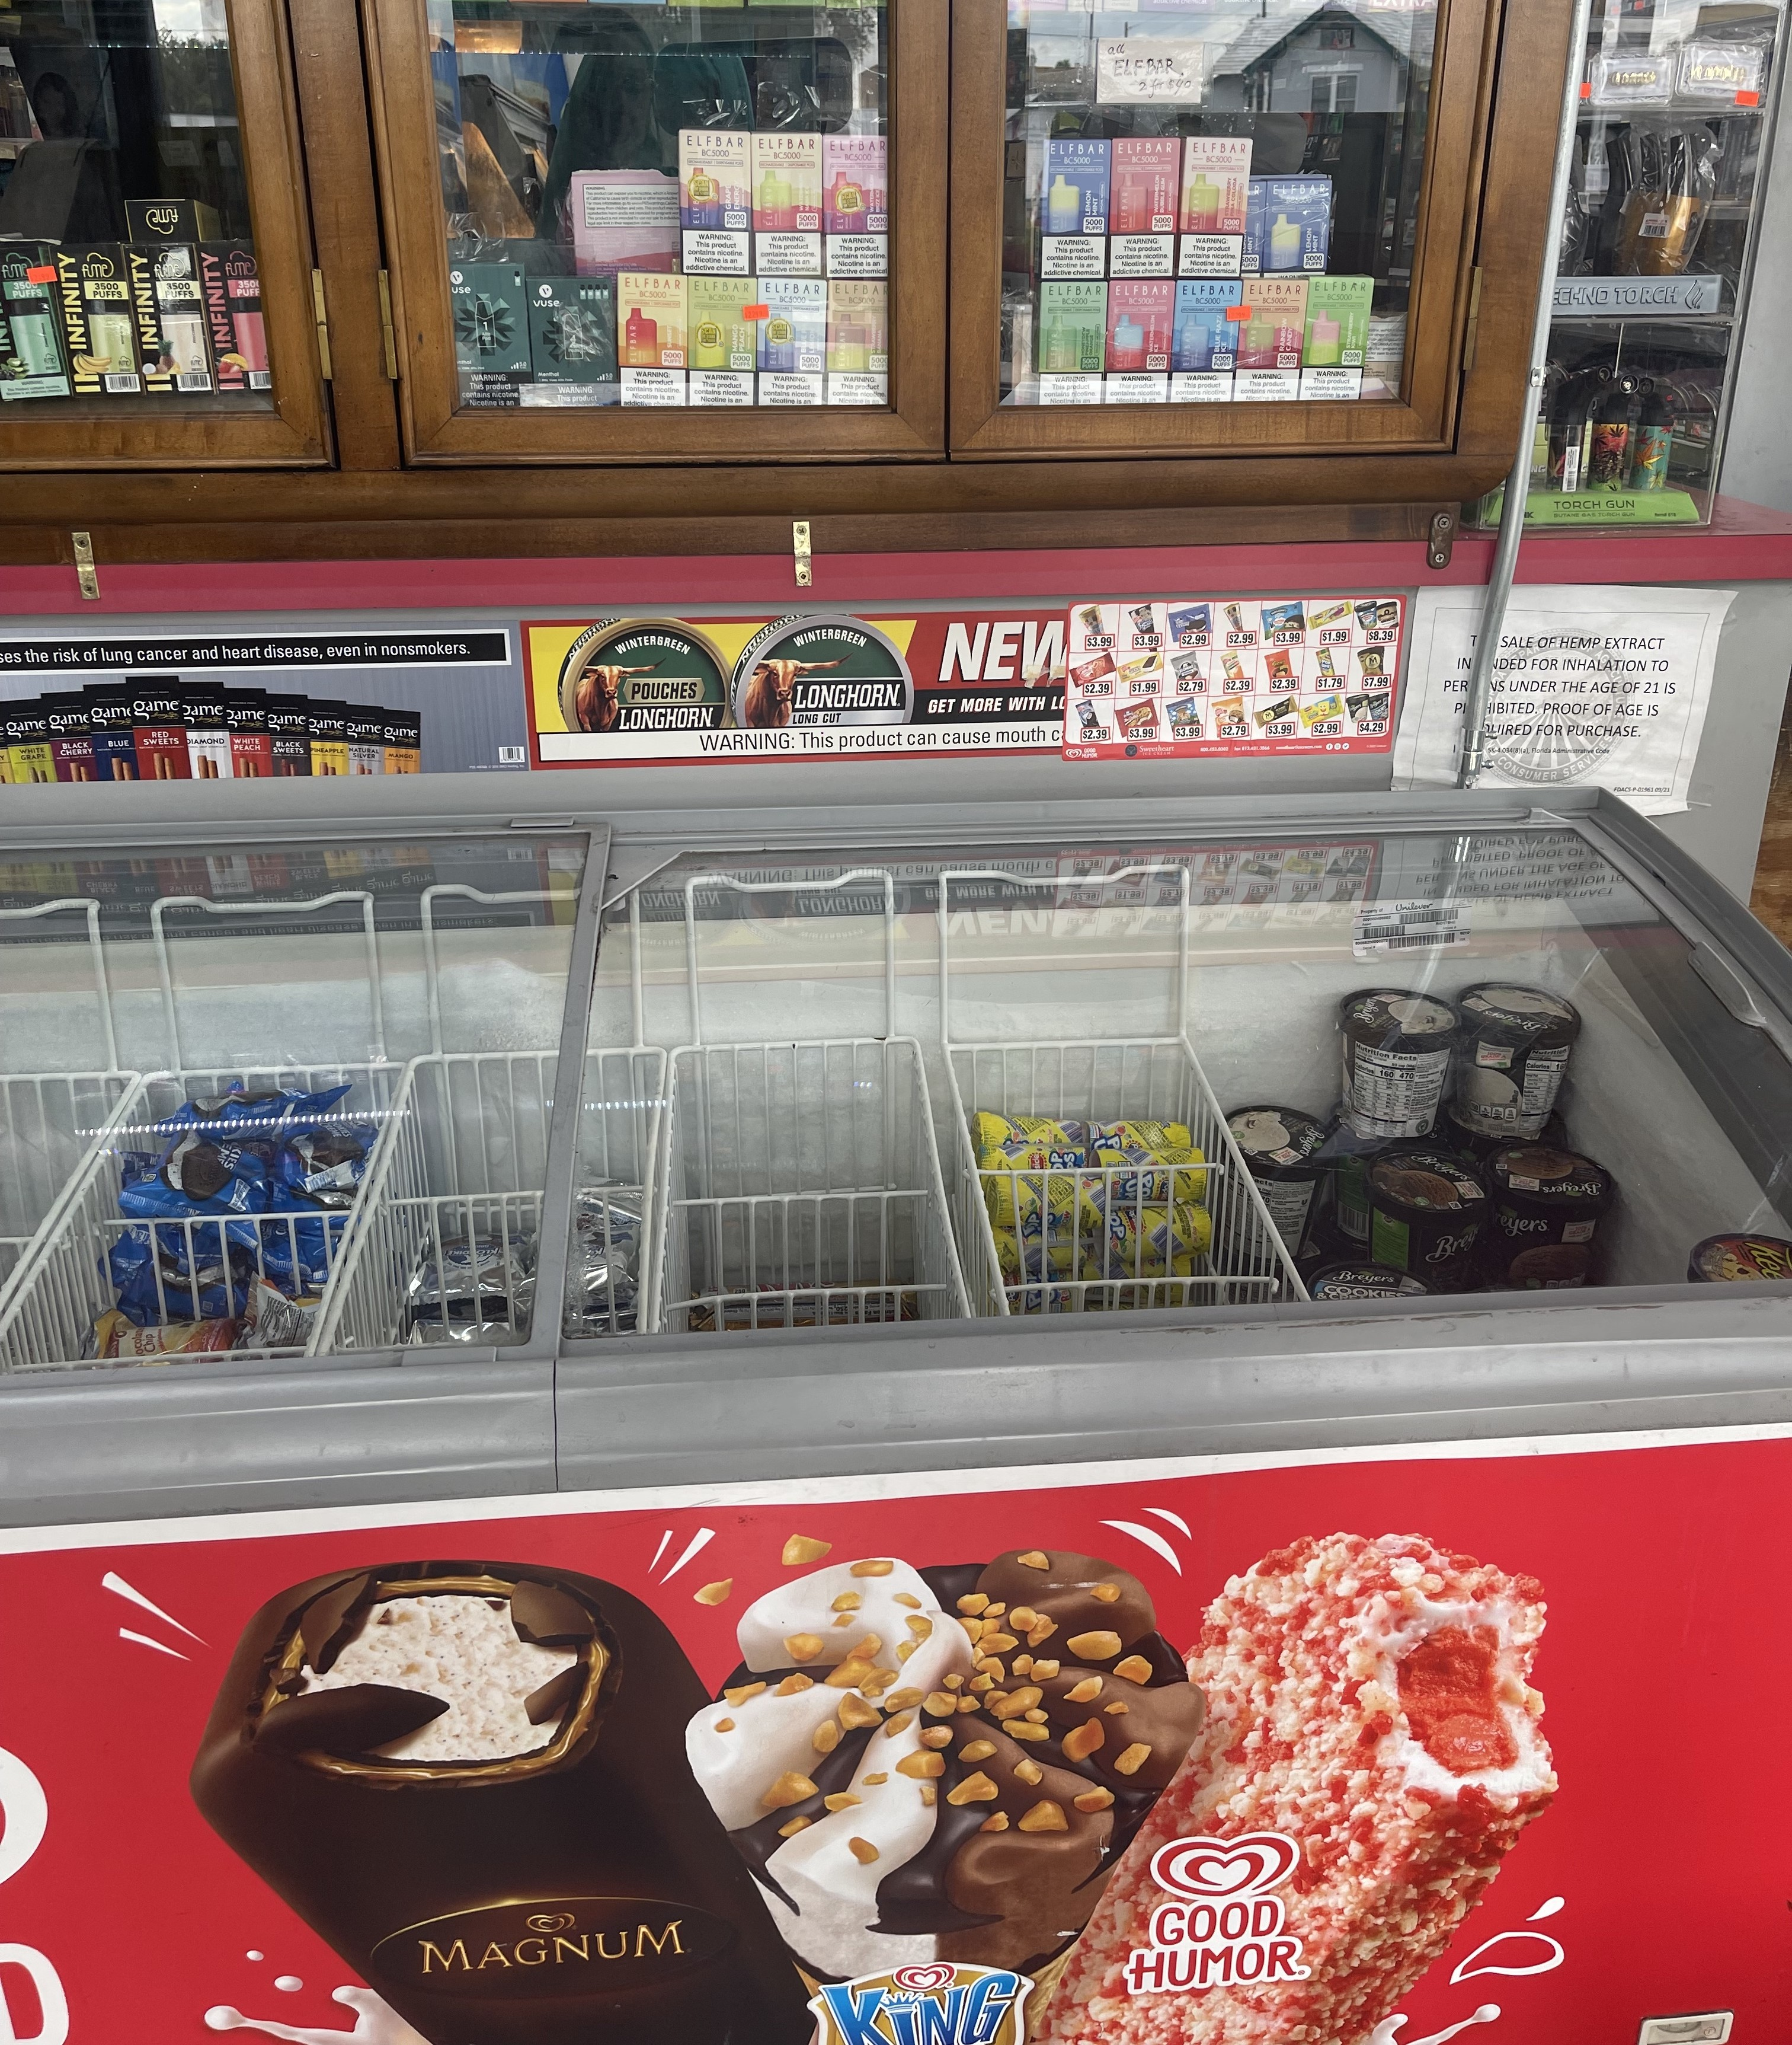
MERCADEO DEL TABACO
Mercadeo en el punto de venta
Empaques que imitan dulces populares
Notes:
KEY POINT: Point-of-sale marketing and design of products is aimed at attracting youth.
SCRIPT: “As laws restricted certain forms of advertising for tobacco products, point of sale marketing became a key focus for the tobacco industry. Tobacco promotions are specifically placed near products that appeal to children, such as candy and ice cream.
(DOUBLE CLICK TO IMAGE OF GUM AND PACK OF CAMELS AND TEXT) They use colorful packaging that often mimics popular candy and gum and tobacco companies also use candy and fruit flavors in many of their products to appeal to youth in an attempt to create lifelong customers.”

Slide 6
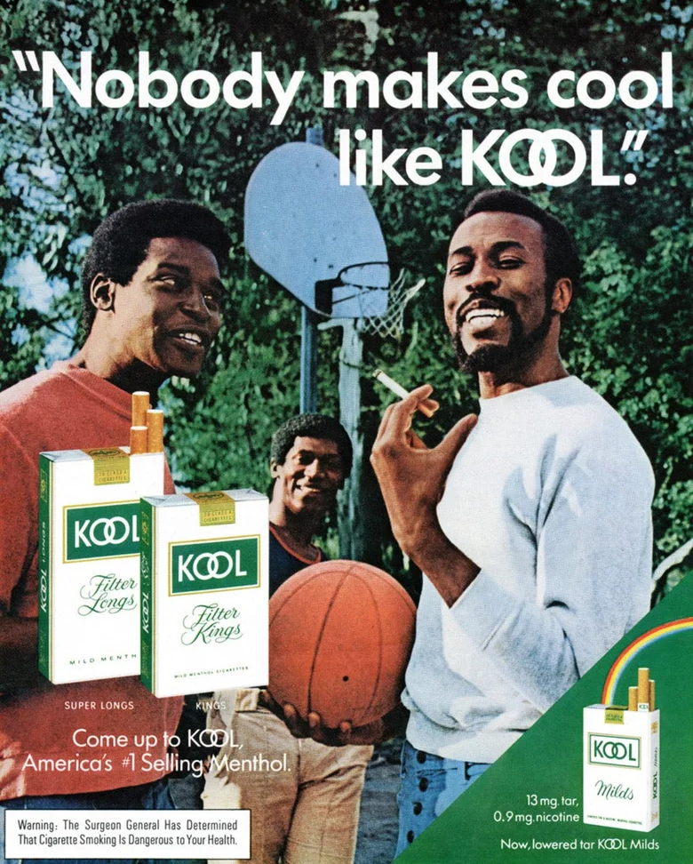
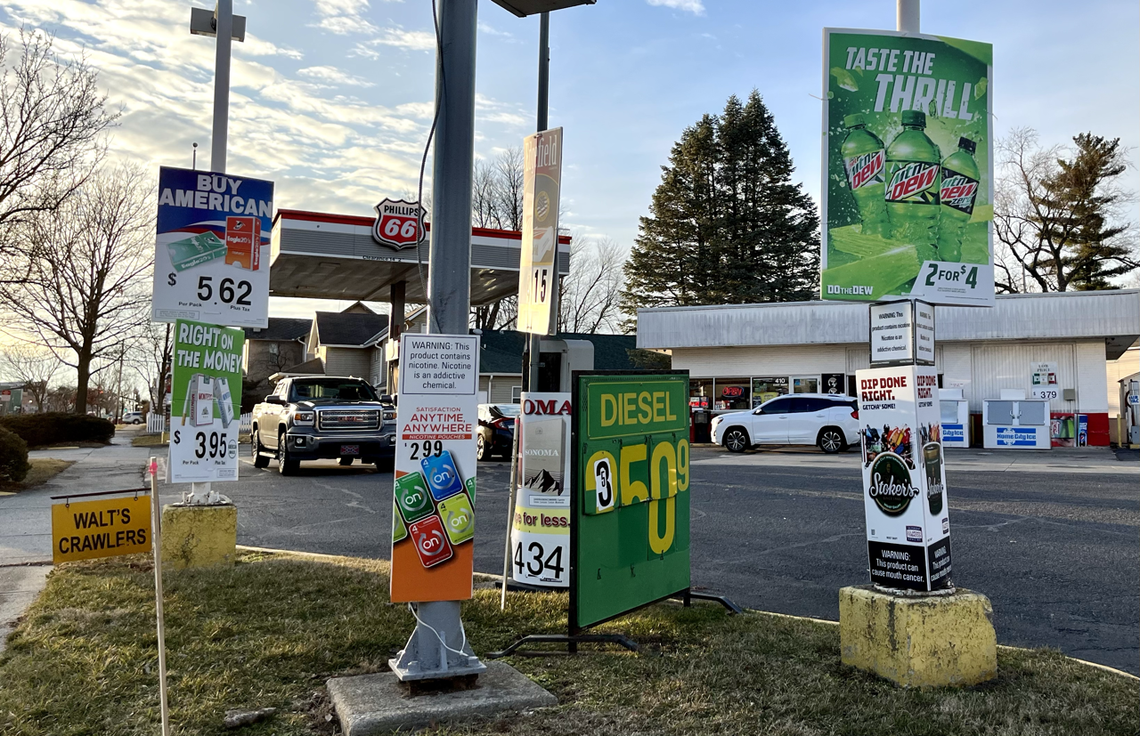
PUBLICIDAD DIRIGIDA
Publicidad intensiva en barrios de bajos ingresos
Productos Amentolados ​
& Los Afroamericanos
Notes:
KEY POINT: The tobacco industry uses aggressive and targeted marketing strategies aimed at marginalized populations, such as communities with low income households and African Americans, creating further health disparities.
SCRIPT: “The tobacco industry aggressively targets and markets their products to various marginalized groups, including people of color, those living in rural communities, and to people who identify as LGBTQ+. Higher levels of advertising, discounts, and displays of tobacco products are strategically placed in communities with lower household incomes.
(DOUBLE CLICK) Another example is the overt marketing strategy seen with Menthol cigarettes being targeted to African Americans over several decades. When flavored cigarettes were banned the tobacco industry lobbied hard for Menthol cigarettes to be excluded from the ban, which created a higher burden of tobacco for African Americans.”

Slide 7
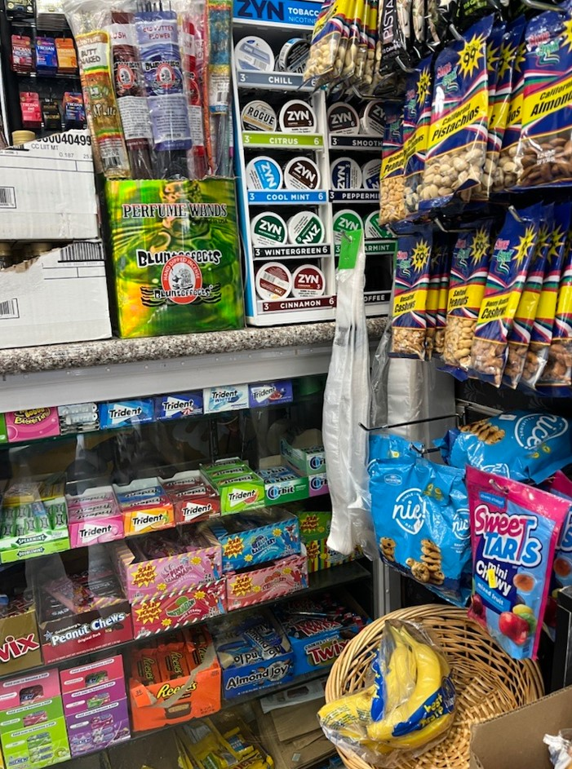
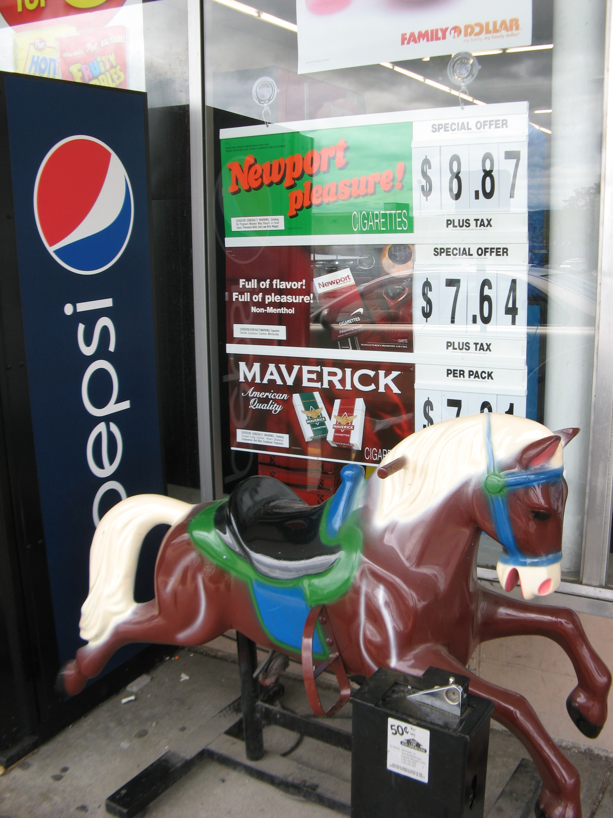
PUBLICIDAD DIRIGIDA
¡Las grandes tabacaleras están trabajando en nuestra comunidad!
La industria tabacalera desarrolla nuevos productos para evadir las leyes y captar nuevos clientes.
Notes:
KEY POINT: The tobacco industry is at work in this community.
SCRIPT: “As new laws are put in place to protect Americans from these dangerous products and the negative effects of secondhand smoke, the tobacco industry continues to innovate and develop new and addictive products in an attempt to get around laws aimed to protect all Hoosiers, and exploitation of marginalized populations continues. I want to be clear that the Breathe program is not against people who use tobacco. I am here to provide education, support, and resources so that each of you can make informed decisions for your families.
(CLICK TO YELLOW BAR) The reality is that Big Tobacco is at work right here in this community…but there is a lot we can do to support healthy families and fight against the tobacco industry’s dangerous tactics…and that starts with educating ourselves! ”

Slide 8
MITO
El consumo de tabaco ya no es un problema
Notes:
KEY POINT: Even though smoking rates have gone down, the tobacco burden is still huge.
SCRIPT: “Of course there are a lot of myths going around about tobacco so I hope to share information today that will bust some of those popular myths. The first myth I want to address is the idea that tobacco is no longer a problem. While great strides have been made over several decades to lower smoking rates and educate people about the dangers of secondhand smoke, the tobacco burden is still taking a huge toll on Hoosiers and now all the new forms of e-cigarettes add to the complexity and the negative outcomes associated with commercial tobacco use in its many forms. But more on vaping in a bit.”

Slide 9
ESTADÍSTICAS DEL TABACO EN INDIANA​
El 13.9% de los adultos en Indiana fuma actualmente.​
Y el 9.2% de los adultos en Indiana usan cigarros electrónicos actualmente.​
    Parte de la "Nación Tabacalera" – Un grupo de 12 estados del Medio Oeste y del Sur de EE. UU. que tienen tasas de tabaquismo casi un 50% más altas que el promedio.​
Notes:
KEY POINT: While smoking has decreased over the past few decades various forms of commercial tobacco use continues to remain high.
SCRIPT: “I won’t bore you with too many stats today, but I do want to give you an idea of the current tobacco burden here in Indiana. While traditional smoking has decreased over the past several decades, 13.9% of Indiana adults still currently smoke.. And 9.2% use e-cigarettes, with many using multiple forms of commercial tobacco products. Sadly, Indiana falls into the part of the country deemed Tobacco Nation, which includes 12 Midwest and Southern states where the smoking rate is nearly 50% higher than in other parts of the country.”

Slide 10
ESTADÍSTICAS DEL TABACO EN INDIANA​
El 3.8% de las residentes de Indiana reportó haber fumado durante su embarazo.​
*Datos del BRFSS de 2023.
1 de cada 4 personas que no consumen tabaco está expuesta al humo de segunda mano. ​
(principalmente afroamericanos, personas de bajos ingresos y quienes viven en viviendas multifamiliares).
Aproximadamente 1,300 residentes de Indiana mueren cada año a causa del humo de OTRA PERSONA!
Notes:
KEY POINT: Additional data sheds light on the tobacco burden for various populations.
SCRIPT: “We also know that 3.8% of pregnant people in Indiana reported smoking during their pregnancy. In some Indiana counties the smoking rate during pregnancy is over 20%, so we clearly have some work to do in this area. We will cover the negative health effects related to this stat in just a bit. Even those who don’t smoke suffer negative health effects and even death from exposure to secondhand smoke. And the burden in disproportionate with African Americans, people with low incomes, and those who live in multiunit housing being more likely to be exposed to secondhand smoke. It is rather sobering to realize that around1,300 Hoosiers die each year due to someone else’s smoking.”

Slide 11
NUESTRA COMUNIDAD
Consumo de tabaco en esta comunidad​
Avances a nivel local​
Contactos Locales​
Notes:
KEY POINT: Share the status of tobacco use in this community and local resources addressing the tobacco burden.
INSTRUCTIONS: Personalize this slide with your local information!!
What are the rates and statistics of tobacco use in your county?
What is happening in your local county to address tobacco issues?
Are there any resources available in your community?

Slide 12
MITO
Las personas que fuman sólo se hacen daño a sí mismas.​
Notes:
KEY POINT: Smoking harms more than the smoker, especially when kids are exposed.
SCRIPT: “Another myth I would like to challenge is the idea that people who smoke are only harming themselves. What we really want to focus on today is the impact and the harm associated with tobacco use as it relates to children.”

Slide 13

CONSUMO DE TABACO DURANTE EL EMBARAZO
  Efectos en la salud
    Parto prematuro
    Aborto espontáneo
    Bajo peso al nacer
    Complicaciones de la placenta
    Retraso en el desarrollo cerebral del bebé
    Síntomas de abstinencia del bebé
    Aumento de la frecuencia cardíaca y la presión arterial durante elembarazo
Notes:
KEY POINT: Tobacco use during pregnancy leads to many negative health effects for both the adult and the baby.
SCRIPT: “Let’s start by looking at the impact during pregnancy. Because we do have higher rates of smoking while pregnant in Indiana, it is critical that pregnant people understand the impact of tobacco use on their unborn baby. Tobacco use during pregnancy can cause preterm labor, miscarriage, low birth weight, problems with the placenta, and slow development of the brain. Babies will also experience withdrawal symptoms after birth, and if you have ever been around someone who is quitting smoking or if you have quit smoking you know this can be an unpleasant process. Now imagine a newborn dealing with withdrawal! The pregnant person may also experience increased heart rate and blood pressure. I want to go back for a minute to discuss another myth that is still going around with some women who actually believe that a low birth weight is a good thing and will make delivery easier…which is not true and is not healthy for the baby!”

Slide 14
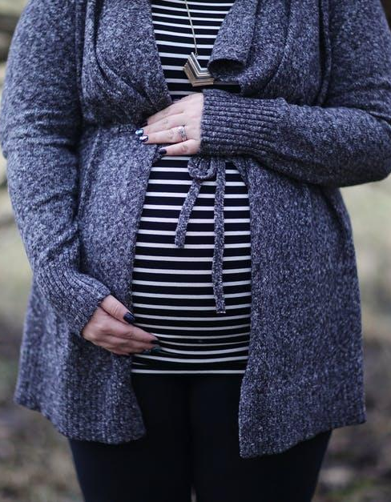
CONSUMO DE TABACO DURANTE EL EMBARAZO
Dejar de fumar durante el embarazo ayudará al bebé AHORA y DESPUÉS de que nazca.
  ¡NO EXISTE UNA CANTIDAD SEGURA DE CONSUMO DE TABACO DURANTE EL EMBARAZO!
Notes:
KEY POINT: There is no safe amount of tobacco use during pregnancy.
SCRIPT: “The good news is that no matter how far along someone is in their pregnancy, stopping tobacco use will help the baby! Not only will it help the baby before birth, but if a baby is born into a smoke free home they will not have all of the dangerous health impacts of secondhand and thirdhand smoke in the future. The bottom line and what we want to stress to pregnant people is that there is no safe amount of tobacco use during pregnancy.”

Slide 15

HUMO DE SEGUNDA MANO: EMBARAZO
Incluso si alguien NO consume tabaco,
el humo de segunda mano puede causar problemas GRAVES en su embarazo, como:
      Parto prematuro
      Muerte fetal y abortos espontáneos
      Síndrome de muerte súbita infantil
      Embarazo ectópico
      Feto con bajo desarrollo
      Defectos cardíacos
      Hendiduras orofaciales
      Bajo peso al nacer
Notes:
KEY POINT: Being around secondhand smoke is also dangerous for pregnant people and can lead to some of the same health problems as smoking.
SCRIPT: “Now I want to touch on secondhand smoke. Even if someone does not use tobacco themselves, if they are exposed to secondhand smoke it can cause problems with the pregnancy. I won’t read the whole list of possible negative health outcomes, but you will notice that many are the same ones that can result from direct smoking during pregnancy. It is very important to avoid secondhand smoke during pregnancy for their own health and the health of their baby.”

Slide 16

HUMO DE SEGUNDA MANO: NIÑOS
El humo de segunda mano es especialmente dañino para los niños porque sus pulmones y cerebros aún se están desarrollando y puede causar:
Infecciones de oído
Bronquitis
Neumonía
Ataques de asma
Dificultades de aprendizaje
Cáncer y enfermedades cardíacas en la edad adulta
Notes:
KEY POINT: Secondhand smoke also has lots of negative health effects for children who are exposed.
SCRIPT: “Beyond pregnancy, Secondhand smoke is also harmful to children as their lungs and brains are still developing. Long-term secondhand smoke exposure can cause these children to have health issues now and in the future. Children who are around secondhand smoke may get frequent ear infections, suffer from bronchitis, pneumonia, and asthma attacks. They may also experience learning difficulties and even develop cancer or heart disease later on in life. Sharing this information with parents can help them make informed decisions for their children's future-self!”

Slide 17
HUMO DE TERCERA MANO
      El humo de tercera mano es lo que se huele en la ropa, en las casas, o automóviles después de que alguien haya fumado.
      Los productos químicos se adhieren y quedan en la ropa, los muebles, las alfombras, las cortinas, el cabello, los asientos del automóvil, los juguetes y a las mascotas incluso mucho después de que se deje de fumar.
      El humo de tercera mano NO SE PUEDE eliminar.
      Ni abriendo ventanas, usando ventiladores/aires acondicionados o fumando en una sola habitación.
Notes:
KEY POINT: Thirdhand smoke may be less well-known, but it also exposes children to the same dangerous chemicals as secondhand smoke.
SCRIPT: “I’m sure you have all heard of secondhand smoke, but Thirdhand smoke may not be as familiar to you. Thirdhand smoke is the lingering odor and harmful chemicals left behind when someone smokes in an area. If I’m on an elevator with a smoker I don’t need to see them actually smoking I can tell they are a smoker by the smell that follows them. The dangerous chemicals in smoke stick to everything…clothes, furniture, carpet, curtains, hair, carseats, toys, and even pets, and they can cause serious health problems. Unfortunately, these chemicals can’t simply be removed by airing out the room. If you have ever moved into a home or apartment where someone smoked you know it takes a lot of work to get the smell and the harmful chemicals out.”

Slide 18
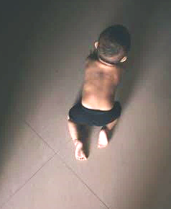
HUMO DE TERCERA MANO
¿Quién está en riesgo de sufrir el humo de tercera mano?
¡TODOS ESTAMOS EN RIESGO!
Especialmente bebés y niños pequeños
  Los bebés se llevan todo a la boca
  Los niños que están en contacto con
  personas que fuman están expuestos a las
  sustancias químicas del humo de tercera mano en la piel,
  la ropa y el cabello.
  Los bebés respiran CUATRO veces más sustancias químicas que un adulto al caminar por la misma zona
Notes:
KEY POINT: Infants and Children are at high risk from thirdhand smoke.
SCRIPT: “Everyone is at risk from thirdhand smoke, but this can be especially harmful for infants and children. We all know that babies love to put everything in their mouths! So if someone smoked in that area, even when the baby wasn’t around, they are still ingesting the chemicals left behind by thirdhand smoke. If someone who smokes holds a tiny baby close to them that baby is taking in all the chemicals and toxins that are lingering on their hair and clothes. And when infants and toddlers crawl around on the floor they kick up all the toxins that have fallen on the floor and breathe them in. Simply because of their size and how they breathe infants take in four times as many chemicals as an adult would in the same area, which can damage their growing bodies.”

Slide 19

VIDE0 DE HUMO DE TERCERA MANO
Notes:
KEY POINT: Show the Thirdhand smoke video.
SCRIPT: “Let’s watch this short video on thirdhand smoke.”

Slide 20
ACTIVIDAD
¿Cómo están expuestos los niños al humo de segunda y tercera mano?
Notes:
KEY POINT: Brainstorm where children may be exposed to second and thirdhand smoke.
VIRTUAL MODIFICATION: Have participants types answers in chat box and read them aloud as you validate the responses.
SCRIPT/INSTRUCTIONS: “Even though some laws have been passed to limit exposure, let’s think about where children might still be exposed to both second and thirdhand smoke.” (Encourage participants to share their thoughts and then validate their responses. If you want, you can record their responses on newsprint or a whiteboard.)

Slide 21

LUGARES EN DONDE LOS NIÑOS ESTÁN EXPUESTOS
Lugares comunes en los que los niños están expuestos al humo de segunda y tercera mano:​
En la casa​
En el auto​
En lugares públicos​
En casa de un cuidador/familiar​
En parques o áreas de juego​
Cerca de entradas a tiendas y restaurantes.
Notes:
KEY POINT: There are lots of places where children could be exposed to secondhand smoke.
SCRIPT: “Some common places children are exposed to second and thirdhand smoke include their own home or in cars as well as public places that are not covered by a comprehensive tobacco ordinance. Relatives and caregivers houses is a big one and can be difficult situations, especially when children travel back and forth between two parents’ homes and one household allows smoking and the other doesn’t. Parks and playgrounds are another place where children often spend time yet people may smoke around them. And even though there is a law in Indiana that prohibits smoking near the entrances of stores and restaurants this is hard to enforce so exposure still happens. It’s important to help families identify where their children may be exposed to second and thirdhand smoke and then help them make a plan to eliminate or at least minimize that exposure.”

Slide 22
ACTIVIDAD
¿Cómo pueden los adultos proteger a los niños de la exposición al humo de segunda y tercera mano?
Notes:
KEY POINT: Find out what ideas the training participants have about limiting exposure to second and thirdhand smoke.
VIRTUAL MODIFICATION: Have participants types answers in chat box and read them aloud as you validate their responses.
SCRIPT/INSTRUCTIONS: “So now that we have some ideas on where children might be exposed, how can we protect kids from second and thirdhand smoke?” (Allow training participants to engage in group discussion about potential answers. After several suggestions are given proceed to next slide to discuss the answers. If you are pressed for time you can simply go to the next slide and provide the answers.)

Slide 23

COMO PODEMOS PROTEGER A LOS NIÑOS​
      Educar a los padres/cuidadores​
      Dejar de fumar​
      Fumar afuera​
      No fumar en el carro​
      Use una chaqueta de fumar​
      Apoye a las empresas libres de humo
      Permitir que los niños solo estén en casas y carros libres de humo​
      Aumentar la conciencia sobre las estrategias de venta engañosas de la​ industria tabacalera.​
      Pasar pólizas (para hogares, empresas, niveles locales, estatales y federales)
Notes:
KEY POINT: Quitting is a great way to protect children from second and thirdhand smoke but if parents are not ready to quit there are lots of baby steps they can take.
SCRIPT: “So how can we protect children from second and thirdhand smoke? Education is always a great first step, and that’s why we are here today. Of course, if adults quit using tobacco that is the best way to protect their own health as well as their family’s health. But even if someone is not ready to quit, there are lots of other things they can do to minimize exposure for their children such as designating their home as smoke free and only smoking outside, and also not smoking in the car. They can wear a smoking jacket and peel off that outer layer of thirdhand smoke before coming around their children. Supporting smoke-free businesses is another great idea and only allowing children to be in smoke free homes and cars. This may require some difficult conversations with family members and caregivers, but those conversations should always come back to what is best for the children’s health. We can increase awareness of the deceptive marketing tactics of the tobacco industry as well as pass policies that protect everyone from second and thirdhand smoke. These policies can be official laws at all levels of government as well as the rules we put in place in our own homes and businesses. Taking many of these steps is not always easy, but even small steps in the right direction can help protect our children.”

Slide 24
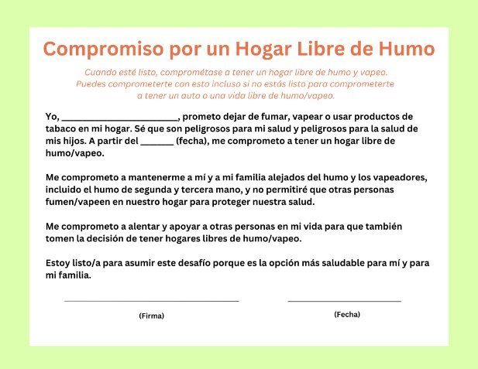
HOJAS DE COMPROMISO​
Notes:
KEY POINT: Ask parents to sign a smoke/vape free home and/or car pledge.
MATERIALS NEEDED: Bring plenty of copies of the Pledge for a Smoke/Vape Free Home and the one for the Car from the Breathe Parent Journal/Worksheet, which can be found here: https://justbreathein.org/wp-content/uploads/2022/02/37.-Pledge-for-a-SmokeVape-Free-Home-and-Car.pdf
SCRIPT: “I brought some pledges for a smoke/vape free home and car that I hope you will all thoughtfully consider. Then if you are ready to make this commitment, I encourage you to sign the pledge(s). These pledges can serve as a way to stay accountable as you work to minimize your children’s exposure to second and thirdhand smoke…and don’t worry, we will get to vaping in just a minute!”

Slide 25
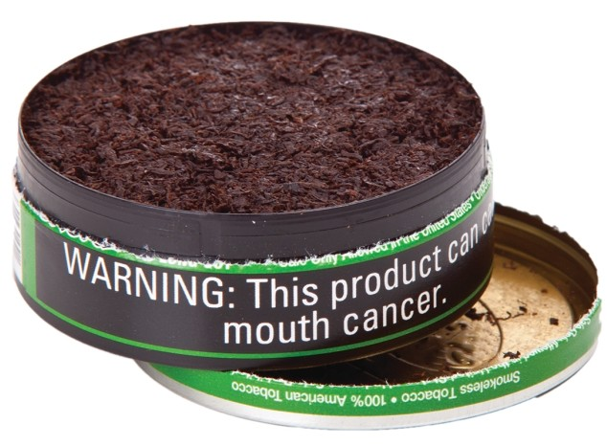
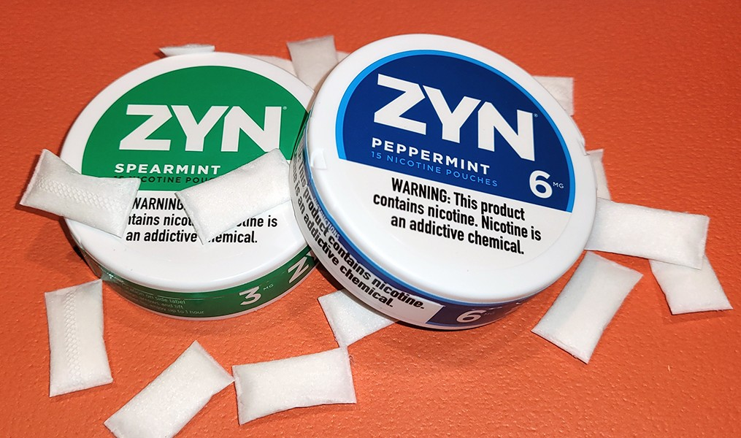
TABACO SIN HUMO
El tabaco sin humo aumenta el riesgo de:
Ciertos tipos de cáncer
Mortalidad fetal, si está embarazada
Accidente cerebrovascular y cardiopatía
Bolsitas de nicotina:
Populares entre los jóvenes, vienen con sabores.
      El polvo se disuelve (no necesitas escupir).
      La nicotina se absorbe a través de las encías y el revestimiento de la boca.
  Los niños pueden ingerir tabaco sin humo
  y envenenarse
Notes:
KEY POINT: Smokeless tobacco doesn’t carry the risk of secondhand smoke, but it still dangerous for the user and if children get ahold of smokeless products.
SCRIPT: “First, I want to touch briefly on smokeless tobacco. There is not the same risk of second and thirdhand smoke with smokeless tobacco, however it does carry many health risks for the user, including pregnant people. Smokeless tobacco now comes in many different forms, including small pouches. These are actually spitless and they are gaining in popularity with youth. Zyn is just one popular brand of nicotine pouches and they come in flavors that may make them more appealing then traditional smokeless/chewing tobacco. These flavors and minty smell might also make these products intriguing to very small children so it is important to remember that Smokeless tobacco products should not be left where children can get them. If they eat or put these products in their mouths they could experience nicotine poisoning, which can very dangerous.”

Slide 26
MITO
Vapear es seguro… ​
es solo vapor de agua.
Notes:
KEY POINT: Vaping is not a safe alternative.
SCRIPT: “We can’t talk about tobacco without mentioning vaping and e-cigarettes and there are plenty of myths around this growing area of tobacco use. Let’s start with the myth that vaping is safe and that it’s just water vapor. Not true!!”

Slide 27
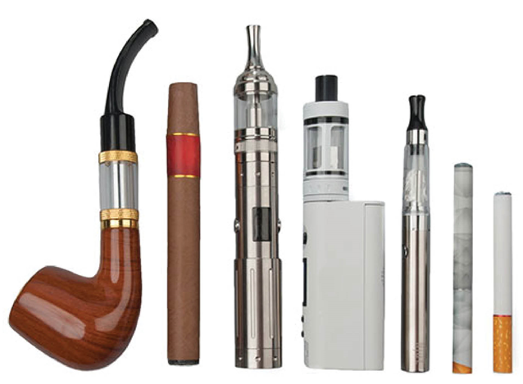
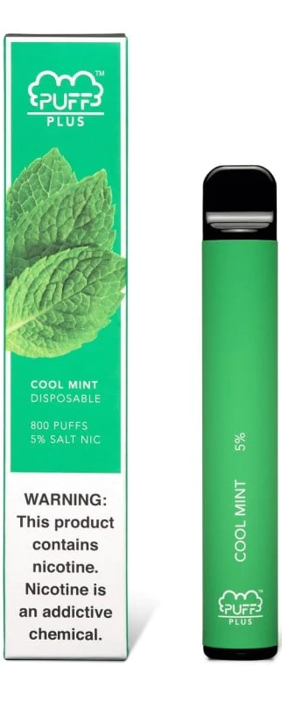
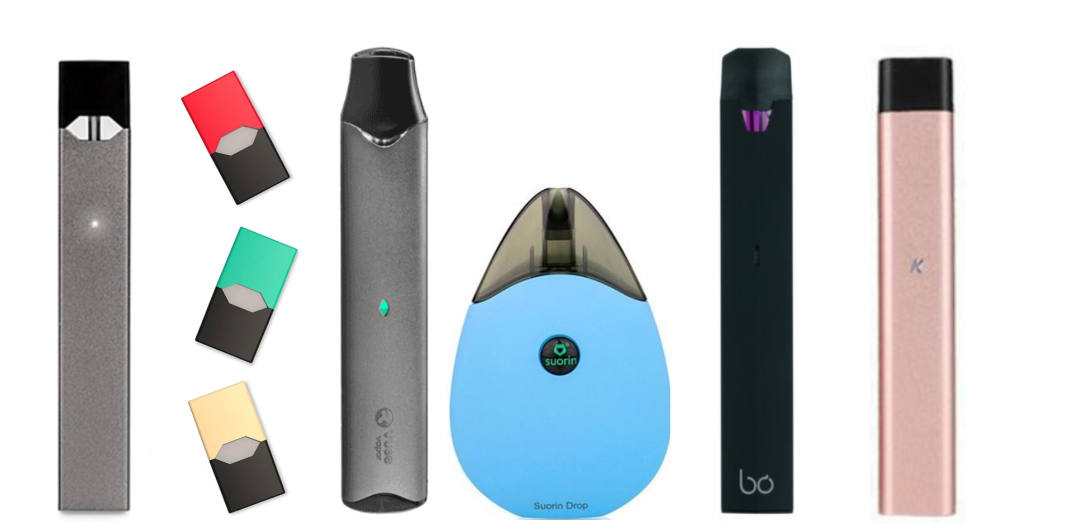
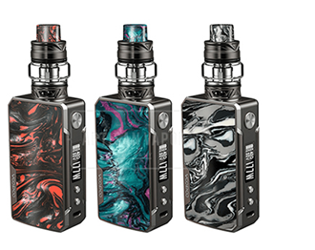
CIGARRO ELECTRONICO Y EL VAPEO
Los cigarrillos electrónicos NO solo emiten vapor de agua, sino aerosoles
Los líquidos electrónicos contienen ingredientes similares a los cigarrillos normales, como plomo y otros
productos químicos peligrosos
Los cigarrillos electrónicos y los vaporizadores vienen en muchas formas diferentes.
MITO EXTRA DESMENTIDO:
Los cigarrillos electrónicos NO son una herramienta comprobada
para dejar de fumar
Notes:
KEY POINT: E-cigarettes/vapes are not safe and are not proven cessation tools.
SCRIPT: “Whether you use the term e-cigarettes or vapes, this is a very hot topic that we get lots of questions about. Vaping has grown in popularity tremendously over the past ten years and there is a lot we are still learning about the negative health impact of these products. It is important to understand that e-cigarettes don’t emit harmless water vapor, but rather an aerosol that contains many of the same dangerous chemicals found in traditional cigarettes. Vapes come in many different forms. Some look like flashdrives or highlighters. Some come with pre-filled pods and some can be refilled with e-juice. It is important to know that e-cigarettes are not a proven cessation strategy. Don’t worry, in just a bit we will touch on some of the strategies that have been proven to help people quit smoking. Unfortunately, many people who smoke and then start vaping actually end up dual using or just continue vaping and don’t actually quit.”

Slide 28
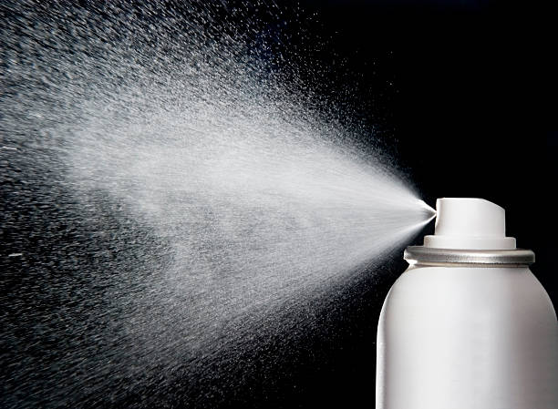
CIGARROS ELECTRONICOS Y EL VAPEO
Los líquidos electrónicos contienen nicotina, que es
extremadamente adictiva.
El envenenamiento por nicotina puede ser mortal
Ocurre si una persona bebe,
huele o toca el líquido
Las baterías de los cigarrillos
electrónicos pueden explotar y provocar quemaduras graves.
¡NO ES SEGURO vapear cerca de los niños!
¡NO dejes los PRODUCTOS PARA VAPEAR al alcance de los niños!
Notes:
KEY POINT: It is not safe for young children to have access to vapes/e-cigarettes and e-juice.
SCRIPT: “Research is still being done on the long-term effects of vaping and the FDA is slowly starting to regulate these products. We do know that E-liquids contain nicotine, which is extremely addictive, and nicotine poisoning can be very dangerous for children if they drink the e-juice or just get it on their skin. The batteries in e-cigarettes have also been know to explode. It is important that parents understand that it is not safe for young children to have access to vapes and e-juice or to be around people who are vaping. ”

Slide 29
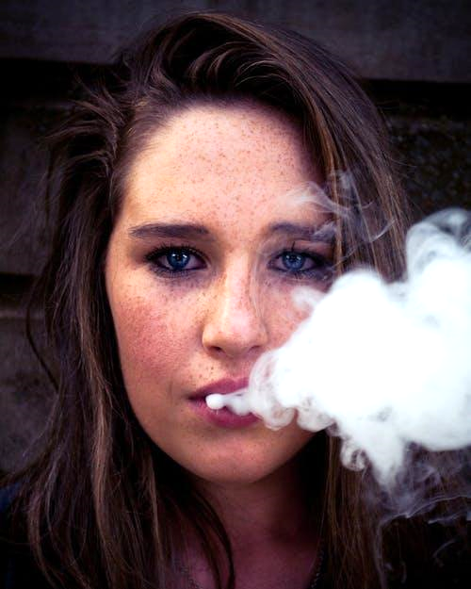
EL CIGARRO ELECTRONICO, VAPEOY LA JUVENTUD
Casi 1 de cada 20 estudiantes de secundaria
Admiten el uso de cigarrillos electrónicos
(Indiana Youth Tobacco Survey, 2012-2024)
El Cirujano General de Estados Unidos declaró
que el uso de cigarrillos electrónicos por parte
de menores es una epidemia:
  Vapear se convirtió en el mayor aumento
  en el abuso de sustancias entre jóvenes
  JAMÁS registrado.
  Sabores como algodón de azúcar, mezcla de frutas y
  crème-brulée atraen a los usuarios jóvenes.
  La nicotina puede dañar el cerebro adolescente en desarrollo.
Notes:
KEY POINT: Vaping has become an epidemic among youth.
SCRIPT: “Even though you have to be 21 years or older to purchase tobacco products, youth vaping is a huge concern…so if you have children in Middle School or High Schools you’ll really want to listen to this part! The most recent tobacco survey shows that 1 in 20 high school students report current e-cigarette use, and unfortunately middle school and even some grade school students are also vaping. Vaping has actually declined some since the previous study so that is good news, but since this data is self-reported my guess is it could actually be even higher than that! A few years ago the U.S. Surgeon General declared e-cigarette usage an epidemic and shared that vaping use had the biggest increase in youth substance abuse EVER recorded! That means it was bigger than marijuana use during Woodstock! Even though in the U.S. it is not legal to sell tobacco products, including e-cigarettes, to anyone under 21, the tobacco industry clearly markets these products to youth and entices them with appealing flavors like cotton candy, fruit, and flavors with names like unicorn poop! No self-respecting 50-year-old is going to buy unicorn poop flavored e-juice! Unfortunately, e-cigarettes are appealing to youth, which is leading to nicotine addiction for a whole new generation and a host of health issues. The adolescent brain does not fully develop until age 25 and nicotine can harm the developing brain so the vaping epidemic is of great concern among parents, educators, and anyone who cares about the wellbeing of our youth.”

Slide 30
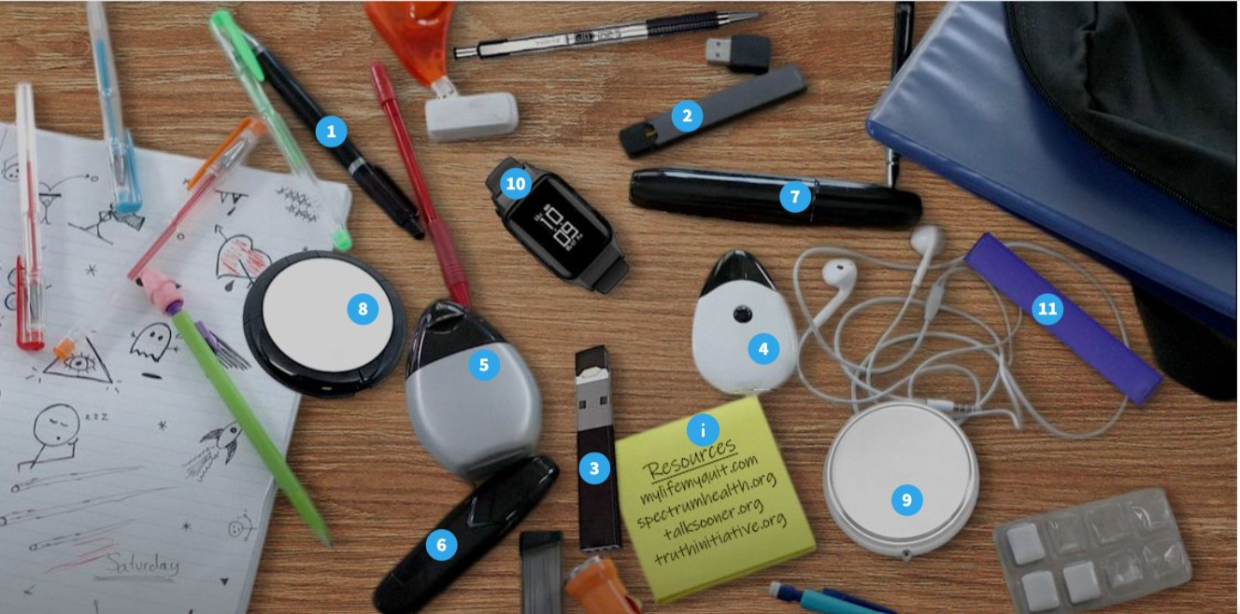
¿PUEDES VER LOS DISPOSITIVOS?
https://view.genial.ly/5f874bce0ba9f90d4e3c2503/interactive-image-can-you-spot-the-vaping-devices
Notes:
KEY POINT: Vapes can be hiding in plain sight.
VIRTUAL MODIFICATION: Place your cursor on each item and have participants use the chat box or reaction buttons to indicate if they think an item is a vape.
SCRIPT/INSTRUCTIONS: “As I mentioned vapes come in many different forms, making it difficult to even identify them. It is possible for vapes to hide in plain sight! For fun, let’s see if you can spot the vapes in this photo of what looks like the typical contents of a teen’s backpack.” (Point to various items and have participants raise their hands to indicate if they believe that item is a vape. If you are short on time, simply go to the next slide to reveal the answers.)

Slide 31
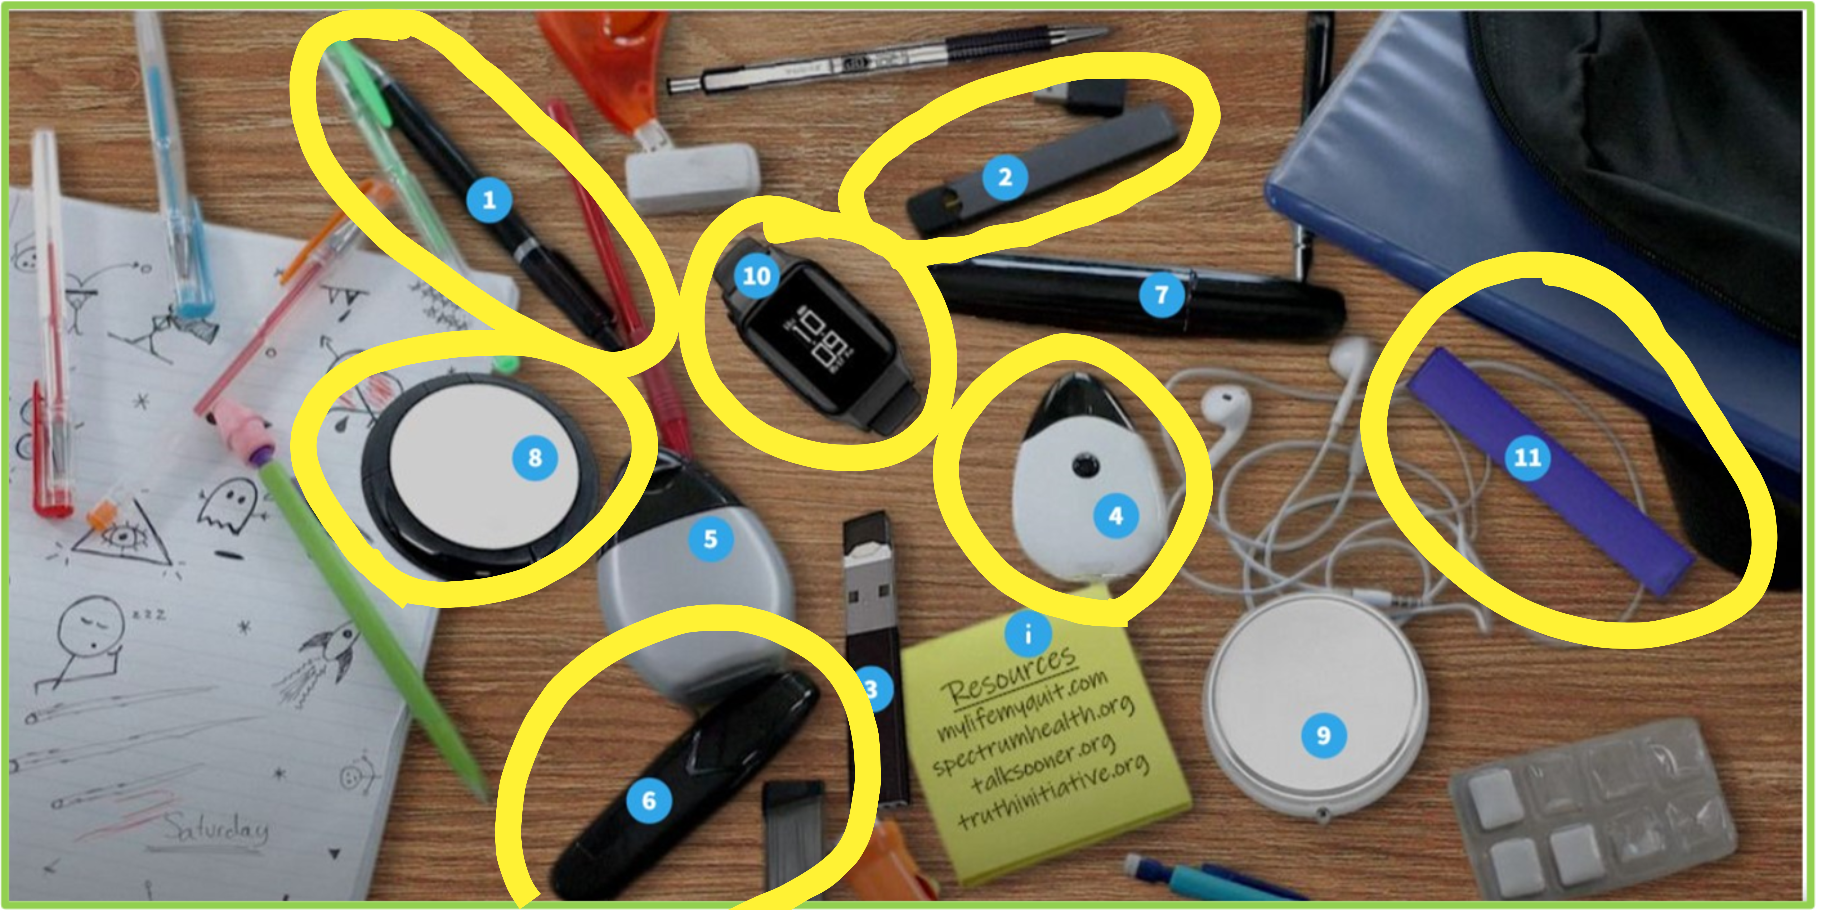
¿PUEDES VER LOS DISPOSITIVOS?
1. Pen Pal Stealth Vaporizer 2. JUUL 3. USB flash drive 4. Sourin Drop
5. MiO Liquid flavoring enhancer for water 6. Sourin Vagon Black 7. Black Sharpie 8. Khree UFO 9. Compact mirror 10. UwellAmulet Pod System 11. Puff Bar
Notes:
KEY POINT: Identify which are vapes and which aren’t.
SCRIPT/INSTRUCTIONS: “Let’s see how we did! Out of the 11 numbered items in this photo, 7 of them are actually vapes!” (As time allows you can point out which ones are vapes and show how they look very similar to other items in the photo that are not vapes.)

Slide 32
MITO
La marihuana es natural... ​
y por lo tanto segura de consumir durante el embarazo y alrededor de los niños.
Notes:
KEY POINT: Point out the common myth that marijuana is natural and that makes it safe to use while pregnant and around kids.
SCRIPT: “It’s time to talk about marijuana! I must admit I am not an expert on this topic and it’s not necessarily something we typically address with our tobacco prevention funding, but it is such an important topic that is sometimes intertwined with tobacco, so we knew we needed to include it. What I specifically want to focus on is how marijuana impacts children and that starts with dispelling the myth that marijuana is safe to use while pregnant or around children because it’s natural.”

Slide 33
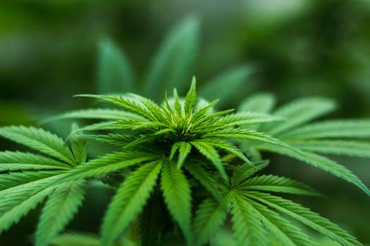
MARIHUANA
Muchos estados han legalizado alguna forma de
marihuana para uso médico o recreativo.
Dado que la marihuana proviene de una planta, a menudo existe un malentendido sobre sus efectos durante el embarazo y en los niños.
Notes:
KEY POINT: Even though marijuana comes from a plant it is not safe during pregnancy or to smoke around children.
SCRIPT: “I want to briefly touch on this timely topic as it relates to the health of children. Many states have legalized certain forms of marijuana for various uses, but it is currently illegal in Indiana. Because marijuana derives from a plant many people believe that it is safe, but the key point I want to convey is that marijuana is not safe to use during pregnancy or to smoke it around children.”

Slide 34
MARIHUANA: EMBARAZO Y MÁS ALLÁ
Efectos en la Salud
Nacimiento prematuro o muerte
Problemas de desarrollo cerebral
Síntomas de abstinencia
Problemas para dormir
Dificultades de atención, memoria y aprendizaje
Problemas de comportamiento
El THC y otras sustancias químicas de la marihuana pueden transmitirse a los bebés a través de la leche materna.
Una persona que está amamantando NO debe consumir marihuana.
Notes:
KEY POINT: Marijuana use during pregnancy or while breastfeeding has many negative health effects.
SCRIPT: “Marijuana use during pregnancy can lead to premature birth or still birth, brain development issues, withdrawal symptoms for the baby, trouble sleeping, attention, memory, and learning difficulties as well as behavior problems. Research has also shown that THC, the main chemical in marijuana, is passed to babies through breast milk. Therefore, it is not safe for someone who is breastfeeding to use marijuana.”

Slide 35

HUMO DE MARIHUANA DE SEGUNDA MANO
Niños expuestos al humo de marihuana de segunda mano:
Han mostrado rastros de THC en la orina.
Puede desencadenarse tener ataques de asma.
Puede experimentar reducción de memoria y coordinación
Notes:
KEY POINT: Exposure to secondhand marijuana smoke is harmful to children.
SCRIPT: “It is also not safe for children to be around secondhand marijuana smoke. Again, research shows that children exposed to marijuana smoke have traces of THC in their urine. This can also lead to asthma attacks and problems with memory and coordination.”

Slide 36
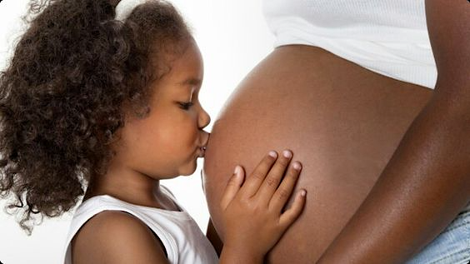
MARIHUANA
No existe un nivel seguro de exposición a...
El humo de la marihuana durante el embarazo o la lactancia
El humo de la marihuana de segunda mano para
bebés y niños
Notes:
KEY POINT: There is no safe level of exposure to marijuana smoke during pregnancy or while breastfeeding or for children being exposed to secondhand marijuana smoke.
SCRIPT: “The bottom line is that there is no safe level of exposure to marijuana smoke during pregnancy or while breastfeeding, and it is not safe for children to be exposed to secondhand marijuana smoke.”

Slide 37
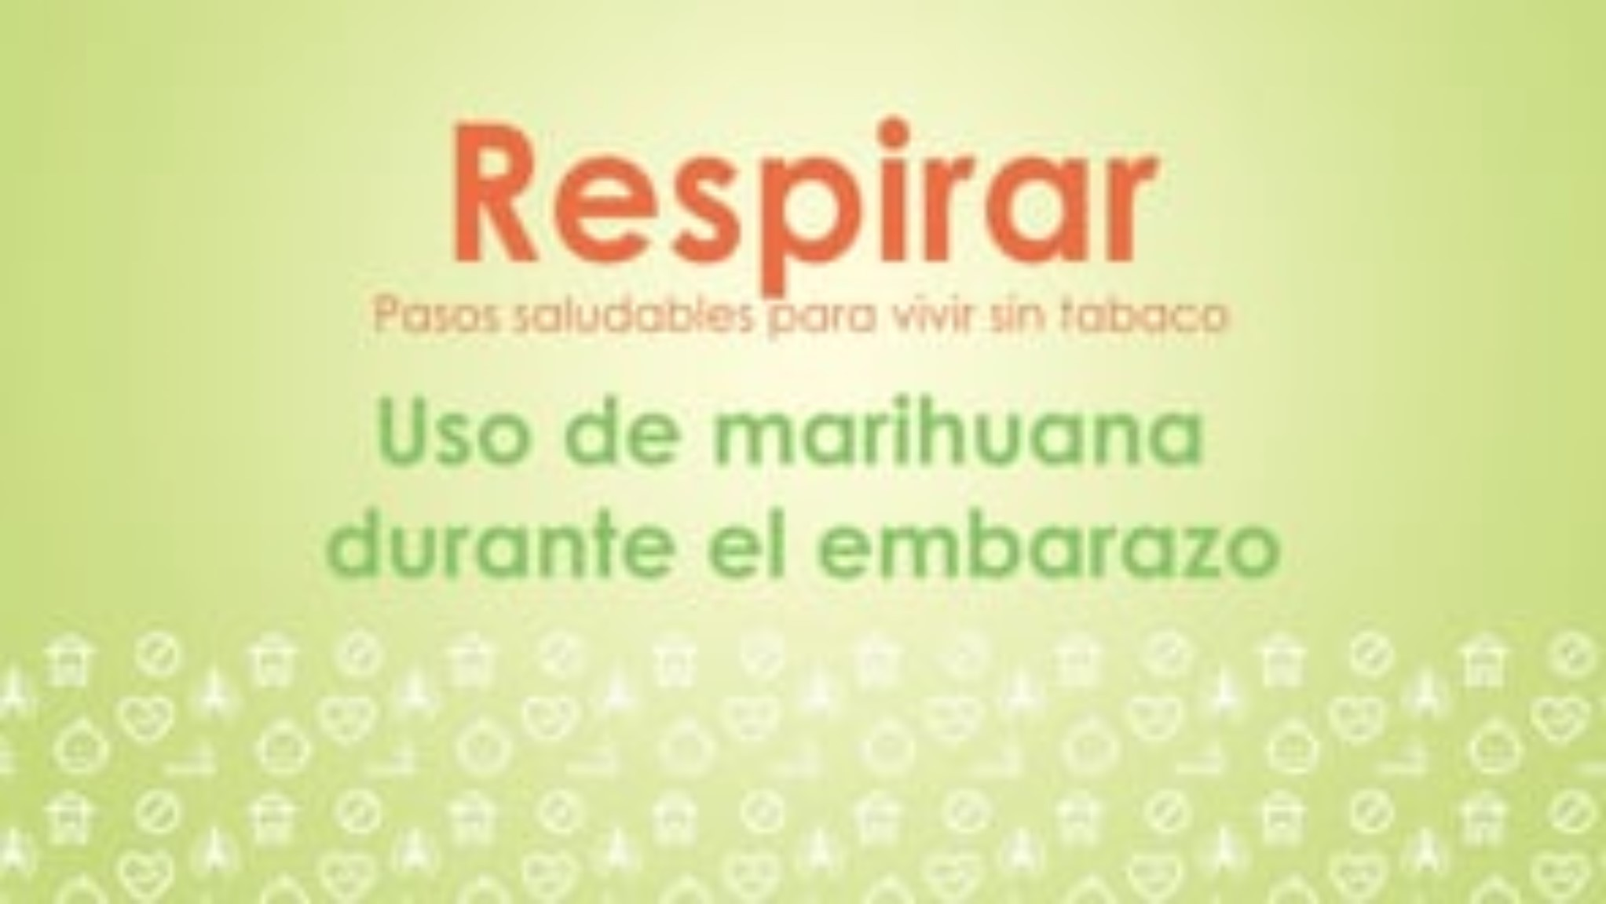
VIDE0 SOBRE LA MARIHUANA
Notes:
KEY POINT: This is another great video that Breathe offers on marijuana.
SCRIPT: “Now let’s watch this short video on marijuana.”

Slide 38
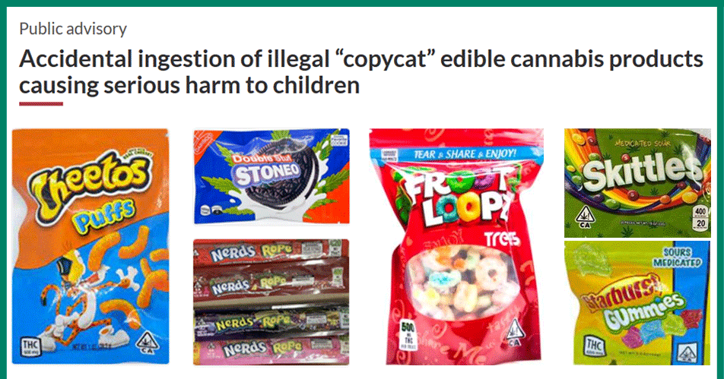
MARIHUANA
Gomitas – comestibles - productos con delta - bebidas con THC...
A menudo no están regulados o son ilegales, y son atractivos para los niños.
Notes:
KEY POINT: Marijuana comes in many different forms and can be a poison danger for children.
SCRIPT: “Smoking isn’t the only way people use marijuana or injest THC. There are gummies, homemade and storebought edibles, various Delta products, and drinks containing THC. At first glance it might look like this is a photo of popular snacks…but if you look closer you will see that they all include THC! Imagine a 4 year old coming across this bag of Cheetos or Skittles! When it comes to the safety of children it is important to keep all marijuana products out of reach of curious, young children.”

Slide 39
MITO
Es demasiado caro dejar de fumar
Notes:
KEY POINT: Using tobacco is expensive and there are lots of free resources to help people quit.
SCRIPT: “I’ve hit the negative health aspect of tobacco use pretty hard, so now let’s talk about money! A common misconception is that it will be expensive to quit, but I’m here to challenge that thought and counter with the reality that using tobacco products is what is truly expensive.”

Slide 40

HABLEMOS DE DINERO
El consumo de tabaco no sólo nos cuesta la salud, ¡sino también mucho dinero!
En Indiana el costo promedio de un paquete de cigarros es de $11
Fumar un paquete al día podría costar hasta $4,015 al año.
Los gastos adicionales incluyen visitas
al médico y medicamentos, además de tiempo libre en el trabajo y faltas a la escuela.
Notes:
KEY POINT: In addition to negative health effects, tobacco use also costs a lot of money.
SCRIPT: “A tobacco addiction can cost someone their health, but it can also cost a ton of money. And it just got even more expensive in Indiana! The cigarette tax increased as of July 1st and data shows that a substantial price increase leads more adults to quit and fewer youth to start smoking. We have already seen a huge spike in calls to Indiana’s tobacco quitline…more on that in a minute! The average price of a pack of cigarettes in Indiana is now $11. So someone who smokes a pack a day will end up spending over $4000 a year just on cigarettes. And if they smoke more than a pack a day that cost could really skyrocket. The tobacco industry will try to combat this with coupons and price promotions, but they aren’t trying to help the consumer…they are just trying to create lifelong customers by getting people addicted to nicotine. On top of the cost of the products themselves, prolonged tobacco use also leads to additional expenses for doctor’s visits and medications, plus the financial impact of missing work and school.”

Slide 41

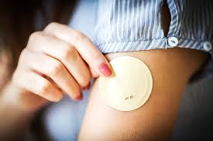


MEDICAID LO CUBRE
El Medicaid en Indiana cubre:
Asesoramiento
Terapias
de reemplazo
con Nicotina
Medicamentos
Recetados
Notes:
KEY POINT: Indiana Medicaid offers lots of cessation support.
SCRIPT: “Many people who use tobacco may say they can’t afford to quit, but using tobacco on a regular basis is what ends up being very costly! Fortunately, Indiana Medicaid offers lots of cessation support so anyone wanting to quit who is on Medicaid should look into this coverage. Indiana Medicaid covers cessation counseling as well as several proven nicotine replacement therapies (such as gum, lozenges, and patches), and medications that can help in their quit attempt. Even if someone doesn’t have Medicaid, they can review their health insurance plan as many other insurances also help with cessation support.”

Slide 42

VIDEO - EL COSTO DEL TABACO
Notes:
KEY POINT: Share the video on the cost of tobacco.
SCRIPT: “Now let’s watch our final video on the cost of tobacco.”

Slide 43
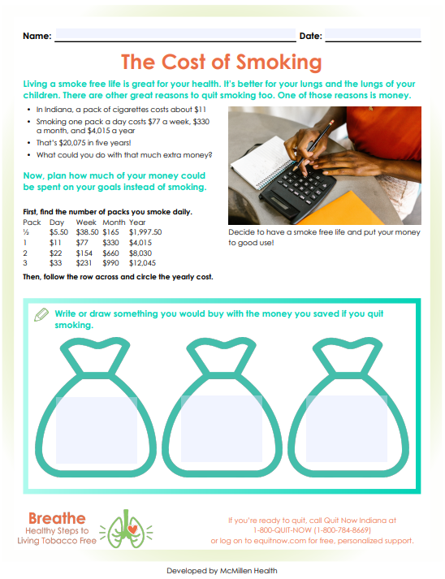
¿QUÉ HARÍAS CON $4,015?
Esta hoja de trabajo le ayuda a identificar cuánto le está costando el tabaco y las diferentes formas en las que podría gastar ese dinero si adopta un estilo de vida ¡libre de tabaco!
Notes:
KEY POINT: Use The Cost of Smoking worksheet to talk to parents about the financial impact of tobacco.
MATERIALS NEEDED: You can provide copies of The Cost of Smoking worksheet, if you choose, which can be found here: https://justbreathein.org/wp-content/uploads/2022/03/21.-Cost-of-Smoking.pdf
VIRTUAL MODIFICATION: Encourage participants type in the chat box how they would spend $2,190?
SCRIPTS/INSTRUCTIONS: “So how would you spend $4,015 if you had this much extra money? (Let a few participants share how they would spend this money. Then click twice to bring up the worksheet and text box.) I’m guessing everyone in this room would love to have this kind of extra money to be able to pay for necessities or what may seem like luxuries or even just to be able to save some money. The Cost of Smoking worksheet is a great tool to help identify how much you are actually spending on tobacco products and encourages you to think about other ways you could spend that money if you gave up tobacco.” (If you have time, you can have parents complete the worksheet or they could take it home. Since not all participants use tobacco, you could suggest sharing the worksheet with someone who does, rather than singling out and only giving the worksheet to some parents.)

Slide 44
MITO
Dejar de fumar es imposible
Notes:
KEY POINT: Quitting tobacco isn’t easy, but it is possible and there are lots of resources to help.
SCRIPT: “Whether you have ever tried to quit tobacco yourself or know someone who has, you know it is not a simple task. Tobacco addiction is real, but I want to challenge the idea that quitting is impossible and arm all of you with additional strategies and resources that can help you or someone you know who wants to quit.”

Slide 45
¡DEJALO YA!
Una de las mejores cosas que los padres pueden hacer por su propia salud y la de sus hijos es dejar el tabaco.​
​
Dejarlo también ayuda a mejorar los resultados de salud en nuestra comunidad y crea una mayor equidad en la salud.​
Pero usted no puede OBLIGAR a alguien a dejar el tabaco.
¡Dejarlo es difícil! Generalmente se necesitan entre 8 y 11 intentos para dejar de fumar con éxito.
¡El apoyo es vital y la ayuda está disponible!
Notes:
KEY POINT: You can’t make someone quit tobacco, but support is critical to their success.
SCRIPT: “Quitting is one of the best things parents can do for their own health as well as the health of their children. Quitting tobacco can also help our communities experience better health outcomes and help create improved health equity. But we all know that it is hard to quit! I can’t make you quit and you can’t make someone else quit. It has to be the individual’s choice. For those who are ready to quit there is lots of support. And if someone you love is ready to quit, you can help support them in a quit attempt. If you have ever tried to quit tobacco or know someone who has you know just how hard it can be. It actually takes someone on average 8-11 quit attempts to successfully quit for good. Each quit attempt is a step in the right direction so we want to support people when they make an attempt and acknowledge that setbacks are often a part of the process.”

Slide 46
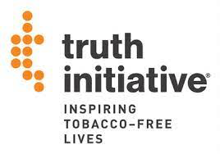
MÁS AYUDA PARA DEJAR DE FUMAR
Consulte a su proveedor de atención médica​
Sugiera a los padres que pregunten sobre las terapias de reemplazo de nicotina (NRT)​
En el estado de Indiana, los medicamentos para dejar de fumar ya no necesitan receta médica​
Truth Initiative- Textea DITCHVAPE al 88709​
Sistema de mensajería de texto anónimo para adolescentes y adultos jóvenes que quieren dejar de vapear
Notes:
KEY POINT: Provide additional quit resources and suggestions.
SCRIPT: ““Whether you are trying to quit or supporting someone who is, you don’t have to be the expert on quitting. To find help with quitting tobacco, talk to a healthcare provider about quitting and getting nicotine replacement therapies, such as nicotine gum, lozenges, patches, or medications.. A few years ago Indiana passed a law to minimize barriers to accessing tobacco cessation medications by no longer requiring a prescription, so people can even go straight to the pharmacist to get nicotine replacement therapies if they want. The Truth Initiative also offers quit help for geared towards youth and young adults and can be accessed by texting DITCHVAPE to 88709.”

Slide 47

QUITNOW INDIANA
GRATUITO y Disponible 24/7
Asesor Experto para
Dejar de Fumar
>> Llamada, Mensaje de Textoo,
En Línea o por la Aplicación​
>> Plan de Abandono, Personalizado
    Terapias de Reemplazo de Nicotina (TRN) GRATUITAS, según disponibilidad
1-800-Quit-Now (784-8669)
1-855-DÉJELO-YA (Spanish)
1-877-777-6534 (TTY)
Text READY to 34191
Text LISTO to 34191 (Spanish)
quitnowindiana.com
Notes:
KEY POINT: There are lots of resources available for those who want to quit.
SCRIPT: “Another great option for quit support is Quit Now Indiana. Quit Now Indiana is free and available 24/7. A trained quit coach will help you or someone you love create a customized quit plan just for them. People can call, text, go online or use the app to access services in whatever way works best for them. Quit Now Indiana has a dedicated number for those who speak Spanish and other language services are available as well as TTY capabilities for those who are deaf or hard of hearing.”

Slide 48
PROGRAMAS ESTÁNDAR Y PERSONALIZADOS DE QNI
Programa (autorreporte) | Sesiones | NRT | Ofrece | Duración (subject to change)
Embarazo | 7 | Si* | Parche o Goma de Mascar | 4 semanas
Salud Conductual | 7 | Si | Parche o Goma de Mascar | 4 semanas
Jóvenes en Linea | 6 Pasos | No | N/A | N/A
Aumento de Mentol | 5 or 7 | Si | Parche o Goma de Mascar | 4 semanas
Adulto Estandar | 5 | Si* para los que califican | Parche o Goma de Mascar | 4 semanas
Notes:
KEY POINT: Quit Now Indiana handouts are free to order and are great resources to have on hand.
SCRIPT: “Quit Now Indiana offers specialized services for youth ages 13-17, as well as for pregnant people, those with behavioral health issues and people who use menthol products as each of these populations may need a unique approach. This chart breaks down the current offerings for the standard adult as well as these four specialized programs including the amount of NRT available (subject to change).”

Slide 49
¿PREGUNTAS?
Notes:
KEY POINT: I am happy to answer any questions now or in the future.
I
VIRTUAL MODIFICATION: Check the chat box for any questions that may have been posted during the training and let participants know they can post questions in the chat box or unmute to ask questions now.
SCRIPT: “I know we covered a ton on information and we are about out of time for today. I would love to answer any questions you may have as time allows.”

Slide 50
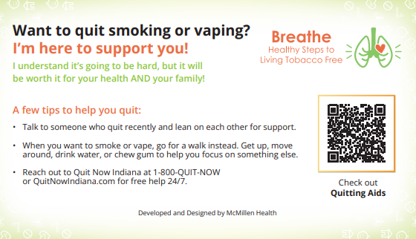
Notes:
KEY POINT: Let parents know you are her to offer support.
MATERIALS NEEDED: Print out and cut Pocket Guides with Quitting Tips, which can be downloaded here: https://justbreathein.org/wp-content/uploads/2024/09/Pocket-Fact-Sheet-Quitting-w-cut-marks.pdf
SCRIPT: “As we wrap up, I just want to remind you that I am here to support anyone who is ready to quit using tobacco. As a reminder, feel free to take one of the pocket cards and it also has some additional tips and resources that could be helpful to someone who is considering quitting.”

Slide 51
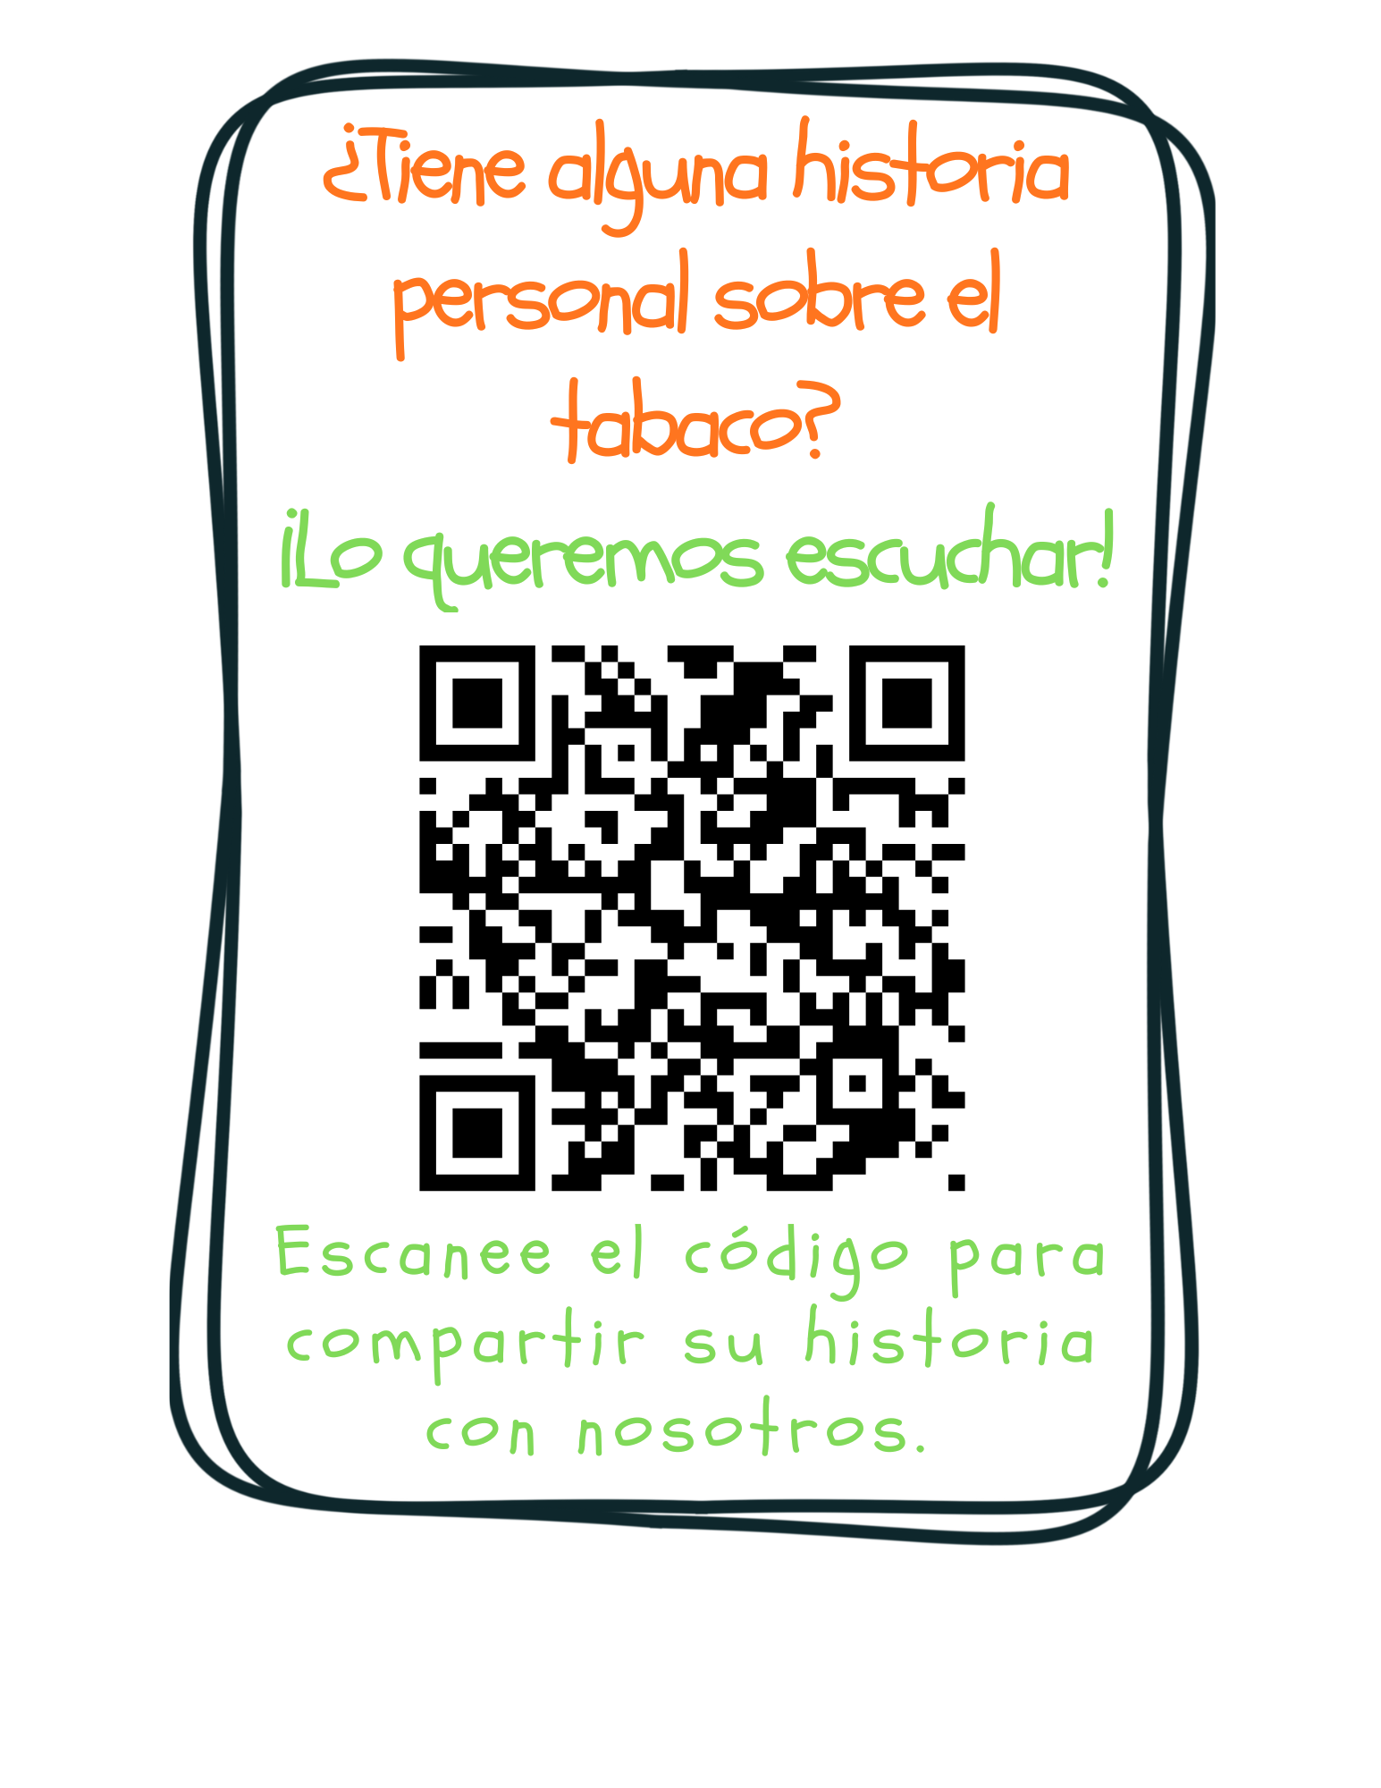
Notes:
KEY POINT: Ask for personal stories about tobacco.
VIRTUAL MODIFICATION: Post this link in the chat box: https://www.surveymonkey.com/r/tobaccostory
SCRIPT: “We love answering your questions as well as hearing stories about how tobacco has affected you, the people you love, and the families you serve. We don’t have time to hear all those great stories today, but we encourage you to share those stories with us at this link, which you can also find on the Breathe website and in the monthly newsletters. Tobacco isn’t just about stats, it’s about people and sharing stories about tobacco helps us all make a personal connection to this important work we are doing. We look forward to hearing your stories!”

Slide 52


¡¡GRACIAS!!
Tanya Shelburne, Project Manager
tanyas@healthedpros.org
317-902-4505
Alison Mucherheide, Tobacco Control Specialist
alisonm@healthedpros.org
Notes:
KEY POINT: Share contact information.
SCRIPT/INSTRUCTIONS: (Personalize this slide with your contact information.) “Thank you so much for attending today’s presentation. If you have questions in the future don’t hesitate to reach out. I will also hang around for a little while if you have additional questions.”

Slide 53
FUENTES DE DATOS​
2023 Indiana Behavioral Risk Factor Surveillance System (BRFSS)
www.in.gov/health/tpc/
www.cdc.gov/tobacco/
www.cancer.org/cancer/risk-prevention/tobacco
For a more detailed list of data sources used
to create Breathe materials go to
justbreathein.org/additional-resources/data-sources/
Notes:
KEY POINT: Share basic data sources and where they can find more.
SCRIPT/INSTRUCTIONS: (You can just leave this slide up for people to see or refer to it if anyone asks about the source of information you shared.)

