Slide 1


HEALTH ED PROS
Tanya Shelburne MPH, CHES
Alision Mucherheide BS
Notes:
KEY POINT: Participants should know your name and a bit about your background and position.
MATERIALS NEEDED: Sample Breathe kit and Quit Now Indiana materials
VIRTUAL MODIFICATION: Make plans with your site contact to deliver Quit Now Indiana materials either before or after the training.
INSTRUCTIONS: Personalize this slide with your information. Welcome everyone to the Breathe Teaser, introduce yourself, and give a brief background on your experience, your organization, and your position. Bring materials to the training (sample breathe kit, Quit Now Indiana materials, etc.) but do not distribute them until the end of the training as some attendees will leave/not pay attention if materials are distrusted too early.

Slide 2
Guidelines for Virtual Training
Training is being recorded
Mute yourself when not speaking
Minimize distractions
Interact!!! (chat box, unmute)
Notify co-host if you have issues
Notes:
DELETE THIS SLIDE IF CONDUCTING AN IN-PERSON TRAINING!
KEY POINT: Go over housekeeping and expectations for the training.
SCRIPT/INSTRUCTIONS: (Personalize this slide as needed.) “Now before we jump into the actual training, I want to go over a few housekeeping items. I want to make sure everyone is aware that the training is being recorded and I will share a link to the recording in a follow up email in a day or two should you want to watch it again or share it with someone on staff who may have missed the training. Please keep yourself on mute to minimize background noise and just unmute yourself when you want to share something or ask a question. Do your best to minimize distractions around you. We only have a short time today so I’m going to talk fast! But hopefully we will have some time to interact so feel free to use the chat box or raise your hand at any time. If you have any issues during the training feel free to message the co-host and we will try to assist.”

Slide 3

BREATHE VIDEO
Notes:
KEY POINT: Show the Breathe Promo video.
SCRIPT: “Today we only have time for a brief teaser of our Breathe program, but I want to start by sharing our short Breathe Promo video that will give you a better idea of the full program and all the free materials available once an organization completes the full training, which I would be happy to discuss with your leadership whenever they are ready.”

Slide 4
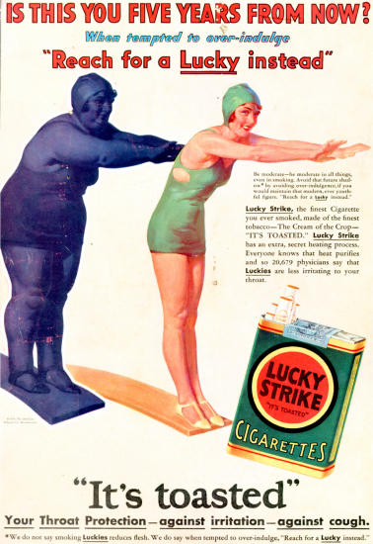
SETTING THE STAGE
Tobacco Industry spends billions of dollars aggressively marketing deadly products
Notes:
KEY POINT: The tobacco industry spends a lot of money to aggressively market deadly products.
SCRIPT/INSTRUCTIONS: (STAY ON BLANK SLIDE) “Next I want to set the stage and provide some context for the tobacco burden here in Indiana and all across the country.
(DOUBLE CLICK) For many decades the tobacco industry has been hard at work creating and selling addictive products that when used as directed lead to all kinds of negative health outcomes, including death. Billions of dollars are spent by the tobacco industry to market their deadly products, and Big Tobacco uses targeted and aggressive marketing strategies to prey on certain populations, thereby creating health disparities. Here you can see a very old ad encouraging women to take up smoking as a way to lose weight. The tobacco industry is still aggressively marketing to women with new and deceptive strategies as well as targeting many other groups of people.

Slide 5
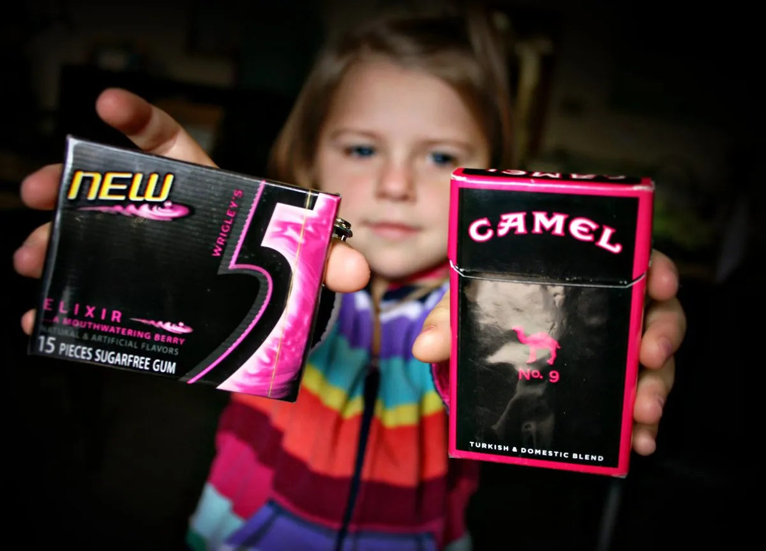

TOBACCO MARKETING
Point-of-Sale Marketing
Packaging mimics popular candy
Notes:
KEY POINT: Point-of-sale marketing and design of products is aimed at attracting youth.
“As laws restricted certain forms of advertising for tobacco products, point of sale marketing became a key focus for the tobacco industry. Tobacco promotions are specifically placed near products that appeal to children, such as candy and ice cream.
(DOUBLE CLICK TO IMAGE OF GUM AND PACK OF CAMELS AND TEXT) They use colorful packaging that often mimics popular candy and gum and tobacco companies also use candy and fruit flavors in many of their products to appeal to youth in an attempt to create lifelong customers.

Slide 6
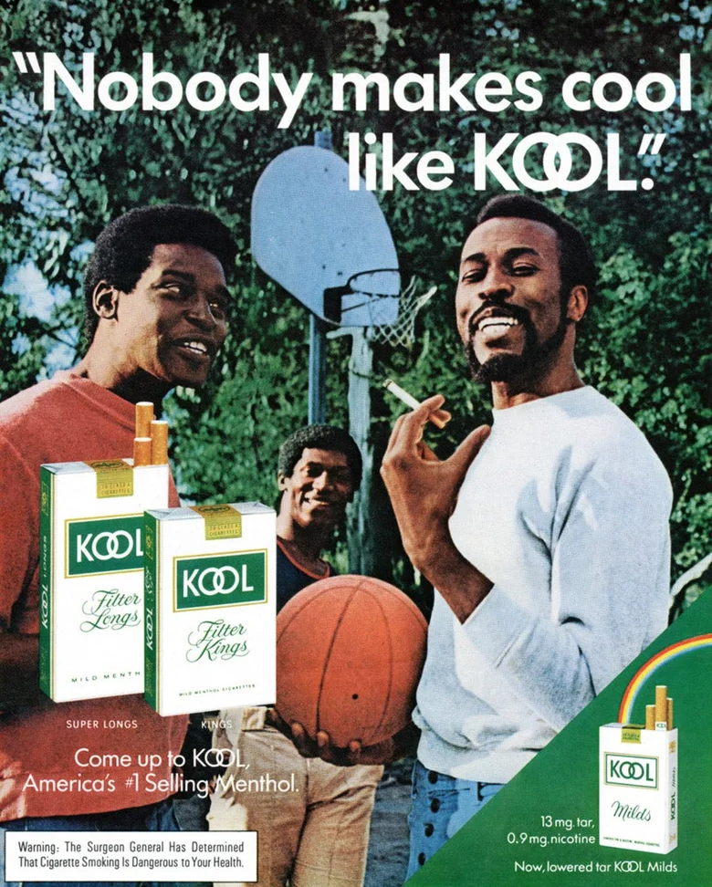

TARGETED MARKETING
Heavy advertising in low income neighborhoods
Menthol products & African Americans
Notes:
KEY POINT: The tobacco industry uses aggressive and targeted marketing strategies aimed at marginalized populations, such as communities with low income households and African Americans, creating further health disparities.
“The tobacco industry aggressively targets and markets their products to various marginalized groups, including people of color, those living in rural communities, and to people who identify as LGBTQ+. Higher levels of advertising, discounts, and displays of tobacco products are strategically placed in communities with lower household incomes.
(DOUBLE CLICK) Another example is the overt marketing strategy seen with Menthol cigarettes being targeted to African Americans over several decades. When flavored cigarettes were banned the tobacco industry lobbied hard for Menthol cigarettes to be excluded from the ban, which created a higher burden of tobacco for African Americans.”

Slide 7
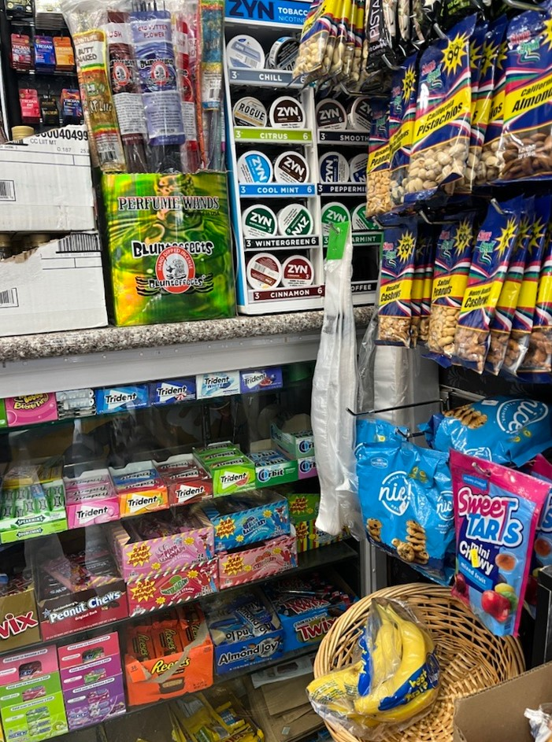
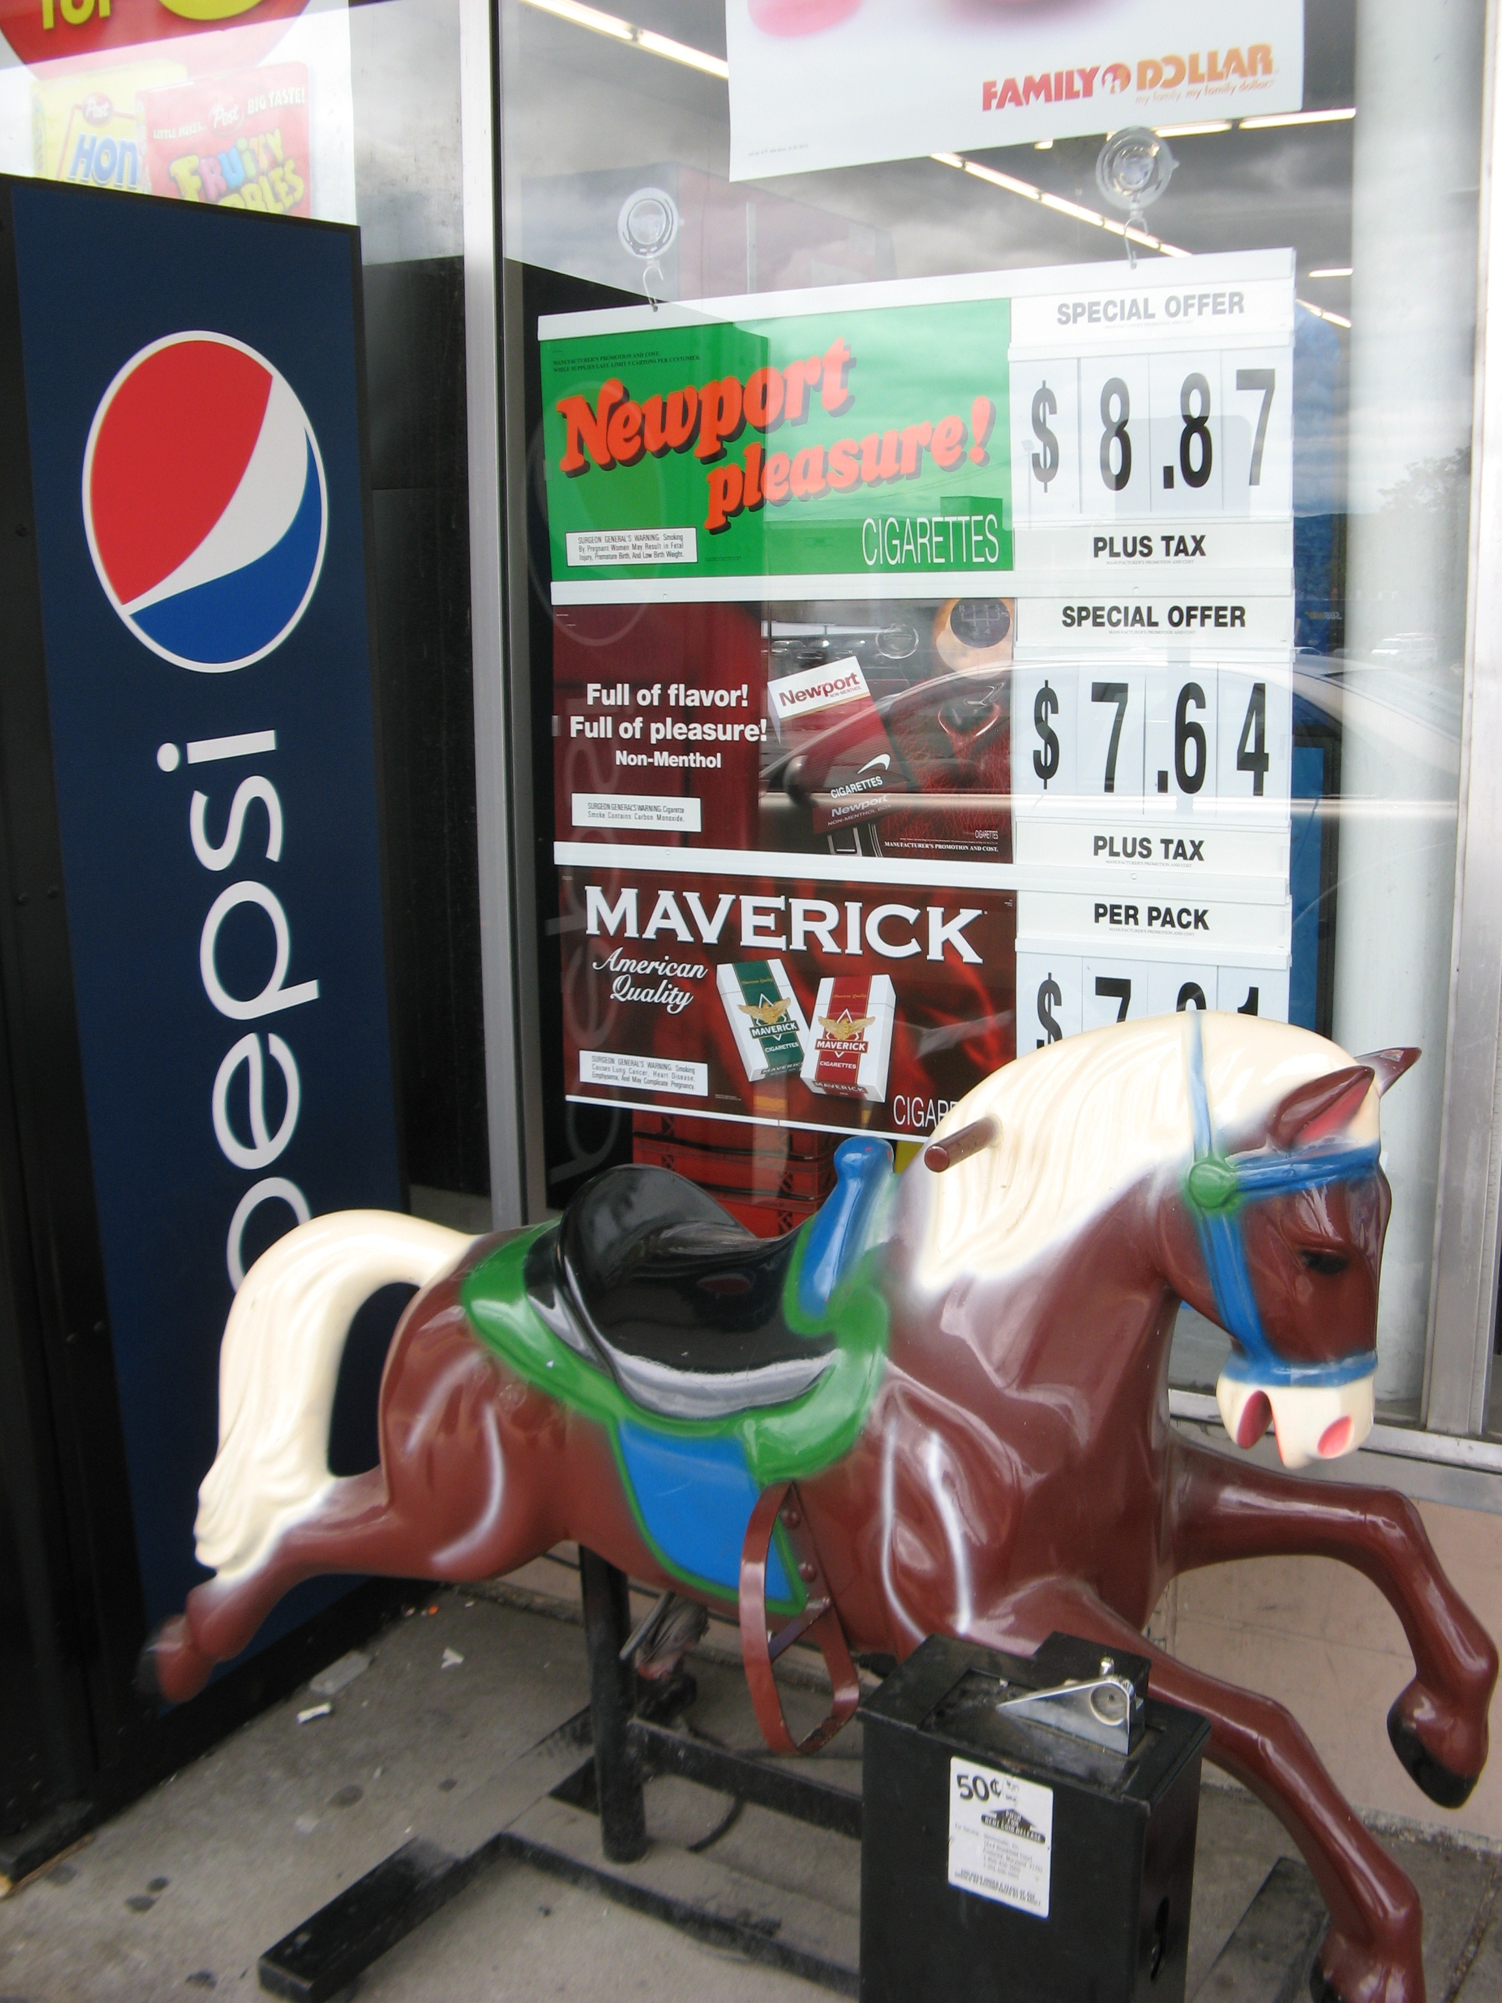
TARGETED MARKETING
Big Tobacco is at work in our community!
Tobacco Industry develops new products to
get around laws and recruit new customers
Notes:
KEY POINT: The tobacco industry is at work in this community.
“As new laws are put in place to protect Americans from these dangerous products and the negative effects of secondhand smoke, the tobacco industry continues to innovate and develop new and addictive products in an attempt to get around laws aimed to protect all Hoosiers, and exploitation of marginalized populations continues. I want to be clear that the Breathe program is not against people who use tobacco. I am here to provide education, support, and resources so that each of you can effectively communicate with the parents and families you serve in a non-judgmental way so they can make informed decisions for their families.
(CLICK TO YELLOW BAR) The reality is that Big Tobacco is at work right here in this community…but there is a lot we can do to support the health of families and fight against the tobacco industry’s dangerous tactics…and that starts with educating ourselves! And that’s why we want to partner with your organization and join together to reduce the burden of tobacco!”

Slide 8
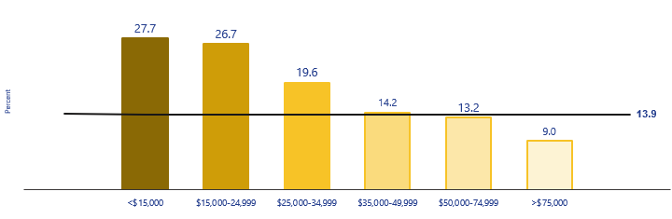
INDIANA TOBACCO STATS
13.9% of Indiana adults currently smoke*
And 9.2% of Indiana adults currently use e-cigarettes*
    *Data from 2024 Indiana Behavioral Risk Factor Surveillance System (BRFSS)
    Part of “Tobacco Nation” – 12 Midwestern/Southern States with nearly 50% higher smoking rates
        Smoking is much higher among people on Medicaid
        and those with low incomes*
Notes:
KEY POINT: While smoking has decreased over the past few decades various forms of commercial tobacco use continues to remain high.
SCRIPT: “I won’t bore you with too many stats today and honestly the data can get pretty complicated as there are so many different ways to look at it and dissect the data. But I do want to give you an idea of the current tobacco burden here in Indiana. While traditional smoking has decreased over the past several decades 13.9% of Hoosier adults smoke traditional cigarettes and 9.2% use e-cigarettes. Unfortunately, we know that many adult tobacco user actually use multiple forms of commercial tobacco products. Sadly, Indiana falls into the part of the country deemed “Tobacco Nation”, which includes 12 Midwest and Southern states where the smoking rate is nearly 50% higher than in other parts of the country. As I mentioned earlier the tobacco industry preys on low income communities and that is a huge factor in the smoking rate being so much higher for those on Medicaid and with low incomes, as evidenced by this chart. For those making less than $15,000 a year, the smoking rate is 27.7%, compared to 9% among Hoosiers earning over $75,000 a year. This is just one reason why it is so important to us to partner with Head Start and other organizations that serve families with low incomes. We believe all families deserve access to healthy smoke free environments and accurate health information.”

Slide 9
INDIANA TOBACCO STATS
3.8% of Indiana residents reported smoking
during their pregnancy
*2024 BRFSS data
1 in 4 non-tobacco users are exposed to secondhand smoke
(Primarily African Americans, people with low incomes,
and those who live in multiunit housing)
About 1,300 Hoosiers die each year
from SOMEONE ELSE’S smoking!
Notes:
KEY POINT: Additional data sheds light on the tobacco burden for various populations.
SCRIPT: “We also know that 3.8% of pregnant people in Indiana reported smoking during their pregnancy. In some Indiana counties the smoking rate during pregnancy is over 12%, so we clearly still have some work to do in this area. We know this is a concern for many of you who want to help ensure healthy pregnancies and a good start to life for Hoosier babies and we will cover the negative health effects related to this stat in just a bit. Even those who don’t smoke suffer negative health effects and even death from exposure to secondhand smoke. Again, the burden in disproportionate with African Americans, people with low incomes, and those who live in multiunit housing being more likely to be exposed to secondhand smoke. It is rather sobering to realize that around1,300 Hoosiers dies each year due to someone else’s smoking.”

Slide 10

TOBACCO USE DURING PREGNANCY
  Health Effects
Preterm Labor
Miscarriage
Low Birth Weight
Placenta Complications
Slowed Development of Baby’s Brain
  Baby Experiences Withdrawal Symptoms
  Increased Heart Rate & Blood Pressure During Pregnancy
Notes:
KEY POINT: Tobacco use during pregnancy leads to many negative health effects for both the adult and the baby.
SCRIPT: “Because we do have higher rates of smoking while pregnant in Indiana, it is critical that pregnant people understand the impact of tobacco use on their unborn baby. Tobacco use during pregnancy can cause preterm labor, miscarriage, low birth weight, problems with the placenta, and slow development of the brain. Babies will also experience withdrawal symptoms after birth. The pregnant person may experience increased heart rate and blood pressure. There is a myth a low birth weight is a good thing and will make delivery easier…which is not true and is not healthy for the baby!”

Slide 11

TOBACCO USE DURING PREGNANCY
Quitting smoking while pregnant will help the baby NOW and AFTER they are born.
  THERE IS NO SAFE AMOUNT OF TOBACCO USE DURING PREGNANCY!
Notes:
KEY POINT: There is no safe amount of tobacco use during pregnancy.
SCRIPT: “The good news is that no matter how far along someone is in their pregnancy, stopping tobacco use will help the baby! Not only will it help the baby before birth, but if a baby is born into a smoke free home they will not have all of the dangerous health impacts of secondhand and thirdhand smoke in the future. The bottom line and what we want to stress to pregnant people is that there is no safe amount of tobacco use during pregnancy.”

Slide 12

SECONDHAND SMOKE: PREGNANCY
Even if someone does NOT use tobacco, secondhand smoke can cause SERIOUS problems with their pregnancy such as:
      Preterm Delivery
  Stillbirth & Miscarriages
  Sudden Infant Death Syndrome
  Ectopic Pregnancy
  Under Developed Fetus
  Heart Defects
  Orofacial Clefts
  Low Birth Weight
Notes:
KEY POINT: Being around secondhand smoke is also dangerous for pregnant people and can lead to some of the same health problems as smoking.
SCRIPT: “Even if someone does not use tobacco themselves, if they are exposed to secondhand smoke, it can cause problems with the pregnancy. I won’t read the whole list of possible negative health outcomes, but you will notice that many are the same ones that can result from direct smoking during pregnancy. It is very important to avoid secondhand smoke during pregnancy for their own health and the health of their baby.”

Slide 13

SECONDHAND SMOKE: CHILDREN
Secondhand smoke is especially harmful to children because their lungs and brains are still developing and can cause:
      Ear Infections
      Bronchitis
      Pneumonia
      Asthma Attacks
      Learning Difficulties
      Cancer & Heart Disease in Adulthood
Notes:
KEY POINT: Secondhand smoke also has lots of negative health effects for children who are exposed.
SCRIPT: “Beyond pregnancy, Secondhand smoke is also harmful to children as their lungs and brains are still developing. Long-term secondhand smoke exposure can cause these children to have health issues now and in the future. Children who are around secondhand smoke may get frequent ear infections, suffer from bronchitis, pneumonia, and asthma attacks. They may also experience learning difficulties and even develop cancer or heart disease later in life. Sharing this information with parents can help them make informed decisions for their children's future!”

Slide 14
THIRDHAND SMOKE
      Thirdhand smoke is what you smell on clothes, in homes,
      or cars after someone has been smoking.
      Chemicals stick to clothing, furniture, carpet, curtains, hair, car seats, toys & pets long after the smoking has stopped.
      Thirdhand smoke CANNOT be removed by opening windows, using fans/air conditioners, or smoking in only one room.
Notes:
KEY POINT: Thirdhand smoke may be less well-known, but it also exposes children to the same dangerous chemicals as secondhand smoke.
SCRIPT: “I’m sure you have all heard of secondhand smoke, but Thirdhand smoke may not be as familiar. Thirdhand smoke is the lingering odor and harmful chemicals left behind when someone smokes in an area. The dangerous chemicals in smoke stick to everything…clothes, furniture, carpet, curtains, hair, carseats, toys, and even pets, and they can cause serious health problems. Unfortunately, these chemicals can’t simply be removed by airing out the room.”

Slide 15

THIRDHAND SMOKE
Who is at risk from Thirdhand Smoke?
EVERYONE!
Especially infants & young children
  Infants put everything in their mouths
  Children held by people who smoke are exposed to thirdhand smoke chemicals on skin, clothing & hair
  Infants breathe in FOUR times as many chemicals as an adult from walking across the same area
Notes:
KEY POINT: Infants and Children are at high risk from thirdhand smoke.
SCRIPT: “Everyone is at risk from thirdhand smoke, but this can be especially harmful for infants and children. We all know that babies love to put everything in their mouths! So if someone smoked in that area, even when the baby wasn’t around, they are still ingesting the chemicals left behind by thirdhand smoke. If someone who smokes holds a tiny baby close to them that baby is taking in all the chemicals and toxins that are lingering on their hair and clothes. And when infants and toddlers crawl around on the floor they kick up all the toxins that have fallen on the floor and breathe them in. Simply because of their size and how they breathe infants take in four times as many chemicals as an adult would in the same area, which can damage their growing bodies.”

Slide 16

THIRDHAND SMOKE VIDE0
Notes:
KEY POINT: Breathe offers several short videos that can be shown to parents, like this one on Thirdhand smoke.
SCRIPT: “Let’s watch this short video on thirdhand smoke, which is just one of over 20 videos available in the Breathe kits for our fully trained partners.”

Slide 17

PLACES CHILDREN ARE EXPOSED
Common places children are exposed to Second and Thirdhand Smoke:
      In their home
      In cars
      In public places
      At a caregiver/relative’s house
      At parks or playgrounds
      Near entrances to stores and restaurants
Notes:
KEY POINT: There are lots of places where children could be exposed to secondhand smoke.
SCRIPT: “Some common places children are exposed to second and thirdhand smoke include their own home or in cars as well as public places that are not covered by a comprehensive tobacco ordinance. Relatives and caregivers houses is a big one and can be difficult situations, especially when children travel back and forth between two parents’ homes and one household allows smoking and the other doesn’t. Parks and playgrounds are another place where children often spend time yet people may smoke around them. And even though there is a law in Indiana that prohibits smoking near the entrances of stores and restaurants this is hard to enforce so exposure still happens. It’s important to help families identify where their children may be exposed to second and thirdhand smoke and then help them make a plan to eliminate or at least minimize that exposure.”

Slide 18

HOW WE CAN PROTECT CHILDREN
      Educate parents/caregivers
      Quit smoking
      Smoke outside
      Do not smoke in the car
      Wear a smoking jacket
      Support smoke-free businesses
      Allow children to only be in smoke free homes & cars
      Increase awareness of deceptive tobacco industry marketing
      Pass policies (homes, businesses, local, state, federal levels)
Notes:
KEY POINT: Quitting is a great way to protect children from second and thirdhand smoke but if parents are not ready to quit there are lots of baby steps they can take.
SCRIPT: “So how can we protect children from second and thirdhand smoke? Education is a great first step, and that’s why we are here today! Of course, if parents quit smoking that is the best way to protect their own health as well as their family’s health. But even if they are not ready to quit, there are lots of other things they can do to minimize exposure for their children such as designating their home as smoke free and only smoking outside, and also not smoking in the car. They can wear a smoking jacket and peel off that outer layer of thirdhand smoke before coming around their children. Supporting smoke-free businesses is another great idea and only allowing children to be in smoke free homes and cars. This may require some difficult conversations with family members and caregivers but those conversations should always come back to what is best for the children’s health. We can increase awareness of the deceptive marketing tactics of the tobacco industry as well as pass policies that protect everyone from second and thirdhand smoke. These policies can be official laws at all levels of government as well as the rules we put in place in our own homes and businesses. Encourage parents to take baby steps and reinforce that even small steps in the right direction can help protect their children.”

Slide 19
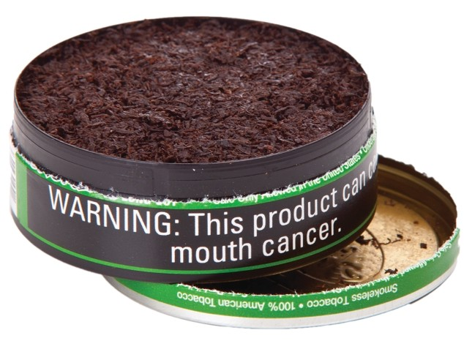
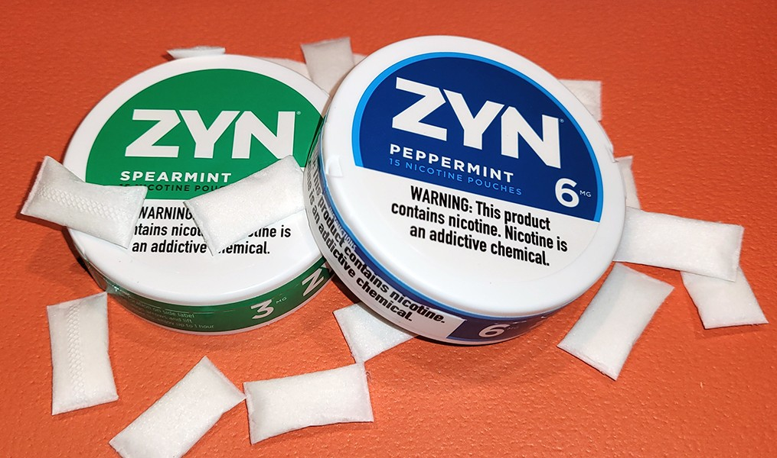
SMOKELESS TOBACCO/NICOTINE POUCHES
Smokeless Tobacco increases risk of:
Certain cancers
  Stillbirth, if pregnant
  Stroke & heart disease
Nicotine Pouches:
      Popular with youth, flavors
Powder dissolves (spitless)
Nicotine absorbed through gums/lining of mouth
  Children can ingest smokeless tobacco
  and become poisoned
Notes:
KEY POINT: Smokeless tobacco doesn’t carry the risk of secondhand smoke, but it still dangerous for the user and if children get ahold of smokeless products.
SCRIPT: “There is not the same risk of second and thirdhand smoke with smokeless tobacco, however it does carry many health risks for the user, including pregnant people. Smokeless tobacco now comes in many different forms, including small pouches. These are actually spitless and they are gaining in popularity with youth. Zyn is just one popular brand of nicotine pouches and they come in flavors that may make them more appealing then traditional smokeless/chewing tobacco. These flavors and minty smell might also make these products intriguing to very small children so it is important to remind parents that Smokeless tobacco products should not be left where children can get them. If they eat or put these products in their mouths they could experience nicotine poisoning, which can very dangerous.”

Slide 20
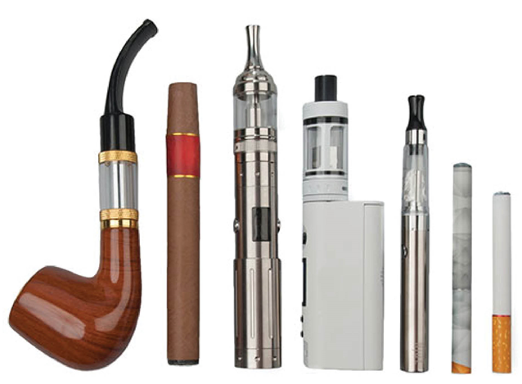

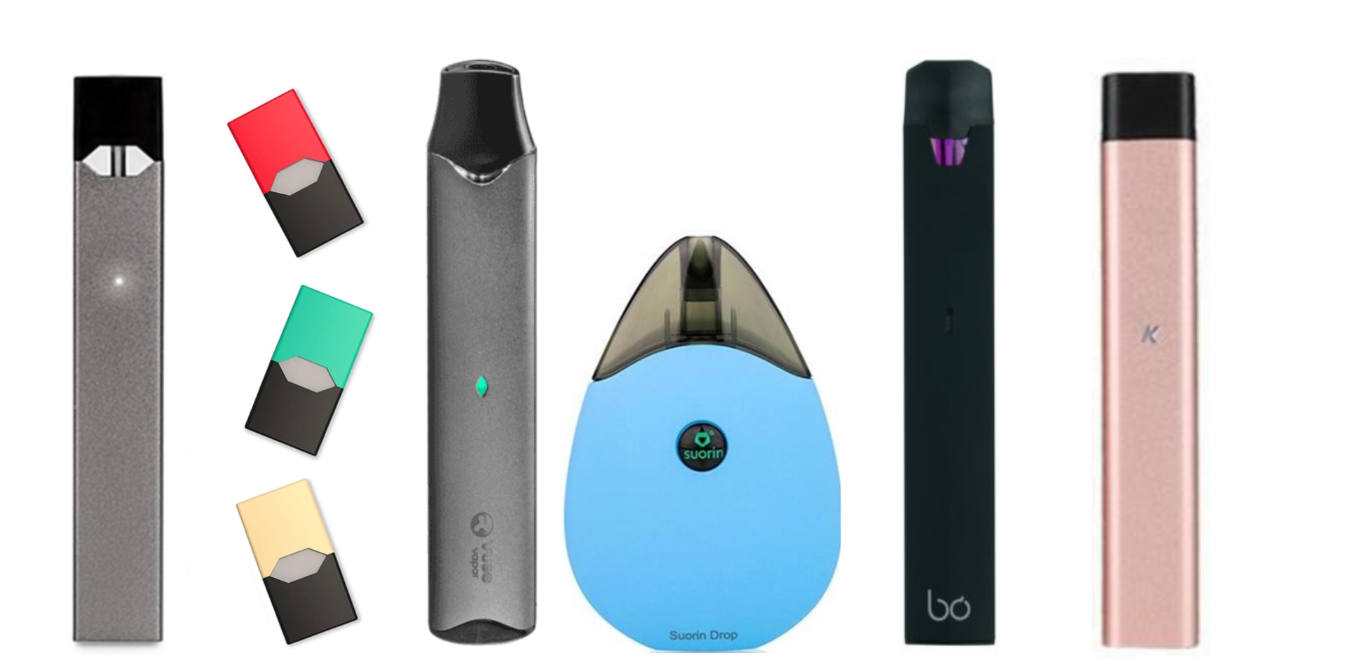
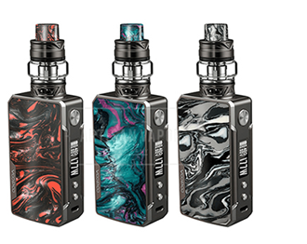
E-CIGARETTES AND VAPING
E-cigarettes DO NOT just emit water vapor, but rather aerosol
E-liquids contain ingredients similar to regular cigarettes such as lead & other
dangerous chemicals
E-cigarettes and vapes come in many different forms
MYTH BUSTER:
E-cigarettes are NOT a proven cessation tool
Notes:
KEY POINT: E-cigarettes/vapes are not safe and are not proven cessation tools.
SCRIPT: “Whether you use the term e-cigarettes or vapes, this is a very hot topic that we get lots of questions about. Vaping has grown in popularity tremendously over the past ten+ years and there is a lot we are still learning about the negative health impact of these products. It is important to understand that e-cigarettes don’t emit harmless water vapor, but rather an aerosol that contains many of the same dangerous chemicals found in traditional cigarettes. Vapes come in many different forms. Some look like flashdrives or highlighters. Some come with pre-filled pods and some can be refilled with e-juice. It is important to know that e-cigarettes are not a proven cessation strategy. Many people who smoke and then start vaping actually end up dual using or just continue vaping and don’t actually quit.”

Slide 21

E-CIGARETTES AND VAPING
E-liquids contain nicotine, which is extremely addictive
Nicotine poisoning can be deadly
Occur if a person drinks, sniffs, or touches e-liquid
E-cigarette batteries can explode, causing severe burns.
It is NOT SAFE to vape around children!
Don’t leave VAPING PRODUCTS around children!
Notes:
KEY POINT: It is not safe for young children to have access to vapes/e-cigarettes and e-juice.
SCRIPT: “Research is still being done on the long-term effects of vaping and the FDA is slowly starting to regulate these products. We do know that E-liquids contain nicotine, which is extremely addictive, and nicotine poisoning can be very dangerous for children if they drink the e-juice or just get it on their skin. The batteries in e-cigarettes have also been know to explode. It is important that parents understand that it is not safe for young children to have access to vapes and e-juice or to be around people who are vaping. ”

Slide 22
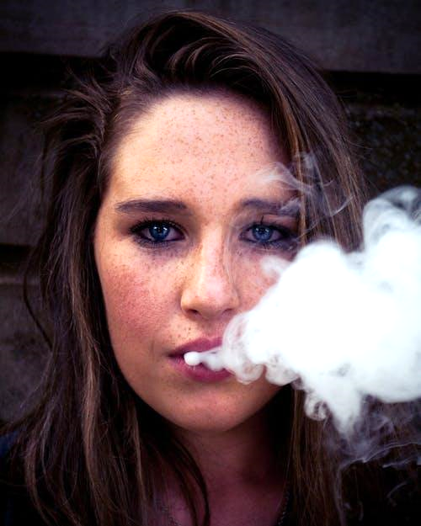
E-CIGARETTES/VAPING AND YOUTH
Nearly 1 in 20 High School students
report current e-cigarette use
(Indiana Youth Tobacco Survey, 2012-2024)
The U.S. Surgeon General declared e-cigarette use by minors an epidemic.
Vaping became the biggest increase in youth substance abuse EVER recorded
Flavors like cotton candy, fruit medley & crème-brulee attract youth users.
Nicotine can harm the developing adolescent brain.
Notes:
KEY POINT: Vaping has become an epidemic among youth.
SCRIPT: “Vaping is a huge concern for teachers and school administrators in Middle Schools and High Schools these days! The most recent tobacco survey shows that 1 in 20 high school students report current e-cigarette use, and unfortunately middle school and even some grade school students are also vaping. Vaping has actually declined some since the previous study so that is good news. A few years ago the U.S. Surgeon General declared e-cigarette usage an epidemic and shared that vaping use had the biggest increase in youth substance abuse EVER recorded! Even though in the U.S. it is not legal to sell tobacco products, including e-cigarettes, to anyone under 21, the tobacco industry clearly markets these products to youth and entices them with appealing flavors like cotton candy, fruit, and flavors with names like unicorn poop! Unfortunately, e-cigarettes are appealing to youth, which is leading to nicotine addiction for a whole new generation and a host of health issues. The adolescent brain does not fully develop until age 25 and nicotine can harm the developing brain so the vaping epidemic is of great concern among parents, educators, and anyone who cares about the wellbeing of our youth.”

Slide 23

MARIJUANA
Many states have legalized some form of
marijuana for medical or recreational use.
Since marijuana comes from a plant, there is often a misunderstanding about the effects during pregnancy and on children.
Notes:
KEY POINT: Even though marijuana comes from a plant it is not safe during pregnancy or to smoke around children.
SCRIPT: “With Breathe we do briefly touch on marijuana as well. Of course, many states have legalized certain forms of marijuana for various uses, but it remains illegal in Indiana. Because marijuana derives from a plant many people believe that it is safe, but the key point I want to convey is that marijuana is not safe to use during pregnancy or to smoke it around children.”

Slide 24
MARIJUANA: PREGNANCY & BEYOND
Health Effects
Premature or Still Birth
Brain Development Issues
Experience Withdrawal Symptoms
Trouble Sleeping
Attention, Memory & Learning Difficulties
Behavior Problems
THC and other marijuana chemicals can be passed to babies through breast milk.
Someone who is breastfeeding should NOT use marijuana.
Notes:
KEY POINT: Marijuana use during pregnancy or while breastfeeding has many negative health effects.
SCRIPT: “Marijuana use during pregnancy can lead to premature birth or still birth, brain development issues, withdrawal symptoms for the baby, trouble sleeping, attention, memory, and learning difficulties as well as behavior problems. Research has also shown that THC, the main chemical in marijuana, is passed to babies through breast milk. Therefore, it is not safe for someone who is breastfeeding to use marijuana.”

Slide 25

SECONDHAND MARIJUANA SMOKE
Children exposed to secondhand marijuana smoke:
Have shown traces of THC in their urine
Can be triggered to have asthma attacks
Experience reduced memory & coordination
Notes:
KEY POINT: Exposure to secondhand marijuana smoke is harmful to children.
SCRIPT: “It is also not safe for children to be around secondhand marijuana smoke. Again, research shows that children exposed to marijuana smoke have traces of THC in their urine. This can lead to asthma attacks and problems with memory and coordination.”

Slide 26
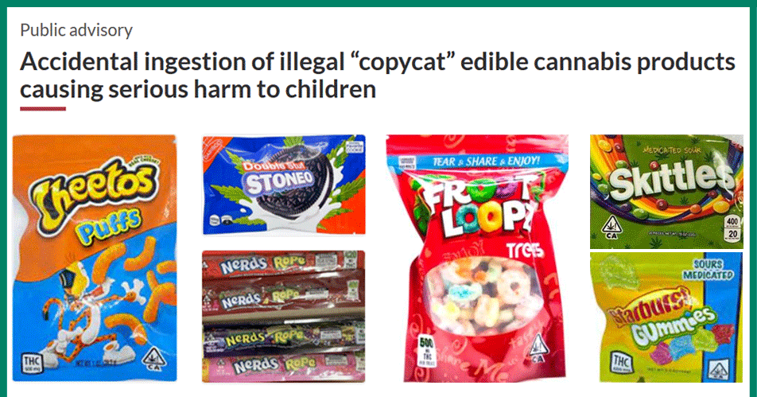
MARIJUANA
Gummies – Edibles - Delta Products - THC Drinks
often unregulated/illegal & appeal to children
Notes:
KEY POINT: Marijuana comes in many different forms and can be a poison danger for children.
SCRIPT: “Smoking isn’t the only way people use marijuana or injest THC. There are gummies, homemade and storebought edibles, various Delta products, and drinks containing THC. At first glance it might look like this is a photo of popular snacks…but if you look closer you will see that they all include THC! Imagine a 4 year old coming across this bag of Cheetos or Skittles! When it comes to the safety of children it is important to keep all marijuana products out of reach of young children.”

Slide 27

LET’S TALK MONEY
Tobacco use not only costs us our health, but also a lot of money!
In Indiana the average cost of a pack of cigarettes is $11
Smoking a pack a day costs
$4,015 a year!
(over $20,000 in 5 years!)
Additional expenses include doctor’s visits & medications, plus time off work and missed school.
Notes:
KEY POINT: In addition to negative health effects, tobacco use also costs a lot of money.
SCRIPT: “A tobacco addiction can cost someone their health, but it can also cost a ton of money. And it just got even more expensive in Indiana! The cigarette tax increased as of July 1st and data shows that a substantial price increase leads more adults to quit and fewer youth to start smoking. The average price of a pack of cigarettes in Indiana is now $11. So someone who smokes a pack a day will end up spending over $4000 a year just on cigarettes. The tobacco industry will try to combat this with coupons and price promotions, but they aren’t trying to help the consumer…they are just trying to create lifelong customers by getting people addicted to nicotine. On top of the cost of the products themselves, prolonged tobacco use also leads to additional expenses for doctor’s visits and medications, plus the financial impact of missing work and school.”

Slide 28

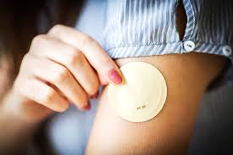


MEDICAID COVERS QUITTING
Indiana Medicaid covers:
Counseling
Nicotine
Replacement
Therapies
Prescribed
Medications
Notes:
KEY POINT: Indiana Medicaid offers lots of cessation support.
SCRIPT: “Fortunately, Indiana Medicaid offers lots of cessation support so encourage your families that are on Medicaid to check into this coverage. Indiana Medicaid covers cessation counseling as well as several forms of nicotine replacement therapies and medications that can help in their quit attempt. Even if a family does not have Medicaid, encourage them to find out what their health insurance covers because many other insurances may help with cessation support as well!”

Slide 29
QUITTING
One of the best things parents can do for their own health and their children’s health is to quit smoking.
But you CAN’T make
someone quit tobacco.
Quitting is hard!!!
It usually takes 8-11 quit attempts to successfully quit
Notes:
KEY POINT: You can’t make someone quit tobacco, but support is critical to their success.
SCRIPT: “Speaking of quitting…this is one of the best things parents can do for their own health as well as the health of their children. But we you can’t make someone quit. It has to be their choice. But for those who are ready to quit, you can support them in a quit attempt. It actually takes someone on average 8-11 quit attempts to successfully quit for good. Each quit attempt is a step in the right direction so we want to support people when they make an attempt and acknowledge that setbacks are often a part of the process. You never know when someone will be ready to quit, so its important to be prepared and let them know you can provide support when they are ready to take that step.”

Slide 30

QUITNOW INDIANA
FREE & Available 24/7 >> Call, Text, Online, or App
Trained Quit Coach >> Customized Quit Plan
    FREE Nicotine Replacement Therapies (NRT), as available
1-800-Quit-Now (784-8669)
1-855-DÉJELO-YA (Spanish)
1-877-777-6534 (TTY)
Text READY to 34191
Text LISTO to 34191 (Spanish)
quitnowindiana.com
Notes:
KEY POINT: Quit Now Indiana is a great resource for those who want to quit.
MATERIALS NEEDED: Bring a variety of Quit Now Indiana materials for participants to pick up after the training.
SCRIPT: “You don’t have to be the expert on quitting, but you can help parents who want to quit by connecting them to Quit Now Indiana.. Quit Now Indiana is free and available 24/7. A trained quit coach will help them create a customized quit plan just for them. People can call, text, go online or use the app to access services in whatever way works best for them. Quit Now Indiana has a dedicated number for those who speak Spanish and other language services are available as well as TTY capabilities for those who are deaf or hard of hearing. Quit Now Indiana handouts are available and free to order. I have brought a stack for you today and I encourage you to make these handouts easily accessible in your lobbies and to have them on hand when you do home visits or meet with parents so you can share this valuable resource when the time is right.”

Slide 31

QUITNOW INDIANA
FREE & Available 24/7 at 1-800-QUIT-NOW
Trained Quit Coach & Customized Quit Plan
Call, Text, Go Online, or Use the New Rally Coach App
Free Nicotine Replacement Therapies, as available
Specialized Services: Youth, Pregnancy & Behavioral Health
Visit QuitNowIndiana.com or text READY to 34191
For Spanish: 1-855-DEJELO-YA or text LISTO to 34191
Notes:
KEY POINT: Quit Now Indiana is a great resource for those who want to quit.
MATERIALS NEEDED: Bring a variety of Quit Now Indiana materials for participants to pick up after the training.
SCRIPT: “You don’t have to be the expert on quitting, but you can help parents who want to quit by connecting them to Quit Now Indiana. Tons of updates and enhancements have been made to this services making it even more user friendly and accessible. Quit Now Indiana is free and available 24/7. A trained quit coach will help them create a customized quit plan just for them. People can call, text, go online or use the brand new app to access services in whatever way works best for them. There are specialized services provided for youth, pregnant people and those with behavioral health issues and there is a separate line for those who speak Spanish. I brought some Quit Now Indiana materials so feel free to take some to share with the parents you serve.”

Slide 32
QUESTIONS??
Notes:
KEY POINT: I am happy to answer any questions now or in the future.
I
VIRTUAL MODIFICATION: Check the chat box for any questions that may have been posted during the training and let participants know they can post questions in the chat box or unmute to ask questions now.
SCRIPT: “I know we covered a ton on information very quickly, but that is all we have time for today. I would love to answer any questions you may have as time allows.”

Slide 33
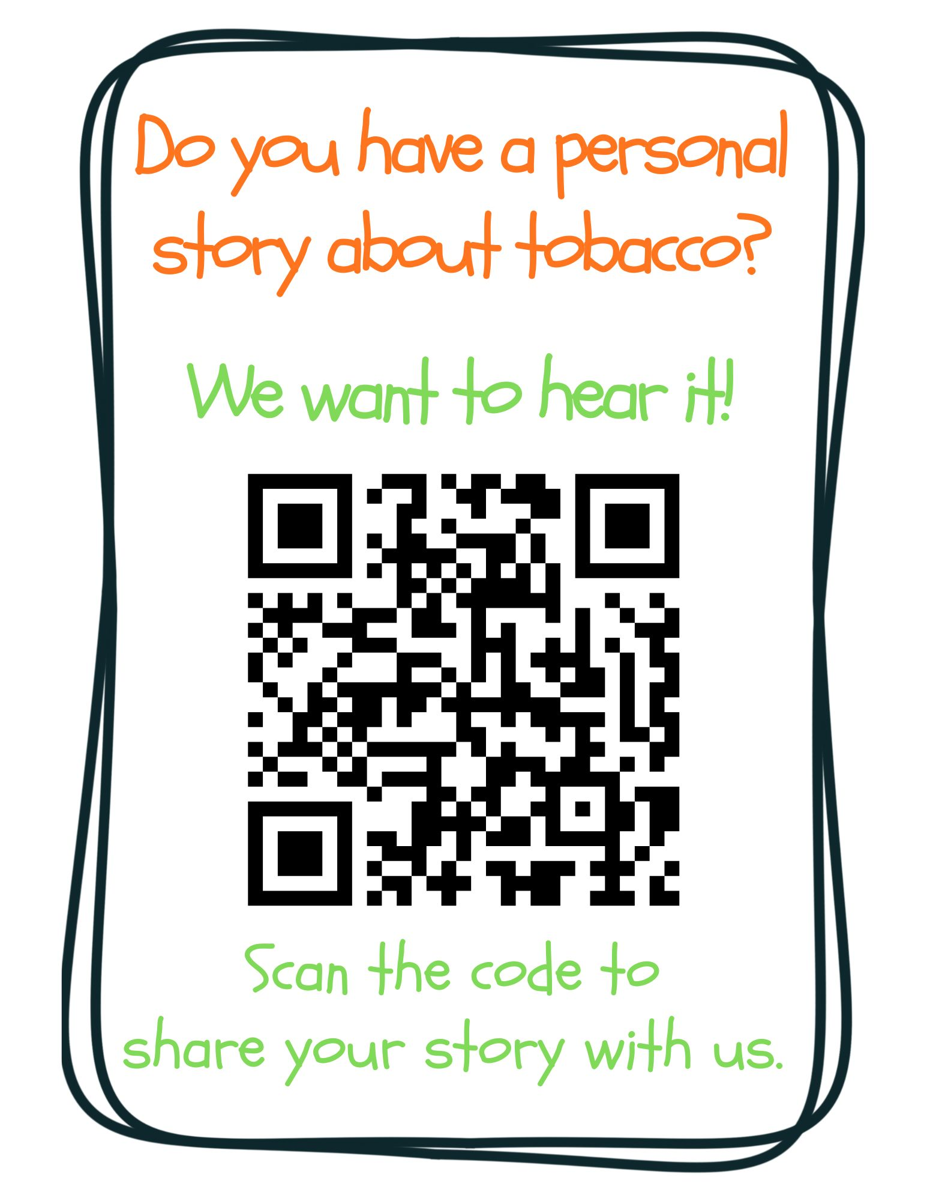
Notes:
KEY POINT: Ask for personal stories about tobacco.
VIRTUAL MODIFICATION: Post this link in the chat box: https://www.surveymonkey.com/r/tobaccostory
SCRIPT: “We love answering your questions as well as hearing stories about how tobacco has affected you, the people you love, and the families you serve. We don’t have time to hear all those great stories today, but we encourage you to share those stories with us at this link, which you can also find on the Breathe website and in the monthly newsletters. Tobacco isn’t just about stats, it’s about people and sharing stories about tobacco helps us all make a personal connection to this important work we are doing. We look forward to hearing your stories!”

Slide 34


THANK YOU!!
Contact Health Ed Pros to schedule a full Breathe training
for your staff and receive FREE Breathe kits!
Tanya Shelburne, Project Manager
tanyas@healthedpros.org
317-902-4505
Alison Muckerheide, Tobacco Control Specialist
alisonm@healthedpros.org
Notes:
KEY POINT: Share contact information.
SCRIPT/INSTRUCTIONS: (Personalize this slide with your contact information.) “Thank you so much for participating in today’s Breathe teaser. It was my pleasure to provide a brief overview of tobacco and the Breathe program. Feel free to contact me at any time when you are ready to schedule a full Breathe training for your staff and receive our free Breathe kits.”

Slide 35
DATA SOURCES
2023 Indiana Behavioral Risk Factor Surveillance System (BRFSS)
www.in.gov/health/tpc/
www.cdc.gov/tobacco/
www.cancer.org/cancer/risk-prevention/tobacco
For a more detailed list of data sources used
to create Breathe materials go to
justbreathein.org/additional-resources/data-sources/
Notes:
KEY POINT: Share basic data sources and where they can find more.
SCRIPT/INSTRUCTIONS: (You can just leave this slide up for people to see or refer to it if anyone asks about the source of information you shared.)

