Slide 1
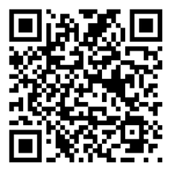
BREATHE TRAINING
“BREATHE REFRESHER”
USE THE QR CODE
to take the
PRE- ASSESSMENT
Notes:
HOW TO USE THE NOTES SECTION: Each slide in this presentation has a notes section that can help you deliver the presentation.
The KEY POINT let’s you know the most important message to convey and along with the text on the screen, that may be all the guidance an experienced county coordinator/tobacco expert may need to conduct the training effectively.
If any handouts or other resources are necessary for a given slide you will see a MATERIALS NEEDED section.
If modifications are needed to share a slide or conduct an activity for a virtual training, you will see a VIRTUAL MODIFICATION section.
The SCRIPT portion of each page will give you a sample script (in italics) of what you might say for each slide as well as instructions, if needed. DO NOT READ THE SCRIPT VERBATIM! Instead, use the script to practice the presentation and then adjust it as needed to make it your own. The script is simply meant to be a guide/suggestion!
KEY POINT: All participants need to complete a pre assessment and sign the sign-in sheet.
MATERIALS NEEDED: Participants can complete the pre assessment online with the QR code on this slide. This is the preferred method as it will save you time doing data entry after the training! (The slide now indicates “Breathe Refresher” so they know how to fill answer the first question regarding the type of training they are attending.) To encourage compliance you could have them indicate they are done or show you their completion screen and you could give them a handout, magnet, or other giveaway when they do. You still need to bring copies of the sign-in sheets and some printed out pre assessments in case participants prefer to complete a hard copy. **If you choose NOT to have participants complete the assessment online, modify this slide by removing the QR code.
VIRTUAL MODIFICATION: Participants can use another device to access the QR code on the screen and/or you can place the link in the chat box so they can complete it on the device they are using for the training. You may need to keep posting the link in the chat box as people enter the training since they may not be able to see earlier chat box entries. Ask participants to type DONE in the chat box to encourage compliance and assess completion. Here is the link to the pre assessment: https://www.surveymonkey.com/r/PreAssess2527
SCRIPT: “Before we get started, I need everyone to complete a pre assessment. To access the survey, just open the camera in your smartphone and point it at the QR code on the screen to get the link. If you prefer to complete the assessment with pen and paper just let me know and I will bring you a hard copy. I will also be asking you to complete a post-assessment at the end of the training, and these are important parts of our evaluation so I appreciate you completing them. There are also sign-in sheets being passed around. Please make sure you put your name and contact info on one of the sign-in sheets so we will have a record of everyone’s attendance and if you want to receive our monthly Breathe E-newsletter you can indicate that on the sign in as well.”

Slide 2


HEALTH ED PROS
Tanya Shelburne MPH, CHES
Alison Muckerheide MPH, CHES
Notes:
KEY POINT: Participants should know your name and a bit about your background and position.
MATERIALS NEEDED: Breathe kits and Quit Now Indiana materials
VIRTUAL MODIFICATION: Make plans with your site contact to deliver Breathe Kits and Quit Now Indiana materials either before or after the training and discuss how the materials should be divided up between the training participants.
INSTRUCTIONS: Personalize this slide with your information. Welcome everyone to the training, introduce yourself, and give a brief background on your experience, your organization, and your position. Bring materials to the training (breathe kits, Quit Now Indiana materials, etc.) but do not distribute them until the end of the training as some attendees will leave/not pay attention if materials are distrusted too early.

Slide 3
Guidelines for Virtual Training
Training is being recorded
Keep video on
Mute yourself when not speaking
Rename yourself, if necessary
Minimize distractions
Stay for entire training (60 minutes)
Interact!!! (pre/post assessments, chat box, unmute)
Notify co-host if you have issues
Notes:
DELETE THIS SLIDE IF CONDUCTING AN IN-PERSON TRAINING!
KEY POINT: Go over housekeeping and expectations for the training.
SCRIPT/INSTRUCTIONS: (Personalize this slide as needed.) “Now before we jump into the actual training I want to go over a few housekeeping items. I want to make sure everyone is aware that the training is being recorded and I will share a link to the recording in a follow up email in a day or two should you want to watch it again or share it with someone on staff who may have missed the training. I do ask that you keep your videos on during the training so I can see everyone’s smiling faces and it will feel a bit more like we are actually in person, but do keep yourself on mute to minimize background noise and just unmute yourself when you want to share something or ask a question. If the name on the screen is not your name, please rename yourself, which will help us with attendance and knowing who everyone is. To rename yourself put your cursor in your box on the screen and click the blue box in the upper right corner with 3 dots in it and you should see the option to rename yourself. Do your best to minimize distractions around you and I do ask that you stay for the full 90 minute training. There will be several options to interact so feel free to use the chat box or raise your hand at any time, and I hope you will interact as it is way more fun when it’s not just me talking the whole time! If you have any issues during the training feel free to message the co-host and we will try to assist.”

Slide 4
Connection Before Content
No one cares how much you know,
until they know how much you care.
- Theodore Roosevelt
Notes:
KEY POINT: Connect with participants before you get into the training content.
SCRIPT: “We will get to discussing tobacco in just a bit, but I think it is important that we focus on “Connection Before Content”. This quote from Theodore Roosevelt really sums up why Connection Before Content is important and serves as the basis for why we designed the Breathe program the way we did. He said ‘No one cares how much you know, until they know how much your care.’ Hopefully as we get to know each other a little better you will see that I have a heart for protecting children and families and supporting the staff who serve them! And we know all of you have a heart for the families you serve and that they know and trust you. That’s why we focus on training staff at Head Start and other organizations rather than going directly to the parents ourselves. So let’s connect a bit with a fun ice breaker and get to know each other better!”

Slide 5
WOULD YOU
RATHER?
Notes:
KEY POINT: Give instructions for how to play Would You Rather.
VIRTUAL MODIFICATION: If everyone is on their own device and their camera’s work, instruct them to put their camera on if they agree with the first option and turn their camera off for the second option as each question is presented. Another option would be to use thumbs up or thumbs down or some other hand gesture or reaction button to signify which option they prefer. As participants reveal their options, have some friendly discussion between the trainer and cotrainer to acknowledge how the majority of the group is responding and allow participants to chime in if they want to share details about their choice.
SCRIPT/INSTRUCTIONS: “We are going to play Would You Rather?! I will put 2 options on the screen and you will let everyone know which option you prefer by standing on one side of the room or the other, if you are able. And if you can’t decide feel free to stand in the middle.” If you don’t have enough space, another option would be to have participants march in place for one option and do arm circle for the other option, or use other hand signals from a seated position. “Is everyone ready to move?”

Slide 6
WOULD YOU RATHER?
Vacation at the beach OR in the mountains?
Spend the day reading OR shopping?
Drink Coke products OR Pepsi products?
Have someone clean your home OR cook your meals?
Be able to travel back in time OR into the future?
Win a lifetime supply of ice cream OR chips?
Wear a swimsuit in winter OR a snowsuit in summer?
Notes:
KEY POINT: .Reveal Would You Rather options and have participants choose.
INSTRUCTIONS: Click to reveal each set of options one at a time and read each aloud. Tell participants to stand on the left side of the room if they would choose the first option or the right side of the room if they would choose the second option. Trainers should participate as well so the participants can get to know them. As participants reveal their options, have some friendly discussion about what is being revealed and allow participants to chime in if they want to share details about their choice. You can also ask some probing questions such as favorite beach, good book they have read lately, or why they chose traveling to the future.

Slide 7
WOULD YOU RATHER?
Sit through this training
OR
be locked in a box with
10 poisonous snakes?
Notes:
KEY POINT: Wrap up Would You Rather gam.
SCRIPT: “For our last Would You Rather option, I want to know if you would rather sit through this training OR be locked in a box with 10 poisonous snakes! If you would rather sit through this training go sit in your seat and if you would rather be locked in a box with 10 poisonous snakes stay standing where you are.” Allow participants to move back to their seats. “I’m thrilled to see everyone would rather sit through our Breathe training and now I feel like I know you all a bit better!”

Slide 8
GAME TIME!
How Much Do You Know/Remember
About Tobacco?
Notes:
KEY POINT: Set the stage for this training being a refresher and the game.
SCRIPT: “Now that we all know a little more about each other, let’s see how much you all know about tobacco and what you remember from our last training. By now you guys know that we don’t believe in boring trainings…we like to learn through fun games…”

Slide 9









“Breathe: Healthy Steps to Living Tobacco Free” Edition
Trivia
Notes:
KEY POINT: Introduce the overall concept of Breathe Trivia.
SCRIPT: “So let’s have a trivia night! Or rather a trivia day. How many of you have enjoyed trivia night with family and friends, either at home or your favorite pub? Now it’s time for the Breathe edition of trivia night! I know we have some smart and rather competitive people in this group, so this should be fun!”

Slide 10


Game Rules
  The game consists of four rounds of three questions each.
  Each correct answer earns the team one point.
  No googling or use of electronic devises.
  Be kind and have fun!
  Find your team and create a team name.
Notes:
KEY POINT: Review the rules of Trivia.
MATERIALS NEEDED: Blank sheet of paper and pen for each team to keep score
VIRTUAL MODIFICATION: If participants are all in the same room and streaming from one device, you can play trivia basically the same as you would if you were in the same room with them. If everyone is on their own device, they will play as individuals rather than as a team. You could have them change their name on the screen to a “fun name” and when you go through the answer rounds have participants use the chat box to reveal their answers and create some chatter about the topics covered. Each person would keep their own score and at the end you could ask who got all 12 points to declare the winners.
INSTRUCTIONS: Read through the instructions on the slide, then give them a few minutes to break into groups of 3-5, depending on the size and set up of the room, and come up with their team names. Have someone from each team share their team name and them write their team name at the top of a blank piece of paper. Then tell them to draw a line down the center of the paper and across the center of the paper, creating 4 boxes. Instruct them to put “1, 2, 3” in each box where they will record their answers for each round.

Slide 11

Round 1
Notes:
KEY POINT: Introduce Round 1.
SCRIPT: “Is everyone ready for Round 1? Here we go!”

Slide 12
Round 1
1. What do Vapes/E-cigarettes emit?
Aerosol
Water Vapor
Harmless Flavors
Fruity Mist
Notes:
KEY POINT: Present Round 1, Question 1
INSTRUCTIONS: Read question and answer choices aloud and give teams a little time to determine and write down their answer. Do not provide any additional education at this point; you will have time to do that when you reveal the answers!

Slide 13
Round 1
2. What do we call the chemicals and odors left behind after someone smoked or vaped in a home/car?
Residual Nicotine
Secondhand Smoke
Thirdhand Smoke
Harmless
Notes:
KEY POINT: Present Round 1, Question 2
INSTRUCTIONS: Read question and answer choices aloud and give teams a little time to determine and write down their answer.

Slide 14
Round 1
3. How does Big Tobacco target marginalized populations?
Fighting laws that would protect certain groups
Aggressive Marketing to specific groups
Donating to events in marginalized communities
All of these strategies
Notes:
KEY POINT: Present Round 1, Question 3
INSTRUCTIONS: Read question and answer choices aloud and give teams a little time to determine and write down their answer.

Slide 15
Round 1
ANSWERS
Notes:
KEY POINT: Announce that it is time to reveal the answers for Round 1.
SCRIPT: “Your answers for Round 1 should be locked in, so let’s find out the correct answers and see how everyone did! As the answers are revealed, give your team 1 point for each correct answer and then tally up your points for this round. There is a possibility of earning 3 points in each round.”

Slide 16
Round 1
1. What do Vapes/E-cigarettes emit?
Notes:
KEY POINT: Review the question and let participants respond.
INSTRUCTIONS: Read the question out loud and have participants shout out what they believe the correct answer is.

Slide 17
Round 1
1. What do Vapes/E-cigarettes emit?
Aerosol
Water Vapor
Harmless Flavors
Fruity Mist
Notes:
KEY POINT: Reveal the correct answer and share additional education about the harms of vaping.
SCRIPT: “The correct answer is aerosol! Great job! Give your team 1 point if you got that right. Many people think vapes just emit harmless wator vapor and it may have a sweet or fruity smell, but vaping actually emits an aerosol full of tiny particles of harmful chemicals. This can be unhealthy for the user as well as those around them breathing in the secondhand aerosol.”

Slide 18
Round 1
2. What do we call the chemicals and odors left behind after someone smoked or vaped in a home/car?
Notes:
KEY POINT: Review the question and let participants respond.
INSTRUCTIONS: Read the question out loud and have participants shout out what they believe the correct answer is.

Slide 19
Round 1
2. What do we call the chemicals and odors left behind after someone smoked or vaped in a home/car?
Residual Nicotine
Secondhand Smoke
Thirdhand Smoke
Harmless
Notes:
KEY POINT: Reveal the correct answer and share additional education about thirdhand smoke.
SCRIPT: “Yes, we have learned about Thirdhand Smoke from our previous Breathe trainings so I figured you guys would get this one right. Many of the parents you serve many not be as familiar with thirdhand smoke so feel free to use the video and handout about thirdhand smoke as you encourage them to protect their children by not smoking or vaping in their homes or cars.”

Slide 20
Round 1
3. How does Big Tobacco target marginalized populations?
Notes:
KEY POINT: Review the question and let participants respond.
INSTRUCTIONS: Read the question out loud and have participants shout out what they believe the correct answer is.

Slide 21
Round 1
3. How does Big Tobacco target marginalized populations?
Fighting laws that would protect certain groups
Aggressive Marketing to specific groups
Donating to events in marginalized communities
All of these strategies
Notes:
KEY POINT: Reveal the correct answer and share additional education about Big Tobacco .
SCRIPT: “Give your team a point if you knew that Big Tobacco uses all of these sneaky tactics to get marginalized populations, including people with low incomes, addicted to their deadly products.”

Slide 22
Round 2
Notes:
KEY POINT: Introduce Round 2.
SCRIPT: “Great job with Round 1! Let’s move on to Round 2 where the questions may be a bit harder!”

Slide 23
Round 2
1. What is the average price of a pack of cigarettes in Indiana (after the tobacco tax was raised in July 2025)?
$6
$8.50
$11
$15
Notes:
KEY POINT: Present Round 2, Question 1
INSTRUCTIONS: Read questions and answer choices aloud and give teams a little time to determine and write down their answer.

Slide 24
Round 2
2. Which is NOT true about Quit Now Indiana (QNI)?
It is available 24/7
It is only accessible by calling 1-800-QUIT-NOW
It is free
Calls to QNI increased in July 2025
Notes:
KEY POINT: Present Round 2, Question 2
INSTRUCTIONS: Read questions and answer choices aloud and give teams a little time to determine and write down their answer.

Slide 25
Round 2
3. How many attempts, on average, does it take for someone to quit smoking for good??
1-3
4-7
8-11
12-15
Notes:
KEY POINT: Present Round 2, Question 3
INSTRUCTIONS: Read questions and answer choices aloud and give teams a little time to determine and write down their answer.

Slide 26
Round 2
ANSWERS
Notes:
KEY POINT: Announce that it is time to reveal the answers for Round 2.
SCRIPT: “Answers for Round 2 should be locked in. Remember to give your team 1 point for each correct answer. Another 3 points are up for grabs in Round 2.”

Slide 27
Round 2
1. What is the average price of a pack of cigarettes in Indiana (after the tobacco tax was raised in July 2025)?
Notes:
KEY POINT: Review the question and let participants respond.
INSTRUCTIONS: Read the question out loud and have participants shout out what they believe the correct answer is.

Slide 28
Round 2
1. What is the average price of a pack of cigarettes in Indiana (after the tobacco tax was raised in July 2025)?
$6
$8.50
$11
$15
Notes:
KEY POINT: Reveal the correct answer and share additional education about the cost of tobacco and the increased tobacco tax.
SCRIPT: “I knew we would stump some of you with this one! Currently the average price of a pack of cigarettes in Indiana is $11…that’s a lot of money literally going up in smoke. The cost went up in July of 2025 when the Indiana legislature passed a law to increase the cigarette tax by $2. This is actually good news because research shows that a significant increase in the price of tobacco leads to fewer youth starting to smoke and more regular users deciding to quit. Of course, Big Tobacco uses their sneaky tactics to keep people addicted by offering coupons and other discounts.”

Slide 29
Round 2
2. Which is NOT true about Quit Now Indiana (QNI)?
Notes:
KEY POINT: Review the question and let participants respond.
INSTRUCTIONS: Read the question out loud and have participants shout out what they believe the correct answer is.

Slide 30
Round 2
2. Which is NOT true about Quit Now Indiana (QNI)?
It is available 24/7
It is only accessible by calling 1-800-QUIT-NOW
It is free
Calls to QNI increased in July 2025
Notes:
KEY POINT: Reveal the correct answer and share additional education about Quit Now Indiana.
SCRIPT: “Quit Now Indiana isn’t ONLY accessible by calling 1-800-QUIT-NOW. You can also text, go online, or use the app. If you know someone who is ready to quit, let them know Quit Now Indiana is free, available 24/7, and accessible in a variety of ways so they can choose whichever way works best for them. And there was a big increase in calls to Quit Now Indiana in July of 2025. Anyone want to guess why that might have happened? I’ll give you a hint…it’s related to the previous trivia question… When Indiana’s tobacco tax increased we saw a big spike in calls to Quit Now Indiana and more tobacco users were motivated to quit.”

Slide 31
Round 2
3. How many attempts, on average, does it take for someone to quit smoking for good??
Notes:
KEY POINT: Review the question and let participants respond.
INSTRUCTIONS: Read the question out loud and have participants shout out what they believe the correct answer is.

Slide 32
Round 2
3. How many attempts, on average, does it take for someone to quit smoking for good??
1-3
4-7
8-11
12-15
Notes:
KEY POINT: Reveal the correct answer and share additional education about quitting.
SCRIPT: “The correct answer is 8-11 attempts! While some people may successfully quit on the first try, that is not the norm. Nicotine addiction is real and relapses are often part of the process. That’s why offering non-judgmental support is critical. Every attempt is a step in the right direction and with support and encouragement, they will be more likely to try again.”

Slide 33
Round 3
Notes:
KEY POINT: Introduce Round 3.
SCRIPT/INSTRUCTIONS: “We are halfway done!” Find out each team’s score and indicate which teams are in the lead. “There are still 6 points up for grabs so any team could win!”

Slide 34
Round 3
1. Which is NOT an effective way to minimize second and thirdhand smoke/vapor exposure for children?
Installing a ventilation system
Wearing a smoking jacket
Not allowing smoking or vaping in your home or car
Quitting smoking/vaping
Notes:
KEY POINT: Present Round 3, Question 1
INSTRUCTIONS: Read questions and answer choices aloud and give teams a little time to determine and write down their answer.

Slide 35
Round 3
2. What percentage of Indiana adults currently smoke? (according to the 2024 BRFSS, does not include vaping)
3.8%
13.9%
23.3%
50%
Notes:
KEY POINT: Present Round 3, Question 2
INSTRUCTIONS: Read questions and answer choices aloud and give teams a little time to determine and write down their answer.

Slide 36
Round 3
3. Which of these health outcomes has NOT been linked to smoking while pregnant?
Low Birth Weight
Preterm Labor
Miscarriage
Down Syndrome
Notes:
KEY POINT: Present Round 3, Question 3
INSTRUCTIONS: Read questions and answer choices aloud and give teams a little time to determine and write down their answer.

Slide 37
Round 3
ANSWERS
Notes:
KEY POINT: Announce that it is time to reveal the answers for Round 3.
SCRIPT: “It’s time to reveal the answers for Round 3. Will we have a new team at the top of the leaderboard? Let’s find out!”

Slide 38
Round 3
1. Which is NOT an effective way to minimize second and thirdhand smoke/vapor exposure for children?
Notes:
KEY POINT: Review the question and let participants respond.
INSTRUCTIONS: Read the question out loud and have participants shout out what they believe the correct answer is.

Slide 39
Round 3
1. Which is NOT an effective way to minimize second and thirdhand smoke/vapor exposure for children?
Installing a ventilation system
Wearing a smoking jacket
Not allowing smoking or vaping in your home or car
Quitting smoking/vaping
Notes:
KEY POINT: Reveal the correct answer and share additional education about reducing exposure to second and thirdhand smoke.
SCRIPT: “Installing a ventilation system may minimize the smell, but it does NOT remove all the harmful chemicals from second and thirdhand smoke. Of course the best way to minimize exposure for children is for parents/caregivers to quit smoking/vaping. But not all parents may be ready to quit, so not using tobacco in the home or car and not allowing others to and wearing a smoking jacket that they can take off before they come inside are good options for minimizing exposure to second and thirdhand smoke and vapor.”

Slide 40
Round 3
2. What percentage of Indiana adults currently smoke? (according to the 2024 BRFSS, does not include vaping)
Notes:
KEY POINT: Review the question and let participants respond.
INSTRUCTIONS: Read the question out loud and have participants shout out what they believe the correct answer is.

Slide 41
Round 3
2. What percentage of Indiana adults currently smoke? (according to the 2024 BRFSS, does not include vaping)
3.8%
13.9%
23.3%
50%
Notes:
KEY POINT: Reveal the correct answer and share additional education about current tobacco use rates.
SCRIPT: “This was a hard one, but that answer is 13.9%! You may have realized that this stat has been going down in recent years and that is great news! However there are still thousands of Hoosiers using traditional cigarettes and being exposed to second and thirdhand smoke.” You can also share your county’s smoking rate and see how it compares. “And as you all know, many adults as well as youth are now becoming addicted to nicotine through vaping and that presents a bunch of new challenges.”

Slide 42
Round 3
3. Which of these health outcomes has NOT been linked to smoking while pregnant?
Notes:
KEY POINT: Review the question and let participants respond.
INSTRUCTIONS: Read the question out loud and have participants shout out what they believe the correct answer is.

Slide 43
Round 3
3. Which of these health outcomes has NOT been linked to smoking while pregnant?
Low Birth Weight
Preterm Labor
Miscarriage
Down Syndrome
Notes:
KEY POINT: Reveal the correct answer and share additional education about effects of smoking while pregnant.
SCRIPT: “This may have been a tricky one, but the answer is Down Syndrome as there is no established link between smoking and chromosomal conditions, such as Down Syndrome. Low birth weight, preterm labor, and miscarriages are all possible outcomes related to tobacco use during pregnancy. Presenting parents with these facts, based on accurate science, can help them make informed decisions for their family.”

Slide 44
Round 4
Notes:
KEY POINT: Introduce Round 4.
SCRIPT: “This is our last round, so everyone finish strong! You got this!”

Slide 45
Round 4
1. What is Zyn?
A State of Complete Calm
Brand of Spitless Nicotine Pouches
A Smart Vape
New Reality TV Show
Notes:
KEY POINT: Present Round 4, Question 1
INSTRUCTIONS: Read questions and answer choices aloud and give teams a little time to determine and write down their answer.

Slide 46
Round 4
2. Which statement about marijuana is FALSE?
THC can pass through breast milk
Secondhand marijuana smoke can trigger asthma attacks
Marijuana is natural, so it’s safe during pregnancy
Edible marijuana may look like popular candy/snacks
Notes:
KEY POINT: Present Round 4, Question 2
INSTRUCTIONS: Read questions and answer choices aloud and give teams a little time to determine and write down their answer.

Slide 47
Round 4
3. Which of these is NOT part of the 3-step framework to address tobacco use?
Ask
Advise
Refer
Reprimand
Notes:
KEY POINT: Present Round 4, Question 3
INSTRUCTIONS: Read questions and answer choices aloud and give teams a little time to determine and write down their answer.

Slide 48
Round 4
ANSWERS
Notes:
KEY POINT: Announce that it is time to reveal the answers for Round 4.
SCRIPT: “This is your last chance to earn points, so let’s see how are teams did on Round 4 and then we will reveal our winner!”

Slide 49
Round 4
1. What is Zyn?
Notes:
KEY POINT: Review the question and let participants respond.
INSTRUCTIONS: Read the question out loud and have participants shout out what they believe the correct answer is.

Slide 50
Round 4
1. What is Zyn?
A State of Complete Calm
Brand of Spitless Nicotine Pouches
A Smart Vape
New Reality TV Show
Notes:
KEY POINT: Reveal the correct answer and share additional education about Zyn and other emerging products.
SCRIPT: “Zyn may sound like a state of complete calm, but it’s actually a popular brand of spitless nicotine pouches. These pouches are not like typical smokeless tobacco and are especially popular among youth, since they come in minty flavors and can be easily concealed. And there is no need for a spit, but they are still full of harmful chemical and lead to nicotine addiction for the user. While these pouches don’t create secondhand smoke or vapor, the concern with young children occurs when adults or teens leave these products laying around and curious little ones find them, which could quickly lead to nicotine poisoning if these minty pouches are put in their mouths. Smart Vapes was not the correct answer to this question but I do want to point out that these are another form of emerging products that are especially appealing to children. These vapes may have built in video games or blue tooth speakers…another gimmick by Big Tobacco to lure young people into a dangerous addiction.”

Slide 51
Round 4
2. Which statement about marijuana is FALSE?
Notes:
KEY POINT: Review the question and let participants respond.
INSTRUCTIONS: Read the question out loud and have participants shout out what they believe the correct answer is.

Slide 52
Round 4
2. Which statement about marijuana is FALSE?
THC can pass through breast milk
Secondhand marijuana smoke can trigger asthma attacks
Marijuana is natural, so it’s safe during pregnancy
Edible marijuana may look like popular candy/snacks
Notes:
KEY POINT: Reveal the correct answer and share additional education about marijuana.
SCRIPT: “I knew you guys would get this one! Just because marijuana comes from a plant that does not mean it is safe during pregnancy. Additionally, THC can pass through breastmilk and secondhand marijuana smoke can have a negative effect on children, including asthma attacks. Of course, smoking isn’t the only form of tobacco. With lots of edibles and THC beverages on the market now, some that look just like regular skittles or cheese puffs, this poses a significant risk to young children if they get their hands on these products. Adults who choose to use these products need to be very careful about keeping them out of reach of children.”

Slide 53
Round 4
3. Which of these is NOT part of the 3-step framework to address tobacco use?
Notes:
KEY POINT: Review the question and let participants respond.
INSTRUCTIONS: Read the question out loud and have participants shout out what they believe the correct answer is.

Slide 54
Round 4
3. Which of these is NOT part of the 3-step framework to address tobacco use?
Ask
Advise
Refer
Reprimand
Notes:
KEY POINT: Reveal the correct answer and share additional education about Ask Advise Refer.
SCRIPT: “Nice job! It has been a while since we talked about the Ask Advise Refer method, but this is a great strategy for discussing tobacco with parents and only takes a few minutes. Ask about tobacco use, advise parents to quit, and Refer them to evidence based quitting resources, such at Quit Now Indiana. All of this can be conveyed in a supportive way, without judgment. Reprimanding adults for tobacco use is not likely to motivate anyone to quit, but showing support and offering resources may help them consider making healthier choices for themselves and their families.”

Slide 55
Add Up Points From All 4 Rounds
Notes:
KEY POINT: Instruct teams to add up their points.
SCRIPT/INSTRUCTIONS: “It’s time to add up your team’s points. Remember there is a possibility of earning 12 points.” Call out each team name and have them reveal their scores.

Slide 56
And the
Trivia Champs are...
Notes:
KEY POINT: Reveal the winning team (and distribute prizes).
MATERIALS NEEDED: Prizes (optional). Give a prize to each member of the winning team, so have at least 5 prizes on hand. Prizes could be small gift cards, QNI swag, promotional items from your organization, or something fun or seasonal from the dollar store. Prizes don’t have to be expensive!
IF ONE TEAM HAS THE MOST POINTS…..SCRIPT/INSTRUCTIONS: “The winning team is _______! Great job! Each member of ______________ (team name) gets a _________________ (type of prize)!” If you aren’t able to offer prizes, simply give them a round of applause and remind them you are grant funded! “You guys all did an amazing job and I declare everyone Breathe Trivia experts. I hope you will share your expertise with the families you serve! If you enjoyed playing Breathe Trivia, you can actually find the stand-alone Trivia game PowerPoint on the For Partners webpage, where all the Breathe resources are, so you could play Breathe Trivia with your families.”
IF THERE IS A TIE…..SCRIPT/INSTRUCTIONS: “It looks like we have a tie between ____________ and ____________, so we have a tie breaker questions just for those teams. Take out a blank sheet of paper and I’ll give you 30 seconds to write down your answer. The tie breaker question is…according to the 2024 BRFSS, about how many Hoosier adults currently smoke? We are looking for the NUMBER of Hoosiers, not at a percentage. You have 30 seconds to write down your answer and the team who is closest wins.” Have each team hold up their answer. Whichever team is closest to 7228000 wins. “Currently about 722,800 Hoosier adults currently smoke…and that means ________ are the Breathe Trivia Champs! Great job! Each member of ______________ (team name) gets a _________________ (type of prize)! If you aren’t able to offer prizes, simply give them a round of applause and remind them you are grant funded! “You guys all did an amazing job and I declare everyone Breathe Trivia experts. I hope you will share your expertise with the families you serve! If you enjoyed playing Breathe Trivia, you can actually find the stand alone Trivia game powerpoint on the For Partners webpage, where all the Breathe resources are, so you could play Breathe Trivia with your families.”

Slide 57
Breathe Materials
Let’s review all the materials you have access to!
Notes:
KEY POINT: Remind participants that they have access to lot of Breathe materials online.
VIRTUAL MODIFICATION: Place the link to the For Partners webpage in the chat box: https://justbreathein.org/for-partners/
SCRIPT/INSTRUCTIONS: “Now that we have all brushed up on our knowledge of tobacco and the importance of protecting children from second and thirdhand smoke, I want to remind you about all the Breathe resources you have access to that can aid in educating and supporting the families you work with. Hopefully you know where your Breathe kits are stored, but if not, talk to your leadership to find out and let me know if you need any replacement items. If you are new or haven’t used some of the Breathe materials yet I hope this refresher will get your wheels spinning as you think about which materials would work best depending on your specific job and how you may interact with families and young children.”

Slide 58
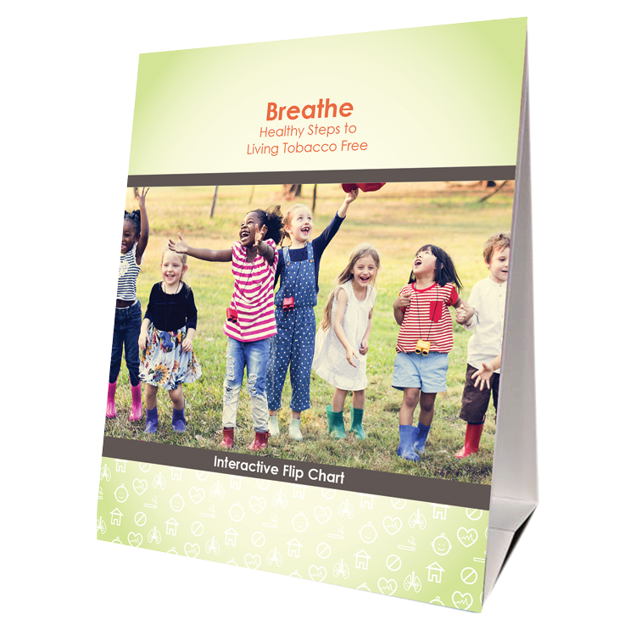



FOR PARENTS/CAREGIVERS
Flip
Chart
Activities Booklet
Worksheets
Handouts
Notes:
KEY POINT: Review Breathe resources focused on parents/caregivers.
MATERIALS NEEDED: Sample Breathe kit; additional supplies as needed.
SCRIPT/INSTRUCTIONS: “Several of the items in the Breathe kit are specifically geared towards parents/caregivers or the adults in the household. (CLICK TO REVEAL THE LABELS AS YOU TALK ABOUT EACH BREATHE RESOURCE) The flipchart is great for one on one or small group interactions with talking points on the back of each page to guide your conversation. The parent handouts cover many different tobacco topics can be printed or downloaded and shared electronically with all parents or have them and share with specific parents when relevant. The worksheets also provide great information on many tobacco topics but also include interactive components that help parents set goals and think through challenges aspects of quitting or minimizing smoke/vapor exposure for their children. The activities booklet is a great tool for anyone who needs activities to do with groups of parents. There are instructions for 9 different activities that take very little prep and minimal materials and will get parents discussion a variety of tobacco related topics.

Slide 59
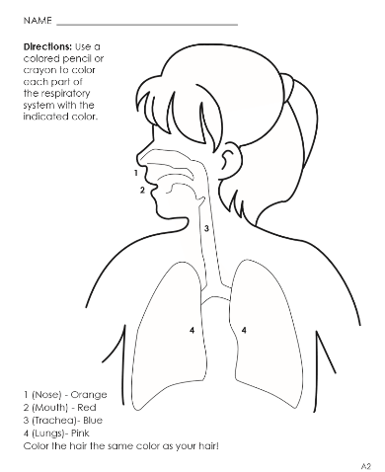


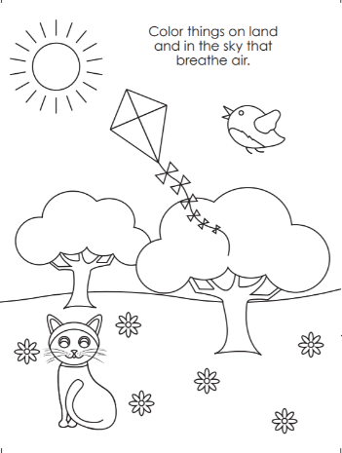
FOR YOUNG CHILDREN
Coloring Book/Sheets
Children’s Activities Booklet
Notes:
KEY POINT: Review Breathe resources focused on young children.
SCRIPT/INSTRUCTIONS: “The Breathe kit also includes some resources that can be used directly with children. These resources are focused on healthy bodies and are not specifically tobacco focused. There are coloring sheets that can be printed or downloaded and shared electronically. There is also a Children’s Activities Booklet with 15 short activities focused on healthy bodies that work great with children ages 3-7. These activities require very little prep work or outside materials. Both of these resources are great for anyone who works directly with children and they can also be given to parents as take-home activities.”

Slide 60
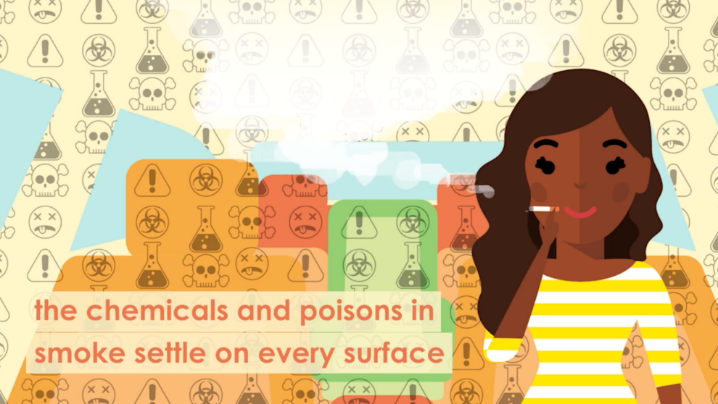
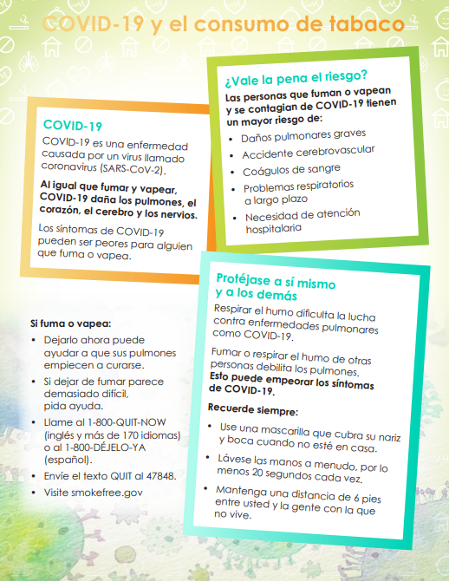

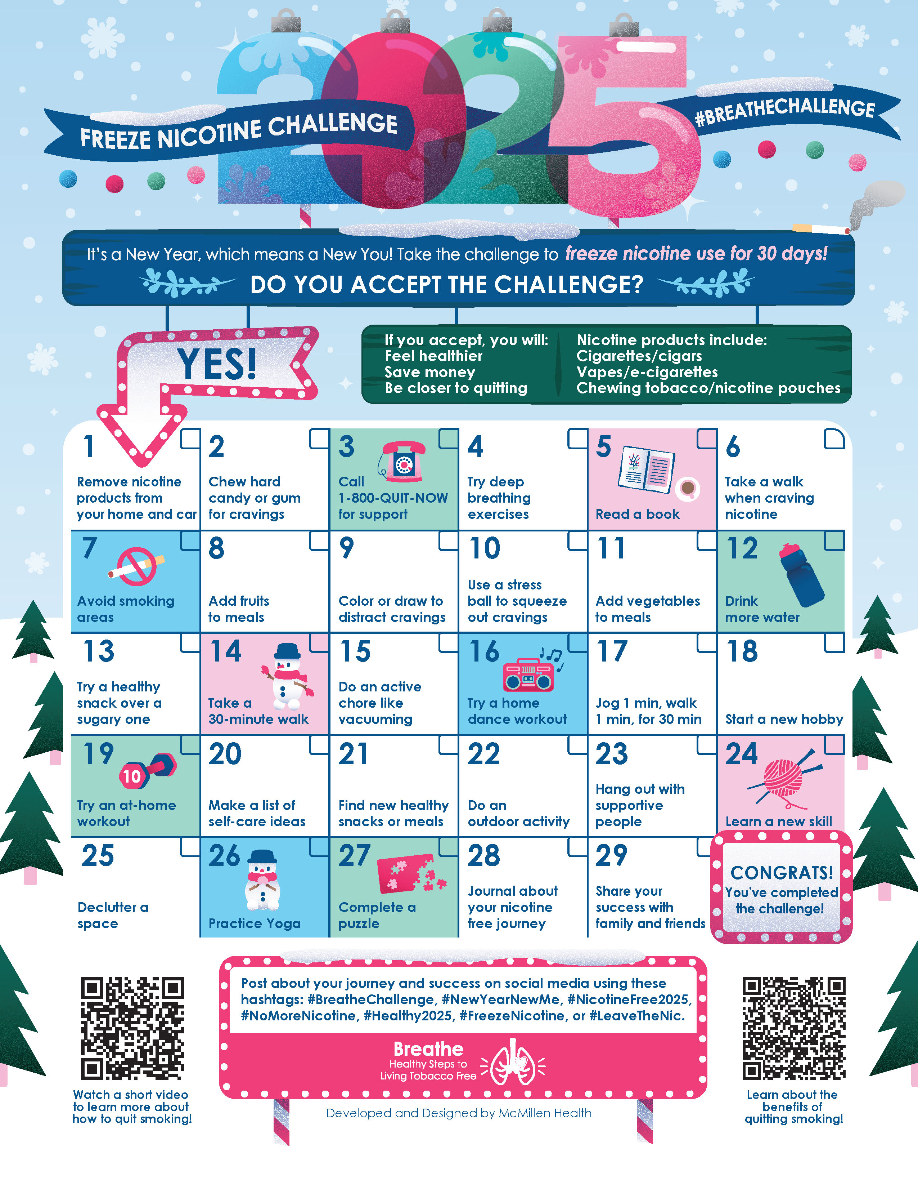
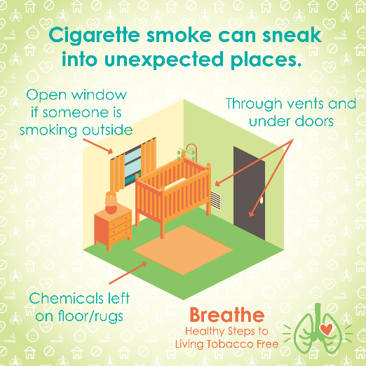
MORE RESOURCES
Spanish Materials
Short
Videos
Quarterly Challenges
Social Media Posts
Monthly
E-newsletter
Notes:
KEY POINT: Review additional Breathe resources and ways to share tobacco information.
SCRIPT: (CLICK TO REVEAL THE LABELS AS YOU TALK ABOUT EACH BREATHE RESOURCE) “And that’s not all! Many of the Breathe materials are also available in Spanish, so please access those materials if you are working with Spanish Speaking parents/caregivers. There are also lots of short videos, just 2-3 minutes each that help reinforce important tobacco education. Feel free to pull these up on an ipad to show to parents as appropriate or post them on your social media. Speaking of social media, the webpage also includes 12 ready to go graphics and accompanying text that you can post on your social media pages as a way to keep tobacco education on everyone’s radar. We also create a monthly Breathe e-newsletter that we will send send directly to anyone who indicated they would like to receive it on today’s sign in sheet. We hope that you will share the newsletter by forwarding it, printing the pdf, or copying and pasting sections of it into your own organization’s newsletter. Finally, we have a new challenge each quarter that is a fun way to motivate families when it comes to quitting tobacco or minimizing exposure to second and thirdhand smoke/vapor. I hope this quick overview of the Breathe materials was helpful and that each of you can find at least one or two resources that might be useful in your current role and that you will feel comfortable sharing.”

Slide 61
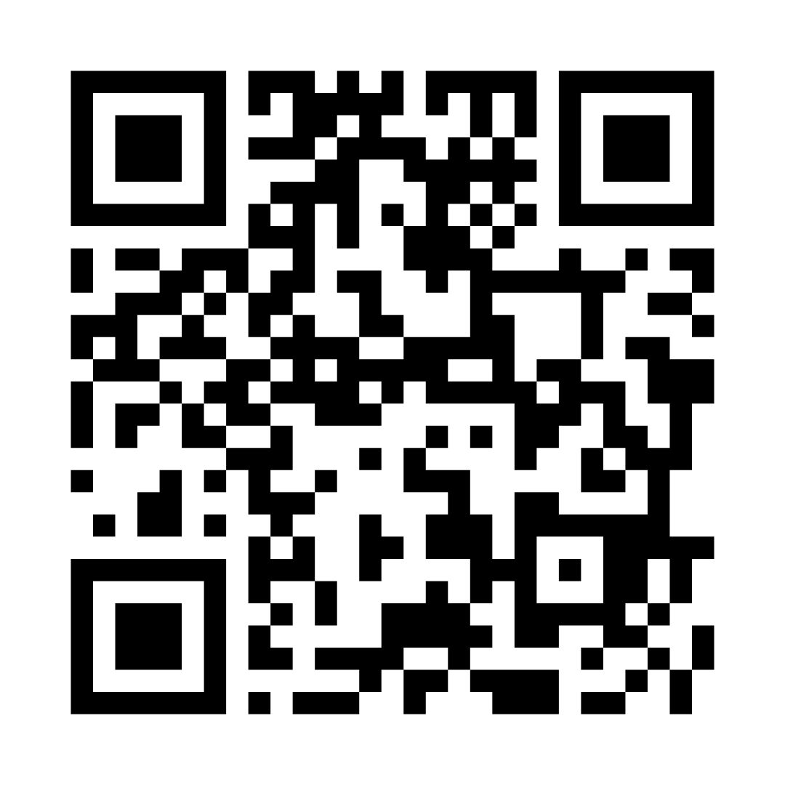
Access All Breathe Materials Online!
Trained partners
may download
materials here!
justbreathein.org/for-partners/
Notes:
KEY POINT: Trained Breathe partners can access all the Breathe materials online.
MATERIALS NEEDED: Print outs of the Partner QR code flyers that can be found here: https://justbreathein.org/for-partners/
VIRTUAL MODIFICATION: Place the link to the For Partners webpage in the chat box: https://justbreathein.org/for-partners/
SCRIPT/INSTRUCTIONS: “You received physical kits at the Initial Breathe training, which included a few of these items, including the flipchart. Let us know if you need any more hard copies of those.. But all of the materials we just received are available to you digitally at the webpage on the screen. Don’t worry I’ll send you this link in a follow up email and I also brought some signs you can post with a QR code that will take you right to this webpage.”

Slide 62
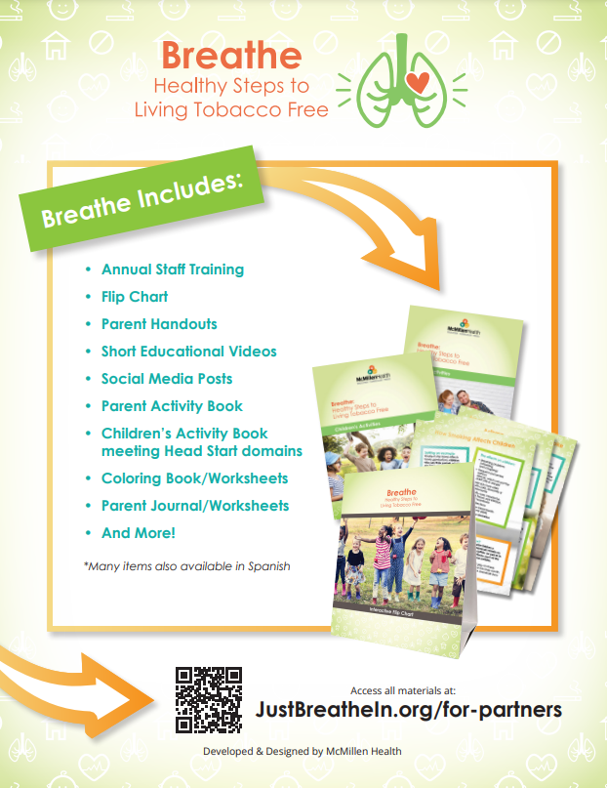
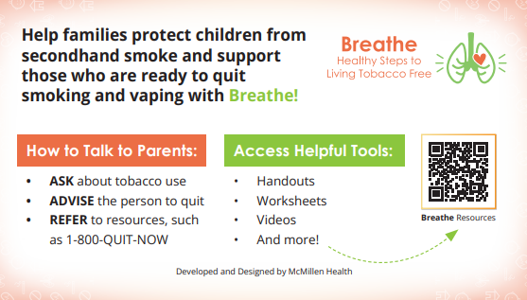
ACCESS WEBSITE
            QR Code Flyer
        Pocket Guide
Notes:
KEY POINT: Share resources that will link participants to the Breathe resources online.
MATERIALS NEEDED: Optional, Print outs of the Breathe Kit QR code flyers (https://justbreathein.org/wp-content/uploads/2024/07/Breathe-Flyer-QR-Code-For-Partners.pdf) and Pocket Guides for Partners (https://justbreathein.org/wp-content/uploads/2024/09/Pocket-Fact-Sheet-Partner-w-cut-marks.pdf)
SCRIPT: “To help you remember how to access the Breathe materials, we have flyers as well as pocket guides with QR codes to the Breathe website. I printed and brought some with me today, but you can also find these resources on the website and download or print more yourself and share them with your staff.”

Slide 63




Order QNI Materials for FREE at: quitnowindiana.com/educational-materials
QUIT NOW INDIANA
In English & Spanish
Notes:
KEY POINT: Quit Now Indiana handouts are free to order and are great resources to have on hand.
MATERIALS NEEDED: Bring a variety of Quit Now Indiana handouts, in English and Spanish.
VIRTUAL MODIFICATION: Paste the link to order QNI materials in the chat box so they can order their own and/or let them know if you plan to drop off materials. Here is the link: https://www.quitnowindiana.com/educational-materials
SCRIPT: “I also brought a bunch of Quit Now Indiana handouts for you today. I encourage you to make these handouts easily accessible in your lobbies and to have them on hand when you do home visits or meet with parents so you can share this valuable resource when the time is right. You are also welcome to order these materials yourself for free at the website on the screen. In case you have forgotten about Quit Now Indiana, this is a great resource for anyone who is ready and wants help to quit tobacco.”

Slide 64

QUITNOW INDIANA
FREE & Available 24/7 >> Call, Text, Online, or App
Trained Quit Coach >> Customized Quit Plan
    FREE Nicotine Replacement Therapies (NRT), as available
1-800-Quit-Now (784-8669)
1-855-DÉJELO-YA (Spanish)
1-877-777-6534 (TTY)
Text READY to 34191
Text LISTO to 34191 (Spanish)
quitnowindiana.com
Notes:
KEY POINT: There are lots of resources available for those who want to quit.
SCRIPT: “You don’t have to be the expert on quitting, but you can help parents who want to quit by connecting them Quit Now Indiana. Tons of updates and enhancements have been made to this services making it even more user friendly and accessible. Quit Now Indiana is free and available 24/7. People can call, text, go online or use the app to access services in whatever way works best for them. A trained quit coach will help them create a customized quit plan just for them. Free Nicotine Replacement Therapies, including the patch and gum, are provided for free, as available. Quit Now Indiana has a separate line for Spanish Speaking callers and TTY services are available for anyone with hearing impairments.”

Slide 65
QNI STANDARD & TAILORED PROGRAMS
Program (self-report) | Sessions | NRT | Offering | Amount (subject to change)
Pregnancy | 7 | Yes* | Patch or Gum | 4 weeks
Behavioral Health | 7 | Yes | Patch or Gum | 4 weeks
Youth Online | 6 Steps | No | N/A | N/A
Menthol Enhancement | 5 or 7 | Yes | Patch or Gum | 4 weeks
Standard Adult | 5 | Yes* for qualifying participants | Patch or Gum | 4 weeks
Notes:
KEY POINT: Quit Now Indiana offers specialized services for pregnant people, those with behavioral health issues, youth and those who use menthol products.
SCRIPT: “Quit Now Indiana offers specialized services for several populations that may need a tailored approach. This chart shows what is offered for the standard adult program at the bottom as well as the services available to pregnant people, those with behavioral health issues, youth ages 13-17, and people who use menthol products.”

Slide 66
Time to Reflect
Think Pair Share
Notes:
KEY POINT: Introduce the Think – Pair – Share format.
SCRIPT: “For our final activity I’m going to ask everyone to reflect on what you’ve learned and how tobacco affects your work and the families you serve. We are going to use the Think – Pair – Share format for this activity. Once I share the specific reflection topic I’ll give you a minute to think about it yourself and write down a few thoughts, then I’ll announce when it is time to pair up and you and a partner sitting near year will have about 2 minutes to discuss what you each came up with, then I’ll bring the whole group back together and I’ll give those who are willing to share with the full group. Does everyone understand the basic Think – Pair – Share format?”

Slide 67
Time to Reflect
How Does Tobacco Affect the Families You Serve?
Mind Heart Body
(what have you learned?)
(how do you feel?)
(what will you do?)
THINK
Notes:
KEY POINT: Review the Mind – Heart – Body questions.
SCRIPT: “When you do Think – Pair – Share, I want you to reflect on how tobacco affects the families you serve and the impact on your Mind – Heart – and Body. Try to just down one response for each. For Mind: what have you learned about how tobacco affects the families you serve? For Heart – how do you feel when you think about tobacco and the families you serve?. And for Body – what will you do based on what you know and feel about this issue, or it could be something you have already done using Breathe. The body is all about action, so we want to hear what actions you are or plan to take. Any questions? There are no right or wrong answers! I’ll give you 1 minute to jot down your responses for the Mind, Heart, and Body questions.”

Slide 68
Time to Reflect
How Does Tobacco Affect the Families You Serve?
Mind Heart Body
(what have you learned?)
(how do you feel?)
(what will you do?)
PAIR
Notes:
KEY POINT: Have participants pair up to share what came to mind in the Think segment.
SCRIPT: “Hopefully everyone came up with something for each question, now it’s time to pair up. I’ll give you 2 minutes to both discuss what you wrote down and see if you and your partner came up with similar answers or maybe you will get some new insights from your partner.”

Slide 69
Time to Reflect
How Does Tobacco Affect the Families You Serve?
Mind Heart Body
(what have you learned?)
(how do you feel?)
(what will you do?)
SHARE
Notes:
KEY POINT: Have participants share some of the Aha’s that came up in the Think/Pair segments.
SCRIPT: “I’m hearing some great conversations from our pairs, and now I’d like to bring us all back together and see who wants to share with the full group. You are welcome to share your own thought or idea or feel free to brag on your partner if you liked what they came up with. Let’s start with the mind…what is something you have learned about how tobacco affects the families you serve? Listen to 3-4 responses and validate (or gently correct any misinformation) what is shared. “Now who would like to chime in on the feelings this topic brings up for you, or your partner? Listen to 3-4 responses and validate all feelings and ask if others relate. “And now, what will we do? Who wants to share an action they have taken or plan to take to address tobacco with the families you serve? Listen to as many responses as you have time for and praise/encourage their ideas. “Thank you all so much for sharing. I’m excited about all the creative ways you plan to educate families about tobacco and are so happy to have your organization as a Breathe Partner.”

Slide 70
QUESTIONS??
Notes:
KEY POINT: Answer any questions now or in the future.
VIRTUAL MODIFICATION: Check the chat box for any questions that may have been posted during the training and let participants know they can post questions in the chat box or unmute to ask questions now.
SCRIPT: “We are just about done with the training, but I would love to answer any additional questions you may have. And as you continue implementing Breathe please do not hesitate to reach out with questions as they come up.”

Slide 71
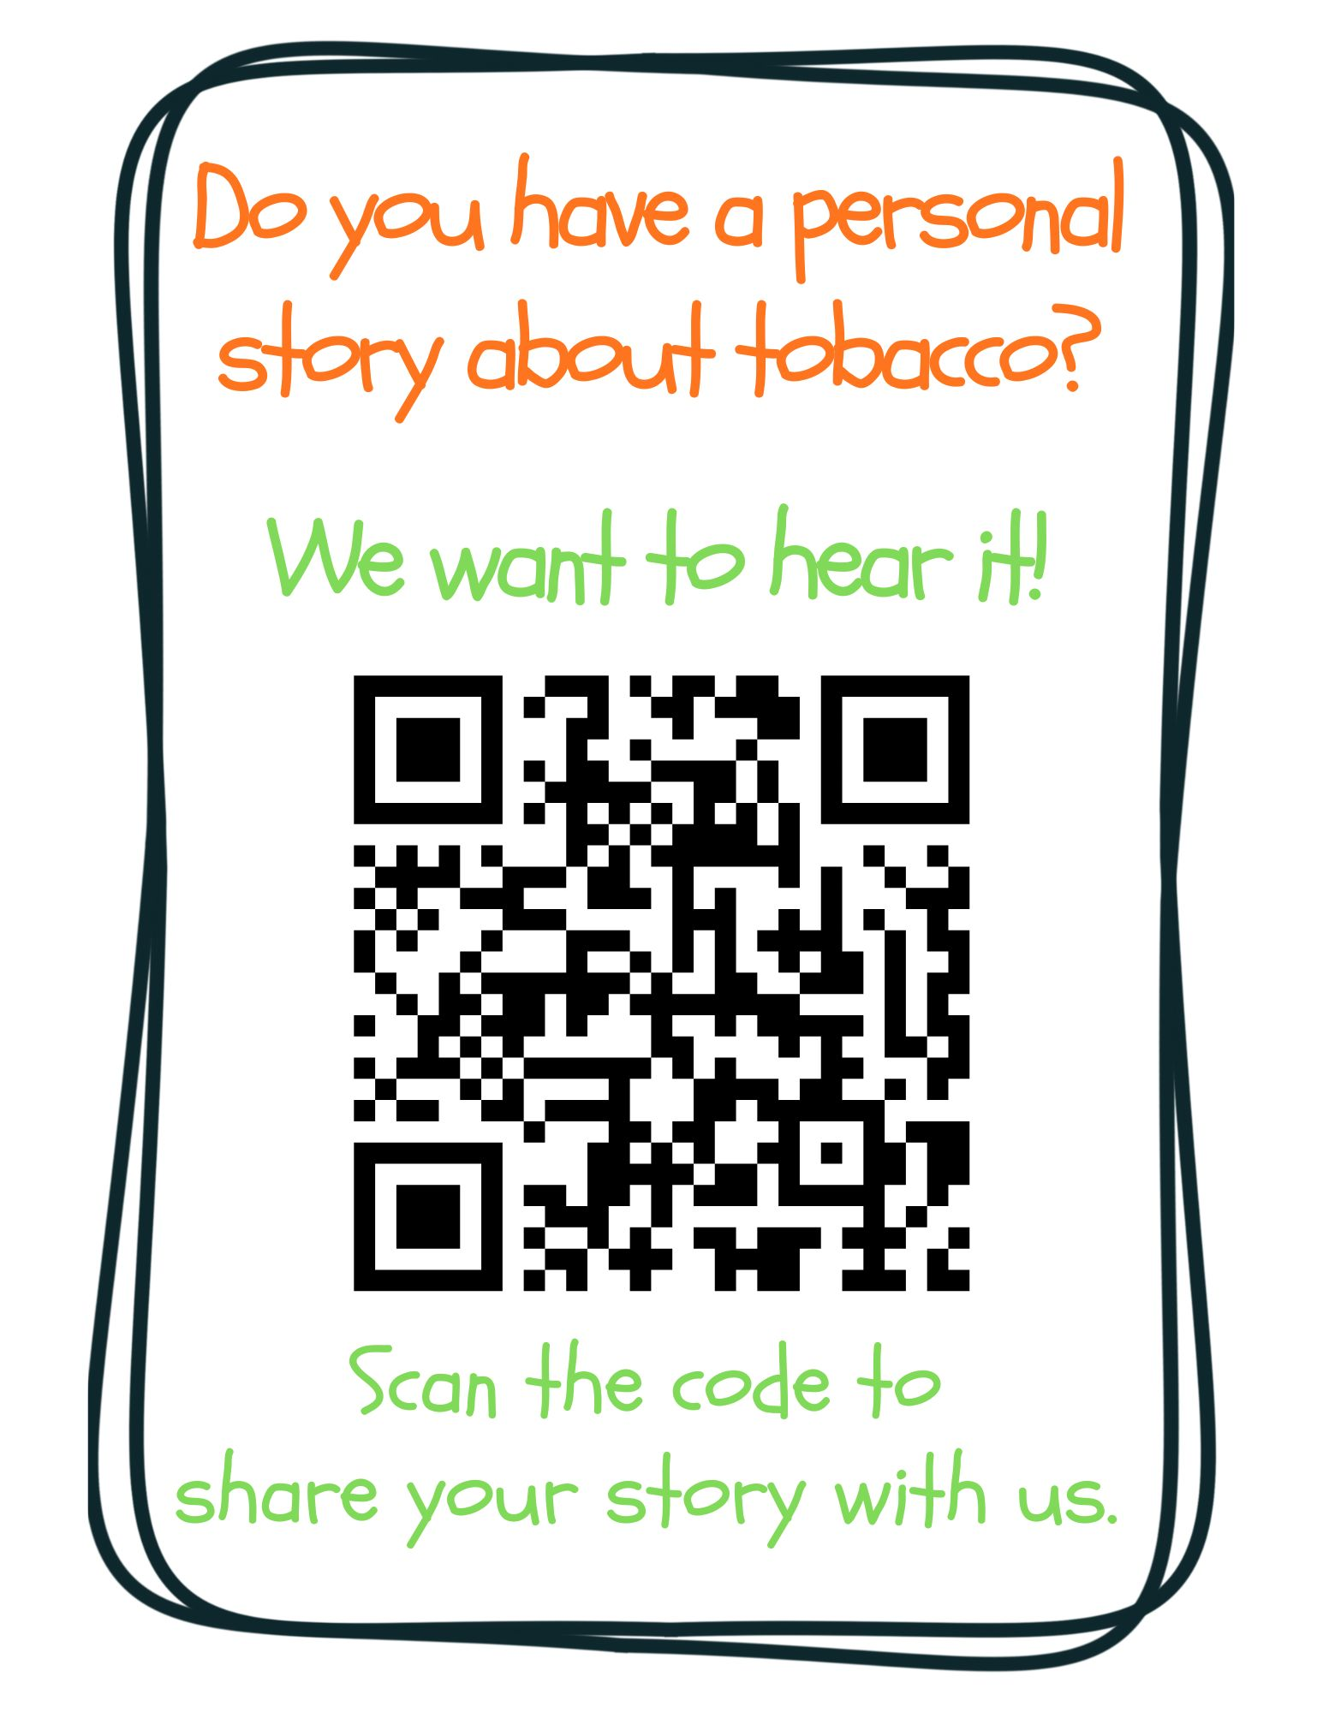
Notes:
KEY POINT: Ask for personal stories about tobacco.
VIRTUAL MODIFICATION: Post this link in the chat box: https://www.surveymonkey.com/r/tobaccostory
SCRIPT: “We love answering your questions as well as hearing stories about how tobacco has affected you, the people you love, and the families you serve. We don’t have time to hear all those great stories today, but we encourage you to share those stories with us at this link, which you can also find on the Breathe website and in the monthly newsletters. Tobacco isn’t just about stats, it’s about people and sharing stories about tobacco helps us all make a personal connection to this important work we are doing. We look forward to hearing your stories!”

Slide 72
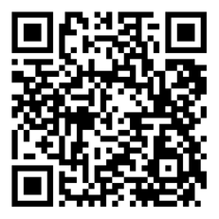
BREATHE TRAINING
“BREATHE REFRESHER”
USE THE QR CODE
to take the
POST- ASSESSMENT
Notes:
KEY POINT: All participants need to complete a post assessment.
MATERIALS NEEDED: Participants can complete the post assessment online with the QR code on this slide. This is the preferred method as it will save you time doing data entry after the training! (The slide now indicates “Breathe Refresher” so they know how to fill answer the first question regarding the type of training they attended.) To encourage compliance you could have them indicate they are done or show you their completion screen and you could give them a handout, magnet, or other giveaway when they do. You still need to bring some printed out post assessments, preferable on a different color of paper, in case participants prefer to complete a hard copy. The Post Assessment can be downloaded from this webpage: https://justbreathein.org/additional-resources/materials/ **If you choose NOT to have participants complete the assessment online, modify this slide by removing the QR code.
VIRTUAL MODIFICATION: Participants can use another device to access the QR code on the screen and/or you can place the link in the chat box so they can complete it on the device they are using for the training. Ask participants to type DONE in the chat box to encourage compliance and assess completion. Here is the link to the post assessment: https://www.surveymonkey.com/r/BreathePostAssessments
SCRIPT: “Thank you for participating in today’s Breathe training! Before we wrap up, I need everyone to complete the post assessment. Once you have completed the post assessment please bring it to me/hold it up and I will give you (a magnet, certificate of completion, or whatever handout you choose).”

Slide 73
PICK UP MATERIALS
Expect 1-Month Post Training Survey from
JustBreatheIndiana@gmail.com
NEW INCENTIVE!
Each month - Random drawing for a $25 gift card from all 1-month surveys received!
Notes:
KEY POINT: Participants can pick up Quit Now Indiana materials and should expect a follow up survey in one month.
SCRIPT: “After you complete the post assessment you can pick up Quit Now Indiana handouts/QR code flyers/supplemental Breathe materials. I’ll be sending a follow up email soon with the link to the webpage with all the digital materials as well as a certificate of completion for today’s training. Then expect an email in about a month from justbreatheindiana@gmail.com with our 1 month follow up survey. Please complete that survey when you get it as it really helps us gain feedback to evaluate and improve the Breathe program. (Click to reveal incentive) As an added incentive we are now doing a monthly drawing of all the 1 month follow up surveys received and one lucky winner will be awarded a $25 gift card, winner will get to choose between Walmart or Starbucks…and it could be you, if you complete the 1 month survey!”

Slide 74


THANK YOU!!
Tanya Shelburne, Project Manager
tanyas@healthedpros.org 317-902-4505
Alison Muckerheide, Tobacco Control Specialist
alisonm@healthedpros.org
Notes:
KEY POINT: Share contact information.
SCRIPT/INSTRUCTIONS: (Personalize this slide with your contact information.) “Thank you so much for participating in today’s Breathe Refresher. It was my pleasure to get to see all of you again and meet the new staff. I know that working with families on this topic may not be easy, but I hope this training reinvigorated you and that you have even more ideas for how utilize the Breathe materials. As always, please reach out to me any time you have questions or great ideas and want to share your successes!”

Slide 75
DATA SOURCES
2023 Indiana Behavioral Risk Factor Surveillance System (BRFSS)
www.in.gov/health/tpc/
www.cdc.gov/tobacco/
www.cancer.org/cancer/risk-prevention/tobacco
For a more detailed list of data sources used
to create Breathe materials go to
justbreathein.org/additional-resources/data-sources/
Notes:
KEY POINT: Share basic data sources and where they can find more.
SCRIPT/INSTRUCTIONS: (You can just leave this slide up for people to see or refer to it if anyone asks about the source of information you shared.)

