Slide 1
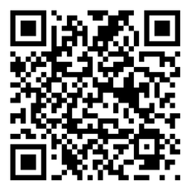
BREATHE TRAINING
“BREATHE REFRESHER”
USE THE QR CODE
to take the
PRE- ASSESSMENT
Notes:
HOW TO USE THE NOTES SECTION: Each slide in this presentation has a notes section that can help you deliver the presentation.
The KEY POINT let’s you know the most important message to convey and along with the text on the screen, that may be all the guidance an experienced County Coordinator/tobacco expert may need to conduct the training effectively.
If any handouts or other resources are necessary for a given slide you will see a MATERIALS NEEDED section.
If modifications are needed to share a slide or conduct an activity for a virtual training, you will see a VIRTUAL MODIFICATION section.
The SCRIPT portion of each page will give you a sample script (in italics) of what you might say for each slide as well as instructions, if needed. DO NOT READ THE SCRIPT VERBATIM! Instead, use the script to practice the presentation and then adjust it as needed to make it your own. The script is simply meant to be a guide/suggestion!
KEY POINT: All participants need to complete a pre assessment and sign the sign-in sheet.
MATERIALS NEEDED: Participants can complete the pre assessment online with the QR code on this slide. This is the preferred method as it will save you time doing data entry after the training! The slide indicates “Breathe Refresher” so they know how to answer the first question regarding the type of training they are attending. To encourage compliance, you could have them indicate they are done or show you their completion screen and you could give them a handout, magnet, or other giveaway when they do. You still need to bring copies of the sign-in sheets and some printed out pre assessments in case participants prefer to complete a hard copy….then after the training you will need to complete the data entry. **If you choose NOT to have participants complete the assessment online, modify this slide by removing the QR code.
VIRTUAL MODIFICATION: Participants can use another device to access the QR code on the screen and/or you can place the link in the chat box so they can complete it on the device they are using for the training. You may need to keep posting the link in the chat box as people enter the training since they may not be able to see earlier chat box entries. Ask participants to type DONE in the chat box to encourage compliance and assess completion. Here is the link to the pre assessment: https://www.surveymonkey.com/r/PreAssess2527
SCRIPT: “Before we get started, I need everyone to complete a pre assessment. To access the survey, just open the camera on your smartphone and point it at the QR code on the screen to get the link. If you prefer to complete the assessment with pen and paper just let me know and I will bring you a hard copy. I will also be asking you to complete a post-assessment at the end of the training, and these are important parts of our evaluation, so I appreciate you completing them. There are also sign-in sheets being passed around. Please make sure you put your name and contact info on one of the sign-in sheets so we will have a record of everyone’s attendance and if you want to receive our monthly Breathe E-newsletter you can indicate that on the sign in as well.”

Slide 2


HEALTH ED PROS
Tanya Shelburne MPH, CHES
Alison Muckerheide MPH, CHES
Notes:
KEY POINT: Participants should know your name and a bit about your background and position.
MATERIALS NEEDED: Breathe kits and Quit Now Indiana materials
VIRTUAL MODIFICATION: Make plans with your site contact to deliver Breathe Kits and Quit Now Indiana materials either before or after the training and discuss how the materials should be divided up between the training participants.
INSTRUCTIONS: Personalize this slide with your information. Welcome everyone to the training, introduce yourself, and give a brief background on your experience, your organization, and your position. Bring materials to the training (breathe kits, Quit Now Indiana materials, etc.) but do not distribute them until the end of the training as some attendees will leave/not pay attention if materials are distrusted too early.

Slide 3
Guidelines for Virtual Training
Training is being recorded
Keep video on
Mute yourself when not speaking
Rename yourself, if necessary
Minimize distractions
Stay for entire training (60 minutes)
Interact!!! (pre/post assessments, chat box, unmute)
Notify co-host if you have issues
Notes:
DELETE THIS SLIDE IF CONDUCTING AN IN-PERSON TRAINING!
KEY POINT: Go over housekeeping and expectations for the training.
SCRIPT/INSTRUCTIONS: (Personalize this slide as needed.) “Now before we jump into the actual training I want to go over a few housekeeping items. I want to make sure everyone is aware that the training is being recorded and I will share a link to the recording in a follow up email in a day or two should you want to watch it again or share it with someone on staff who may have missed the training. I do ask that you keep your videos on during the training so I can see everyone’s smiling faces and it will feel a bit more like we are actually in person, but do keep yourself on mute to minimize background noise and just unmute yourself when you want to share something or ask a question. If the name on the screen is not your name, please rename yourself, which will help us with attendance and knowing who everyone is. To rename yourself put your cursor in your box on the screen and click the blue box in the upper right corner with 3 dots in it and you should see the option to rename yourself. Do your best to minimize distractions around you and I do ask that you stay for the full 90 minute training. There will be several options to interact so feel free to use the chat box or raise your hand at any time, and I hope you will interact as it is way more fun when it’s not just me talking the whole time! If you have any issues during the training feel free to message the co-host and we will try to assist.”

Slide 4
Connection Before Content
No one cares how much you know,
until they know how much you care.
- Theodore Roosevelt
Notes:
KEY POINT: Connect with participants before you get into the training content.
SCRIPT: “We will get to discussing tobacco in just a bit, but I think it is important that we focus on “Connection Before Content”. This quote from Theodore Roosevelt really sums up why Connection Before Content is important and serves as the basis for why we designed the Breathe program the way we did. He said ‘No one cares how much you know, until they know how much your care.’ Hopefully as we get to know each other a little better you will see that I have a heart for protecting children and families and supporting the staff who serve them! And we know all of you have a heart for the families you serve and that they know and trust you. That’s why we focus on training staff at Head Start and other organizations rather than going directly to the parents ourselves. So let’s connect a bit with an ice breaker”

Slide 5
TIME TO DE-STRESS!
What worries are weighing on you?
What are healthy ways you like to de-stress?
How does this relate to tobacco?
Notes:
KEY POINT: Help everyone reduce their stress level.
MATERIALS NEEDED: Each participant needs two blank half sheets of paper and something to write with, and you may want print outs of the stress management parent handout found here: https://justbreathein.org/additional-resources/breathe-kit-materials/
VIRTUAL MODIFICATION: Have participants write their stressors down, rip them up, and then write down their healthy ways to de-stress just as you would in person. Then ask them to share examples of their de-stressing activities in the chat box. Read the responses aloud and provide validation.
SCRIPT/INSTRUCTIONS: “Chances are each of you came into this training with lots of things on your mind…long to-do lists, work related stress, challenges in your home life…and now you have to sit through an hour-long training! I take no offense to the fact that some of you may wish you were somewhere else right now! But I hope that we can all make the best use of this hour so you can leave here with more knowledge and some ideas for how to better support your families. First, I want us all to set the right mood by taking a few moments to be mindful and de-stress with a short activity. Not only can this exercise help all of us right now, but it is something you can replicate with the children and families you serve as I’m betting they could also benefit from de-stressing!
(CLICK TO BRING UP WHAT WORRIES ARE WEIGHING ON YOU?) First, take a moment to “check-in” with yourself by writing down a few worries or things that are weighing on your mind right now. You won’t be asked to share what you write down, this is just for you! (Give them 1 minute to write down their worries) Now that you have written down what is stressing you, I want you to rip up those sheets into tiny pieces and toss them in the trash can. (Walk around with the trash can to collect the paper scraps) With this activity I am encouraging you to let those worries and stressors go…just Let It Go at least for the next hour so you can have better focus and feel a bit lighter even if just for a while. I’ll resist the urge to sing the Frozen theme song, but I do hope you can all Let It Go!
(CLICK TO BRING UP WHAT ARE HEALHY WAYS YOU LIKE TO DE-STRESS?) Next, I want everyone to write down on another slip of paper a few healthy ways you like to de-stress. (Give them a minute or two to write down their ways to de-stress) Would anyone like to share some of their tactics for de-stressing? (Let several people share examples.) Not everyone’s list will look the same and that’s ok! The idea of going for a really long run sounds like torture to me, but for someone else that is exactly what they need to clear their mind and release tension! The most important thing is that we each have some healthy go-to options for when the worries and responsibilities of life get to be a bit much. (If people share somewhat unhealthy habits like drinking wine, eating chocolate, etc, acknowledge that for most people those things, in moderation, can be reasonable ways to de-stress.)
(CLICK TO BRING UP HOW DOES THIS RELATED TO TOBACCO?) So you may be thinking, what the heck does any of this have to do with Breathe and learning about tobacco? I’m so glad you asked! For many stressed out people, smoking or vaping might have been on their list of de-stressing activities…it we weren’t focusing on HEALTHY stress management. While many people who use tobacco think of it as a stress reliever, it can be a vicious cycle that actually creates more stress. From the added expense, health problems, lingering odor, physical dependence, and more…tobacco use just adds unnecessary stress and more worries. By helping your families deal with stress in a healthy way you can help pave the way for tobacco free families. Even though we can’t do all the de-stressing activities on your lists right now, I hope you will all take time for a bubble bath or a long walk of some other kind of self-care that appeals to you this evening!”

Slide 6
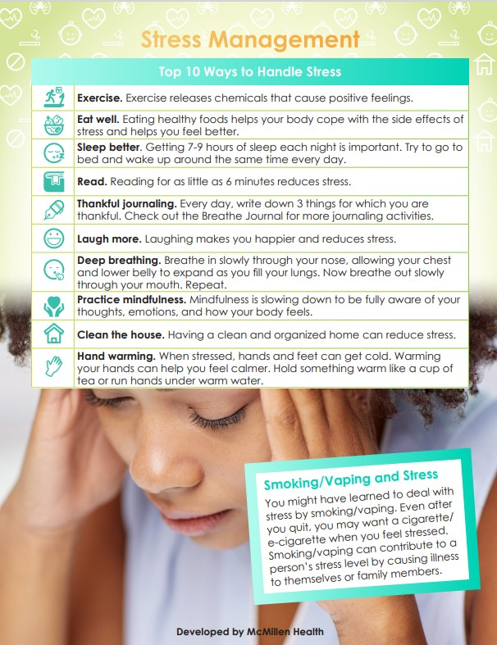
STRESS MANAGEMENT HANDOUT
As a Breathe Partner you have access to
TONS of free materials, including this handout on Stress Management!
Notes:
KEY POINT: Remind participants they have access to lots of free resources, including the Stress Management handout.
MATERIALS NEEDED: You can provide copies of the Stress Management handout, if you choose.
SCRIPT/INSTRUCTIONS: “And I want to remind everyone that as a Breathe partner you have access to TONS of Breathe materials online, including this Stress Management handout. So if you find that parents are experiencing lots of stress and that might be contributing to tobacco use, this could be a very helpful handout. A little bit later I’ll remind you of all the Breathe materials available to you as a Breathe partner and how to access them.”

Slide 7
GAME TIME!
How Much Do You Know/Remember
About Tobacco?
Notes:
KEY POINT: Set the stage for this training being a refresher.
SCRIPT: “Now that everyone’s stress levels have decreased a bit, let’s see how much you remember from our last training. Of course if I expect you to talk to parents about tobacco use and secondhand smoke then you need to be aware of some basic information on this topic. I realize not everyone attended the previous training and you have all slept since then, so just do your best!”

Slide 8



Notes:
KEY POINT: Announce that we will be playing Family Feud to test what we know about tobacco.
SCRIPT: “We are going to have a little fun with this…and play Family Feud!!! I’m guessing we may have at least a few competitive people in this group so this should be fun!”

Slide 9



STAGE
Break up into TWO teams!
0
0
TEAM 1
TEAM 2
8
7
6
5
4
3
2
1
0
0
0
0
0
0
0
0
Stage
Notes:
KEY POINT: Review the structure for how to play Family Feud.
MATERIALS NEEDED: Dry erase board and markers or newsprint to keep the score on. The Family Feud Cheat Sheet so you know which answers to reveal, which can be found here: https://justbreathein.org/staff-training/breathe-refresher/
VIRTUAL MODIFICATION: For the virtual version of Family Feud have everyone play individually. Instruct participants to type just ONE answer in the chat box after the question appears. Read the responses aloud and identify who earned the points as you click the correct answers on the game board (using the cheat sheet). It will be very helpful to have a co-host to assist with tracking points, especially if you have a big group!
SCRIPT: “This is a modified version of Family Feud, where I get to decide which family you are on! So everyone on this side of the room will be on one team and this side will be on the other team. Decide who will be your team’s spokesperson and pick a name for your team/Family. (Give them a minute to do that.) The team leader with the closest birthday will go first. Then we will take turns going back and forth providing a guess at the posted survey question. In this version of Family Feud All correct answers are worth 10 points as no answer is considered “better” than another. Are we ready to play?”
INSTRUCTIONS: Use your cheesiest Game Show voice and divide the participants into 2 groups and ask them to pick a leader/spokesperson. The team leader with the closest upcoming birthday goes first. Ask for a volunteer or have your co-trainer record the score on paper or a dry erase board. Have teams rotate providing answers to each of the posted survey questions. For example: Question 1-What common products are used to deliver nicotine to the body?
Team 1 guesses * Cigarettes*-CORRECT- 10 Points goes to Team 1…It is now Team 2’s turn ON THE SAME QUESTION! (question 1) Team 2 guesses *Toilet Bowl Plunger*- INCORRECT- No points go to Team 2…It is Team 1’s turn again.
Continue alternating turns until all questions have been answered. Answers can be revealed individually by clicking on the correct number. You can find a cheat sheet with the answers under each number (so you will know which numbers to click) here:https://justbreathein.org/staff-training/breathe-refresher/ After each answer is revealed, you can fill in with some additional info and tobacco education on that particular topic. All correct answers are worth 10 points as no answer is considered “better” than another, they are either correct or incorrect.
If a team comes up with an answer that is not listed as a correct answer on the board, but you feel it is still a good/correct response you can use your own discretion to award that team with 10 points. If correct answers are still remaining on the board but both teams have had a turn and didn’t come up with one of the remaining responses or you are running short on time, simply reveal the remaining correct answer(s) and move on to the next question.

Slide 10

What common products are used to deliver nicotine to the body?
1
5
Cigarettes
10
Nicotine Replacement Therapies (NRT)
10
2
0
E-cigarettes/ Vapes/ Juul
10
0
TEAM 1
TEAM 2
3
Smokeless/Chewing Tobacco & Nicotine Pouches
10
ADD ROUND POINTS
ADD ROUND POINTS
4
Cigars/Cigarillos/ Pipes
10
BACK TO SCORES
0
NEXT ROUND
Notes:
KEY POINT: Review common tobacco products.
SCRIPT/INSTRUCTIONS: (When first opening these slides either wait for numbers to appear or push the right arrow key to show numbers.)
“(Team 1) will go first and the question is What common products are used to deliver nicotine to the body? (Team 1 provides an answer. Use the Family Feud Cheat sheet to know which number on the board corresponds to that answer. Click on that number to reveal the answer and give that team 10 points.) “(Team 2) Now it is your turn to answer the same question.” (Keep alternating between teams until all answers are revealed or until both teams fail to get a correct answer and then reveal any remaining answers.) “Great job everyone! There are lots of tobacco products on the market these days, so it is helpful to know a little about the various products when you are providing education to parents.” (Give some background information about each of these products, especially emerging or new versions of these products and share how NRT are proven to help people step down their tobacco use. Then click the right arrow key to advance to the next question/slide.)

Slide 11
Who is at risk for secondhand smoke exposure?
1
5
Everyone
10
Pets
10
2
0
Infants/Children
10
0
TEAM 1
TEAM 2
3
Unborn Babies
10
ADD ROUND POINTS
ADD ROUND POINTS
4
Pregnant People
10
BACK TO SCORES
0
NEXT ROUND
Notes:
KEY POINT: Review who is at risk for secondhand smoke exposure.
SCRIPT/INSTRUCTIONS: “(Team X) will go next and the question is Who is at risk for secondhand smoke exposure? (Keep alternating between teams until all answers are revealed or until both teams fail to get a correct answer and then reveal any remaining answers. If “Everyone” is guessed first, then ask what are some other key groups that we know are especially vulnerable to secondhand smoke.) “Awesome job again! Everyone is at risk for secondhand smoke and the work you are doing to educate families is extremely important as we all want to protect our children from the negative effects of tobacco.” (Click the right arrow key to advance to the next question/slide.)

Slide 12
What health problems can occur if an infant/child is exposed to secondhand smoke?
1
5
Asthma Attacks
10
Learning
Difficulties
10
2
0
Ear Infections
10
0
TEAM 1
TEAM 2
3
Respiratory Infections
10
ADD ROUND POINTS
ADD ROUND POINTS
4
Sudden Infant Death Syndrome (SIDS)
10
BACK TO SCORES
0
NEXT ROUND
Notes:
KEY POINT: Review common health problems for infants/children exposed to secondhand smoke.
SCRIPT/INSTRUCTIONS: “(Team X) is up next and the question is What health problems can occur if an infant or child is exposed to secondhand smoke? (Keep alternating between teams until all answers are revealed or until both teams fail to get a correct answer and then reveal any remaining answers. Since there are many problems that can result from secondhand smoke be prepared to give out 10 points if they give a good response even if it isn’t on the screen.
You can also give hints if they are not getting a specific answer.) “There are tons of negative health effects from secondhand smoke exposure for little ones so it is important that we help make parents aware of this and provide support and resources that will help protect their families.” (Click the right arrow key to advance to the next question/slide.)

Slide 13
How can children be protected from second/thirdhand smoke?
1
5
Quit Smoking
10
Pass Smoke
Free Policies
10
2
0
Smoke Outside
10
0
TEAM 1
TEAM 2
3
Don’t Smoke
in the Car
10
ADD ROUND POINTS
ADD ROUND POINTS
4
Wear a Smoking Jacket
10
BACK TO SCORES
0
NEXT ROUND
Notes:
KEY POINT: Review how we can protect children from second/thirdhand smoke.
SCRIPT/INSTRUCTIONS: “(Team X)’s turn and the question is How can children be protected from second and thirdhand smoke? You may remember from the last training that thirdhand smoke includes all the chemicals and toxins left on furniture, clothes, toys, etc. when someone smokes in a room or car and this can be dangerous to children even if they aren’t present when the smoking takes place.” (Keep alternating between teams until all answers are revealed or until both teams fail to get a correct answer and then reveal any remaining answers. Be prepared to give out 10 points if they give a good response even if it isn’t on the screen.) “You guys came up with great strategies to protect kids from second and thirdhand smoke and these are important tips to share with parents when you provide tobacco education. And even if they aren’t ready to quit smoking you can share other ways to minimize exposure for their families.” (Click the right arrow key to advance to the next question/slide.)

Slide 14
Who does the tobacco industry aggressively target in their marketing?
1
5
Youth
10
Communities/families with low incomes
10
2
0
Women
10
0
TEAM 1
TEAM 2
3
People of Color
10
ADD ROUND POINTS
ADD ROUND POINTS
4
LGBTQ+
10
BACK TO SCORES
0
NEXT ROUND
Notes:
KEY POINT: Review who the tobacco industry targets.
SCRIPT/INSTRUCTIONS: “It is (Team X)’s turn and we want to know Who does the tobacco industry aggressively target in their marketing? What groups of people does the tobacco industry prey on with their marketing tactics? (Keep alternating between teams until all answers are revealed or until both teams fail to get a correct answer and then reveal any remaining answers. Since there could be additional groups targeted be prepared to give out 10 points if they give a good response even if it isn’t on the screen. You can also give hints if they are not getting a specific group.) “Nice job! Unfortunately, the tobacco industry is hard at work marketing their deadly products and preying on vulnerable populations, including the children and families that you serve, and that is why we all need to do our part to share the facts about tobacco as well as prevention and cessation resources with our families.”

Slide 15
In what ways might infants or children come into contact with marijuana/THC?
1
5
Secondhand Smoke Exposure
10
Through Breast Milk
10
2
0
Storebought Edibles or Drinks with THC
10
0
TEAM 1
TEAM 2
3
Homemade Edibles Infused with THC
10
ADD ROUND POINTS
ADD ROUND POINTS
4
While In Utero
10
BACK TO SCORES
0
NEXT ROUND
Notes:
KEY POINT: Review who the tobacco industry targets.
SCRIPT/INSTRUCTIONS: “For our final question it is (Team X)’s turn and we are going to a touch on marijuana. Our survey question is In what ways might infants or children come into contact with marijuana or THC, which is the psychoactive compound in the cannabis plant? (Keep alternating between teams until all answers are revealed or until both teams fail to get a correct answer and then reveal any remaining answers. Be prepared to give out 10 points if a good response is given even if it isn’t on the screen. You can also give hints if they are not getting a specific answer.) “Well done! Breathe doesn’t go into marijuana in great detail, but we do think it is important to make sure families understand the dangers of marijuana when it comes to pregnancy and young children. So not smoking marijuana while pregnant or breast feeding and keeping any products with THC away from little ones is a critical message to share and the Breathe toolkit includes a great video on marijuana as well as some helpful handouts.”

Slide 16

THANK YOU FOR PLAYING!
And the winner is…?
Notes:
KEY POINT: Identify the winner of Family Feud.
VIRTUAL MODIFICATION: Have the co-host tally up the points and declare the individual winner.
SCRIPT: “Thank you all for playing Breathe’s version of Family Feud! And now…drum roll please….the winner of Family Feud is….(Team X)!! Let’s give them a round of applause! Actually, you all did an awesome job and by using the Breathe materials and educating families about tobacco, ALL the children and families you serve can be the real winners! If you enjoyed playing this game and think your parents or other staff who couldn’t be here today would also enjoy playing Breathe Family Feud, you can find the PowerPoint slides for the game you just played on the Breathe website!”

Slide 17
Breathe Materials
Let’s review all the materials you have access to!
Notes:
KEY POINT: Remind participants that they have access to lot of Breathe materials online.
VIRTUAL MODIFICATION: Place the link to the For Partners webpage in the chat box: https://justbreathein.org/for-partners/
SCRIPT/INSTRUCTIONS: “Now that we have all brushed up on our knowledge of tobacco and the importance of protecting children from second and thirdhand smoke, I want to remind you about all the Breathe resources you have access to that can aid in educating and supporting the families you work with. Hopefully you know where your Breathe kits are stored, but if not, talk to your leadership to find out and let me know if you need any replacement items. If you are new or haven’t used some of the Breathe materials yet I hope this refresher will get your wheels spinning as you think about which materials would work best depending on your specific job and how you may interact with families and young children.”

Slide 18
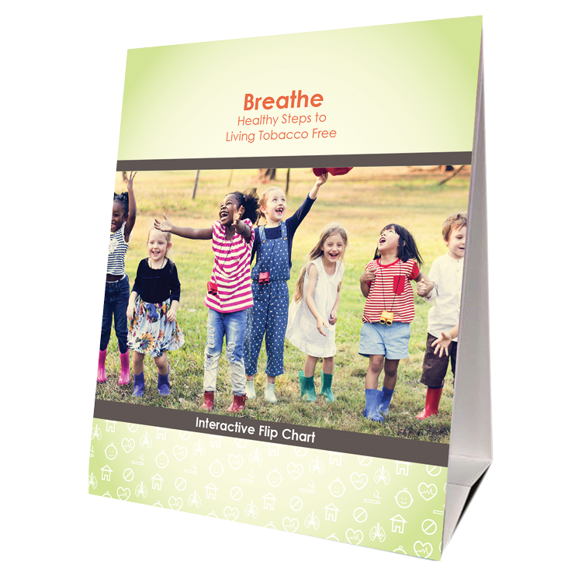



FOR PARENTS/CAREGIVERS
Flip
Chart
Activities Booklet
Worksheets
Handouts
Notes:
KEY POINT: Review Breathe resources focused on parents/caregivers.
MATERIALS NEEDED: Sample Breathe kit; additional supplies as needed.
SCRIPT/INSTRUCTIONS: “Several of the items in the Breathe kit are specifically geared towards parents/caregivers or the adults in the household. (CLICK TO REVEAL THE LABELS AS YOU TALK ABOUT EACH BREATHE RESOURCE) The flipchart is great for one on one or small group interactions with talking points on the back of each page to guide your conversation. The parent handouts cover many different tobacco topics and can be printed or downloaded and shared electronically with all parents or with specific parents when relevant. The worksheets also provide great information on many tobacco topics but also include interactive components that help parents set goals and think through challenges of quitting or minimizing smoke/vapor exposure for their children. The activities booklet is a great tool for anyone who needs activities to do with groups of parents. There are instructions for 9 different activities that take very little prep and minimal materials and will get parents discussing a variety of tobacco related topics.

Slide 19
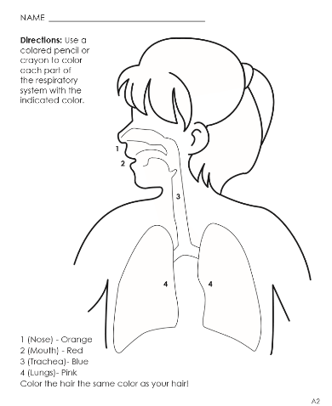


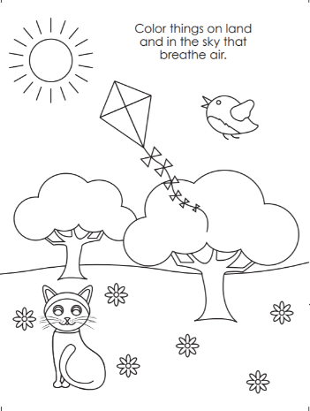
FOR YOUNG CHILDREN
Coloring Book/Sheets
Children’s Activities Booklet
Notes:
KEY POINT: Review Breathe resources focused on young children.
SCRIPT/INSTRUCTIONS: “The online Breathe kit also includes some resources that can be used directly with children. These resources are focused on healthy bodies and are not specifically tobacco focused. There are coloring sheets that can be printed or downloaded and shared electronically. There is also a Children’s Activities Booklet with 15 short activities focused on healthy bodies that work great with children ages 3-7. These activities require very little prep work or outside materials. Both of these resources are great for anyone who works directly with children and they can also be given to parents as take-home activities.”

Slide 20

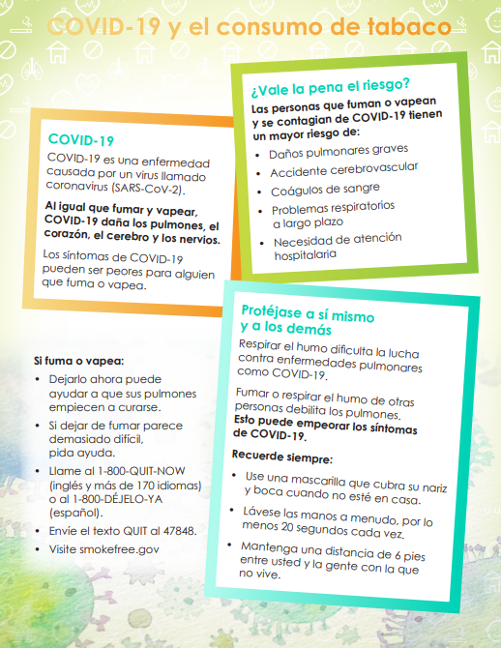

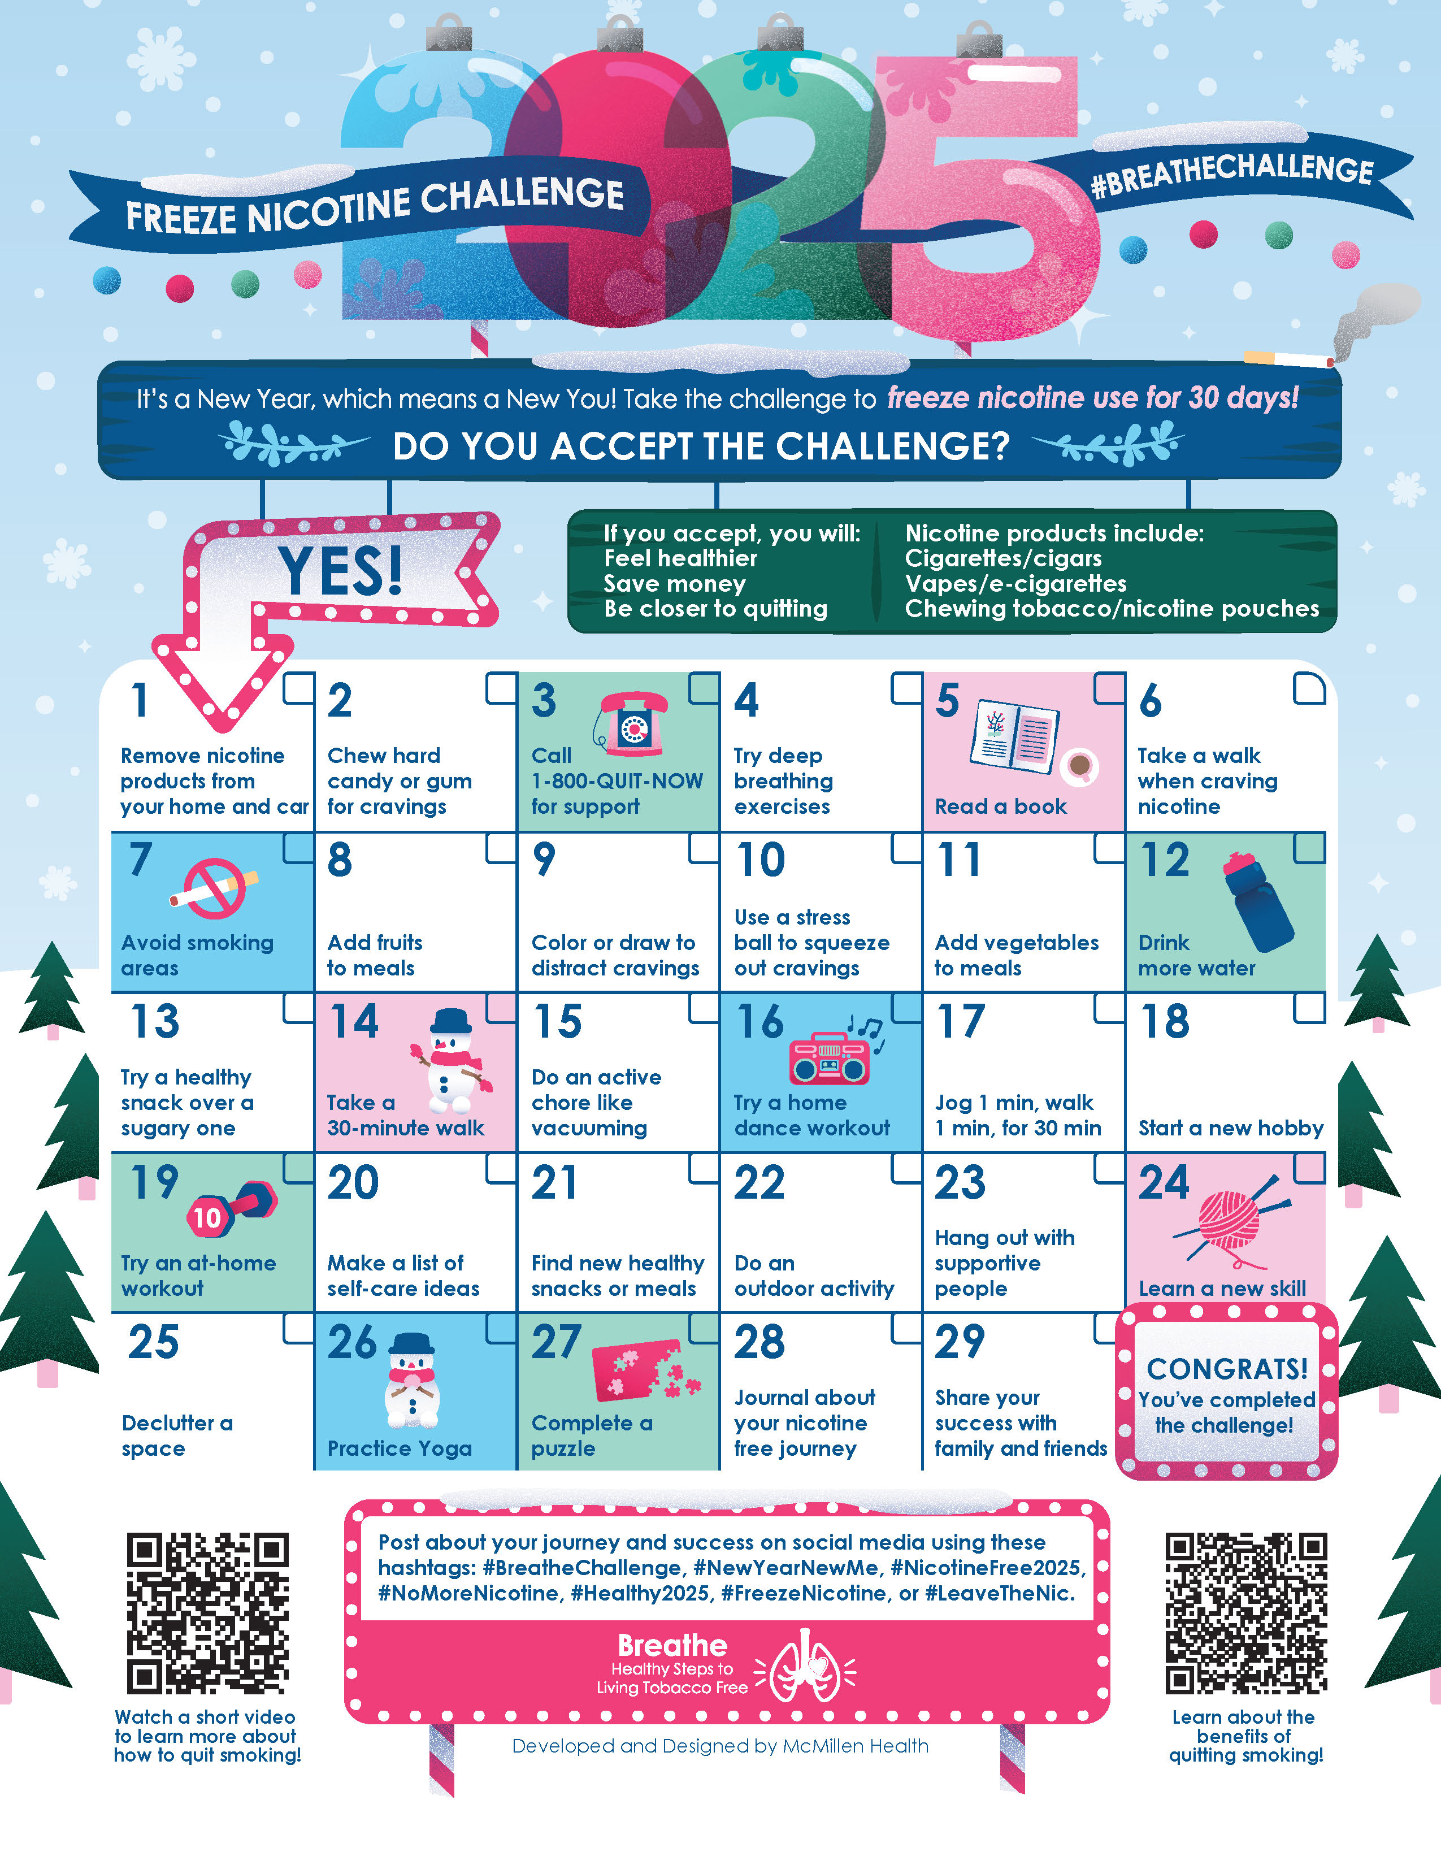
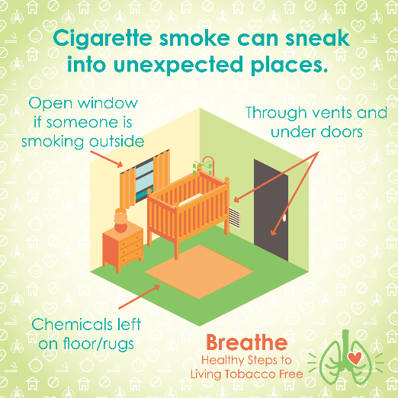
MORE RESOURCES
Spanish Materials
Short
Videos
Quarterly Challenges
Social Media Posts
Monthly
E-newsletter
Notes:
KEY POINT: Review additional Breathe resources and ways to share tobacco information.
SCRIPT: (CLICK TO REVEAL THE LABELS AS YOU TALK ABOUT EACH BREATHE RESOURCE) “And that’s not all! Many of the Breathe materials are also available in Spanish, so please access those materials if you are working with Spanish Speaking parents/caregivers. There are also lots of short videos, just 2-3 minutes each that help reinforce important tobacco related topics. Feel free to pull these up on an ipad to show to parents as appropriate or post them on your social media. Speaking of social media, the website also includes 12 ready to go graphics and accompanying text that you can post on your social media pages as a way to keep tobacco education on everyone’s radar. We also create a monthly Breathe e-newsletter that we will send directly to anyone who indicated they would like to receive it on today’s sign in sheet, if you aren’t already. We hope that you will share the newsletter by forwarding it, printing the pdf, or copying and pasting sections of it into your own organization’s newsletter. Finally, we have a new challenge each quarter that is a fun way to motivate families when it comes to quitting tobacco or minimizing exposure to second and thirdhand smoke/vapor. I hope this quick overview of the Breathe materials was a helpful refresher and that each of you can find at least one or two resources that might be useful in your current role and that you will feel comfortable sharing.”

Slide 21
Access All Breathe Materials Online!
Trained partners may download materials at
justbreathein.org/for-partners/
Notes:
KEY POINT: Trained Breathe partners can access all the Breathe materials online.
MATERIALS NEEDED: Print outs of the Partner QR code flyers that can be found here: https://justbreathein.org/for-partners/
VIRTUAL MODIFICATION: Place the link to the For Partners webpage in the chat box: https://justbreathein.org/for-partners/
SCRIPT/INSTRUCTIONS: “All of the Breathe materials can be accessed at the webpage on the screen. Don’t worry I’ll send you this link in a follow up email in case you don’t already have it bookmarked.”

Slide 22
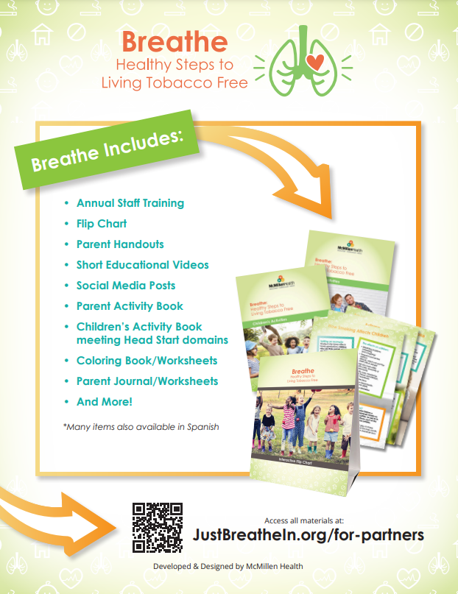
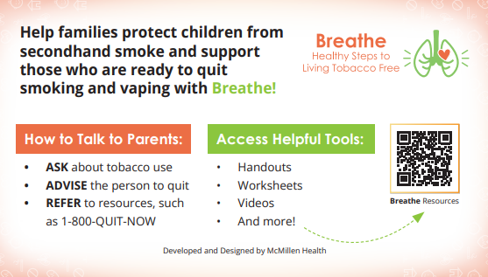
ACCESS BREATHE WEBSITE
            QR Code Flyer
            Pocket Guide
Notes:
KEY POINT: Share resources that will link participants to the Breathe resources online.
MATERIALS NEEDED: Optional, Print outs of the Breathe Kit QR code flyers (https://justbreathein.org/wp-content/uploads/2024/07/Breathe-Flyer-QR-Code-For-Partners.pdf) and Pocket Guides for Partners (https://justbreathein.org/wp-content/uploads/2024/09/Pocket-Fact-Sheet-Partner-w-cut-marks.pdf)
SCRIPT: “To help you remember how to access the Breathe materials, we have flyers as well as pocket guides with QR codes to the Breathe website. I printed and brought some with me today, but you can also find these resources on the website and download or print more yourself and share them with your staff.”

Slide 23




Order QNI Materials for FREE at: quitnowindiana.com/educational-materials
QUIT NOW INDIANA
In English & Spanish
Notes:
KEY POINT: Quit Now Indiana handouts are free to order and are great resources to have on hand.
MATERIALS NEEDED: Bring a variety of Quit Now Indiana handouts, in English and Spanish.
VIRTUAL MODIFICATION: Paste the link to order QNI materials in the chat box so they can order their own and/or let them know if you plan to drop off materials. Here is the link: https://www.quitnowindiana.com/educational-materials
SCRIPT: “I also brought a bunch of Quit Now Indiana handouts for you today. I encourage you to make these handouts easily accessible in your lobbies and to have them on hand when you do home visits or meet with parents so you can share this valuable resource when the time is right. You are also welcome to order these materials yourself for free at the website on the screen. In case you have forgotten about Quit Now Indiana, this is a great resource for anyone who is ready and wants help to quit tobacco.”

Slide 24

QUITNOW INDIANA
FREE & Available 24/7 >> Call, Text, Online, or App
Trained Quit Coach >> Customized Quit Plan
    FREE Nicotine Replacement Therapies (NRT), as available
1-800-Quit-Now (784-8669)
1-855-DÉJELO-YA (Spanish)
1-877-777-6534 (TTY)
Text READY to 34191
Text LISTO to 34191 (Spanish)
quitnowindiana.com
Notes:
KEY POINT: There are lots of resources available for those who want to quit.
SCRIPT: “You don’t have to be the expert on quitting, but you can help parents who want to quit by connecting them to Quit Now Indiana. Quit Now Indiana is free and available 24/7. People can call, text, go online or use the app to access services in whatever way works best for them. A trained quit coach will help them create a customized quit plan just for them. Free Nicotine Replacement Therapies, including the patch and gum, are provided for free, as available. Quit Now Indiana has a dedicated number for those who speak Spanish and other language services are available as well as TTY capabilities for those who are deaf or hard of hearing.”

Slide 25
QNI STANDARD & TAILORED PROGRAMS
Program (self-report) | Sessions | NRT | Offering | Amount (subject to change)
Pregnancy | 7 | Yes* | Patch or Gum | 4 weeks
Behavioral Health | 7 | Yes | Patch or Gum | 4 weeks
Youth Online | 6 Steps | No | N/A | N/A
Menthol Enhancement | 5 or 7 | Yes | Patch or Gum | 4 weeks
Standard Adult | 5 | Yes* for qualifying participants | Patch or Gum | 4 weeks
Notes:
KEY POINT: Quit Now Indiana offers specialized services for pregnant people, those with behavioral health issues, youth and those who use menthol products.
SCRIPT: “Quit Now Indiana offers specialized services for several populations that may need a tailored approach. This chart shows what is offered for the standard adult program at the bottom as well as the services available to pregnant people, those with behavioral health issues, youth ages 13-17, and people who use menthol products.”

Slide 26
IN JUST ONE WORD
(or maybe a short phrase)
Let’s talk about your experience with the Breathe materials & addressing tobacco with families…
Notes:
KEY POINT: Introduce the activity In Just One Word.
MATERIALS NEEDED: Everyone needs 2 sheets of blank paper and something to write with, or you could do this with post-it notes and have everyone put their answers on a wall.
VIRTUAL MODIFICATION: Have participants share their one word answers to each statement in the chat box. Read the responses aloud and provide commentary and validation as appropriate.
SCRIPT/INSTRUCTIONS: “Now that I have refreshed your memories about the Breathe materials, I want to dive into learning more about your experience with the Breathe materials and addressing tobacco with families since you first learned about Breathe. Whether you are using the materials on a regular basis, have used them just a few times, or you’ve tucked them away and never pulled them out, I think we can all learn from each other about how we are or are not addressing this topic with our families. So I’m going to ask for everyone’s active involvement again, but don’t stress…I’m only asking for one word! Those of you who are overachievers I’ll allow a short phrase as well! I’ll post some brief statements or phrases on the screen, one at a time, and for each one I want you to think of one word that comes to mind or that describes how you feel about that statement or phrase. Then write your one word really big on a blank slip of paper. You can use the other side for the next statement so write really big! Keep in mind there are no right or wrong answers, we are just looking for honest answers! Everybody understand?”

Slide 27
IN JUST ONE WORD
(or maybe a short phrase)
Children who are exposed to second/thirdhand smoke…
Notes:
KEY POINT: Discuss participants thoughts about children who are exposed to secondhand smoke.
SCRIPT/INSTRUCTIONS: “Our first phrase is Children who are exposed to secondhand smoke. So write down one word or a short phrase that comes to mind when I mention children being exposed to second or thirdhand smoke. Write it really big and remember there are no right or wrong answers and this is a safe space for learning and sharing! (Give everyone a minute to come up with their word.) Now, hold up your papers so we can see what everyone wrote.” (Read several of the words/phrases out loud. Comment on similar words. Call on a couple people to share why they wrote a specific word or ask if anyone wants to share why they chose that word. Be sure to give a quick review of what both second and thirdhand smoke are and why they are dangerous. You may get words that express concern or feeling helpless or that it’s not their place. Share your own insights in a validating way and remind them that we all have a heart for children and want them to be happy and healthy.)

Slide 28
IN JUST ONE WORD
(or maybe a short phrase)
Tobacco Industry Marketing…
Notes:
KEY POINT: Discuss participants thoughts about tobacco industry marketing.
SCRIPT/INSTRUCTIONS: “You guys are did great! Let’s see how you feel about this one: Tobacco Industry Marketing. Use the other side of your paper and write down one word or a short phrase that comes to mind when you think about tobacco industry marketing. (Give everyone a minute to come up with their word.) Hold up your papers now and let’s see what you guys think.” (Read several of the words/phrases out loud. Comment on similar words. Call on a couple people to share why they wrote a specific word or ask if anyone wants to share why they chose that word. Share any of your own thoughts about the aggressive and targeted marketing strategies of the tobacco industry.)

Slide 29
IN JUST ONE WORD
(or maybe a short phrase)
The cost of tobacco…
Notes:
KEY POINT: Discuss participants thoughts about talking to parents about tobacco.
SCRIPT/INSTRUCTIONS: “I think you guys have the hang of it! Now come up with one word that comes to mind when you think about The cost of tobacco. Use another slip of paper to write down one word or a short phrase that comes to mind when I mention the cost of tobacco. (Give everyone a minute to come up with their word.) Ok now everyone hold up their paper so we can see what everyone wrote.” (Read several of the words/phrases out loud. Comment on similar words. Call on a couple people to share why they wrote a specific word or ask if anyone wants to share why they chose that word. You may get words that address the financial cost of tobacco, which gives you an opportunity to talk about the tobacco tax, the cost of the products themselves as well as the cost of medications and missed work. You can also slip in some information about free services and NRT offered through Medicaid, QNI, and many insurance companies. They may also reference the health costs and you can add any additional facts about death and disability related to tobacco use.)

Slide 30
IN JUST ONE WORD
(or maybe a short phrase)
My role in tobacco education…
Notes:
KEY POINT: Discuss participants thoughts about their role in tobacco education.
SCRIPT/INSTRUCTIONS: “ This is our last phrase, so on the other side of your paper write down one word or a short phrase that comes to mind when you think about Your Role in Tobacco Education. (Give everyone a minute to come up with their word.) Ok now everyone hold up their paper so we can see what everyone wrote. (Read several of the words/phrases out loud. Comment on similar words. Call on a couple people to share why they wrote a specific word or ask if anyone wants to share why they chose that word. Anticipate that some participants will share that their job doesn’t fit with tobacco education. Validate that this likely isn’t anyone’s primary role, except for you! But share that we all do care about children and with that in common there are certainly things we can all do to help protect kids and educate parents about tobacco. You may get words that reference how hard it is to discuss this subject or why they don’t want to. Validate those concerns as normal. Offer creative ways to share tobacco information without being confrontational or seeming judgmental. Encourage them to think about their specific role in the organization and if there might be creative ways to share tobacco information through that role. It could include providing support for other staff, making written resources available, posting on social media, creating a bulletin board, teaching the kids about healthy habits, copying and pasting portions of the Breathe newsletter in their parent newsletter, adding questions to their health assessment forms, making tobacco a standard topic at home visits, having a booth or presentation at an upcoming parent night, etc.) You all did great with this activity and I love the ideas you have for educating parents about tobacco. And I am happy to serve as a continual resource and support for all of you!”

Slide 31
QUESTIONS??
Notes:
KEY POINT: I am happy to answer any questions now or in the future.
VIRTUAL MODIFICATION: Check the chat box for any questions that may have been posted during the training and let participants know they can post questions in the chat box or unmute to ask questions now.
SCRIPT: “Awesome job today! I am encouraged to hear how some of you have been educating parents about tobacco and I hope you got some new ideas in today’s Breathe Refresher. We are just about done with the training, but I would love to answer any additional questions you may have. And as you continue implementing Breathe please do not hesitate to reach out with questions as they come up.”

Slide 32
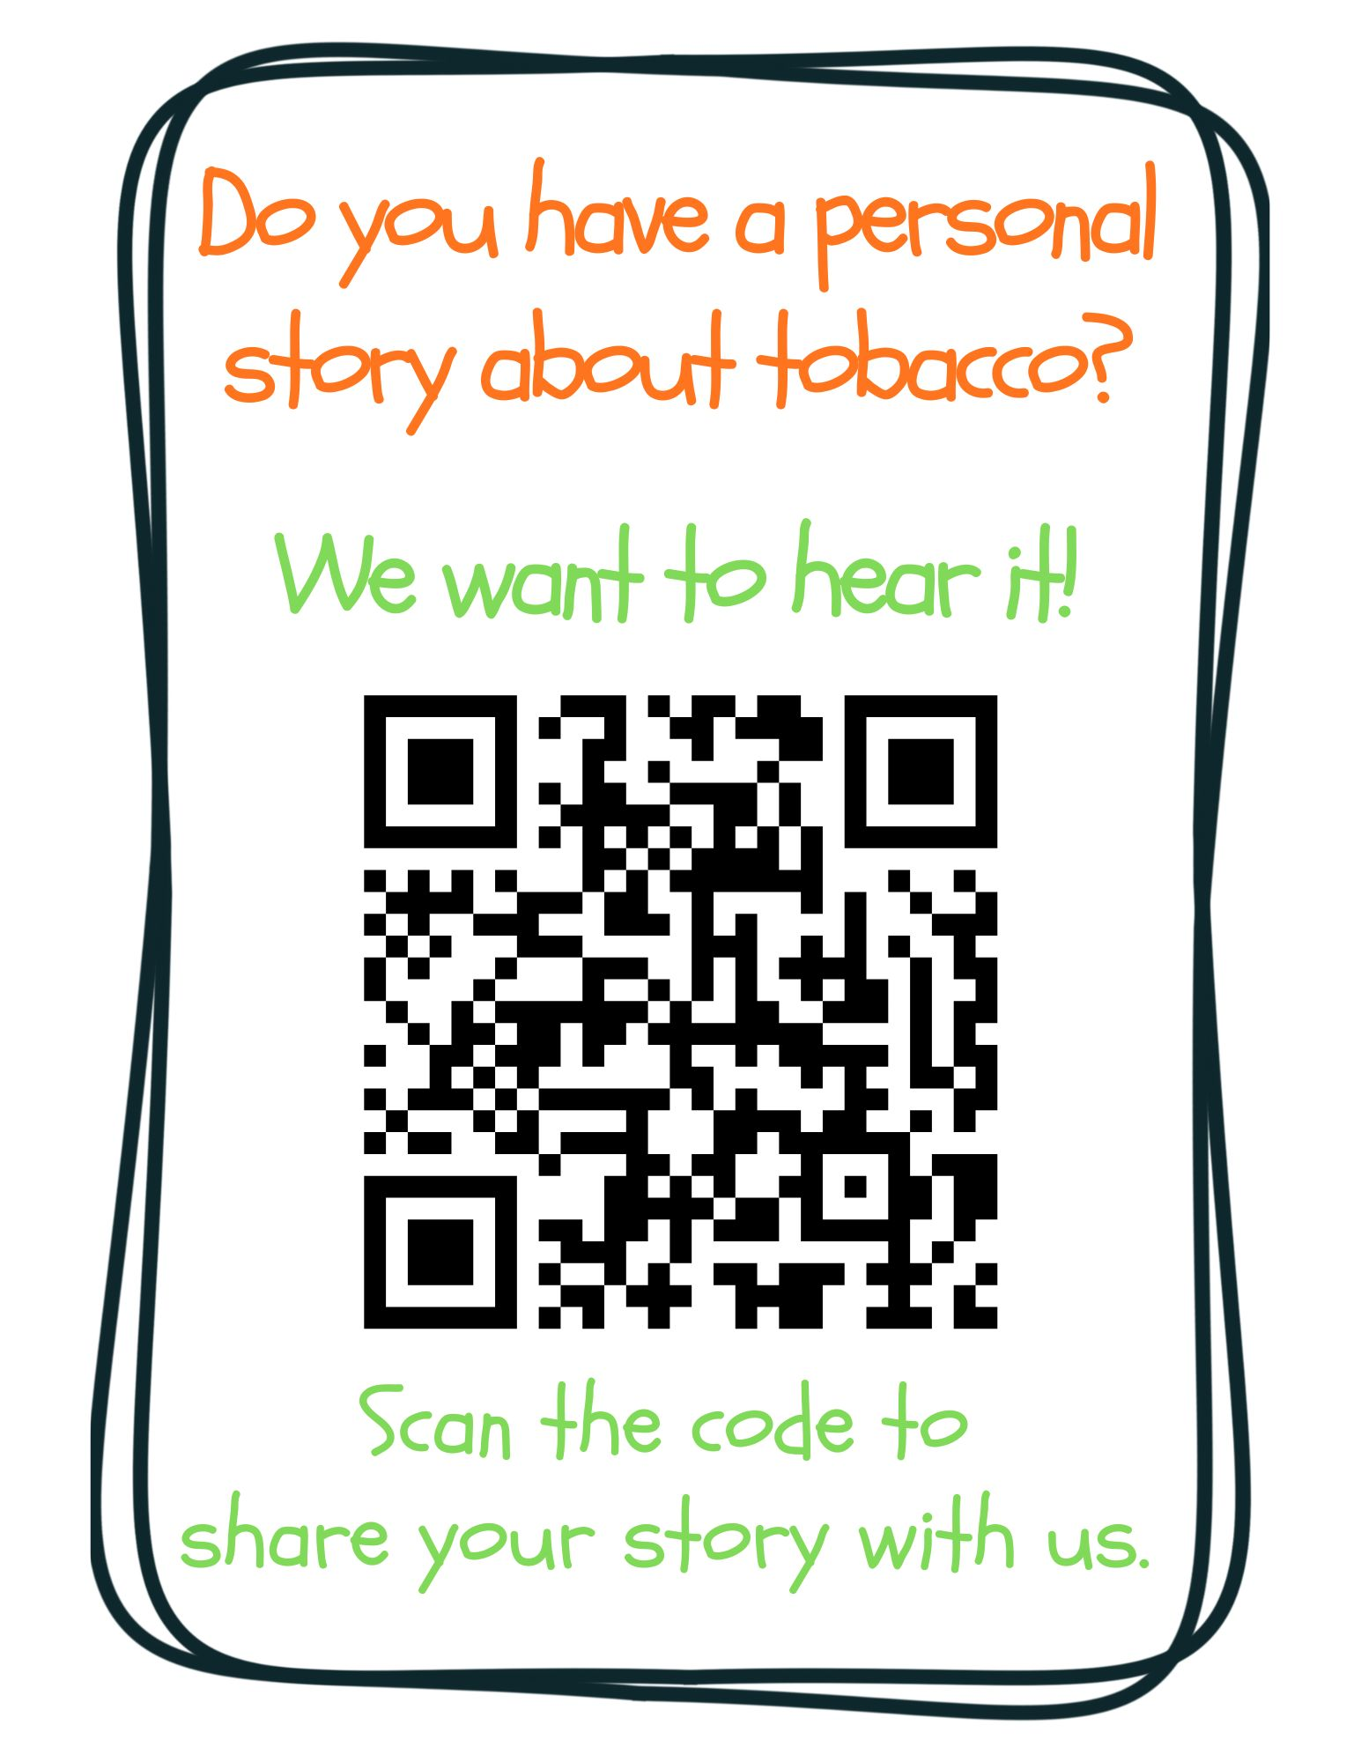
Notes:
KEY POINT: Ask for personal stories about tobacco.
VIRTUAL MODIFICATION: Post this link in the chat box: https://www.surveymonkey.com/r/tobaccostory
SCRIPT: “We love answering your questions as well as hearing stories about how tobacco has affected you, the people you love, and the families you serve. We don’t have time to hear all those great stories today, but we encourage you to share those stories with us at this link, which you can also find on the Breathe website and in the monthly newsletters. Tobacco isn’t just about stats, it’s about people and sharing stories about tobacco helps us all make a personal connection to this important work we are doing. We look forward to hearing your stories!”

Slide 33
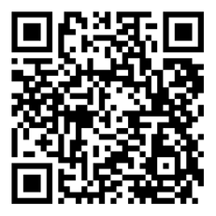
BREATHE TRAINING
“BREATHE REFRESHER”
USE THE QR CODE
to take the
POST- ASSESSMENT
Notes:
KEY POINT: All participants need to complete a post assessment.
MATERIALS NEEDED: Participants can complete the post assessment online with the QR code on this slide. This is the preferred method as it will save you time doing data entry after the training! (The slide now indicates “Breathe Refresher” so they know how to fill answer the first question regarding the type of training they attended.) To encourage compliance, you could have them indicate they are done or show you their completion screen and you could give them a handout, magnet, or other giveaway when they do. You still need to bring some printed out post assessments, preferable on a different color of paper, in case participants prefer to complete a hard copy. The Post Assessment can be downloaded from this webpage: https://justbreathein.org/staff-training/breathe-refresher/ **If you choose NOT to have participants complete the assessment online, modify this slide by removing the QR code.
VIRTUAL MODIFICATION: Participants can use another device to access the QR code on the screen and/or you can place the link in the chat box so they can complete it on the device they are using for the training. Ask participants to type DONE in the chat box to encourage compliance and assess completion. Here is the link to the post assessment: https://www.surveymonkey.com/r/PostAssess2527
SCRIPT: “Thank you for participating in today’s Breathe training! Before we wrap up, I need everyone to complete the post assessment. Once you have completed the post assessment, please bring it to me/hold it up and I will give you (a magnet, certificate of completion, or whatever handout you choose).”

Slide 34
PICK UP MATERIALS
Expect 1-Month Post Training Survey from
JustBreatheIndiana@gmail.com
NEW INCENTIVE!
Each month - Random drawing for a $25 gift card from all 1-month surveys received!
Notes:
KEY POINT: Participants can pick up Quit Now Indiana materials and should expect a follow up survey in one month.
SCRIPT: “After you complete the post assessment you can pick up Quit Now Indiana handouts/QR code flyers/supplemental Breathe materials. I’ll be sending a follow up email soon with the link to the webpage with all the digital materials as well as a certificate of completion for today’s training. Then expect an email in about a month from justbreatheindiana@gmail.com with our 1 month follow up survey. Please complete that survey when you get it as it really helps us gain feedback to evaluate and improve the Breathe program. (Click to reveal incentive) As an added incentive we are now doing a monthly drawing of all the 1 month follow up surveys received and one lucky winner will be awarded a $25 gift card, the winner will get to choose between Walmart or Starbucks…and it could be you, if you complete the 1 month survey!”

Slide 35


THANK YOU!!
Tanya Shelburne, Project Manager
tanyas@healthedpros.org
317-902-4505
Alison Muckerheide, Tobacco Control Specialist
alisonm@healthedpros.org
Notes:
KEY POINT: Share contact information.
SCRIPT/INSTRUCTIONS: (Personalize this slide with your contact information.) “Thank you so much for participating in today’s Breathe Refresher. It was my pleasure to get to see all of you again and meet the new staff. I know that working with families on this topic may not be easy, but I hope this training reinvigorated you and that you have even more ideas for how you can utilize the Breathe materials. As always, please reach out to me any time you have questions or great ideas and want to share your successes!”

Slide 36
DATA SOURCES
2023 Indiana Behavioral Risk Factor Surveillance System (BRFSS)
www.in.gov/health/tpc/
www.cdc.gov/tobacco/
www.cancer.org/cancer/risk-prevention/tobacco
For a more detailed list of data sources used
to create Breathe materials go to
justbreathein.org/additional-resources/data-sources/
Notes:
KEY POINT: Share basic data sources and where they can find more.
SCRIPT/INSTRUCTIONS: (You can just leave this slide up for people to see or refer to it if anyone asks about the source of information you shared.)

