Slide 1

BREATHE TRAINING
“BREATHE REFRESHER”
USE THE QR CODE
to take the
PRE- ASSESSMENT
Notes:
HOW TO USE THE NOTES SECTION: Each slide in this presentation has a notes section that can help you deliver the presentation.
The KEY POINT let’s you know the most important message to convey and along with the text on the screen, that may be all the guidance an experienced County Coordinator/tobacco expert may need to conduct the training effectively.
If any handouts or other resources are necessary for a given slide you will see a MATERIALS NEEDED section.
If modifications are needed to share a slide or conduct an activity for a virtual training, you will see a VIRTUAL MODIFICATION section.
The SCRIPT portion of each page will give you a sample script (in italics) of what you might say for each slide as well as instructions, if needed. DO NOT READ THE SCRIPT VERBATIM! Instead, use the script to practice the presentation and then adjust it as needed to make it your own. The script is simply meant to be a guide/suggestion!
KEY POINT: All participants need to complete a pre assessment and sign the sign-in sheet.
MATERIALS NEEDED: Participants can complete the pre assessment online with the QR code on this slide. This is the preferred method as it will save you time doing data entry after the training! The slide indicates “Breathe Refresher” so they know how to answer the first question regarding the type of training they are attending. To encourage compliance, you could have them indicate they are done or show you their completion screen and you could give them a handout, magnet, or other giveaway when they do. You still need to bring copies of the sign-in sheets and some printed out pre assessments in case participants prefer to complete a hard copy….then after the training you will need to complete the data entry. **If you choose NOT to have participants complete the assessment online, modify this slide by removing the QR code.
VIRTUAL MODIFICATION: Participants can use another device to access the QR code on the screen and/or you can place the link in the chat box so they can complete it on the device they are using for the training. You may need to keep posting the link in the chat box as people enter the training since they may not be able to see earlier chat box entries. Ask participants to type DONE in the chat box to encourage compliance and assess completion. Here is the link to the pre assessment: https://www.surveymonkey.com/r/PreAssess2527
SCRIPT: “Before we get started, I need everyone to complete a pre assessment. To access the survey, just open the camera on your smartphone and point it at the QR code on the screen to get the link. If you prefer to complete the assessment with pen and paper just let me know and I will bring you a hard copy. I will also be asking you to complete a post-assessment at the end of the training, and these are important parts of our evaluation, so I appreciate you completing them. There are also sign-in sheets being passed around. Please make sure you put your name and contact info on one of the sign-in sheets so we will have a record of everyone’s attendance and if you want to receive our monthly Breathe E-newsletter you can indicate that on the sign in as well.”

Slide 2


HEALTH ED PROS
Tanya Shelburne MPH, CHES
Alison Muckerheide MPH, CHES
Notes:
KEY POINT: Participants should know your name and a bit about your background and position.
MATERIALS NEEDED: Breathe kits and Quit Now Indiana materials
VIRTUAL MODIFICATION: Make plans with your site contact to deliver Breathe Kits and Quit Now Indiana materials either before or after the training and discuss how the materials should be divided up between the training participants.
INSTRUCTIONS: Personalize this slide with your information. Welcome everyone to the training, introduce yourself, and give a brief background on your experience, your organization, and your position. Bring materials to the training (breathe kits, Quit Now Indiana materials, etc.) but do not distribute them until the end of the training as some attendees will leave/not pay attention if materials are distrusted too early.

Slide 3
Guidelines for Virtual Training
Training is being recorded
Keep video on
Mute yourself when not speaking
Rename yourself, if necessary
Minimize distractions
Stay for entire training (60 minutes)
Interact!!! (pre/post assessments, chat box, unmute)
Notify co-host if you have issues
Notes:
DELETE THIS SLIDE IF CONDUCTING AN IN-PERSON TRAINING!
KEY POINT: Go over housekeeping and expectations for the training.
SCRIPT/INSTRUCTIONS: (Personalize this slide as needed.) “Now before we jump into the actual training I want to go over a few housekeeping items. I want to make sure everyone is aware that the training is being recorded and I will share a link to the recording in a follow up email in a day or two should you want to watch it again or share it with someone on staff who may have missed the training. I do ask that you keep your videos on during the training so I can see everyone’s smiling faces and it will feel a bit more like we are actually in person, but do keep yourself on mute to minimize background noise and just unmute yourself when you want to share something or ask a question. If the name on the screen is not your name, please rename yourself, which will help us with attendance and knowing who everyone is. To rename yourself put your cursor in your box on the screen and click the blue box in the upper right corner with 3 dots in it and you should see the option to rename yourself. Do your best to minimize distractions around you and I do ask that you stay for the full 90 minute training. There will be several options to interact so feel free to use the chat box or raise your hand at any time, and I hope you will interact as it is way more fun when it’s not just me talking the whole time! If you have any issues during the training feel free to message the co-host and we will try to assist.”

Slide 4
Connection Before Content
No one cares how much you know,
until they know how much you care.
- Theodore Roosevelt
Notes:
KEY POINT: Connect with participants before you get into the training content.
SCRIPT: “We will get to discussing tobacco in just a bit, but I think it is important that we focus on “Connection Before Content”. This quote from Theodore Roosevelt really sums up why Connection Before Content is important and serves as the basis for why we designed the Breathe program the way we did. He said ‘No one cares how much you know, until they know how much you care.’ Hopefully as we get to know each other a little better you will see that I have a heart for protecting children and families and supporting the staff who serve them! And we know all of you have a heart for the families you serve and that they know and trust you. That’s why we focus on training staff at Head Start and other organizations rather than going directly to the parents ourselves. So let’s connect a bit with an ice breaker”

Slide 5

LET’S MAKE A SALAD!
Notes:
KEY POINT: Introduce the get-to-know-you activity of building a salad.
SCRIPT/INSTRUCTIONS: “Rather than do the standard boring round of introductions we thought we would make a salad, figurately speaking, as a way to get to know you guys a little better! I promise this will make sense when we are done!”

Slide 6
WHAT SALAD TOPPING DESCRIBES WHAT YOU BRING TO THE MIX?
Bacon bits, radishes, onions, ham, ranch dressing, banana peppers, croutons, vinegar and oil, Craisens, mandarin oranges, arugula, bell peppers, salt, blue cheese, tomatoes, eggs, feta cheese, avocado, pepper, Italian dressing, mushrooms, pine nuts, cucumbers, anchovies…
Notes:
KEY POINT: Have anyone who wants to share say what salad topping describes them best.
VIRTUAL MODIFICATION: Instruct participants to type the salad topping that best describes them in the chat box. Read the comments aloud and ask a few participants to share why they chose a certain topping.
SCRIPT/INSTRUCTIONS: “I want you guys to help build a virtual salad by thinking about what salad topping you feel best describes what you bring to the mix here at your organization. You all represent different roles within the organizations, length of work history, a variety of expertise and personal experience, as well as unique personalities. So think about all those factors as you determine the salad topping that best represents you. I am excited to find out what kind of unique salad you all create that represents your organization! (CLICK TO BRING UP TOPPING IDEAS) To help you out a bit, here is a list of possible salad toppings, but you don’t have to stick to these toppings, get as creative as you want! I’ll get us started by sharing that what I bring to the salad is the big bowl! I try to offer some structure but also plenty of room to mix things up and allow everyone space to learn and grow. (Turn to co-host) What do you bring to our salad? {I bring the romaine lettuce, I offer a foundation of resources and ideas for others to build on and plenty of healthy information to chew on! OR I bring the salad tongs because I like to get in there and mix things up and have some fun!} Now, who wants to share the salad topping that describes them?” As people share salad toppings probe as to how that describes them and what they offer to their work environment. Validate answers and thank those who contribute. Not everyone has to share, but get several people’s input spending about 3-5 minutes on this activity.

Slide 7

Notes:
KEY POINT: Set the stage for this training being a refresher.
SCRIPT: “Thank you all for helping us build a beautiful one-of-a-kind salad! This image doesn’t perfectly depict the salad we just created in our minds, but it does gives us a good representation of a salad with many different toppings. I want you to notice the diversity in the salad we just created. Think about all the different colors and textures. Recognize that each ingredient remains identifiable even as the salad gets tossed rather than simply getting muddied into the mix like ingredients in a soup would. Some of the ingredients are spicy and pungent, some are mild and less noticeable but still important. Each ingredient plays an important role and makes the salad unique and beautiful. That is how we want all of you to think about your organization and your role in it. As well as your role with Breathe and tobacco education. You all play a different part in the organization and in the work to help families create healthy smoke and vape free environments for their children. Some of you have a bit more in-your-face kind of personality, while some may have more of a behind the scenes role. Breathe offers plenty of opportunities and resources that can work with your individual roles and personalities. No organization implements Breathe in exactly the same way and that is great! As we conduct the Breathe Refresher today we want you to think about how tobacco information and the Breathe resources can best mix in with the work each of you already do. Now, let’s have a little fun with a game that will show us how much everyone knows/remembers about tobacco!”

Slide 8




CALL A FRIEND
LIFELINE
Notes:
KEY POINT: Review the structure for how to play Who wants to be a millionaire.
MATERIALS NEEDED: Dry erase board and markers or newsprint to keep the score on. The Who Wants to be a Millionaire cheat sheet so you know which answers to reveal, which can be found here: https://justbreathein.org/staff-training/breathe-refresher/
VIRTUAL MODIFICATION: Participants will play as individuals and enter their guesses in the chat box. Provide commentary as the guesses come in and use the honor system by instructing participants to keep track of how many answers they get correct. At the end you can ask them to type how much money they earned ($100,000 per right answer) in the chat box…and then declare them all millionaires in your book. And remind them you are grant funded and therefore don’t have a million dollars to give away!
SCRIPT: “ Who wants to be a Millionaire? I sure do! Today we are going to play a modified version of Who wants to be a millionaire! So as a group decide who will be your team’s spokesperson. I want you to work together as a group to decide on a final answer, but I will only take the final answer from the spokesperson. There are 10 questions, each worth $100,000. Now some of these questions can be kind of tricky, but you do have ONE “call a friend” option and ONE ”lifeline”. Call a friend means you can “call” me (you the presenter) for help. The lifeline option you can literally use your lifeline, *cough* your phone and google the answer!”
INSTRUCTIONS: Use your cheesiest Game Show voice and ask them to pick a leader/spokesperson. If you want, ask for a volunteer or have your co-trainer record the score on paper or a dry erase board. Go through the questions in order 1 through 10 until all question are completed. After each answer is revealed, another slide provides additional commentary that will help you continue the conversation on that topic. At the end of the game add up how much “money” they have won to see if they are millionaires. Congratulate them on doing a good job and acknowledge some of the questions were difficult, but hopefully we all walk away with a good review or learned something new.

Slide 9
CALL A FRIEND
LIFELINE
$ 100,000
1. Which communities are directly targeted by Big Tobacco companies?
Youth & Women
People of Color & LGBTQ+
A
B
Low Income Households/Communities
All of the above
C
D
Notes:
Read the question and answer choices aloud. Periodically remind participants they can use a lifeline, if they haven’t already and seem to be struggling.

Slide 10
$ 100,000
1. Which communities are directly targeted by Big Tobacco companies?
Youth & Women
People of Color & LGBTQ+
A
B
Low Income Households
All of the above
C
D
Notes:
Read the correct answer out loud.

Slide 11
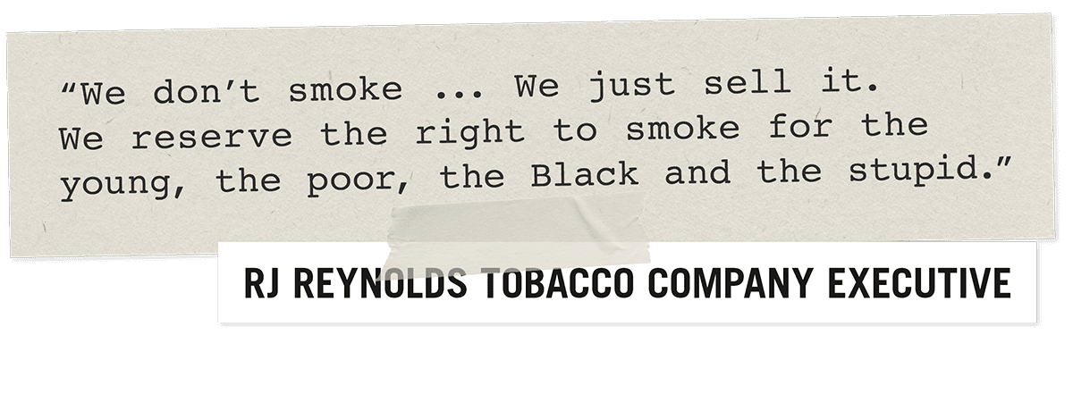
The tobacco industry aggressively markets to historically marginalized groups and this creates many health inequities.
Notes:
KEY POINT: Big Tobacco targets marginalized communities.
SCRIPT: “*Read the quote out loud* “This was an actual quote from back in the day that was in the documents seized from Big Tobacco. These companies know the product they are promoting is extremely harmful and they deliberately and aggressively market their products to various marginalized groups, thereby creating more health inequities.”

Slide 12
CALL A FRIEND
LIFELINE
$ 100,000
2. What level of smoke/vapor exposure is considered safe during pregnancy?
Personally smoking/vaping
Being around someone else who smokes/vapes
A
B
C
Being in a house/car where someone smoked/vaped previously
D
No smoke or vapor exposure is safe during pregnancy
Notes:
Read the question and answer choices aloud. Periodically remind participants they can use a lifeline, if they haven’t already and seem to be struggling.

Slide 13
$ 100,000
2. What level of smoke/vapor exposure is considered safe during pregnancy?
Personally smoking/vaping
Being around someone else who smokes/vapes
A
B
C
Being in a house/car where someone smoked /vaped previously
D
No smoke or vapor exposure is safe during pregnancy
Notes:
Read the correct answer out loud.

Slide 14
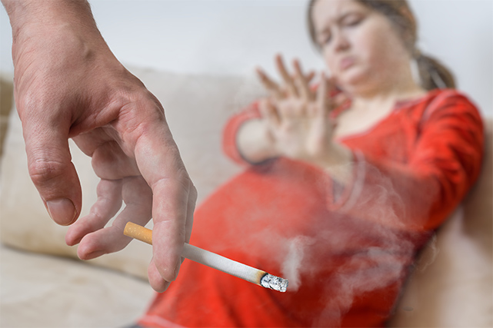
Use of tobacco/vape products and second/thirdhand smoke negatively impacts the person who is pregnant and their unborn child.
Notes:
KEY POINT: There is no safe amount of smoking or vaping that is recommended during pregnancy.
SCRIPT: “Obviously we don’t want someone who is pregnant directly using tobacco and vape products, but we also know second & thirdhand smoke/vapor can harm the pregnant person and the development of the baby. Also, smoking & vaping has the ability to impact every phase of reproduction. If someone is trying to become pregnant, smoking & vaping could also cause problems with fertility.”

Slide 15
CALL A FRIEND
LIFELINE
$ 100,000
3. What does an E-cigarette emit?
Water Vapor
Gasoline
A
B
Aerosol
Harmless Flavorings
C
D
Notes:
Read the question and answer choices aloud. Periodically remind participants they can use a lifeline, if they haven’t already and seem to be struggling.

Slide 16
$ 100,000
3. What does an E-cigarette emit?
Water Vapor
Gasoline
A
B
Aerosol
Harmless Flavorings
C
D
Notes:
Read the correct answer out loud.

Slide 17
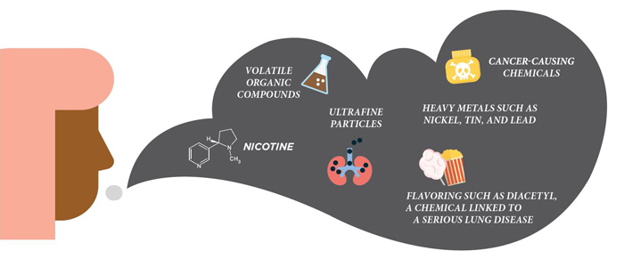
The CDC has stated that e-cigarette aerosol is not harmless “water vapor”!
Notes:
KEY POINT: E-cigarettes are not considered harmless water vapor.
SCRIPT: “Many people think when someone vapes they they are just inhaling water vapor with flavors, but E-cigarettes contain many harmful substances including nicotine, ultrafine particles that can be inhaled deep into the lungs, like heavy metals, and cancer-causing chemicals. Think of inhaling a can of hairspray, that is more comparable to vaping!”

Slide 18
$ 100,000
4. E-cigarette companies primarily target which group of people with candy/fruit flavorings?
People who smoke traditional cigarettes
Athletes
A
B
Senior Citizens
Youth
C
D
Notes:
Read the correct answer out loud.

Slide 19
$ 100,000
4. E-cigarette companies primarily target which group of people with candy/fruit flavorings?
People who smoke traditional cigarettes
Athletes
A
B
Senior Citizens
Youth
C
D
Notes:
Read the correct answer out loud.

Slide 20

Companies sell
e-cigarettes in thousands of unique flavors, including candy and fruit flavors that appeal to youth. The majority of youth who begin vaping start with flavored products.
Notes:
KEY POINT: There are thousands of e-liquid flavors out there that attract youth users.
SCRIPT: “There are thousands of flavors being produced ranging from fruit medley to cookies and even unicorn poop! All of these candy and fun flavored products are targeting our youth. Realistically, grandpa is not going to one day decide to pick up a starburst flavored e-cigarette and create a new habit, but our youth might. Big tobacco companies know once they get our adolescents addicted, they will have life-long customers.”

Slide 21
CALL A FRIEND
LIFELINE
$ 100,000
5. Which is an example of ‘Point of Sale’ marketing of tobacco products?
Brightly colored ads on storefronts and gas pumps
In store coupons & deals
A
B
Placing advertisements by candy
All of the above
C
D
Notes:
Read the question and answer choices aloud. Periodically remind participants they can use a lifeline, if they haven’t already and seem to be struggling.

Slide 22
CALL A FRIEND
LIFELINE
$ 100,000
5. Which is an example of ‘Point of Sale’ marketing of tobacco products?
Brightly colored ads on storefronts and gas pumps
In store coupons & deals
A
B
Placing advertisements by candy
All of the above
C
D
Notes:
Read the correct answer out loud.

Slide 23
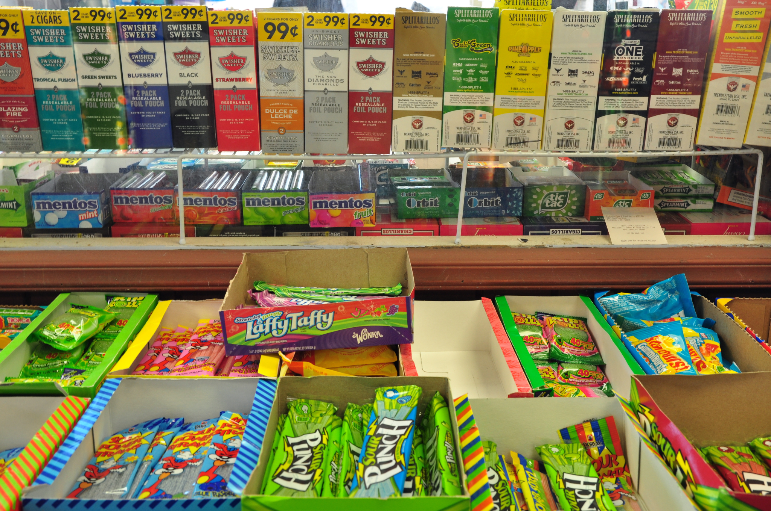
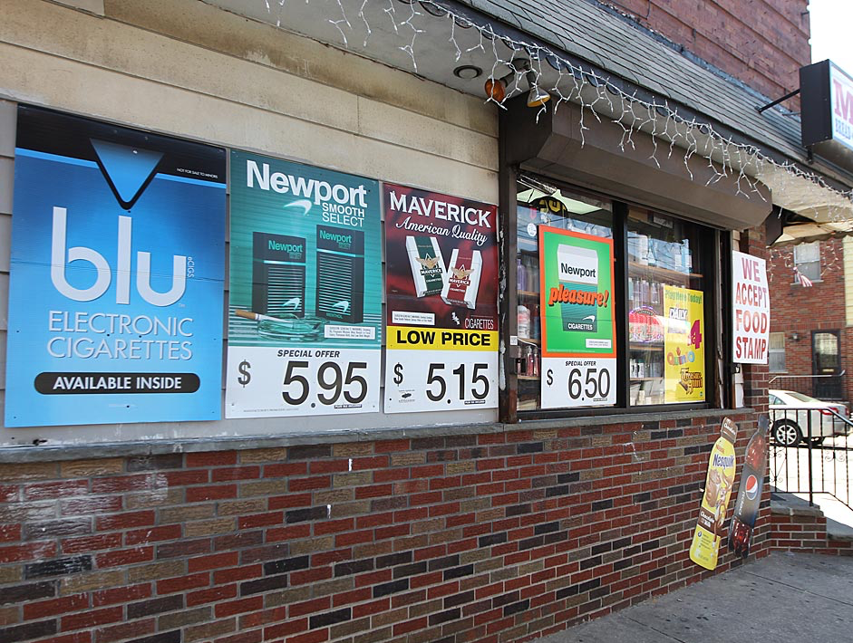

Notes:
KEY POINT: Point of Sale includes marketing tactics used by Big Tobacco to obtain new customers.
SCRIPT: “Point of Sale advertising exposes marginalized populations, including youth, to pro-tobacco/vape messages & creates positive attitudes toward tobacco / vaping products and brands. So tactics used to attract customers include placing ads by candy and other items that attract children, or splattering multiple advertisements across businesses , or offering cost saving coupons and discounts. These tactics also make it harder for people who are trying to quit tobacco.”

Slide 24
CALL A FRIEND
LIFELINE
$ 100,000
6. When is it safe to use marijuana?
While Pregnant
While Breastfeeding
A
B
Around Children
None of the above
C
D
Notes:
Read the question and answer choices aloud. Periodically remind participants they can use a lifeline, if they haven’t already and seem to be struggling.

Slide 25
$ 100,000
6. When is it safe to use marijuana?
While Pregnant
While Breastfeeding
A
B
Around Children
None of the above
C
D
Notes:
Read the correct answer out loud.

Slide 26

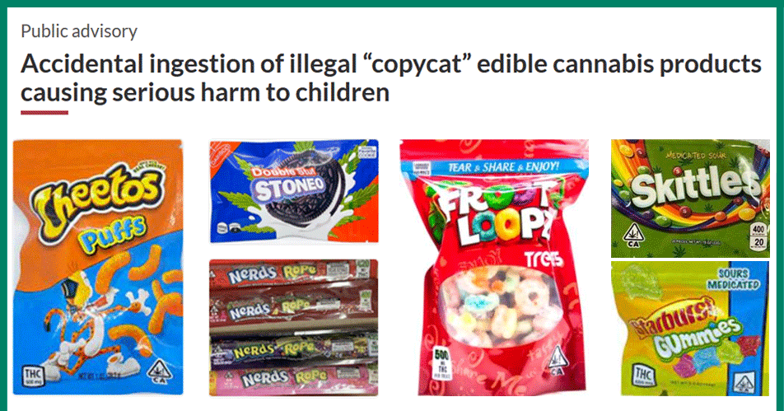
It’s common to hear people say marijuana is safe because they feel it is “natural.” There are many plants found in nature that are not safe for children or pregnant people to be exposed to and marijuana is one of them.
Notes:
KEY POINT: Marijuana is not safe while pregnant or breastfeeding or around children.
SCRIPT: “Breathe doesn’t go into marijuana in great detail, but we do think it is important to make sure families understand the dangers of marijuana when it comes to pregnancy and young children. So not smoking marijuana while pregnant or breast feeding and keeping any products with THC away from little ones is a critical message to share. The Breathe toolkit includes a great video on marijuana as well as some helpful handouts.”

Slide 27
CALL A FRIEND
LIFELINE
$ 100,000
7. What percentage of Hoosier youth are exposed to secondhand smoke in cars/homes?
10%
25%
A
B
50%
75%
C
D
Notes:
Read the question and answer choices aloud. Periodically remind participants they can use a lifeline, if they haven’t already and seem to be struggling.

Slide 28
$ 100,000
7. What percentage of Hoosier youth are exposed to secondhand smoke in cars/homes?
10%
25%
A
B
50%
75%
C
D
Notes:
Read the correct answer out loud.

Slide 29

…and if a Hoosier youth lives with someone who smokes their chances of being exposed to secondhand smoke in the home/car greatly increases.
Notes:
KEY POINT: The number of youth exposed to secondhand/thirdhand smoke has come down, but we want it lower.
SCRIPT: “The rate is likely even higher among people of color, those who live in multi-unit housing and in families with low incomes. Breathe is all about making sure we keep kiddos safe and healthy. Even if someone isn’t ready to quit, helping parents find ways to protect their children from second and thirdhand smoke/vapor is our biggest concern with Breathe.”

Slide 30
CALL A FRIEND
LIFELINE
$ 100,000
8. Individuals who reported exposure to 5 or more Adverse Childhood Experiences-ACES (traumatic events before age 18) were ___ times as likely to start smoking at an early age.
2
3
A
B
4
5
C
D
Notes:
Read the question and answer choices aloud. Periodically remind participants they can use a lifeline, if they haven’t already and seem to be struggling.

Slide 31
$ 100,000
8. Individuals who reported exposure to 5 or more Adverse Childhood Experiences-ACES (traumatic events before age 18) were ___ times as likely to start smoking at an early age.
2
3
A
B
4
5
C
D
Notes:
Read the correct answer out loud.

Slide 32
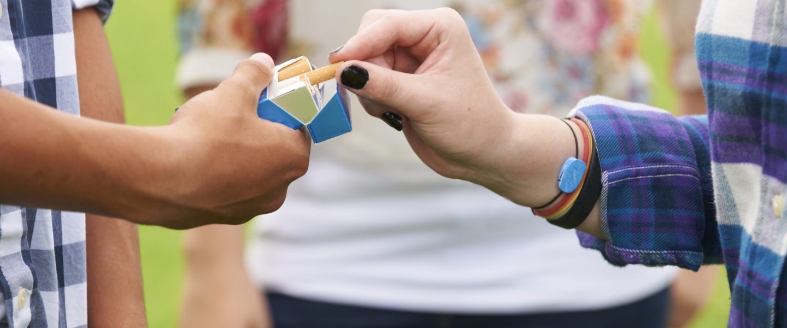
…And if someone has 5 or more ACEs and already smokes they are MORE likely to smoke heavily.
Notes:
KEY POINT: People with 5 or more aces are more likely to be start smoking and smoke heavily.
SCRIPT: “You have probably heard of ACEs before in other trainings. ACEs can have lasting negative effects on health, wellbeing, and opportunity. These kiddos need extra help to set themselves up for success and a healthy future and to protect them from the burden of tobacco. So this is something to keep in mind when working with your families.”

Slide 33
CALL A FRIEND
LIFELINE
$ 100,000
9. What are the financial costs of smoking/vaping?
Cost of Tobacco & Vaping Products
Missed days of work
A
B
Medical Bills
All of the above
C
D
Notes:
Read the question and answer choices aloud. Periodically remind participants they can use a lifeline, if they haven’t already and seem to be struggling.

Slide 34
CALL A FRIEND
LIFELINE
$ 100,000
9. What are the financial costs of smoking / vaping?
Cost of Tobacco & Vaping Products
Missed days of work
A
B
Medical Bills
All of the above
C
D
Notes:
Read the correct answer out loud.

Slide 35
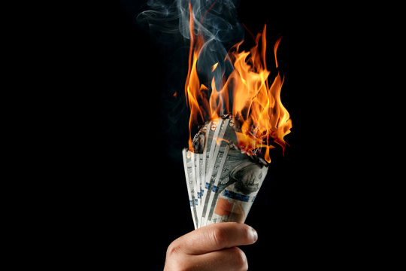
Smoking & vaping have many financial, social, and health costs for the person who smokes/vapes
and their family.
Notes:
KEY POINT: Smoking/Vaping costs money, and so much more!
SCRIPT: “We think about the cost of the actual products most of the time, but the cost of smoking & vaping is more than just the amount someone spends on tobacco products. Tobacco/Vape use also leads to loss of wages from missed time at work and extra medical bills for the tobacco user or family members who suffer from smoking related illnesses such as asthma, bronchitis, etc.”

Slide 36
CALL A FRIEND
LIFELINE
$ 100,000
10. Which organization helps provide FREE tobacco cessation resources and 24/7 support?
Stop it Indiana
Quit Now Indiana
A
B
Smoke Free Indiana
Fresh Air Indiana
C
D
Notes:
Read the question and answer choices aloud. Periodically remind participants they can use a lifeline, if they haven’t already and seem to be struggling.

Slide 37
$ 100,000
10. Which organization helps provide FREE tobacco cessation resources and 24/7 support?
Stop it Indiana
Quit Now Indiana
A
B
Smoke Free Indiana
Fresh Air Indiana
C
D
Notes:
Read the correct answer out loud.

Slide 38

Quit Now Indiana is the
FREE frontline tool for helping Hoosiers who use tobacco break their addiction.
Support those who are ready to quit by referring them to Quit Now Indiana!
Notes:
KEY POINT: Quit Now Indiana is new and improved.
SCRIPT: “You don’t have to be the expert on quitting, but you can help parents who want to quit by connecting them to Quit Now Indiana. Quit Now Indiana is free and available 24/7. People can call, text, go online or use the app to access services in whatever way works best for them. A trained quit coach will help them create a customized quit plan just for them. Free Nicotine Replacement Therapies, including the patch and gum, are provided for free, as available. Quit Now Indiana has a dedicated number for those who speak Spanish and other language services are available as well as TTY capabilities for those who are deaf or hard of hearing.”

Slide 39


So… are you a millionaire?
Thanks for playing!
Notes:
KEY POINT: Acknowledge how much everyone knows about tobacco.
SCRIPT/INSTRUCTIONS: (Add up how much money they have won and congratulate them on their hard work. Quickly discuss with them how the game went and do not forget to give them a big shout out for playing.) “You guys did an awesome job and I hope you learned a lot and had fun too! I really wish I had $1,000,000 to hand out today, but this program is grant driven so you will have to settle for a round of applause! But everyone of you is worth a million bucks in my book and I’m so glad to have your organization as a Breathe partner.”

Slide 40
Breathe Materials
Let’s review all the materials you have access to!
Notes:
KEY POINT: Remind participants that they have access to lot of Breathe materials online.
VIRTUAL MODIFICATION: Place the link to the For Partners webpage in the chat box: https://justbreathein.org/for-partners/
SCRIPT/INSTRUCTIONS: “Now that we have all brushed up on our knowledge of tobacco and the importance of protecting children from second and thirdhand smoke, I want to remind you about all the Breathe resources you have access to that can aid in educating and supporting the families you work with. Hopefully you know where your Breathe kits are stored, but if not, talk to your leadership to find out and let me know if you need any replacement items. If you are new or haven’t used some of the Breathe materials yet I hope this refresher will get your wheels spinning as you think about which materials would work best depending on your specific job and how you may interact with families and young children.”

Slide 41




FOR PARENTS/CAREGIVERS
Flip
Chart
Activities Booklet
Worksheets
Handouts
Notes:
KEY POINT: Review Breathe resources focused on parents/caregivers.
MATERIALS NEEDED: Sample Breathe kit; additional supplies as needed.
SCRIPT/INSTRUCTIONS: “Several of the items in the Breathe kit are specifically geared towards parents/caregivers or the adults in the household. (CLICK TO REVEAL THE LABELS AS YOU TALK ABOUT EACH BREATHE RESOURCE) The flipchart is great for one on one or small group interactions with talking points on the back of each page to guide your conversation. The parent handouts cover many different tobacco topics and can be printed or downloaded and shared electronically with all parents or with specific parents when relevant. The worksheets also provide great information on many tobacco topics but also include interactive components that help parents set goals and think through challenges of quitting or minimizing smoke/vapor exposure for their children. The activities booklet is a great tool for anyone who needs activities to do with groups of parents. There are instructions for 9 different activities that take very little prep and minimal materials and will get parents discussing a variety of tobacco related topics.

Slide 42
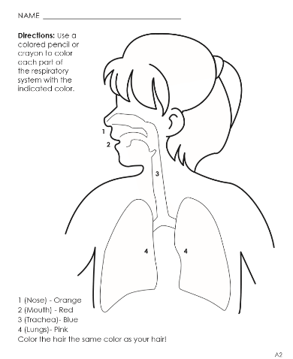


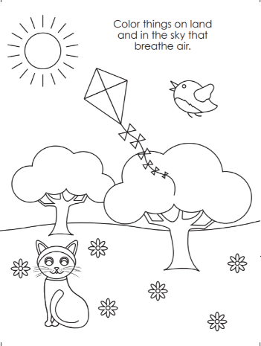
FOR YOUNG CHILDREN
Coloring Book/Sheets
Children’s Activities Booklet
Notes:
KEY POINT: Review Breathe resources focused on young children.
SCRIPT/INSTRUCTIONS: “The online Breathe kit also includes some resources that can be used directly with children. These resources are focused on healthy bodies and are not specifically tobacco focused. There are coloring sheets that can be printed or downloaded and shared electronically. There is also a Children’s Activities Booklet with 15 short activities focused on healthy bodies that work great with children ages 3-7. These activities require very little prep work or outside materials. Both of these resources are great for anyone who works directly with children and they can also be given to parents as take-home activities.”

Slide 43

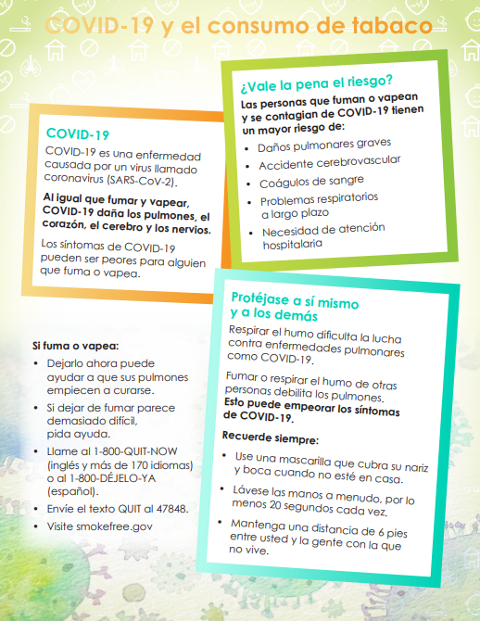

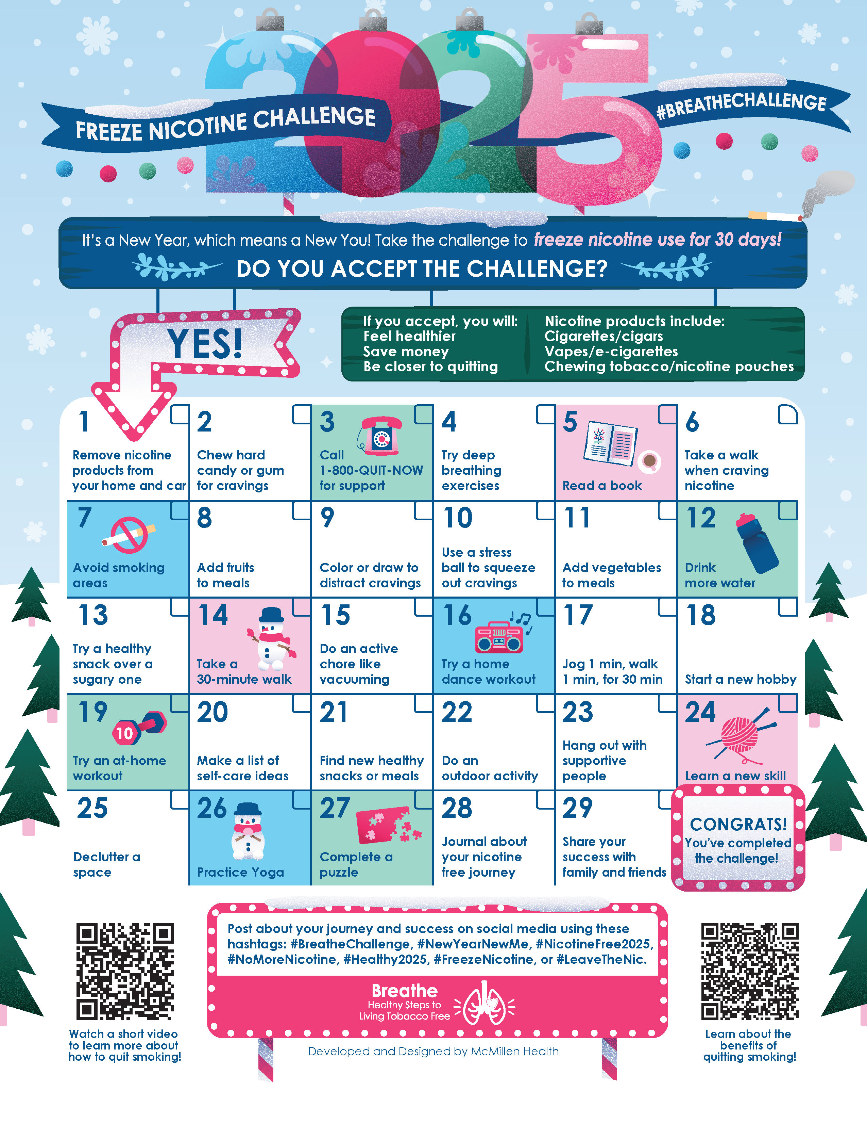
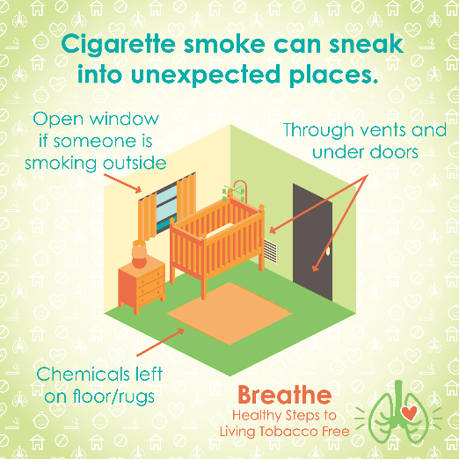
MORE RESOURCES
Spanish Materials
Short
Videos
Quarterly Challenges
Social Media Posts
Monthly
E-newsletter
Notes:
KEY POINT: Review additional Breathe resources and ways to share tobacco information.
SCRIPT: (CLICK TO REVEAL THE LABELS AS YOU TALK ABOUT EACH BREATHE RESOURCE) “And that’s not all! Many of the Breathe materials are also available in Spanish, so please access those materials if you are working with Spanish Speaking parents/caregivers. There are also lots of short videos, just 2-3 minutes each that help reinforce important tobacco related topics. Feel free to pull these up on an ipad to show to parents as appropriate or post them on your social media. Speaking of social media, the website also includes 12 ready to go graphics and accompanying text that you can post on your social media pages as a way to keep tobacco education on everyone’s radar. We also create a monthly Breathe e-newsletter that we will send directly to anyone who indicated they would like to receive it on today’s sign in sheet, if you aren’t already. We hope that you will share the newsletter by forwarding it, printing the pdf, or copying and pasting sections of it into your own organization’s newsletter. Finally, we have a new challenge each quarter that is a fun way to motivate families when it comes to quitting tobacco or minimizing exposure to second and thirdhand smoke/vapor. I hope this quick overview of the Breathe materials was a helpful refresher and that each of you can find at least one or two resources that might be useful in your current role and that you will feel comfortable sharing.”

Slide 44
Access All Breathe Materials Online!
Trained partners may download materials at
justbreathein.org/for-partners/
Notes:
KEY POINT: Trained Breathe partners can access all the Breathe materials online.
MATERIALS NEEDED: Print outs of the Partner QR code flyers that can be found here: https://justbreathein.org/for-partners/
VIRTUAL MODIFICATION: Place the link to the For Partners webpage in the chat box: https://justbreathein.org/for-partners/
SCRIPT/INSTRUCTIONS: “All of the Breathe materials can be accessed at the webpage on the screen. Don’t worry I’ll send you this link in a follow up email in case you don’t already have it bookmarked.”

Slide 45
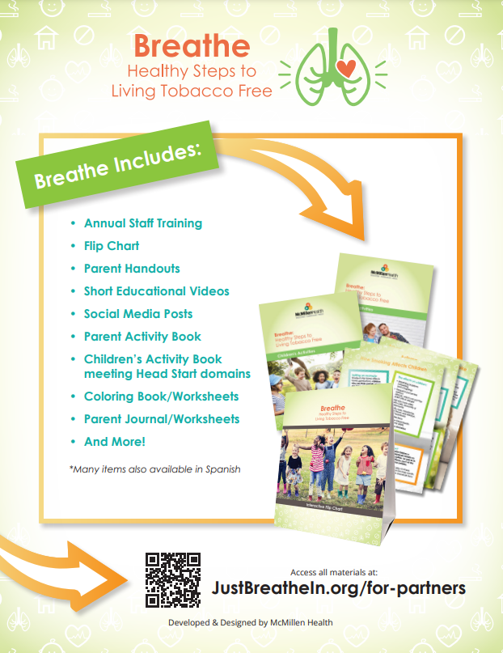
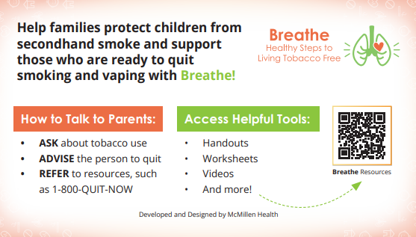
ACCESS BREATHE WEBSITE
            QR Code Flyer
            Pocket Guide
Notes:
KEY POINT: Share resources that will link participants to the Breathe resources online.
MATERIALS NEEDED: Optional, Print outs of the Breathe Kit QR code flyers (https://justbreathein.org/wp-content/uploads/2024/07/Breathe-Flyer-QR-Code-For-Partners.pdf) and Pocket Guides for Partners (https://justbreathein.org/wp-content/uploads/2024/09/Pocket-Fact-Sheet-Partner-w-cut-marks.pdf)
SCRIPT: “To help you remember how to access the Breathe materials, we have flyers as well as pocket guides with QR codes to the Breathe website. I printed and brought some with me today, but you can also find these resources on the website and download or print more yourself and share them with your staff.”

Slide 46




Order QNI Materials for FREE at: quitnowindiana.com/educational-materials
QUIT NOW INDIANA
In English & Spanish
Notes:
KEY POINT: Quit Now Indiana handouts are free to order and are great resources to have on hand.
MATERIALS NEEDED: Bring a variety of Quit Now Indiana handouts, in English and Spanish.
VIRTUAL MODIFICATION: Paste the link to order QNI materials in the chat box so they can order their own and/or let them know if you plan to drop off materials. Here is the link: https://www.quitnowindiana.com/educational-materials
SCRIPT: “I also brought a bunch of Quit Now Indiana handouts for you today. I encourage you to make these handouts easily accessible in your lobbies and to have them on hand when you do home visits or meet with parents so you can share this valuable resource when the time is right. You are also welcome to order these materials yourself for free at the website on the screen. In case you have forgotten about Quit Now Indiana, this is a great resource for anyone who is ready and wants help to quit tobacco.”

Slide 47

QUITNOW INDIANA
FREE & Available 24/7 >> Call, Text, Online, or App
Trained Quit Coach >> Customized Quit Plan
    FREE Nicotine Replacement Therapies (NRT), as available
1-800-Quit-Now (784-8669)
1-855-DÉJELO-YA (Spanish)
1-877-777-6534 (TTY)
Text READY to 34191
Text LISTO to 34191 (Spanish)
quitnowindiana.com
Notes:
KEY POINT: There are lots of resources available for those who want to quit.
SCRIPT: “You don’t have to be the expert on quitting, but you can help parents who want to quit by connecting them to Quit Now Indiana. Quit Now Indiana is free and available 24/7. People can call, text, go online or use the app to access services in whatever way works best for them. A trained quit coach will help them create a customized quit plan just for them. Free Nicotine Replacement Therapies, including the patch and gum, are provided for free, as available. Quit Now Indiana has a dedicated number for those who speak Spanish and other language services are available as well as TTY capabilities for those who are deaf or hard of hearing.”

Slide 48
QNI STANDARD & TAILORED PROGRAMS
Program (self-report) | Sessions | NRT | Offering | Amount (subject to change)
Pregnancy | 7 | Yes* | Patch or Gum | 4 weeks
Behavioral Health | 7 | Yes | Patch or Gum | 4 weeks
Youth Online | 6 Steps | No | N/A | N/A
Menthol Enhancement | 5 or 7 | Yes | Patch or Gum | 4 weeks
Standard Adult | 5 | Yes* for qualifying participants | Patch or Gum | 4 weeks
Notes:
KEY POINT: Quit Now Indiana offers specialized services for pregnant people, those with behavioral health issues, youth and those who use menthol products.
SCRIPT: “Quit Now Indiana offers specialized services for several populations that may need a tailored approach. This chart shows what is offered for the standard adult program at the bottom as well as the services available to pregnant people, those with behavioral health issues, youth ages 13-17, and people who use menthol products.”

Slide 49
Let’s talk about real life scenarios!
How Would You Use Breathe?
modified from the
Daily Dilemmas Parent Activity
Notes:
KEY POINT: Introduce the activity as a way to think about how to utilize Breathe materials in various scenarios.
SCRIPT/INSTRUCTIONS: “Now that I have refreshed your memories about the Breathe materials, let’s really put Breathe in action and walk through a few different scenarios that you might encounter. (CLICK TO SHOW REMAINING TEXT) Then think about how you might be able to use the Breathe materials in each scenario. These scenarios have been modified from the Daily Dilemma activity that is in the Parent Activities Booklet. Keep in mind there aren’t always right or wrong ways to share this information with parents so just think about your role and what feels most natural to you. You know the families you serve, so in each situation you will also want to consider what approach or what resource might work best for them. I’m excited to see how you guys might handle these scenarios and I’ll offer some of my own ideas as well.”

Slide 50

SCENARIO 1
Mom wants to commit to a smoke free home. She has two young children and can’t leave them alone to go outside to smoke.
What could she do when she needs to smoke?
Notes:
KEY POINT: Share the first scenario.
SCRIPT/INSTRUCTIONS: “Here is our first scenario. (Read what is on the slide.) You guys may already have some thoughts on how to handle this, but I’m going to help you out with some potential options!”

Slide 51
Which suggestions
would you offer?
Arrange for a neighbor to watch the kids
Cut down on the number of cigarettes and how often she smokes
Use nicotine replacement products such as patches or gum to reduce cravings
Distract herself by cleaning or playing with the children
Other suggestions??
Notes:
KEY POINT: Share the possible options and find out which ones the participants might use.
VIRTUAL MODIFICATION: After you read the possible options have participants type in the chat box the letter(s) that correspond with the suggestion(s) that they might offer this parent. Announce which options seem most popular among the participants and provide commentary.
SCRIPT/INSTRUCTIONS: (Read each of the options out loud. Have participants either raise their hand or move to a designated area of the room based on the suggestions(s) they would be most likely offer this parent. Call on a couple people to share why they chose a specific suggestion or if they have additional thoughts on what they would say to this parent. Reinforce that there is more than one way to handle every scenario and that participants may adjust their approach given the setting and their relationship with a given parent.)

Slide 52
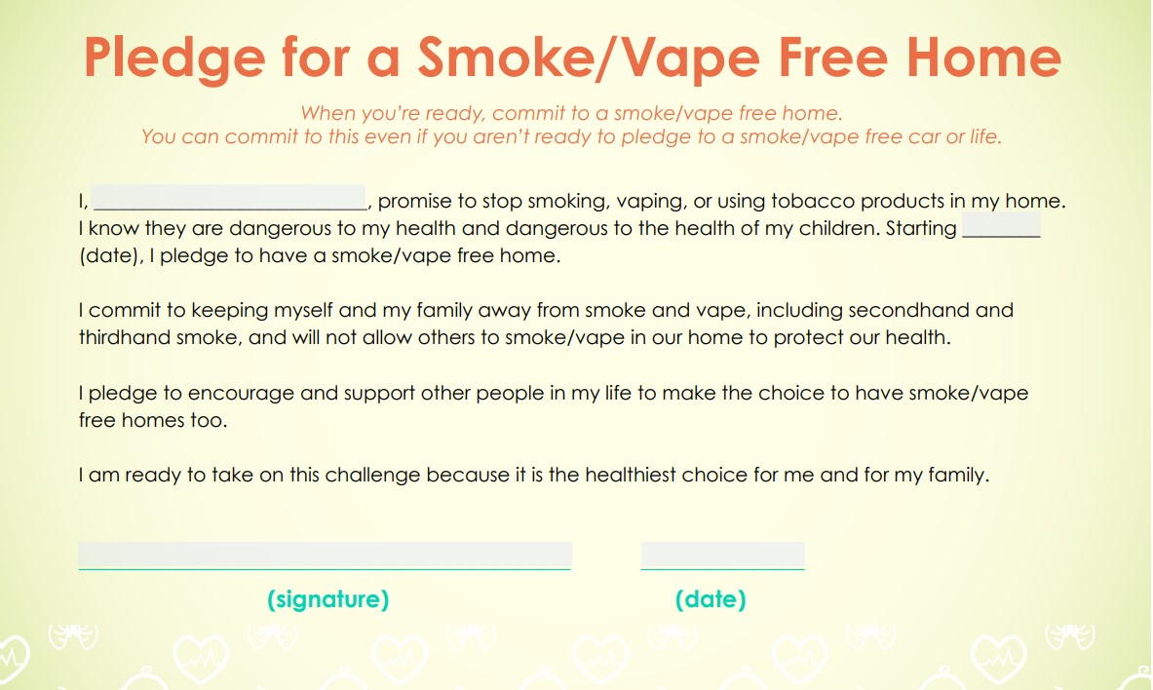

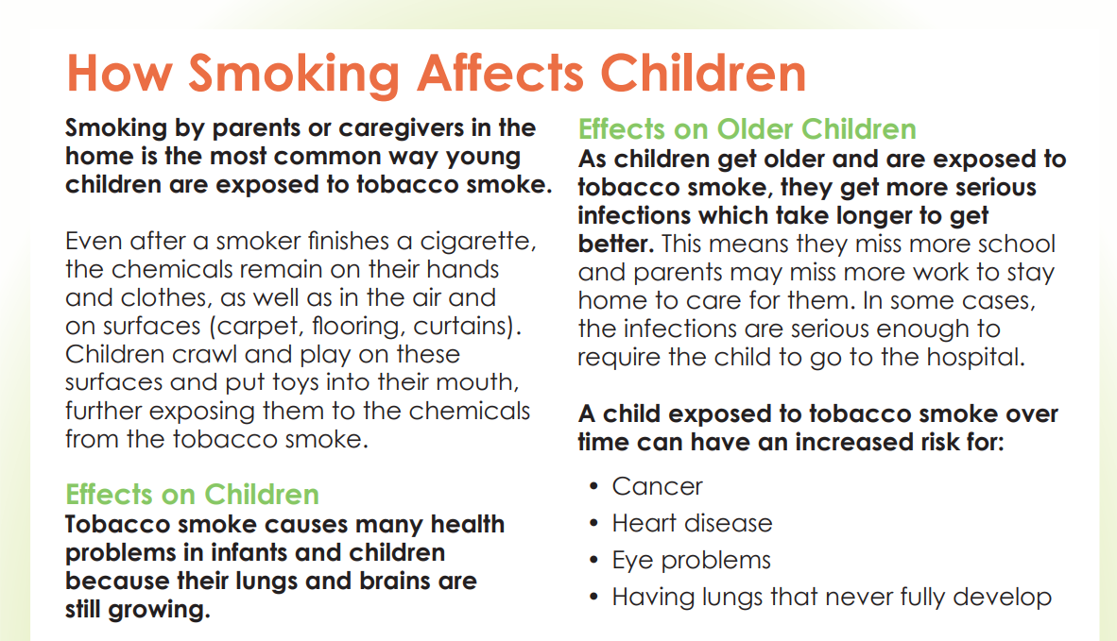
BREATHE RESOURCES
Pledge, Flipchart & Quit Now Indiana Handouts
Notes:
KEY POINT: Suggest materials that might be helpful to share with the parent in this scenario.
SCRIPT: “You guys are doing great! Here are some specific resources that might be useful when interacting with this parent. You could use the smoke/vape free home pledge in the parent worksheets as a way to help this mom stay accountable. You could also use the How Smoking Affects Children page in the flip chart to help remind this mom why she decided to not smoke inside as you offer suggestions. And if she indicates interest in trying to quit smoking you can offer a Quit Now Indiana handout and tell her about this free service.”

Slide 53

SCENARIO 2
New parents have guests coming for the weekend and the guests vape. The couple feels uncomfortable
telling the guests
they can’t vape
in their home.
Notes:
KEY POINT: Share the second scenario.
SCRIPT/INSTRUCTIONS: “Nice job! Let’s try another one.” (Read what is on the slide.)

Slide 54
Which suggestions
would you offer?
Let guests know ahead of time that your house is a smoke/vape free zone
Hang a “No Smoking/Vaping” sign on the front door
Tell the guests they can vape outside, away from the house
Share your reasons for keeping your home smoke/vape free
Other suggestions??
Notes:
KEY POINT: Share the possible options and find out which ones the participants might use.
VIRTUAL MODIFICATION: After you read the possible options have participants type in the chat box the letter(s) that correspond with the suggestion(s) that they might offer this parent. Announce which options seem most popular among the participants and provide commentary.
SCRIPT/INSTRUCTIONS: (Read each of the options out loud. Have participants either raise their hand or move to a designated area of the room based on the suggestions(s) they would be most likely offer this parent. Call on a couple people to share why they chose a specific suggestion or if they have additional thoughts on what they would say to this parent. Reinforce that there is more than one way to handle every scenario and that participants may adjust their approach given the setting and their relationship with a given parent.)

Slide 55
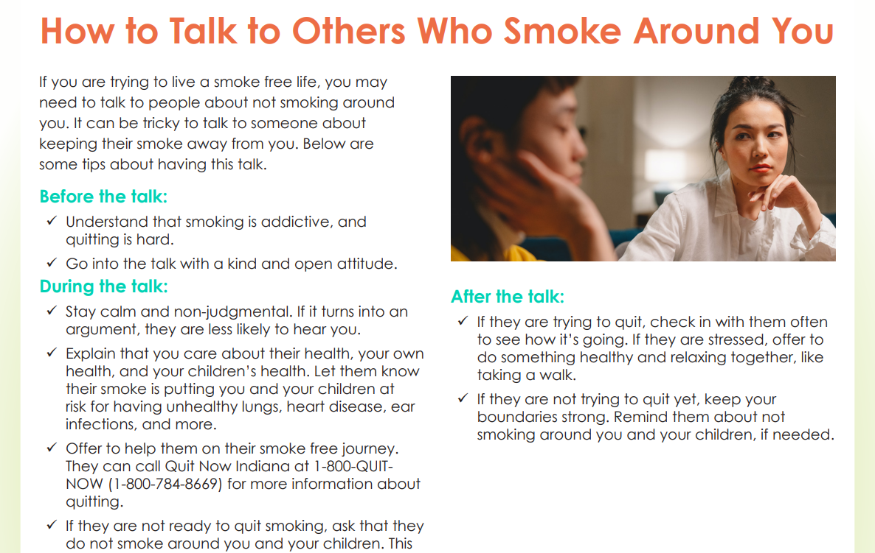

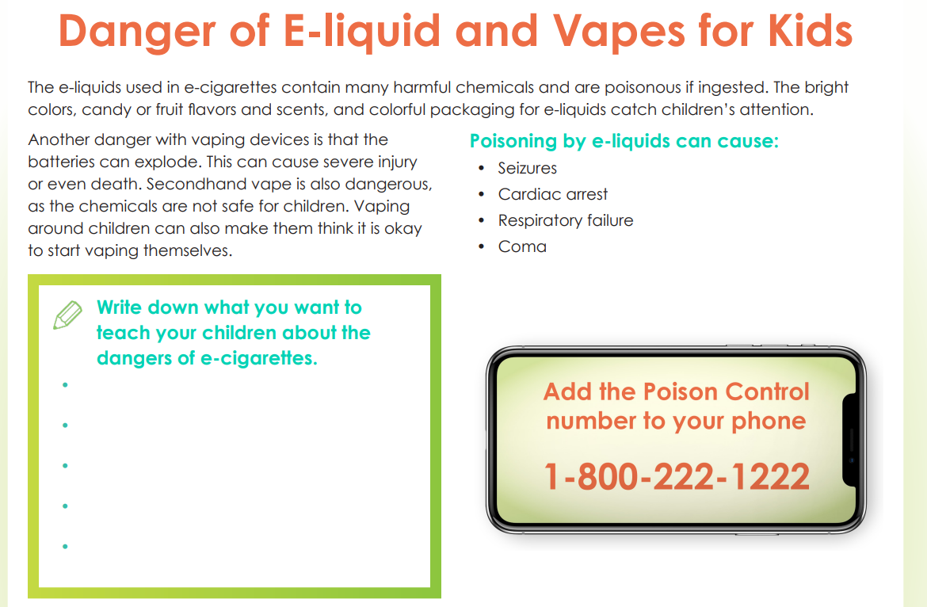
BREATHE RESOURCES
Parent Worksheets & Quit Now Indiana Handouts
Notes:
KEY POINT: Suggest materials that might be helpful to share with the parent in this scenario.
SCRIPT: “Here are some more resources available to you that might be helpful with this scenario. Again Quit Now Indiana has some helpful handouts about smoke/vape free living. And there are parent worksheets that could guide the parent in talking to others who smoke around them as well as the one about the dangers of E-liquids and vapes for kids to reinforce their stance on not allowing their guests to vape in their home.”

Slide 56
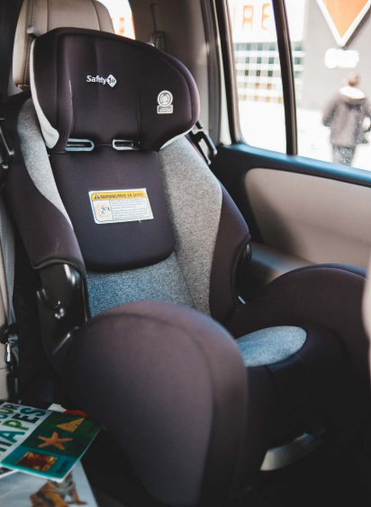
SCENARIO 3
Dad learned about thirdhand smoke and has stopped smoking in his car. He drops his children at childcare and
goes straight to work,
where he can’t smoke.
At the end of the day he
is having trouble not
smoking in the car.
Notes:
KEY POINT: Share the third and final scenario.
SCRIPT/INSTRUCTIONS: “I think you guys have the hang of this! Let’s try one final scenario.” (Read what is on the slide.)

Slide 57
Which suggestions
would you offer?
Contact Quit Now Indiana for quit support
Plan extra time so he can smoke outside before getting into the car
Use nicotine replacement products to reduce cravings
Have hard candy to suck on or gum to chew in the car
Other suggestions??
Notes:
KEY POINT: Share the possible options and find out which ones the participants might use.
VIRTUAL MODIFICATION: After you read the possible options have participants type in the chat box the letter(s) that correspond with the suggestion(s) that they might offer this parent. Announce which options seem most popular among the participants and provide commentary.
SCRIPT/INSTRUCTIONS: (Read each of the options out loud. Have participants either raise their hand or move to a designated area of the room based on the suggestions(s) they would be most likely offer this parent. Call on a couple people to share why they chose a specific suggestion or if they have additional thoughts on what they would say to this parent. Reinforce that there is more than one way to handle every scenario and that participants may adjust their approach given the setting and their relationship with a given parent.)

Slide 58


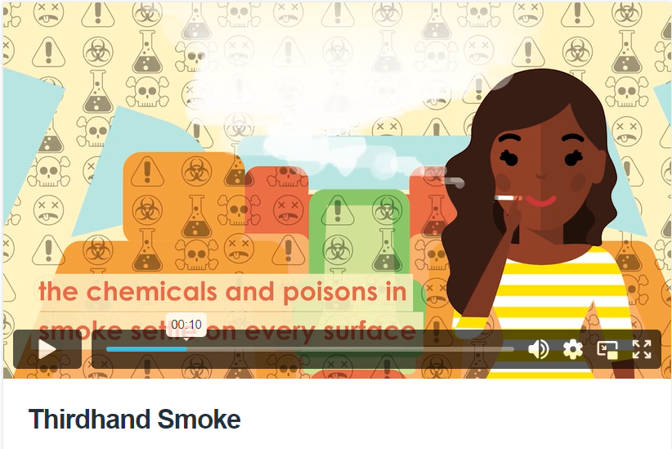
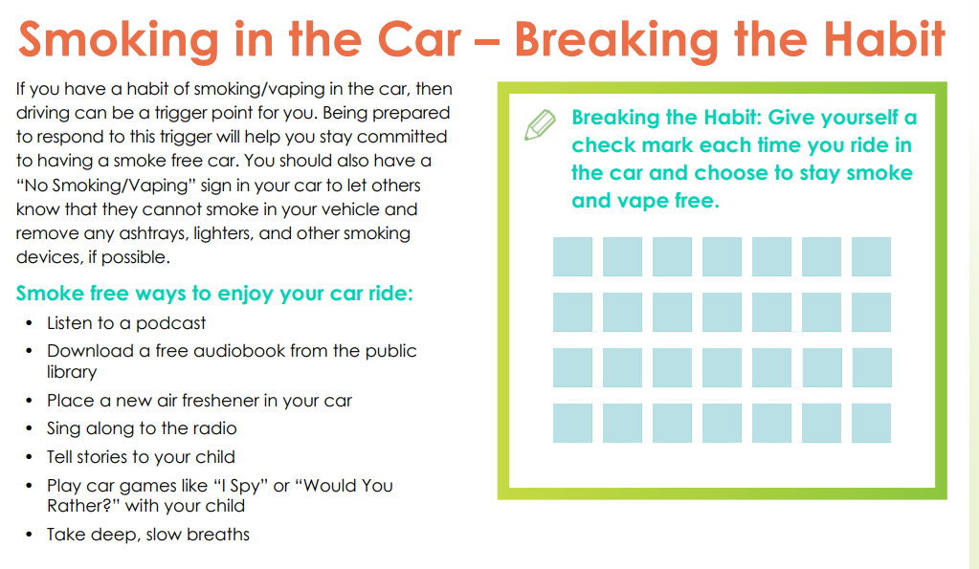
BREATHE RESOURCES:
Quit Now Indiana Cards, Breathe Video, Parent Handouts & Worksheets
Notes:
KEY POINT: Suggest materials that might be helpful to share with the parent in this scenario.
SCRIPT: “You are definitely getting the hang of these scenarios! And of course Breathe offers some good resources that could help this parent as well. If he is interested in trying to quit smoking you can offer a Quit Now Indiana card. You could pull up the thirdhand smoke video to reinforce the importance of not smoking in her car. You might also share the parent handout with tips on keeping your home & car smoke/vape free or the parent worksheet that will help him break the habit of smoking in the car and track his success.”

Slide 59
Great Job!!!
There are lots of ways to address tobacco related challenges…
and plenty of Breathe resources to help!
Notes:
KEY POINT: Praise participants for their active participation.
SCRIPT: “You guys did an awesome job with the scenarios and I’m so encouraged to hear how you might handle these real life examples. And I hope this training is helping reinforce that you have access to tons of great resources to help you out and feel more confident as you approach this sensitive subject with the parents you serve.”

Slide 60
QUESTIONS??
Notes:
KEY POINT: I am happy to answer any questions now or in the future.
VIRTUAL MODIFICATION: Check the chat box for any questions that may have been posted during the training and let participants know they can post questions in the chat box or unmute to ask questions now.
SCRIPT: “I am encouraged to hear all the ways you are already supporting the families you serve and the new ideas that were generated in today’s Breathe Refresher. We are just about done with the training, but I would love to answer any additional questions you may have. And as you continue implementing Breathe please do not hesitate to reach out with questions as they come up.”

Slide 61
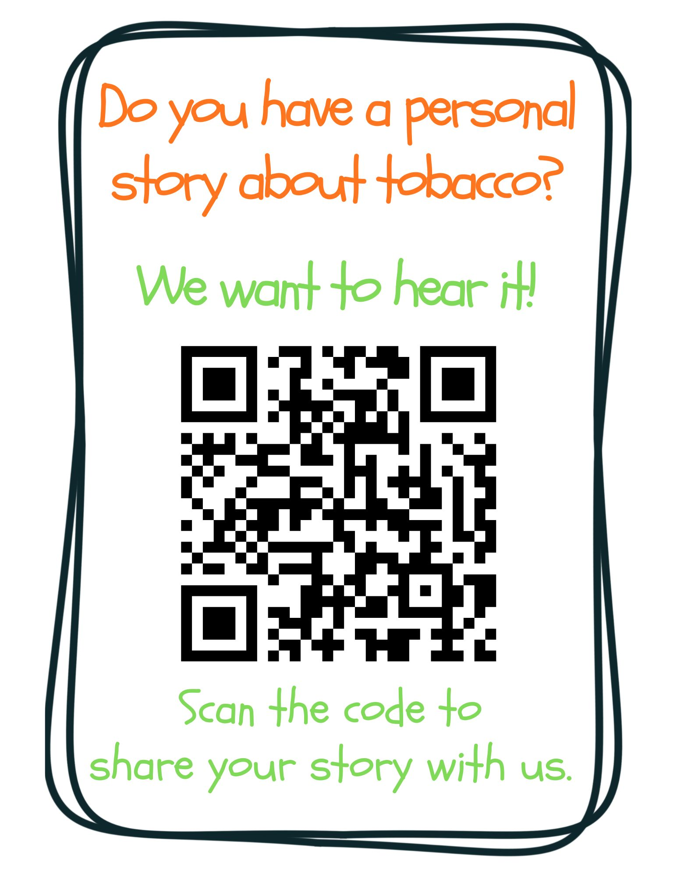
Notes:
KEY POINT: Ask for personal stories about tobacco.
VIRTUAL MODIFICATION: Post this link in the chat box: https://www.surveymonkey.com/r/tobaccostory
SCRIPT: “We love answering your questions as well as hearing stories about how tobacco has affected you, the people you love, and the families you serve. We don’t have time to hear all those great stories today, but we encourage you to share those stories with us at this link, which you can also find on the Breathe website and in the monthly newsletters. Tobacco isn’t just about stats, it’s about people and sharing stories about tobacco helps us all make a personal connection to this important work we are doing. We look forward to hearing your stories!”

Slide 62
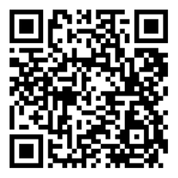
BREATHE TRAINING
“BREATHE REFRESHER”
USE THE QR CODE
to take the
POST- ASSESSMENT
Notes:
KEY POINT: All participants need to complete a post assessment.
MATERIALS NEEDED: Participants can complete the post assessment online with the QR code on this slide. This is the preferred method as it will save you time doing data entry after the training! (The slide now indicates “Breathe Refresher” so they know how to fill answer the first question regarding the type of training they attended.) To encourage compliance, you could have them indicate they are done or show you their completion screen and you could give them a handout, magnet, or other giveaway when they do. You still need to bring some printed out post assessments, preferable on a different color of paper, in case participants prefer to complete a hard copy. The Post Assessment can be downloaded from this webpage: https://justbreathein.org/staff-training/breathe-refresher/ **If you choose NOT to have participants complete the assessment online, modify this slide by removing the QR code.
VIRTUAL MODIFICATION: Participants can use another device to access the QR code on the screen and/or you can place the link in the chat box so they can complete it on the device they are using for the training. Ask participants to type DONE in the chat box to encourage compliance and assess completion. Here is the link to the post assessment: https://www.surveymonkey.com/r/PostAssess2527
SCRIPT: “Thank you for participating in today’s Breathe training! Before we wrap up, I need everyone to complete the post assessment. Once you have completed the post assessment, please bring it to me/hold it up and I will give you (a magnet, certificate of completion, or whatever handout you choose).”

Slide 63
PICK UP MATERIALS
Expect 1-Month Post Training Survey from
JustBreatheIndiana@gmail.com
NEW INCENTIVE!
Each month - Random drawing for a $25 gift card from all 1-month surveys received!
Notes:
KEY POINT: Participants can pick up Quit Now Indiana materials and should expect a follow up survey in one month.
SCRIPT: “After you complete the post assessment you can pick up Quit Now Indiana handouts/QR code flyers/supplemental Breathe materials. I’ll be sending a follow up email soon with the link to the webpage with all the digital materials as well as a certificate of completion for today’s training. Then expect an email in about a month from justbreatheindiana@gmail.com with our 1 month follow up survey. Please complete that survey when you get it as it really helps us gain feedback to evaluate and improve the Breathe program. (Click to reveal incentive) As an added incentive we are now doing a monthly drawing of all the 1 month follow up surveys received and one lucky winner will be awarded a $25 gift card, the winner will get to choose between Walmart or Starbucks…and it could be you, if you complete the 1 month survey!”

Slide 64


THANK YOU!!
Tanya Shelburne, Project Manager
tanyas@healthedpros.org
317-902-4505
Alison Muckerheide, Tobacco Control Specialist
alisonm@healthedpros.org
Notes:
KEY POINT: Share contact information.
SCRIPT/INSTRUCTIONS: (Personalize this slide with your contact information.) “Thank you so much for participating in today’s Breathe Refresher. It was my pleasure to get to see all of you again and meet the new staff. I know that working with families on this topic may not be easy, but I hope this training reinvigorated you and that you have even more ideas for how you can utilize the Breathe materials. As always, please reach out to me any time you have questions or great ideas and want to share your successes!”

Slide 65
DATA SOURCES
2023 Indiana Behavioral Risk Factor Surveillance System (BRFSS)
www.in.gov/health/tpc/
www.cdc.gov/tobacco/
www.cancer.org/cancer/risk-prevention/tobacco
For a more detailed list of data sources used
to create Breathe materials go to
justbreathein.org/additional-resources/data-sources/
Notes:
KEY POINT: Share basic data sources and where they can find more.
SCRIPT/INSTRUCTIONS: (You can just leave this slide up for people to see or refer to it if anyone asks about the source of information you shared.)

