Slide 1
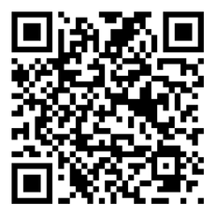



CAPACITACIÓN BREATHE
“Capacitación inicial de Breathe”
Usa el Codigo QR
Para tomar la PRE- Evaluación
Notes:
HOW TO USE THE NOTES SECTION: Each slide in this presentation has a notes section that can help you deliver the presentation.
The KEY POINT let’s you know the most important message to convey and along with the text on the screen, that may be all the guidance an experienced County Coordinator/tobacco expert may need to conduct the training effectively.
If any handouts or other resources are necessary for a given slide you will see a MATERIALS NEEDED section.
If modifications are needed to share a slide or conduct an activity for a virtual training, you will see a VIRTUAL MODIFICATION section.
The SCRIPT portion of each page will give you a sample script (in italics) of what you might say for each slide as well as instructions, if needed. DO NOT READ THE SCRIPT VERBATIM! Instead, use the script to practice the presentation and then adjust it as needed to make it your own. The script is simply meant to be a guide/suggestion!
KEY POINT: All participants need to complete a pre assessment and sign the sign-in sheet.
MATERIALS NEEDED: Participants can complete the pre assessment online with the QR code on this slide. This is the preferred method as it will save you time doing data entry after the training! The slide indicates “Initial Breathe Training” so they know how to answer the first question regarding the type of training they are attending. To encourage compliance, you could have them indicate they are done or show you their completion screen and you could give them a handout, magnet, or other giveaway when they do. Bring copies of the sign-in sheets and some printed out pre assessments in case participants prefer to complete a hard copy. **If you choose NOT to have participants complete the assessment online, modify this slide by removing the QR code.
VIRTUAL MODIFICATION: Participants can use another device to access the QR code on the screen and/or you can place the link in the chat box so they can complete it on the device they are using for the training. You may need to keep posting the link in the chat box as people enter the training since they may not be able to see earlier chat box entries. Ask participants to type DONE in the chat box to encourage compliance and assess completion. Here is the link to the pre assessment: https://www.surveymonkey.com/r/PreAssess2527
SCRIPT: “Before we get started, I need everyone to complete a pre assessment. To access the survey, just open the camera in your smartphone and point it at the QR code on the screen to get the link. If you prefer to complete the assessment with pen and paper just let me know and I will bring you a hard copy. I will also be asking you to complete a post-assessment at the end of the training, and these are important parts of our evaluation so I appreciate you completing them. There are also sign-in sheets being passed around. Please make sure you put your name and contact info on one of the sign-in sheets so we will have a record of everyone’s attendance and if you want to receive our monthly Breathe E-newsletter you can indicate that on the sign in as well.”

Slide 2



HEALTH ED PROS
Tanya Shelburne MPH, CHES
Alison Muckerheide MPH, CHES
Notes:
KEY POINT: Participants should know your name and a bit about your background and position.
MATERIALS NEEDED: Breathe kits and Quit Now Indiana materials
VIRTUAL MODIFICATION: Make plans with your site contact to deliver Breathe Kits and Quit Now Indiana materials either before or after the training and discuss how the materials should be divided up between the training participants.
INSTRUCTIONS: Personalize this slide with your information. Welcome everyone to the training, introduce yourself, and give a brief background on your experience, your organization, and your position. Bring materials to the training (breathe kits, Quit Now Indiana materials, etc.) but do not distribute them until the end of the training as some attendees will leave/not pay attention if materials are distrusted too early.

Slide 3



Pautas para la capacitación virtual
La capacitación se está grabando
Mantenga el video activado
Silencie su voz cuando no esté hablando
Cambie su nombre si es necesario
Minimice las distracciones
Permanezca durante toda la capacitación
¡Interactúe! (evaluaciones previas y posteriores, chat, active el sonido)
Notifique si tiene algún problema
Notes:
DELETE THIS SLIDE IF CONDUCTING AN IN-PERSON TRAINING!
KEY POINT: Go over housekeeping and expectations for the training.
SCRIPT/INSTRUCTIONS: (Personalize this slide as needed.) “Now before we jump into the actual training, I want to go over a few housekeeping items. I want to make sure everyone is aware that the training is being recorded and I will share a link to the recording in a follow up email in a day or two should you want to watch it again or share it with someone on staff who may have missed the training. I do ask that you keep your videos on during the training so I can see everyone’s smiling faces and it will feel a bit more like we are actually in person, but do keep yourself on mute to minimize background noise and just unmute yourself when you want to share something or ask a question. If the name on the screen is not your name, please rename yourself, which will help us with attendance and knowing who everyone is. To rename yourself put your cursor in your box on the screen and click the blue box in the upper right corner with 3 dots in it and you should see the option to rename yourself. Do your best to minimize distractions around you and I do ask that you stay for the full 90 minute training. There will be several options to interact so feel free to use the chat box or raise your hand at any time, and I hope you will interact as it is way more fun when it’s not just me talking the whole time! If you have any issues during the training feel free to message the co-host and we will try to assist.”

Slide 4
Conexión Antes Que Contenido
Notes:
KEY POINT: Establish that you want to get to know the training participants and for them to know you better.
SCRIPT: “We really value relationship building, so before we dive right into content on tobacco I’d like to do a short activity so we can get to know each other a bit better. Connection Before Content is a critical part of the Breathe program and I’ll talk about that a little more later as it relates to all of you and the families you serve.”

Slide 5
¿Qué te impide estar completamente presente durante este entrenamiento?
Notes:
KEY POINT: Get to know participants with this ice breaker.
VIRTUAL MODIFICATION: Participants could put their answers in the chat box or raise hands and unmute to share responses.
SCRIPT: “I know everyone in this room has a lot on their plate beyond this 90 minutes training, so to break the ice I invite anyone who is willing to share…”What might keep you from being fully present during this training? I’ll even go first!” (Share something that is one your mind or to-do list, could be personal or professional, that gives a bit of insight into who you are and what you have going on besides this training.) Now who would like to go next? (Listen and respond with empathy, praise, or whatever emotion acknowledges that you see and hear each person. Don’t force anyone to share, but create a welcoming environment that encourages participation.) Thank you to everyone who shared. I already feel like I am getting to know this group a little better! Even if you didn’t share something out loud, just know that I understand this training and this topic isn’t the only thing you have going on in your life right now. I do hope that by the end of the training you will understand the importance of educating your families about tobacco and that you will walk away with some tangible ideas of how you can do that within the scope of your job and the important work you are already doing.”

Slide 6
NUESTRA ASOCIACIÓN
Fondos estatales a través de la Comisión para la Prevención y Cesación del Tabaquismo de Indiana.
Colaboración con Indiana Head Start y socios similares por mas de una década.
Recursos de alta calidad diseñados por McMillen Health.
Educación y empoderamiento del personal que tiene relaciones de confianza con los padres.
Notes:
KEY POINT: Our program provides on-going support and resources to partners who have trusted relationships with parents/families.
SCRIPT: “Before we dive further into information on tobacco, I want to share a basic overview of our partnership with your organization. Funding for Breathe comes from the Indiana Department of Health’s Tobacco Prevention and Cessation Commission and we have been working with Head Start centers and similar partners for well over a decade. As one of our Breathe Partners you will get access to a bunch of quality resources designed by McMillen Health our of Fort Wayne and I’ll go over those materials in a few minutes. Our main goal with Breathe is to educate and empower staff at organizations just like yours because we know you have trusted relationships with the parents and families you serve, and you have the opportunity to discuss the sensitive topic of tobacco use and secondhand smoke exposure.”

Slide 7
"A nadie le importa cuánto sabes, hasta que saben cuánto te importan.“
-Theodore Roosevelt
Notes:
KEY POINT: The training participants can be effective sharing tobacco education because parents know they care about them.
SCRIPT: “This quote from Theodore Roosevelt captures the spirit of why we developed the Breathe program the way we did. It reads, No one cares how much you know, until they know how much you care. While I could provide tobacco education directly to your families/parents, they don’t know and trust me so it may not be well received. You likely know some of the issues each family may be facing as well as what motivates them and how they learn and receive information most effectively. So I want to come alongside you to give you the expertise and resources you need so you can support your parents when it comes to tobacco education and do it in a way that feels right to you and each of the families you serve.”

Slide 8
COMPONENTES DEL PROGRAMA
Capacitación anual del personal
Evaluación e informes
Materiales gratuitos y boletín electrónico mensual
Revisión y fortalecimiento de la política sobre tabaco
Educación y eventos para padres e hijos
¡Apoyo continuo!
¡Ahora Hablemos De Esos Recursos GRATUITOS!
Notes:
KEY POINT: The staff training is the foundation of the Breathe program, but we also offer lots of other services and on-going support.
SCRIPT: (Personalize this slide as desired for each unique partnership.) “Here is a brief overview of the services and support we are able to offer to your organization through the Breathe program. Breathe is meant to be an ON-GOING relationship, and not just a one-time training and then we disappear! We have already signed a memorandum of understanding with your leadership that says we will be working together on tobacco education. The yearly staff training is what you are currently going through, which is the foundation of the program, and each year we offer a fun, interactive Breathe Refresher to provide additional information and resources. Evaluation is an important part of the Breathe program and we are happy to share the data we collect with you. You have already helped us with our evaluation by completing the pre assessment. Everyone likes free stuff, and Breathe comes with LOTS of FREE STUFF, but we will get to that in a minute. We are also able to review your agency’s tobacco policy and give suggestion on how to strengthen it, if needed. While the goal of Breathe is that all of you will use the information in the training and the free resources to educate families about tobacco use, I can also be available to help you educate your families and community further by participating in community events, suppling handouts, or presenting directly to parents or children. Again, I want this to be an on-going relationship and I am available to help throughout the year so I hope you will reach out to me if you have challenges and that you will also share successes along the way. Since we are grant funded all the materials and support we offer are completely free to your organization.”
(CLICK TO GREEN BAR) Now let’s talk about those FREE resources! I’ve learned that if I pass out the resources at the beginning of the training everyone gets excited looking through them and they don’t listen to me, so you will get your kits a little later. But I do want to review the types of items you will have access to so you can start thinking about how you can use them in your specific role at the organization. I realize that not every item in the kit will make sense or be appropriate for your specific job, but that is why we offer lots of different resources. My hope by the end of the training is that you not only have increased your knowledge about tobacco, but you also walk away with some practical ideas on how you can use some of the Breathe materials. And together your staff can make a healthy impact on the families you serve!”

Slide 9
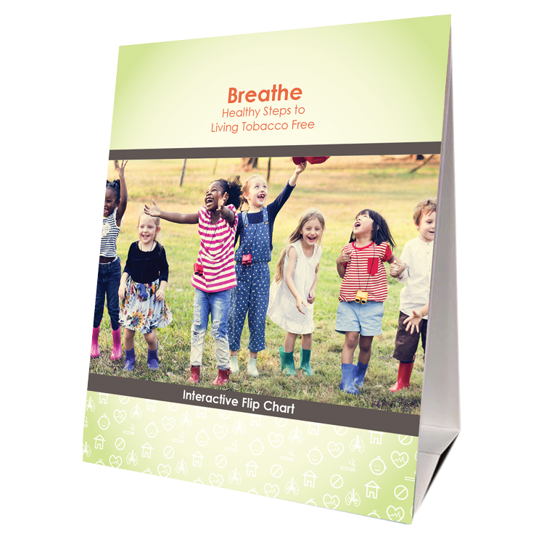
Rotafolio
Individual o en grupos pequeños
Ideal para visitas a domicilio
Concéntrese en 1 o 2 páginas relevantes
Use las notas del orador como guía
Códigos QR con enlaces a videos
Notes:
KEY POINT: The Breathe flipchart is available in the kit and is helpful in providing tobacco education and guiding discussions.
MATERIALS NEEDED: Sample Breathe flipchart to hold up.
SCRIPT: “Hard copies of the flipchart are in the Breathe kits you are receiving today and then tons of other resources can be found on the Breathe website that you can download and share or print out. (Let them know who at their organization has the physical kits and they can share where the will be stored or distributed) The Breathe flipchart covers many of the same topics we will talk about today. Parents can view the front side that has a basic image and limited text, and the back side is your cheat sheet that gives you information to share and questions to generate dialogue. The flipchart is great for one-on-one education during a home visit or parent teacher conference or for use with a small group of parents. I don’t recommend sitting down with parents and going through the whole thing page by page, but if you identify that a parent is stressed out and smokes to attempt to alleviate stress you may want to spend some time going over the stress management page. Or if their child has asthma, review the asthma page with them. If you see a QR code on a page that means there is a corresponding video. Simply use your camera on your smartphone to pull up the video and view it together.”

Slide 10
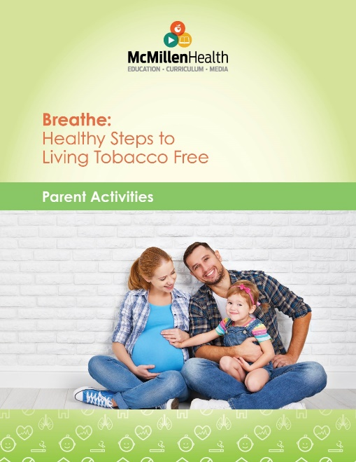
FOLLETO DE ACTIVIDADES PARA PADRES
9 actividades
Perfectas para reuniones de padres
Muy poca preparación
Excelentes temas para iniciar conversaciones
Notes:
KEY POINT: The Parent Activities Booklet provides lots of activities to do with parents around tobacco issues.
MATERIALS NEEDED: Sample Breathe Parent Activities Booklet to hold up. (We will be doing away with hard copies of these once our current supply runs out, but they will continue to be available on the Breathe website)
SCRIPT: “Next is the parent activity booklet, which is to be used by all of you, not the parents directly. The booklet contains 9 different activities you can do with a group of parents to educate them about various tobacco issues and generate discussion. These are fairly short activities that won’t require much planning or outside materials so you can quickly be prepared to use these at a parent night or other gathering of parents. Activities cover topics such as the cost of tobacco use and what could be done with the money saved, planning for a tobacco free life, and tobacco marketing tactics.”

Slide 11
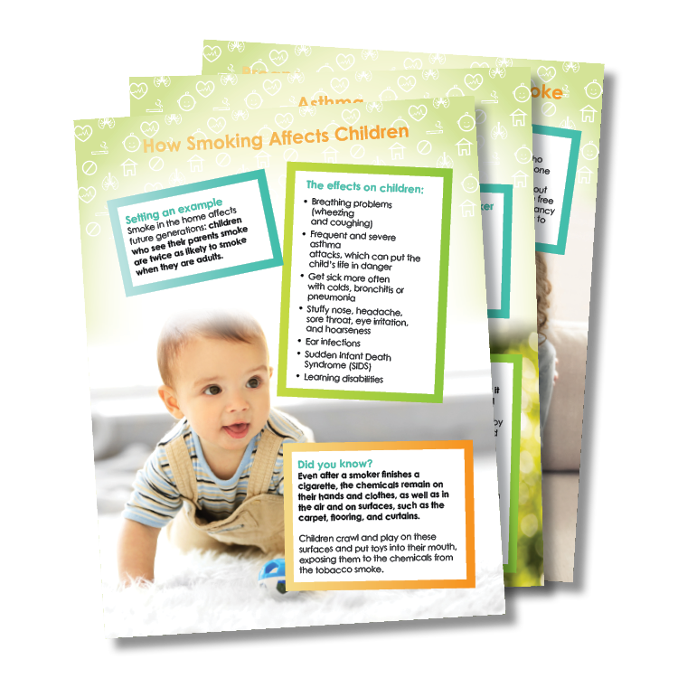
FOLLETOS PARA PADRES/TUTORES
Más de 20 folletos
Muchos temas sobre tabaco
Imprimir y distribuir
Publicarlos en tu organización
Descargar y compartir electrónicamente
Compartir con todos los padres o durante conversaciones individuales
Notes:
KEY POINT: Parent handouts cover lots of tobacco related topics and can be downloaded and shared or printed.
SCRIPT: “You will have access to more than 20 educational handouts online that cover a variety of tobacco topics. You can download them and either print them yourselves or share them with parents electronically or use them in your newsletters. You can share them with individual parents as the need arises or share a specific handout with all the parents as a way to do general tobacco education.”

Slide 12
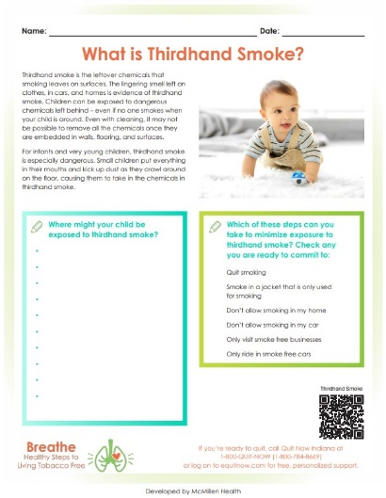
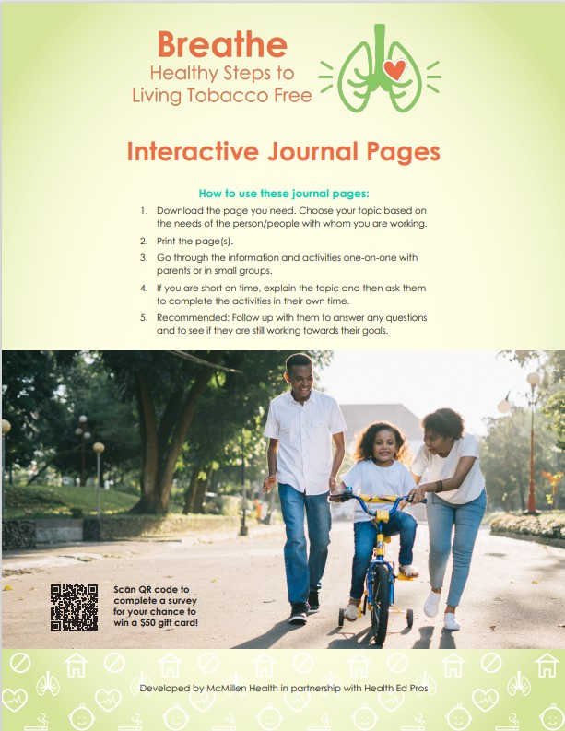
HOJAS DE TRABAJO PARA PADRES
Hojas de trabajo interactivas que ayudan a los padres a establecer metas.
¡Muchos temas!
Para imprimir o compartir electrónicamente.
Opciones para quienes consumen tabaco y quienes no.
Notes:
KEY POINT: Breathe also includes a worksheets for parents/caregivers.
SCRIPT: “You also have access to 49 individual worksheets on various tobacco topics, with some specific to tobacco users as well as ones geared towards those who don’t use tobacco and focus on protecting children from second and thirdhand smoke. You can download the set or each individual pdf of the worksheets as needed. They can be printed and filled out or filled in on the computer. Many of the worksheets help parents with goal setting and planning as they work towards creating healthy environments for their children.”

Slide 13
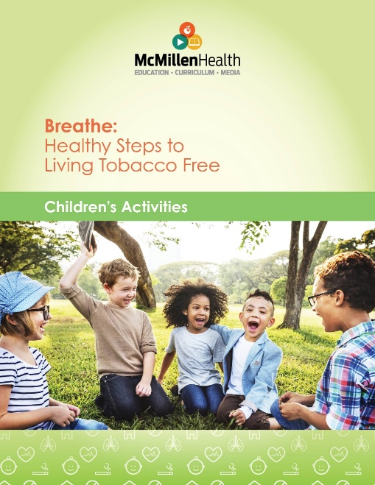
FOLLETO DE ACTIVIDADES INFANTILES
15 actividades para el salón de clases.
Actividades para enviar a casa para que los padres las practiquen con sus hijos
Con un enfoque en cuerpos saludables
Ideal para niños de 3 a 7 años
Requiere muy poca preparación
Actividades sencillas y divertidas
Notes:
KEY POINT: The Children’s Activities Booklet provides lots of activities to do with preschoolers about healthy bodies.
MATERIALS NEEDED: Sample Children’s Activities Booklet to pass around.
SCRIPT: “Breathe also includes some resources to use directly with children. The Children’s Activities booklet provides 15 short activities that can be used in classrooms or other settings with groups of children, and these activities work best with ages 3-7. These are simple activities that do not require much prep time or additional materials and they are not overtly tobacco specific, instead they are focused on healthy bodies. Head Start teachers will especially love these activities as the Head Start domains are listed for each one.”

Slide 14
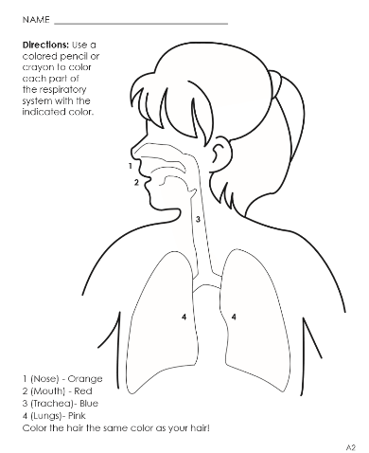

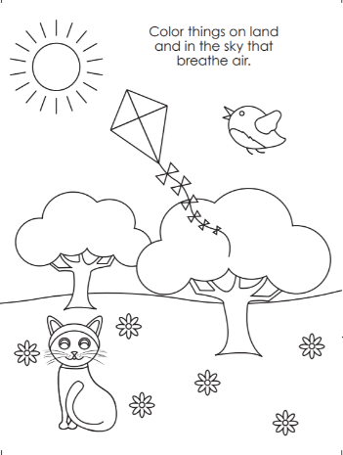
HOJAS PARA COLOREAR
Se centra en cuerpos saludables
Imprima o descargue el libro completo o las hojas individuales
Para usar en el salón o enviar a casa
Notes:
KEY POINT: Breathe includes a children’s coloring book/sheets.
SCRIPT: “Breathe also has a fun coloring book for kids, which can be downloaded from the website. You can print or share the entire coloring book or individual coloring sheets. These are focused on healthy bodies and you can have children do them as a classroom activity or they can be sent home or used at events or to occupy little ones while you are trying to have important conversations with the parents!”

Slide 15
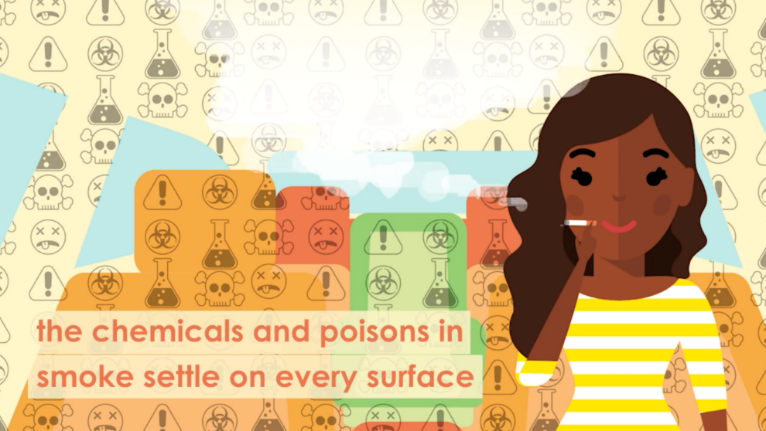
VIDEOS DE BREATHE
Embarazo y tabaquismo
Niños y humo de segunda mano
Humo de tercera mano
Consejos para dejar de Fumar
Vapeo
Actividades para niños
¡Y más!
Códigos QR en diversos
materiales y enlaces en el sitio web
¡Comparte En Las Redes Sociales!
¡Vídeos disponibles en inglés y español!
Notes:
KEY POINT: There are lots of short Breathe videos that cover many tobacco related topics.
SCRIPT: “You will also be able to access and share all the great videos we have for Breathe. These are 2-3 minute videos that convey a variety of tobacco related messages and we also have videos showing how to do some of the children’s activities. The videos are great to use one-on-one when you are discussing a certain topic with a parent and you can also share the videos on your social media channels as a way to keep tobacco education on everyone’s radar. The videos are available in both English and Spanish and can be accessed through the QR codes on the flipchart and journal worksheets. Links to all the videos are also on the Breathe website and I’ll be sharing that link very soon.”

Slide 16
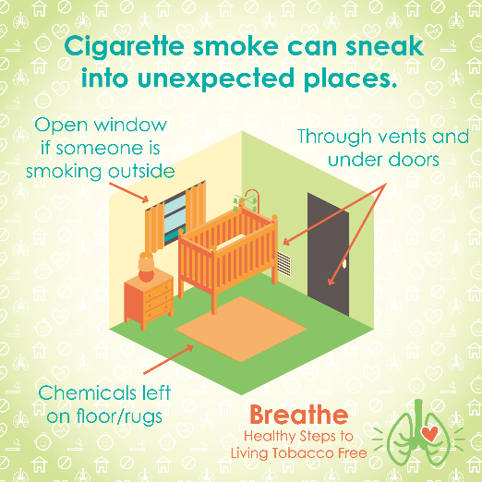
PUBLICACIONES EN REDES SOCIALES
¡Mantenga la educación sobre el tabaco en el radar con publicaciones en redes sociales listas para usar!
Notes:
KEY POINT: Breathe includes social media posts and text messages to help keep tobacco education on everyone’s radar.
SCRIPT: “You will also have access to a bunch of social media graphics with suggested text that can be copied and pasted onto your social media platforms as a way to keep the issue of tobacco education on everyone’s radar. If the person who does your organization’s social media isn’t at the training right now, make sure you share this resource with them.

Slide 17
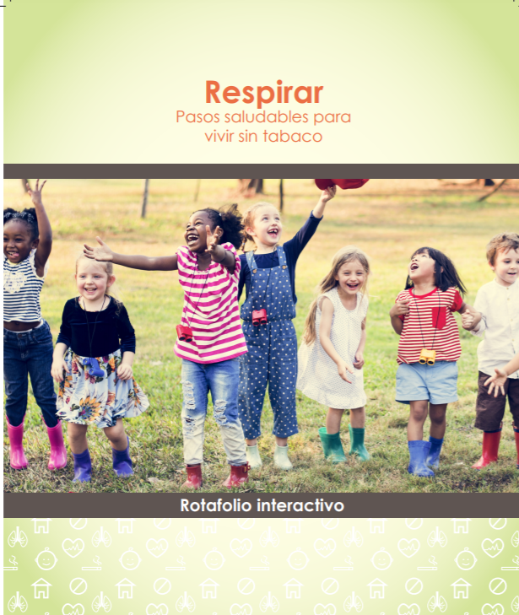
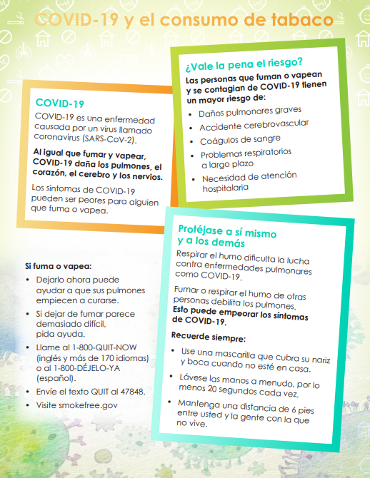
MATERIALES EN ESPAÑOL
Materiales disponibles en español
(¡o próximamente!)
Notes:
KEY POINT: Several of the Breathe materials are available in Spanish, digitally.
SCRIPT: “In addition to the videos, most of the Breathe materials are available in Spanish as well…or they are in the works and will be on the website soon. If you regularly work with Spanish-speaking families you will want to have these handy, but even if you don’t, it’s good to know they are there in case you do need them in the future.”

Slide 18

BOLETÍN ELECTRÓNICO BREATHE
Boletín electrónico mensual.
Reenvía el correo a las familias.
Con enfoque estacional
Descarga el PDF para imprimir y compartir.
Copia y pega en tu boletín informativo, sitio web o redes sociales.
¡Ahora disponible en Español!
Notes:
KEY POINT: We create and share a monthly Breathe e-newsletter.
SCRIPT: “One valuable resource that is not on the website is our monthly Breathe e-newsletter, which you will soon start receiving if you indicated you would like to get it on the sign in sheet. The newsletter generally centers around the season or upcoming holiday as a way to share basic tobacco information in a relevant way. Anything in the newsletter can be copied and pasted into your own communications or you can share a pdf of the newsletter with your parents. We know that talking to parents is not a one time event that just magically addresses the issue and protects all children, so that is why Breathe offers lots of resources that can be sued in a variety of setting and I hope you will use many of them to keep tobacco education on your parent’s radar and let them know that you are there to offer support when needed.”

Slide 19
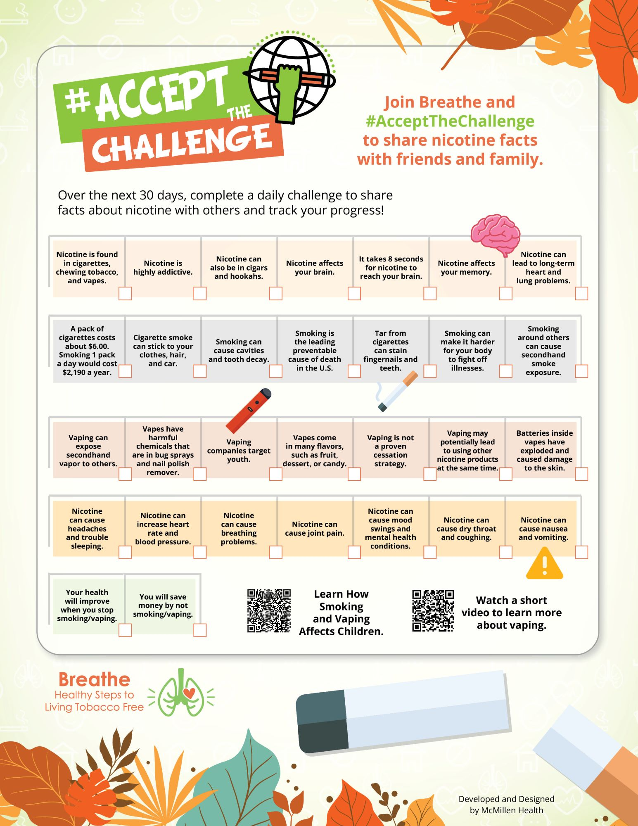
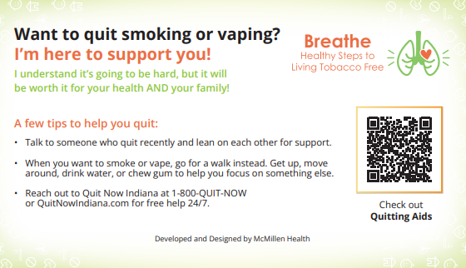
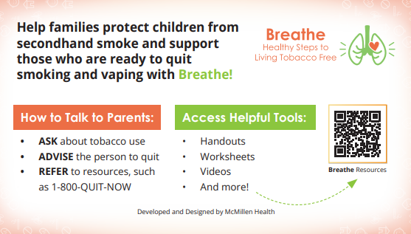
DESAFÍOS TRIMESTRALES Y GUÍAS DE BOLSILLO
Desafíos: Educar y motivar a padres y cuidadores
Adaptados a la temporada
PDF para imprimir y compartir
Guías de bolsillo: ¡fáciles de tener a mano!
Notes:
KEY POINT: Quarterly Challenges and Pocket Guides are two new resources.
SCRIPT: “And finally we have two fairly new resources. Each Quarter we issue a Challenge that serves as a fun way to education and motivate parents/caregivers around various aspects of tobacco. There are also two pocket guides that are small and make it easy to keep Breathe right in your pocket. One is for you to serve as a reminder about Breathe and has a QR codes that will link you to all the resources online. The other pocket guide can be given to a parent to remind them that you are there to support them if they are ready to quit tobacco. As you probably guessed, these can all be downloaded from the Breathe website!”

Slide 20
¡Acceda a todos los materiales de Breathe en línea!
Los socios capacitados pueden descargar materiales en justbreathein.org/for-partners/
Notes:
KEY POINT: Trained Breathe partners can access all the Breathe materials online.
MATERIALS NEEDED: Extra copies of the Partner QR code flyers that can be found here: https://justbreathein.org/wp-content/uploads/2024/07/Breathe-Flyer-QR-Code-For-Partners.pdf
VIRTUAL MODIFICATION: Place the link to the For Partners webpage in the chat box: https://justbreathein.org/for-partners/
SCRIPT/INSTRUCTIONS: “All the materials I’ve just mentioned can be accessed at the webpage on the screen. Don’t worry I’ll send you this link in a follow up email and I also brought some flyers you can post with a QR code that will take you right to this webpage and there are some in the physical Breathe kits. I hope you will take some time to familiarize yourself with everything soon and then consider how you might be able to use these resources with your families.”

Slide 21
OTRAS ESTRATEGIAS CREATIVAS
Actividades para el Salón En Mochilas
Correos Electrónicos Mural Informativo En Eventos Reuniones de Padres Redes sociales Mensajes de texto Boletín informativo
Notes:
KEY POINT: One-on-one conversations aren’t the only way to educate about tobacco and provide support.
SCRIPT: “I know that many of the people we train share concerns about having one-on-one conversations with parents about tobacco, and that is understandable. Hopefully now you can see that there are lots of other creative ways to educate on tobacco with the Breathe materials. Consider which of these creative strategies might work well for you and your current position and feel free to come up with your own creative ideas!” (Read off some of the ideas in the word cloud or share some of the creative ways your partners have used Breathe.)

Slide 22
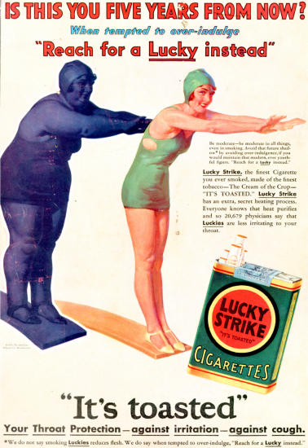
PREPARANDO EL ESCENARIO
La industria tabacalera gasta miles de millones de dólares en comercializar agresivamente productos letales
Notes:
KEY POINT: The tobacco industry spends a lot of money to aggressively market deadly products.
SCRIPT/INSTRUCTIONS: (STAY ON BLANK SLIDE) “Now that you are excited about all the free resources you now have access to…Next I want to set the stage and provide some context for the tobacco burden here in Indiana and all across the country.
(DOUBLE CLICK) For many decades the tobacco industry has been hard at work creating and selling addictive products that when used as directed lead to all kinds of negative health outcomes, including death. Billions of dollars are spent by the tobacco industry to market their deadly products, and Big Tobacco uses targeted and aggressive marketing strategies to prey on certain populations, thereby creating health disparities. Here you can see a very old ad encouraging women to take up smoking as a way to lose weight. The tobacco industry is still aggressively marketing to women with new and deceptive strategies as well as targeting many other groups of people.

Slide 23
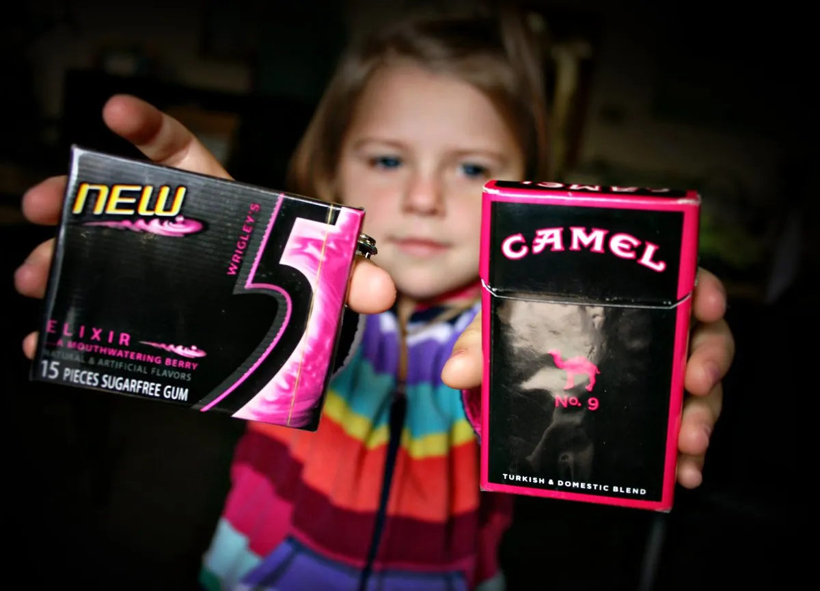
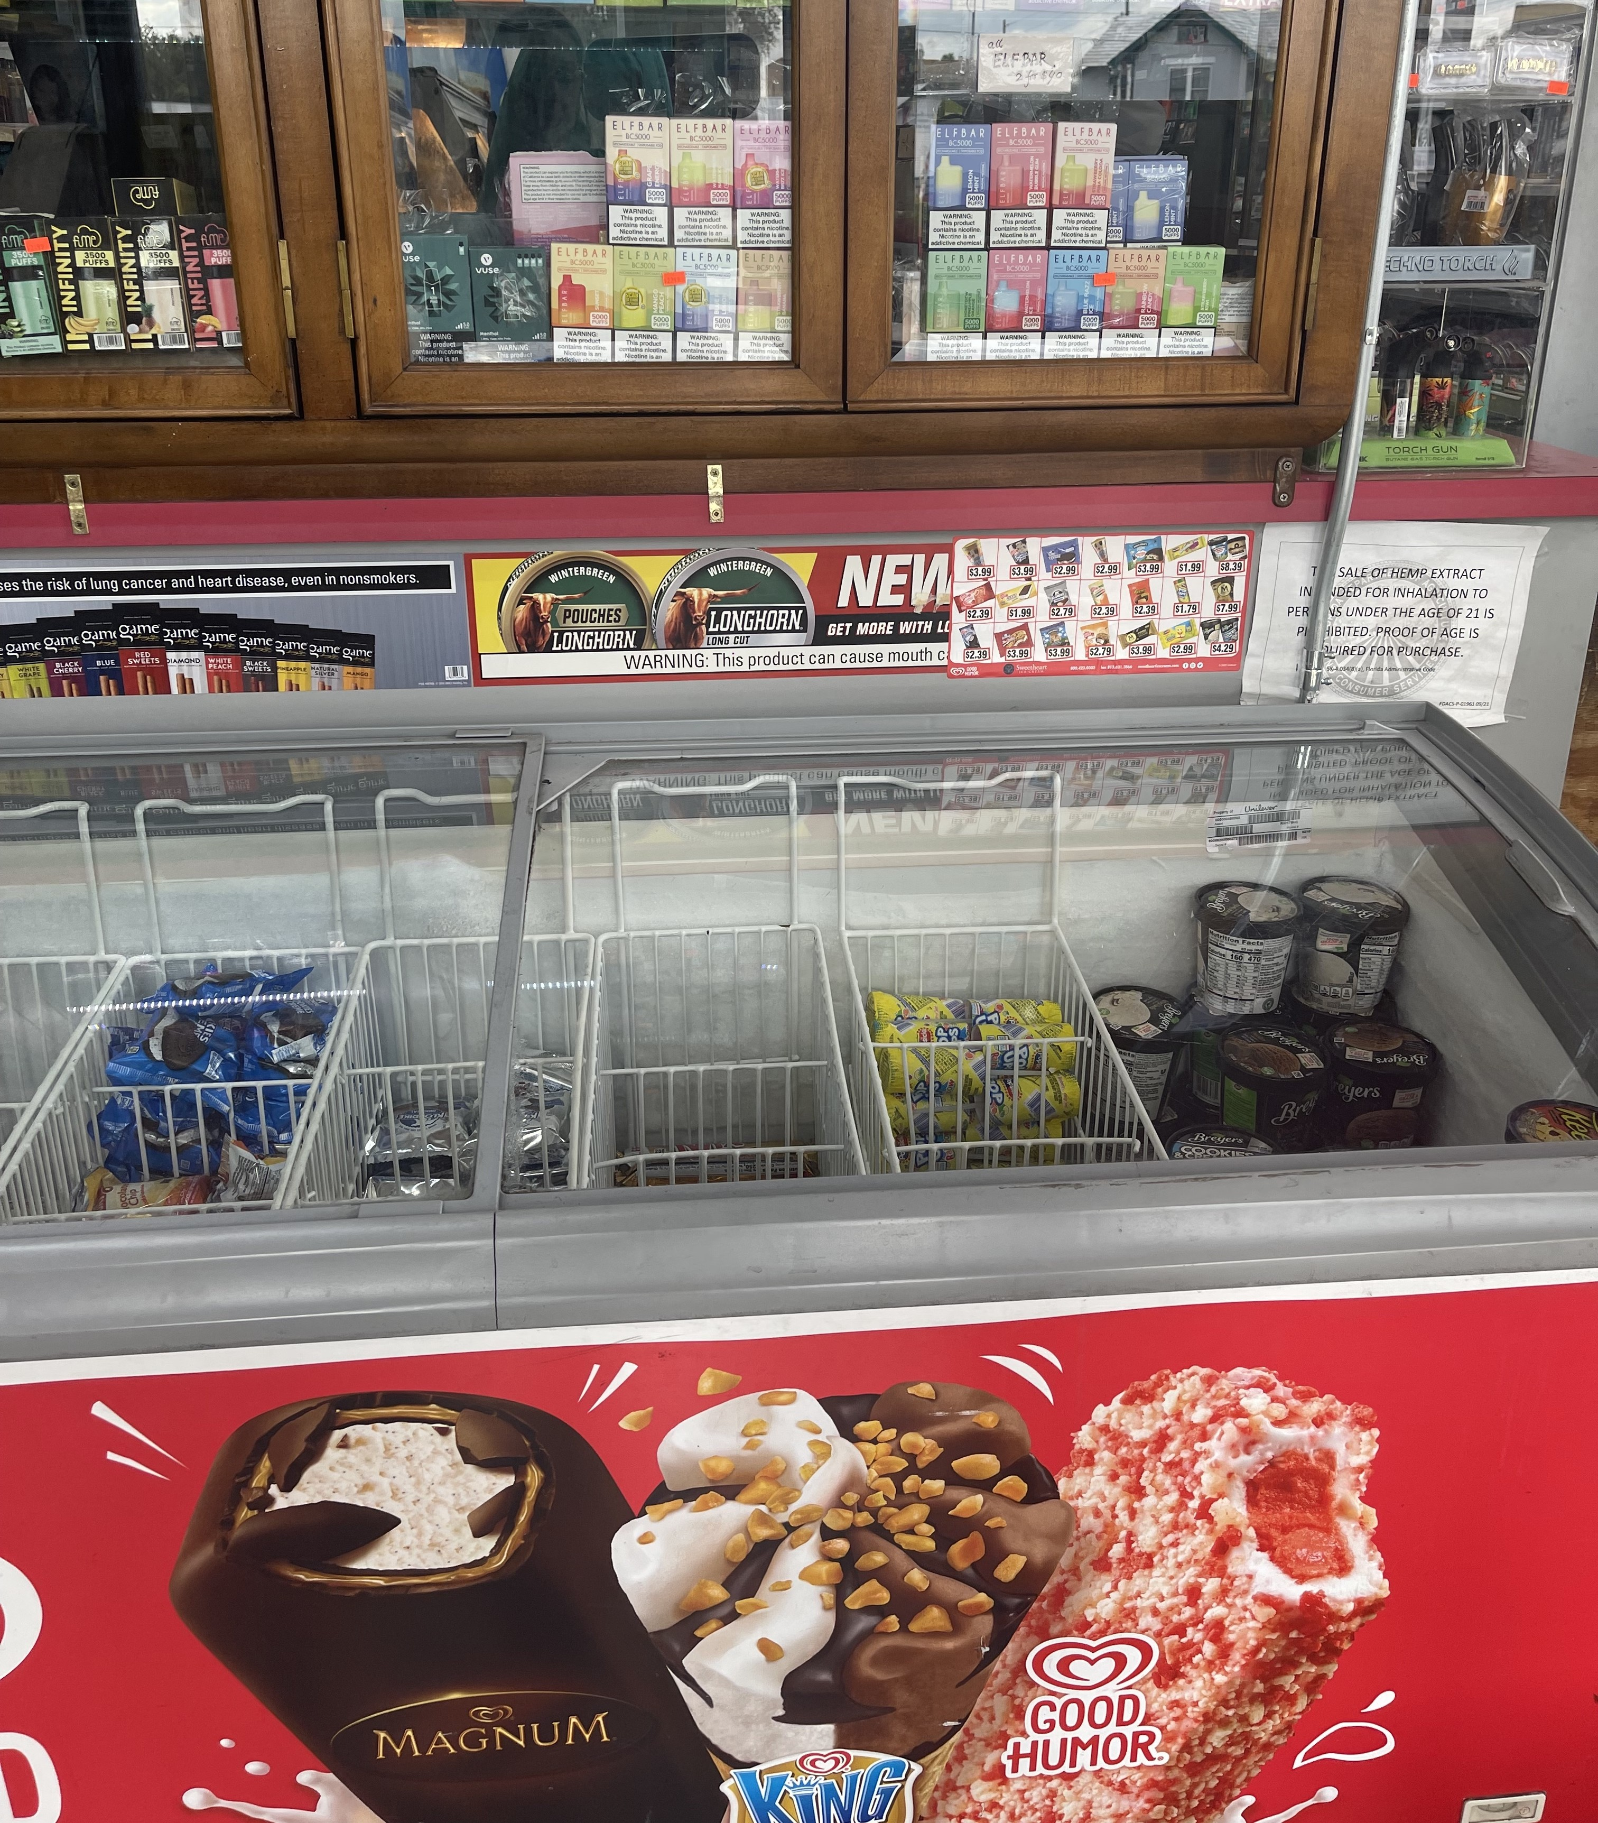
MARKETING DEL TABACO
Mercadeo en el punto de venta
Empaques que imitan dulces populares
Notes:
KEY POINT: Point-of-sale marketing and design of products is aimed at attracting youth.
“As laws restricted certain forms of advertising for tobacco products, point of sale marketing became a key focus for the tobacco industry. Tobacco promotions are specifically placed near products that appeal to children, such as candy and ice cream.
(DOUBLE CLICK TO IMAGE OF GUM AND PACK OF CAMELS AND TEXT) They use colorful packaging that often mimics popular candy and gum and tobacco companies also use candy and fruit flavors in many of their products to appeal to youth in an attempt to create lifelong customers.

Slide 24
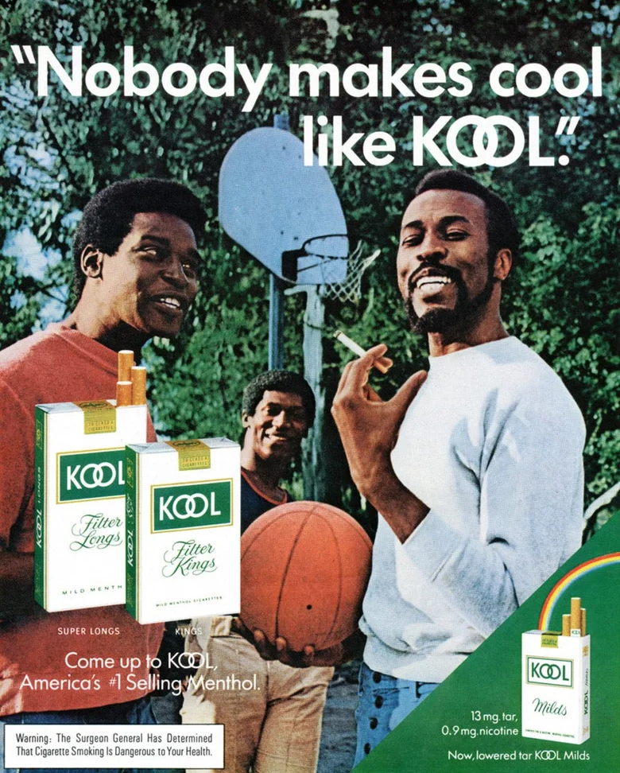
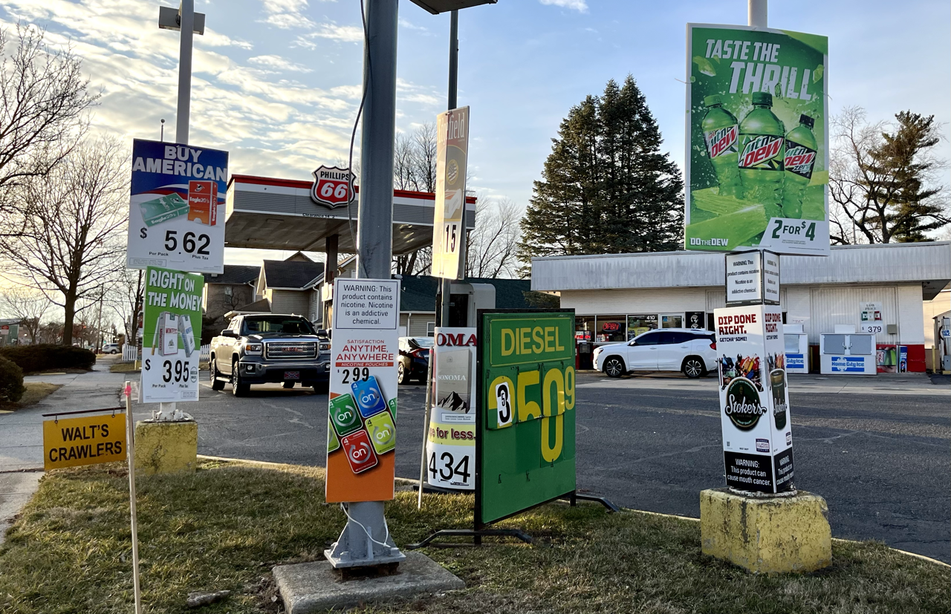
MARKETING DIRIGIDO
Publicidad intensiva en barrios de bajos ingresos
Productos Amentolados
& Los Afroamericanos
Notes:
KEY POINT: The tobacco industry uses aggressive and targeted marketing strategies aimed at marginalized populations, such as communities with low income households and African Americans, creating further health disparities.
“The tobacco industry aggressively targets and markets their products to various marginalized groups, including people of color, those living in rural communities, and to people who identify as LGBTQ+. Higher levels of advertising, discounts, and displays of tobacco products are strategically placed in communities with lower household incomes.
(DOUBLE CLICK) Another example is the overt marketing strategy seen with Menthol cigarettes being targeted to African Americans over several decades. When flavored cigarettes were banned the tobacco industry lobbied hard for Menthol cigarettes to be excluded from the ban, which created a higher burden of tobacco for African Americans.”

Slide 25
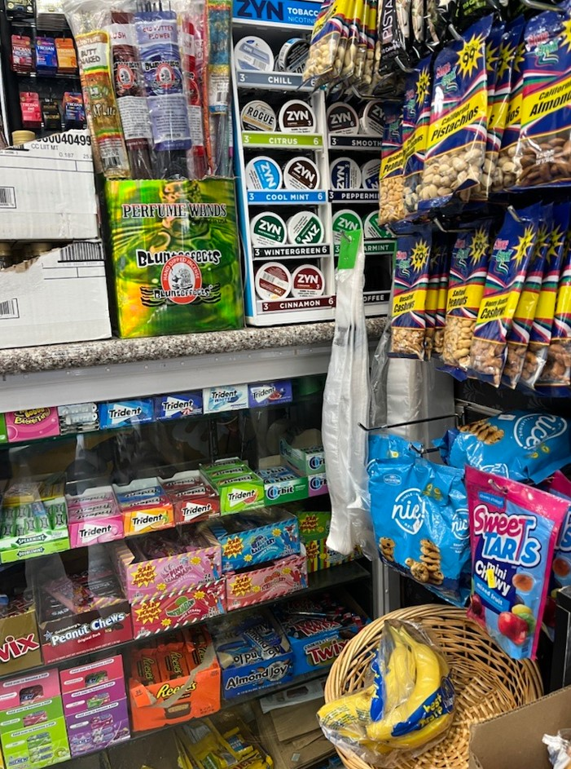
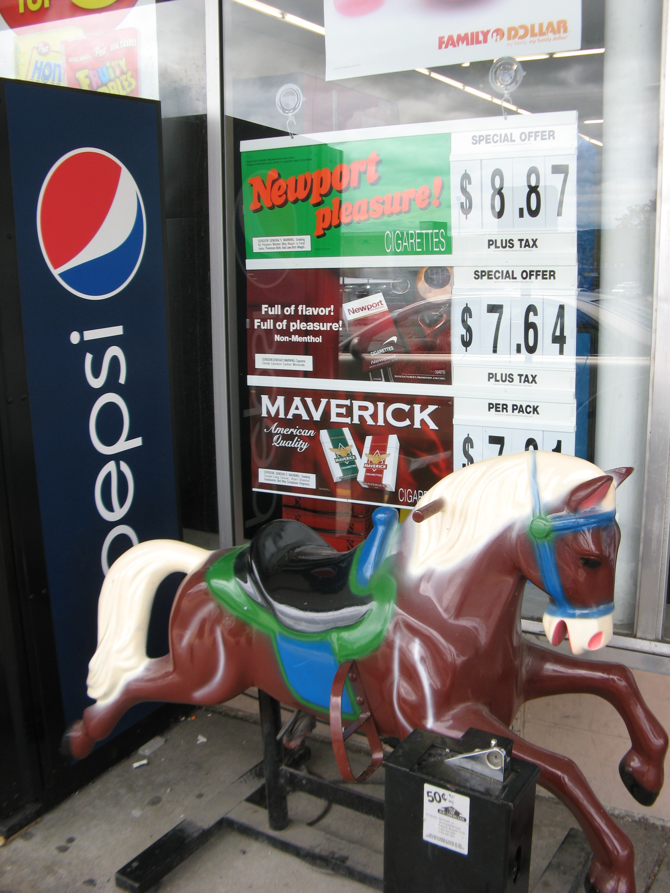
MARKETING DIRIGIDO
¡Las grandes tabacaleras están trabajando en nuestra comunidad!
La industria tabacalera desarrolla nuevos productos para evadir las leyes y captar nuevos clientes.
Notes:
KEY POINT: The tobacco industry is at work in this community.
“As new laws are put in place to protect Americans from these dangerous products and the negative effects of secondhand smoke, the tobacco industry continues to innovate and develop new and addictive products in an attempt to get around laws aimed to protect all Hoosiers, and exploitation of marginalized populations continues. I want to be clear that the Breathe program is not against people who use tobacco. I am here to provide education, support, and resources so that each of you can effectively communicate with the parents and families you serve in a non-judgmental way so they can make informed decisions for their families.
(CLICK TO YELLOW BAR) The reality is that Big Tobacco is at work right here in this community…but there is a lot we can do to support the health of families and fight against the tobacco industry’s dangerous tactics…and that starts with educating ourselves! I’m so excited to partner with your organization as we join together to reduce the burden of tobacco! ”

Slide 26
¡Vamos a desmentir algunos mitos sobre el tabaco e identificar cómo puedes utilizar los recursos de Breathe!
Notes:
KEY POINT: Breathe provides education that can dispel common myths about tobacco.
(DOUBLE CLICK)
SCRIPT: “Now as we dive into some basic tobacco education, we will bust some common myths. Chances are some of the parents you serve may believe these myths to be true, and some of you may as well. And the best way to bust myths is with the facts about tobacco!”

Slide 27
MITO
El consumo de tabaco ya no es un problema
Notes:
KEY POINT: Even though smoking rates have gone down, the tobacco burden is still huge.
SCRIPT: “The first myth I want to address is the idea that tobacco is no longer a problem. While great strides have been made over several decades to lower smoking rates and educate people about the dangers of secondhand smoke, the tobacco burden is still taking a huge toll on Hoosiers and now all the new forms of e-cigarettes add to the complexity and the negative outcomes associated with tobacco use in its many forms. But more on vaping in a bit.”

Slide 28
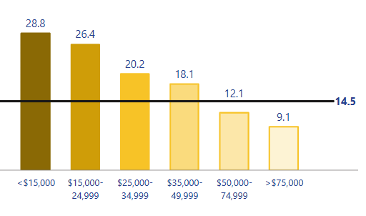
ESTADÍSTICAS DEL TABACO EN INDIANA
El 14.5% de los adultos en Indiana fuma actualmente.
Y el 8.5% de los adultos en Indiana usan cigarros electronicos actualmente.
    *Estos datos provienen del Sistema de Vigilancia de Factores de Riesgo del Comportamiento (BRFSS) de Indiana, 2023.
    Parte de la "Nación Tabacalera" – Un grupo de 12 estados del Medio Oeste y del Sur de EE. UU. que tienen tasas de tabaquismo casi un 50% más altas que el promedio.
Las tasas de tabaquismo ​son
mucho más altas entre ​las
personas con Medicaid y ​
aquellas con bajos ingresos.​
*Estos datos provienen del (BRFSS) 2023.
Notes:
KEY POINT: While smoking has decreased over the past few decades various forms of commercial tobacco use continues to remain high.
SCRIPT: “I won’t bore you with too many stats today and honestly the data can get pretty complicated as there are so many different ways to look at it and dissect the data. But I do want to give you an idea of the current tobacco burden here in Indiana. While traditional smoking has decreased over the past several decades 14.5% of Hoosier adults smoke traditional cigarettes and 8.5% use e-cigarettes. Unfortunately, we know that many adult tobacco user actually use multiple forms of commercial tobacco products. Sadly, Indiana falls into the part of the country deemed “Tobacco Nation”, which includes 12 Midwest and Southern states where the smoking rate is nearly 50% higher than in other parts of the country. As I mentioned earlier the tobacco industry preys on low income communities and that is a huge factor in the smoking rate being so much higher for those on Medicaid and with low incomes, as evidenced by this chart. For those making less than $15,000 a year, the smoking rate is 28.8%, compared to 9.1% among Hoosiers earning over $75,000 a year. This is just one reason why it is so important to us to partner with Head Start and other organizations that serve families with low incomes. We believe all families deserve access to healthy smoke free environments and accurate health information.”

Slide 29
ESTADÍSTICAS DEL TABACO EN INDIANA
El 5.3% de las residentes de Indiana reportó haber fumado durante su embarazo.
*Datos del BRFSS de 2023.
1 de cada 4 personas que no consumen tabaco está expuesta al humo de segunda mano.
(principalmente afroamericanos, personas de bajos ingresos y quienes viven en viviendas multifamiliares).
Aproximadamente 1,300 residentes de Indiana mueren cada año a causa del humo de OTRA PERSONA!
Notes:
KEY POINT: Additional data sheds light on the tobacco burden for various populations.
SCRIPT: “We also know that 5.3% of pregnant people in Indiana reported smoking during their pregnancy. In some Indiana counties the smoking rate during pregnancy is over 20%, so we clearly have some work to do in this area. We know this is a concern for many of you who want to help ensure healthy pregnancies and a good start to life for Hoosier babies and we will cover the negative health effects related to this stat in just a bit. Even those who don’t smoke suffer negative health effects and even death from exposure to secondhand smoke. Again, the burden in disproportionate with African Americans, people with low incomes, and those who live in multiunit housing being more likely to be exposed to secondhand smoke. It is rather sobering to realize that around1,300 Hoosiers dies each year due to someone else’s smoking.”

Slide 30
NUESTRA COMUNIDAD
Consumo de tabaco en esta comunidad
Avances a nivel local
Contactos Locales
Notes:
KEY POINT: Share the status of tobacco use in this community and local resources addressing the tobacco burden.
INSTRUCTIONS: Personalize this slide with your local information!!
What are the rates and statistics of tobacco use in your county?
What is happening in your local county to address tobacco issues?
Are there any resources available in your community?

Slide 31
MITO
Las personas que fuman sólo se hacen daño a sí mismas.
Notes:
KEY POINT: Smoking harms more than the smoker, especially when kids are exposed.
SCRIPT: “Another myth I would like to challenge is the idea that smokers are only harming themselves, which may lead to the thought that if they are adults of legal age to use the product then the tobacco burden really shouldn’t be our concern. Given that everyone in this room cares about the well being of children, what we really want to focus on with Breathe is the impact and the harm associated with tobacco use as it relates to children.”

Slide 32

CONSUMO DE TABACO DURANTE EL EMBARAZO
  Efectos en la salud
    Parto prematuro
    Aborto espontáneo
    Bajo peso al nacer
    Complicaciones de la placenta
    Retraso en el desarrollo cerebral del bebé
    Síntomas de abstinencia del bebé
    Aumento de la frecuencia cardíaca y la presión arterial durante elembarazo
Notes:
KEY POINT: Tobacco use during pregnancy leads to many negative health effects for both the adult and the baby.
SCRIPT: “Let’s start by looking at the impact during pregnancy. Because we do have higher rates of smoking while pregnant in Indiana, it is critical that pregnant people understand the impact of tobacco use on their unborn baby. Tobacco use during pregnancy can cause preterm labor, miscarriage, low birth weight, problems with the placenta, and slow development of the brain. Babies will also experience withdrawal symptoms after birth, and if you have ever been around someone who is quitting smoking or if you have quit smoking you know this can be an unpleasant process. Now imagine a newborn dealing with withdrawal! The pregnant person may also experience increased heart rate and blood pressure. I want to go back for a minute to discuss another myth that is still going around with some women who actually believe that a low birth weight is a good thing and will make delivery easier…which is not true and is not healthy for the baby!”

Slide 33
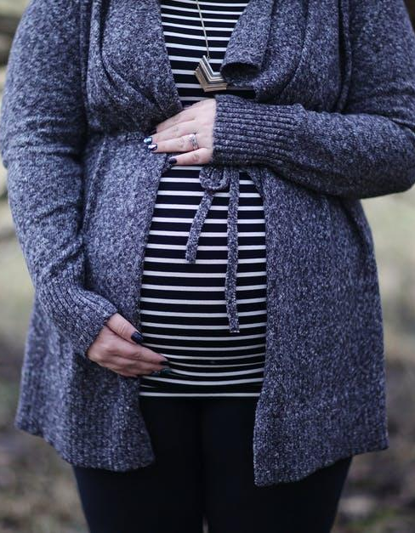
CONSUMO DE TABACO DURANTE EL EMBARAZO
Dejar de fumar durante el embarazo ayudará al bebé AHORA y DESPUÉS de que nazca.
  ¡NO EXISTE UNA CANTIDAD SEGURA DE CONSUMO DE TABACO DURANTE EL EMBARAZO!
Notes:
KEY POINT: There is no safe amount of tobacco use during pregnancy.
SCRIPT: “The good news is that no matter how far along someone is in their pregnancy, stopping tobacco use will help the baby! Not only will it help the baby before birth, but if a baby is born into a smoke free home they will not have all of the dangerous health impacts of secondhand and thirdhand smoke in the future. The bottom line and what we want to stress to pregnant people is that there is no safe amount of tobacco use during pregnancy.”

Slide 34


Erica ha estado fumando desde que tenía 15 años. Ahora tiene 5 meses de embarazo. Durante una visita domiciliaria, ella menciona de forma casual que sabe que fumar no es bueno para su bebé.
Notes:
KEY POINT: Consider a scenario about talking to a pregnant women about smoking.
VIRTUAL MODIFICATION: If there is time, you can have participants type in the chat box possible ideas for how they would handle this scenario.
SCRIPT/INSTUCTIONS: “Now we have our first scenario! These scenarios will give us all a chance to think about how we might use the information we are learning today and the Breathe resources you now have access to in your everyday work. For this scenario, Erica has been smoking since she was 15. Now she is 5 months pregnant. During a home visit she casually mentions that she knows smoking isn’t good for her baby. I realize not all of you may conduct home visits, so either imagine that you do or that you are in a setting the applies more to your role and a parent shares a similar statement. How would you react?” (You can let participants chime in and share their ideas, based on time and how interactive the group seems, or you can jump right to the next slide and offer suggestions.)

Slide 35
A. Continúa con tu lista de verificación porque tienes mucho que cubrir durante esta visita.
B. Elogia a Erica por las cosas saludables que ya está
haciendo y por compartir sus preocupaciones sobre fumar.
C. Dile que tienes recursos educativos gratuitos y ofrécele 1 o 2 artículos del kit Breathe.
D. Enumera rápidamente todos los posibles efectos secundarios que podrían resultar al fumar durante el embarazo.
Notes:
KEY POINT: Have participants consider which options they may feel comfortable doing in this scenario.
VIRTUAL MODIFICATION: Have participants use the reaction buttons as you read each option to signify if they would use that one, or read all the answer options and have them type the letter(s) of the options they would feel most comfortable doing.
SCRIPT: “Here are just a few options of how someone may handle this scenario. Keep in mind there aren’t necessarily right or wrong options. Some may be more effective than others, but it also depends on your specific role, your relationship with the parent, and your level of comfort as well as lots of other factors!” (Read each answer choice out loud and have participants raise their hand or move to a certain area of the room if that is the option that feels most comfortable to them. As time permits you can ask for some participants to share feedback as to why they chose that option. Reinforce that option A might be realistic, but finding another time to address the topic is important. With option B reinforce that praising what parents are doing right goes a long way in building rapport. With option C reinforce that they now have lots of great resources that can aid them in this kind of encounter. With Option D reinforce that while this might be true for many pregnant people this might be overwhelming and cause them not open up and go to you for support.)

Slide 36

HUMO DE SEGUNDA MANO: EMBARAZO
Incluso si alguien NO consume tabaco,
el humo de segunda mano puede causar problemas GRAVES en su embarazo, como:
      Parto prematuro
      Muerte fetal y abortos espontáneos
      Síndrome de muerte súbita infantil
      Embarazo ectópico
      Feto con bajo desarrollo
      Defectos cardíacos
      Hendiduras orofaciales
      Bajo peso al nacer
Notes:
KEY POINT: Being around secondhand smoke is also dangerous for pregnant people and can lead to some of the same health problems as smoking.
SCRIPT: “Now I want to touch on secondhand smoke. Even if someone does not use tobacco themselves, if they are exposed to secondhand smoke it can cause problems with the pregnancy. I won’t read the whole list of possible negative health outcomes, but you will notice that many are the same ones that can result from direct smoking during pregnancy. It is very important to avoid secondhand smoke during pregnancy for their own health and the health of their baby.”

Slide 37

HUMO DE SEGUNDA MANO: NIÑOS
El humo de segunda mano es especialmente dañino para los niños porque sus pulmones y cerebros aún se están desarrollando y puede causar:
Infecciones de oído
Bronquitis
Neumonía
Ataques de asma
Dificultades de aprendizaje
Cáncer y enfermedades cardíacas en la edad adulta
Notes:
KEY POINT: Secondhand smoke also has lots of negative health effects for children who are exposed.
SCRIPT: “Beyond pregnancy, Secondhand smoke is also harmful to children as their lungs and brains are still developing. Long-term secondhand smoke exposure can cause these children to have health issues now and in the future. Children who are around secondhand smoke may get frequent ear infections, suffer from bronchitis, pneumonia, and asthma attacks. They may also experience learning difficulties and even develop cancer or heart disease later on in life. Sharing this information with parents can help them make informed decisions for their children's future-self!”

Slide 38

Durante una reunión de padres y maestros, Jessie comparte sus preocupaciones sobre el asma de su hijo. Además, te enteras de que la pareja de Jessie fuma cerca de su hijo.
Notes:
KEY POINT: Consider a scenario about talking to a parent about asthma and secondhand smoke.
SCRIPT/INSTUCTIONS: “Let’s consider another scenario! During a parent/teacher conference Jessie shares concerns about her son’s asthma. You learn that Jessie’s partner smokes around her son. How would you react?” (You can let participants chime in and share their ideas, based on time and how interactive the group seems, or you can jump right to the slide and offer suggestions.)

Slide 39
A. Ofrécerle a Jessie el folleto para padres sobre el asma.
B. Llama la atención a Jessie por exponer a su hijo en riesgo y aconséjale que se separe de su pareja.
C. Trabaja con Jessie en la hoja de trabajo de "Cómo hablar con otras personas que fuman a tu alrededor"
D. Anima a Jessie a hablar con el médico de su hijo sobre la creación de un Plan de Acción contra el Asma.
Notes:
KEY POINT: Have participants consider which options they may feel comfortable doing in this scenario.
VIRTUAL MODIFICATION: Have participants use the reaction buttons as you read each option to signify if they would use that one, or read all the answer options and have them type the letter(s) of the options they would feel most comfortable doing.
SCRIPT: “Here are a just a few options of how someone may handle this scenario. Again, there aren’t necessarily “right” options and you may even want to choose a combination of these options.” (Read each answer choice out loud and have participants raise their hand or move to a certain area of the room if that is the option that feels most comfortable to them. As time permits you can ask for some participants to share feedback as to why they chose that option. With option A reinforce that sharing resources and educating parents is always a good idea, but there may be more you can do as well. When I said there are no wrong options, option B might be the exception! This one comes across as judgmental and oversteps bounds, and likely won’t have the positive results we are hoping for. With option C reinforce that there are often other people in children’s lives who expose them to secondhand smoke so it is important to support parents in how to have those difficult conversations. With Option D reinforce that they don’t have to have all the answers, especially when it comes to medical care, so making referrals to other reliable sources is a great option.)

Slide 40
HUMO DE TERCERA MANO
      El humo de tercera mano es lo que se huele en la ropa, en las casas, o automóviles después de que alguien haya fumado.
      Los productos químicos se adhieren y quedan en la ropa, los muebles, las alfombras, las cortinas, el cabello, los asientos del automóvil, los juguetes y a las mascotas incluso mucho después de que se deje de fumar.
      El humo de tercera mano NO SE PUEDE eliminar.
      Ni abriendo ventanas, usando ventiladores/aires acondicionados o fumando en una sola habitación.
Notes:
KEY POINT: Thirdhand smoke may be less well-known, but it also exposes children to the same dangerous chemicals as secondhand smoke.
SCRIPT: “I’m sure you have all heard of secondhand smoke, but Thirdhand smoke may not be as familiar to you. Thirdhand smoke is the lingering odor and harmful chemicals left behind when someone smokes in an area. If I’m on an elevator with a smoker I don’t need to see them actually smoking I can tell they are a smoker by the smell that follows them. The dangerous chemicals in smoke stick to everything…clothes, furniture, carpet, curtains, hair, carseats, toys, and even pets, and they can cause serious health problems. Unfortunately, these chemicals can’t simply be removed by airing out the room. If you have ever moved into a home or apartment where someone smoked you know it takes a lot of work to get the smell and the harmful chemicals out.”

Slide 41
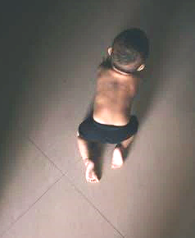
HUMO DE TERCERA MANO
¿Quién está en riesgo de sufrir el humo de tercera mano?
¡TODOS ESTAMOS EN RIESGO!
Especialmente bebés y niños pequeños
  Los bebés se llevan todo a la boca
  Los niños que están en contacto con
  personas que fuman están expuestos a las
  sustancias químicas del humo de tercera mano en la piel,
  la ropa y el cabello.
  Los bebés respiran CUATRO veces más sustancias químicas que un adulto al caminar por la misma zona
Notes:
KEY POINT: Infants and Children are at high risk from thirdhand smoke.
SCRIPT: “Everyone is at risk from thirdhand smoke, but this can be especially harmful for infants and children. We all know that babies love to put everything in their mouths! So if someone smoked in that area, even when the baby wasn’t around, they are still ingesting the chemicals left behind by thirdhand smoke. If someone who smokes holds a tiny baby close to them that baby is taking in all the chemicals and toxins that are lingering on their hair and clothes. And when infants and toddlers crawl around on the floor they kick up all the toxins that have fallen on the floor and breathe them in. Simply because of their size and how they breathe infants take in four times as many chemicals as an adult would in the same area, which can damage their growing bodies.”

Slide 42

VIDE0 DE HUMO DE TERCERA MANO
Notes:
KEY POINT: Breathe offers several short videos that can be shown to parents, like this one on Thirdhand smoke.
SCRIPT: “As I mentioned earlier, you have access to several short videos as a Breathe partner. Let’s watch this video on thirdhand smoke and think about how and when you might be able to share it with the parents you serve.”

Slide 43
ACTIVIDAD
¿Cómo están expuestos los niños al humo de segunda y tercera mano?
Notes:
KEY POINT: Brainstorm where children may be exposed to second and thirdhand smoke.
VIRTUAL MODIFICATION: Have participants types answers in chat box and read them aloud as you validate the responses.
SCRIPT/INSTRUCTIONS: “Even though some laws have been passed to limit exposure, let’s think about where children might still be exposed to both second and thirdhand smoke.” (Encourage participants to share their thoughts and then validate their responses. If you want, you can record their responses on newsprint or a whiteboard.)

Slide 44

LUGARES EN DONDE LOS NIÑOS ESTÁN EXPUESTOS
Lugares comunes en los que los niños están expuestos al humo de segunda y tercera mano:
      En la casa
      En el auto
      En lugares públicos
      En casa de un cuidador/familiar
      En parques o áreas de juego
      Cerca de entradas a tiendas y restaurantes.
Notes:
KEY POINT: There are lots of places where children could be exposed to secondhand smoke.
SCRIPT: “Nice job! Let’s see how your list compares with mine. Some common places children are exposed to second and thirdhand smoke include their own home or in cars as well as public places that are not covered by a comprehensive tobacco ordinance. Relatives and caregivers’ houses is a big one and can be a difficult situation, especially when children travel back and forth between two parents’ homes and one household allows smoking and the other doesn’t. Parks and playgrounds are another place where children often spend time yet people may smoke around them. And even though there is a law in Indiana that prohibits smoking near the entrances of stores and restaurants this is hard to enforce so exposure still happens. It’s important to help families identify where their children may be exposed to second and thirdhand smoke and then help them make a plan to eliminate or at least minimize that exposure.”

Slide 45
ACTIVIDAD
¿Cómo pueden los adultos proteger a los niños de la exposición al humo de segunda y tercera mano?
Notes:
KEY POINT: Find out what ideas the training participants have about limiting exposure to second and thirdhand smoke.
VIRTUAL MODIFICATION: Have participants types answers in chat box and read them aloud as you validate their responses.
SCRIPT/INSTRUCTIONS: “So now that we have some ideas on where children might be exposed, how can we protect kids from second and thirdhand smoke?” (Allow training participants to engage in group discussion about potential answers. After several suggestions are given proceed to next slide to discuss the answers. If you are pressed for time you can simply go to the next slide and provide the answers.)

Slide 46

COMO PODEMOS PROTEGER A LOS NIÑOS
      Educar a los padres/cuidadores
      Dejar de fumar
      Fumar afuera
      No fumar en el carro
      Use una chaqueta de fumar
      Apoye a las empresas libres de humo
      Permitir que los niños solo estén en casas y carros libres de humo
      Aumentar la conciencia sobre las estrategias de venta engañosas de la
      industria tabacalera.
      Pasar pólizas (para hogares, empresas, niveles locales, estatales y federales)
Notes:
KEY POINT: Quitting is a great way to protect children from second and thirdhand smoke but if parents are not ready to quit there are lots of baby steps they can take.
SCRIPT: “You guys came up with lots of great ideas, now let’s check my list. Education is always a great first step, and that’s why we are here today and hope you will share what you are learning with the parents you serve. Of course, if parents quit smoking that is the best way to protect their own health as well as their family’s health. But even if they are not ready to quit, there are lots of other things they can do to minimize exposure for their children such as designating their home as smoke free and only smoking outside, and also not smoking in the car. They can wear a smoking jacket and peel off that outer layer of thirdhand smoke before coming around their children. Supporting smoke-free businesses is another great idea and only allowing children to be in smoke free homes and cars. This may require some difficult conversations with family members and caregivers but those conversations should always come back to what is best for the children’s health. We can increase awareness of the deceptive marketing tactics of the tobacco industry as well as pass policies that protect everyone from second and thirdhand smoke. These policies can be official laws at all levels of government as well as the rules we put in place in our own homes and businesses. Taking many of these steps is not always easy and parents or other family members may resist, but you can encourage them to take baby steps and reinforce that even small steps in the right direction can help protect their children.”

Slide 47
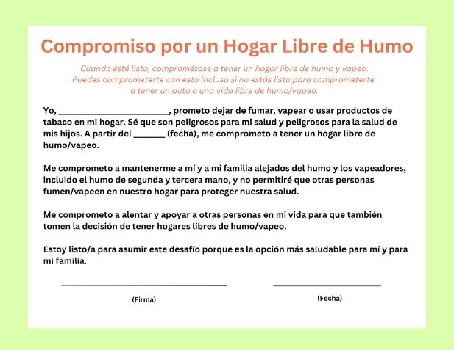
HOJAS DE COMPROMISO
      ¡Las hojas de promesas se pueden encontrar en las hojas de trabajo para padres!
Notes:
KEY POINT: Asking parents to sign a smoke/vape free home and/or car pledge is a great way to increase accountability.
SCRIPT: “One great resource that you can find in the parent worksheets are the pledges for a smoke/vape free home and car. After doing some education on second and thirdhand smoke you may want to distribute these pledges and encourage parents to sign them as a way to stay accountable in their effort to minimize their children’s exposure to second and thirdhand smoke…and don’t worry, we will get to vaping in just a minute!”

Slide 48
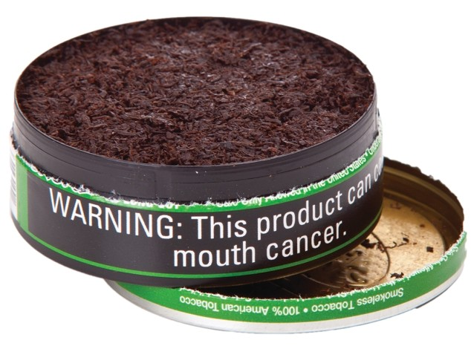
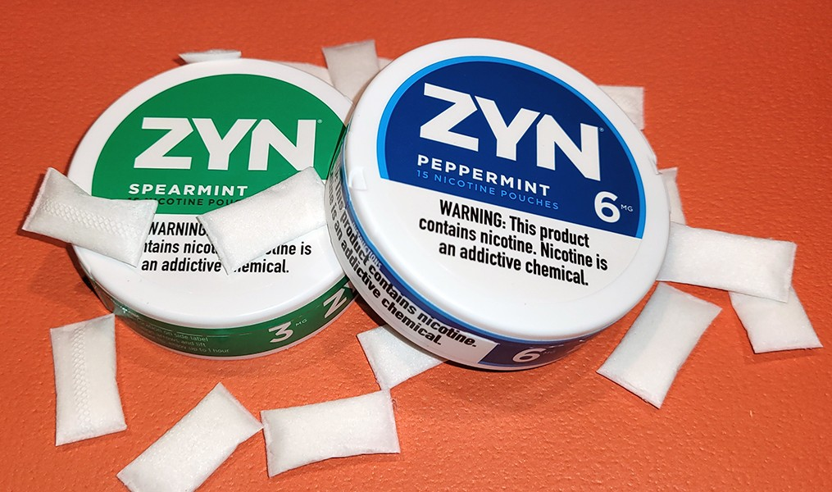
TABACO SIN HUMO
El tabaco sin humo aumenta el riesgo de:
Ciertos tipos de cáncer
Mortalidad fetal, si está embarazada
Accidente cerebrovascular y cardiopatía
Bolsitas de nicotina:
Populares entre los jóvenes, vienen con sabores.
      El polvo se disuelve (no necesitas escupir).
      La nicotina se absorbe a través de las encías y el revestimiento de la boca.
  Los niños pueden ingerir tabaco sin humo
  y envenenarse
Notes:
KEY POINT: Smokeless tobacco doesn’t carry the risk of secondhand smoke, but it still dangerous for the user and if children get ahold of smokeless products.
SCRIPT: “I want to touch briefly on smokeless tobacco. There is not the same risk of second and thirdhand smoke with smokeless tobacco, however it does carry many health risks for the user, including pregnant people. Smokeless tobacco now comes in many different forms, including small pouches. These are actually spitless and they are gaining in popularity with youth. Zyn is just one popular brand of nicotine pouches and they come in flavors that may make them more appealing then traditional smokeless/chewing tobacco. These flavors and minty smell might also make these products intriguing to very small children so it is important to remind parents that Smokeless tobacco products should not be left where children can get them. If they eat or put these products in their mouths they could experience nicotine poisoning, which can very dangerous.”

Slide 49
MITO
Vapear es seguro…
es solo vapor de agua.
Notes:
KEY POINT: Vaping is not a safe alternative.
SCRIPT: “We can’t talk about tobacco without mentioning vaping and e-cigarettes and there are plenty of myths around this growing area of tobacco use. Let’s start with the myth that vaping is safe and that it’s just water vapor. Not true!!”

Slide 50
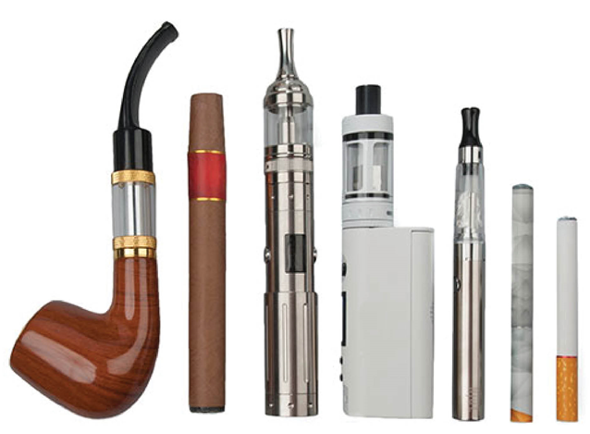
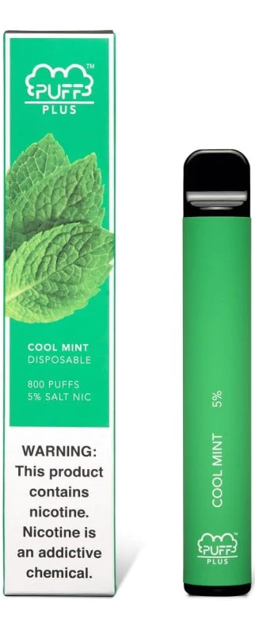
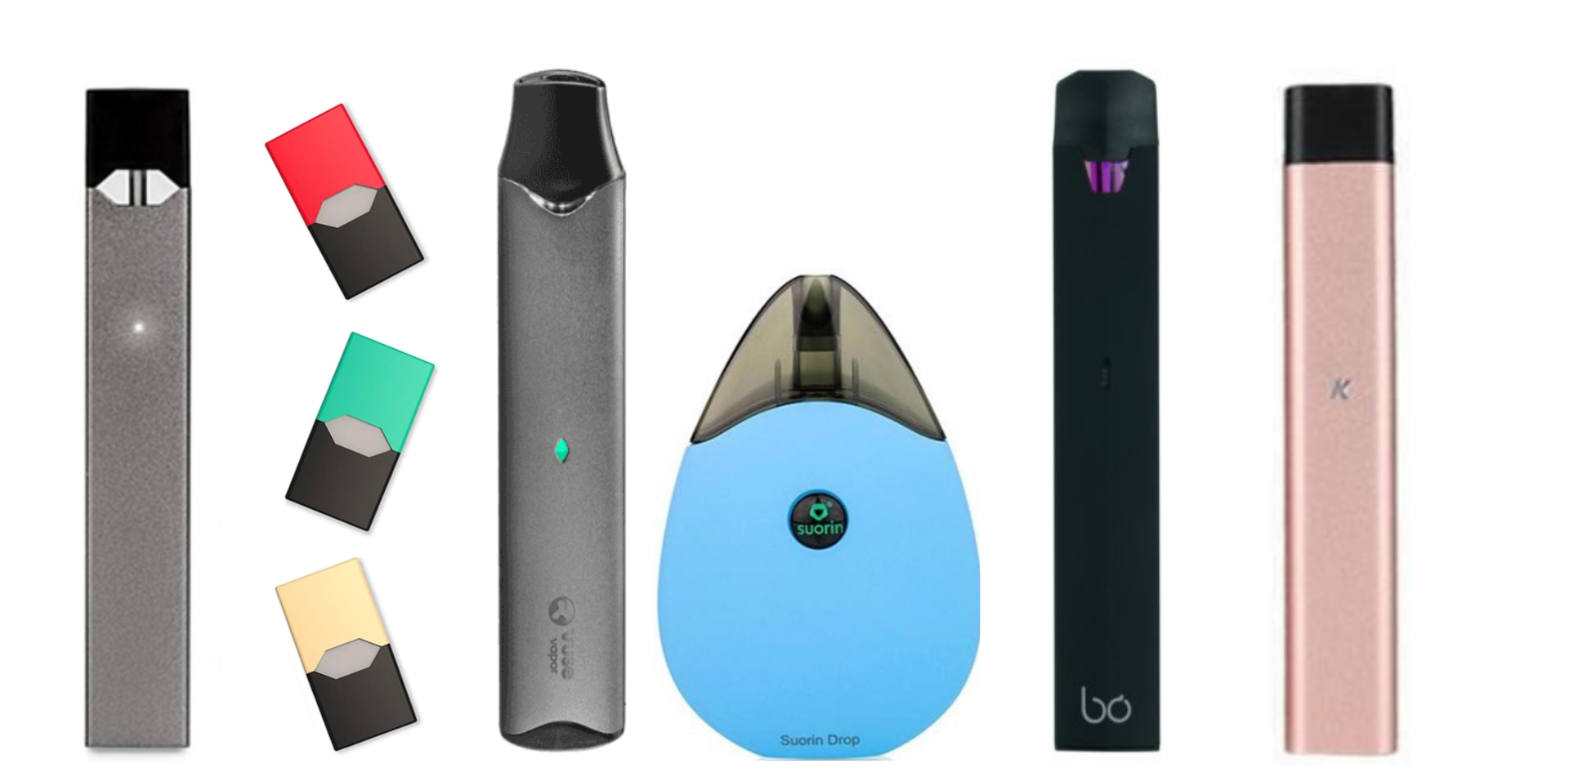
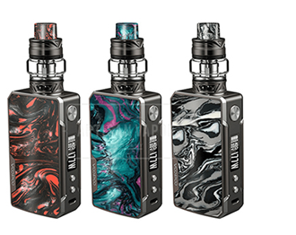
CIGARRO ELECTRONICO Y EL VAPEO
Los cigarrillos electrónicos NO solo emiten vapor de agua, sino aerosoles
Los líquidos electrónicos contienen ingredientes similares a los cigarrillos normales, como plomo y otros
productos químicos peligrosos
Los cigarrillos electrónicos y los vaporizadores vienen en muchas formas diferentes.
MITO EXTRA DESMENTIDO:
Los cigarrillos electrónicos NO son una herramienta comprobada
para dejar de fumar
Notes:
KEY POINT: E-cigarettes/vapes are not safe and are not proven cessation tools.
MATERIALS NEEDED, optional: samples of different kinds of vapes and e-cigarettes to pass around
SCRIPT: “Whether you use the term e-cigarettes or vapes, this is a very hot topic that we get lots of questions about. Vaping has grown in popularity tremendously over the past ten+ years and there is a lot we are still learning about the negative health impact of these products. It is important to understand that e-cigarettes don’t emit harmless water vapor, but rather an aerosol that contains many of the same dangerous chemicals found in traditional cigarettes. Vapes come in many different forms. Some look like flashdrives or highlighters. Some come with pre-filled pods and some can be refilled with e-juice. It is important to know that e-cigarettes are not a proven cessation strategy. Many people who smoke and then start vaping actually end up dual using or just continue vaping and don’t actually quit.”

Slide 51
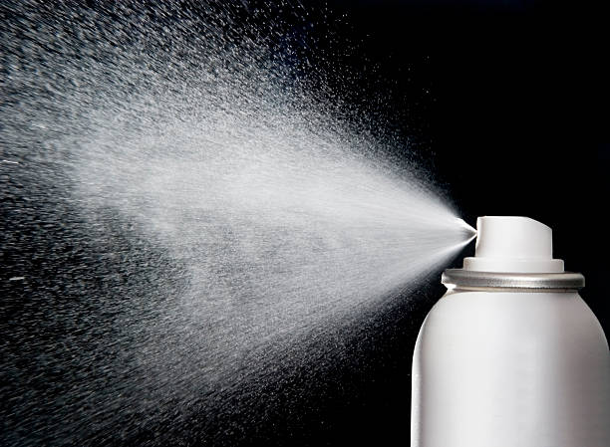
CIGARROS ELECTRONICOS Y EL VAPEO
Los líquidos electrónicos contienen nicotina, que es
extremadamente adictiva.
El envenenamiento por nicotina puede ser mortal
Ocurre si una persona bebe,
huele o toca el líquido
Las baterías de los cigarrillos
electrónicos pueden explotar y provocar quemaduras graves.
¡NO ES SEGURO vapear cerca de los niños!
¡NO dejes los PRODUCTOS PARA VAPEAR al alcance de los niños!
Notes:
KEY POINT: It is not safe for young children to have access to vapes/e-cigarettes and e-juice.
SCRIPT: “Research is still being done on the long-term effects of vaping and the FDA is slowly starting to regulate these products. We do know that E-liquids contain nicotine, which is extremely addictive, and nicotine poisoning can be very dangerous for children if they drink the e-juice or just get it on their skin. The batteries in e-cigarettes have also been know to explode. It is important that parents understand that it is not safe for young children to have access to vapes and e-juice or to be around people who are vaping. ”

Slide 52

En un evento donde estás dando educación sobre el tabaco, un padre comparte que dejó de fumar. Pero hora, vapea.
Notes:
KEY POINT: Consider a scenario about talking to parents about vaping.
SCRIPT/INSTUCTIONS: “Time for another scenario! At a parent night event where you are providing tobacco education, one parent shares that he has quit smoking. Now he vapes instead. How would you react?” (You can let participants chime in and share their ideas, based on time and how interactive the group seems, or you can jump right to the slide and offer suggestions.)

Slide 53
A. Celebralo mientras lo felicitas por ya no fumar cigarrillos tradicionales.
B. Agradécele por mencionar el popular tema de los cigarrillos electrónicos y comienza a desmentir suavemente los mitos comunes.
C. Informa a todos los que puedan oír que ha sido engañado haciéndole creer que los cigarrillos electrónicos son seguros.
D. Abre la página "Cigarrillos electrónicos" del rotafolio y
centra la discusión en la protección de los niños.
Notes:
KEY POINT: Have participants consider which options they may feel comfortable doing in this scenario.
VIRTUAL MODIFICATION: Have participants use the reaction buttons as you read each option to signify if they would use that one, or read all the answer options and have them type the letter(s) of the options they would feel most comfortable doing.
SCRIPT: “Let’s see which options you might lean towards in this scenario.” (Read each answer choice out loud and have participants raise their hand or move to a certain area of the room if that is the option that feels most comfortable to them. As time permits you can ask for some participants to share feedback as to why they chose that option. With option A reinforce that praising positive behaviors is a great first step, but you will want to follow this up with some accurate information about vaping. Option B is a great way to build off of topics parents bring up and provide a natural segway to share accurate information. With option C reinforce the delivery of accurate information makes all the different in whether or not parents will listen to what you have to say. Publicly shaming someone is generally not an affective approach! With Option D reinforce that they there are lots of applicable resources in the Breathe kit and that bringing the topic back to how to protect children is a good strategy and the ultimate goal of Breathe.)

Slide 54
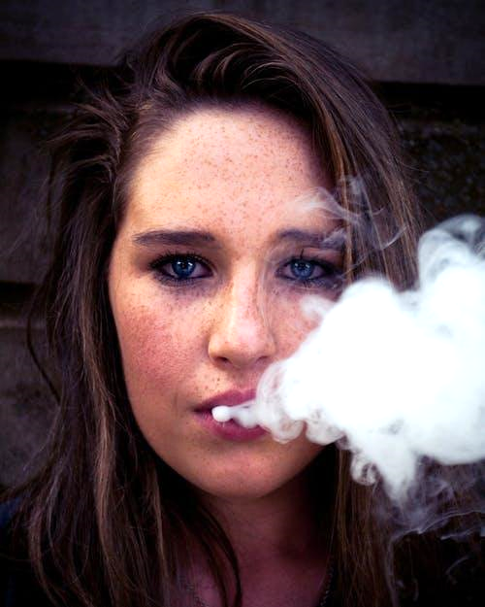
EL CIGARRO ELECTRONICO, VAPEOY LA JUVENTUD
Casi 1 de cada 20 estudiantes de secundaria
Admiten el uso de cigarrillos electrónicos
(Indiana Youth Tobacco Survey, 2012-2024)
El Cirujano General de Estados Unidos declaró
que el uso de cigarrillos electrónicos por parte
de menores es una epidemia:
  Vapear se convirtió en el mayor aumento
  en el abuso de sustancias entre jóvenes
  JAMÁS registrado.
  Sabores como algodón de azúcar, mezcla de frutas y
  crème-brulée atraen a los usuarios jóvenes.
  La nicotina puede dañar el cerebro adolescente en desarrollo.
Notes:
KEY POINT: Vaping has become an epidemic among youth.
SCRIPT: “Be grateful that you work with young children because vaping is a huge concern for teachers and school administrators in Middle Schools and High Schools these days! The most recent tobacco survey shows that 1 in 20 high school students report current e-cigarette use, and unfortunately middle school and even grade school students also also vaping. Vaping has actually declined some since the previous study so that is good news, but since this data is self-reported my guess is it could actually be even higher than that! A few years ago the U.S. Surgeon General declared e-cigarette usage an epidemic and shared that vaping use had the biggest increase in youth substance abuse EVER recorded! That means it was bigger than marijuana use during Woodstock! Even though in the U.S. it is not legal to sell tobacco products, including e-cigarettes, to anyone under 21, the tobacco industry clearly markets these products to youth and entices them with appealing flavors like cotton candy, fruit, and flavors with names like unicorn poop! No self-respecting 50-year-old is going to buy unicorn poop flavored e-juice! Unfortunately, e-cigarettes are appealing to youth, which is leading to nicotine addiction for a whole new generation and a host of health issues. The adolescent brain does not fully develop until age 25 and nicotine can harm the developing brain so the vaping epidemic is of great concern among parents, educators, and anyone who cares about the wellbeing of our youth.”

Slide 55
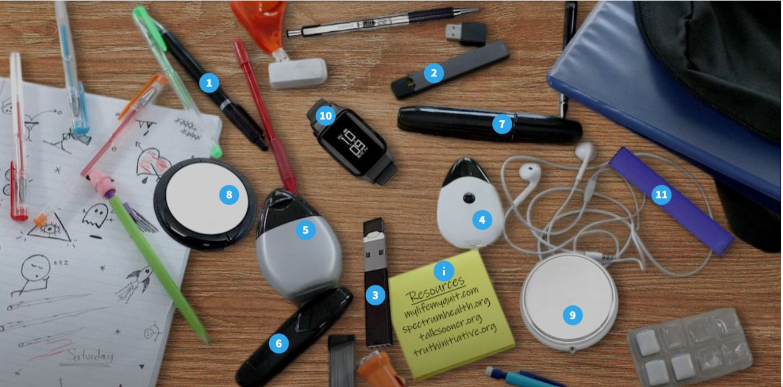
¿PUEDES VER LOS DISPOSITIVOS?
https://view.genial.ly/5f874bce0ba9f90d4e3c2503/interactive-image-can-you-spot-the-vaping-devices
Notes:
KEY POINT: Vapes can be hiding in plain sight.
VIRTUAL MODIFICATION: Place your cursor on each item and have participants use the chat box or reaction buttons to indicate if they think an item is a vape.
SCRIPT/INSTRUCTIONS: “As I mentioned vapes come in many different forms, making it difficult for parents and educators to even identify them. It is possible for vapes to hide in plain sight! For fun, let’s see if you can spot the vapes in this photo of what looks like the typical contents of a teen’s backpack.” (Point to various items and have participants raise their hands to indicate if they believe that item is a vape or have participants yell out which items they think are vapes.)

Slide 56
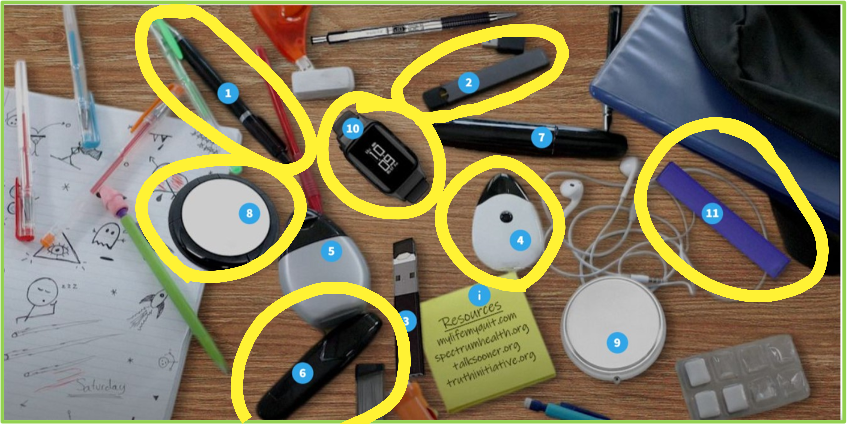
¿PUEDES VER LOS DISPOSITIVOS?
1. Pen Pal Stealth Vaporizer 2. JUUL 3. USB flash drive 4. Sourin Drop
5. MiO Liquid flavoring enhancer for water 6. Sourin Vagon Black 7. Black Sharpie 8. Khree UFO 9. Compact mirror 10. UwellAmulet Pod System 11. Puff Bar
Notes:
KEY POINT: Identify which are vapes and which aren’t.
SCRIPT/INSTRUCTIONS: “Let’s see how you did! Out of the 11 numbered items in this photo, 7 of them are actually vapes! (As time allows you can point out which ones are vapes and show how they look very similar to other items in the photo that are not vapes.)

Slide 57
MITO
La marihuana es natural...
y por lo tanto segura de consumir durante el embarazo y alrededor de los niños.
Notes:
KEY POINT: Point out the common myth that marijuana is natural and that makes it safe to use while pregnant and around kids.
SCRIPT: “Now it’s time to talk about another hot topic…marijuana! I must admit I am not an expert on this topic and it’s not necessarily something we typically address with our tobacco prevention funding, but it is such an important topic that is sometimes intertwined with tobacco products. So we knew we needed to include it. What I specifically want to focus on is how marijuana impacts children and that starts with dispelling the myth that marijuana is safe to use while pregnant or around children just because it comes from a plant and many see it as ‘natural”.”

Slide 58
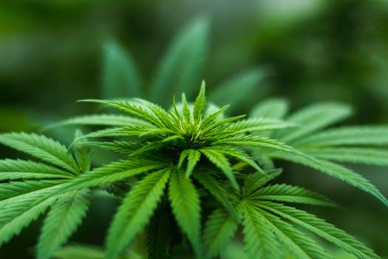
MARIHUANA
Muchos estados han legalizado alguna forma de
marihuana para uso médico o recreativo.
Dado que la marihuana proviene de una planta, a menudo existe un malentendido sobre sus efectos durante el embarazo y en los niños.
Notes:
KEY POINT: Even though marijuana comes from a plant it is not safe during pregnancy or to smoke around children.
SCRIPT: “Of course, many states have legalized certain forms of marijuana for various uses, but it remains illegal in Indiana. Because marijuana derives from a plant many people believe that it is safe, but the key point I want to convey is that marijuana is not safe to use during pregnancy or to smoke it around children.”

Slide 59
MARIHUANA: EMBARAZO Y MÁS ALLÁ
Efectos en la Salud
Nacimiento prematuro o muerte
Problemas de desarrollo cerebral
Síntomas de abstinencia
Problemas para dormir
Dificultades de atención, memoria y aprendizaje
Problemas de comportamiento
El THC y otras sustancias químicas de la marihuana pueden transmitirse a los bebés a través de la leche materna.
Una persona que está amamantando NO debe consumir marihuana.
Notes:
KEY POINT: Marijuana use during pregnancy or while breastfeeding has many negative health effects.
SCRIPT: “Marijuana use during pregnancy can lead to premature birth or still birth, brain development issues, withdrawal symptoms for the baby, trouble sleeping, attention, memory, and learning difficulties as well as behavior problems. None of the things we want for healthy babies. Research has also shown that THC, the main chemical in marijuana, is passed to babies through breast milk. Therefore, it is not safe for someone who is breastfeeding to use marijuana.”

Slide 60

HUMO DE MARIHUANA DE SEGUNDA MANO
Niños expuestos al humo de marihuana de segunda mano:
Han mostrado rastros de THC en la orina.
Puede desencadenarse tener ataques de asma.
Puede experimentar reducción de memoria y coordinación
Notes:
KEY POINT: Exposure to secondhand marijuana smoke is harmful to children.
SCRIPT: “It is also not safe for children to be around secondhand marijuana smoke. Again, research shows that children exposed to marijuana smoke have traces of THC in their urine. This can lead to asthma attacks and problems with memory and coordination.”

Slide 61

MARIHUANA
No existe un nivel seguro de exposición a...
El humo de la marihuana durante el embarazo o la lactancia
El humo de la marihuana de segunda mano para
bebés y niños
Notes:
KEY POINT: There is no safe level of exposure to marijuana smoke during pregnancy or while breastfeeding or for children being exposed to secondhand marijuana smoke.
SCRIPT: “The bottom line and what we need to communicate to parents is that there is no safe level of exposure to marijuana smoke during pregnancy or while breastfeeding, and it is not safe for children to be exposed to secondhand marijuana smoke. There are several resources in the Breathe toolkit that can help you share facts about marijuana with the parents you serve”

Slide 62

VIDE0 SOBRE LA MARIHUANA
Notes:
KEY POINT: This is another great video that Breathe offers on marijuana.
SCRIPT: “Now let’s watch this short video on marijuana.”

Slide 63
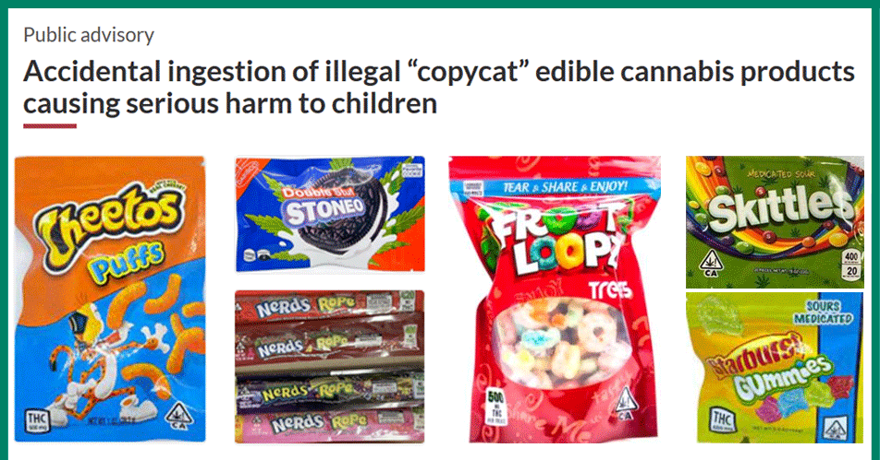
MARIHUANA
Gomitas – comestibles - productos con delta - bebidas con THC...
A menudo no están regulados o son ilegales, y son atractivos para los niños.
Notes:
KEY POINT: Marijuana comes in many different forms and can be a poison danger for children.
SCRIPT: “Smoking isn’t the only way people use marijuana or inject THC. There are gummies, homemade and storebought edibles, various Delta products, and drinks containing THC. At first glance it might look like this is a photo of popular snacks…but if you look closer you will see that they all include THC! Imagaine a 4 year old coming across this bag of Cheetos or skittles! When it comes to the safety of children it is important to keep all marijuana products out of reach for young children and that is an important message we need to stress with the families we serve.”

Slide 64
MITO
Es demasiado caro dejar de fumar
Notes:
KEY POINT: Using tobacco is expensive and there are lots of free resources to help people quit.
SCRIPT: “I’ve hit the negative health aspect of tobacco use pretty hard, so now let’s talk about money! A common misconception of those who use tobacco is that it will be expensive to quit, but I’m here to challenge that thought and counter with the reality that using tobacco products is what is truly expensive.”

Slide 65

HABLEMOS DE DINERO
El consumo de tabaco no sólo nos cuesta la salud, ¡sino también mucho dinero!
En Indiana el costo promedio de un paquete de cigarros es de $11
Fumar un paquete al día podría costar hasta $4,015 al año.
Los gastos adicionales incluyen visitas
al médico y medicamentos, además de tiempo libre en el trabajo y faltas a la escuela.
Notes:
KEY POINT: In addition to negative health effects, tobacco use also costs a lot of money.
SCRIPT: “A tobacco addiction can cost someone their health, but it can also cost a ton of money. And it just got even more expensive in Indiana! The cigarette tax increased as of July 1st and data shows that a substantial price increase leads more adults to quit and fewer youth to start smoking. We have already seen a huge spike in calls to Quit Now Indiana! The average price of a page of cigarettes in Indiana is now $11. So someone who smokes a pack a day will end up spending over $4000 a year just on cigarettes. And if they smoke more than a pack a day that cost could really skyrocket. The tobacco industry will try to combat this with coupons and price promotions, but they aren’t trying to help the consumer…they are just trying to create lifelong customers by getting people addicted to nicotine. On top of the cost of the products themselves, prolonged tobacco use also leads to additional expenses for doctor’s visits and medications, plus the financial impact of missing work and school.

Slide 66

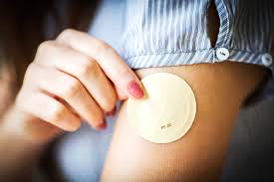

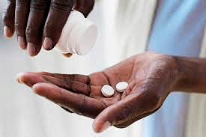
MEDICAID LO CUBRE
El Medicaid en Indiana cubre:
Asesoramiento
Terapias
de reemplazo
con Nicotina
Medicamentos
Recetados
Notes:
KEY POINT: Indiana Medicaid offers lots of cessation support.
SCRIPT: “Many people who use tobacco may say they can’t afford to quit, but as we saw earlier using tobacco on a regular basis is what ends up being very costly! Fortunately, Indiana Medicaid offers lots of cessation support so encourage your families that are on Medicaid to check into this coverage. Indiana Medicaid covers cessation counseling as well as several forms of nicotine replacement therapies and medications that can help in their quit attempt. Even if a family does not have Medicaid, encourage them to find out what their health insurance covers because many other insurances may help with cessation support as well!”

Slide 67
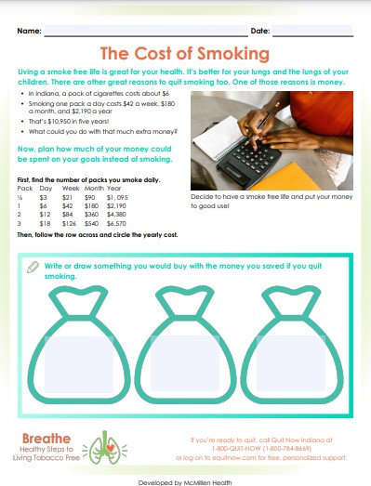
¿QUÉ HARÍAS CON $4,015?
Utiliza la hoja de trabajo "El costo de fumar"
Ayuda a los padres a identificar cuánto dinero les cuesta el use de tabaco y cncuentren otras formas en las que podrían gastar ese dinero si adoptaran un estilo de vida libre de humo y vapor.
Notes:
KEY POINT: Suggest The Cost of Smoking worksheet as a way to talk to parents about the financial impact of tobacco.
MATERIALS NEEDED: You can provide copies of The Cost of Smoking worksheet, if you choose.
VIRTUAL MODIFICATION: Encourage participants to type in the chat box how they would spend $2,190?
SCRIPTS/INSTRUCTIONS: “So how would you spend $4,000 if you had this much extra money? (Let a few participants share how they would spend this money) I’m guessing all of the parents we work with, not to mention everyone in this room, would love to have some extra money to be able to pay for necessities or what may seem like luxuries or even just to be able to save some money. One of the worksheets that you can download from the Breathe website is The Cost of Smoking worksheet. This is a great tool you can use with parents to help them identify how much they are actually spending on tobacco products and then encourage them to think about other ways they could spend that money if they gave up tobacco. For some, improved health is their motivation for quitting. For others, saving money might be a huge incentive to make a quit attempt. Talk to parents to find out what might be the motivating factor for them and then utilize the items in the Breathe toolkit that best meet each individual’s needs.”

Slide 68
MITO
Dejar de fumar es imposible
Notes:
KEY POINT: Quitting tobacco isn’t easy, but it is possible and there are lots of resources to help.
SCRIPT: “Whether you have ever tried to quit tobacco yourself or known someone who has, you know it is not a simple task. Nicotine addiction is real, but I want to challenge the idea that quitting is impossible and arm all of you with additional strategies and resources that can help someone who wants to quit.”

Slide 69
¡DEJALO YA!
Una de las mejores cosas que los padres pueden hacer por su propia salud y la de sus hijos es dejar el tabaco.
Dejarlo también ayuda a mejorar los resultados de salud en nuestra comunidad y crea una mayor equidad en la salud.
No puedes obligar a alguien a dejar el tabaco.
¡Pero sí puedes ofrecerle apoyo!
Notes:
KEY POINT: You can’t make someone quit tobacco, but support is critical to their success.
SCRIPT: “Now that we have covered the health effects and the financial impact of tobacco, let’s talk a bit about quitting as we know this is one of the best things parents can do for their own health as well as the health of their children. Quitting tobacco can also help our communities experience better health outcomes and help create improved health equity. But we all know that it is hard to quit! You can’t make someone quit. It has to be their choice. But for those who are ready to quit, you can support them in a quit attempt.”

Slide 70
Dejar de fumar.
Casi el 70% de los adultos que fuman dicen que quieren dejarlo.
Más del 50% de los adultos que fuman hicieron un intento por dejarlo el año pasado.
Por lo general, se necesitan de 8 a 11 intentos para dejar de fumar con éxito.
¡El apoyo es vital y la ayuda está disponible!
Notes:
KEY POINT: Many smokers want help with quitting so this should encourage you to talk about this topic with parents.
SCRIPT: “A national surveys show that nearly 70% of adults who smoke say they do want to quit and more then 50% made a quit attempt in the past year, but they need support to be successful. So if you don’t bring up this topic then you are missing an opportunity to provide support to many parents who actually want help! It takes someone on average 8-11 quit attempts to successfully quit for good. Each quit attempt is a step in the right direction so we want to support people when they make an attempt and acknowledge that setbacks are often a part of the process. You never know when someone will be ready to quit, so its important to be prepared and let them know you can provide support when they are ready to take that step. Talking about quitting smoking with parents can sometimes feel uncomfortable, but supporting people in their quit attempts and providing them with the right resources can allow them to be more successful and ultimately improve the health of their children. If you have ever tried to quit tobacco or know someone who has you know just how hard it can be and that experience can be helpful to others trying to quit, if you are comfortable sharing your own experience.”

Slide 71

MÁS AYUDA PARA DEJAR DE FUMAR
Consulte a su proveedor de atención médica
Sugiera a los padres que pregunten sobre las terapias de reemplazo de nicotina (NRT)
En el estado de Indiana, los medicamentos para dejar de fumar ya no necesitan receta médica
Truth Initiative- Textea DITCHVAPE al 88709
Sistema de mensajería de texto anónimo para adolescentes y adultos jóvenes que quieren dejar de vapear
Notes:
KEY POINT: Provide additional quit resources and suggestions.
SCRIPT: “You don’t have to know everything about how to quit tobacco, but you can point parents who are ready to quit in the right direction. You can encourage parents to talk to their healthcare provider about quitting and getting nicotine replacement therapies, such as nicotine gum, lozenges, patches, or medications.. A few years ago Indiana passed a law to minimize barriers to accessing tobacco cessation medications by no longer requiring a prescription, so people can go straight to the pharmacist to get nicotine replacement therapies if they want. The Truth Initiative also offers quit help and is a great resource that is tailored for youth and young adults and can be accessed by texting DITCHVAPE to 88709.”

Slide 72

QUITNOW INDIANA
GRATUITO y Disponible 24/7
Asesor Experto para
Dejar de Fumar
>> Llamada, Mensaje de Textoo,
En Línea o por la Aplicación​
>> Plan de Abandono, Personalizado
    Terapias de Reemplazo de Nicotina (TRN) GRATUITAS, según disponibilidad
1-800-Quit-Now (784-8669)
1-855-DÉJELO-YA (Spanish)
1-877-777-6534 (TTY)
Text READY to 34191
Text LISTO to 34191 (Spanish)
quitnowindiana.com
Notes:
KEY POINT: There are lots of resources available for those who want to quit.
SCRIPT: “Another great option is to refer parents to Quit Now Indiana. Quit Now Indiana is free and available 24/7. A trained quit coach will help them create a customized quit plan just for them. People can call, text, go online or use the app to access services in whatever way works best for them. Quit Now Indiana has a dedicated number for those who speak Spanish and other language services are available as well as TTY capabilities for those who are deaf or hard of hearing.”

Slide 73
PROGRAMAS ESTÁNDAR Y PERSONALIZADOS DE QNI
Programa (autorreporte) | Sesiones | NRT | Ofrece | Duración (subject to change)
Embarazo | 7 | Si* | Parche o Goma de Mascar | 2 semanas
Salud Conductual | 7 | Si | Parche o Goma de Mascar | 2 semanas
Jóvenes en Linea | 6 Pasos | No | N/A | N/A
Aumento de Mentol | 5 or 7 | Si | Parche o Goma de Mascar | 2 semanas
Adulto Estandar | 5 | Si* para los que califican | Parche o Goma de Mascar | 2 semanas
Notes:
KEY POINT: Quit Now Indiana handouts are free to order and are great resources to have on hand.
SCRIPT: “There are specialized services provided for youth ages 13-17, as well as for pregnant people, those with behavioral health issues and people who use menthol products as each of these populations may need a unique approach. This chart breaks down the current offerings for the standard adult as well as these four specialized programs including the amount of NRT available (subject to change).”

Slide 74




Solicita Materiales de QNI GRATIS en: quitnowindiana.com/educational-materials
QUIT NOW INDIANA
En Ingles & Español
Notes:
KEY POINT: Quit Now Indiana handouts are free to order and are great resources to have on hand.
MATERIALS NEEDED: Bring a variety of Quit Now Indiana handouts, in English and Spanish.
VIRTUAL MODIFICATION: Paste the link to order QNI materials in the chat box so they can order their own and/or let them know if you plan to drop off materials. Here is the link: https://www.quitnowindiana.com/educational-materials
SCRIPT: “Quit Now Indiana handouts are available and free to order. I have brought a stack for you today and I encourage you to make these handouts easily accessible in your lobbies and to have them on hand when you do home visits or meet with parents so you can share this valuable resource when the time is right.”

Slide 75
PREGUNTA – ACONSEJA - REFIERE
Notes:
KEY POINT: Ask, Advice, Refer is a quick and simple way to discuss tobacco with parents.
SCRIPT: “I realize that having conversations with parents about tobacco use can be difficult so I’d like to suggest a simple framework that is often used with tobacco cessation called Ask, Advise, Refer that can help guide you in these conversations.”

Slide 76

PREGUNTA
PREGUNTE sobre el consumo
de tabaco
¡Pregunte a todos!
¡Pregunte rutinariament!
¡Sin juzgar!
¿Actualmente fuma o usa otras formas de tabaco?
En los formularios
Durante las visitas a domicilio
En las reuniones de padres y maestros
¿Alguien en su casa ha estado expuesto al humo de segunda mano en la última semana?
Notes:
KEY POINT: Ask all parents about tobacco use and secondhand smoke exposure in a non-judgmental way.
SCRIPT: “ASK includes asking everyone, not just the parent who you may think uses tobacco and doing so on a routine basis, so it becomes part of your processes, maybe on your health forms, during home visits or at parent teacher conference. And ask in a non-judgmental way. Here are some examples of how you might ask about tobacco use.” (Click to fill in each bubble and read the questions aloud.)

Slide 77

ACONSEJA
ACONSEJE a la persona que deje de fumar:
Claro-Contundente-Personalizado
Es importante que deje de fumar. (Claro)
Dejar de fumar es lo más importante que puede hacer para proteger su salud y la de su familia. (Contundente)
Sé que le preocupa el asma de su hijo. Si designa su casa y su coche como zonas libres de humo, Timmy podría tener menos ataques de asma. (Personalizado)
Notes:
KEY POINT: Advise parents to quit with clear, strong, personalized language.
SCRIPT: “Next, advise them to quit using tobacco or to set boundaries that protect their kids from secondhand smoke. BE CLEAR by using simple statements, but BE STRONG by providing direct and honest information and since you know your families well personalize your message in a way that makes sense for them. Here are some examples of how you might advise parents about quitting and protecting their families.” (Click to fill in each bubble and read the statements aloud.)

Slide 78
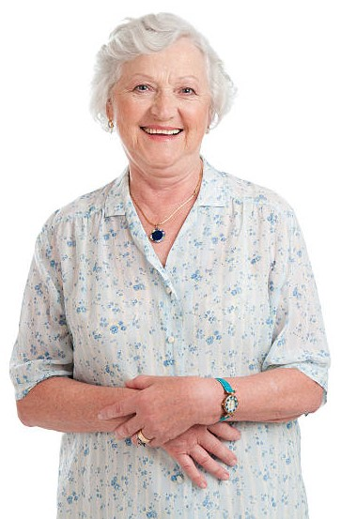
REFIERA
REFIERA a Recursos Accesibles y Basados en Evidencia.
Hable con su médico sobre cómo dejar de fumar y las terapias de reemplazo de
nicotina comprobadas que podrían ser adecuadas para usted. (en persona)
Llame al 1-800-QUIT-NOW o envíe un mensaje de texto con la palabra READY al 34191. Es gratuito, confidencial y está disponible 24 horas al día, 7 días a la semana. Le ayudarán a crear un plan personalizado para dejar de fumar. Puede que sea elegible para productos de reemplazo de nicotina gratuitos.
(por telefono / mensaje de texto)
Obtenga más información sobre cómo dejar de fumar y consiga el apoyo que necesita en www.quitnowindiana.com (en linea)
Notes:
KEY POINT: Refer parents to evidence-based, accessible resources
SCRIPT: “Finally, let them know that support is available and offer evidence-based resources that are easily accessible to them. That could include help that is in person, via phone or text or online. Remember that you don’t have to be an expert in tobacco cessation, but you can be supportive by referring families to professionals that are trained to help.” (Click to fill in each bubble and read the questions aloud.)

Slide 79

¡HAY ESPERANZA Y HAY AYUDA!
¡Y TÚ puedes ser parte de la solución!
Notes:
KEY POINT: There is hope and lots of support when it comes to tackling the burden of tobacco.
SCRIPT: “I have covered A LOT of information today, but the most important concept I want to leave you with is that when it comes to the tobacco burden in Indiana there is hope and there are lots of resources to help you and your families. Children and families will benefit when we reduce the negative effect of second and thirdhand smoke and Indiana has had some big wins over the years when it comes to smoke free air policies, smoke free housing, and the recent tobacco tax increase. But there is still work to do and I hope you are all excited that you can be part of the solution! And I’m excited to have you guys as our newest Breathe Partner!”

Slide 80
¡MUCHOS MATERIALES DE BREATHE!
Notes:
KEY POINT: Remind participants that they have access to lots of great Breathe resources.
MATERIALS NEEDED: Breathe kits, which may contain the Breathe flipchart, parent activity booklet, and children’s activity booklet in a bright green bag.
SCRIPT/INSTRUCTIONS: “And now as a full-fledged Breathe partner, don’t forget that you have access to TONS of great resources in your Breathe kits that I hope you will put to use.!(Let them know how many kits you will be leaving with them and who you are giving them to, most likely your main contact or the center director. That person will then decide where the kits will be stored.)

Slide 81
ACTIVIDAD
Completa una nota adhesiva para ambas categorías:
Acciones que tomaré
en los próximos
60 días
Posibles obstáculos
que podría
enfrentar
Notes:
KEY POINT: Identify next steps and potential barriers.
MATERIALS NEEDED: You will need two post it notes for each participant and two large pieces of newsprint paper that everyone can stick their post it notes on with the categories listed at the top. (If you don’t have newsprint you can just have them stick post it notes in a specified area on a wall or place them in three different piles.)
VIRTUAL MODIFICATION: Work through each category and have participants put their responses in the chat box. Provide commentary and add your own insights before moving on to the second category. Download the chat box after the training so you have a record of all the responses and share them with the organization’s leadership.
SCRIPT: “Before we wrap up the training I want to give everyone a few minutes to think about what happens next. If you are like me it is easy to go to a training and get all these great ideas and new resources…and then get busy with all my other work tasks that I don’t put them into practice. So I want everyone to take 2 post it notes.
(CLICK TO BRING UP GREEN TEXT) On the first one write one action you will take in the next 60 days based on what you learned today and what makes sense for your role in the organization.
(CLICK TO BRING UP ORANGE TEXT) Then on your second post it note, because I know this work is not easy, I want you to write down any anticipated barriers you think you might face in addressing tobacco with the families you serve.” (Give participants a few minutes to fill out their post it notes and place them on the newsprints under each category. As time allows read a few post it notes from each category outload as you comment on their action items and validate the anticipated barriers, offering suggestions as appropriate. Take a photo of each newsprint and leave the newsprints with the organization’s leadership. Consider typing all this up and sharing it with your site contact; include suggestions to overcome the barriers shared. As you provide on-going support to the organization you can check in on action items and help identify possible solutions to barriers they may face.)

Slide 82
¿PREGUNTAS?
Notes:
KEY POINT: I am happy to answer any questions now or in the future.
VIRTUAL MODIFICATION: Check the chat box for any questions that may have been posted during the training and let participants know they can post questions in the chat box or unmute to ask questions now.
SCRIPT: “Awesome job! You guys are well on your way to successfully implementing the Breathe program and helping create healthy environments for the families you serve. We are just about done with the training, but I would love to answer any additional questions you may have. And as you begin implementing Breathe please do not hesitate to reach out with questions as they come up.”

Slide 83
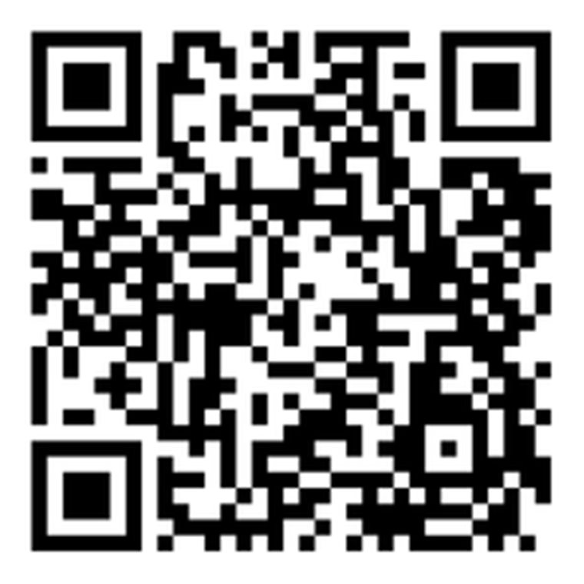
CAPACITACIÓN BREATHE
“Capacitacion inicial de Breathe”
Usa el Codigo QR
Para tomar la POS- Evaluación
Notes:
KEY POINT: All participants need to complete a post assessment.
MATERIALS NEEDED: Participants can complete the post assessment online with the QR code on this slide. This is the preferred method as it will save you time doing data entry after the training! (The slide now indicates “Breathe Refresher” so they know how to fill answer the first question regarding the type of training they attended.) To encourage compliance you could have them indicate they are done or show you their completion screen and you could give them a handout, magnet, or other giveaway when they do. You still need to bring some printed out post assessments, preferable on a different color of paper, in case participants prefer to complete a hard copy. The Post Assessment can be downloaded from this webpage: https://justbreathein.org/additional-resources/materials/ **If you choose NOT to have participants complete the assessment online, modify this slide by removing the QR code.
VIRTUAL MODIFICATION: Participants can use another device to access the QR code on the screen and/or you can place the link in the chat box so they can complete it on the device they are using for the training. Ask participants to type DONE in the chat box to encourage compliance and assess completion. Here is the link to the post assessment: https://www.surveymonkey.com/r/PostAssess2527
SCRIPT: “Thank you for participating in today’s Breathe training! Before we wrap up, I need everyone to complete the post assessment. Once you have completed the post assessment please bring it to me/hold it up and I will give you (a magnet, certificate of completion, or whatever handout you choose).”

Slide 84
RECOJA LOS MATERIALES
DE BREATHE
Espera una encuesta de seguimiento un mes después de la capacitación de JustBreatheIndiana@gmail.com
Notes:
KEY POINT: Participants can pick up free materials and should expect a follow up survey in one month.
SCRIPT: “After you complete the post assessment you can pick up Quit Now Indiana handouts. I’ll be sending a follow up email soon with the link to the webpage with all the digital materials as well as a certificate of completion for today’s training. Then expect an email in about a month from justbreatheindiana@gmail.com with our 1 month survey. Please complete that survey when you get it as it really helps us gain feedback to evaluate and improve the Breathe program.”

Slide 85


¡¡GRACIAS!!
Tanya Shelburne, Project Manager
tanyas@healthedpros.org
317-902-4505
Alison Muckerheide, Tobacco Control Specialist
alisonm@healthedpros.org
Notes:
KEY POINT: Share contact information.
SCRIPT/INSTRUCTIONS: (Personalize this slide with your contact information.) “Thank you so much for participating in today’s Breathe training. It was my pleasure to meet all of you and I know that working with families on this topic may not be easy, but I hope you are excited about the Breathe materials and that you will reach out to me any time you have questions or great ideas and want to share your successes.”

Slide 86
FUENTES DE DATOS
2023 Indiana Behavioral Risk Factor Surveillance System (BRFSS)
www.in.gov/health/tpc/
www.cdc.gov/tobacco/
www.cancer.org/cancer/risk-prevention/tobacco
Para obtener una lista más detallada de las fuentes de datos utilizadas para crear los materiales de Breathe, vaya a:
justbreathein.org/additional-resources/data-sources/
Notes:
KEY POINT: Share basic data sources and where they can find more.
SCRIPT/INSTRUCTIONS: (You can just leave this slide up for people to see or refer to it if anyone asks about the source of information you shared.)

