Slide 1
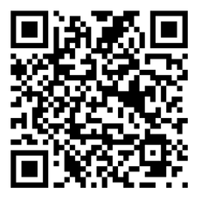



BREATHE TRAINING
“BREATHE REFRESHER”
USE THE QR CODE
to take the
PRE- ASSESSMENT
Notes:
HOW TO USE THE NOTES SECTION: Each slide in this presentation has a notes section that can help you deliver the presentation.
The KEY POINT let’s you know the most important message to convey and along with the text on the screen, that may be all the guidance an experienced County Coordinator/tobacco expert may need to conduct the training effectively.
If any handouts or other resources are necessary for a given slide you will see a MATERIALS NEEDED section.
If modifications are needed to share a slide or conduct an activity for a virtual training, you will see a VIRTUAL MODIFICATION section.
The SCRIPT portion of each page will give you a sample script (in italics) of what you might say for each slide as well as instructions, if needed. DO NOT READ THE SCRIPT VERBATIM! Instead, use the script to practice the presentation and then adjust it as needed to make it your own. The script is simply meant to be a guide/suggestion!
KEY POINT: All participants need to complete a pre assessment and sign the sign-in sheet.
MATERIALS NEEDED: Participants can complete the pre assessment online with the QR code on this slide. This is the preferred method as it will save you time doing data entry after the training! The slide indicates “Breathe Refresher” so they know how to answer the first question regarding the type of training they are attending. To encourage compliance, you could have them indicate they are done or show you their completion screen and you could give them a handout, magnet, or other giveaway when they do. You still need to bring copies of the sign-in sheets and some printed out pre assessments in case participants prefer to complete a hard copy….then after the training you will need to complete the data entry. **If you choose NOT to have participants complete the assessment online, modify this slide by removing the QR code.
VIRTUAL MODIFICATION: Participants can use another device to access the QR code on the screen and/or you can place the link in the chat box so they can complete it on the device they are using for the training. You may need to keep posting the link in the chat box as people enter the training since they may not be able to see earlier chat box entries. Ask participants to type DONE in the chat box to encourage compliance and assess completion. Here is the link to the pre assessment: https://www.surveymonkey.com/r/PreAssess2527
SCRIPT: “Before we get started, I need everyone to complete a pre assessment. To access the survey, just open the camera on your smartphone and point it at the QR code on the screen to get the link. If you prefer to complete the assessment with pen and paper just let me know and I will bring you a hard copy. I will also be asking you to complete a post-assessment at the end of the training, and these are important parts of our evaluation, so I appreciate you completing them. There are also sign-in sheets being passed around. Please make sure you put your name and contact info on one of the sign-in sheets so we will have a record of everyone’s attendance and if you want to receive our monthly Breathe E-newsletter you can indicate that on the sign in as well.”

Slide 2



HEALTH ED PROS
Tanya Shelburne MPH, CHES
Alison Muckerheide MPH, CHES
Please put your Name, County, & Email in chat box for attendance
Notes:
KEY POINT: Participants should know your name and a bit about your background and position.
MATERIALS NEEDED: Breathe kits and Quit Now Indiana materials
VIRTUAL MODIFICATION: Make plans with your site contact to deliver Breathe Kits and Quit Now Indiana materials either before or after the training and discuss how the materials should be divided up between the training participants.
INSTRUCTIONS: Personalize this slide with your information. Welcome everyone to the training, introduce yourself, and give a brief background on your experience, your organization, and your position. Bring materials to the training (breathe kits, Quit Now Indiana materials, etc.) but do not distribute them until the end of the training as some attendees will leave/not pay attention if materials are distrusted too early.

Slide 3



Guidelines for Virtual Training
Training is being recorded
Keep video on
Mute yourself when not speaking
Rename yourself, if necessary
Stay for entire training (60 minutes)
Interact!!! (pre/post assessments, chat box, unmute)
Notify Alison if you have issues
Notes:
DELETE THIS SLIDE IF CONDUCTING AN IN-PERSON TRAINING!
KEY POINT: Go over housekeeping and expectations for the training.
SCRIPT/INSTRUCTIONS: (Personalize this slide as needed.) “Now before we jump into the actual training I want to go over a few housekeeping items. I want to make sure everyone is aware that the training is being recorded and I will share a link to the recording in a follow up email in a day or two should you want to watch it again or share it with someone on staff who may have missed the training. I do ask that you keep your videos on during the training so I can see everyone’s smiling faces and it will feel a bit more like we are actually in person, but do keep yourself on mute to minimize background noise and just unmute yourself when you want to share something or ask a question. If the name on the screen is not your name, please rename yourself, which will help us with attendance and knowing who everyone is. To rename yourself put your cursor in your box on the screen and click the blue box in the upper right corner with 3 dots in it and you should see the option to rename yourself. Do your best to minimize distractions around you and I do ask that you stay for the full 90 minute training. There will be several options to interact so feel free to use the chat box or raise your hand at any time, and I hope you will interact as it is way more fun when it’s not just me talking the whole time! If you have any issues during the training feel free to message the co-host and we will try to assist.”

Slide 4
Connection Before Content
No one cares how much you know,
until they know how much you care.
- Theodore Roosevelt
Notes:
KEY POINT: Connect with participants before you get into the training content.
SCRIPT: “We will get to discussing tobacco in just a bit, but I think it is important that we focus on “Connection Before Content”. This quote from Theodore Roosevelt really sums up why Connection Before Content is important and serves as the basis for why we designed the Breathe program the way we did. He said ‘No one cares how much you know, until they know how much you care.’ Hopefully as we continue to get to know each other you will see that I have a heart for protecting children and families and supporting the staff who serve them! And we know all of you have a heart for the families you serve and that they know and trust you. That’s why we focus on training staff at Head Start and other organizations rather than going directly to the parents ourselves. So let’s connect a bit with an ice breaker I call That’s Me!”

Slide 5
I have no idea what Breathe is!
I work directly with children/teens
I have used the Breathe videos
I have used the Breathe Children’s Activities/Coloring Sheets
I have used the Breathe Parent Activities/Handouts/Worksheets
I could use more help talking to parents about tobacco & secondhand smoke!
That’s Me!
My Health Dept has experienced budget cuts
I attended the Breathe training last Fall
I love my job!
I work directly with parents/grandparents/families
I have used the Breathe Flip Chart
I have read the monthly Breathe E-Newsletter
I am part of my Health Dept.’s leadership
I have talked to parents about tobacco
Notes:
DELETE THIS SLIDE IF YOU ARE TRAINING A HEAD START CENTER!!
KEY POINT: Get to know the participants with an interactive game.
VIRTUAL MODIFICATION: Instruct the participants to wave their hands, type in the chat box, or use the reaction buttons to signify if each statement applies to them and provide commentary as appropriate. If it is a small group, you may even choose to have everyone unmute and just shout out that’s me when appropriate. Given that it is hard to look at the participants and the slide as the statements appear, you can print out a cheat sheet with the statements in order here: https://justbreathein.org/staff-training/breathe-refresher/
SCRIPT/INSTRUCTIONS: “This fun game will help me learn a bit more about all of you. That’s Me is a super easy game. I’ll read a statement, which will also appear on the screen. When you hear that statement if it applies to you just stand up, throw your arms in the air, and shout That’s Me! The more you agree with the statement the louder I want to hear you! Sound good? Ok, let’s go!” (Flip through each statement and read it out loud as you learn about who is in the audience. Based on the amount of space and the ability of the participants you can ask them to actually stand for each statement or just throw their hands up as they say That’s Me! For Head Start organizations use the slide before this instead.)

Slide 6
REVIEW OF OUR PARTNERSHIP
State Funding through Indiana Tobacco Prevention & Cessation Commission (TPC); statewide & county funded partners
Partnering with Indiana Head Start and similar partners for over a decade
Educate and empower staff who have trusted relationships with parents
Lots of free materials and on-going support!
There have been changes to Health First Indiana…but we still want to partner with those doing tobacco work!
Notes:
KEY POINT: Our program provides on-going support and resources to partners who have trusted relationships with parents/families.
SCRIPT: “Before we dive further into information on tobacco, I want to share a basic overview of our partnership with your organization. Funding for Breathe comes from the Indiana Department of Health’s Tobacco Prevention and Cessation Commission and we have been working with Head Start centers and similar partners for well over a decade. Our main goal is to educate and empower staff at organizations just like yours because we know you have trusted relationships with the parents and families you serve, and you have the opportunity to discuss the sensitive topic of tobacco use and secondhand smoke exposure. While I could provide education directly to your parents, they don’t know and trust me so it may not be well received. I want to come alongside you to give you the expertise and resources you need so you can support your parents when it comes to tobacco education. Since we are grant funded all the materials and support we offer are completely free to your organization. And I want to be a source of on-going support for you so you can come to me with challenges you are facing, and I hope you will also share your successes with me!”

Slide 7
ROLE OF LOCAL HEALTH DEPTS
Use Breathe resources and tobacco information with families you serve
Help identify additional partners we could train in your county!
Notes:
KEY POINT: Our program provides on-going support and resources to partners who have trusted relationships with parents/families.
SCRIPT: “Before we dive further into information on tobacco, I want to share a basic overview of our partnership with your organization. Funding for Breathe comes from the Indiana Department of Health’s Tobacco Prevention and Cessation Commission and we have been working with Head Start centers and similar partners for well over a decade. Our main goal is to educate and empower staff at organizations just like yours because we know you have trusted relationships with the parents and families you serve, and you have the opportunity to discuss the sensitive topic of tobacco use and secondhand smoke exposure. While I could provide education directly to your parents, they don’t know and trust me so it may not be well received. I want to come alongside you to give you the expertise and resources you need so you can support your parents when it comes to tobacco education. Since we are grant funded all the materials and support we offer are completely free to your organization. And I want to be a source of on-going support for you so you can come to me with challenges you are facing, and I hope you will also share your successes with me!”

Slide 8
How much do you know/remember about tobacco?
Notes:
KEY POINT: Set the stage for this training being a refresher.
SCRIPT: “Now that I know a bit more about all of you, let’s see how much you remember from our last training. Of course if I expect you to talk to parents/caregivers about tobacco use and secondhand smoke then you need to be aware of some basic information on this topic. I realize not everyone attended the previous training and you have all slept since then, so just do your best! We are going to have a little fun with this…and play Jeopardy!!! I’m guessing we may have at least a few competitive people in this group so this should be fun!”

Slide 9
LET’S PLAY JEOPARDY!!
Notes:
KEY POINT: Review the structure for how to play Jeopardy.
VIRTUAL MODIFICATION: With virtual Jeopardy everyone gets to play as individuals. Instruct participants to use the chat box to answer the questions and let them know that both speed and accuracy count. For multiple choice, tell them to just type the letter that corresponds with the correct answer into the chat box. For true or false they can just type T or F. It helps to have a co-trainer who determines who gets the correct answer in first and keeps score...or you can decide just to play for fun and not keep score. You can find a tracking sheet to help you keep score here: https://justbreathein.org/staff-training/breathe-refresher/
SCRIPT/INSTRUCTIONS: “This is a modified version of Jeopardy, played with teams. Everyone on this side of the room will be on one team and everyone on this side will be on the other team. Decide who will be your team’s spokesperson and pick a name for your team. The team leader with the closest birthday will go first. Then we will take turns going back and forth between the two teams and you don’t have to worry about answering in the form of a question for this version of Jeopardy! (After dividing the participants into two teams, ask for a volunteer or have your co-trainer record the score on newsprint or a dry erase board. After each answer is revealed, you can fill in some additional info on that particular topic and then click on the green house at the bottom of the screen to return to the list of categories/questions and alternate between teams to select and answer a question. Questions already completed will change to Orange. Or instead of clicking the house to go back to the main screen, you can just click through all the slides and go in order. Determine how much time you have to play the game and stop when that time is up and do the Final Jeopardy question. You may or may not get through all the questions and that is fine.)

Slide 10
JEOPARDY
Tobacco
101
Industry
Tactics
Pregnancy/Child Health
E-cigs
Quitting
$100
$100
$100
$100
$100
$200
$200
$200
$200
$200
$300
$300
$300
$300
$300
Final Jeopardy
Notes:
KEY POINT: Review the Jeopardy Game Board.
SCRIPT/INSTRUCTIONS: “We have five categories on the game board: Tobacco 101, Industry Tactics, Pregnancy/Child Health, E-cigs, and Quitting. And there are options for $100, $200, and $300 questions for each one. (Team one) will go first. Which question would you like?” (Click on the category and dollar amount they choose to go to that question.)

Slide 11
$100 Question Tobacco 101
    True or False: Traditional Cigarette usage rates have decreased over the past 30 years.
Notes:
INSTRUCTIONS: Read the question out loud.

Slide 12
$100 Answer Tobacco 101
    TRUE!
Notes:
KEY POINT: While traditional cigarette smoking has gone down there is still work to be done, especially with e-cigarettes.
SCRIPT: “That is true! There has been a lot of great progress as people have learned about the danger of smoking and laws have been put in place to restrict some forms of tobacco marketing and to protect people from secondhand smoke exposure. But there is still work to be done, and especially with the recent growth of e-cigarettes and vaping. (Team X) gets $100!”

Slide 13

$200 Question Tobacco 101
    The majority of people start using tobacco before the age of?
    21 years old
    25 years old
    30 years old
    40 years old
Notes:
INSTRUCTIONS: Read the question out loud.

Slide 14
$200 Answer Tobacco 101
A) AGE OF 21
Notes:
KEY POINT: Most smokers start by the age of 21.
SCRIPT: “The answer is A. About 95% of adult smokers begin smoking before they turn 21 so that is why preventing teens and young adults from starting is so critical. (Team X) gets $200!”

Slide 15
$300 Question Tobacco 101
Infants and toddlers ingest what amount of thirdhand smoke chemicals compared to adults?
The same amount as adults
4 times more than adults
4 times less than adults
Notes:
INSTRUCTIONS: Read the question out loud.

Slide 16
$300 Answer Tobacco 101
B) 4 TIMES THE AMOUNT!
Notes:
KEY POINT: Thirdhand smoke is especially dangerous for infants and children.
SCRIPT: “The answer is B. If you remember from our last training, Thirdhand smoke includes the toxins and chemicals left behind in a room or a car when someone smokes there. Because of the way infants breathe and the size of their developing lungs they actually take in 4 times the amount of chemicals that an adult would in the same space. That is why it is critical to educate parents about thirdhand smoke and encourage them not to smoke in places where children will later be. (Team X) gets $300!”

Slide 17
$100 Question Industry Tactics
    True or False: The tobacco industry markets their products to resemble popular candies & food items
Notes:
INSTRUCTIONS: Read the question out loud.

Slide 18
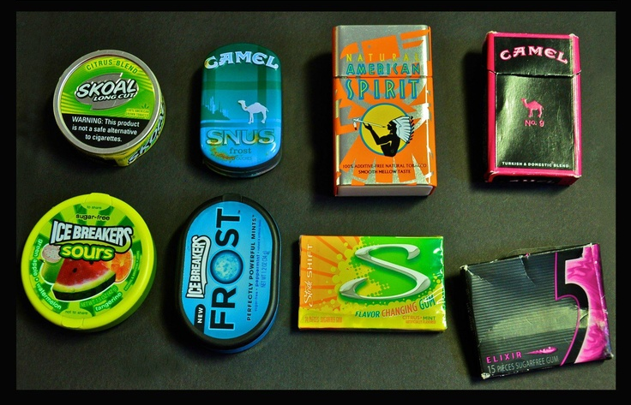
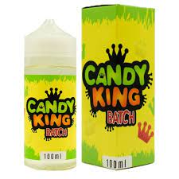
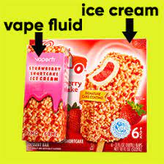
$100 Answer Industry Tactics
    True!
Notes:
KEY POINT: The tobacco industry markets to youth with packaging that is similar to candy.
SCRIPT: “The answer is true! The tobacco industry deliberately targets young people and one of their strategies is to mimic the packaging of popular candy and other items that appeal to youth. These pictures show just a few examples of vape juice, chewing tobacco and cigarettes that look strikingly similar to candy! (Team X) gets $100!”

Slide 19
$200 Question Industry Tactics
How much money does the tobacco industry spend every day on marketing in the United States?
$750,000
$3.5 Million
$10 Million
$23.5 Million
Notes:
INSTRUCTIONS: Read the question out loud.

Slide 20
$200 Answer Industry Tactics
D) $23.5 Million!
Notes:
KEY POINT: The tobacco industry spends A LOT of money on marketing.
SCRIPT: “The answer is D. The tobacco industry spends 23.5 MILLION dollars every day to market their deadly products in the United States.. I personally could think of a lot better ways to spend that money! (Team X) gets $200!”

Slide 21
$300 Question Industry Tactics
The tobacco industry targets which group(s) of people?
People of Color
Youth
Communities with low incomes
LGBTQ+
All of the above
Notes:
INSTRUCTIONS: Read the question out loud.

Slide 22
$300 Answer Industry Tactics
E) ALL OF THE ABOVE
Notes:
KEY POINT: The tobacco industry aggressively markets several marginalized populations.
SCRIPT: “The answer is E, all of the above. The tobacco industry preys on several marginalized populations, including but not limited to people of color, youth, those in communities with low incomes, and the LGBTQ+ community. They use aggressive marketing strategies in order to create life-long customers, which results in even greater health disparities for these groups. (Team X) gets $300!”

Slide 23
$100 Question
Pregnancy/Child Health
    What is considered a safe amount of tobacco use during pregnancy?
    1 pack throughout the pregnancy
    1 pack a month
    C) 1-2 cigarettes a month
    D) There is NO safe amount
Notes:
INSTRUCTIONS: Read the question out loud.

Slide 24
$100 Answer
Pregnancy/Child Health
D) THERE IS NO SAFE AMOUNT!
Notes:
KEY POINT: There is no safe amount of tobacco use during pregnancy.
SCRIPT: “The answer is D. There is no safe amount of tobacco use during pregnancy. But even if someone has smoked during part of their pregnancy, it is always a good idea to stop now to help their baby have the healthiest outcome possible. (Team X) gets $100!”

Slide 25
$200 Question
Pregnancy/Child Health
    True or False: The THC in marijuana can pass through breastmilk.
Notes:
INSTRUCTIONS: Read the question out loud.

Slide 26
$200 Answer
Pregnancy/Child Health
TRUE!
Notes:
KEY POINT: THC passes to babies through breastmilk.
SCRIPT: “That is true. THC can pass to babies through breastmilk, so we need to encourage those who are breastfeeding not to use marijuana. (Team X) gets $200!”

Slide 27
$300 Question
Pregnancy/Child Health
    Smoking during pregnancy can cause which health problem(s)?
    Low Birthweight
    Preterm Labor
    Miscarriage
    All of the Above
Notes:
INSTRUCTIONS: Read the question out loud.

Slide 28
$300 Answer
Pregnancy/Child Health
D) ALL OF THE ABOVE!
Notes:
KEY POINT: Smoking during pregnancy can lead to asthma attacks, bronchitis, and ear infections.
SCRIPT: “The answer is D, all of the above. These are just some of the health problems that can result from smoking during pregnancy. Many of the same health concerns can also occur if another person smokes around someone who is pregnant and they breathe in secondhand smoke. (Team X) gets $300!”

Slide 29
$100 Question E-cigarettes
    True or False: Using E-Cigarettes/Vapes is a proven cessation method to quit smoking.
Notes:
INSTRUCTIONS: Read the question out loud.

Slide 30
$100 Answer E-cigarettes
FALSE!
Notes:
KEY POINT: Vaping is not a proven cessation method.
SCRIPT: “That is false. While you may hear of some people using e-cigarettes to help them quit smoking, vaping is not a proven cessation method, and many people end up becoming dual users and teens start vaping when they never would have started using traditional cigarettes. (Team X) gets $100!”

Slide 31
$200 Question E-cigarettes
    Who is it safe to use e-cigarettes around?
    Children
    Adults
    Pets
    None of the above
Notes:
INSTRUCTIONS: Read the question out loud.

Slide 32
$200 Answer E-cigarettes
D) NONE OF THE ABOVE!
Notes:
KEY POINT: It is not safe to use e-cigarettes around anyone.
SCRIPT: “The answer is D, none of the above. Anyone, even pets, who are around people who are vaping are exposed to the dangerous toxins in the aerosol that comes from these products. Of course, infants and children with developing lungs are especially susceptible to health problems from this exposure. (Team X) gets $200!”

Slide 33
$300 Question E-cigarettes
    True or False:
    E-cigarettes/Vapes emit harmless water vapor.
Notes:
INSTRUCTIONS: Read the question out loud.

Slide 34

$300 Answer E-cigarettes
FALSE!
Notes:
KEY POINT: E-cigarettes emit an aerosol that is full of harmful chemicals.
SCRIPT: “That is false. Many people incorrectly think that vaping just creates harmless water vapor, but e-cigarettes actually produce an aerosol that is full of harmful chemicals. (Team X) gets $300!”

Slide 35
$100 Question Quitting
    What is the FREE, clinically proven, phone/text/online quit program available in Indiana?
    Quit Now Indiana
    Smoke, The Big NOPE Foundation
    You Can Do It Incorporated
    Helping Hoosiers Quit
Notes:
INSTRUCTIONS: Read the question out loud.

Slide 36
$100 Answer Quitting
QUIT NOW INDIANA
Notes:
KEY POINT: Quit Now Indiana is a free cessation resource that can be shared with parents.
MATERIALS NEEDED: Quit Now Indiana materials
SCRIPT: “The answer is A. Quit Now Indiana is a wonderful free resource that parents can use 24/7 to get help and support if they are ready to quit tobacco. I brought lots of Quit Now Indiana materials with me today so please make sure you take some. (Team X) gets $100!” (share more about QNI as time allows)

Slide 37
$200 Question Quitting
    True or False: Indiana Medicaid offers multiple tobacco cessation resources for people trying to quit tobacco.
Notes:
INSTRUCTIONS: Read the question out loud.

Slide 38
$200 Answer Quitting
TRUE!
Notes:
KEY POINT: Those with Indiana Medicaid coverage have access to lots of great tobacco cessation resources.
SCRIPT: “That is true! Indiana Medicaid covers several forms of proven nicotine replacement products as well as prescription medications and counseling sessions. (Team X) gets $200!”

Slide 39
$300 Question Quitting
    On average, how many attempts does it take for someone to successfully quit smoking?
    1 time
    3-4 times
    8-11 times
    5 million times
Notes:
INSTRUCTIONS: Read the question out loud.

Slide 40
$300 Answer Quitting
C) 8-11
TIMES!
Notes:
KEY POINT: It often takes 8-11 quit attempts before someone quits for good.
SCRIPT: “The answer is C. Quitting tobacco is not easy and it often takes 8-11 quit attempts before someone quits for good. All quit attempts are a step in the right direction so offer plenty of support along the way. (Team X) gets $300!”

Slide 41
Final Jeopardy
    How much would someone in Indiana spend on cigarettes in a year if they smoke 1 pack a day?
    (based on the average price of a pack of cigarettes)
Notes:
KEY POINT: Determine how much smoking costs.
VIRTUAL MODIFICATION: Have participants type their guess into the chat box and then read the responses aloud and provide commentary and praise.
SCRIPT/INSTRUCTIONS: “It is now time for final Jeopardy! Each team get out a blank sheet of paper. When I share the question write your team’s answer down and how much you want to wager, then wait until I ask you to hold it up.
(CLICK TO THE STATEMENT) How much would someone in Indiana spend on cigarettes in a year if they smoke 1 pack a day? Your answer should be based on the average price of a pack of cigarettes currently in Indiana. I’ll give you wiggle room of $50 over or under for a correct answer. Don’t forget to write down how much you want to wager as well. (Give teams a minute to confer and write down their answer.) (Team 1) what is your answer? (Team 2) please share your answer.”

Slide 42
Final Jeopardy
    $4,015!!
    ($4,026 if it’s Leap Year!)
    I’ll accept answers
    between $3,965 and $4,076
    (based on $11 as the average price of a pack of cigarettes in Indiana X 365 days)
Notes:
KEY POINT: It costs over $4,000 a year for someone who smokes a pack a day.
VIRTUAL MODIFICATION: If you chose to keep score, announce who had the highest score, add or deduct the wagers, and offer a round of applause!
SCRIPT/INSTRUCTIONS: “And the answer is…$4,015 a year, $4,026 if its Leap Year! That is A LOT of money and I bet we could all think of better ways to spend that money. This is based on the average price of a pack of cigarettes being $11 in Indiana. That number went up recently as Indiana’s new cigarette tax increase went into effect on July 1 of 2025. The other number that shot up…calls to Quit Now Indiana! Raising the cost of tobacco products is a proven strategy that motivates people to quit as well as discourages youth from starting. This means that the parents/caregivers you serve who smoke may be even more receptive to quit support now, so it is a great time to share the Breathe and Quit Now Indiana resources.” (Determine the winning team and shower them with praise!)

Slide 43
Thanks for Playing Jeopardy!
Helping our communities become healthier and smoke/vape free is EVERYONE’S job.
Notes:
KEY POINT: It is everyone’s job to help our communities become healthier and smoke/vape free.
SCRIPT/INSTRUCTIONS: “Thank you so much for playing Jeopardy! I hope everyone had fun and learned something. As one of our Breathe Partners, I also hope you recognize that it is EVERYONE’S job to help our communities become healthier and smoke/vape free! You can all play a role in lowering the tobacco burden by sharing this information and using the Breathe materials that work best with your specific job. And if you would like to play this same round of Jeopardy with the parents you serve or other staff members who couldn’t be here today, you can now find the Jeopardy game on the Breathe website along with all the other Breathe Resources.”

Slide 44
Breathe Materials
Let’s review all the materials you have access to!
Notes:
KEY POINT: Remind participants that they have access to lot of Breathe materials online.
VIRTUAL MODIFICATION: Place the link to the For Partners webpage in the chat box: https://justbreathein.org/for-partners/
SCRIPT/INSTRUCTIONS: “Now that we have all brushed up on our knowledge of tobacco and the importance of protecting children from second and thirdhand smoke, I want to remind you about all the Breathe resources you have access to that can aid in educating and supporting the families you work with. Hopefully you know where your Breathe kits are stored, but if not, talk to your leadership to find out and let me know if you need any replacement items. If you are new or haven’t used some of the Breathe materials yet I hope this refresher will get your wheels spinning as you think about which materials would work best depending on your specific job and how you may interact with families and young children.”

Slide 45
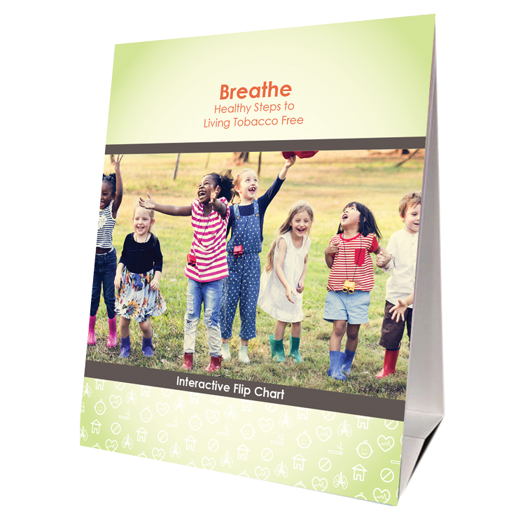



FOR PARENTS/CAREGIVERS
Flip
Chart
Activities Booklet
Worksheets
Handouts
Notes:
KEY POINT: Review Breathe resources focused on parents/caregivers.
MATERIALS NEEDED: Sample Breathe kit; additional supplies as needed.
SCRIPT/INSTRUCTIONS: “Several of the items in the Breathe kit are specifically geared towards parents/caregivers or the adults in the household. (CLICK TO REVEAL THE LABELS AS YOU TALK ABOUT EACH BREATHE RESOURCE) The flipchart is great for one on one or small group interactions with talking points on the back of each page to guide your conversation. The parent handouts cover many different tobacco topics and can be printed or downloaded and shared electronically with all parents or with specific parents when relevant. The worksheets also provide great information on many tobacco topics but also include interactive components that help parents set goals and think through challenges of quitting or minimizing smoke/vapor exposure for their children. The activities booklet is a great tool for anyone who needs activities to do with groups of parents. There are instructions for 9 different activities that take very little prep and minimal materials and will get parents discussing a variety of tobacco related topics.

Slide 46
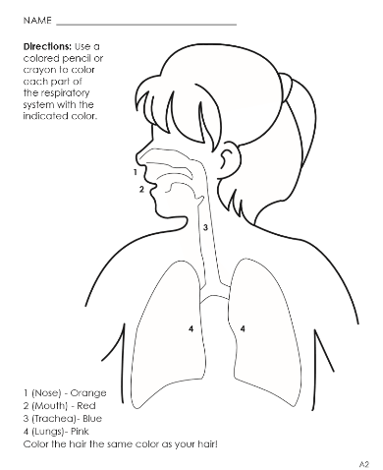


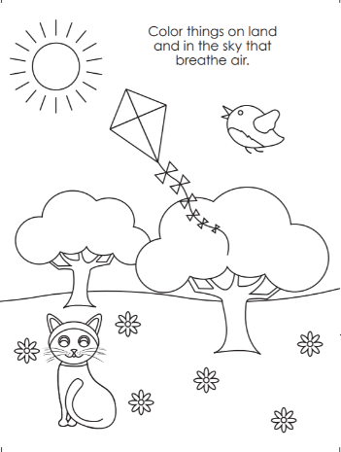
FOR YOUNG CHILDREN
Coloring Book/Sheets
Children’s Activities Booklet
Notes:
KEY POINT: Review Breathe resources focused on young children.
SCRIPT/INSTRUCTIONS: “The online Breathe kit also includes some resources that can be used directly with children. These resources are focused on healthy bodies and are not specifically tobacco focused. There are coloring sheets that can be printed or downloaded and shared electronically. There is also a Children’s Activities Booklet with 15 short activities focused on healthy bodies that work great with children ages 3-7. These activities require very little prep work or outside materials. Both of these resources are great for anyone who works directly with children and they can also be given to parents as take-home activities.”

Slide 47

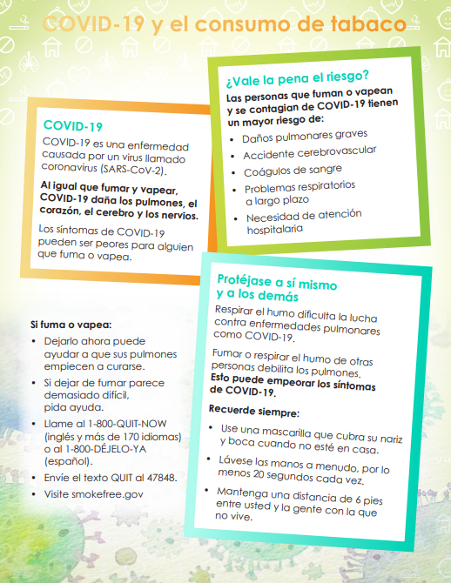

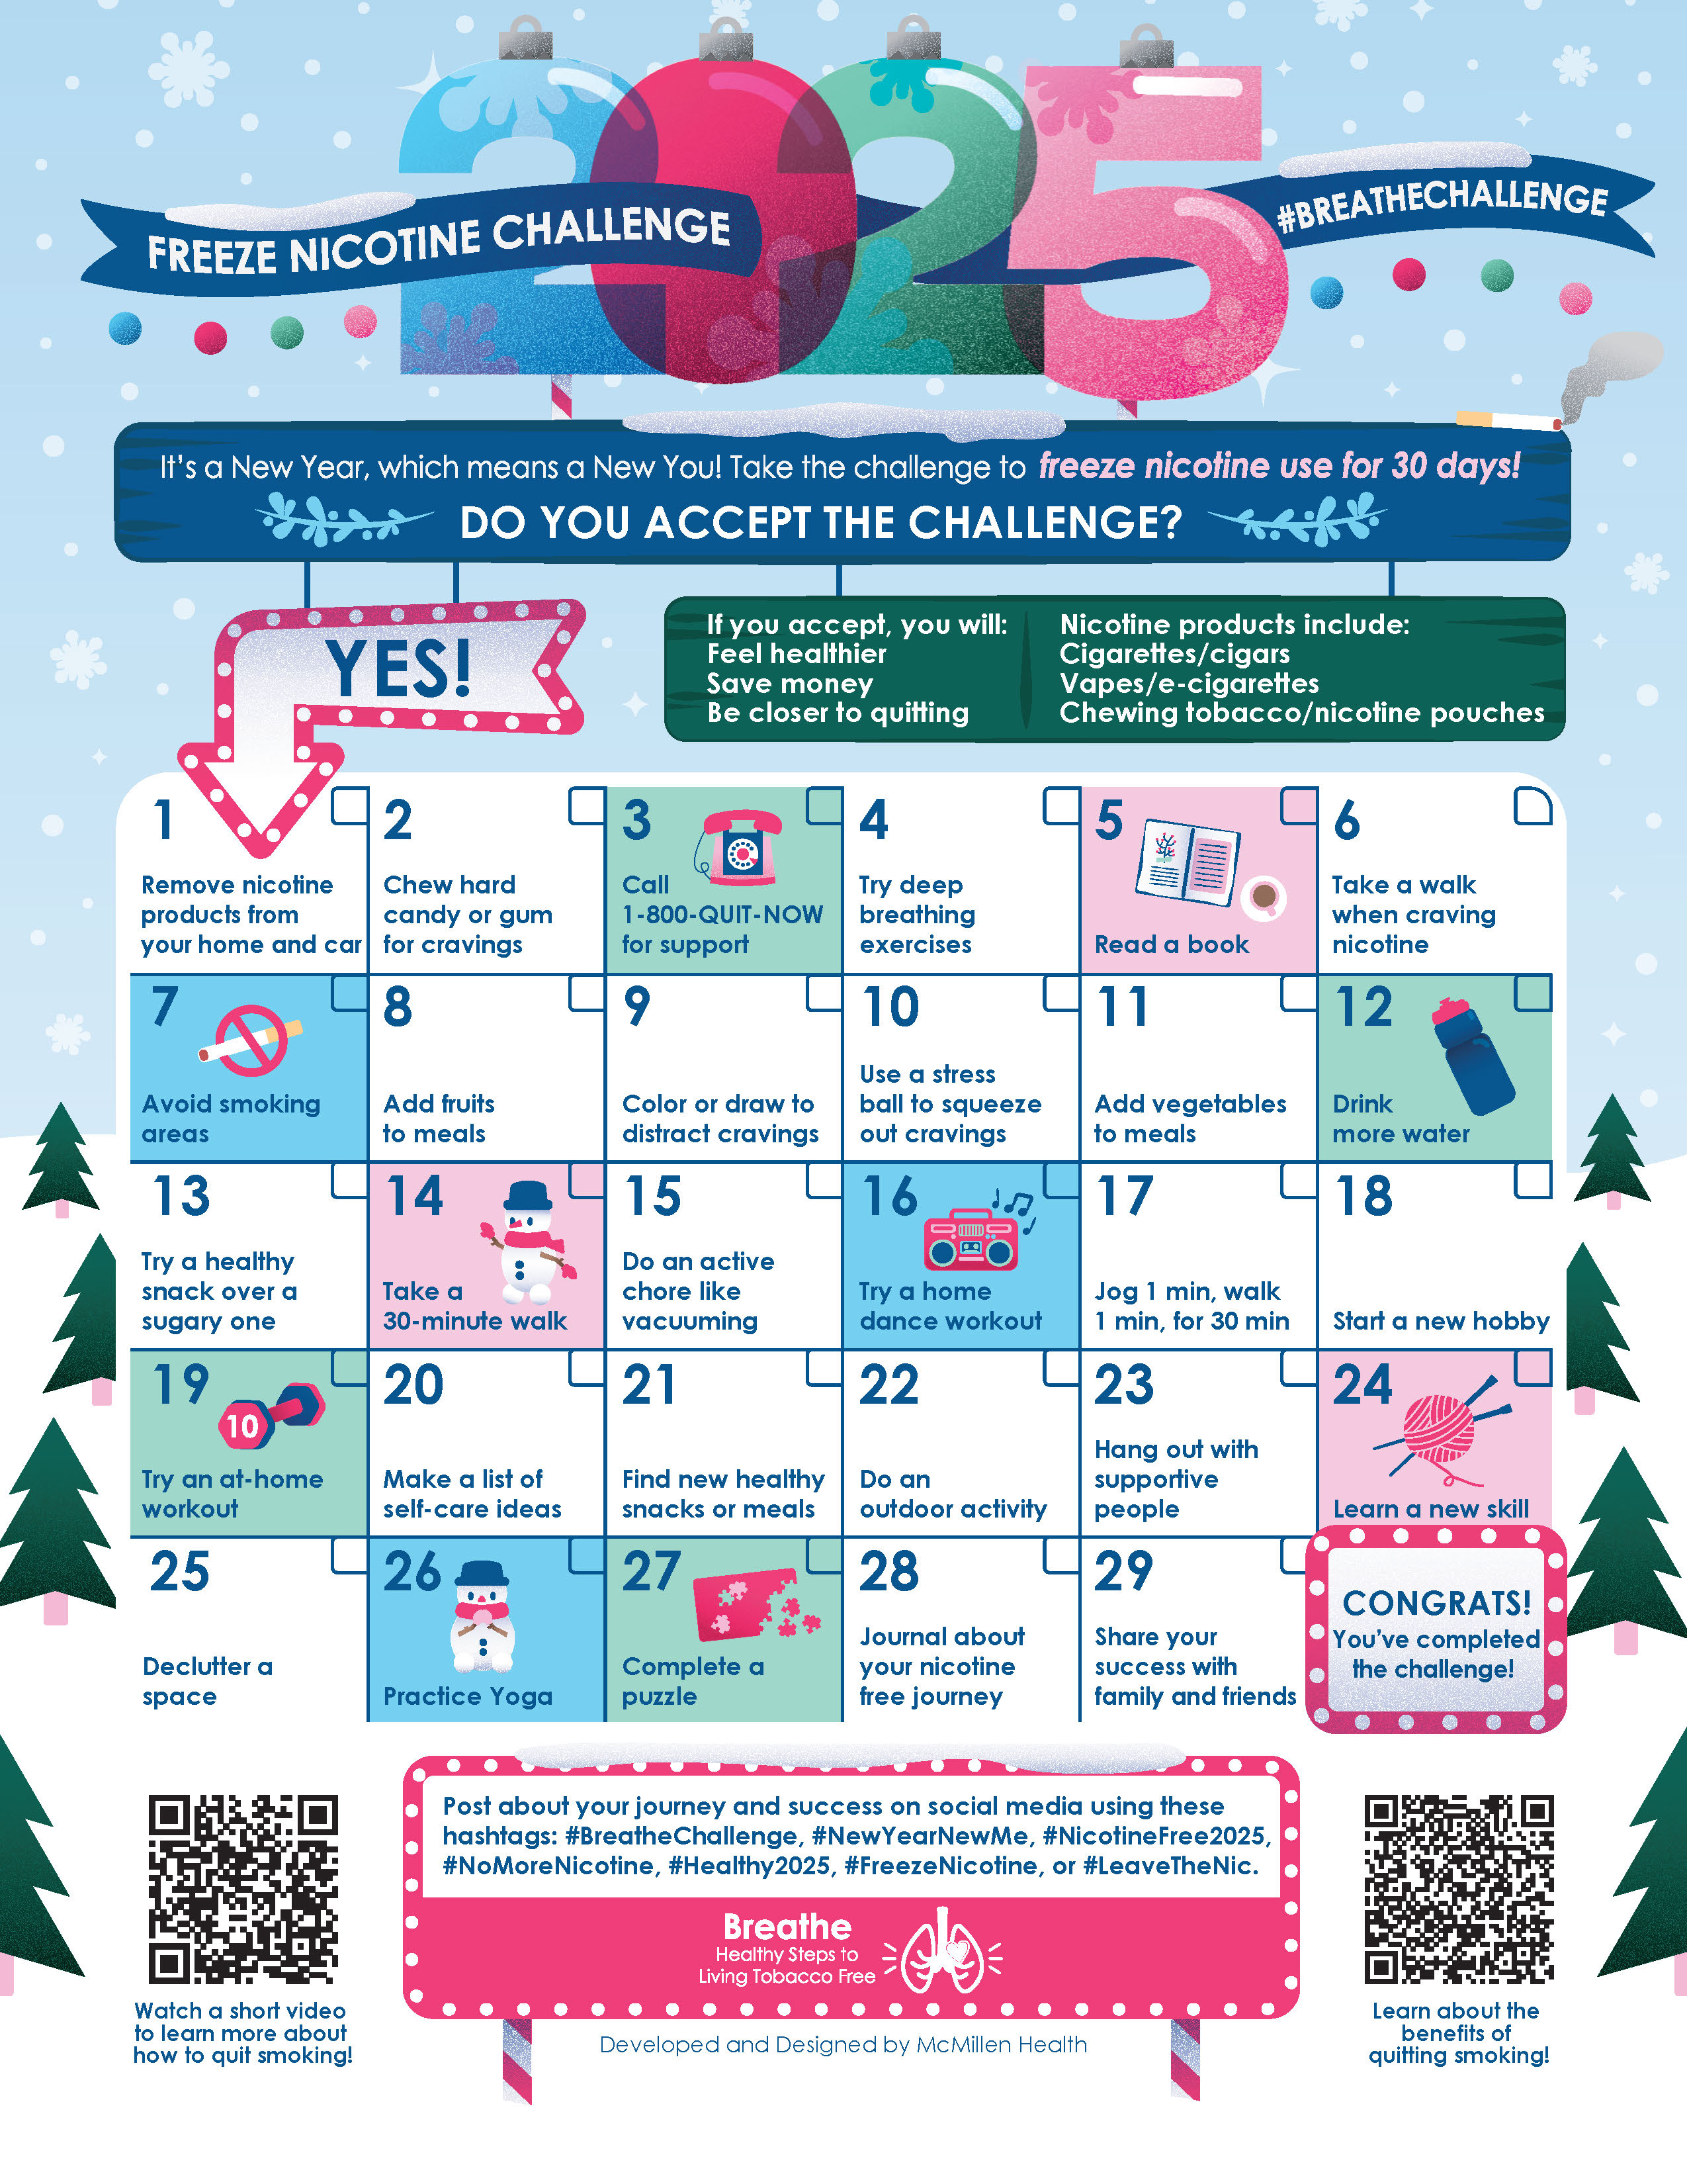
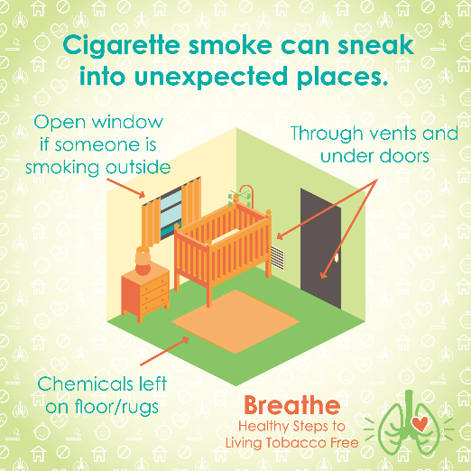
MORE RESOURCES
Spanish Materials
Short
Videos
Quarterly Challenges
Social Media Posts
Monthly
E-newsletter
Notes:
KEY POINT: Review additional Breathe resources and ways to share tobacco information.
SCRIPT: (CLICK TO REVEAL THE LABELS AS YOU TALK ABOUT EACH BREATHE RESOURCE) “And that’s not all! Many of the Breathe materials are also available in Spanish, so please access those materials if you are working with Spanish Speaking parents/caregivers. There are also lots of short videos, just 2-3 minutes each that help reinforce important tobacco related topics. Feel free to pull these up on an ipad to show to parents as appropriate or post them on your social media. Speaking of social media, the website also includes 12 ready to go graphics and accompanying text that you can post on your social media pages as a way to keep tobacco education on everyone’s radar. We also create a monthly Breathe e-newsletter that we will send directly to anyone who indicated they would like to receive it on today’s sign in sheet, if you aren’t already. We hope that you will share the newsletter by forwarding it, printing the pdf, or copying and pasting sections of it into your own organization’s newsletter. Finally, we have a new challenge each quarter that is a fun way to motivate families when it comes to quitting tobacco or minimizing exposure to second and thirdhand smoke/vapor. I hope this quick overview of the Breathe materials was a helpful refresher and that each of you can find at least one or two resources that might be useful in your current role and that you will feel comfortable sharing.”

Slide 48
Access All Breathe Materials Online!
Trained partners may download materials at
justbreathein.org/for-partners/
Notes:
KEY POINT: Trained Breathe partners can access all the Breathe materials online.
MATERIALS NEEDED: Print outs of the Partner QR code flyers that can be found here: https://justbreathein.org/for-partners/
VIRTUAL MODIFICATION: Place the link to the For Partners webpage in the chat box: https://justbreathein.org/for-partners/
SCRIPT/INSTRUCTIONS: “All of the Breathe materials can be accessed at the webpage on the screen. Don’t worry I’ll send you this link in a follow up email in case you don’t already have it bookmarked.”

Slide 49
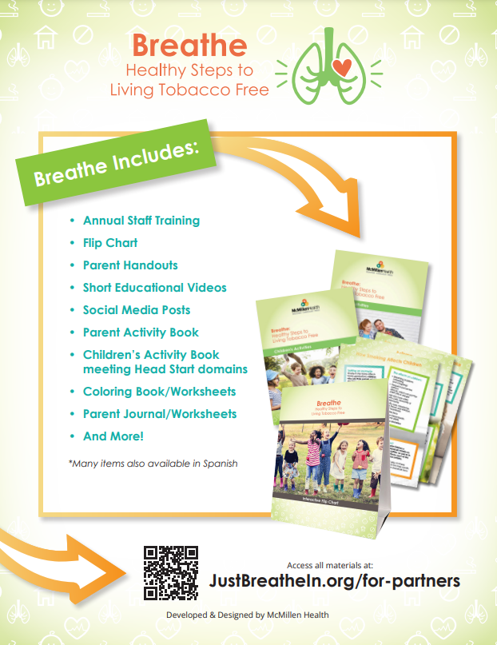
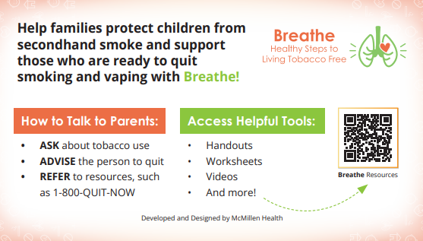
ACCESS BREATHE WEBSITE
            QR Code Flyer
            Pocket Guide
Notes:
KEY POINT: Share resources that will link participants to the Breathe resources online.
MATERIALS NEEDED: Optional, Print outs of the Breathe Kit QR code flyers (https://justbreathein.org/wp-content/uploads/2024/07/Breathe-Flyer-QR-Code-For-Partners.pdf) and Pocket Guides for Partners (https://justbreathein.org/wp-content/uploads/2024/09/Pocket-Fact-Sheet-Partner-w-cut-marks.pdf)
SCRIPT: “To help you remember how to access the Breathe materials, we have flyers as well as pocket guides with QR codes to the Breathe website. I printed and brought some with me today, but you can also find these resources on the website and download or print more yourself and share them with your staff.”

Slide 50




Order QNI Materials for FREE at: quitnowindiana.com/educational-materials
QUIT NOW INDIANA
In English & Spanish
Notes:
KEY POINT: Quit Now Indiana handouts are free to order and are great resources to have on hand.
MATERIALS NEEDED: Bring a variety of Quit Now Indiana handouts, in English and Spanish.
VIRTUAL MODIFICATION: Paste the link to order QNI materials in the chat box so they can order their own and/or let them know if you plan to drop off materials. Here is the link: https://www.quitnowindiana.com/educational-materials
SCRIPT: “I also brought a bunch of Quit Now Indiana handouts for you today. I encourage you to make these handouts easily accessible in your lobbies and to have them on hand when you do home visits or meet with parents so you can share this valuable resource when the time is right. You are also welcome to order these materials yourself for free at the website on the screen. In case you have forgotten about Quit Now Indiana, this is a great resource for anyone who is ready and wants help to quit tobacco.”

Slide 51

QUITNOW INDIANA
FREE & Available 24/7 >> Call, Text, Online, or App
Trained Quit Coach >> Customized Quit Plan
    FREE Nicotine Replacement Therapies (NRT), as available
1-800-Quit-Now (784-8669)
1-855-DÉJELO-YA (Spanish)
1-877-777-6534 (TTY)
Text READY to 34191
Text LISTO to 34191 (Spanish)
quitnowindiana.com
Notes:
KEY POINT: There are lots of resources available for those who want to quit.
SCRIPT: “You don’t have to be the expert on quitting, but you can help parents who want to quit by connecting them to Quit Now Indiana. Quit Now Indiana is free and available 24/7. People can call, text, go online or use the app to access services in whatever way works best for them. A trained quit coach will help them create a customized quit plan just for them. Free Nicotine Replacement Therapies, including the patch and gum, are provided for free, as available. Quit Now Indiana has a dedicated number for those who speak Spanish and other language services are available as well as TTY capabilities for those who are deaf or hard of hearing.”

Slide 52
QNI STANDARD & TAILORED PROGRAMS
Program (self-report) | Sessions | NRT | Offering | Amount (subject to change)
Pregnancy | 7 | Yes* | Patch or Gum | 2 weeks
Behavioral Health | 7 | Yes | Patch or Gum | 2 weeks
Youth Online | 6 Steps | No | N/A | N/A
Menthol Enhancement | 5 or 7 | Yes | Patch or Gum | 2 weeks
Standard Adult | 5 | Yes* for qualifying participants | Patch or Gum | 2 weeks
Notes:
KEY POINT: Quit Now Indiana offers specialized services for pregnant people, those with behavioral health issues, youth and those who use menthol products.
SCRIPT: “Quit Now Indiana offers specialized services for several populations that may need a tailored approach. This chart shows what is offered for the standard adult program at the bottom as well as the services available to pregnant people, those with behavioral health issues, youth ages 13-17, and people who use menthol products.”

Slide 53
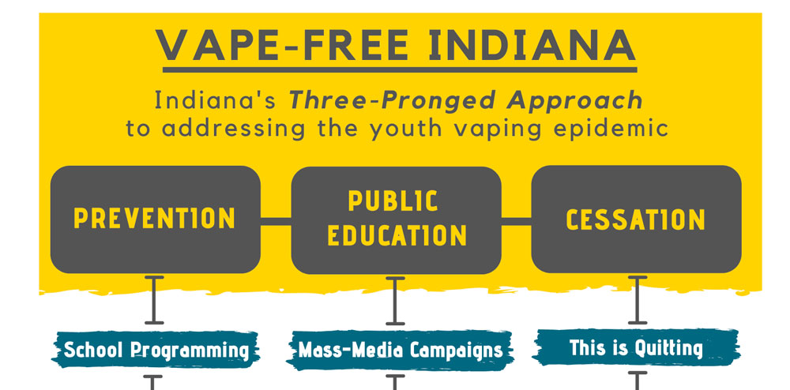


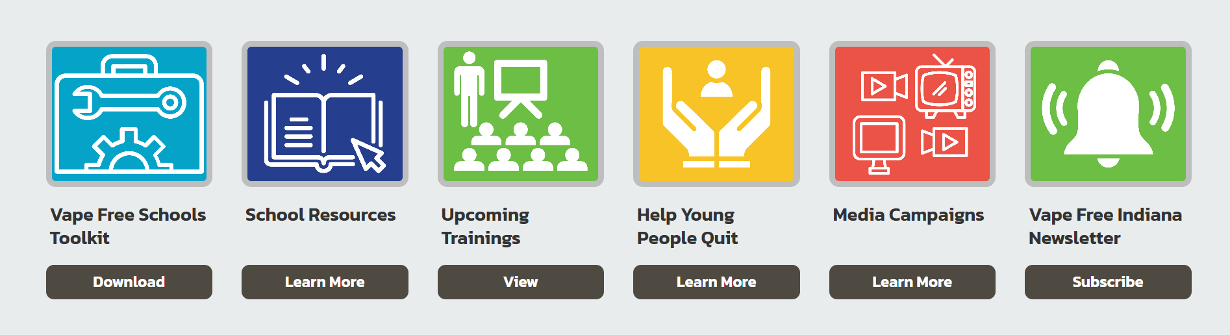


ADDITIONAL RESOURCES
INDEPTH: An Alternative to Teen Nicotine Suspension or Citation
www.in.gov/vapefreeindiana/
VAPING: KNOW THE TRUTH: Empowering
with the facts on e-cigarettes & tools to quit
Notes:
KEY POINT: Quit Now Indiana offers specialized services for pregnant people, those with behavioral health issues, youth and those who use menthol products.
SCRIPT: “Quit Now Indiana offers specialized services for several populations that may need a tailored approach. This chart shows what is offered for the standard adult program at the bottom as well as the services available to pregnant people, those with behavioral health issues, youth ages 13-17, and people who use menthol products.”

Slide 54
VALUE VOTING
How has your experience been as you share the Breathe materials and address tobacco with families?
Thumbs Up if you agree 100% with the statement.
Thumbs Down if you 100% disagree with the statement.
Or Thumb Sideways if you are somewhere in between regarding your level of agreement with the statement.
Let’s Learn From Each Other!
Notes:
KEY POINT: Introduce how Value Voting works.
VIRTUAL MODIFICATION: Let participants know that since we are not all in the same room we will use hand gestures to signify their level of agreement with each statement. If they agree with the statement 100% then they can give a thumbs up. If they 100% disagree with that statement, they can give a thumbs down. Or they can do a thumbs sideways or somewhere in between depending on their level of agreement with that statement. Demonstrate with your own hand gestures as you explain the hand signals and advise them to have their cameras on and use their actual hands rather than the reaction buttons. Given that it is hard to look at the participants and the slide as the statements appear, you can print out a cheat sheet with these statements in order here: https://justbreathein.org/staff-training/breathe-refresher/ Provide appropriate commentary as necessary and ask some people to expand on the reasoning behind their hand gesture by either unmuting and sharing or typing in the chat box.
SCRIPT/INSTRUCTIONS: “Before we wrap up our Refresher training, I want to learn more about your experience with the Breathe materials and addressing tobacco with families over the past year through an activity. Whether you are using the materials on a regular basis, have used them just a few times, or you’ve tucked them away and never pulled them out, I think we can all learn from each other about how we are or are not addressing this topic with our families. So I’m going to ask for your active involvement again with Value Voting. Here is how value voting works. (CLICK TO INSTRUCTIONS) I will post a statement on the screen and read it out loud. If you agree with the statement 100% then I want you to move to the far right side of the room. If you 100% disagree with that statement, move to the far left of the room. Or you can stand anywhere in between depending on your level of agreement with that statement. Everybody understand? (If there is not room for everyone to move around you can have everyone do a thumbs up, thumbs down, or thumbs sideways to indicate their level of agreement.)

Slide 55
I have experienced challenges talking to parents/caregivers about tobacco in the past year.
Notes:
KEY POINT: Assess level of agreement with “I have experienced challenges talking to parents about tobacco in the past year” and validate everyone’s comments.
SCRIPT/INSTRUCTIONS: “The first statement is ‘I have experienced challenges talking to parents/caregivers about tobacco in the past year.’ If you are in 100% agreement with that statement, make your way to the right side of the room. If you disagree completely with that statement move to the left side. Or stand somewhere in between.” (Once everyone has moved to their chosen spot, start with one side of the room and ask 1 or 2 people to state why they chose to stand there. Then flip to the opposite side and inquire about their choice. Then ask a few people who chose to be somewhere in the middle what their reason was. As people share their experiences, provide helpful comments, validate that the challenges they faced are common and ask others to chime in as well. Some people may say they disagree with this statement because they haven’t had any conversations with parents about tobacco yet and this is fine. Let them know that is exactly why we do the refresher trainings!)

Slide 56
I have found creative ways to share information about tobacco.
Notes:
KEY POINT: Assess level of agreement with “I have been successful talking to parents about tobacco use/secondhand smoke exposure in the past year OR I have found creative ways to share this information.” and validate everyone’s comments.
SCRIPT/INSTRUCTIONS: “Great job! Get ready to move. Our second statement is ‘I have found creative ways to share information about tobacco.’ If you are in 100% agreement with that statement make your way to the right side of the room. If you disagree completely with that statement move to the left side. Or stand somewhere in between.” (Once everyone has moved to their chosen spot, start with one side of the room and ask 1 or 2 people to state why they chose to stand there. Then flip to the opposite side and inquire about their choice. Then ask a few people who chose to be somewhere in the middle what their reason was. As people share their experiences/ideas provide helpful comments, validate those who have used creative strategies, share other creative examples you have seen, and encourage the others to think about if those same strategies might work for them or if they can help support each other.)

Slide 57
I am able to talk
about tobacco in a
non-judgmental way.
Notes:
KEY POINT: Assess level of agreement with “I have some ideas for how we could address tobacco with the families we serve” and validate everyone’s comments.
SCRIPT/INSTRUCTIONS: “Awesome! For our last statement decide how much you agree with this statement. ‘I am able to talk about tobacco in a non-judgmental way.’ Go ahead and move around the room to show your level of agreement for that statement. (Once everyone has moved to their chosen spot, start with one side of the room and ask 1 or 2 people to state why they chose to stand there. Then flip to the opposite side and inquire about their choice. Then ask a few people who chose to be somewhere in the middle what their reason was. As people share their thoughts, validate any concerns/challenges about being non-judgmental and provide support and encouragement for the ideas they share. Ask others to chime in if they support those ideas. Remind participants that having one on one conversations with parents about tobacco isn’t the only way to provide education. Encourage them to share information on social media, create a bulletin board about Quit Now Indiana, send parent handouts home in back packs, add tobacco related questions to intake forms, or other strategies you have heard similar partners use.) You guys did a great job with that activity. I know it isn’t always easy to discuss tobacco with the families you serve, but I’m excited about all the ideas you have for how your organization can continue to use the Breathe materials and promote healthy families. We even have a new handout and short video about discussing tobacco in a non-judgmental way, so look for those on the Breathe website! Thanks for participating in this activity! You can go ahead and find your seat.”

Slide 58
QUESTIONS??
Notes:
KEY POINT: I am happy to answer any questions now or in the future.
VIRTUAL MODIFICATION: Check the chat box for any questions that may have been posted during the training and let participants know they can post questions in the chat box or unmute to ask questions now.
SCRIPT: “Awesome job today! I am encouraged to hear all the ways you are already supporting the families you serve and the new ideas that were generated in today’s Breathe Refresher. We are just about done with the training, but I would love to answer any additional questions you may have. And as you continue implementing Breathe please do not hesitate to reach out with questions as they come up.”

Slide 59
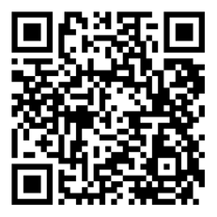
BREATHE TRAINING
“BREATHE REFRESHER”
USE THE QR CODE
to take the
POST- ASSESSMENT
Notes:
KEY POINT: All participants need to complete a post assessment.
MATERIALS NEEDED: Participants can complete the post assessment online with the QR code on this slide. This is the preferred method as it will save you time doing data entry after the training! (The slide now indicates “Breathe Refresher” so they know how to fill answer the first question regarding the type of training they attended.) To encourage compliance, you could have them indicate they are done or show you their completion screen and you could give them a handout, magnet, or other giveaway when they do. You still need to bring some printed out post assessments, preferable on a different color of paper, in case participants prefer to complete a hard copy. The Post Assessment can be downloaded from this webpage: https://justbreathein.org/staff-training/breathe-refresher/ **If you choose NOT to have participants complete the assessment online, modify this slide by removing the QR code.
VIRTUAL MODIFICATION: Participants can use another device to access the QR code on the screen and/or you can place the link in the chat box so they can complete it on the device they are using for the training. Ask participants to type DONE in the chat box to encourage compliance and assess completion. Here is the link to the post assessment: https://www.surveymonkey.com/r/PostAssess2527
SCRIPT: “Thank you for participating in today’s Breathe training! Before we wrap up, I need everyone to complete the post assessment. Once you have completed the post assessment, please bring it to me/hold it up and I will give you (a magnet, certificate of completion, or whatever handout you choose).”

Slide 60
FOLLOW UP
Will get email with certificate & links
Expect 1-Month
Post Training Survey from
JustBreatheIndiana@gmail.com
Notes:
KEY POINT: Participants can pick up Quit Now Indiana materials and should expect a follow up survey in one month.
SCRIPT: “After you complete the post assessment you can pick up Quit Now Indiana handouts/QR code flyers/supplemental Breathe materials. I’ll be sending a follow up email soon with the link to the webpage with all the digital materials as well as a certificate of completion for today’s training. Then expect an email in about a month from justbreatheindiana@gmail.com with our 1 month survey. Please complete that survey when you get it as it really helps us gain feedback to evaluate and improve the Breathe program.”

Slide 61


THANK YOU!!
Tanya Shelburne, Project Manager
tanyas@healthedpros.org
317-902-4505
Alison Muckerheide, Tobacco Control Specialist
alisonm@healthedpros.org
Notes:
KEY POINT: Share contact information.
SCRIPT/INSTRUCTIONS: (Personalize this slide with your contact information.) “Thank you so much for participating in today’s Breathe Refresher. It was my pleasure to get to see all of you again and meet the new staff. I know that working with families on this topic may not be easy, but I hope this training reinvigorated you and that you have even more ideas for how you can utilize the Breathe materials. As always, please reach out to me any time you have questions or great ideas and want to share your successes!”

Slide 62
DATA SOURCES
2023 Indiana Behavioral Risk Factor Surveillance System (BRFSS)
www.in.gov/health/tpc/
www.cdc.gov/tobacco/
www.cancer.org/cancer/risk-prevention/tobacco
For a more detailed list of data sources used
to create Breathe materials go to
justbreathein.org/additional-resources/data-sources/
Notes:
KEY POINT: Share basic data sources and where they can find more.
SCRIPT/INSTRUCTIONS: (You can just leave this slide up for people to see or refer to it if anyone asks about the source of information you shared.)

