Slide 1




CALL A FRIEND
LIFELINE
Notes:
KEY POINT: Review the structure for how to play Who wants to be a millionaire.
MATERIALS NEEDED: Dry erase board and markers or newsprint to keep the score on. The Who Wants to be a Millionaire cheat sheet so you know which answers to reveal, which can be found here: https://justbreathein.org/for-partners/
VIRTUAL MODIFICATION: Participants will play as individuals and enter their guesses in the chat box. Provide commentary as the guesses come in and use the honor system by instructing participants to keep track of how many answers they get correct. At the end you can ask them to type how much money they earned ($100,000 per right answer) in the chat box…and then declare them all millionaires in your book. And remind them you are grant funded and therefore don’t have a million dollars to give away!
SCRIPT: “ Who wants to be a Millionaire? I sure do! Today we are going to play a modified version of Who wants to be a millionaire! So as a group decide who will be your team’s spokesperson. I want you to work together as a group to decide on a final answer, but I will only take the final answer from the spokesperson. There are 10 questions, each worth $100,000. Now some of these questions can be kind of tricky, but you do have ONE “call a friend” option and ONE ”lifeline”. Call a friend means you can “call” me (you the presenter) for help (and you can use the cheat sheet!). For the lifeline option you can literally use your lifeline, *cough* your phone and google the answer!”
INSTRUCTIONS: Use your cheesiest Game Show voice and divide the participants into two groups. Ask them to pick a leader/spokesperson. If you want, ask for a volunteer to record the score on paper or a dry erase board. Go through the questions in order 1 through 10 until all question are completed. After each answer is revealed, another slide provides additional commentary that will help you continue the conversation on that topic. At the end of the game add up how much “money” they have won to see if they are millionaires. Congratulate them on doing a good job and acknowledge some of the questions were difficult, but hopefully we all walk away with a good review or learned something new.

Slide 2
CALL A FRIEND
LIFELINE
$ 100,000
1. Which communities are directly targeted by Big Tobacco companies?
Youth & Women
People of Color & LGBTQ+
A
B
Low Income Households/Communities
All of the above
C
D
Notes:
Read the question and answer choices aloud. Periodically remind participants they can use a lifeline, if they haven’t already and seem to be struggling.

Slide 3
$ 100,000
1. Which communities are directly targeted by Big Tobacco companies?
Youth & Women
People of Color & LGBTQ+
A
B
Low Income Households
All of the above
C
D
Notes:
Read the correct answer out loud.

Slide 4
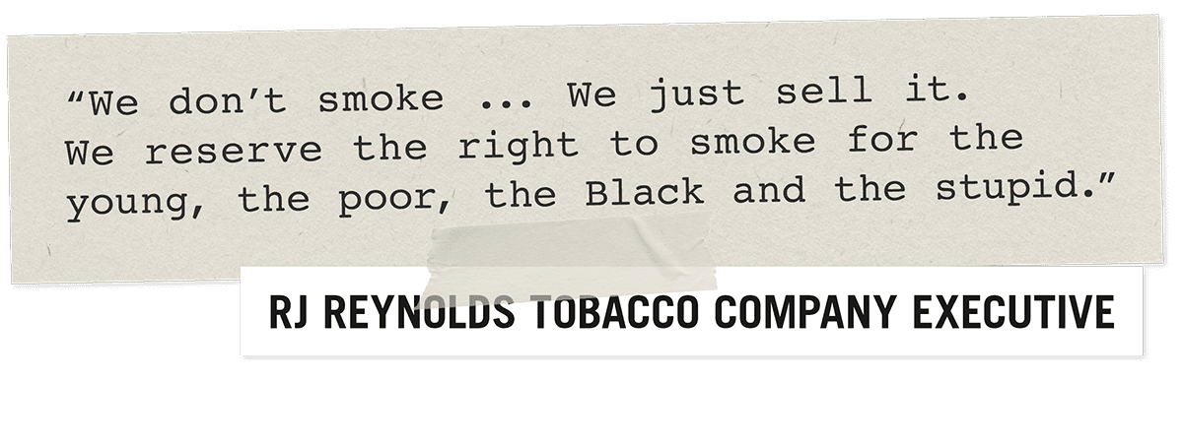
The tobacco industry aggressively markets to historically marginalized groups and this creates many health inequities.
Notes:
KEY POINT: Big Tobacco targets marginalized communities.
SCRIPT: “*Read the quote out loud* “This was an actual quote from back in the day that was in the documents seized from Big Tobacco. These companies know the product they are promoting is extremely harmful and they deliberately and aggressively market their products to various marginalized groups, thereby creating more health inequities.”

Slide 5
CALL A FRIEND
LIFELINE
$ 100,000
2. What level of smoke/vapor exposure is considered safe during pregnancy?
Personally smoking/vaping
Being around someone else who smokes/vapes
A
B
C
Being in a house/car where someone smoked/vaped previously
D
No smoke or vapor exposure is safe during pregnancy
Notes:
Read the question and answer choices aloud. Periodically remind participants they can use a lifeline, if they haven’t already and seem to be struggling.

Slide 6
$ 100,000
2. What level of smoke/vapor exposure is considered safe during pregnancy?
Personally smoking/vaping
Being around someone else who smokes/vapes
A
B
C
Being in a house/car where someone smoked /vaped previously
D
No smoke or vapor exposure is safe during pregnancy
Notes:
Read the correct answer out loud.

Slide 7
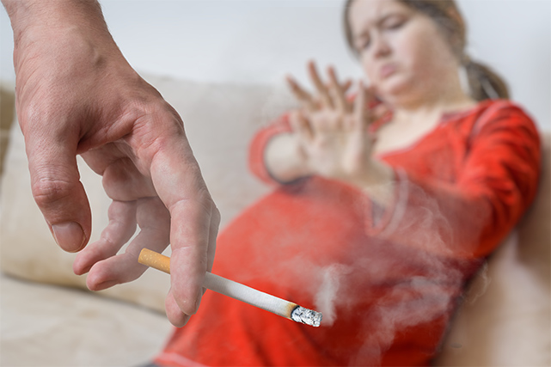
Use of tobacco/vape products and second/thirdhand smoke negatively impacts the person who is pregnant and their unborn child.
Notes:
KEY POINT: There is no safe amount of smoking or vaping that is recommended during pregnancy.
SCRIPT: “Obviously we don’t want someone who is pregnant directly using tobacco and vape products, but we also know second & thirdhand smoke/vapor can harm the pregnant person and the development of the baby. Also, smoking & vaping has the ability to impact every phase of reproduction. If someone is trying to become pregnant, smoking & vaping could also cause problems with fertility.”

Slide 8
CALL A FRIEND
LIFELINE
$ 100,000
3. What does an E-cigarette emit?
Water Vapor
Gasoline
A
B
Aerosol
Harmless Flavorings
C
D
Notes:
Read the question and answer choices aloud. Periodically remind participants they can use a lifeline, if they haven’t already and seem to be struggling.

Slide 9
$ 100,000
3. What does an E-cigarette emit?
Water Vapor
Gasoline
A
B
Aerosol
Harmless Flavorings
C
D
Notes:
Read the correct answer out loud.

Slide 10
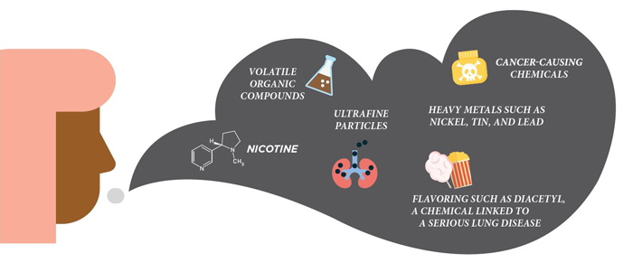
The CDC has stated that e-cigarette aerosol is not harmless “water vapor”!
Notes:
KEY POINT: E-cigarettes are not considered harmless water vapor.
SCRIPT: “Many people think when someone vapes they they are just inhaling water vapor with flavors, but E-cigarettes contain many harmful substances including nicotine, ultrafine particles that can be inhaled deep into the lungs, like heavy metals, and cancer-causing chemicals. Think of inhaling a can of hairspray, that is more comparable to vaping!”

Slide 11
$ 100,000
4. E-cigarette companies primarily target which group of people with candy/fruit flavorings?
People who smoke traditional cigarettes
Athletes
A
B
Senior Citizens
Youth
C
D
Notes:
Read the correct answer out loud.

Slide 12
$ 100,000
4. E-cigarette companies primarily target which group of people with candy/fruit flavorings?
People who smoke traditional cigarettes
Athletes
A
B
Senior Citizens
Youth
C
D
Notes:
Read the correct answer out loud.

Slide 13
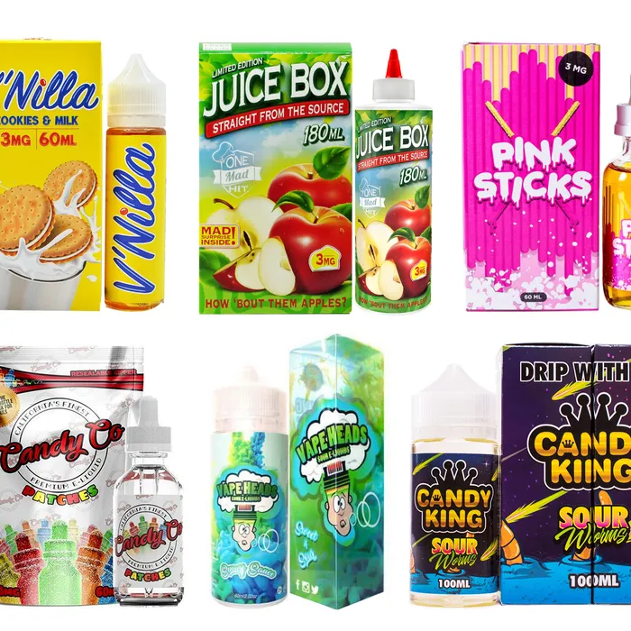
Companies sell
e-cigarettes in thousands of unique flavors, including candy and fruit flavors that appeal to youth. The majority of youth who begin vaping start with flavored products.
Notes:
KEY POINT: There are thousands of e-liquid flavors out there that attract youth users.
SCRIPT: “There are thousands of flavors being produced ranging from fruit medley to cookies and even unicorn poop! All of these candy and fun flavored products are targeting our youth. Realistically, grandpa is not going to one day decide to pick up a starburst flavored e-cigarette and create a new habit, but our youth might. Big tobacco companies know once they get our adolescents addicted, they will have life-long customers.”

Slide 14
CALL A FRIEND
LIFELINE
$ 100,000
5. Which is an example of ‘Point of Sale’ marketing of tobacco products?
Brightly colored ads on storefronts and gas pumps
In store coupons & deals
A
B
Placing advertisements by candy
All of the above
C
D
Notes:
Read the question and answer choices aloud. Periodically remind participants they can use a lifeline, if they haven’t already and seem to be struggling.

Slide 15
CALL A FRIEND
LIFELINE
$ 100,000
5. Which is an example of ‘Point of Sale’ marketing of tobacco products?
Brightly colored ads on storefronts and gas pumps
In store coupons & deals
A
B
Placing advertisements by candy
All of the above
C
D
Notes:
Read the correct answer out loud.

Slide 16
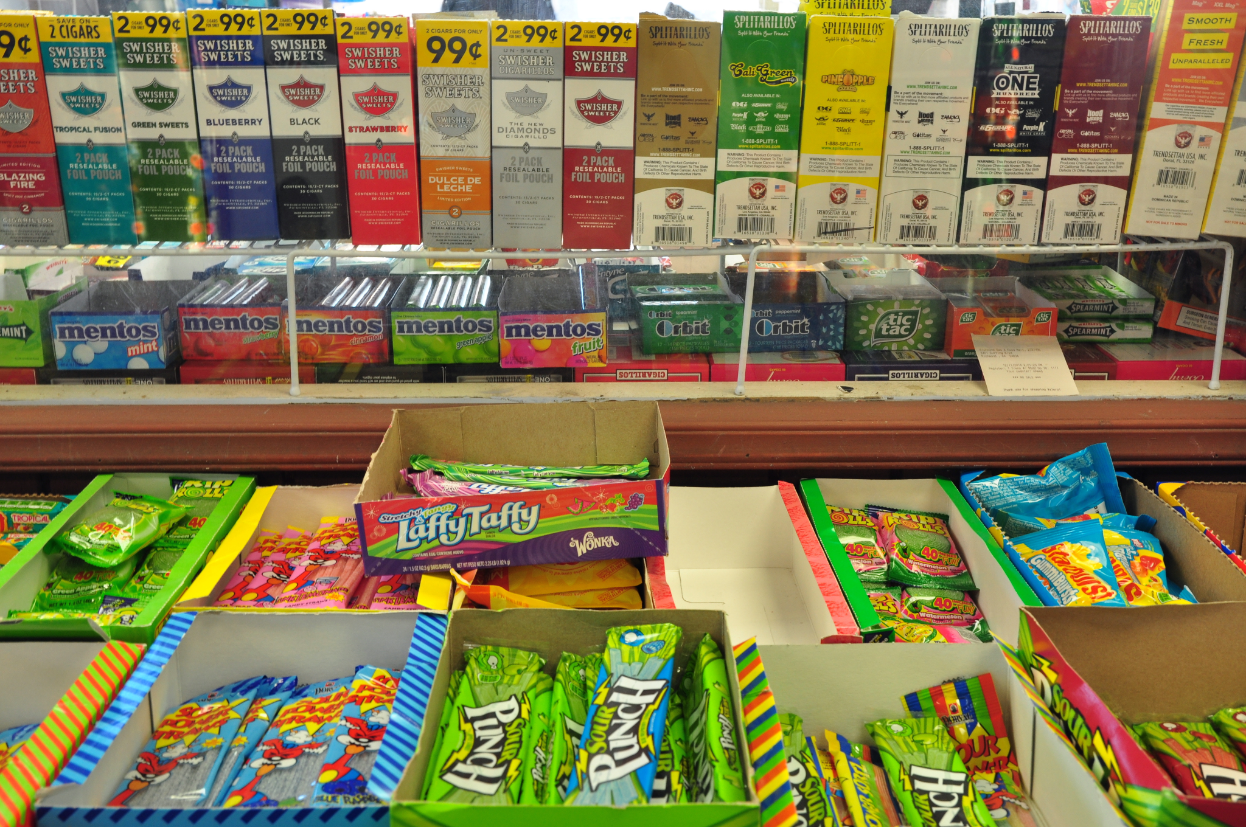
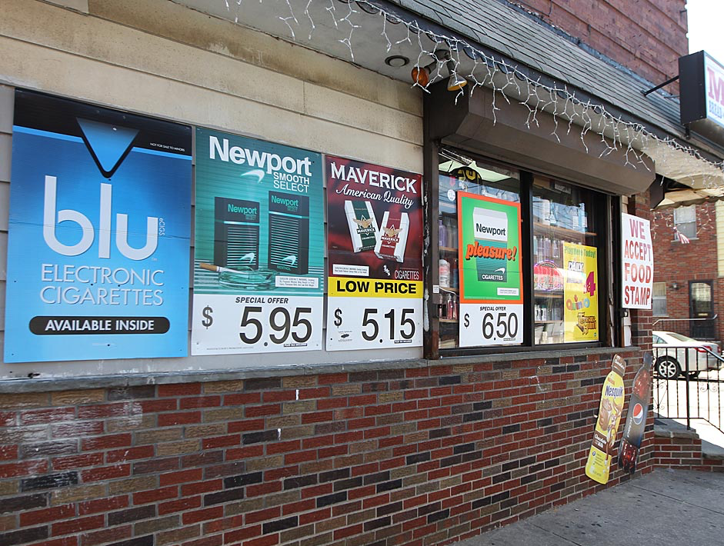

Notes:
KEY POINT: Point of Sale includes marketing tactics used by Big Tobacco to obtain new customers.
SCRIPT: “Point of Sale advertising exposes marginalized populations, including youth, to pro-tobacco/vape messages & creates positive attitudes toward tobacco / vaping products and brands. So tactics used to attract customers include placing ads by candy and other items that attract children, or splattering multiple advertisements across businesses , or offering cost saving coupons and discounts. These tactics also make it harder for people who are trying to quit tobacco.”

Slide 17
CALL A FRIEND
LIFELINE
$ 100,000
6. When is it safe to use marijuana?
While Pregnant
While Breastfeeding
A
B
Around Children
None of the above
C
D
Notes:
Read the question and answer choices aloud. Periodically remind participants they can use a lifeline, if they haven’t already and seem to be struggling.

Slide 18
$ 100,000
6. When is it safe to use marijuana?
While Pregnant
While Breastfeeding
A
B
Around Children
None of the above
C
D
Notes:
Read the correct answer out loud.

Slide 19
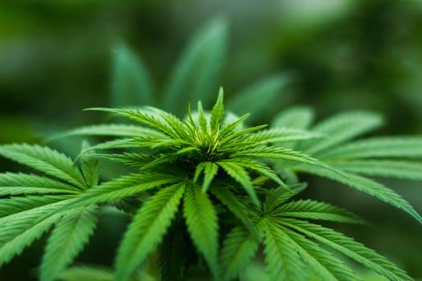
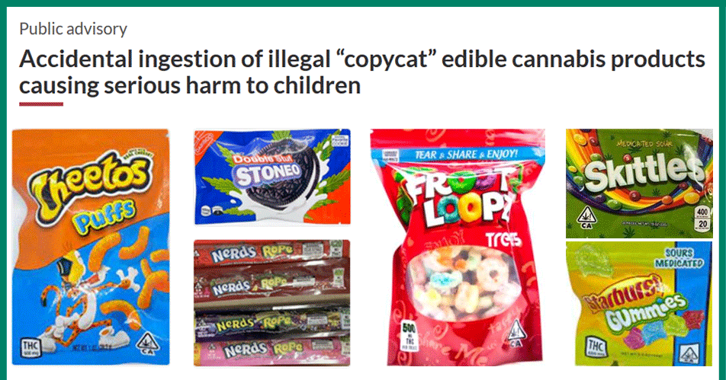
It’s common to hear people say marijuana is safe because they feel it is “natural.” There are many plants found in nature that are not safe for children or pregnant people to be exposed to and marijuana is one of them.
Notes:
KEY POINT: Marijuana is not safe while pregnant or breastfeeding or around children.
SCRIPT: “It is important to make sure families understand the dangers of marijuana when it comes to pregnancy and young children. So not smoking marijuana while pregnant or breast feeding and keeping any products with THC away from little ones is a critical message we want to share.”

Slide 20
CALL A FRIEND
LIFELINE
$ 100,000
7. What percentage of Hoosier youth are exposed to secondhand smoke in cars/homes?
10%
25%
A
B
50%
75%
C
D
Notes:
Read the question and answer choices aloud. Periodically remind participants they can use a lifeline, if they haven’t already and seem to be struggling.

Slide 21
$ 100,000
7. What percentage of Hoosier youth are exposed to secondhand smoke in cars/homes?
10%
25%
A
B
50%
75%
C
D
Notes:
Read the correct answer out loud.

Slide 22
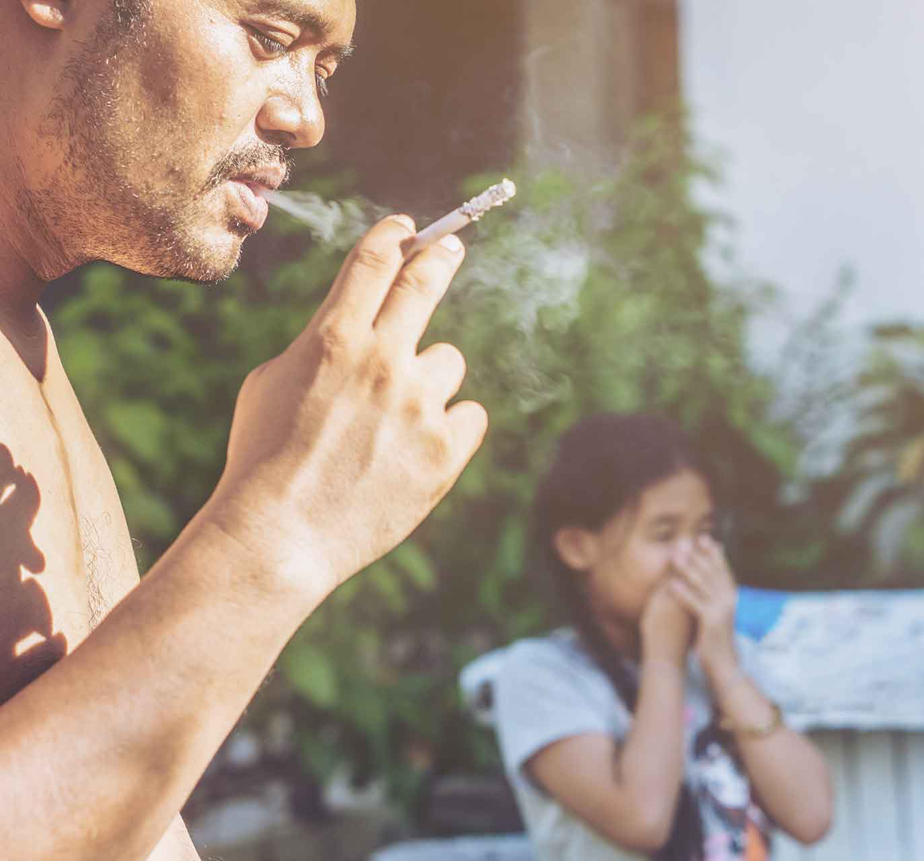
…and if a Hoosier youth lives with someone who smokes their chances of being exposed to secondhand smoke in the home/car greatly increases.
Notes:
KEY POINT: The number of youth exposed to secondhand/thirdhand smoke has come down, but we want it lower.
SCRIPT: “The rate is likely even higher among people of color, those who live in multi-unit housing and in families with low incomes. Breathe is all about making sure we keep kiddos safe and healthy. Even if someone isn’t ready to quit, find ways to protect children from second and thirdhand smoke/vapor should be a top priority.”

Slide 23
CALL A FRIEND
LIFELINE
$ 100,000
8. Individuals who reported exposure to 5 or more Adverse Childhood Experiences-ACES (traumatic events before age 18) were ___ times as likely to start smoking at an early age.
2
3
A
B
4
5
C
D
Notes:
Read the question and answer choices aloud. Periodically remind participants they can use a lifeline, if they haven’t already and seem to be struggling.

Slide 24
$ 100,000
8. Individuals who reported exposure to 5 or more Adverse Childhood Experiences-ACES (traumatic events before age 18) were ___ times as likely to start smoking at an early age.
2
3
A
B
4
5
C
D
Notes:
Read the correct answer out loud.

Slide 25
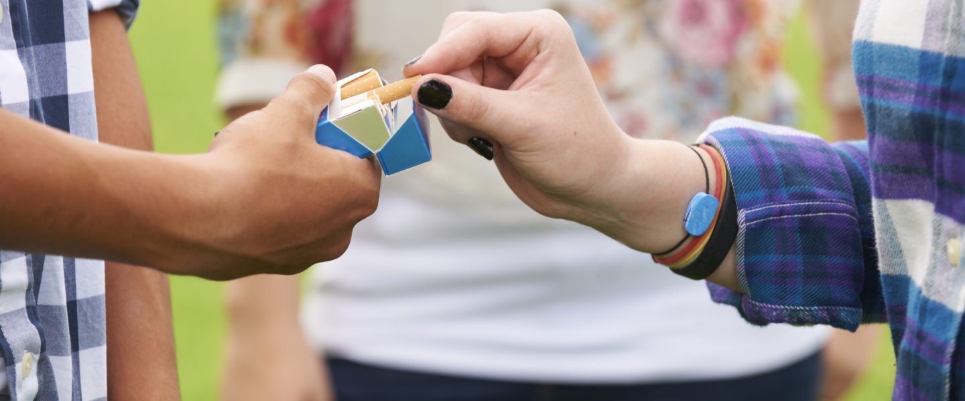
…And if someone has 5 or more ACEs and already smokes they are MORE likely to smoke heavily.
Notes:
KEY POINT: People with 5 or more aces are more likely to be start smoking and smoke heavily.
SCRIPT: “You may not have heard of ACEs, but when children are exposed to various traumatic things, it can have lasting negative effects on health, wellbeing, and opportunity. These kiddos need extra help to set themselves up for success and a healthy future and to protect them from the burden of tobacco.”

Slide 26
CALL A FRIEND
LIFELINE
$ 100,000
9. What are the financial costs of smoking/vaping?
Cost of Tobacco & Vaping Products
Missed days of work
A
B
Medical Bills
All of the above
C
D
Notes:
Read the question and answer choices aloud. Periodically remind participants they can use a lifeline, if they haven’t already and seem to be struggling.

Slide 27
CALL A FRIEND
LIFELINE
$ 100,000
9. What are the financial costs of smoking / vaping?
Cost of Tobacco & Vaping Products
Missed days of work
A
B
Medical Bills
All of the above
C
D
Notes:
Read the correct answer out loud.

Slide 28
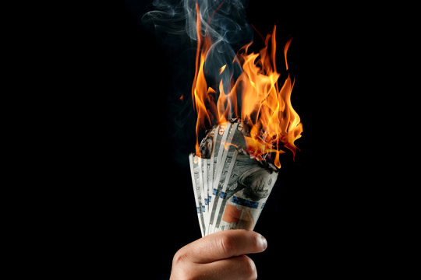
Smoking & vaping have many financial, social, and health costs for the person who smokes/vapes
and their family.
Notes:
KEY POINT: Smoking/Vaping costs money, and so much more!
SCRIPT: “We think about the cost of the actual products most of the time, but the cost of smoking & vaping is more than just the amount someone spends on tobacco products. Tobacco/Vape use also leads to loss of wages from missed time at work and extra medical bills for the tobacco user or family members who suffer from smoking related illnesses such as asthma, bronchitis, etc.”

Slide 29
CALL A FRIEND
LIFELINE
$ 100,000
10. Which organization helps provide FREE tobacco cessation resources and 24/7 support?
Stop it Indiana
Quit Now Indiana
A
B
Smoke Free Indiana
Fresh Air Indiana
C
D
Notes:
Read the question and answer choices aloud. Periodically remind participants they can use a lifeline, if they haven’t already and seem to be struggling.

Slide 30
$ 100,000
10. Which organization helps provide FREE tobacco cessation resources and 24/7 support?
Stop it Indiana
Quit Now Indiana
A
B
Smoke Free Indiana
Fresh Air Indiana
C
D
Notes:
Read the correct answer out loud.

Slide 31

Quit Now Indiana is the
FREE frontline tool for helping Hoosiers who use tobacco break their addiction.
Support those who are ready to quit by referring them to Quit Now Indiana!
Notes:
KEY POINT: Quit Now Indiana is new and improved.
SCRIPT: “If you are someone you know is ready to quit tobacco, Quit Now Indiana is a fabulous resource. Quit Now Indiana is free and available 24/7. People can call, text, go online or use the app to access services in whatever way works best for them. A trained quit coach will help them create a customized quit plan. Free Nicotine Replacement Therapies, including the patch and gum, are provided for free, as available. Quit Now Indiana has a dedicated number for those who speak Spanish and other language services are available as well as TTY capabilities for those who are deaf or hard of hearing.”

Slide 32
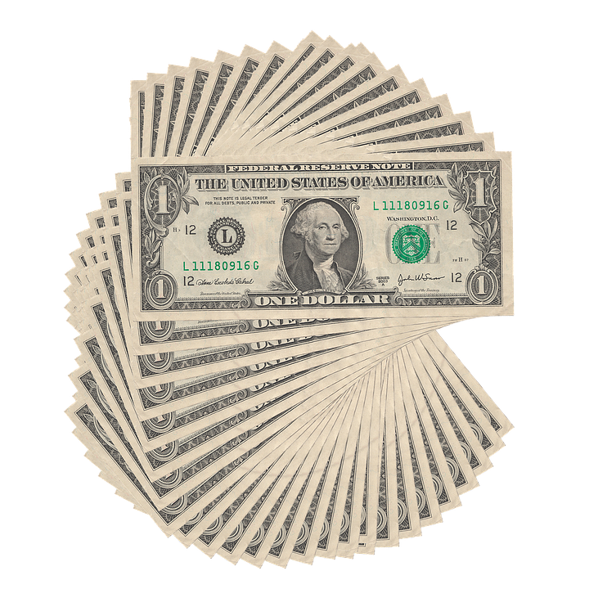
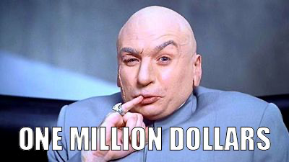
So… are you a millionaire?
Thanks for playing!
Notes:
KEY POINT: Acknowledge how much everyone knows about tobacco.
SCRIPT/INSTRUCTIONS: (Add up how much money they have won and congratulate them on their hard work. Quickly discuss with them how the game went and do not forget to give them a big shout out for playing.) “You guys did an awesome job and I hope you learned a lot and had fun too! I really wish I had $1,000,000 to hand out today, but we are a non-profit organization so you will have to settle for a round of applause! But everyone of you is worth a million bucks in my book! Thanks for playing Who Wants t be a Millionaire!”

