Slide 1



Advanced Train the Trainer Session
YOUR HEALTH ED PROS TEAM
Tanya Shelburne MPH, CHES
Alison Muckerheide MPH, CHES
Type name, county,
& email in chatbox!

Slide 2





Guidelines for Virtual Training
Training is being recorded
Video on; Mute when not speaking
Rename yourself, if necessary
Name, county, and email in chatbox
Stay for entire training - Drawing at the end!
Interact!!! (chat box, unmute)
Notify Alison if you have issues

Slide 3

Connection Before Content
No one cares how much you know,
until they know how much you care.
- Theodore Roosevelt

Slide 4
WOULD YOU
RATHER?

Slide 5
WOULD YOU RATHER?
Vacation at the beach or in the mountains?
Spend the day reading or shopping?
Drink Coke products or Pepsi products?
Have someone clean your home or cook your meals?
Be able to travel back in time or into the future?
Win a lifetime supply of ice cream or chips?
Wear a swimsuit in winter or
a snowsuit in summer?

Slide 6
WOULD YOU RATHER?
Sit through this training
OR
be locked in a box with
10 poisonous snakes?

Slide 7
How Breathe Savvy
Are You?

Slide 8
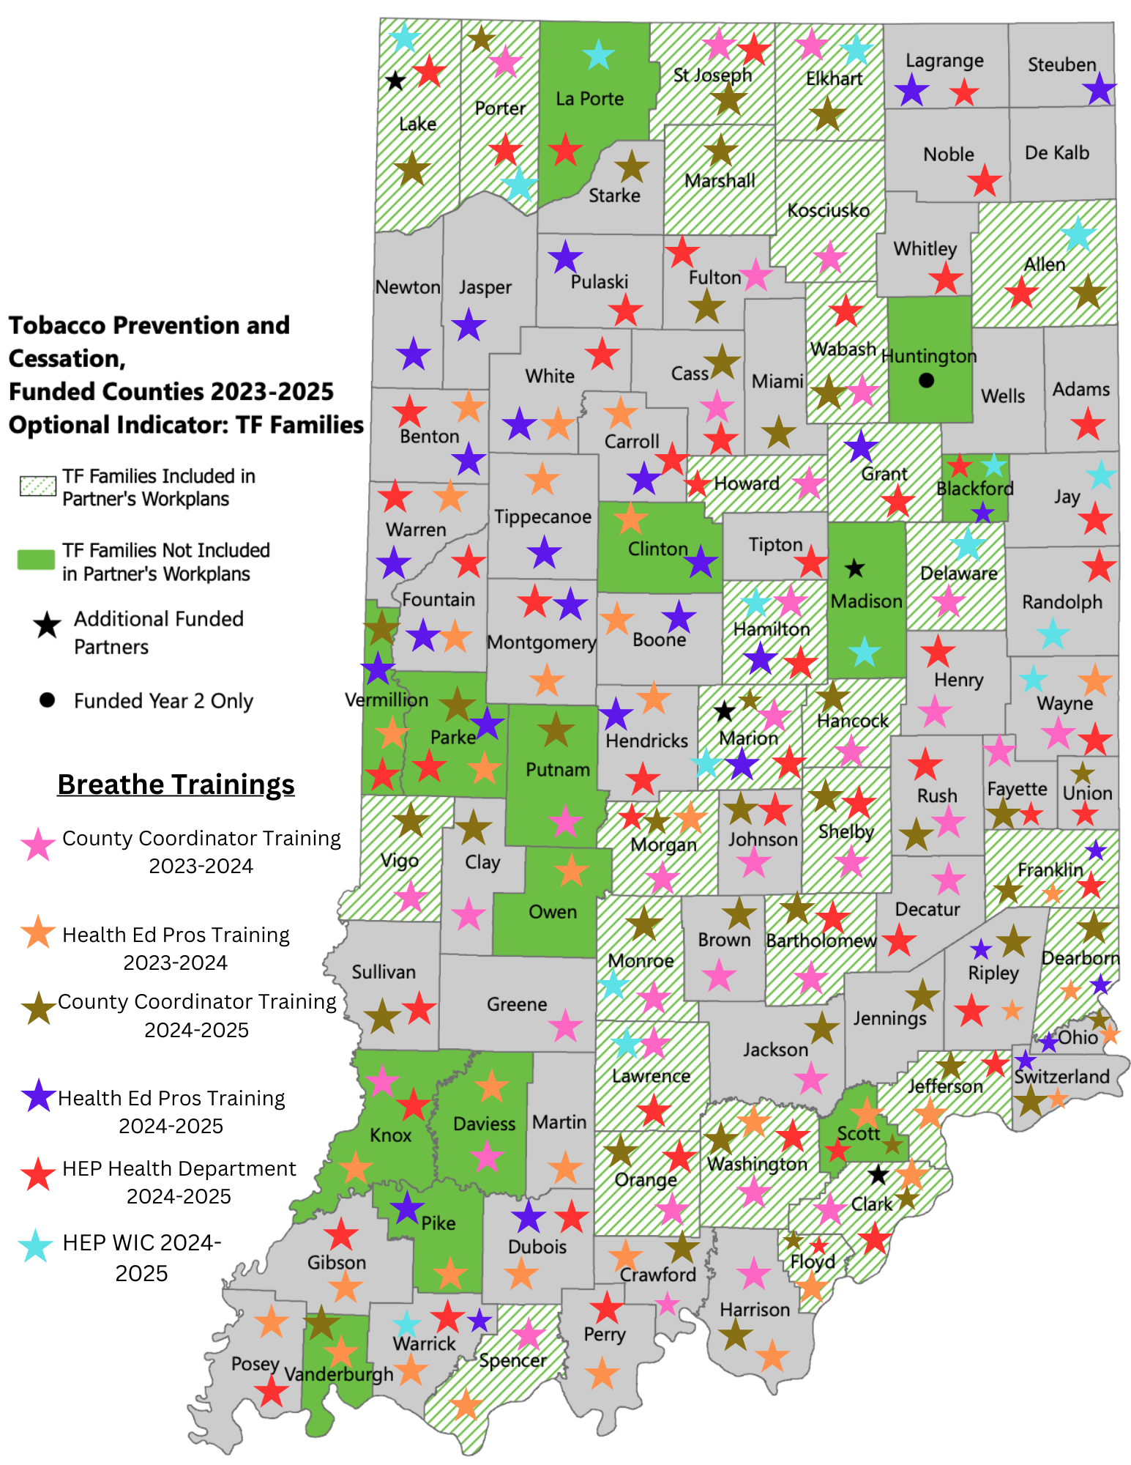
2023-2025 Breathe Stats
85 Breathe trainings!
(25 Breathe Refreshers, 3 teasers, & 9 parent presentations) Trained 1,607 people in 89 of the 92 counties!
99.1% would recommend Breathe Training!
Those who felt prepared to discuss tobacco/smoking with parents went from 58.1% before training to 94.2% after training

Slide 9
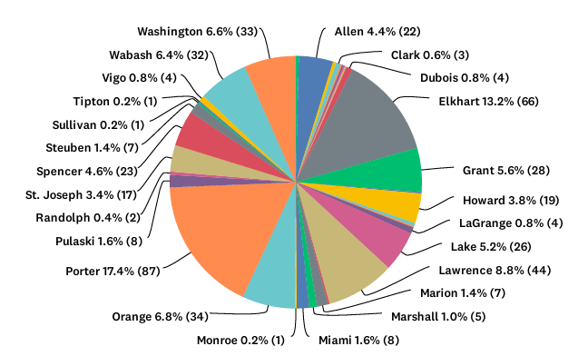
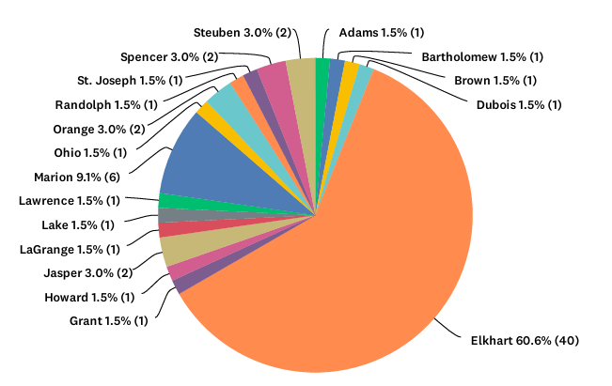











Parent Surveys
570 Parent Surveys completed representing 31 counties!
<< English Surveys
Thanks for all your hard work!
Spanish Surveys >>

Slide 10
What’s STAYING THE SAME ?
HEP Providing Technical Assistance & Evaluation Support
www.justbreathein.org Your Go-To Source for Info
Complete Breathe Training Notification Form for ALL Breathe presentations (Initial, Refresher, Teaser, & Parent–gets star on the map!)
Breathe Facebook Group - Timely Updates & Ideas
Breathe Updates on SharePoint
The Foundation of Breathe still Annual Staff Trainings
Monthly E-Newsletter
TONS of Great Breathe Materials for Trained Partners
FOR PARTNERS Webpage for Your Breathe Partners

Slide 11

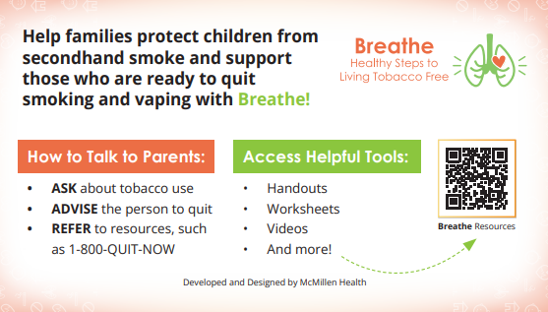
TOOLS TO ACCESS WEBSITE
QR Code Flyer
Pocket Guide

Slide 12
What’s Been UPDATED?
Head Start Map and Contact Info; Letters of Support
All PowerPoints - Connection Before Content & TR Quote
- Big Tobacco section spaced out, new pics
- Stats - Smokeless, added Zyn
- Other forms of marijuana - updated cost ($11)
- Some new questions in games (and cheat sheets)
- QR codes - Order of slides
Pre/Post Assessments
- Removed marijuana-now it’s smoking, vaping, SHS/THS
One Month Follow Ups
- Added option to complete phone survey

Slide 13
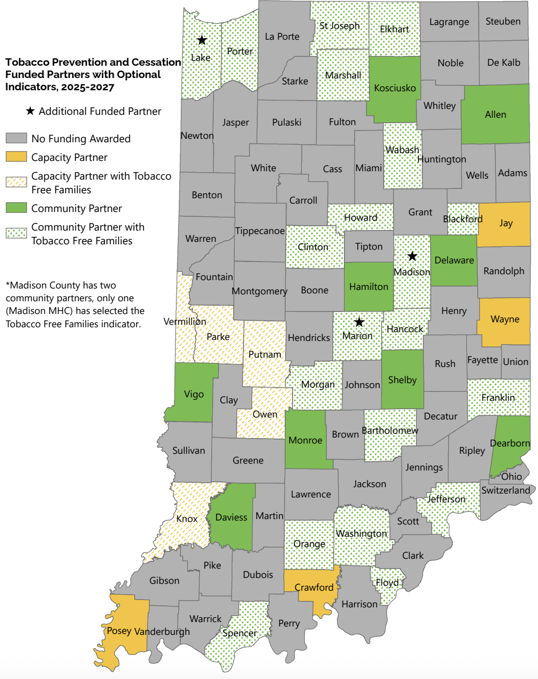
What’s NEW with Breathe?
Data reports for 2023-2025
Alison! alisonm@healthedpros.org
Some new County Coordinators & a new map
Data sources webpage
3rd Deliverable - Utilize Breathe materials for promotion & education outside formal trainings
Games now available for Breathe Partners!
Quarter Sheet flyers

Slide 14

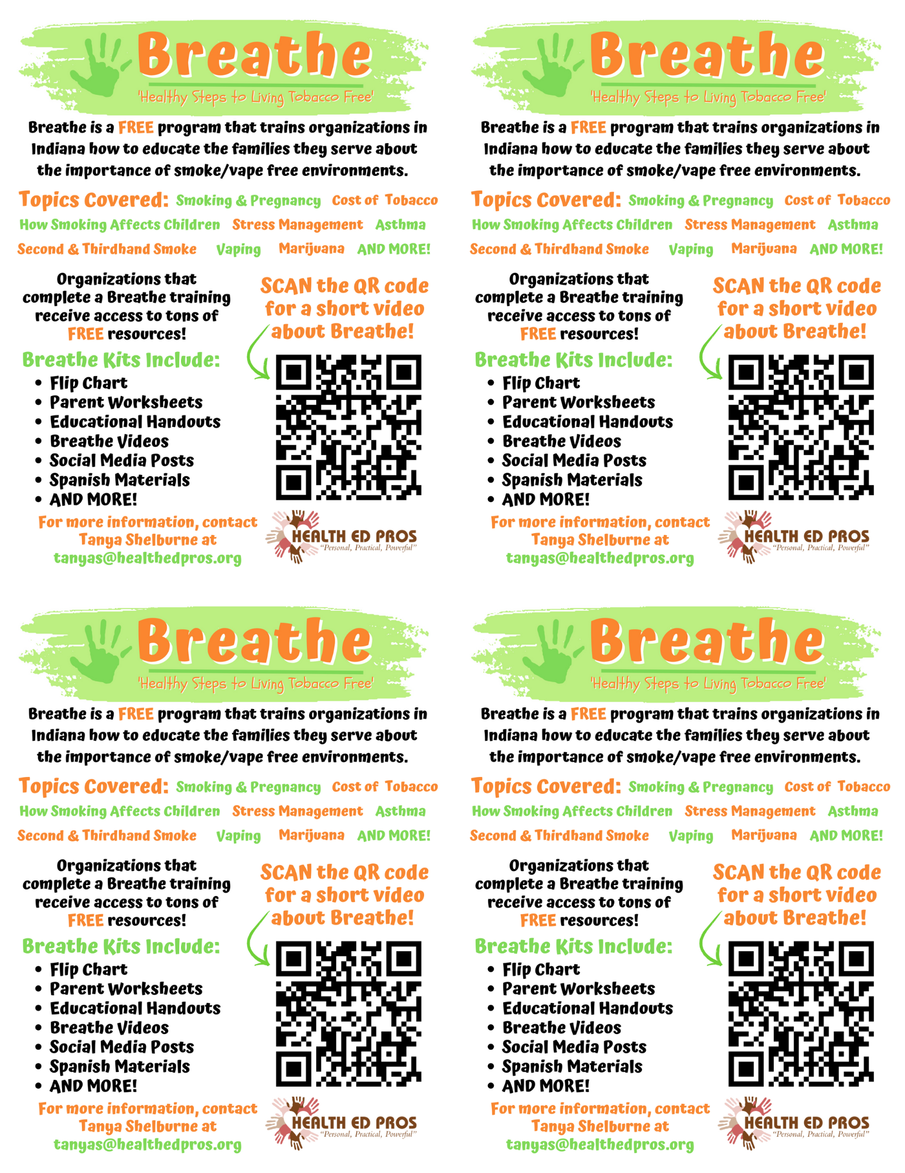
Contact Alison to personalize flyers!

Slide 15
What’s COMING SOON?
Recordings of Advanced/Beginner Breathe Train the Trainer sessions for Funded Partners
Newsletter in Spanish, starting in October! Thanks LHO!
More Breathe materials in Spanish
4th Refresher Option – Trivia
Phasing out hard copies of Parent & Children’s Activities booklets (physical kits will include bag, flipchart, flyer, & magnet)
Updated Parent Presentation
More robust parent evaluation: surveys w/logic, focus groups, etc.
BRAND NEW!!!! FOR PARENTS section on website!!
Finish website cleanup

Slide 16
Sharing Time!
How have you used Breathe with families/parents directly?

Slide 17
QUESTIONS??

Slide 18
NEXT STEPS
Confused? Overwhelmed?
Is there someone else in your agency that should be trained on Breathe?
Register for the Beginner Breathe Train the Trainer
for Funded Partners webinar
on September 19, 10:00-11:30am (EST)!
https://www.surveymonkey.com/r/BreatheTrainTheTrainer2025

Slide 19
NEXT STEPS
Review the website: justbreathein.org - look for NEW!! & (updated)
Familiarize yourself with the updated PowerPoints
Start reaching out to existing Breathe Partners and identifying new ones
Email alisonm@healthedpros.org if you would like personalized Breathe Flyers – include name & email you want on the flyer
Share feedback & any errors you find with us!!

Slide 20


THANK YOU!!
Tanya Shelburne, Project Manager
tanyas@healthedpros.org
317-902-4505
Alison Muckerheide, Tobacco Control Specialist
alisonm@healthedpros.org

