Slide 1



Beginner Train the Trainer Session
YOUR HEALTH ED PROS TEAM
Tanya Shelburne MPH, CHES
Alison Muckerheide MPH, CHES
Type name, county,
& email in chatbox!

Slide 2





Guidelines for Virtual Training
Training is being recorded
Video on; Mute when not speaking
Rename yourself, if necessary
Name, county, and email in chatbox
Stay for entire training - Drawing at the end!
Interact!!! (chat box, unmute)
Notify Alison if you have issues

Slide 3

Connection Before Content
No one cares how much you know,
until they know how much you care.
- Theodore Roosevelt
Notes:
KEY POINT: Connect with participants before you get into the training content.
SCRIPT: “We will get to discussing tobacco in just a bit, but I think it is important that we focus on “Connection Before Content”. This quote from Theodore Roosevelt really sums up why Connection Before Content is important and serves as the basis for why we designed the Breathe program the way we did. He said ‘No one cares how much you know, until they know how much your care.’ Hopefully as we get to know each other a little better you will see that I have a heart for protecting children and families and supporting the staff who serve them! And we know all of you have a heart for the families you serve and that they know and trust you. That’s why we focus on training staff at Head Start and other organizations rather than going directly to the parents ourselves. So let’s connect a bit with an ice breaker”

Slide 4
TIME TO DE-STRESS!
What worries are weighing on you?
What are healthy ways you like to de-stress?
How does this relate to tobacco?
Notes:
KEY POINT: Help everyone reduce their stress level.
MATERIALS NEEDED: Each participant needs two blank half sheets of paper and something to write with, and you may want print outs of the stress management parent handout found here: https://justbreathein.org/additional-resources/breathe-kit-materials/
VIRTUAL MODIFICATION: Have participants write their stressors down, rip them up, and then write down their healthy ways to de-stress just as you would in person. Then ask them to share examples of their de-stressing activities in the chat box. Read the responses aloud and provide validation.
SCRIPT/INSTRUCTIONS: “Chances are each of you came into this training with lots of things on your mind…long to-do lists, work related stress, challenges in your home life…and now you have to sit through an hour-long training! I take no offense to the fact that some of you may wish you were somewhere else right now! But I hope that we can all make the best use of this hour so you can leave here with more knowledge and some ideas for how to better support your families. First, I want us all to set the right mood by taking a few moments to be mindful and de-stress with a short activity. Not only can this exercise help all of us right now, but it is something you can replicate with the children and families you serve as I’m betting they could also benefit from de-stressing!
(CLICK TO BRING UP WHAT WORRIES ARE WEIGHING ON YOU?) First, take a moment to “check-in” with yourself by writing down a few worries or things that are weighing on your mind right now. You won’t be asked to share what you write down, this is just for you! (Give them 1 minute to write down their worries) Now that you have written down what is stressing you, I want you to rip up those sheets into tiny pieces and toss them in the trash can. (Walk around with the trash can to collect the paper scraps) With this activity I am encouraging you to let those worries and stressors go…just Let It Go at least for the next hour so you can have better focus and feel a bit lighter even if just for a while. I’ll resist the urge to sing the Frozen theme song, but I do hope you can all Let It Go!
(CLICK TO BRING UP WHAT ARE HEALHY WAYS YOU LIKE TO DE-STRESS?) Next, I want everyone to write down on another slip of paper a few healthy ways you like to de-stress. (Give them a minute or two to write down their ways to de-stress) Would anyone like to share some of their tactics for de-stressing? (Let several people share examples.) Not everyone’s list will look the same and that’s ok! The idea of going for a really long run sounds like torture to me, but for someone else that is exactly what they need to clear their mind and release tension! The most important thing is that we each have some healthy go-to options for when the worries and responsibilities of life get to be a bit much. (If people share somewhat unhealthy habits like drinking wine, eating chocolate, etc, acknowledge that for most people those things, in moderation, can be reasonable ways to de-stress.)
(CLICK TO BRING UP HOW DOES THIS RELATED TO TOBACCO?) So you may be thinking, what the heck does any of this have to do with Breathe and learning about tobacco? I’m so glad you asked! For many stressed out people, smoking or vaping might have been on their list of de-stressing activities…it we weren’t focusing on HEALTHY stress management. While many people who use tobacco think of it as a stress reliever, it can be a vicious cycle that actually creates more stress. From the added expense, health problems, lingering odor, physical dependence, and more…tobacco use just adds unnecessary stress and more worries. By helping your families deal with stress in a healthy way you can help pave the way for tobacco free families. Even though we can’t do all the de-stressing activities on your lists right now, I hope you will all take time for a bubble bath or a long walk of some other kind of self-care that appeals to you this evening!”

Slide 5
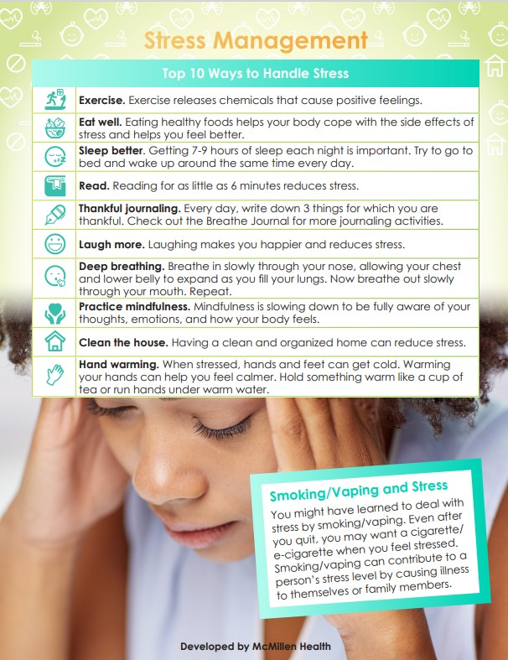
STRESS MANAGEMENT HANDOUT
The Breathe toolkit has
TONS of free materials, including this handout on Stress Management!
Notes:
KEY POINT: Remind participants they have access to lots of free resources, including the Stress Management handout.
MATERIALS NEEDED: You can provide copies of the Stress Management handout, if you choose.
SCRIPT/INSTRUCTIONS: “And I want to remind everyone that as a Breathe partner you have access to TONS of Breathe materials online, including this Stress Management handout. So if you find that parents are experiencing lots of stress and that might be contributing to tobacco use, this could be a very helpful handout. A little bit later I’ll remind you of all the Breathe materials available to you as a Breathe partner and how to access them.”

Slide 6

BREATHE PROMO VIDEO

Slide 7
A QUICK LOOK BACK
Partnering with Head Start >12 years
Higher rate of tobacco use among people with low incomes
Health Ed Pros became STATEWIDE partner 8 years ago
“Breathe: Healthy Steps to Living Tobacco Free” developed 6 years ago with McMillen Health
Expanded beyond Head Start
Added tons of new resources
History varies greatly by county!
Contact RD, HEP, or previous coordinator to learn your county’s history

Slide 8
TERMINOLOGY CLARIFICATION
TPC – Tobacco Prevention & Cessation Commission
IDOH – Indiana Department of Health
HEP – Health Ed Pros (That’s Tanya & Alison!)
TFF – Tobacco Free Families (grant indicator for Breathe!)
Funded Partners – (That’s You!) Organizations receiving TPC funds
Breathe Partners – The organizations you recruit & train
Train the Trainer – What you are experiencing right now!
Breathe Trainings – The trainings you (and HEP) will deliver to staff at organizations

Slide 9
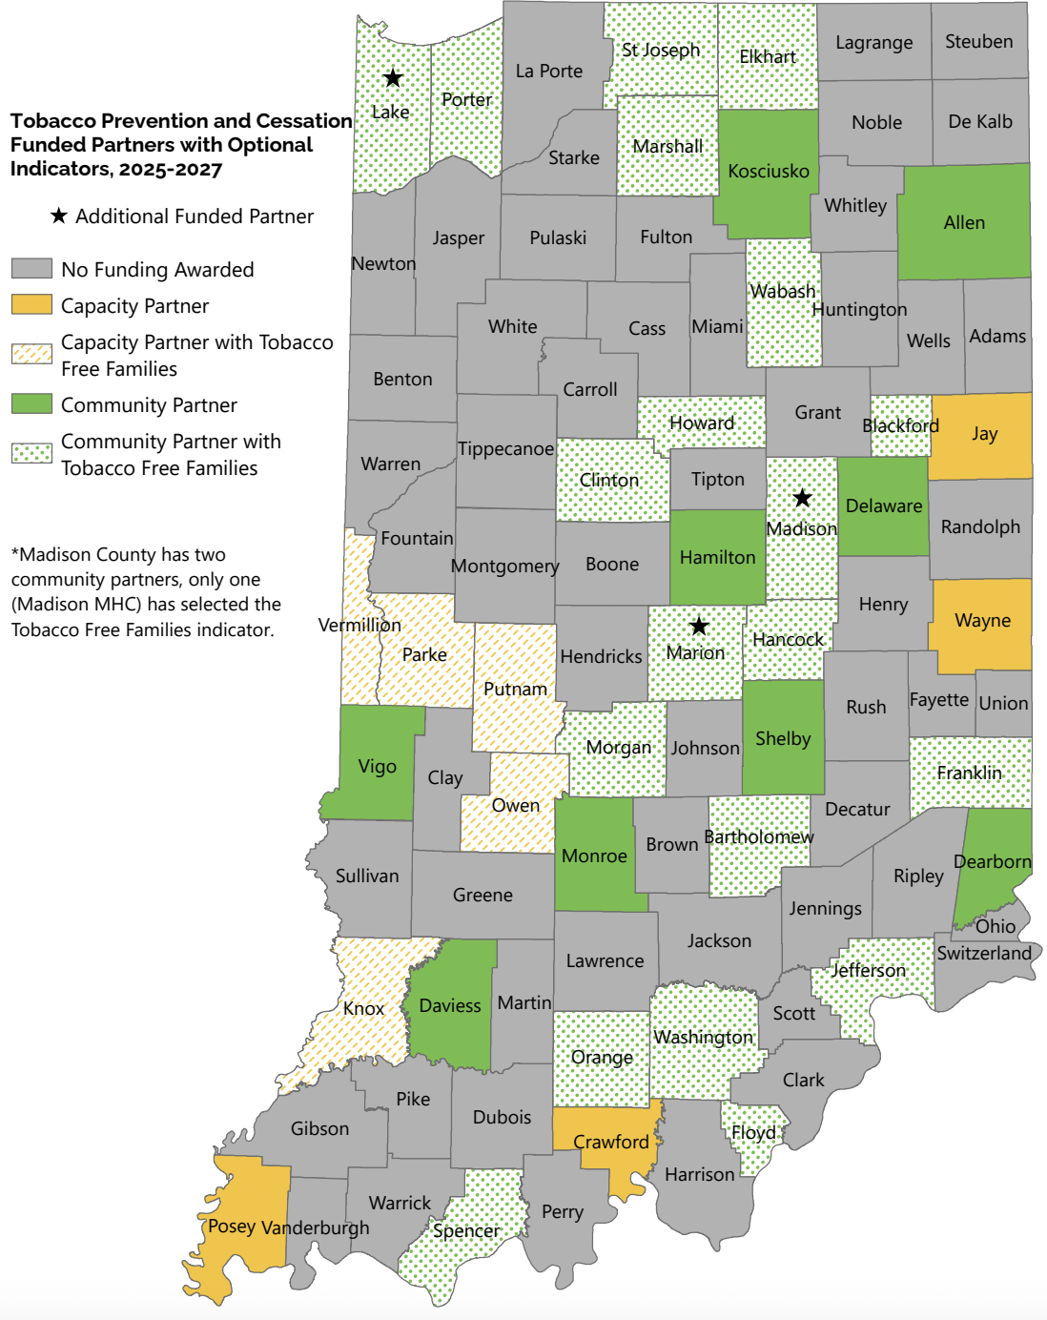
FUNDED PARTNERS - TFF
Tobacco Free Families/ Breathe (used interchangeably!) Indicator was optional this grant cycle
Collaboration with HEP & Neighboring Counties is Encouraged!

Slide 10
TFF INDICATOR & HEP’S ROLE
Priority Area: Protect and maintain a state and local infrastructure necessary to lower commercial tobacco use rates.
Tobacco-Free Families – Increase proportion of organizations serving populations most impacted by tobacco with the “Breathe: Healthy Steps to Living Tobacco Free” education program.
HEP’s Deliverables:
Provide training & technical assistance for Funded Partners
Provide training/on-going support to implement Breathe with Head Start & Alternate Partners in counties not funded by TPC & counties that did not select the TFF indicator
Assist in the development/improvement of Breathe resources & training materials
Serve as liaison between TPC & state-level Head Start leadership

Slide 11
YOUR TFF DELIVERABLES
Implement Breathe in at least one new Head Start Center/ Alternate Organization serving families most impacted in your county (participating in annual Breathe training for trainers, following timeline provided in online toolkit, conducting relational meetings, collecting evaluation data, conducting Breathe training for staff of the organization, providing appropriate resources to organization’s staff and families, offering on-going support) DUE: JUNE 30, 2026; JUNE 30, 2027
Maintain Breathe in at least one existing Head Start Center/ Alternate Organization serving marginalized families in your county (similar to above, but conducting a Breathe Refresher for the staff of the organization) DUE: JUNE 30, 2026*; JUNE 30, 2027
Utilize Breathe materials for promotion and education outside formal trainings. DUE: Report as needed
*may look different for new/existing funded partners

Slide 12

POTENTIAL BREATHE PARTNERS
Any organizations serving
families with low incomes!

Slide 13
The Foundation of Breathe is…
The Annual Training for Your Breathe Partners!

Slide 14
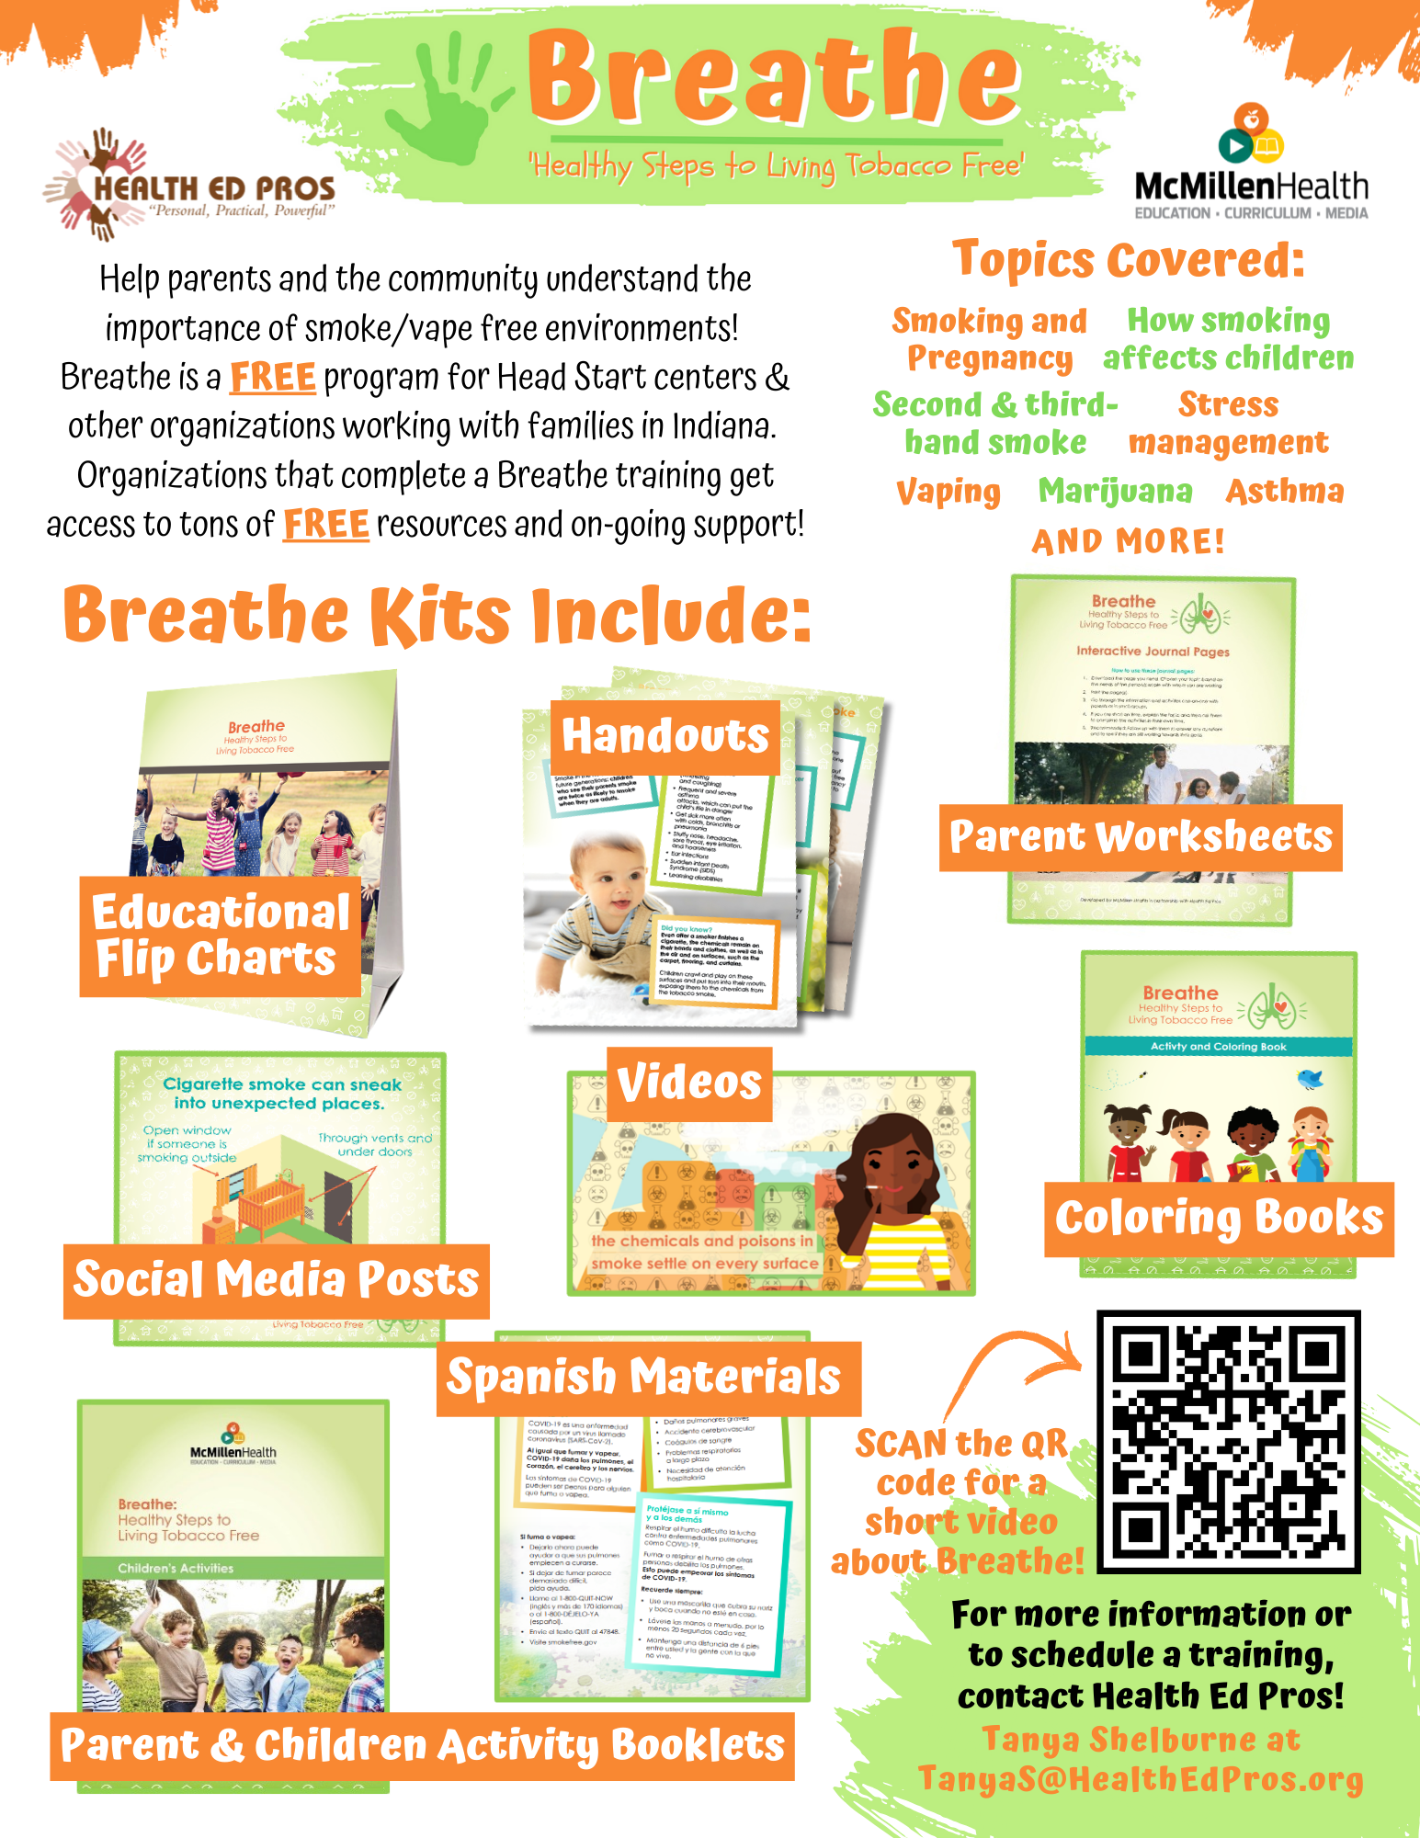
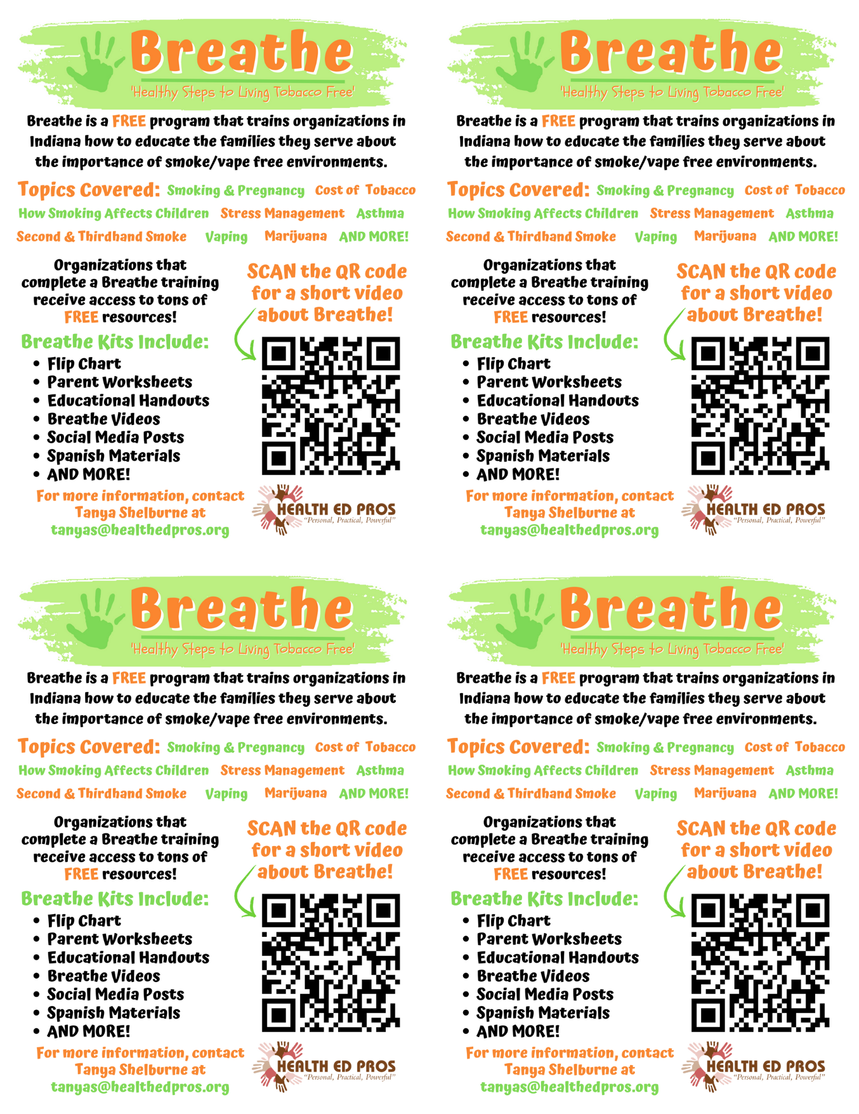
Contact Alison to personalize flyers!

Slide 15
TFF TIMELINE
Sept-Dec
Relationship Building/Recruit Breathe Partners
Sept-March
Conduct Trainings
October-June
On-going Support & Enhanced Activities
April-June
Wrap-up, Acknowledgements, & Plan for Next Year
Repeat in Year 2!

Slide 16
ENHANCED ACTIVITIES
Initiate Memorandum of Understanding (MOU)
Review/Advise partner’s tobacco policy
Review/Advise partner’s health assessment forms
Provide Community and/or Student Education
Serve on partner’s committee
Sign partner up as a QUIT NOW INDIANA Champion Employer
Develop relationships with additional partners

Slide 17
BREATHE SUPPORT
www.justbreathein.org - Go-To Source for Breathe Info!
Health Ed Pros Provides Technical Assistance & Evaluation Support
Breathe Updates on SharePoint
Breathe Facebook Group - Timely Updates #TipTuesday
Regional Directors
Other County Coordinators

Slide 18
BREATHE WEBSITE
www.justbreathein.org
GO HERE FIRST!!! The Breathe website is PRIMARILY for Funded Partners
If you have been around a bit…Look for NEW!! & (updated)
All your instructions for implementing Breathe
All Breathe kit materials available for download
FOR PARTNERS Webpage is for Your Breathe Partners
COMING SOON…FOR PARENTS WEBPAGE!!

Slide 19
Review the
Breathe Website
justbreathein.org

Slide 20
THERE’S A SURVEY FOR THAT!
BEFORE A TRAINING (2 weeks):
Breathe Training Notification Form (in Survey Monkey)
Order kits
Puts training on our master calendar
Allows us to complete evaluation
AFTER A TRAINING:
Breathe Sign-In Sheet Submission (in Survey Monkey) – Sign-in Sheet, Captures Newsletter Interest – Type Up & Save as Word doc, NOT PDF – Upload Word Version (in Survey Monkey)

Slide 21
POWERPOINTS
Initial Breathe Training (90-120 minutes, receive kits!)
4 Interchangeable Breathe Refreshers (60 minutes) – Breathe Refresher with Jeopardy – Breathe Refresher with Family Feud – Breathe Refresher with Who Wants to be a Millionaire
- COMING SOON: Breathe Refresher with Trivia!
Breathe Teaser (30 minutes, no physical kits!)
Breathe Parent/Caregiver Presentation (45-60 minutes)
Always check date on PowerPoint to make sure you
have the most recent version!

Slide 22
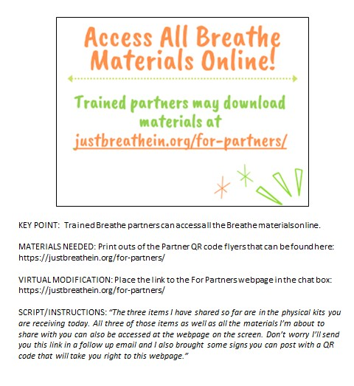
POWERPOINT NOTES
Notes Sections:
Key Point
Script/Instructions
Materials Needed
Virtual Modification

Slide 23
INITIAL BREATHE TRAINING
LOTS of Information! (90-120 minutes)
Review Materials Near Beginning
Suggest Specific Materials Throughout
Myth Busting
Interaction…Scenarios & Activities
Post-it Note Activity

Slide 24
BREATHE REFRESHERS
Same format:
Icebreaker
Game
Review Breathe kit
Activity to assess how Breathe is being used and generate new ideas

Slide 25
EVALUATION
All Trainings put on our Master Calendar once Breathe Training Notification is submitted
Pre & Post Assessments
Hard Copy with Data Entry OR Online Using QR Codes
1 Month Follow Ups
Give Heads Up at Training
Sign in Sheet Submitted Through Link
HEP Initiates Survey, Reminds County Coordinator
Reports from HEP
Share with Partner, Optional
Parent Evaluation…working on new strategies, stay tuned!

Slide 26
Breathe Materials
Let’s review all the materials you have access to!
Notes:
KEY POINT: Remind participants that they have access to lot of Breathe materials online.
VIRTUAL MODIFICATION: Place the link to the For Partners webpage in the chat box: https://justbreathein.org/for-partners/
SCRIPT/INSTRUCTIONS: “Now that we have all brushed up on our knowledge of tobacco and the importance of protecting children from second and thirdhand smoke, I want to remind you about all the Breathe resources you have access to that can aid in educating and supporting the families you work with. Hopefully you know where your Breathe kits are stored, but if not, talk to your leadership to find out and let me know if you need any replacement items. If you are new or haven’t used some of the Breathe materials yet I hope this refresher will get your wheels spinning as you think about which materials would work best depending on your specific job and how you may interact with families and young children.”

Slide 27




FOR PARENTS/CAREGIVERS
Flip
Chart
Activities Booklet
Worksheets
Handouts
Notes:
KEY POINT: Review Breathe resources focused on parents/caregivers.
MATERIALS NEEDED: Sample Breathe kit; additional supplies as needed.
SCRIPT/INSTRUCTIONS: “Several of the items in the Breathe kit are specifically geared towards parents/caregivers or the adults in the household. (CLICK TO REVEAL THE LABELS AS YOU TALK ABOUT EACH BREATHE RESOURCE) The flipchart is great for one on one or small group interactions with talking points on the back of each page to guide your conversation. The parent handouts cover many different tobacco topics and can be printed or downloaded and shared electronically with all parents or with specific parents when relevant. The worksheets also provide great information on many tobacco topics but also include interactive components that help parents set goals and think through challenges of quitting or minimizing smoke/vapor exposure for their children. The activities booklet is a great tool for anyone who needs activities to do with groups of parents. There are instructions for 9 different activities that take very little prep and minimal materials and will get parents discussing a variety of tobacco related topics.

Slide 28
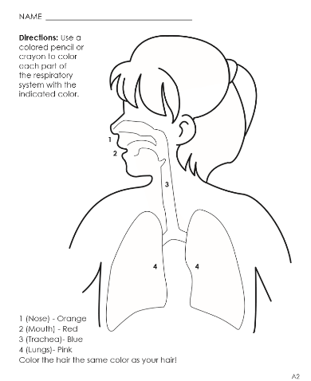


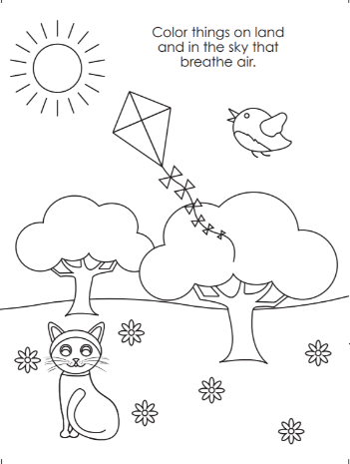
FOR YOUNG CHILDREN
Coloring Book/Sheets
Children’s Activities Booklet
Notes:
KEY POINT: Review Breathe resources focused on young children.
SCRIPT/INSTRUCTIONS: “The online Breathe kit also includes some resources that can be used directly with children. These resources are focused on healthy bodies and are not specifically tobacco focused. There are coloring sheets that can be printed or downloaded and shared electronically. There is also a Children’s Activities Booklet with 15 short activities focused on healthy bodies that work great with children ages 3-7. These activities require very little prep work or outside materials. Both of these resources are great for anyone who works directly with children and they can also be given to parents as take-home activities.”

Slide 29

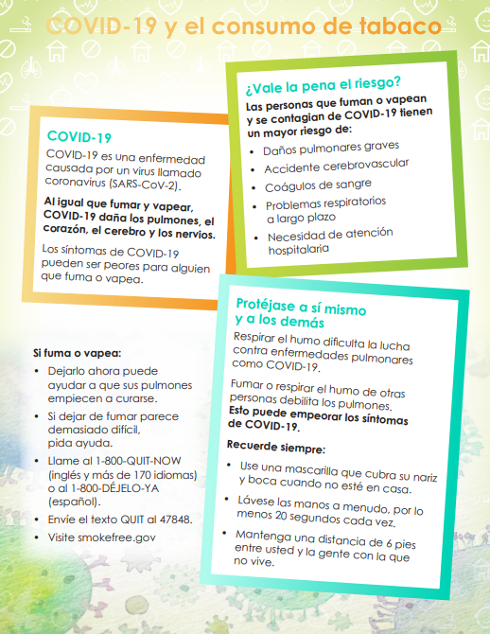

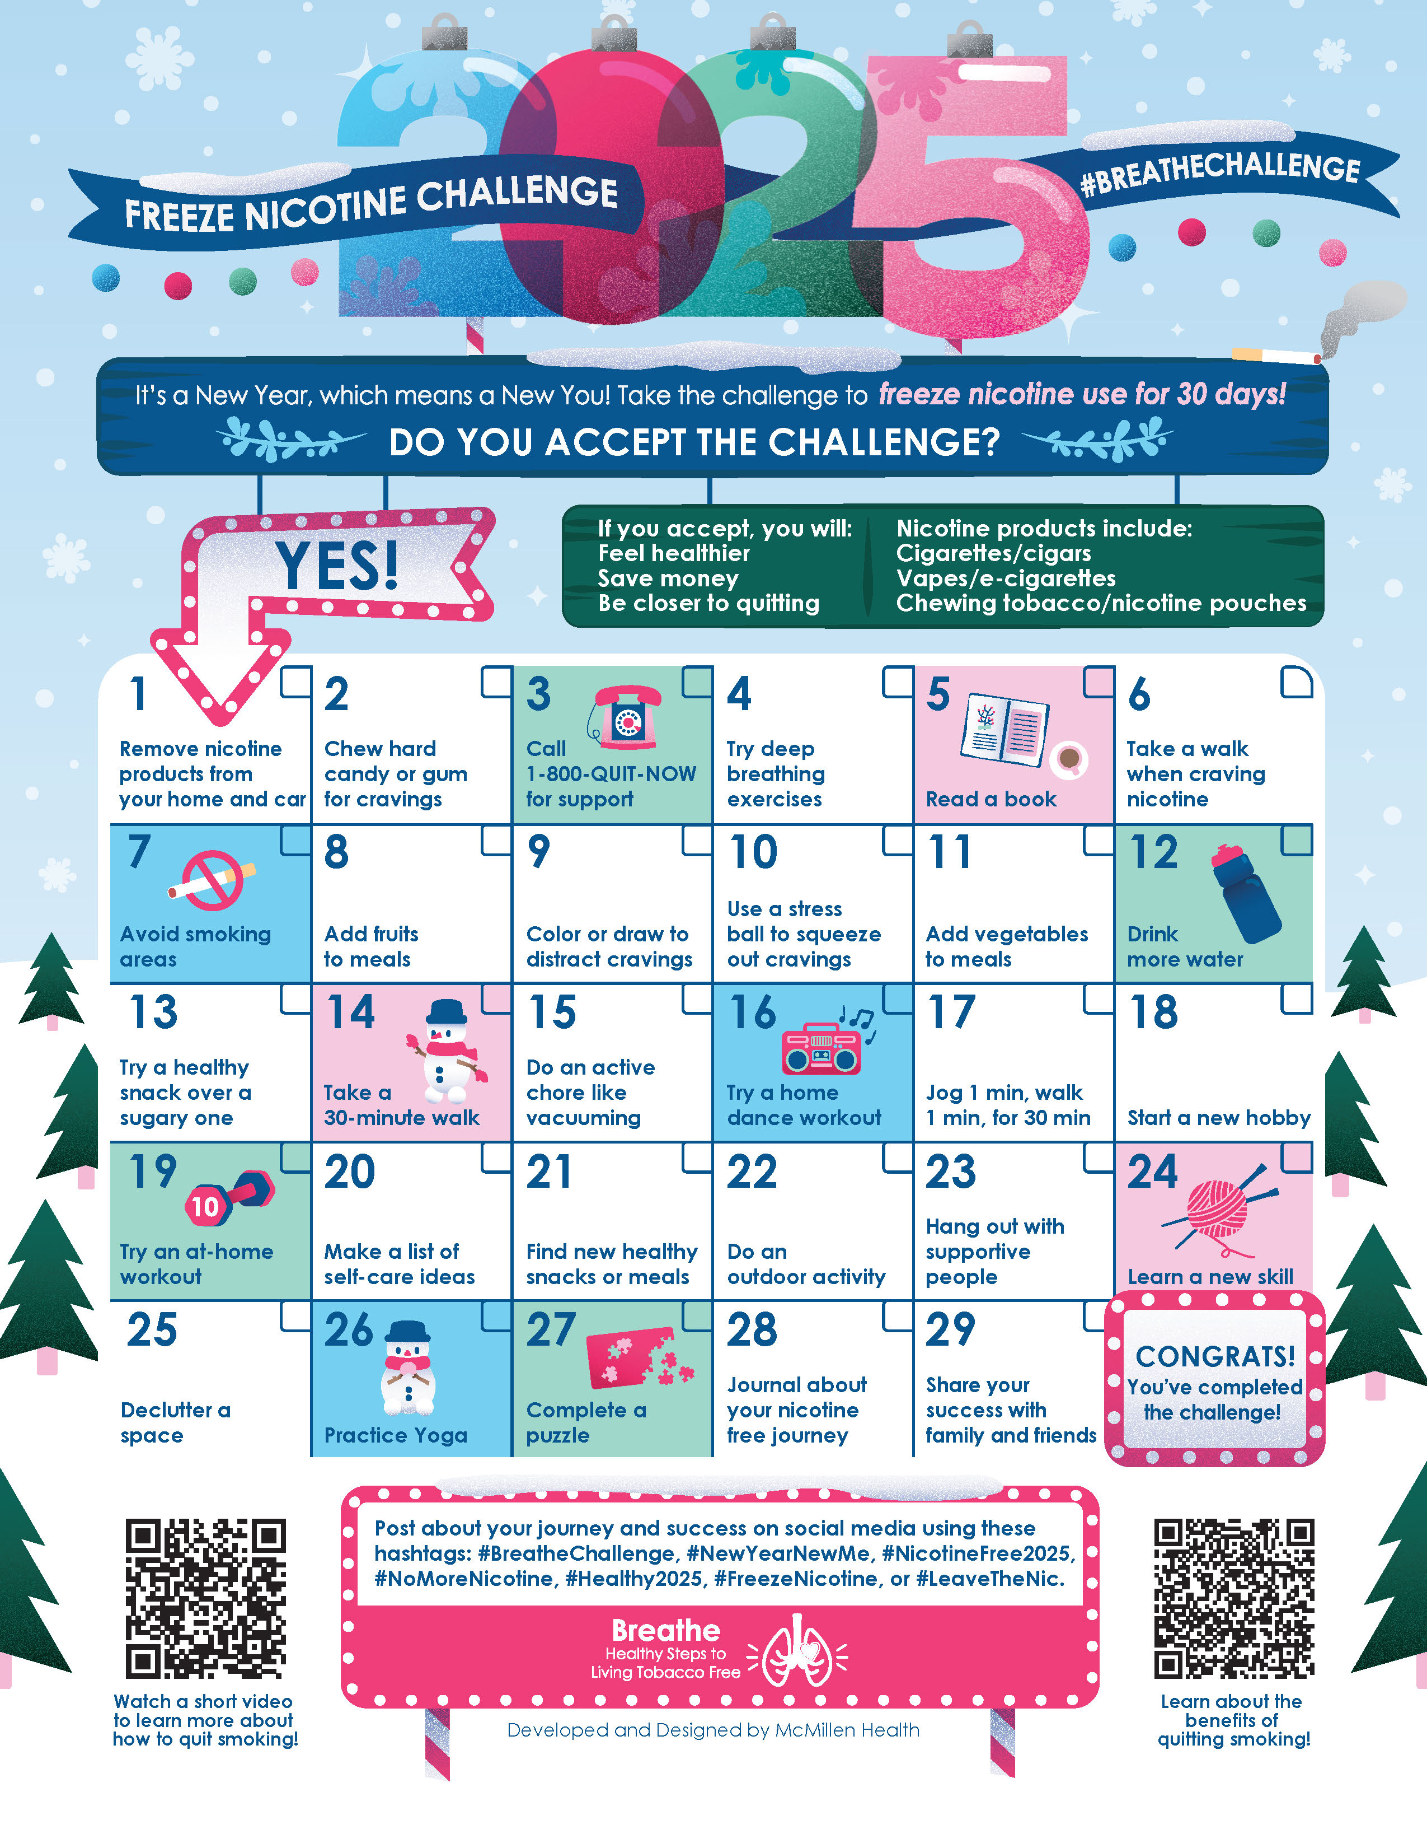
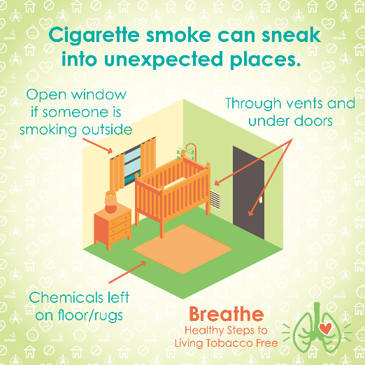
MORE RESOURCES
Spanish Materials
Short
Videos
Quarterly Challenges
Social Media Posts
Monthly
E-newsletter
Notes:
KEY POINT: Review additional Breathe resources and ways to share tobacco information.
SCRIPT: (CLICK TO REVEAL THE LABELS AS YOU TALK ABOUT EACH BREATHE RESOURCE) “And that’s not all! Many of the Breathe materials are also available in Spanish, so please access those materials if you are working with Spanish Speaking parents/caregivers. There are also lots of short videos, just 2-3 minutes each that help reinforce important tobacco related topics. Feel free to pull these up on an ipad to show to parents as appropriate or post them on your social media. Speaking of social media, the website also includes 12 ready to go graphics and accompanying text that you can post on your social media pages as a way to keep tobacco education on everyone’s radar. We also create a monthly Breathe e-newsletter that we will send directly to anyone who indicated they would like to receive it on today’s sign in sheet, if you aren’t already. We hope that you will share the newsletter by forwarding it, printing the pdf, or copying and pasting sections of it into your own organization’s newsletter. Finally, we have a new challenge each quarter that is a fun way to motivate families when it comes to quitting tobacco or minimizing exposure to second and thirdhand smoke/vapor. I hope this quick overview of the Breathe materials was a helpful refresher and that each of you can find at least one or two resources that might be useful in your current role and that you will feel comfortable sharing.”

Slide 30
Access All Breathe Materials Online!
Trained partners may download materials at
justbreathein.org/for-partners/
Physical kits include: bag, QR code flyer, flipchart, Parent & Children’s Activities booklets*
*being discontinued, magnet added
Notes:
KEY POINT: Trained Breathe partners can access all the Breathe materials online.
MATERIALS NEEDED: Print outs of the Partner QR code flyers that can be found here: https://justbreathein.org/for-partners/
VIRTUAL MODIFICATION: Place the link to the For Partners webpage in the chat box: https://justbreathein.org/for-partners/
SCRIPT/INSTRUCTIONS: “All of the Breathe materials can be accessed at the webpage on the screen. Don’t worry I’ll send you this link in a follow up email in case you don’t already have it bookmarked.”

Slide 31
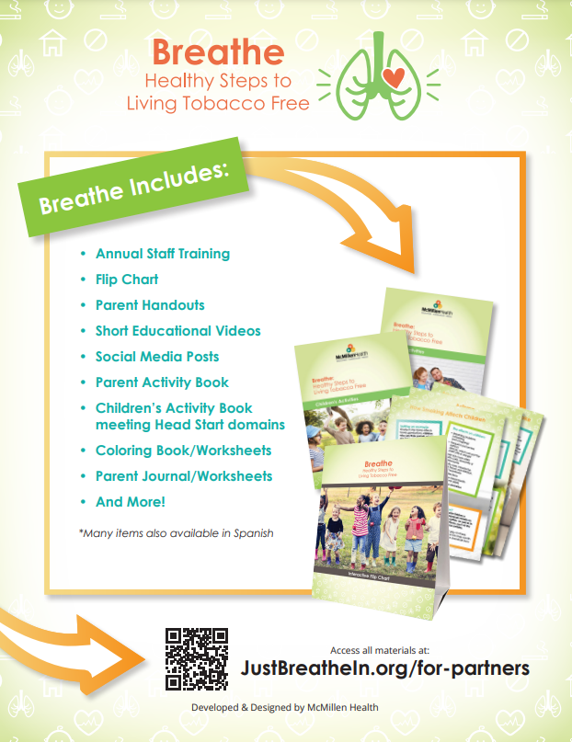
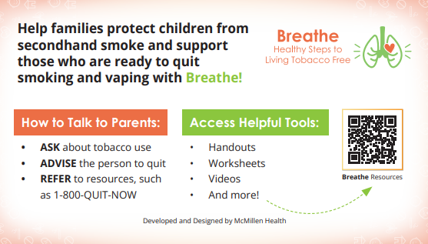
ACCESS BREATHE WEBSITE
QR Code Flyer
Pocket Guide
Notes:
KEY POINT: Share resources that will link participants to the Breathe resources online.
MATERIALS NEEDED: Optional, Print outs of the Breathe Kit QR code flyers (https://justbreathein.org/wp-content/uploads/2024/07/Breathe-Flyer-QR-Code-For-Partners.pdf) and Pocket Guides for Partners (https://justbreathein.org/wp-content/uploads/2024/09/Pocket-Fact-Sheet-Partner-w-cut-marks.pdf)
SCRIPT: “To help you remember how to access the Breathe materials, we have flyers as well as pocket guides with QR codes to the Breathe website. I printed and brought some with me today, but you can also find these resources on the website and download or print more yourself and share them with your staff.”

Slide 32
What’s COMING SOON?
Recordings of Beginner Breathe Train the Trainer sessions for Funded Partners
Newsletter in Spanish, starting in October! Thanks LHO!
More Breathe materials in Spanish
4th Refresher Option – Trivia
Phasing out hard copies of Parent & Children’s Activities booklets (physical kits will include bag, flipchart, flyer, & magnet)
More robust parent evaluation: surveys w/logic, focus groups, etc.
FOR PARENTS section on website!!
Finish website cleanup

Slide 33
QUESTIONS??

Slide 34
NEXT STEPS
After watching the recording, complete the online survey
Review the website: justbreathein.org
Familiarize yourself with the PowerPoints
Familiarize yourself with all items in the Breathe kit
physical & digital items (kits will be mailed, if needed)
Research previous/potential Breathe Partners in your county
Start reaching out to introduce yourself, recruit new Breathe Partners, schedule initial training/refresher, etc.
Email alisonm@healthedpros.org if you would like a personalized Breathe Flyer – include the name & email you want on the flyer
Share feedback & any errors you find with us!!
Need more support? Schedule a Zoom with HEP!

Slide 35


THANK YOU!!
Tanya Shelburne, Project Manager
tanyas@healthedpros.org
317-902-4505
Alison Muckerheide, Tobacco Control Specialist
alisonm@healthedpros.org

