Slide 1
BREATHE TRAINING
“BREATHE REFRESHER”
USE THE QR CODE
to take the
PRE- ASSESSMENT
Notes:
HOW TO USE THE NOTES SECTION: Each slide in this presentation has a notes section that can help you deliver the presentation.
The KEY POINT let’s you know the most important message to convey and along with the text on the screen, that may be all the guidance an experienced county coordinator/tobacco expert may need to conduct the training effectively.
If any handouts or other resources are necessary for a given slide you will see a MATERIALS NEEDED section.
If modifications are needed to share a slide or conduct an activity for a virtual training, you will see a VIRTUAL MODIFICATION section.
The SCRIPT portion of each page will give you a sample script (in italics) of what you might say for each slide as well as instructions, if needed. DO NOT READ THE SCRIPT VERBATIM! Instead, use the script to practice the presentation and then adjust it as needed to make it your own. The script is simply meant to be a guide/suggestion!
KEY POINT: All participants need to complete a pre assessment and sign the sign-in sheet.
MATERIALS NEEDED: Participants can complete the pre assessment online with the QR code on this slide. This is the preferred method as it will save you time doing data entry after the training! (The slide now indicates “Breathe Refresher” so they know how to fill answer the first question regarding the type of training they are attending.) To encourage compliance you could have them indicate they are done or show you their completion screen and you could give them a handout, magnet, or other giveaway when they do. You still need to bring copies of the sign-in sheets and some printed out pre assessments in case participants prefer to complete a hard copy. **If you choose NOT to have participants complete the assessment online, modify this slide by removing the QR code.
VIRTUAL MODIFICATION: Participants can use another device to access the QR code on the screen and/or you can place the link in the chat box so they can complete it on the device they are using for the training. You may need to keep posting the link in the chat box as people enter the training since they may not be able to see earlier chat box entries. Ask participants to type DONE in the chat box to encourage compliance and assess completion. Here is the link to the pre assessment: https://www.surveymonkey.com/r/BreathePreAssessments
SCRIPT: “Before we get started, I need everyone to complete a pre assessment. To access the survey, just open the camera in your smartphone and point it at the QR code on the screen to get the link. If you prefer to complete the assessment with pen and paper just let me know and I will bring you a hard copy. I will also be asking you to complete a post-assessment at the end of the training, and these are important parts of our evaluation so I appreciate you completing them. There are also sign-in sheets being passed around. Please make sure you put your name and contact info on one of the sign-in sheets so we will have a record of everyone’s attendance and if you want to receive our monthly Breathe E-newsletter you can indicate that on the sign in as well.”

Slide 2
HEALTH ED PROS
Tanya Shelburne MPH, CHES
Delyte Meardith BS, CHES
Notes:
KEY POINT: Participants should know your name and a bit about your background and position.
MATERIALS NEEDED: A sample Breathe kit and Quitline materials. (You can bring supplemental Breathe kit items if needed, but Breathe partners should have received kits during their Initial Breathe training.)
VIRTUAL MODIFICATION: Make plans with your site contact to deliver Quit Now Indiana materials either before or after the training to replenish their stock.
SCRIPT/INSTRUCTIONS: Personalize this slide with your information. Welcome everyone to the training, re-introduce yourself, and give a brief background on your experience, your organization, and your position. Bring materials to the training (supplemental breathe kits, Quitline materials, magnets etc.) but do not distribute them until the end of the training as some attendees will leave/not pay attention if materials are distrusted too early. “I am back to provide a refresher course as we continue our on-going relationship with your organization and work together to promote healthy families. Today, rather than sit and listen to me talk about the dangers of tobacco I want to hear from you guys. I want to see what everyone remembers about tobacco and secondhand smoke and how you have been utilizing the Breathe program and any challenges you have had addressing this topic with your families. In order to do that I need your active participation…and we would all like to have a little fun too. Right?! To get everyone warmed up let’s start with a quick game of That’s Me!”

Slide 3
GUIDESLINES FOR VIRTUAL TRAINING
Training is being recorded
Keep video on
Mute yourself when not speaking
Rename yourself, if necessary
Minimize distractions
Stay for entire training (60 minutes)
Interact!!! (pre/post assessments, chat box, unmute)
Notify co-host if you have issues
Notes:
DELETE THIS SLIDE IF CONDUCTING AN IN-PERSON TRAINING!
KEY POINT: Go over housekeeping and expectations for the training.
SCRIPT/INSTRUCTIONS: (Personalize this slide as needed.) “But before we jump into our Breathe Refresher I want to go over a few housekeeping items. I want to make sure everyone is aware that the training is being recorded and I will share a link to the recording in a follow up email in a day or two should you want to watch it again or share it with someone on staff who may have missed the training. I do ask that you keep your videos on during the training so I can see everyone’s smiling faces and it will feel a bit more like we are actually in person, but do keep yourself on mute to minimize background noise and just unmute yourself when you want to share something or ask a question. If the name on the screen is not your name, please rename yourself, which will help us with attendance and knowing who everyone is. To rename yourself put your cursor in your box on the screen and click the blue box in the upper right corner with 3 dots in it and you should see the option to rename yourself. Do your best to minimize distractions around you and I do ask that you stay for the full 60 minute training. There will be several options to interact so feel free to use the chat box or raise your hand at any time, and I hope you will interact as it is way more fun when it’s not just me talking the whole time! If you have any issues during the training feel free to message the co-host and we will try to assist.”

Slide 4
I’m a current or former Head Start parent
I have used the Breathe Children’s Activities
I have given out the Breathe Parent Handouts
I have used the Breathe videos
I have no idea what Breathe is!
I could use more help talking to parents about tobacco & secondhand smoke!
I do home visits
That’s Me!
I attended the last Breathe training
I have used the Breathe Parent Activities
I’m a Head Start Teacher or Aide
I have used the Breathe Flip Chart
I have read the monthly Breathe E-Newsletter
I am part of the Head Start leadership
I have talked to parents about tobacco
Notes:
KEY POINT: Get to know the participants with an interactive game.
VIRTUAL MODIFICATION: Instruct the participants to wave their hands, type in the chat box, or use the reaction buttons to signify if each statement applies to them and provide commentary as appropriate. If it is a small group, you may even choose to have everyone unmute and just shout out that’s me when appropriate. Given that it is hard to look at the participants and the slide as the statements appear, you can print out a cheat sheet with the statements in order here: https://justbreathein.org/additional-resources/materials/
SCRIPT/INSTRUCTIONS: “This fun game will help me learn a bit more about who is in the room today. That’s Me is a super easy game. I’ll read a statement, which will also appear on the screen. When you hear that statement if it applies to you just stand up, throw your arms in the air, and shout That’s Me! The more you agree with the statement the louder I want to hear you! Sound good? Ok, let’s go!” (Flip through each statement and read it out loud as you learn about who is in the audience. Based on the amount of space and the ability of the participants you can ask them to actually stand for each statement or just throw their hands up as they say That’s Me! For non-Head Start organizations you should personalize the first four statements to make them relevant.)

Slide 5
How much do you know/remember about tobacco?
Notes:
KEY POINT: Set the stage for this training being a refresher.
SCRIPT: “Now that I know a bit more about all of you, let’s see how much you remember from our last training. Of course if I expect you to talk to parents about tobacco use and secondhand smoke then you need to be aware of some basic information on this topic. I realize not everyone attended the previous training and you have all slept since then, so just do your best! We are going to have a little fun with this…and play Jeopardy!!! I’m guessing we may have at least a few competitive people in this group so this should be fun!”

Slide 6
LET’S PLAY JEOPARDY!!
Notes:
KEY POINT: Review the structure for how to play Jeopardy.
VIRTUAL MODIFICATION: With virtual Jeopardy everyone gets to play as individuals. Instruct participants to use the chat box to answer the questions and let them know that both speed and accuracy count. For multiple choice, tell them to just type the letter that corresponds with the correct answer into the chat box. For true or false they can just type T or F. It helps to have a co-trainer who determines who gets the correct answer in first and keeps score...or you can decide just to play for fun and not keep score. You can find a tracking sheet to help you keep score here: https://justbreathein.org/additional-resources/materials/
SCRIPT/INSTRUCTIONS: “This is a modified version of Jeopardy, played with teams. Everyone on this side of the room will be on one team and this .side will be on the other team. Decide who will be your team’s spokesperson and pick a name for your team. The team leader with the closest birthday will go first. Then we will take turns going back and forth between the two teams and you don’t have to worry about answering in the form of a question for this version of Jeopardy! (After diving the participants into two teams, ask for a volunteer or have your co-trainer record the score on newsprint or a dry erase board. After each answer is revealed, you can fill in some additional info on that particular topic and then click on the green house at the bottom of the screen to return to the list of categories/questions and alternate between teams to select and answer a question. Questions already completed will change to Orange. Or instead of clicking the house to go back to the main screen, you can just click through all the slides and go in order. Determine how much time you have to play the game and stop when that time is up and do the Final Jeopardy question. You may or may get through all the questions and that is fine.)

Slide 7
JEOPARDY
Tobacco
101
Industry
Tactics
Pregnancy/Child Health
E-cigs
Quitting
$100
$100
$100
$100
$100
$200
$200
$200
$200
$200
$300
$300
$300
$300
$300
Final Jeopardy
Notes:
KEY POINT: Review the Jeopardy Game Board.
SCRIPT/INSTRUCTIONS: “We have five categories on the game board with options for $100, $200, and $300 questions for each one. (Team one) will go first. Which question would you like?” (Click on the category and dollar amount they choose to go to that question.)

Slide 8
$100 Question Tobacco 101
True or False: Traditional Cigarette usage rates have decreased over the past 30 years.
Notes:
INSTRUCTIONS: Read the question out loud.

Slide 9
$100 Answer Tobacco 101
TRUE!
Notes:
KEY POINT: While traditional cigarette smoking has gone down there is still work to be done, especially with e-cigarettes.
SCRIPT: “That is true! There has been a lot of great progress as people have learned about the danger of smoking and laws have been put in place to restrict some forms of tobacco marketing and to protect people from secondhand smoke exposure. But there is still work to be done, and especially with the recent growth of e-cigarettes and vaping. (Team X) gets $100!”

Slide 10
$200 Question Tobacco 101
The majority of people start using tobacco before the age of?
21 years old
25 years old
30 years old
40 years old
Notes:
INSTRUCTIONS: Read the question out loud.

Slide 11
$200 Answer Tobacco 101
A) AGE OF 21
Notes:
KEY POINT: Most smokers start by the age of 21.
SCRIPT: “The answer is A. About 95% of adult smokers begin smoking before they turn 21 so that is why preventing teens and young adults from starting is so critical. (Team X) gets $200!”

Slide 12
$300 Question Tobacco 101
Infants and toddlers ingest what amount of thirdhand smoke chemicals compared to adults?
The same amount as adults
4 times more than adults
4 times less than adults
Notes:
INSTRUCTIONS: Read the question out loud.

Slide 13
$300 Answer Tobacco 101
B) 4 TIMES THE AMOUNT!
Notes:
KEY POINT: Thirdhand smoke is especially dangerous for infants and children.
SCRIPT: “The answer is B. If you remember from our last training, Thirdhand smoke includes the toxins and chemicals left behind in a room or a car when someone smokes there. Because of the way infants breathe and the size of their developing lungs they actually take in 4 times the amount of chemicals that an adult would in the same space. That is why it is critical to educate parents about thirdhand smoke and encourage them not to smoke in places where children will later be. (Team X) gets $300!”

Slide 14
$100 Question Industry Tactics
True or False: The tobacco industry markets their products to resemble popular candies & food items
Notes:
INSTRUCTIONS: Read the question out loud.

Slide 15
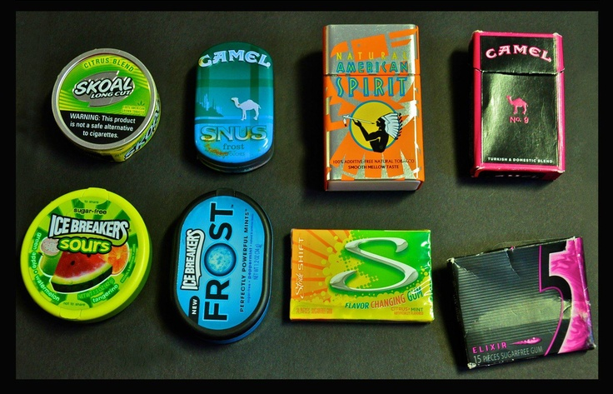
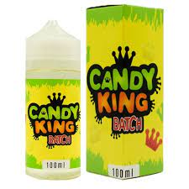
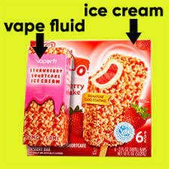
$100 Answer Industry Tactics
True!
Notes:
KEY POINT: The tobacco industry markets to youth with packaging that is similar to candy.
SCRIPT: “The answer is true! The tobacco industry targets young people and one of their strategies is to mimic the packaging of popular candy and other items that appeal to youth. These pictures show just a few examples of vape juice, chewing tobacco and cigarettes that look strikingly similar to candy! (Team X) gets $100!”

Slide 16
$200 Question Industry Tactics
How much money does the tobacco industry spend a day on marketing?
$750,000
$3.5 Million
$10 Million
$22.5 Million
Notes:
INSTRUCTIONS: Read the question out loud.

Slide 17
$200 Answer Industry Tactics
D) $22.5 Million!
Notes:
KEY POINT: The tobacco industry spends A LOT of money on marketing.
SCRIPT: “The answer is D. The tobacco industry spends 22.5 MILLION dollars every day to market their deadly products. I personally could think of a lot better ways to spend that money! (Team X) gets $200!”

Slide 18
$300 Question Industry Tactics
The tobacco industry targets what group(s) of people?
Minorities
Youth
Communities with low incomes
All of the above
Notes:
INSTRUCTIONS: Read the question out loud.

Slide 19
$300 Answer Industry Tactics
D) ALL OF THE ABOVE
Notes:
KEY POINT: The tobacco industry aggressively markets several marginalized populations.
SCRIPT: “The answer is D, all of the above. The tobacco industry preys on several marginalized populations with aggressive marketing strategies in order to create life-long customers, which results in even greater health disparities. (Team X) gets $300!”

Slide 20
$100 Question Pregnancy/Child Health
What is considered a safe amount of tobacco use during pregnancy?
1 pack throughout the pregnancy
1 pack a month
C) 1-2 cigarettes a month
D) There is NO safe amount
Notes:
INSTRUCTIONS: Read the question out loud.

Slide 21
$100 Answer Pregnancy/Child Health
D) THERE IS NO SAFE AMOUNT!
Notes:
KEY POINT: There is no safe amount of tobacco use during pregnancy.
SCRIPT: “The answer is D. There is no safe amount of tobacco use during pregnancy. But even if someone has smoked during part of their pregnancy it is always a good idea to stop now to help their baby have the healthiest outcome possible. (Team X) gets $100!”

Slide 22
$200 Question Pregnancy/Child Health
True or False: The THC in marijuana can pass through breastmilk.
Notes:
INSTRUCTIONS: Read the question out loud.

Slide 23
$200 Answer Pregnancy/Child Health
TRUE!
Notes:
KEY POINT: THC passes to babies through breastmilk.
SCRIPT: “That is true. THC can pass to babies through breastmilk so we need to encourage those who are breastfeeding not to use marijuana. (Team X) gets $200!”

Slide 24
$300 Question Pregnancy/Child Health
Smoking during pregnancy can cause what health problems for children?
Asthma Attacks
Bronchitis
Ear Infections
All of the Above
Notes:
INSTRUCTIONS: Read the question out loud.

Slide 25
$300 Answer Pregnancy/Child Health
D) ALL OF THE ABOVE!
Notes:
KEY POINT: Smoking during pregnancy can lead to asthma attacks, bronchitis, and ear infections.
SCRIPT: “The answer is D, all of the above. These are just some of the health problems children may face when exposed to secondhand smoke. (Team X) gets $300!”

Slide 26
$100 Question E-cigarettes
True or False: Using E-Cigarettes is a proven cessation method to quit tobacco use.
Notes:
INSTRUCTIONS: Read the question out loud.

Slide 27
$100 Answer E-cigarettes
FALSE
Notes:
KEY POINT: Vaping is not a proven cessation method.
SCRIPT: “That is false. While you may hear of some people using e-cigarettes to help them quit smoking, vaping is not a proven cessation method, and many people end up becoming dual users and teens start vaping when they never would have started using traditional cigarettes. (Team X) gets $100!”

Slide 28
$200 Question E-cigarettes
It is safe to use e-cigarettes around the following:
Children
Adults
Pets
None of the above
Notes:
INSTRUCTIONS: Read the question out loud.

Slide 29
$200 Answer E-cigarettes
D) NONE OF THE ABOVE!
Notes:
KEY POINT: It is not safe to use e-cigarettes around anyone.
SCRIPT: “The answer is D, none of the above. Anyone, even pets, who are around people who are vaping are exposed to the dangerous toxins in the aerosol that comes from these products. Of course, infants and children with developing lungs are especially susceptible to health problems from this exposure. (Team X) gets $200!”

Slide 30
$300 Question E-cigarettes
True or False: E-cigarettes emit harmless water vapor.
Notes:
INSTRUCTIONS: Read the question out loud.

Slide 31
$300 Answer E-cigarettes
FALSE!
Notes:
KEY POINT: E-cigarettes emit an aerosol that is full of harmful chemicals.
SCRIPT: “That is false. Many people incorrectly think that vaping just creates harmless water vapor, but e-cigarettes actually produce aerosol that is full of harmful chemicals. (Team X) gets $300!”

Slide 32
$100 Question Quitting
What is the FREE, clinically proven, phone/text based quit program available in Indiana?
Quit Now Indiana
Smoke, The Big NOPE Foundation
You Can Do it Incorporated
Just “Okay” Hoosier Help Corp.
Notes:
INSTRUCTIONS: Read the question out loud.

Slide 33
$100 Answer Quitting
QUIT NOW INDIANA
Notes:
KEY POINT: Quit Now Indiana is a free cessation resource that can be shared with parents.
SCRIPT: “The answer is A. Quit Now Indiana is a wonderful free resource that parents can use 24/7 to get help and support if they are ready to quit tobacco. (Team X) gets $100!”

Slide 34
$200 Question Quitting
True or False: Indiana Medicaid offers multiple tobacco cessation resources for people trying to quit tobacco.
Notes:
INSTRUCTIONS: Read the question out loud.

Slide 35
$200 Answer Quitting
TRUE!
Notes:
KEY POINT: Those with Indiana Medicaid coverage have access to lots of great tobacco cessation resources.
SCRIPT: “That is true! Indiana Medicaid covers several forms of proven nicotine replacement products as well as prescription medications and counseling sessions. (Team X) gets $200!”

Slide 36
$300 Question Quitting
On average, how many attempts does it take for someone to successfully quit smoking?
1 time
3-4 times
8-11 times
5 million times
Notes:
INSTRUCTIONS: Read the question out loud.

Slide 37
$300 Answer Quitting
C) 8-11
TIMES!
Notes:
KEY POINT: It often takes 8-11 quit attempts before someone quits for good.
SCRIPT: “The answer is C. Quitting smoking is not easy and it often takes 8-11 quit attempts before someone quits for good. All quit attempts are a step in the right direction so offer plenty of support along the way. (Team X) gets $300!”

Slide 38
Final Jeopardy
Helping our communities become healthier and smoke/vape free is _____________ job.
Notes:
KEY POINT: Identify whose job it is to help our communities become healthier and smoke/vape free.
VIRTUAL MODIFICATION: Have participants type their guess into the chat box and then read the responses aloud and provide commentary and praise.
SCRIPT/INSTRUCTIONS: “It is now time for final Jeopardy! Each team get out a blank sheet of paper. When I share the question write your team’s answer down and wait until I ask you to hold it up.
(CLICK TO THE STATEMENT) Helping our communities become healthier and smoke/vape free is WHOSE job? (Give teams a minute to confer and write down their answer.) (Team 1) what is your answer? (Team 2) please share your answer.”

Slide 39
Final Jeopardy Answer
Helping our communities become healthier and smoke/vape free is EVERYONE’S job.
Notes:
KEY POINT: It is everyone’s job to help our communities become healthier and smoke/vape free…and identify the Jeopardy winner.
VIRTUAL MODIFICATION: If you chose to keep score, announce who had the highest score and offer a round of applause!
SCRIPT/INSTRUCTIONS: “And the answer is…it is EVERYONE’S job to help our communities become healthier and smoke/vape free! We can all play a role in lowering the tobacco burden. Great job everybody! It looks like (Team X) is our Jeopardy winner!” (If a team said it is OUR or MY responsibility let them know that counts too as that is the spirit of what we want them to get from Breathe. Determine the winning team and shower them with praise!)

Slide 40
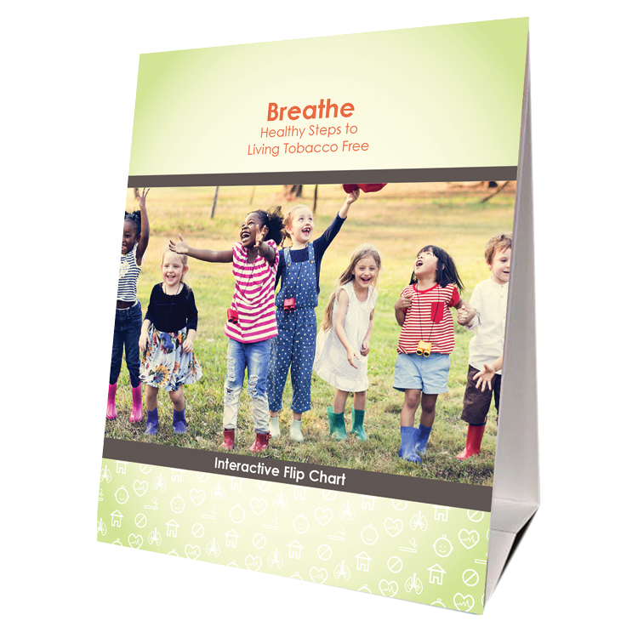
BREATHE MATERIALS
Parent
Activities Booklet
Flip Chart
Children’s Activities Booklet
Notes:
KEY POINT: Remind participants that they have access to lots of great Breathe resources.
MATERIALS NEEDED: Sample Breathe kits with a Breathe flipchart, parent activity booklet, and children’s activity booklet in a bright green bag.
SCRIPT/INSTRUCTIONS: “Now that we have all brushed up on our knowledge of tobacco and the importance of protecting children from second and thirdhand smoke, I want to remind you about all the Breathe resources you have access to that can aid in educating and supporting the families you work with. Hopefully you know where your Breathe kits are stored, but if not, talk to your leadership to find out and let me know if you need any replacement items. Your kits should contain 3 hard copy items. A flip chart that can be used one-on-one or with small groups of parents to provide education on a variety of tobacco related topics. You should also have the Parent Activities Booklet which includes 9 different activities that you can do with groups of parents to get them discussing tobacco related topics. There is also a Children’s Activities Booklet with 15 short activities focused on healthy bodies that work great with children ages 3-7. All of the activities in these booklets require very little prep work or outside materials, so whether you work directly with parents or young children I hope you can think of ways to utilize some of these resources.”

Slide 41
Access All Breathe Materials Online!
Trained partners may download materials at
justbreathein.org/for-partners/
Notes:
KEY POINT: Trained Breathe partners can access all the Breathe materials online.
MATERIALS NEEDED: Print outs of the Partner QR code flyers that can be found here: https://justbreathein.org/for-partners/
VIRTUAL MODIFICATION: Place the link to the For Partners webpage in the chat box: https://justbreathein.org/for-partners/
SCRIPT/INSTRUCTIONS: “The three items I have shared so far are in the physical kits received at the Initial Breathe training. All three of those items as well as all the materials I’m about to share with you can also be accessed at the webpage on the screen. Don’t worry I’ll send you this link in a follow up email and I also brought some signs you can post with a QR code that will take you right to this webpage.”

Slide 42
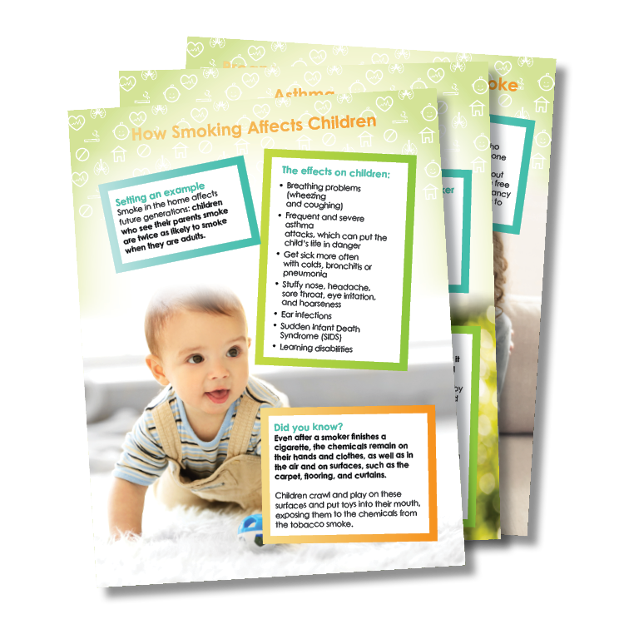
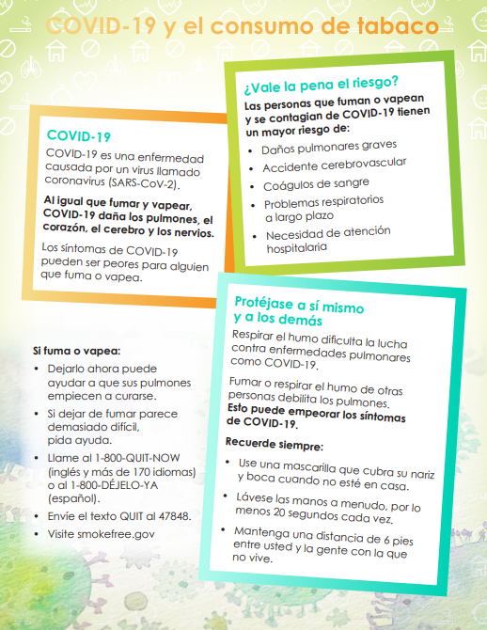
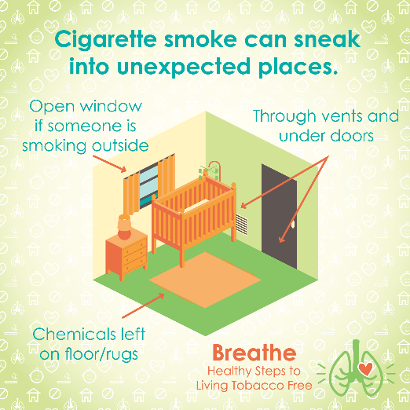
ONLINE BREATHE MATERIALS
Parent Handouts – Parent Worksheets – Videos – Social Media Posts – Coloring Sheets – Spanish Materials –
Monthly E-Newsletter
Notes:
KEY POINT: Remind participants of all the Breathe materials accessible on the For Partners page.
SCRIPT: (CLICK AGAIN TO BRING UP THE LIST OF MATERIALS) “On that webpage you will find over 20 Parent Handouts on a variety of tobacco related topics that you can download and print or share electronically. There is also a Parent Journal with nearly 50 worksheets that you can print or email to parents and these worksheet can aid parents in things like goal setting for both those who use tobacco and those who are looking for help protecting their children from second and thirdhand smoke exposure. There are also lots of short videos, just 2-3 minutes each that help reinforce important tobacco education. Feel free to pull these up on an ipad to show to parents as appropriate or post them on your social media. Speaking of social media, the webpage also includes 12 ready to go graphics and accompanying text that you can post on your social media pages as a way to keep tobacco education on everyone’s radar. For the kids we also have a fun coloring book focused on healthy bodies. You can download and print the whole book or individual coloring sheets to use in the classroom or to send home. Many of the Breathe materials are also available in Spanish, so please access those materials if you are working with Spanish Speaking parents. And finally, we create a monthly Breathe 3-newsletter that we will send to your leadership and will also send it directly to anyone who indicated they would like to receive it on today’s sign in sheet. We hope that you will share the newsletter by forwarding it or copying and pasting sections of it into your own organization’s newsletter. I hope this quick overview of the Breathe materials was helpful and that each of you can find at least one or two resources that might be useful in your current role and that you will feel comfortable sharing. Please take a few minutes when you can to look through all the resources on the website.”

Slide 43
VALUE VOTING
What has your experience been with the Breathe materials and addressing tobacco with families?
Stand on the far right side of the room if you agree 100% with the statement.
Stand on the far left side of the room if you 100% disagree with the statement.
Or stand somewhere in between depending on your level of agreement with the statement.
And What Can We Learn From Each Other?
Notes:
KEY POINT: Introduce how Value Voting works.
VIRTUAL MODIFICATION: Let participants know that since we are not all in the same room we will use hand gestures to signify their level of agreement with each statement. If they agree with the statement 100% then they can give a thumbs up. If they 100% disagree with that statement, they can give a thumbs down. Or they can do a thumbs sideways or somewhere in between depending on their level of agreement with that statement. Demonstrate with your own hand gestures as you explain the hand signals and advise them to have their cameras on and use their actual hands rather than the reaction buttons. Given that it is hard to look at the participants and the slide as the statements appear, you can print out a cheat sheet with thethree statements in order here: https://justbreathein.org/additional-resources/materials/ Provide appropriate commentary as necessary and ask some people to expand on the reasoning behind their hand gesture by either unmuting and sharing or typing in the chat box.
SCRIPT/INSTRUCTIONS: “Now we really want to dive into learning more about your experience with the Breathe materials and addressing tobacco with families over the past year. Whether you are using the materials on a regular basis, have used them just a few times, or you’ve tucked them away and never pulled them out, I think we can all learn from each other about how we are or are not addressing this topic with our families. So I’m going to ask for your active involvement again with Value Voting. Here is how value voting works. I will post a statement on the screen and read it out loud. If you agree with the statement 100% then I want you to move to the far right side of the room. If you 100% disagree with that statement, move to the far left of the room. Or you can stand anywhere in between depending on your level of agreement with that statement. Everybody understand? (If there is not room for everyone to move around you can have everyone do a thumbs up, thumbs down, or thumbs sideways to indicate their level of agreement.)
(CLICK TO BRING UP AND WHAT CAN WE LEARN FROM EACH OTHER?) Like I said this will help me learn a bit more about your experience with Breathe, and you can also learn from each other!”

Slide 44
I have experienced challenges talking to parents about tobacco in the past year.
Notes:
KEY POINT: Assess level of agreement with “I have experienced challenges talking to parents about tobacco in the past year” and validate everyone’s comments.
SCRIPT/INSTRUCTIONS: “The first statement is ‘I have experienced challenges talking to parents about tobacco in the past year.’ If you are in 100% agreement with that statement make your way to the right side of the room. If you disagree completely with that statement move to the left side. Or stand somewhere in between.”
(Once everyone has moved to their chosen spot, start with one side of the room and ask 1 or 2 people to state why they chose to stand there. Then flip to the opposite side and inquire about their choice. Then ask a few people who chose to be somewhere in the middle what their reason was. As people share their experiences provide helpful comments, validate that the challenges they faced are common and ask others to chime in as well. Some people may say they disagree with this statement because they haven’t had any conversations with parents about tobacco yet and this is fine. Let them know that is exactly why we do the refresher trainings!)

Slide 45
I have been successful talking to parents about tobacco use/secondhand smoke exposure in the past year
OR
I have found creative ways to share this information.
Notes:
KEY POINT: Assess level of agreement with “I have been successful talking to parents about tobacco use/secondhand smoke exposure in the past year OR I have found creative ways to share this information.” and validate everyone’s comments.
SCRIPT/INSTRUCTIONS: “Great job! Get ready to move. Our second statement is ‘I have been successful talking to parents about tobacco use/secondhand smoke exposure in the past year OR I have found creative ways to share this information.’ If you are in 100% agreement with that statement make your way to the right side of the room. If you disagree completely with that statement move to the left side. Or stand somewhere in between.”
(Once everyone has moved to their chosen spot, start with one side of the room and ask 1 or 2 people to state why they chose to stand there. Then flip to the opposite side and inquire about their choice. Then ask a few people who chose to be somewhere in the middle what their reason was. As people share their experiences/ideas provide helpful comments, validate those who have had success or used creative strategies, and encourage the others to think about if those same strategies might work for them or if they can help support each other.)

Slide 46
I have some ideas for how we could address tobacco with the families we serve.
Notes:
KEY POINT: Assess level of agreement with “I have some ideas for how we could address tobacco with the families we serve” and validate everyone’s comments.
SCRIPT/INSTRUCTIONS: “Awesome! For our last statement decide how much you agree with this statement. ‘I have some ideas for how we could address tobacco with the families we serve.’ Go ahead and move around the room to show your level of agreement for that statement. (Once everyone has moved to their chosen spot, start with one side of the room and ask 1 or 2 people to state why they chose to stand there. Then flip to the opposite side and inquire about their choice. Then ask a few people who chose to be somewhere in the middle what their reason was. As people share their experiences provide support and encouragement for the ideas they share and ask others to chime in if they support those ideas. Be ready to share your own ideas as well that go beyond just having one on one conversations with parents about tobacco such as sharing information on social media, creating a bulletin board about Quit NowIndiana, sending parent handouts home in back packs, adding tobacco related questions to intake forms, or other strategies you have heard similar partners use.) You guys did a great job with that activity and I’m excited about all the ideas you have for how your organization can continue to use the Breathe materials and promote healthy families. Thank you!”

Slide 47
PARENT SURVEYS
Help us collect meaningful data, improve the Breathe program, and get another opportunity to bring up the topic of tobacco with our parent surveys!
Hard copies or online​
Parents who complete the survey (and provide contact info) entered in quarterly drawing for $50 Walmart gift card!
Follow up support offered to those who request help quitting.
Details and links at justbreathein.org/for-partners/
Notes:
KEY POINT: Parent surveys provide us with critical data and there is an incentive for parents to participate.
MATERIALS NEEDED: Parent survey cards in English and/or Spanish (which may be requested through the Breathe Kit Request link: https://www.surveymonkey.com/r/BreatheKitRequestForm), print out of the Parent Survey QR Code Sheets or hard copies of the surveys (which can be downloaded here: https://justbreathein.org/additional-resources/materials/)
SCRIPT: “I also want to tell you a bit more about the parent surveys we are conducting and ask for your support in having parents complete them. These surveys help us collect critical data from parents about tobacco use and secondhand smoke exposure. Parents can complete the short survey at any time this year and they can be done before or after tobacco education is completed so do whatever works best for you. I can supply hard copies of the survey if you want to hand them out at a parent meeting or during your enrollment process. Then you would simply return the completed surveys to me or you can share the link to the survey and parents can complete the surveys online. You can send out the links to the parent survey in a newsletter or email communications or post a flyer or distribute these cards with QR codes that link to the survey in both English and Spanish. As an incentive, parents who complete the survey will be entered into our quarterly drawing to win a $50 Walmart gift card, as long as they provide their contact information. And we will follow up with those who indicate they want help with quitting, if they want to give their contact information. You can find all the details about the parent surveys on the link with all the Breathe resources..”

Slide 48
QUESTIONS??
Notes:
KEY POINT: I am happy to answer any questions now or in the future.
VIRTUAL MODIFICATION: Check the chat box for any questions that may have been posted during the training and let participants know they can post questions in the chat box or unmute to ask questions now.
SCRIPT: “Awesome job today! I am encouraged to hear all the ways you are already supporting the families you serve and the new ideas that were generated in today’s Breathe Refresher. We are just about done with the training, but I would love to answer any additional questions you may have. And as you continue implementing Breathe please do not hesitate to reach out with questions as they come up.”

Slide 49
BREATHE TRAINING
“BREATHE REFRESHER”
USE THE QR CODE
to take the
POST- ASSESSMENT
Notes:
KEY POINT: All participants need to complete a post assessment.
MATERIALS NEEDED: Participants can complete the post assessment online with the QR code on this slide. This is the preferred method as it will save you time doing data entry after the training! (The slide now indicates “Breathe Refresher” so they know how to fill answer the first question regarding the type of training they attended.) To encourage compliance you could have them indicate they are done or show you their completion screen and you could give them a handout, magnet, or other giveaway when they do. You still need to bring some printed out post assessments, preferable on a different color of paper, in case participants prefer to complete a hard copy. The Post Assessment can be downloaded from this webpage: https://justbreathein.org/additional-resources/materials/ **If you choose NOT to have participants complete the assessment online, modify this slide by removing the QR code.
VIRTUAL MODIFICATION: Participants can use another device to access the QR code on the screen and/or you can place the link in the chat box so they can complete it on the device they are using for the training. Ask participants to type DONE in the chat box to encourage compliance and assess completion. Here is the link to the post assessment: https://www.surveymonkey.com/r/BreathePostAssessments
SCRIPT: “Thank you for participating in today’s Breathe training! Before we wrap up, I need everyone to complete the post assessment. Once you have completed the post assessment please bring it to me/hold it up and I will give you (a magnet, certificate of completion, or whatever handout you choose).”

Slide 50
PICK UP MATERIALS
Expect 1-Month
Post Training Survey from JustBreatheIndiana@gmail.com
Notes:
KEY POINT: Participants can pick up Quit Now Indiana materials and should expect a follow up survey in one month.
SCRIPT: “After you complete the post assessment you can pick up Quit Now Indiana handouts/parent survey cards/QR code flyers/supplemental Breathe materials. I’ll be sending a follow up email soon with the link to the webpage with all the digital materials as well as a certificate of completion for today’s training. Then expect an email in about a month from justbreatheindiana@gmail.com with our 1 month survey. Please complete that survey when you get it as it really helps us gain feedback to evaluate and improve the Breathe program.”

Slide 51
THANK YOU!!
Tanya Shelburne, Project Manager
tanyas@healthedpros.org
317-902-4505
Delyte Meardith, Tobacco Control Specialist
delytem@healthedpros.org
330-469-4007
Notes:
KEY POINT: Share contact information.
SCRIPT/INSTRUCTIONS: (Personalize this slide with your contact information.) “Thank you so much for participating in today’s Breathe Refresher. It was my pleasure to get to see all of you again and meet the new staff. I know that working with families on this topic may not be easy, but I hope this training reinvigorated you and that you have even more ideas for how utilize the Breathe materials. As always, please reach out to me any time you have questions or great ideas and want to share your successes!”

