Slide 1
BREATHE TRAINING
“BREATHE REFRESHER”
USE THE QR CODE
to take the
PRE- ASSESSMENT
Notes:
HOW TO USE THE NOTES SECTION: Each slide in this presentation has a notes section that can help you deliver the presentation.
The KEY POINT let’s you know the most important message to convey and along with the text on the screen, that may be all the guidance an experienced county coordinator/tobacco expert may need to conduct the training effectively.
If any handouts or other resources are necessary for a given slide you will see a MATERIALS NEEDED section.
If modifications are needed to share a slide or conduct an activity for a virtual training, you will see a VIRTUAL MODIFICATION section.
The SCRIPT portion of each page will give you a sample script (in italics) of what you might say for each slide as well as instructions, if needed. DO NOT READ THE SCRIPT VERBATIM! Instead, use the script to practice the presentation and then adjust it as needed to make it your own. The script is simply meant to be a guide/suggestion!
KEY POINT: All participants need to complete a pre assessment and sign the sign-in sheet.
MATERIALS NEEDED: Participants can complete the pre assessment online with the QR code on this slide. This is the preferred method as it will save you time doing data entry after the training! (The slide now indicates “Breathe Refresher” so they know how to fill answer the first question regarding the type of training they are attending.) To encourage compliance you could have them indicate they are done or show you their completion screen and you could give them a handout, magnet, or other giveaway when they do. You still need to bring copies of the sign-in sheets and some printed out pre assessments in case participants prefer to complete a hard copy. **If you choose NOT to have participants complete the assessment online, modify this slide by removing the QR code.
VIRTUAL MODIFICATION: Participants can use another device to access the QR code on the screen and/or you can place the link in the chat box so they can complete it on the device they are using for the training. You may need to keep posting the link in the chat box as people enter the training since they may not be able to see earlier chat box entries. Ask participants to type DONE in the chat box to encourage compliance and assess completion. Here is the link to the pre assessment: https://www.surveymonkey.com/r/BreathePreAssessments
SCRIPT: “Before we get started, I need everyone to complete a pre assessment. To access the survey, just open the camera in your smartphone and point it at the QR code on the screen to get the link. If you prefer to complete the assessment with pen and paper just let me know and I will bring you a hard copy. I will also be asking you to complete a post-assessment at the end of the training, and these are important parts of our evaluation so I appreciate you completing them. There are also sign-in sheets being passed around. Please make sure you put your name and contact info on one of the sign-in sheets so we will have a record of everyone’s attendance and if you want to receive our monthly Breathe E-newsletter you can indicate that on the sign in as well.”

Slide 2
HEALTH ED PROS
Tanya Shelburne MPH, CHES
Delyte Meardith BS, CHES
Notes:
KEY POINT: Participants should know your name and a bit about your background and position.
MATERIALS NEEDED: A sample Breathe kit and Quitline materials. (You can bring supplemental Breathe kit items if needed, but Breathe partners should have received kits during their Initial Breathe training.)
VIRTUAL MODIFICATION: Make plans with your site contact to deliver Quit Now Indiana materials either before or after the training to replenish their stock.
SCRIPT?INSTRUCTIONS: (Personalize this slide with your information. Welcome everyone to the training and let them know you are excited to return for a Breathe Refresher. Introduce yourself, and give a brief background on your experience, your organization, and your position. Do not distribute materials until the end of the training as some attendees will leave/not pay attention if materials are distrusted too early.) “I am back to provide a refresher course as we continue our on-going relationship with your organization and work together to promote healthy families. Today, rather than just sit and listen to me talk about the dangers of tobacco I want to hear from you guys. I want to see what everyone remembers about tobacco and secondhand smoke and how you have been utilizing the Breathe program and any challenges you have had addressing this topic with your families. Don’t worry if you are new or didn’t attend the previous Breathe training. I’m confident you will catch on quickly! In order to do that I need your active participation…and we would all like to have a little fun too. Are you with me?! To get you warmed up let’s start with a quick ice-breaker!”

Slide 3
GUIDELINES FOR VIRTUAL TRAINING
Training is being recorded
Keep video on
Mute yourself when not speaking
Rename yourself, if necessary
Minimize distractions
Stay for entire training (60 minutes)
Interact!!! (pre/post assessments, chat box, unmute)
Notify co-host if you have issues
Notes:
DELETE THIS SLIDE IF CONDUCTING AN IN-PERSON TRAINING!
KEY POINT: Go over housekeeping and expectations for the training.
SCRIPT/INSTRUCTIONS: (Personalize this slide as needed.) “But before we jump into our Breathe Refresher I want to go over a few housekeeping items. I want to make sure everyone is aware that the training is being recorded and I will share a link to the recording in a follow up email in a day or two should you want to watch it again or share it with someone on staff who may have missed the training. I do ask that you keep your videos on during the training so I can see everyone’s smiling faces and it will feel a bit more like we are actually in person, but do keep yourself on mute to minimize background noise and just unmute yourself when you want to share something or ask a question. If the name on the screen is not your name, please rename yourself, which will help us with attendance and knowing who everyone is. To rename yourself put your cursor in your box on the screen and click the blue box in the upper right corner with 3 dots in it and you should see the option to rename yourself. Do your best to minimize distractions around you and I do ask that you stay for the full 60 minute training. There will be several options to interact so feel free to use the chat box or raise your hand at any time, and I hope you will interact as it is way more fun when it’s not just me talking the whole time! If you have any issues during the training feel free to message the co-host and we will try to assist.”

Slide 4
TIME TO DE-STRESS!
What worries are weighing on you?
What are healthy ways you like to de-stress?
How does this relate to tobacco?
Notes:
KEY POINT: Help everyone reduce their stress level.
MATERIALS NEEDED: Each participant needs two blank half sheets of paper and something to write with, and you may want print outs of the stress management parent handout found here: https://justbreathein.org/additional-resources/breathe-kit-materials/
VIRTUAL MODIFICATION: Have participants write their stressors down, rip them up, and then write down their healthy ways to de-stress just as you would in person. Then ask them to share examples of their de-stressing activities in the chat box. Read the responses aloud and provide validation.
SCRIPT/INSTRUCTIONS: “Chances are each of you came into this training with lots of things on your mind…long to-do lists, work related stress, challenges in your home life…and now you have to sit through an hour-long training! I take no offense to the fact that some of you may wish you were somewhere else right now! But I hope that we can all make the best use of this hour so you can leave here with more knowledge and some ideas for how to support your families. First, I want us all to set the right mood by taking a few moments to be mindful and de-stress with a short activity. Not only can this exercise help all of us right now, but it is something you can replicate with the children and families you serve as I’m betting they could also benefit from de-stressing!
(CLICK TO BRING UP WHAT WORRIES ARE WEIGHING ON YOU?) First, take a moment to “check-in” with yourself by writing down a few worries or things that are weighing on your mind right now. You won’t be asked to share what you write down, this is just for you! (Give them 1 minute to write down their worries) Now that you have written down what is stressing you, I want you to rip up those sheets into tiny pieces and toss them in the trash can. (Walk around with the trash can to collect the paper scraps) With this activity I am encouraging you o let those worries and stressors go…just Let It Go at least for the next hour so you can have better focus and feel a bit lighter even if just for a while. I’ll resist the urge to sing the Frozen theme song, but I do hope you can all Let It Go!
(CLICK TO BRING UP WHAT ARE HEALHY WAYS YOU LIKE TO DE-STRESS?) Next, I want everyone to write down on another slip of paper a few healthy ways you like to de-stress. (Give them a minute or two to write down their ways to de-stress) Would anyone like to share some of their tactics for de-stressing? (Let several people share examples.) Not everyone’s list will look the same and that’s ok! The idea of going for a really long run sounds like torture to me, but for someone else that is exactly what they need to clear their mind and release tension! The most important thing is that we each have some healthy go-to options for when the worries and responsibilities of life get to be a bit much. (If people share somewhat unhealthy habits like drinking wine, eating chocolate, etc, acknowledge that for most people those things, in moderation, can be reasonable ways to de-stress.)
(CLICK TO BRING UP HOW DOES THIS RELATED TO TOBACCO?) So you may be thinking, what the heck does any of this have to do with Breathe and learning about tobacco? I’m so glad you asked! For many stressed out people, smoking or vaping might have been on their list of de-stressing activities…it we weren’t focusing on HEALTHY stress management. While many people who use tobacco think of it as a stress reliever, it can be a vicious cycle that actually creates more stress. From the added expense, health problems, lingering odor, physical dependence, and more…tobacco use just adds unnecessary stress and more worries. By helping your families deal with stress in a healthy way you can help pave the way for tobacco free families. Even though we can’t do all the de-stressing activities on your lists right now, I hope you will all take time for a bubble bath or a long walk this evening!”

Slide 5
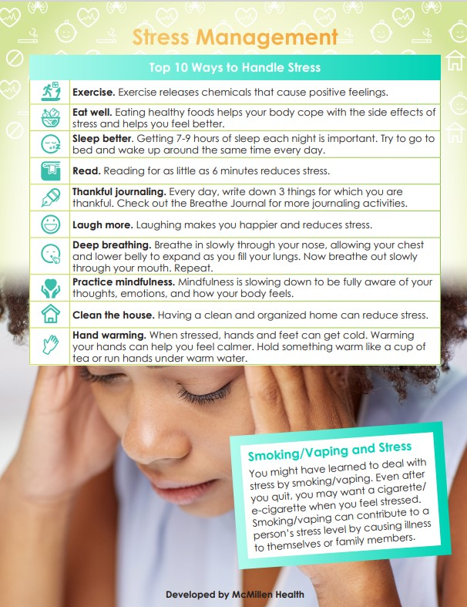
STRESS MANAGEMENT HANDOUT
As a Breathe Partner you have access to
TONS of free materials, including this handout on Stress Management!
Notes:
KEY POINT: Remind participants they have access to lots of free resources, including the Stress Management handout.
MATERIALS NEEDED: You can provide copies of the Stress Management handout, if you choose.
SCRIPT/INSTRUCTIONS: “And I want to remind everyone that as a Breathe partner you have access to TONS of Breathe materials online, including this Stress Management handout. So if you find that parents are experiencing lots of stress and that might be contributing to tobacco use, this could be a very helpful handout. A little bit later I’ll remind you of all the Breathe materials available to you as a Breathe partner and how to access them.”

Slide 6
GAME TIME!
How Much Do You Know/Remember
About Tobacco?
Notes:
KEY POINT: Set the stage for this training being a refresher.
SCRIPT: “Now that everyone’s stress levels have decreased a bit, let’s see how much you remember from our last training. Of course if I expect you to talk to parents about tobacco use and secondhand smoke then you need to be aware of some basic information on this topic. I realize not everyone attended the previous training and you have all slept since then, so just do your best!”

Slide 7
Notes:
KEY POINT: Announce that we will be playing Family Feud to test what we know about tobacco.
SCRIPT: “We are going to have a little fun with this…and play Family Feud!!! I’m guessing we may have at least a few competitive people in this group so this should be fun!”

Slide 8
STAGE
Break up into TWO teams!
0
0
TEAM 1
TEAM 2
8
7
6
5
4
3
2
1
0
0
0
0
0
0
0
0
Stage
Notes:
KEY POINT: Review the structure for how to play Family Feud.
MATERIALS NEEDED: Dry erase board and markers or newsprint to keep the score on. The Family Feud Cheat Sheet so you know which answers to reveal, which can be found here: https://justbreathein.org/staff-training/breathe-refresher/
VIRTUAL MODIFICATION: For the virtual version of Family Feud have everyone play individually. Instruct participants to type just ONE answer in the chat box after the question appears. Read the responses aloud and identify who earned the points as you click the correct answers on the game board (using the cheat sheet). It will be very helpful to have a co-host to assist with tracking points, especially if you have a big group!
SCRIPT: “This is a modified version of Family Feud, where I get to decide which family you are on! So everyone on this side of the room will be on one team and this side will be on the other team. Decide who will be your team’s spokesperson and pick a name for your team/Family. The team leader with the closest birthday will go first. Then we will take turns going back and forth providing a guess at the posted survey question. In this version of Family Feud All correct answers are worth 10 points as no answer is considered “better” than another. Are we ready to play?”
INSTRUCTIONS: Use your cheesiest Game Show voice and divide the participants into 2 groups and ask them to pick a leader/spokesperson. The team leader with the closest upcoming birthday goes first. Ask for a volunteer or have your co-trainer record the score on paper or a dry erase board. Have teams rotate providing answers to each of the posted survey questions. For example: Question 1-What common products are used to deliver nicotine to the body?
Team 1 guesses * Cigarettes*-CORRECT- 10 Points goes to Team 1…It is now Team 2’s turn ON THE SAME QUESTION! (question 1) Team 2 guesses *Toilet Bowl Plunger*- INCORRECT- No points go to Team 2…It is Team 1’s turn again.
Continue alternating turns until all questions have been answered. Answers can be revealed individually by clicking on the correct number. You can find a cheat sheet with the answers under each number (so you will know which numbers to click) here: https://justbreathein.org/additional-resources/materials/ After each answer is revealed, you can fill in with some additional info and tobacco education on that particular topic. All correct answers are worth 10 points as no answer is considered “better” than another, they are either correct or incorrect.
If a team comes up with an answer that is not listed as a correct answer on the board, but you feel it is still a good/correct response you can use your own discretion to award that team with 10 points. If correct answers are still remaining on the board but both teams have had a turn and didn’t come up with one of the remaining responses, simply reveal the remaining correct answer(s) and move on to the next question.

Slide 9
What common products are used to deliver nicotine to the body?
1
5
Cigarettes
10
Pipes
10
2
0
E-cigarettes/ Vapes/ Juul
10
0
TEAM 1
TEAM 2
3
Smokeless/
Chewing Tobacco
10
ADD ROUND POINTS
ADD ROUND POINTS
4
Cigars/Cigarillos
10
BACK TO SCORES
0
NEXT ROUND
Notes:
KEY POINT: Review common tobacco products.
SCRIPT/INSTRUCTIONS: (When first opening these slides either wait for numbers to appear or push the right arrow key to show numbers.)
“(Team 1) will go first and the question is What common products are used to deliver nicotine to the body? (Team 1 provides an answer. Use the Family Feud Cheat sheet to know which number on the board corresponds to that answer. Click on that number to reveal the answer and give that team 10 points.) “(Team 2) Now it is your turn to answer the same question.” (Keep alternating between teams until all answers are revealed or until both teams fail to get a correct answer and then reveal any remaining answers.) “Great job everyone! There are lots of tobacco products on the market these days so it is helpful to know a little about the various products when you are providing education to parents.” (Click the right arrow key to advance to the next question/slide.)

Slide 10
Who is at risk for secondhand smoke exposure?
1
5
Everyone
10
Pets
10
2
0
Infants/Children
10
0
TEAM 1
TEAM 2
3
Unborn Babies
10
ADD ROUND POINTS
ADD ROUND POINTS
4
Pregnant People
10
BACK TO SCORES
0
NEXT ROUND
Notes:
KEY POINT: Review who is at risk for secondhand smoke exposure.
SCRIPT/INSTRUCTIONS: “(Team X) will go next and the question is Who is at risk for secondhand smoke exposure? (Keep alternating between teams until all answers are revealed or until both teams fail to get a correct answer and then reveal any remaining answers. If “Everyone” is guessed first, then ask what are some other key groups that we know are especially vulnerable to secondhand smoke.) “Awesome job again! Everyone is at risk for secondhand smoke and the work you are doing to educate families is extremely important as we all want to protect our children from the negative effects of tobacco.” (Click the right arrow key to advance to the next question/slide.)

Slide 11
What common health problems can occur if an infant/child is exposed to secondhand smoke?
1
5
Asthma Attacks
10
Learning
Difficulties
10
2
0
Ear Infections
10
0
TEAM 1
TEAM 2
3
Respiratory Infections
10
ADD ROUND POINTS
ADD ROUND POINTS
4
Sudden Infant Death Syndrome (SIDS)
10
BACK TO SCORES
0
NEXT ROUND
Notes:
KEY POINT: Review common health problems for infants/children exposed to secondhand smoke.
SCRIPT/INSTRUCTIONS: “(Team X) is up next and the question is What common health problems can occur if an infant or child is exposed to secondhand smoke? (Keep alternating between teams until all answers are revealed or until both teams fail to get a correct answer and then reveal any remaining answers. Since there are many problems that can result from secondhand smoke be prepared to give out 10 points if they give a good response even if it isn’t on the screen.
You can also give hints if they are not getting a specific answer.) “There are tons of negative health effects from secondhand smoke exposure for little ones so it is important that we help make parents aware of this and provide support and resources that will help protect their families.” (Click the right arrow key to advance to the next question/slide.)

Slide 12
How can children be protected from second/thirdhand smoke?
1
5
Quit Smoking
10
Pass Smoke
Free Policies
10
2
0
Smoke Outside
10
0
TEAM 1
TEAM 2
3
Don’t Smoke
in the Car
10
ADD ROUND POINTS
ADD ROUND POINTS
4
Wear a Smoking Jacket
10
BACK TO SCORES
0
NEXT ROUND
Notes:
KEY POINT: Review how we can protect children from second/thirdhand smoke.
SCRIPT/INSTRUCTIONS: “(Team X)’s turn and the question is How can children be protected from second and thirdhand smoke? You may remember from the last training that thirdhand smoke includes all the chemicals and toxins left on furniture, clothes, toys, etc. when someone smokes in a room or car and this can be dangerous to children even if they aren’t present when the smoking takes place.” (Keep alternating between teams until all answers are revealed or until both teams fail to get a correct answer and then reveal any remaining answers. Be prepared to give out 10 points if they give a good response even if it isn’t on the screen.) “You guys came up with great strategies to protect kids from second and thirdhand smoke and these are important tips to share with parents when you provide tobacco education. And even if they aren’t ready to quit smoking you can share other ways to minimize exposure for their families.” (Click the right arrow key to advance to the next question/slide.)

Slide 13
Who does the tobacco industry aggressively target in their marketing?
1
5
Youth
10
Communities/families with low incomes
10
2
0
Women
10
0
TEAM 1
TEAM 2
3
People of Color
10
ADD ROUND POINTS
ADD ROUND POINTS
4
LGBTQ+
10
BACK TO SCORES
0
NEXT ROUND
Notes:
KEY POINT: Review who the tobacco industry targets.
SCRIPT/INSTRUCTIONS: “For our final question it is (Team X)’s turn and we want to know Who does the tobacco industry aggressively target in their marketing? What groups of people does the tobacco industry prey on with their marketing tactics? (Keep alternating between teams until all answers are revealed or until both teams fail to get a correct answer and then reveal any remaining answers. Since there could be additional groups targeted be prepared to give out 10 points if they give a good response even if it isn’t on the screen. You can also give hints if they are not getting a specific group.) “Nice job! Unfortunately, the tobacco industry is hard at work marketing their deadly products and preying on vulnerable populations, including the children and families that you serve, and that is why we all need to do our part to share the facts about tobacco and prevention and cessation resources with our families.”

Slide 14
THANK YOU FOR PLAYING!
And the winner is…?
Notes:
KEY POINT: Identify the winner of Family Feud.
VIRTUAL MODIFICATION: Have the co-host tally up the points and declare the individual winner.
SCRIPT: “Thank you all for playing Breathe’s version of Family Feud! And now…drum roll please….the winner of Family Feud is….(Team X)!! Let’s give them a round of applause! Actually, you all did an awesome job and by using the Breathe materials and educating families about tobacco and ALL the children and families you serve can be the real winners!

Slide 15
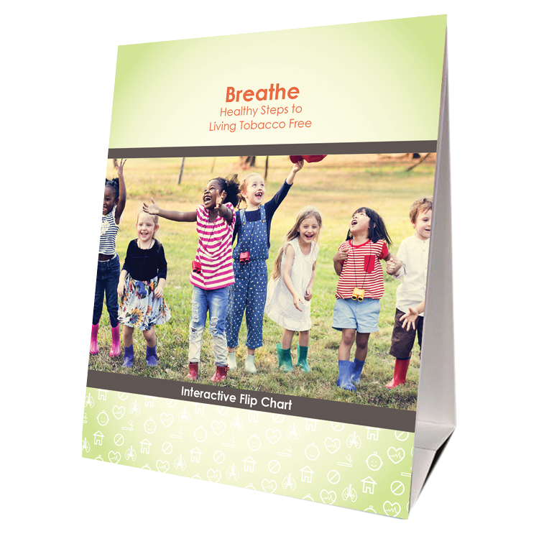
BREATHE MATERIALS
Parent
Activities Booklet
Flip Chart
Children’s Activities Booklet
Notes:
KEY POINT: Remind participants that they have access to lots of great Breathe resources.
MATERIALS NEEDED: Sample Breathe kits with a Breathe flipchart, parent activity booklet, and children’s activity booklet in a bright green bag.
SCRIPT/INSTRUCTIONS: “Now that we have all brushed up on our knowledge of tobacco and the importance of protecting children from second and thirdhand smoke, I want to remind you about all the Breathe resources you have access to that can aid in educating and supporting the families you work with. Hopefully you know where your Breathe kits are stored, but if not, talk to your leadership to find out and let me know if you need any replacement items. Your kits should contain 3 hard copy items. A flip chart that can be used one-on-one or with small groups of parents to provide education on a variety of tobacco related topics. You should also have the Parent Activities Booklet which includes 9 different activities that you can do with groups of parents to get them discussing tobacco related topics. There is also a Children’s Activities Booklet with 15 short activities focused on healthy bodies that work great with children ages 3-7. All of the activities in these booklets require very little prep work or outside materials, so whether you work directly with parents or young children I hope you can think of ways to utilize some of these resources.”

Slide 16
Access All Breathe Materials Online!
Trained partners may download materials at
justbreathein.org/for-partners/
Notes:
KEY POINT: Trained Breathe partners can access all the Breathe materials online.
MATERIALS NEEDED: Print outs of the Partner QR code flyers that can be found here: https://justbreathein.org/for-partners/
VIRTUAL MODIFICATION: Place the link to the For Partners webpage in the chat box: https://justbreathein.org/for-partners/
SCRIPT/INSTRUCTIONS: “The three items I have shared so far are in the physical kits received at the Initial Breathe training. All three of those items as well as all the materials I’m about to share with you can also be accessed at the webpage on the screen. Don’t worry I’ll send you this link in a follow up email and I also brought some signs you can post with a QR code that will take you right to this webpage.”

Slide 17
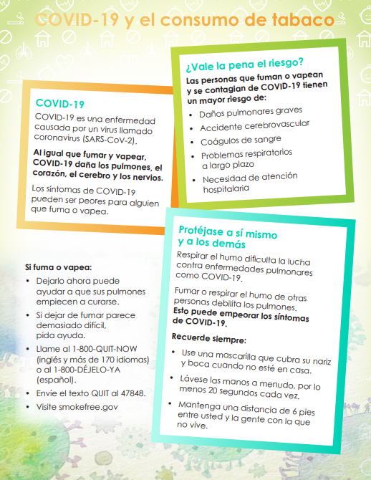
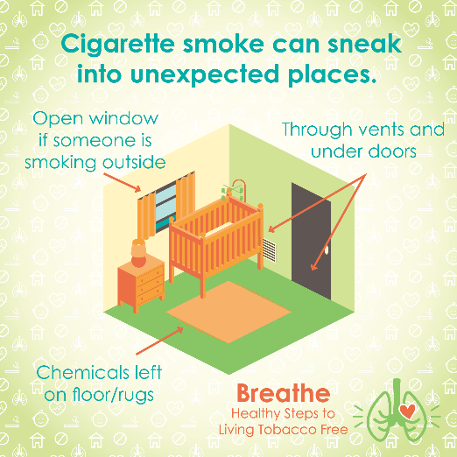
ONLINE BREATHE MATERIALS
Parent Handouts – Parent Worksheets – Videos – Social Media Posts – Coloring Sheets – Spanish Materials –
Monthly E-Newsletter
Notes:
KEY POINT: Remind participants of all the Breathe materials accessible on the For Partners page.
SCRIPT: (CLICK AGAIN TO BRING UP LIST OF MATERIALS) “On that webpage you will find over 20 Parent Handouts on a variety of tobacco related topics that you can download and print or share electronically. There is also a Parent Journal with nearly 50 worksheets that you can print or email to parents and these worksheet can aid parents in things like goal setting for both those who use tobacco and those who are looking for help protecting their children from second and thirdhand smoke exposure. There are also lots of short videos, just 2-3 minutes each that help reinforce important tobacco education. Feel free to pull these up on an ipad to show to parents as appropriate or post them on your social media. Speaking of social media, the webpage also includes 12 ready to go graphics and accompanying text that you can post on your social media pages as a way to keep tobacco education on everyone’s radar. For the kids we also have a fun coloring book focused on healthy bodies. You can download and print the whole book or individual coloring sheets to use in the classroom or to send home. Many of the Breathe materials are also available in Spanish, so please access those materials if you are working with Spanish Speaking parents. And finally, we create a monthly Breathe 3-newsletter that we will send to your leadership and will also send it directly to anyone who indicated they would like to receive it on today’s sign in sheet. We hope that you will share the newsletter by forwarding it or copying and pasting sections of it into your own organization’s newsletter. I hope this quick overview of the Breathe materials was helpful and that each of you can find at least one or two resources that might be useful in your current role and that you will feel comfortable sharing. Please take a few minutes when you can to look through all the resources on the website.”

Slide 18
IN JUST ONE WORD
(or maybe a short phrase)
Let’s talk about your experience with the Breathe materials & addressing tobacco with families…
Notes:
KEY POINT: Introduce the activity In Just One Word.
MATERIALS NEEDED: Everyone needs 2 sheets of blank paper and something to write with.
VIRTUAL MODIFICATION: Have participants share their one word answers to each statement in the chat box. Read the responses aloud and provide commentary and validation as appropriate.
SCRIPT/INSTRUCTIONS: “Now that I have refreshed your memories about the Breathe materials, I want to dive into learning more about your experience with the Breathe materials and addressing tobacco with families since you first learned about Breathe. Whether you are using the materials on a regular basis, have used them just a few times, or you’ve tucked them away and never pulled them out, I think we can all learn from each other about how we are or are not addressing this topic with our families. So I’m going to ask for everyone’s active involvement again, but don’t stress…I’m only asking for one word! Those of you who are overachievers I’ll allow a short phrase as well! I’ll post some brief statements or phrases on the screen, one at a time, and for each one I want you to think of one word that comes to mind or that describes how you feel about that statement or phrase. Then write your one word really big on a blank slip of paper. You can use the other side for the next statement so write really big! Keep in mind there are no right or wrong answers, we are just looking for honest answers! Everybody understand?”

Slide 19
IN JUST ONE WORD
(or maybe a short phrase)
Children who are exposed to secondhand smoke…
Notes:
KEY POINT: Discuss participants thoughts about children who are exposed to secondhand smoke.
SCRIPT/INSTRUCTIONS: “Our first phrase is Children who are exposed to secondhand smoke. So write down one word or a short phrase that comes to mind when I mention children being exposed to secondhand smoke. Write it really big and remember there are no right or wrong answers and this is a safe space for learning and sharing! (Give everyone a minute to come up with their word.) Now, hold up your papers so we can see what everyone wrote.” (Read several of the words/phrases out loud. Comment on similar words. Call on a couple people to share why they wrote a specific word or ask if anyone wants to share why they chose that word. You may get words that express concern or feeling helpless or that it’s not their place. Share your own insights in a validating way and remind them that we all have a heart for children and want them to be happy and healthy.)

Slide 20
IN JUST ONE WORD
(or maybe a short phrase)
Tobacco Industry Marketing…
Notes:
KEY POINT: Discuss participants thoughts about tobacco industry marketing.
SCRIPT/INSTRUCTIONS: “You guys are did great! Let’s see how you feel about this one: Tobacco Industry Marketing. Use the other side of your paper and write down one word or a short phrase that comes to mind when you think about tobacco industry marketing. (Give everyone a minute to come up with their word.) Hold up your papers now and let’s see what you guys think.” (Read several of the words/phrases out loud. Comment on similar words. Call on a couple people to share why they wrote a specific word or ask if anyone wants to share why they chose that word. Share any of your own thoughts about the aggressive and targeted marketing strategies of the tobacco industry.)

Slide 21
IN JUST ONE WORD
(or maybe a short phrase)
Talking to parents about tobacco…
Notes:
KEY POINT: Discuss participants thoughts about talking to parents about tobacco.
SCRIPT/INSTRUCTIONS: “I think you guys have the hang of it! Now come up with one word that comes to mind when you think about Talking to parents about tobacco. Use another slip of paper to write down one word or a short phrase that comes to mind when I mention talking to parents about tobacco. (Give everyone a minute to come up with their word.) Ok now everyone hold up their paper so we can see what everyone wrote.” (Read several of the words/phrases out loud. Comment on similar words. Call on a couple people to share why they wrote a specific word or ask if anyone wants to share why they chose that word. You will likely get words that reference how hard it is to discuss this subject or why they don’t want to. Validate those concerns as normal. Offer creative ways to share tobacco information without being confrontational or seeming judgmental.)

Slide 22
IN JUST ONE WORD
(or maybe a short phrase)
My role in tobacco education…
Notes:
KEY POINT: Discuss participants thoughts about their role in tobacco education.
SCRIPT/INSTRUCTIONS: “ This is our last phrase, so on the other side of your paper write down one word or a short phrase that comes to mind when you think about Your Role in Tobacco Education. (Give everyone a minute to come up with their word.) Ok now everyone hold up their paper so we can see what everyone wrote. (Read several of the words/phrases out loud. Comment on similar words. Call on a couple people to share why they wrote a specific word or ask if anyone wants to share why they chose that word. Anticipate that some participants will share that their job doesn’t fit with tobacco education. Validate that this likely isn’t anyone’s primary role, except for you! But share that we all do care about children and with that in common there are certainly things we can all do to help protect kids and educate parents about tobacco. Encourage them to think about their specific role in the organization and if there might be creative ways to share tobacco information through that role. It could include providing support for other staff, making written resources available, posting on social media, creating a bulletin board, teaching the kids about healthy habits, copying and pasting portions of the Breathe newsletter in their parent newsletter, adding questions to their health assessment forms, making tobacco a standard topic at home visits, having a booth or presentation at an upcoming parent night, etc.) You all did great with this activity and I love the ideas you have for educating parents about tobacco. And I am happy to serve as a continual resource and support for all of you!”

Slide 23
PARENT SURVEYS
Help us collect meaningful data, improve the Breathe program, and get another opportunity to bring up the topic of tobacco with our parent surveys!
Hard copies or online​
Parents who complete the survey (and provide contact info) entered in quarterly drawing for $50 Walmart gift card!
Follow up support offered to those who request help quitting.
Details and links at justbreathein.org/for-partners/
Notes:
KEY POINT: Parent surveys provide us with critical data and there is an incentive for parents to participate.
MATERIALS NEEDED: Parent survey cards in English and/or Spanish (which may be requested through the Breathe Kit Request link: https://www.surveymonkey.com/r/BreatheKitRequestForm), print out of the Parent Survey QR Code Sheets or hard copies of the surveys (which can be downloaded here: https://justbreathein.org/additional-resources/materials/)
SCRIPT: “Before we wrap up, I also want to remind you about the parent surveys we are conducting and ask for your support in having parents complete them. These surveys help us collect critical data from parents about tobacco use and secondhand smoke exposure. Parents can complete the short survey at any time this year and they can be done before or after tobacco education is completed so do whatever works best for you. I can supply hard copies of the survey if you want to hand them out at a parent meeting or during your enrollment process. Then you would simply return the completed surveys to me or you can share the link to the survey and parents can complete the surveys online. You can send out the links to the parent survey in a newsletter or email communications or post a flyer or distribute these cards with QR codes that link to the survey in both English and Spanish. As an incentive, parents who complete the survey will be entered into our quarterly drawing to win a $50 Walmart gift card, as long as they provide their contact information. And we will follow up with those who indicate they want help with quitting, if they want to give their contact information. You can find all the details about the parent surveys on the link with all the Breathe resources..”

Slide 24
QUESTIONS??
Notes:
KEY POINT: I am happy to answer any questions now or in the future.
VIRTUAL MODIFICATION: Check the chat box for any questions that may have been posted during the training and let participants know they can post questions in the chat box or unmute to ask questions now.
SCRIPT: “Awesome job today! I am encouraged to hear all the ways you are already supporting the families you serve and the new ideas that were generated in today’s Breathe Refresher. We are just about done with the training, but I would love to answer any additional questions you may have. And as you continue implementing Breathe please do not hesitate to reach out with questions as they come up.”

Slide 25
BREATHE TRAINING
“BREATHE REFRESHER”
USE THE QR CODE
to take the
POST- ASSESSMENT
Notes:
KEY POINT: All participants need to complete a post assessment.
MATERIALS NEEDED: Participants can complete the post assessment online with the QR code on this slide. This is the preferred method as it will save you time doing data entry after the training! (The slide now indicates “Breathe Refresher” so they know how to fill answer the first question regarding the type of training they attended.) To encourage compliance you could have them indicate they are done or show you their completion screen and you could give them a handout, magnet, or other giveaway when they do. You still need to bring some printed out post assessments, preferable on a different color of paper, in case participants prefer to complete a hard copy. The Post Assessment can be downloaded from this webpage: https://justbreathein.org/additional-resources/materials/ **If you choose NOT to have participants complete the assessment online, modify this slide by removing the QR code.
VIRTUAL MODIFICATION: Participants can use another device to access the QR code on the screen and/or you can place the link in the chat box so they can complete it on the device they are using for the training. Ask participants to type DONE in the chat box to encourage compliance and assess completion. Here is the link to the post assessment: https://www.surveymonkey.com/r/BreathePostAssessments
SCRIPT: “Thank you for participating in today’s Breathe training! Before we wrap up, I need everyone to complete the post assessment. Once you have completed the post assessment please bring it to me/hold it up and I will give you (a magnet, certificate of completion, or whatever handout you choose).”

Slide 26
PICK UP MATERIALS
Expect 1-Month
Post Training Survey from JustBreatheIndiana@gmail.com
Notes:
KEY POINT: Participants can pick up Quit Now Indiana materials and should expect a follow up survey in one month.
SCRIPT: “After you complete the post assessment you can pick up Quit Now Indiana handouts/parent survey cards/QR code flyers/supplemental Breathe materials. I’ll be sending a follow up email soon with the link to the webpage with all the digital materials as well as a certificate of completion for today’s training. Then expect an email in about a month from justbreatheindiana@gmail.com with our 1 month survey. Please complete that survey when you get it as it really helps us gain feedback to evaluate and improve the Breathe program.”

Slide 27
THANK YOU!!
Tanya Shelburne, Project Manager
tanyas@healthedpros.org
317-902-4505
Delyte Meardith, Tobacco Control Specialist
delytem@healthedpros.org
330-469-4007
Notes:
KEY POINT: Share contact information.
SCRIPT/INSTRUCTIONS: (Personalize this slide with your contact information.) “Thank you so much for participating in today’s Breathe Refresher. It was my pleasure to get to see all of you again and meet the new staff. I know that working with families on this topic may not be easy, but I hope this training reinvigorated you and that you have even more ideas for how utilize the Breathe materials. As always, please reach out to me any time you have questions or great ideas and want to share your successes!”

