Slide 1
Refresher/Just Keep Breathing Pre-Training Assessment 2021-2023, Segmented Based on Roles
376 Total Responses
Tuesday, September 26, 2023

Slide 2
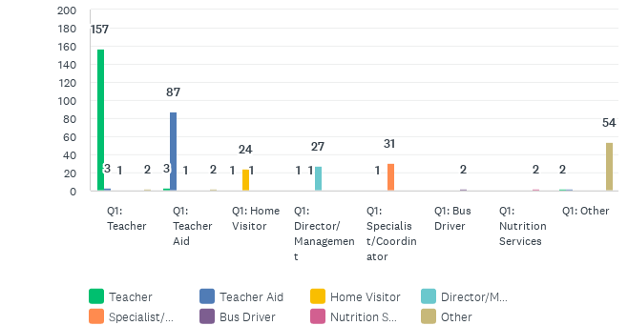
Job roles trained on Breathe (Refresher):
Answered: 373 Skipped: 0

Slide 3
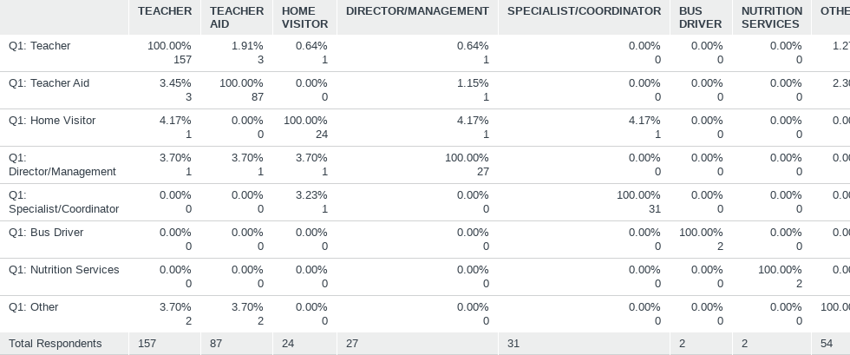
Job roles trained on Breathe (Refresher):
Answered: 373 Skipped: 0

Slide 4
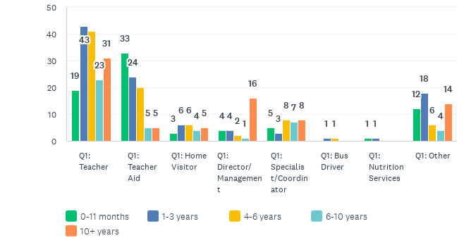
How long have you worked for your organization?
Answered: 373 Skipped: 0

Slide 5
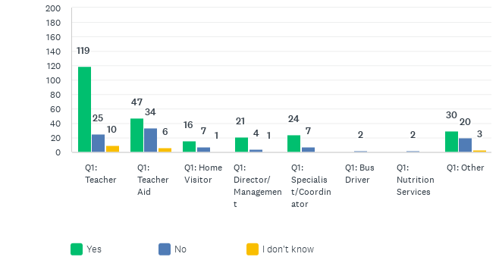
Did you attend the previous Breathe training on tobacco/smoking?
Answered: 369 Skipped: 4

Slide 6
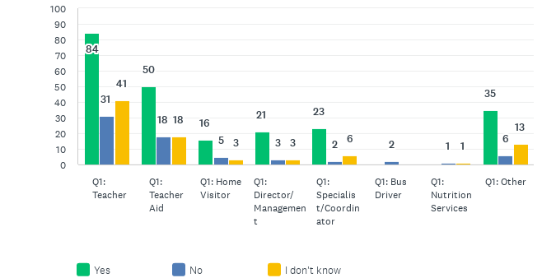
Do you have access/know where a Breathe Kit is stored at your organization?
Answered: 371 Skipped: 2

Slide 7
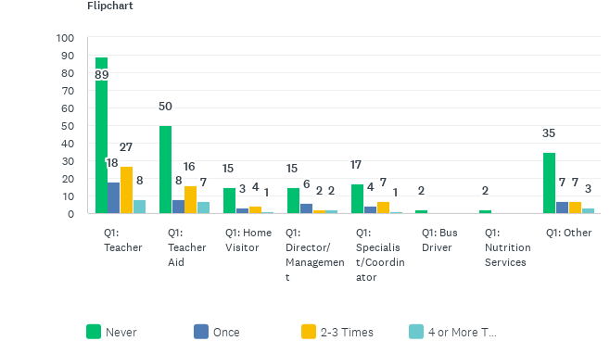
How often have you used each of the Breathe materials in the past year?
Answered: 362 Skipped: 11

Slide 8
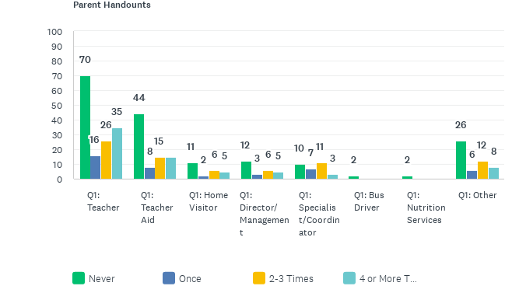
How often have you used each of the Breathe materials in the past year?
Answered: 362 Skipped: 11

Slide 9
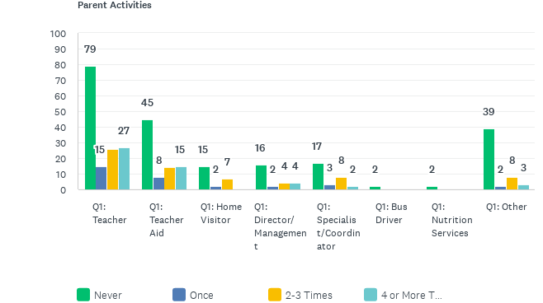
How often have you used each of the Breathe materials in the past year?
Answered: 362 Skipped: 11

Slide 10
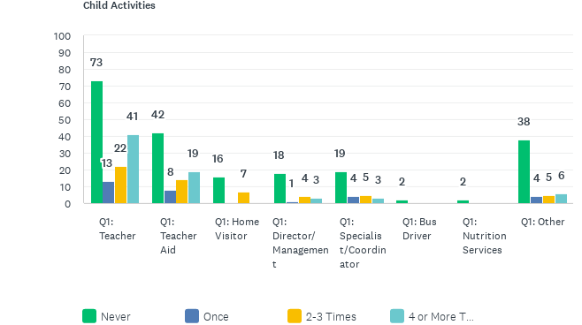
How often have you used each of the Breathe materials in the past year?
Answered: 362 Skipped: 11

Slide 11
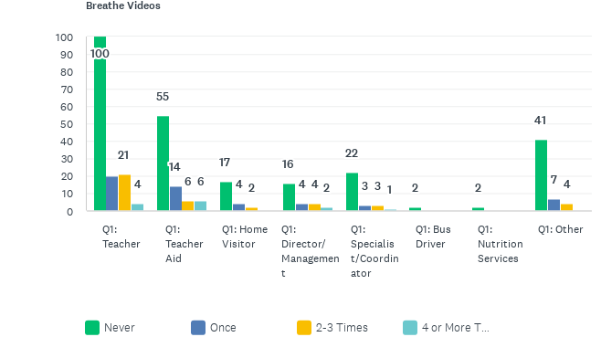
How often have you used each of the Breathe materials in the past year?
Answered: 362 Skipped: 11

Slide 12
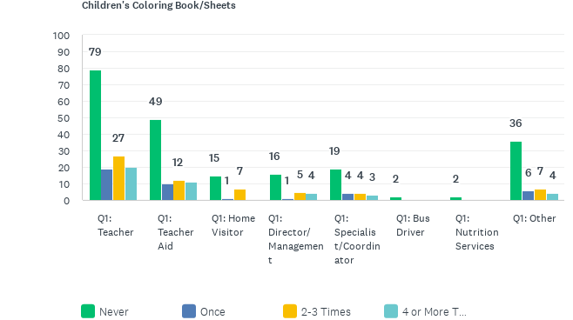
How often have you used each of the Breathe materials in the past year?
Answered: 362 Skipped: 11

Slide 13
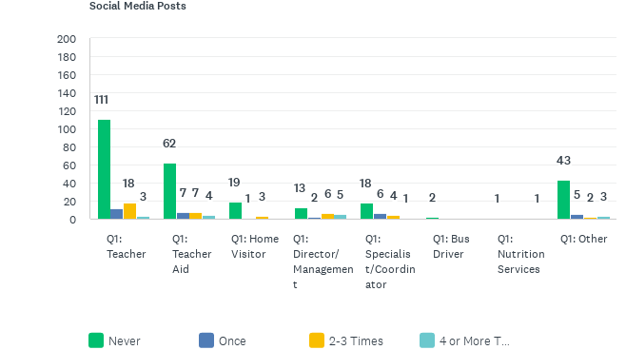
How often have you used each of the Breathe materials in the past year?
Answered: 362 Skipped: 11

Slide 14
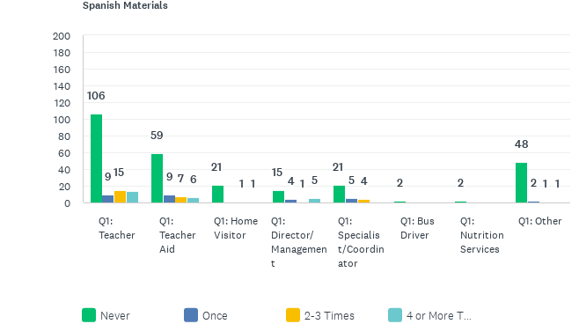
How often have you used each of the Breathe materials in the past year?
Answered: 362 Skipped: 11

Slide 15
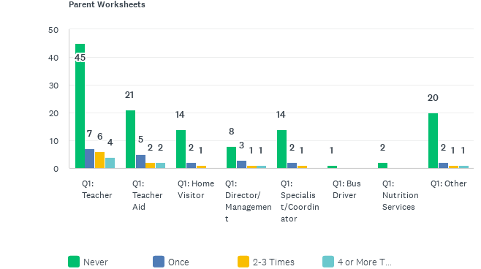
How often have you used each of the Breathe materials in the past year?
Answered: 362 Skipped: 11

Slide 16
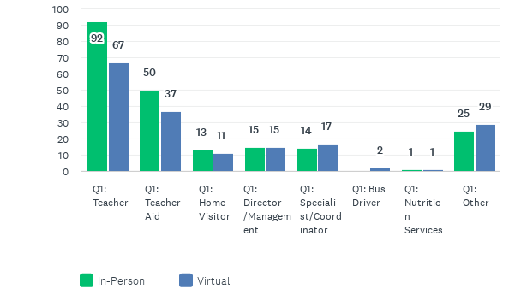
Was your Breathe training in-person or virtual?
Answered: 373 Skipped: 0

