Slide 1
Refresher/Just Keep Breathing Post-Training Assessment 2021-2023, Segmented by In-Person vs Virtual
347 Total Responses
Monday, September 25, 2023

Slide 2
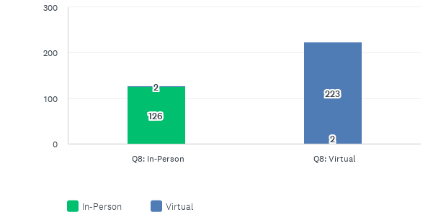
Was your Breathe Training in-person or virtual?
Answered: 347 Skipped: 0

Slide 3
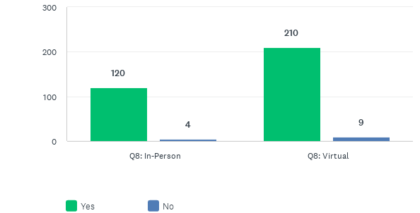
Would you recommend this training to others?
Answered: 341 Skipped: 6

Slide 4
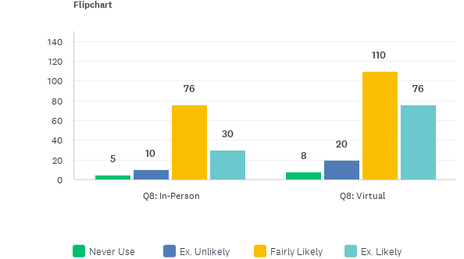
How likely are you to use the Breathe materials in the future?
Answered: 343 Skipped: 4

Slide 5
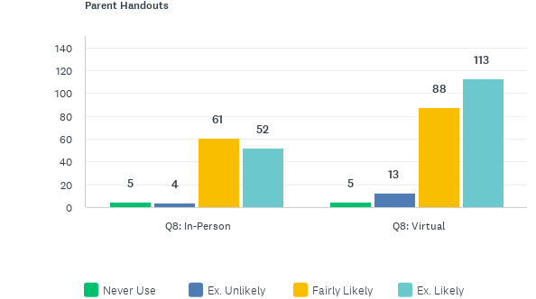
How likely are you to use the Breathe materials in the future?
Answered: 343 Skipped: 4

Slide 6
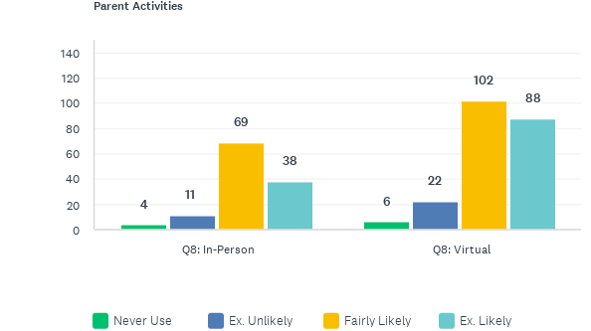
How likely are you to use the Breathe materials in the future?
Answered: 343 Skipped: 4

Slide 7
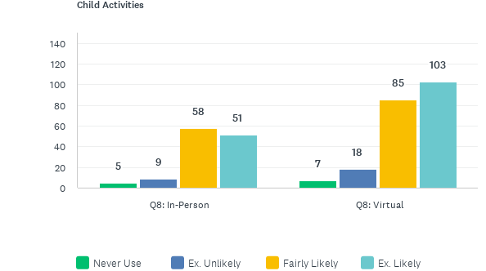
How likely are you to use the Breathe materials in the future?
Answered: 343 Skipped: 4

Slide 8
How likely are you to use the Breathe materials in the future?
Answered: 343 Skipped: 4

Slide 9
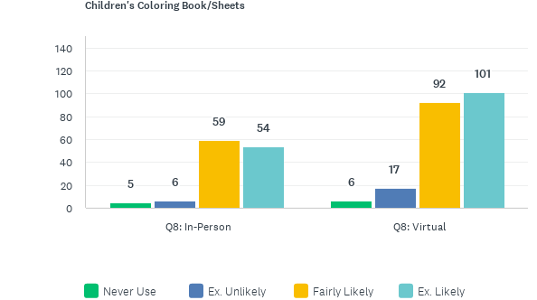
How likely are you to use the Breathe materials in the future?
Answered: 343 Skipped: 4

Slide 10
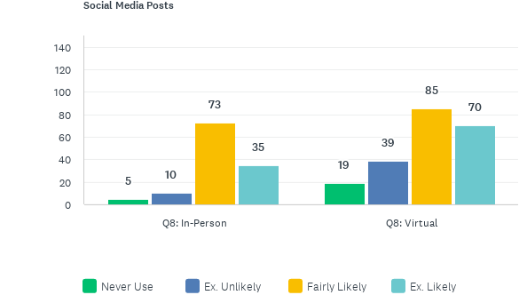
How likely are you to use the Breathe materials in the future?
Answered: 343 Skipped: 4

Slide 11
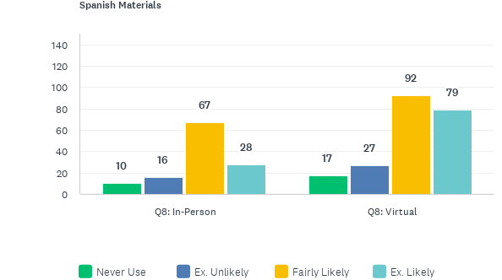
How likely are you to use the Breathe materials in the future?
Answered: 343 Skipped: 4

Slide 12
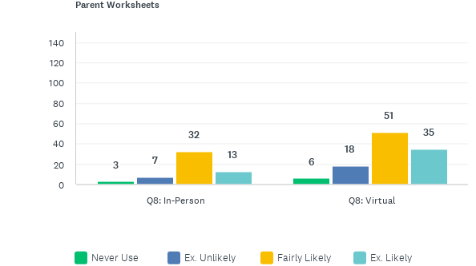
How likely are you to use the Breathe materials in the future?
Answered: 343 Skipped: 4

