Slide 1
Breathe Pre-Training Assessment 2021-2023, Segments by Roles
862 Total Responses
Tuesday, September 26, 2023

Slide 2
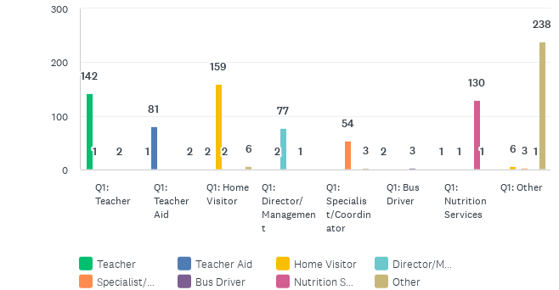
Job roles trained on Breathe (full training):
Answered: 860 Skipped: 0

Slide 3
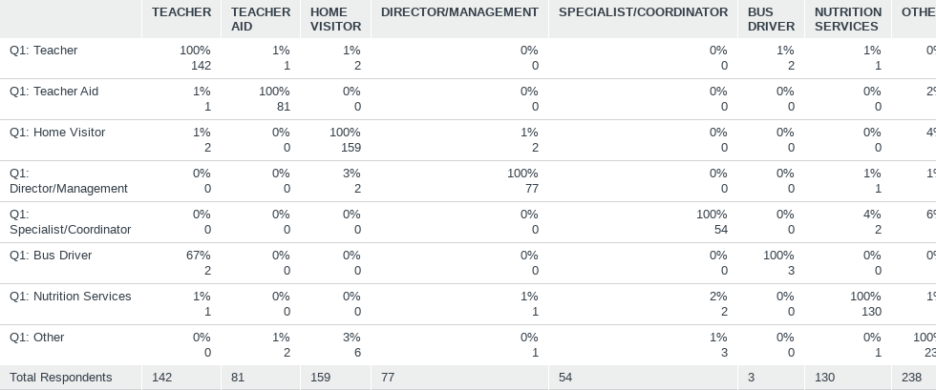
Job roles trained on Breathe (full training):
Answered: 860 Skipped: 0

Slide 4
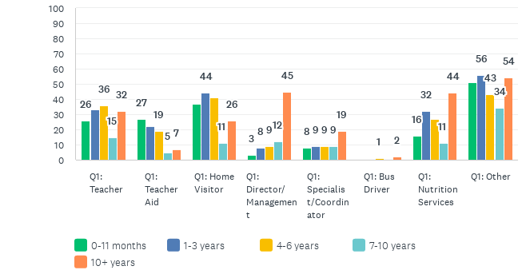
How long have you worked for your organization?
Answered: 859 Skipped: 1

Slide 5
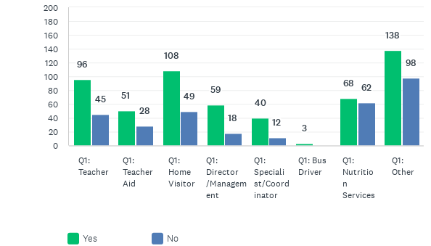
Have you had any previous training on tobacco/smoking?
Answered: 851 Skipped: 9

Slide 6
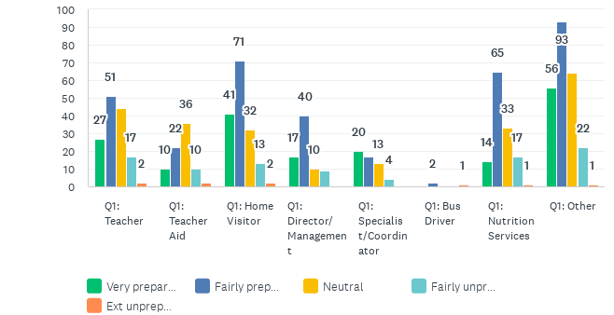
How prepared do you feel to discuss tobacco/smoking with parents?
Answered: 855 Skipped: 5

Slide 7
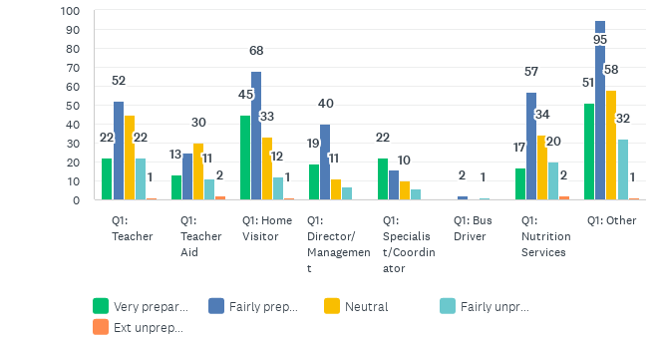
How prepared do you feel to discuss second/third-hand smoke with parents?
Answered: 859 Skipped: 1

Slide 8
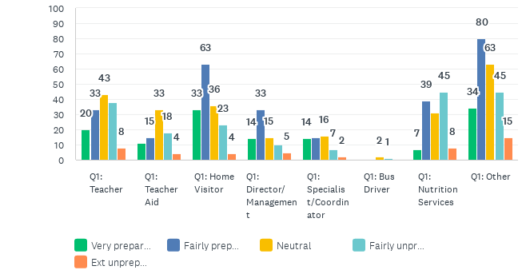
How prepared do you feel to discuss marijuana with parents?
Answered: 859 Skipped: 1

Slide 9
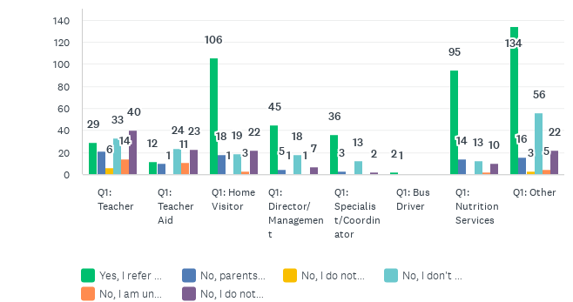
Do you refer parents to smoking cessation resources?
Answered: 849 Skipped: 11

Slide 10
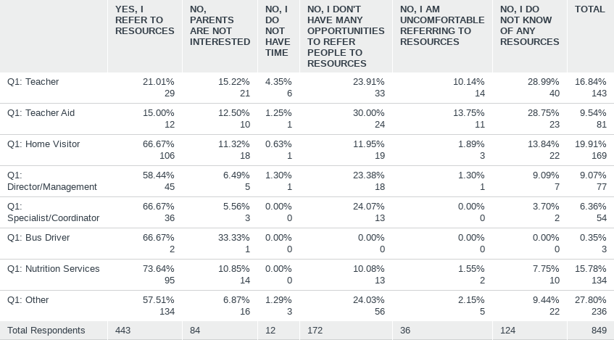
Do you refer parents to smoking cessation resources?
Answered: 849 Skipped: 11

Slide 11
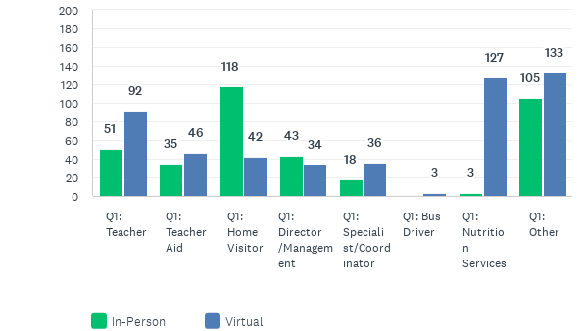
Was your Breathe Training In-Person or Virtual?
Answered: 860 Skipped: 0

