Slide 1
Breathe Post-Training Assessment 2021-2023, Segments by In-Person vs. Virtual
783 Total Responses
Tuesday, September 26, 2023

Slide 2
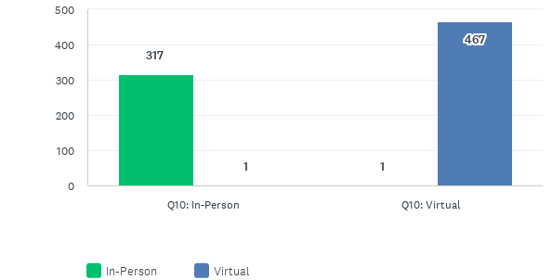
Was your Breathe Training In-Person or Virtual?
Answered: 783 Skipped: 0

Slide 3
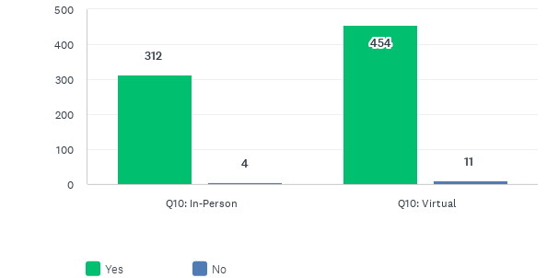
Would you recommend this training to others?
Answered: 780 Skipped: 3

Slide 4
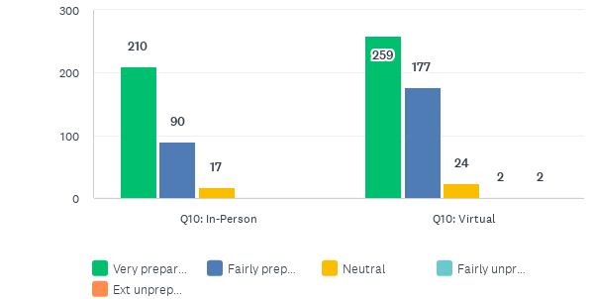
After completing the Breathe Training, how prepared do you feel to discuss tobacco/smoking with parents?
Answered: 780 Skipped: 3

Slide 5
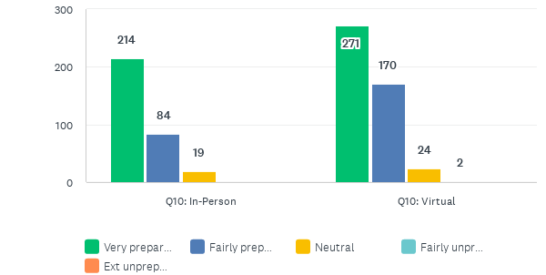
After completing the Breathe Training, how prepared do you feel to discuss second/third-hand smoke with parents?
Answered: 783 Skipped: 0

Slide 6
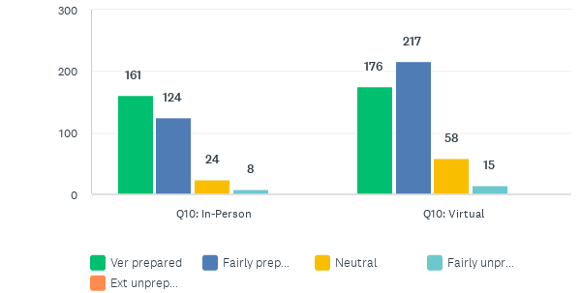
After completing the Breathe Training, how prepared do you feel to discuss marijuana with parents?
Answered: 782 Skipped: 1

Slide 7
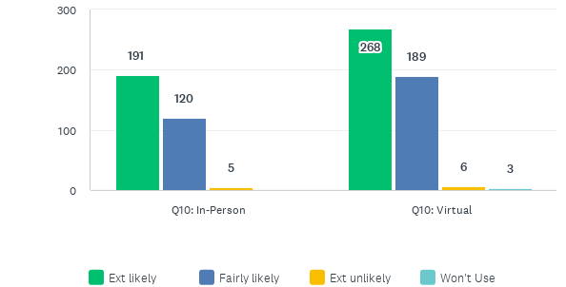
How likely are you to use the Breathe Training Materials?
Answered: 781 Skipped: 2

