Slide 1
Breathe 1 Month Survey 2021-2023, Segmented Based on Roles
174 Total Responses
Monday, September 25, 2023

Slide 2
Since completing the “Breathe” Training, HOW OFTEN have you used each of the materials?
Answered: 117 Skipped: 2

Slide 3
Since completing the “Breathe” Training, HOW OFTEN have you used each of the materials?
Answered: 117 Skipped: 2

Slide 4
Since completing the “Breathe” Training, HOW OFTEN have you used each of the materials?
Answered: 117 Skipped: 2

Slide 5
Since completing the “Breathe” Training, HOW OFTEN have you used each of the materials?
Answered: 117 Skipped: 2

Slide 6
Since completing the “Breathe” Training, HOW OFTEN have you used each of the materials?
Answered: 117 Skipped: 2

Slide 7
Since completing the “Breathe” Training, HOW OFTEN have you used each of the materials?
Answered: 117 Skipped: 2

Slide 8
Since completing the “Breathe” Training, HOW OFTEN have you used each of the materials?
Answered: 117 Skipped: 2

Slide 9
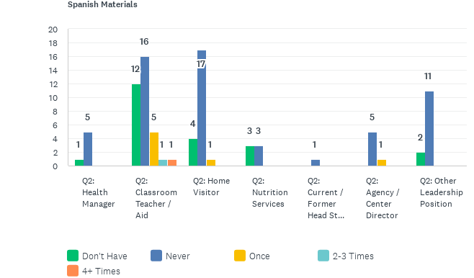
Since completing the “Breathe” Training, HOW OFTEN have you used each of the materials?
Answered: 117 Skipped: 2

Slide 10
Since completing the “Breathe” Training, HOW OFTEN have you used each of the materials?
Answered: 117 Skipped: 2

Slide 11
How USEFUL have you found each of the “Breathe” materials to be when providing education on tobacco?
Answered: 116 Skipped: 3

Slide 12
How USEFUL have you found each of the “Breathe” materials to be when providing education on tobacco?
Answered: 116 Skipped: 3

Slide 13
How USEFUL have you found each of the “Breathe” materials to be when providing education on tobacco?
Answered: 116 Skipped: 3

Slide 14
How USEFUL have you found each of the “Breathe” materials to be when providing education on tobacco?
Answered: 116 Skipped: 3

Slide 15
How USEFUL have you found each of the “Breathe” materials to be when providing education on tobacco?
Answered: 116 Skipped: 3

Slide 16
How USEFUL have you found each of the “Breathe” materials to be when providing education on tobacco?
Answered: 116 Skipped: 3

Slide 17
How USEFUL have you found each of the “Breathe” materials to be when providing education on tobacco?
Answered: 116 Skipped: 3

Slide 18
How USEFUL have you found each of the “Breathe” materials to be when providing education on tobacco?
Answered: 116 Skipped: 3

Slide 19
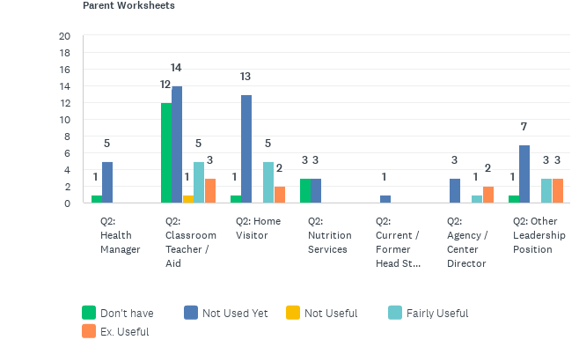
How USEFUL have you found each of the “Breathe” materials to be when providing education on tobacco?
Answered: 116 Skipped: 3

Slide 20
IN THE FUTURE, how likely are you to use each of the “Breathe” materials?
Answered: 117 Skipped: 2

Slide 21
IN THE FUTURE, how likely are you to use each of the “Breathe” materials?
Answered: 117 Skipped: 2

Slide 22
IN THE FUTURE, how likely are you to use each of the “Breathe” materials?
Answered: 117 Skipped: 2

Slide 23
IN THE FUTURE, how likely are you to use each of the “Breathe” materials?
Answered: 117 Skipped: 2

Slide 24
IN THE FUTURE, how likely are you to use each of the “Breathe” materials?
Answered: 117 Skipped: 2

Slide 25
IN THE FUTURE, how likely are you to use each of the “Breathe” materials?
Answered: 117 Skipped: 2

Slide 26
IN THE FUTURE, how likely are you to use each of the “Breathe” materials?
Answered: 117 Skipped: 2

Slide 27
IN THE FUTURE, how likely are you to use each of the “Breathe” materials?
Answered: 117 Skipped: 2

Slide 28
IN THE FUTURE, how likely are you to use each of the “Breathe” materials?
Answered: 117 Skipped: 2

