Slide 1
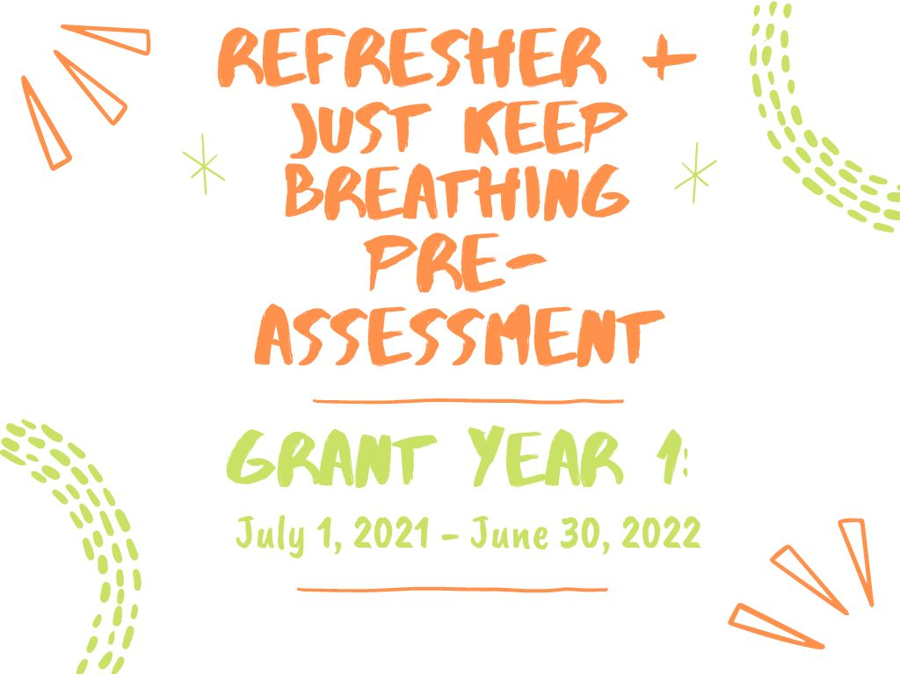

Slide 2
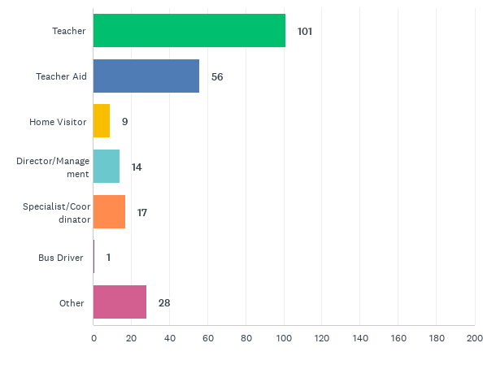
Q1: Job roles trained on Breathe Refresher:
Answered: 222 Skipped: 2

Slide 3
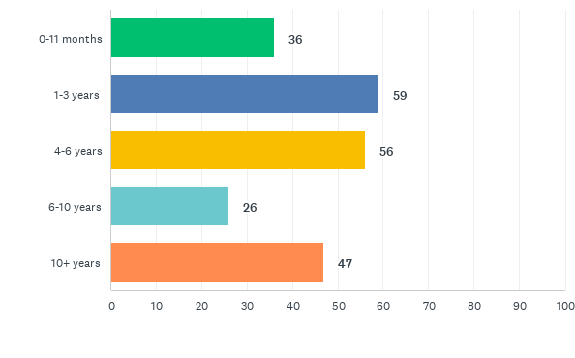
Q2: How long have you worked for your organization?
Answered: 224 Skipped: 0

Slide 4
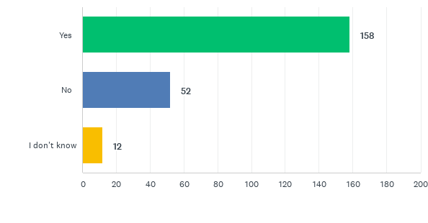
Q3: Did you attend the previous Breathe training on tobacco/smoking?
Answered: 222 Skipped: 2

Slide 5
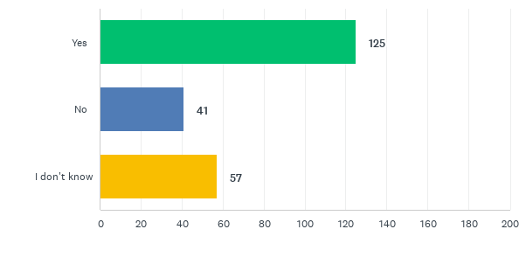
Q4: Do you have access/know where a Breathe Kit is stored at your organization?
Answered: 223 Skipped: 1

Slide 6
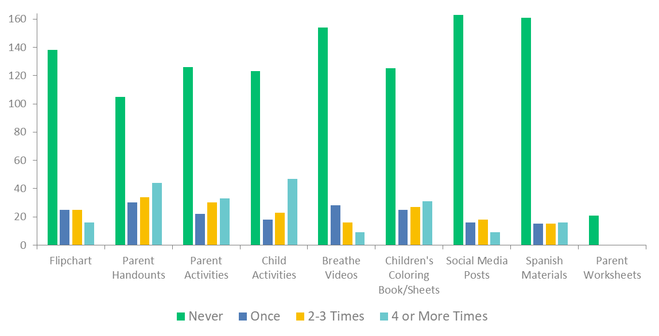
Q5: How often have you used each of the Breathe materials in the past year?
Answered: 215 Skipped: 9

Slide 7
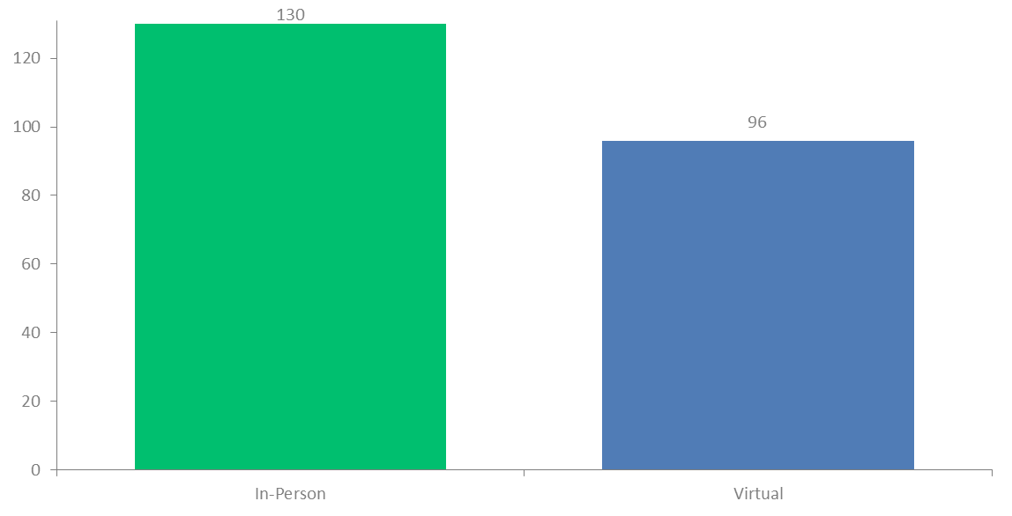
Q7: Was your Breathe training in-person or virtual?
Answered: 224 Skipped: 0

Slide 8
Q8: What county was the Breathe training held in?
Answered: 224 Skipped: 0

