Slide 1
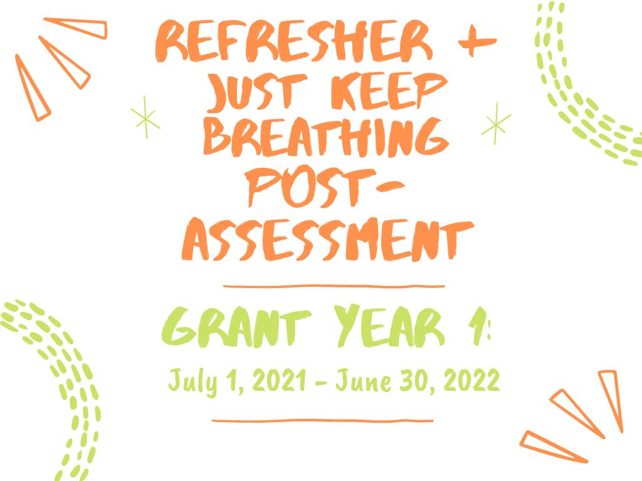

Slide 2
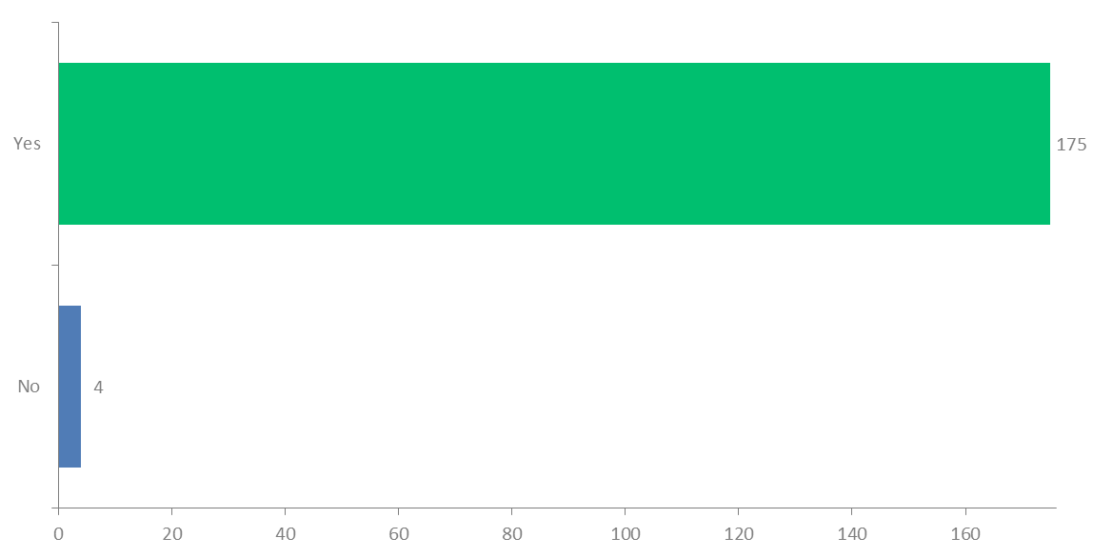
Q4: Would you recommend this training to others?
Answered: 179 Skipped: 4

Slide 3
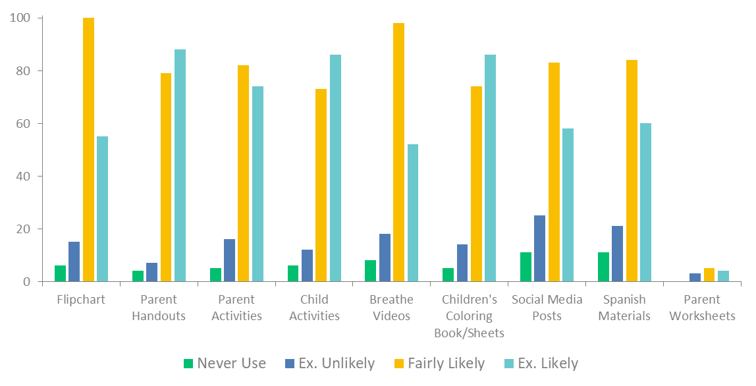
Q5: How likely are you to use the Breathe materials in the future?
Answered: 181 Skipped: 2

Slide 4
Sample of Comments of Participant’s Impression of the Training
You rock!; it was pretty impressive; very informative; a great reminder; it was fun; very well said
Great activities; good information; okay, friendly staff; good to know/share resources;super important for our job, and can be utilized; Presented well and in a reasonable amount of time; Presenter was very knowledgeable
I learned a lot, I had no knowledge of Breathe before; We need to implement it more
Impressed; engaging; Enlightening; informative, good visuals; fast and easy to understand; Quick Review. Important topic; It was fun and interactive and I learned something new!
Great info loved it!; Very informative and positive. Very enthusiastic; it was a fun educational training
It helps remind us how serious it really is; Helped stress the importance and gave a good reminder
A great refresher and motivation to educate families; It was a good reminder of available materials.
How third hand smoke affects everyone around.
It is a community effort to help people, especially parents who don't realize the repercussions for their children being around their smoke.
It was fine; It was ok; We already had prior knowledge; its good but going to be hard to implement with our families; It is important but a touchy subject
I enjoyed getting the information. I am inspired to share more with my parents
Helpful. Liked the zoom format; I liked how it was presented; That they are well prepared.
It was a good source of information to help me to be able to creatively address tobacco use with families.
I am glad Headstart is trying to equip staff to better help families with these issues; I really enjoyed the input from the others in the consortium.
Great information and good to know support and materials are available; I liked having links to many resources digitally, especially new materials.

Slide 5
Sample of Comments on Favorite Part of the Training
Family Feud/ Group Participation; learning through games; game, made learning fun; the jeopardy game - fun & informational; the game had good facts
Interactive; game, made learning fun; the game. we are a competitive group; informative in a fun way; doing things as a team & games; The interactive games and chat box questions.
how to approach parents/others; the ability to share resources with families; discussion on ideas to use the materials with my parents
the materials; hand outs; new materials; ideas from other staff for ways to discuss with families; The great resources for staff and families Information for parents in Spanish
getting up activity; participation from staff
All of it. Very informational; the statistics
Information on talking with parents about the dangers of smoking around their children; tips for parents; Brainstorming ideas on how to approach talking with parents about second hand smoke
I liked that we could still participate virtually. I like learning more about how to use the things we didn't use so much.
quick and concise; Reminder to talk about this; the presenter was helpful

Slide 6
Sample of Comments on Least Favorite part of the Training
sitting still; the long talking without interactions; Dumb questions; No personal contact; too many speakers back and forth
it was short; too long
losing family feud; jeopardy
i enjoyed it all
word correlation; picking sides; being asked direct questions; the questions that moved across room; Asking for opinions
hand outs; Could go over definitions better/ 2nd/3rd hand; surveys; the part about hopefully getting our certificates.
having those hard conversations with parents; sensitivity of smoking topic; need more ideas to help sharing info; I guess where we are to bring it up to parents, not very comfortable doing this; Parents don't want to hear it. I feel uncomfortable, invasive talking about this.
It's sad to go over all the statistics of all the negative consequences for innocent infants and children; how many kids get exposed
I would have liked to see more strategies/tips for how to address this issue with families.
The chat box moved extremely fast from time to time. Sometimes, I wasn't quick in my response time (during the jeopardy game); I’m not good at using the tools on my computer to communicate during zoom; The fact that I did not have a camera, so I could not participate fully.
It was virtual; I miss not having the hands on things as part of the in person training.
Kinda repetitive, some common sense things; it didn't go into much detail, was mostly what we thought of things & how we felt about things; That it is common knowledge & nothing was new.

Slide 7
Sample of Additional Comments
Fun Presentation! You are wonderful!
Thank you for another great refresher and resources!
Thank you for your time and efforts.
Would like to have a copy of the Jeopardy game for parents
Keep up the good work and maybe focus one the younger parents. They are the harder ones to reach.
My classroom is an infant class....
I am not a classroom teacher
Due to my position, I do not have a lot of opportunities to use. However, I can use them in meetings with parents who express interest in quitting.
I love the short and simplicity, but informative information.
Thank you for what you do.

