Slide 2
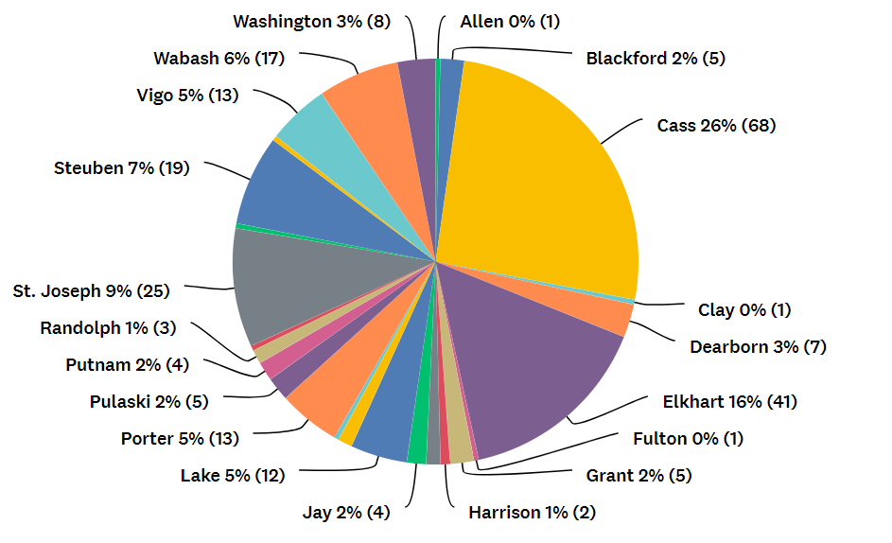
Q1: What County do you live in?
Answered: 264 Skipped: 5

Slide 3
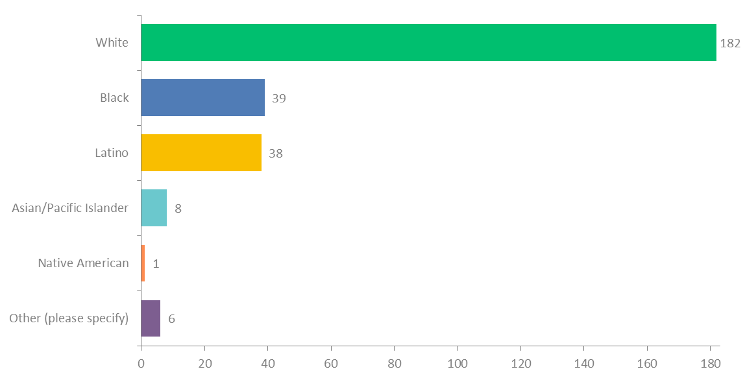
Q3: What is your race/ethnic background?
Answered: 262 Skipped: 7

Slide 4
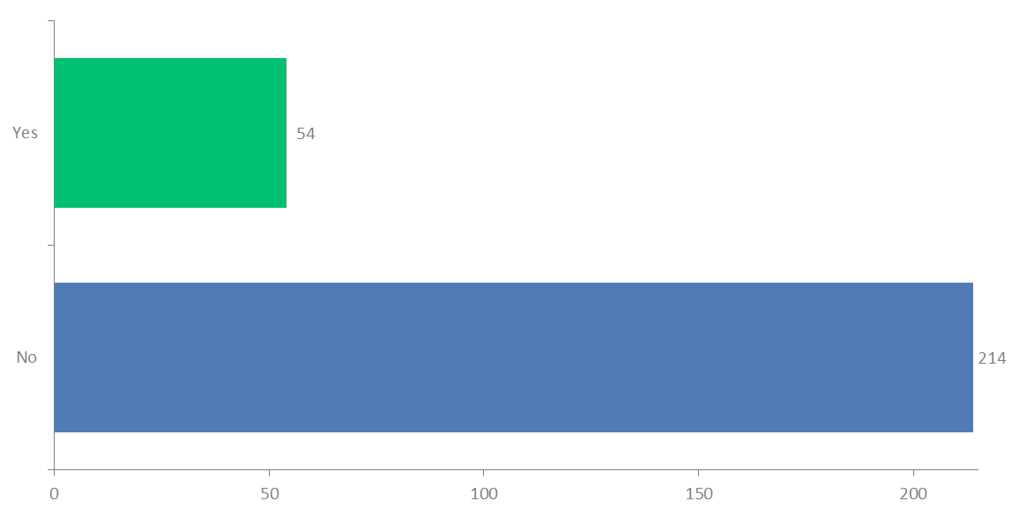
Q4: Do you smoke, chew tobacco, or use e-cigarettes/vape
Answered: 268 Skipped: 1

Slide 5
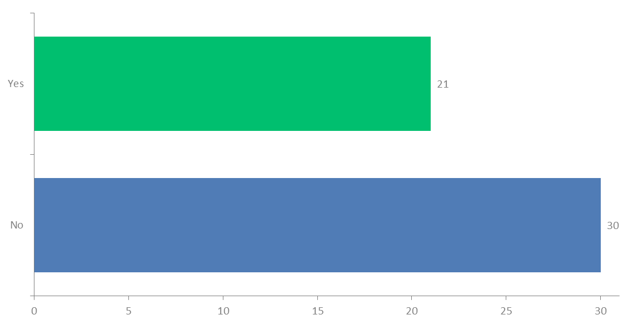
Q5: Are you interested in resources to help you quit?
Answered: 51 Skipped: 218

Slide 6
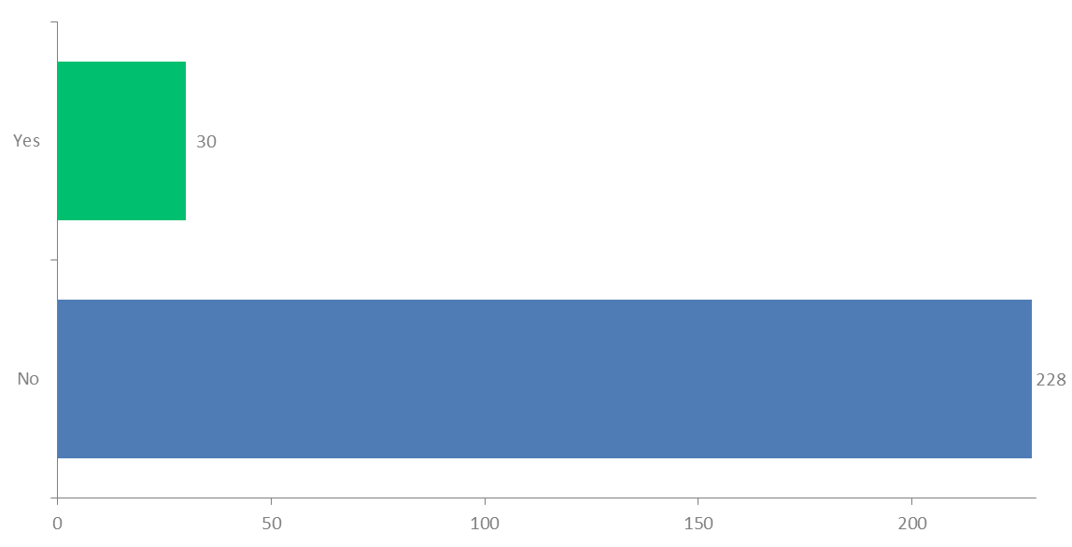
Q6: Is your child exposed to tobacco smoke and/or e-cigarette vapor in the home or car?
Answered: 258 Skipped: 11

Slide 7
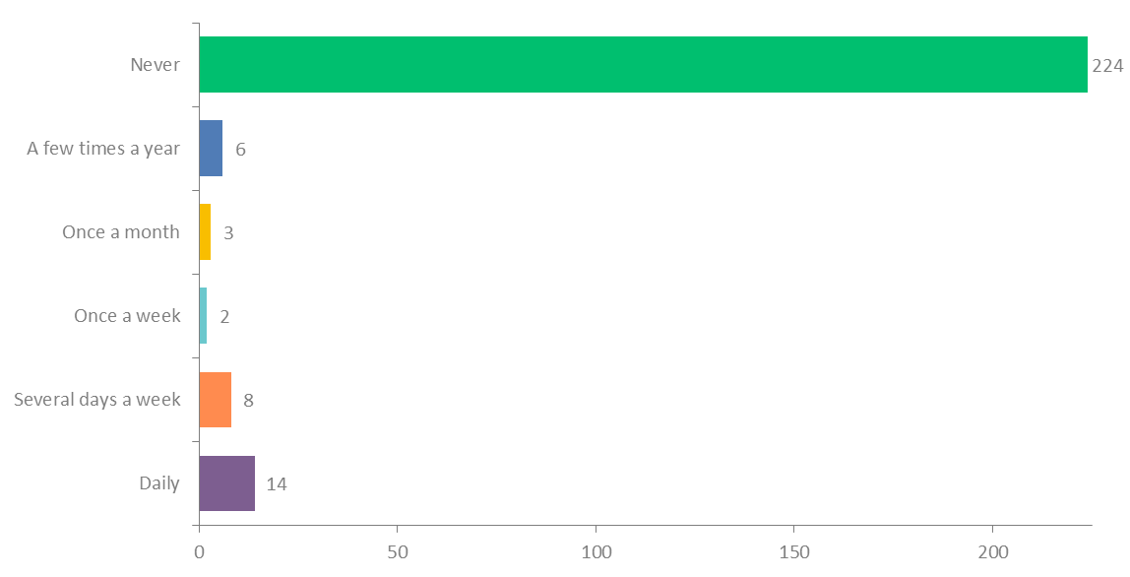
Q7: How often does anyone smoke in your HOME?
Answered: 257 Skipped: 12

Slide 8
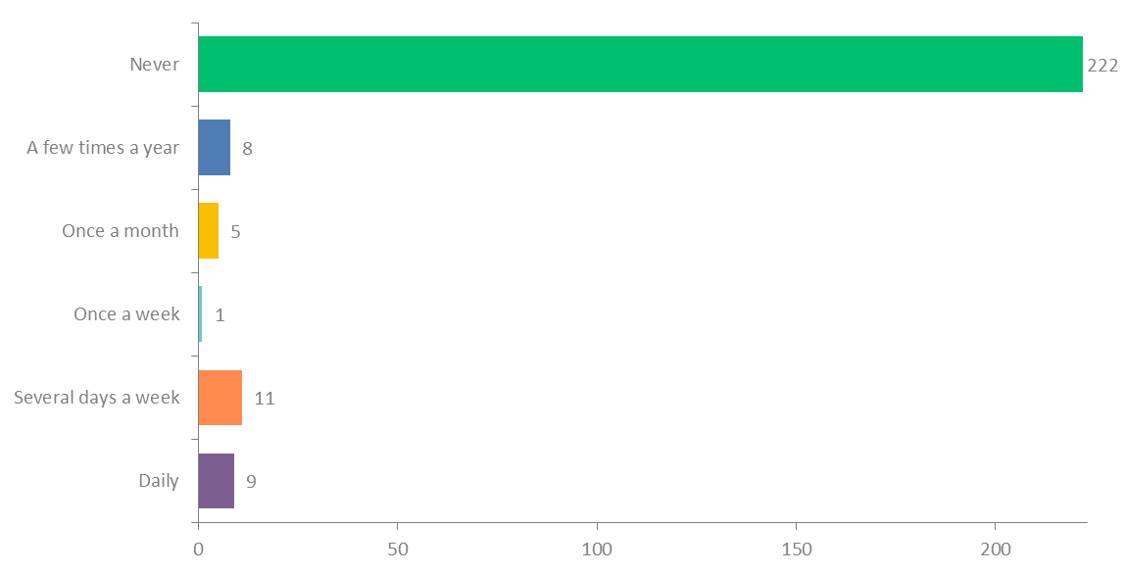
Q8: How often does anyone smoke in your CAR?
Answered: 256 Skipped: 13

Slide 9
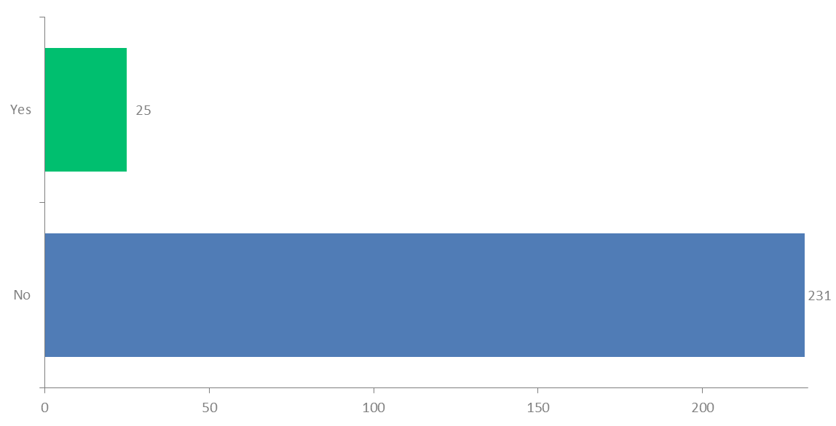
Q9: Has your child ever been diagnosed with asthma or another chronic respiratory illness?
Answered: 256 Skipped: 13

Slide 10
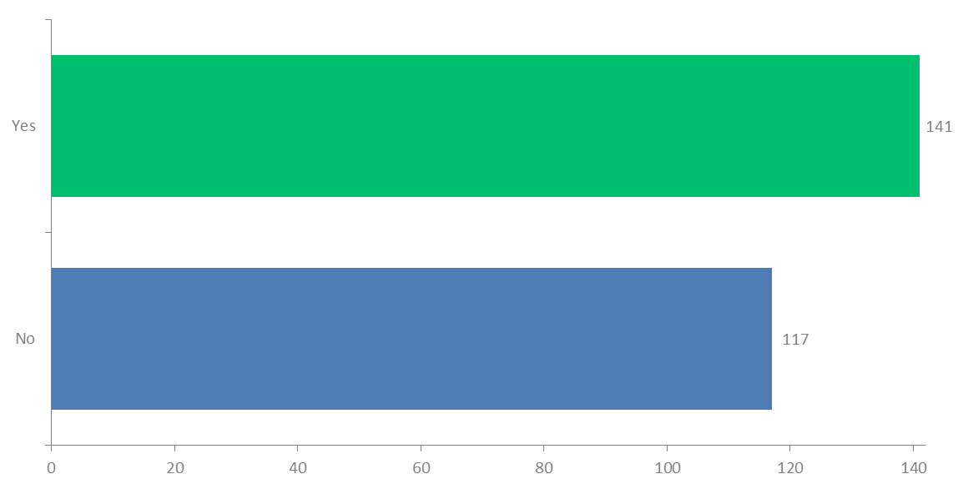
Q10: Have you received education about the dangers of tobacco and secondhand smoke in the past 3 months (including today)?
Answered: 258 Skipped: 11

Slide 11
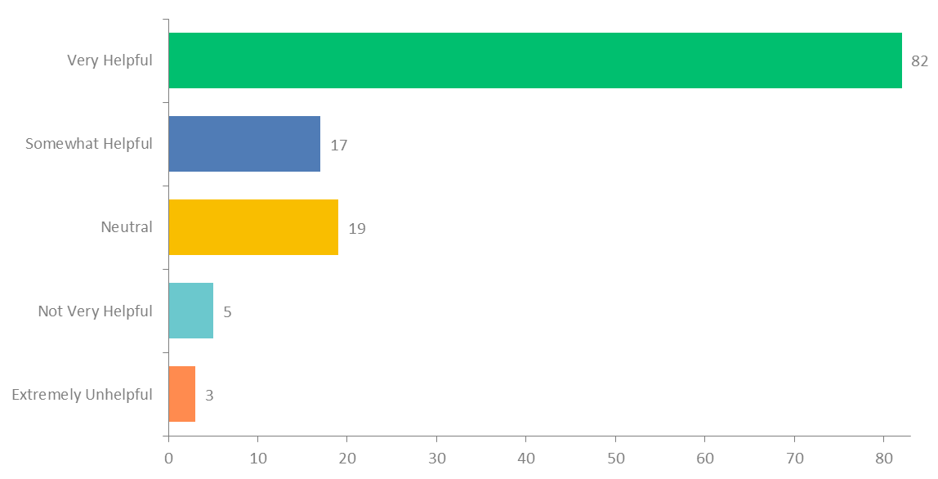
Q12: How helpful was the tobacco education?
Answered: 126 Skipped: 143

Slide 12
Sample of Additional Comments from Parents
I'm ready to quit for myself and my family.
Can't control other people even loved ones
Born 5 weeks early with premature lungs that to this day have not fully developed can't stand to be around smoke
I smoked for over 40 years and quit 7 years ago
I have been smoke free 4 years. I smoked over 22 years. I have breathing issues.
The tobacco class was explained very well
I feel it is very necessary for me to quit
Thank you for all these resources for our Head Start Consortium!
I used to smoke until I realized how dangerous it was not only to me but also my children and others around me.
I am on my way to not smoking. I smoke less and less every week. I want better health for myself and my kids.
We are a nonsmoking household.
It is important to understand your triggers
Would like resources to give to father whom doesn't live with us.
My husband and I are currently trying to quit.
Dad smokes outside and washes his hands when he comes back in the house.
I only smoke like 4 or 5 cigarettes a day.
I currently use a vape to stop smoking cigarettes and I am almost completely off of the vape now.

