Slide 2
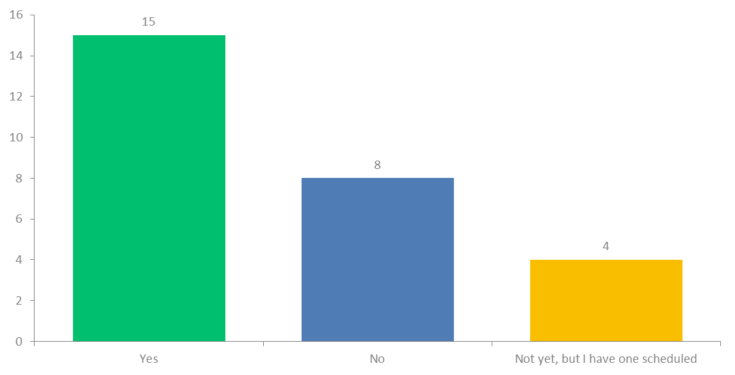
Q3: Have you conducted an in-person or virtual Breathe Training or Breathe Refresher this grant year (July 2021-June 2022)?
Answered: 27 Skipped: 0

Slide 3
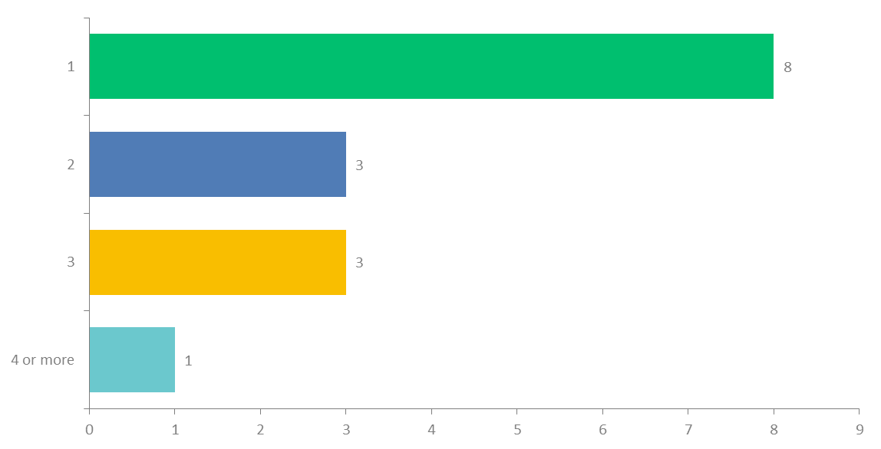
Q4: How many Breathe Trainings have you conducted this grant year?
Answered: 15 Skipped: 12

Slide 4
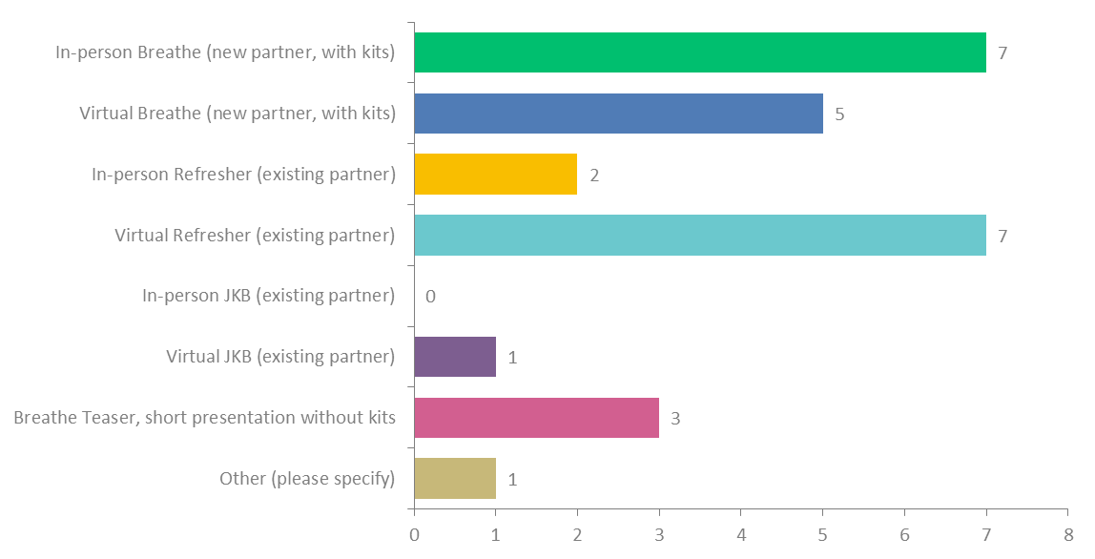
Q5: Which Breathe training(s) did you conduct this year (check all that apply)?
Answered: 15 Skipped: 12

Slide 5
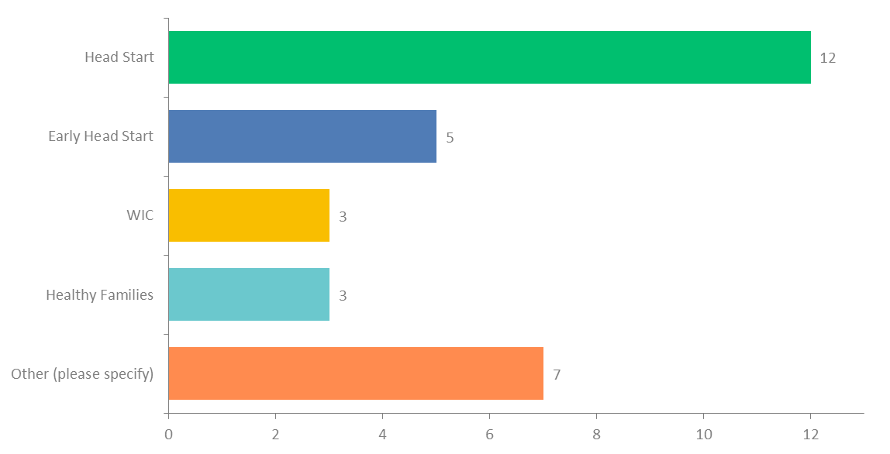
Q6: Which organization(s) have you conducted a Breathe Training for this grant year? (check all that apply):
Answered: 15 Skipped: 12
Other: Early Learning Center, Systems of Care, Hoosier Hills PACT Shelter Services and Transitional Housing Program, Choices Life Resource Center, Goodwill Nurse Family Partnership, Hilltop Neighborhood House, Healthy Start Community Partner, and Heart To Heart INC.

Slide 6
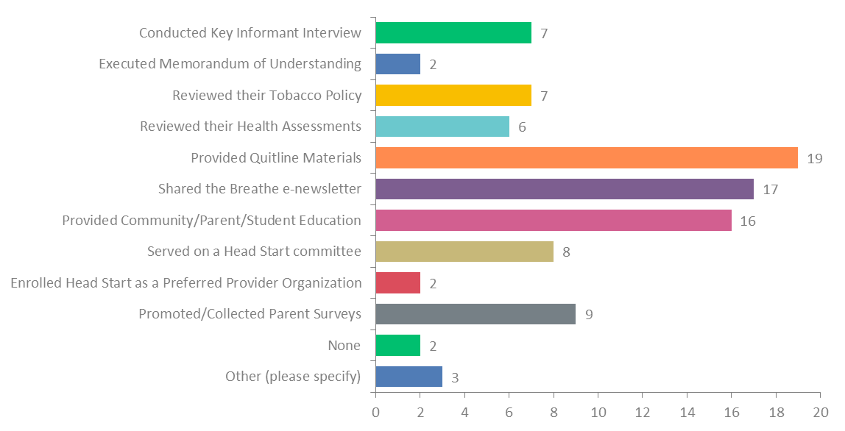
Q7: Which of these additional Breathe components have you completed with your Head Start/Alternate site this grant year? (check all that apply):
Answered: 26 Skipped: 1

Slide 7
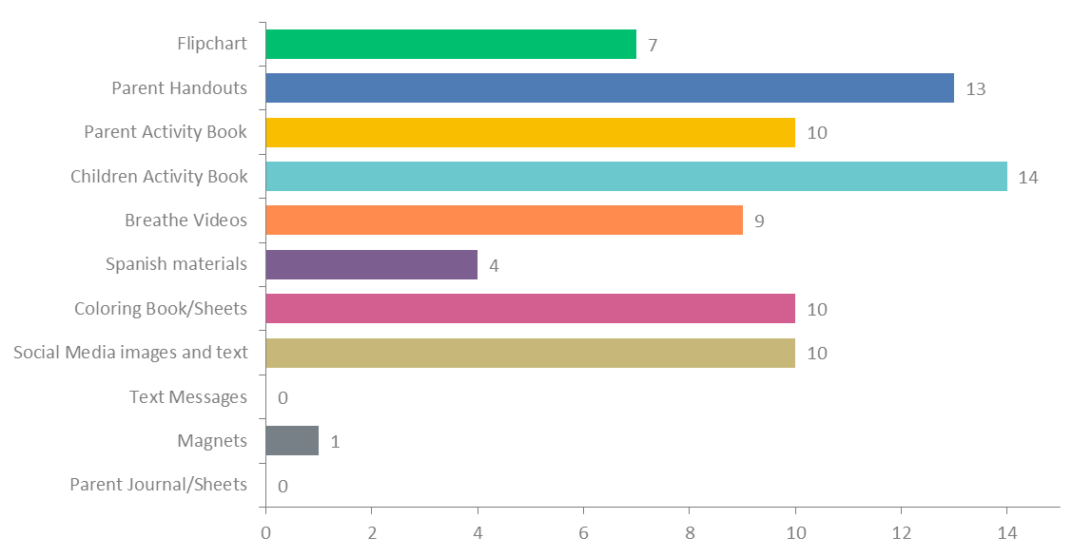
Q8: Which of the Breathe Materials do you find most useful (check all that apply)?
Answered: 24 Skipped: 3

Slide 8
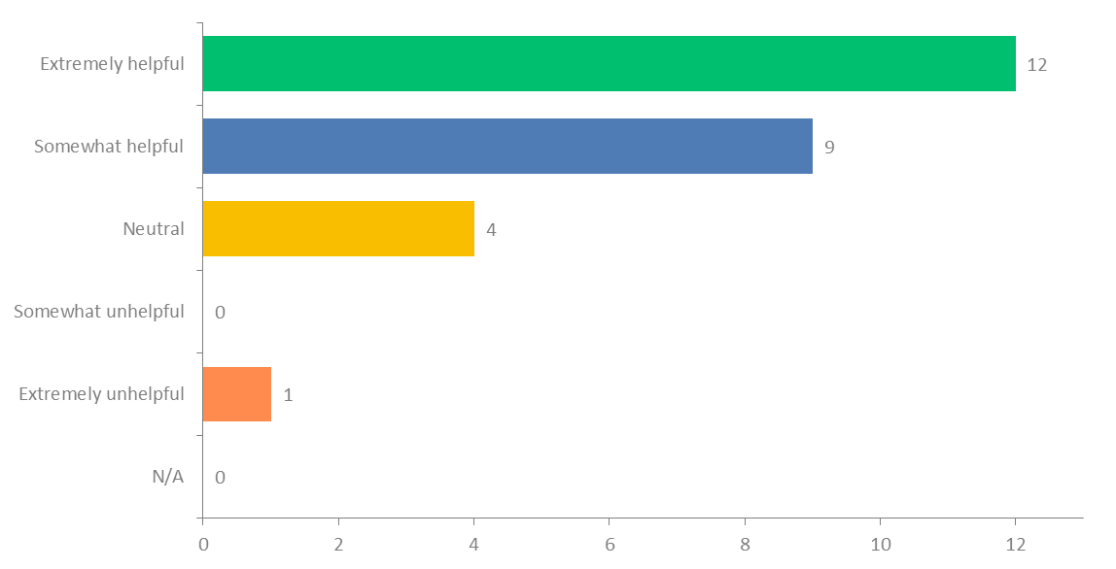
Q9: How useful has the Breathe website (justbreathein.org) been to you this grant year?
Answered: 26 Skipped: 1

Slide 9
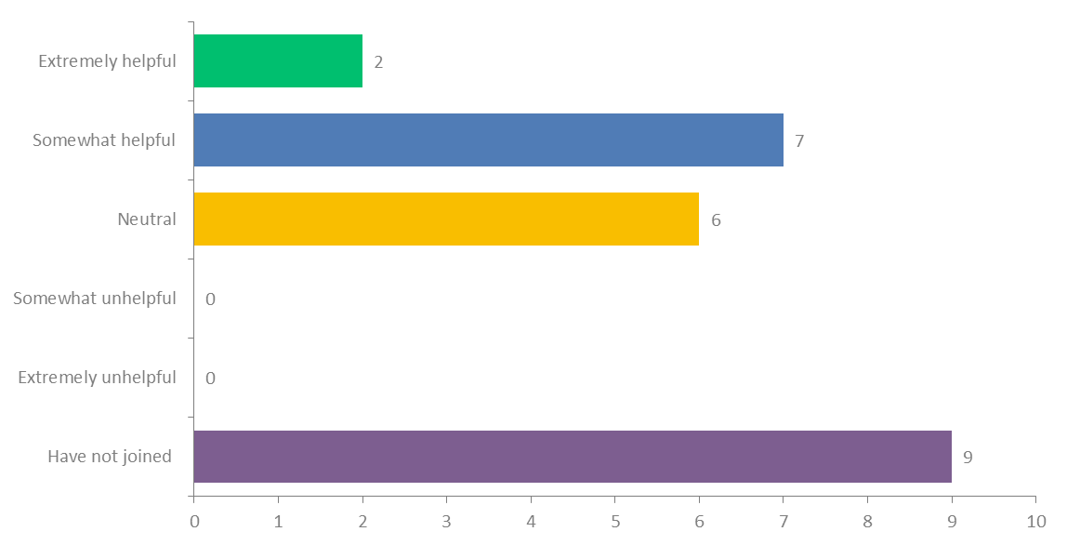
Q10: How useful has the Breathe Facebook group been to you this grant year?
Answered: 24 Skipped: 3

Slide 10
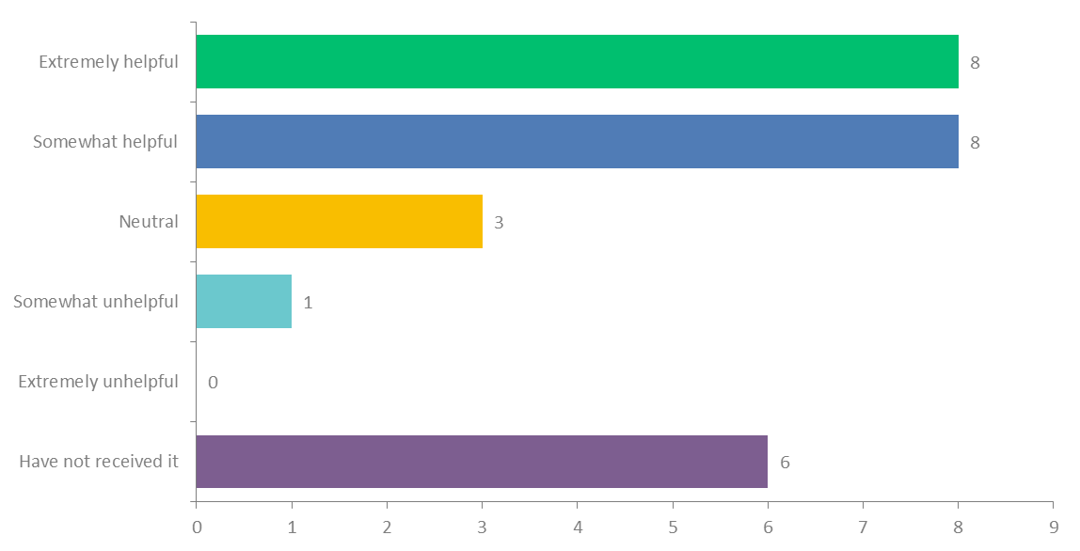
Q11: How useful has the Breathe e-newsletter been to you this grant year?
Answered: 26 Skipped: 1

Slide 11
Sample of Comments on Successes with Breathe
The first parent survey name drawing was from Washington County. That was nice to share with the Breathe program partners. The Hoosier Hills PACT Shelter Support program consistently utilizes the parent handouts and promotes the survey. The Hoosier Uplands former Baby and Me Tobacco Free program coordinator really enjoyed using the materials with her families and was a good partner spokesperson for the Breathe program.
I love using the materials, especially the flipchart for community events such as the Community-Wide Baby Shower.
Head Start contacted me to do something for their employees for nicotine dependence and they also said we will schedule a Breathe Training for staff now that the Pandemic has subsided.
Able to do a virtual refresher with 137 Head Start/Early Head Start staff this year. Provided a virtual educational training for Head Start families in English (74) and Spanish (26) with TPC partners from Elkhart and St. Joseph County. This allowed us to engage with parents and have them complete the parent survey. An Elkhart County parent won the certificate. I already have a meeting set up with Head Start Director to get trainings on the calendar for the 2022-2023 school year.
It has been a hard year to get in to do presentations. I will be attending a family resource fair on 6/3/22 at one of our head start sites and will be distributing information to families and staff.
I have not been able to implement BREATHE in any organizations yet, but I have made progress in connecting with organizations that find the idea interesting.
I was able to get our local WIC supervisor to attend the statewide WIC virtual training.
Shared the info with a new location that serves a marginalized population by serving children of lower income families.
I think it's always a success when Head Start invites you to come back every year to do a training with their staff.
One parent from the training accepted services through the quitline.
Presentations to elementary school children brought teachers attention and they were amazed at what they do not know about tobacco products and vape products & also includes health disparities and the focus on Big Tobacco gaining new smokers and vapors. These presentations have brought new light to prevention and policy. We will be presenting to the Greater Clark County School Board sometime in July with teachers supporting us during the presentation to GCCSB to change and update the policy for all tobacco products and include vaping.

Slide 12
Sample of Comments on Creative Ways County Coordinators Used Breathe
I have used the helpful tips list for one of my other projects- and shared with the schools during vape free awareness month. they shared a tip a day on their morning announcements.
The Breathe program materials were provided as a component of a smoke-free home toolkit for the Head Start parents. Any parents that voluntarily signed a smoke-free home pledge were entered into a name drawing for dinner from three local restaurants. The toolkits were not utilized as I had hoped due to glitches with the end of the year home-visits so they were be used during the 2022-2023 school year.
I use the flipchart and handouts for community events.
I share the monthly newsletter with head start and other community health workers who work with families.
Shared Breathe info with Goodwill Nurse Family Partnership & suggested they get trained. Sent letters to 10 daycares
Trained 20 Healthy Families staff and did a teaser training with WIC. Will follow up with WIC and provide a full training for interested staff.
I have conducted outreach in a few veterinarian offices. I thought that it may be beneficial for pet parents to be aware of potential health hazards for their pets.
We take elements/inspiration from the training and activities and incorporate them into other settings. We also get great feedback when we use similar activities/ideas from the Breathe training.
We provided printed copies of the coloring book with crayons at the local farmers market last year
A parent/student/teacher fair (approximately 2 hours) with information, free haircuts, free icey drinks tobacco/vaping information, short presentations and swag items handed out for free. Both events with the help of the teachers sending flyers home made our events overwhelmingly huge. (we also offered Hispanic information & interpreters).
I altered the presentation a little to present to parents and clinicians at an online event. It went very well!

Slide 13
Sample of Comments on the Biggest Challenges with Breathe
Getting into in-person trainings; My Head Start Center will not respond to my requests to train.
Everyone is understaffed and adding a new curriculum to their plates was not ideal; Staff turnover at the local Head Start center.
Coordinating schedules between SJC and Elkhart as our Headstart program covers both counties
The Parent Surveys were a challenge. I tried to encourage them to post the flyer on their social media page post it in their area where parents do pickup/drop off and offered to print copies of it. To my knowledge there were none completed in our county.
Still dealing with COVID restrictions and I observe people are doing their very best to try and catch their stride and they are slowly being able to handle more, but it is slow!
The only real challenge was the Head Start training planned for new staff was cancelled. Hopefully, by getting trainings on the calendar before the school year starts will help moving forward.
So far the biggest challenge has been finding any of our preferred networks that would like updated Breathe training.
Keeping Head Start and Early Head Start leaders engaged and understanding the need to keep Breathe as a priority.
It's pretty easy to get into my local Head Start for a training. I feel like my biggest challenge is training an alternate site.
It's very difficult to engage Head Start staff virtually. Many staff seemed uninterested or unwilling to participate. Looking forward to future in person trainings.
Getting permission to enter schools. COVID was the one thing that stopped getting all school to permit us entrance. It was a combination of Covid and no time since classes were behind schedule.
The head start and alternate staff have difficultly sharing the info with parents and kids even though we go through ideas of how to talk to people. I know the more they practice and do it the easier it will be but many think it is too touchy a topic (especially talking to parents about this).
The biggest challenge with Breathe implementation continues to be getting the program implemented at Head Start. They do a very limited amount of trainings per year for all staff. So it continues to be a challenge to get on the schedule for that training.

Slide 14
Sample of Comments on Additional Support Needed
We need some training and to set up some collaborative outreach events.
An info flyer that can be shared with the daycare explaining how it will benefit them such as it gives continuing education hours, lesson plans, etc.
It would be nice to be able to order the parent handouts or journal pages as I have to have these printed professionally if I want to provide them to the Breathe program partners. They would be perfect to provide to the Orange County WIC staff each month. These ladies attended the Breathe training provided to the state WIC staff.
It bothers me that I am out of compliance with my grant deliverables because my Head Start Center will not cooperate. I don't know what additional support would help with that other than the state requiring centers to participate.
Patience to meet deliverables
You all do a great job supporting our work locally and updating materials!
I feel that the Breathe staff have been very helpful and engaging. The only additional support I need is another staff member within my organization to assist me with the grant.
Let us know if you are training organizations we are charged with handling in our counties so we know what our role is with them. If you are training WIC, WE should know this before THEY do. I was pushing our WIC to let us provide a training and they said you were already doing it and how did we not already know about that. It was a bit embarrassing to not have been made aware of this. PLUS, if you tell us to just do a follow-up to provide materials or whatever you want our role to be with those organizations in our county - we need to know how to schedule our time and efforts. I spent a lot of time trying to get into WIC and then was told we don't need to conduct Breathe for them.
Possibly a letter from you introducing Breathe

Slide 15
Sample of Additional Comments
The Parent Handouts are great, but not a cost that centers want to pay to print, and our grants are limited on funds, so having the handouts available to order instead of having to use our grant funds to print would be helpful.
Head start has not been very cooperative with me. I have tried numerous times and it has been very frustrating for me.
I love the program and materials itself, we use elements of the training/activities in other settings. Our alternative settings seem to enjoy the training but it's difficult to convince Head Start staff to see the value. I believe that has more to do with their overall workload/burnout rather than our program but it is a barrier nonetheless.

