Slide 1
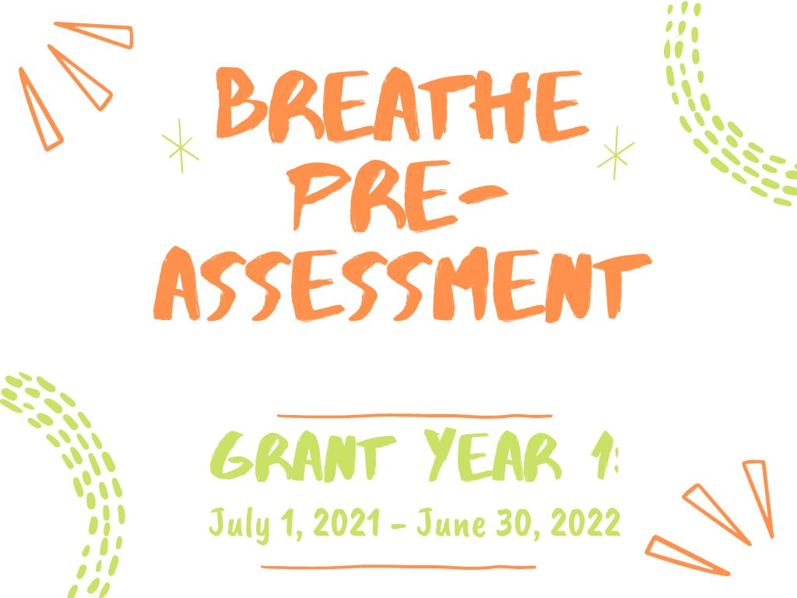

Slide 2
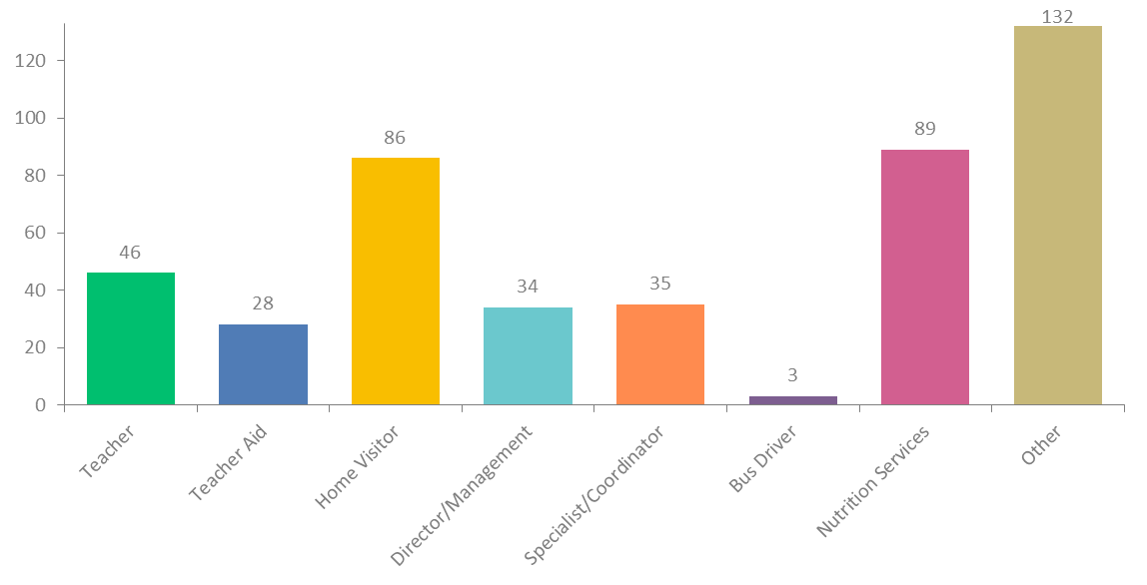
Q1: Job roles trained on Breathe (full training):
Answered: 437 Skipped: 1

Slide 3
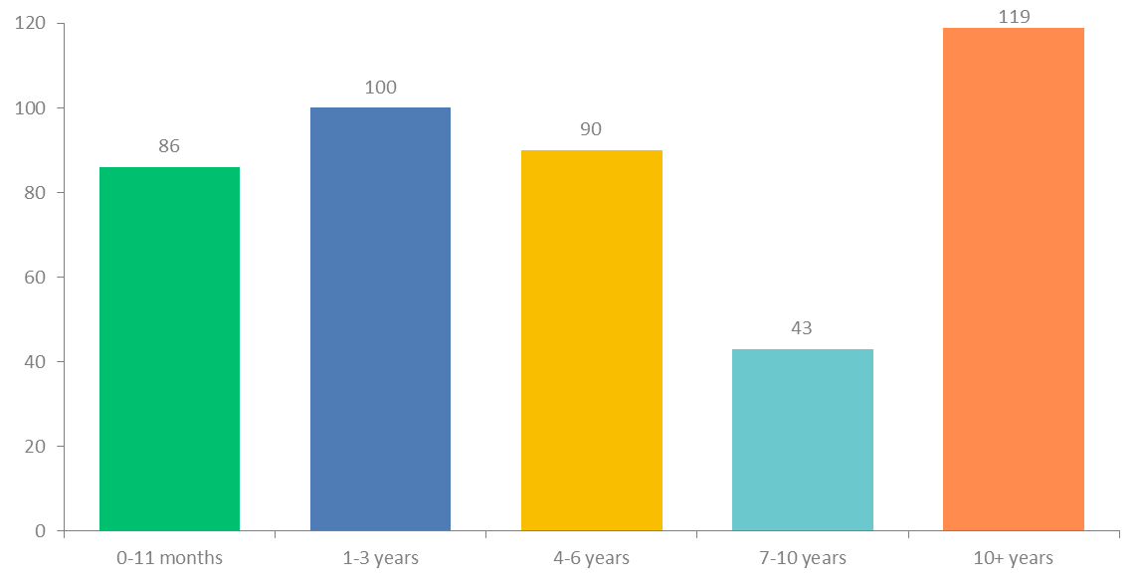
Q2: How long have you worked for your organization?
Answered: 438 Skipped: 0

Slide 4
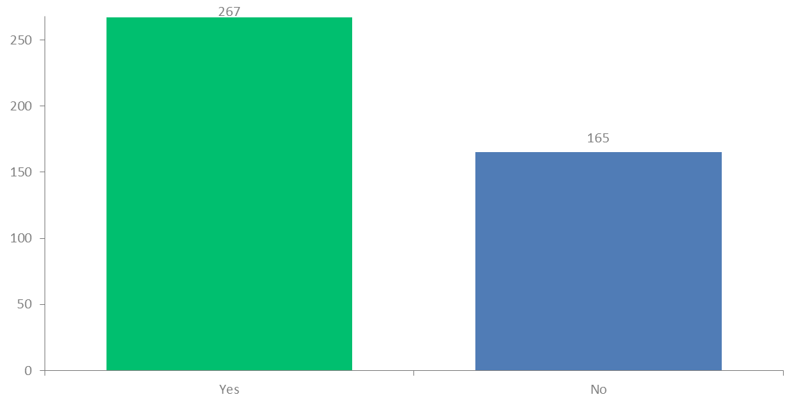
Q3: Have you had any previous training on tobacco/smoking?
Answered: 432 Skipped: 6

Slide 5
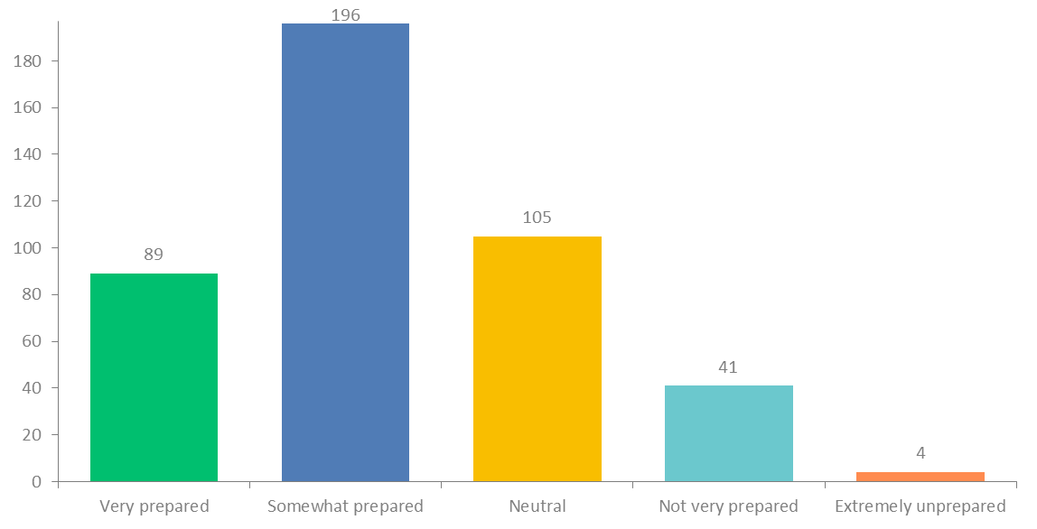
Q4: How prepared do you feel to discuss tobacco/smoking with parents?
Answered: 435 Skipped: 3

Slide 6
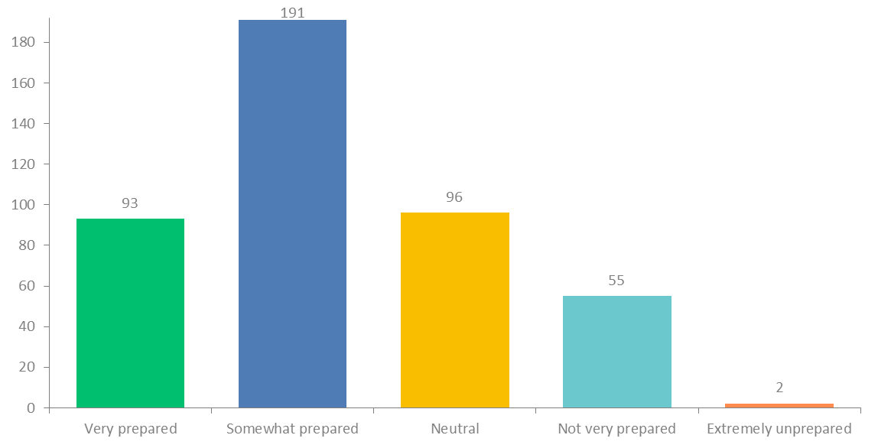
Q5: How prepared do you feel to discuss second/third-hand smoke with parents?
Answered: 437 Skipped: 1

Slide 7
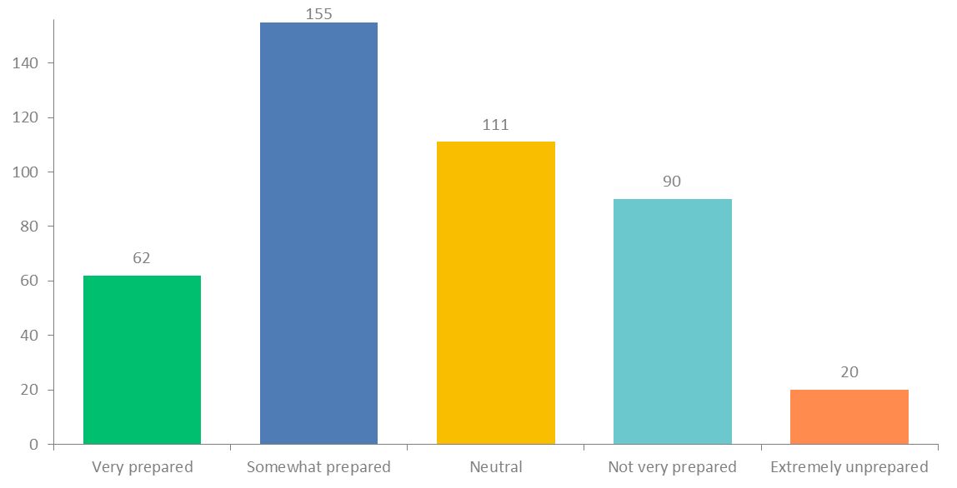
Q6: How prepared do you feel to discuss marijuana with parents?
Answered: 438 Skipped: 0

Slide 8
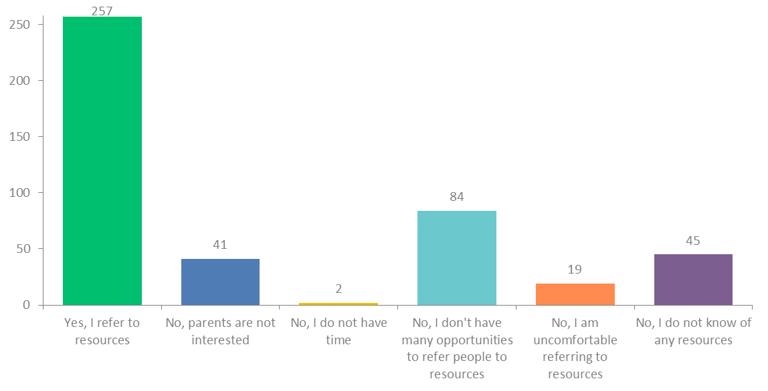
Q7: Do you refer parents to smoking cessation resources?
Answered: 432 Skipped: 6

Slide 9
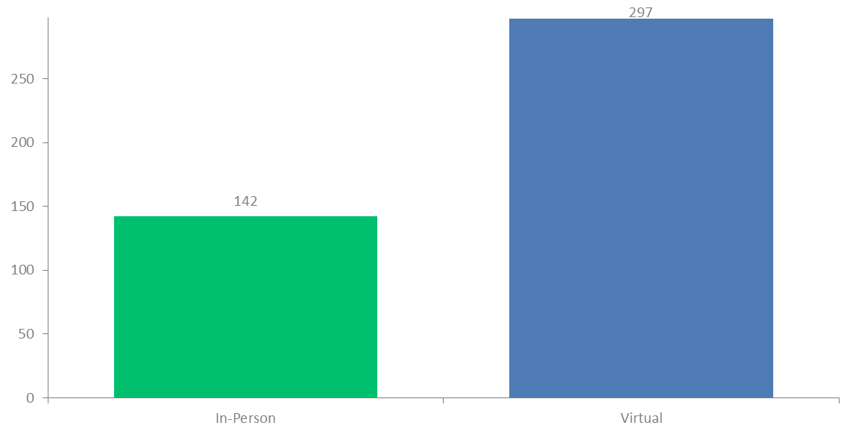
Q9: Was your Breathe Training In-Person or Virtual?
Answered: 438 Skipped: 0

Slide 10
Q10: What county was the Breathe training held in?
Answered: 427 Skipped: 11

