Slide 1
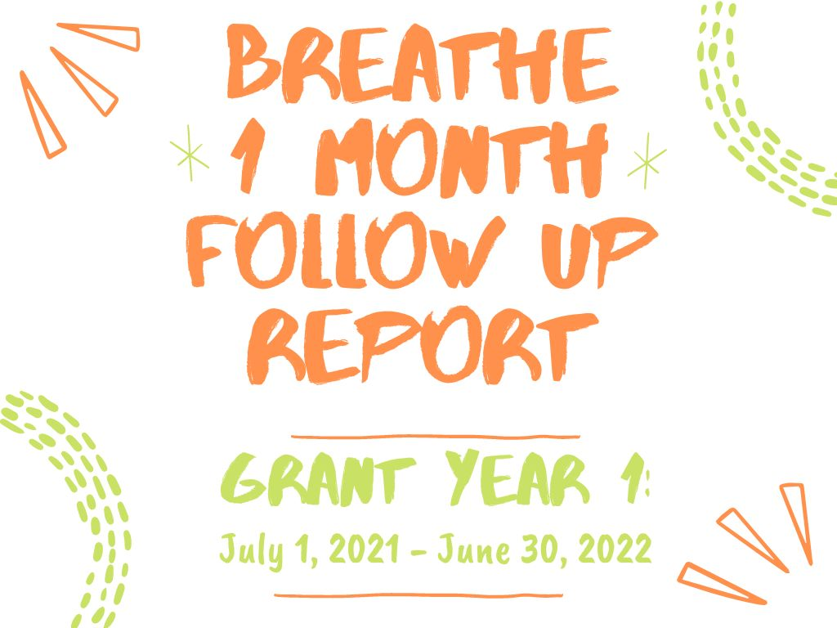

Slide 2
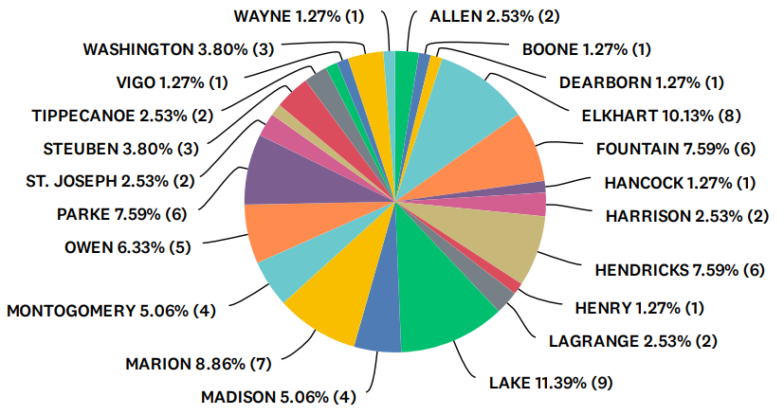
Q1: Counties that received Breathe Training:
Answered: 79 Skipped: 0

Slide 3
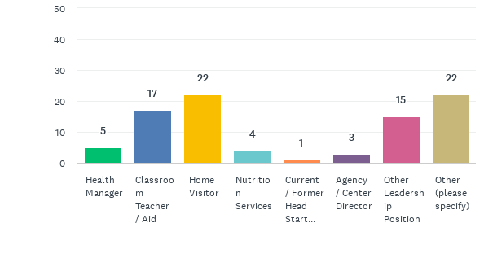
Q2: Please select the title/role that best describes your position(s) within your organization (check all that apply):
Answered: 78 Skipped: 1

Slide 4
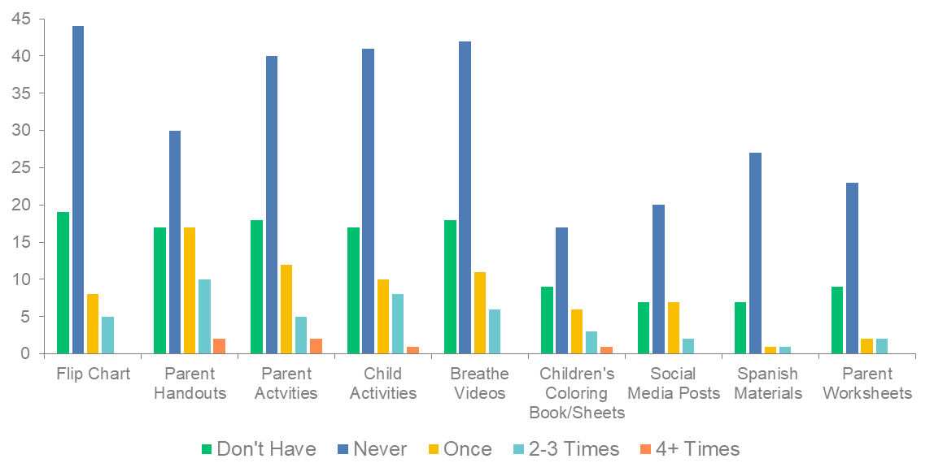
Q3: Since completing the “Breathe” Training, HOW OFTEN have you used each of the materials?
Answered: 78 Skipped: 1

Slide 5
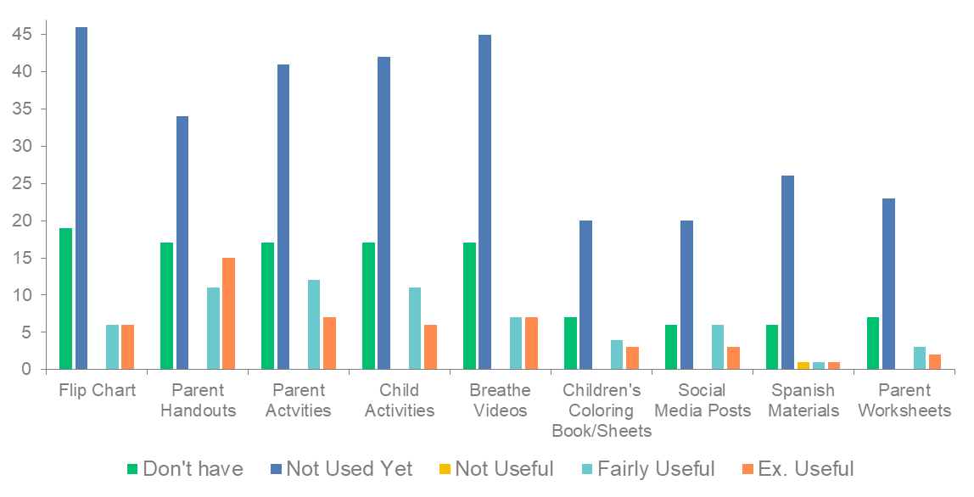
Q4: How USEFUL have you found each of the “Breathe” materials to be when providing education on tobacco?
Answered: 77 Skipped: 2

Slide 6
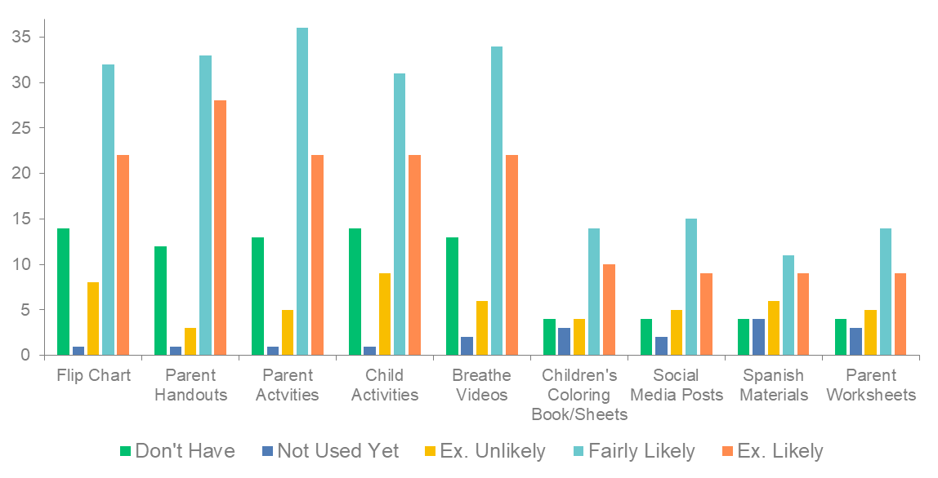
Q5: IN THE FUTURE, how likely are you to use each of the “Breathe” materials?
Answered: 77 Skipped: 2

Slide 7
Sample of Comments on Successes/Challenges
I am still reading some of the information. This is great for our community to be aware of the concerns and dangers of smoking.
I am not front line staff so that is why my responses reflect limited use of materials personally; I don't work with the children. I do the kitchen work; In my leadership position, it is doubtful that I will get the opportunity to use the materials.
We have recently hired an RN who will do the Breathe training along with the on-site Dietitian.
Have not received the materials; Need the updated materials I have bits and pieces of ones from a prior teacher
Scheduling a time when it is convenient for parents when they work a full time job and when they also have a full time job at their home caring for their children. Sometimes it's hard for them to focus on the lesson.
We have been closed due to Covid and weather. Our time has been limited so I have not used the materials yet. I plan on using it soon.
Often don't know if parents smoke or not.
We are in the middle of our review week, so unfortunately all of my focus this past month has been leading up to this. I have looked through the materials and will be putting them to use very soon. I like the graphics for social media posts, especially. It seems like it will be a helpful resource to reach families and share this important message.
having the activities to send home for the parents and kids to do together
I have not had an opportunity to use them yet. I speak to clients about good health habits for their sake and their children's sake. When I find they are smokers I talk about 1st, 2nd & 3rd hand smoke and give appropriate materials.
It is hard to get parents to see the benefits even through you provide them all the information
Often times smokers do not want to hear this, they say they have already heard it all and know the dangers.
I would like to use it at a parent meeting
I have used the knowledge from the materials to start conversations with several parents. One mom was telling my how she felt vaping was safer since there was no smoke cloud. I talked to her about the chemicals being left behind. She had no idea chemicals would be left if there was no smoke cloud.
The curriculum is too vague when working with a parent that is trying to quit smoking. It is an extremely useful supplemental tool.

Slide 8
Sample of Suggestions Offered and Additional Comments
None. I've read them, and I am very impressed with them. They are colorful and informative, easy to use. Getting excited to see how we use them in our facility.
It was all fine. The families I have worked with do not smoke.
Don't really have any suggestions for improving. I thought the training was good, it would have been better in person instead of Zoom but that couldn't be helped.
Having a follow through on materials.
The information was good but too much time was spent on co-sponsors, etc. That really isn't something we need or care to know. Only the meat of the issue is important and it shouldn't be clouded by a lot of names of organizations.
The parent handouts are somewhat difficult to locate on your website.
I just need to use them more to be more comfortable with them
nothing at this time, the program does work for those that are open to the option of quitting
I would love to have a pocket-sized version of some of the facts. Conversations about smoking don't always come up as a planned part of the visit and having something I can keep on me without taking up much space would be nice.
In my agency we need an evidence-based curriculum that addresses the behavior to help people to stop smoking.

